Slide 1

Holland@CERN 2021
The CERN Alumni Network
Rachel.Bray@cern.ch
Head of CERN Alumni Relations

Slide 2
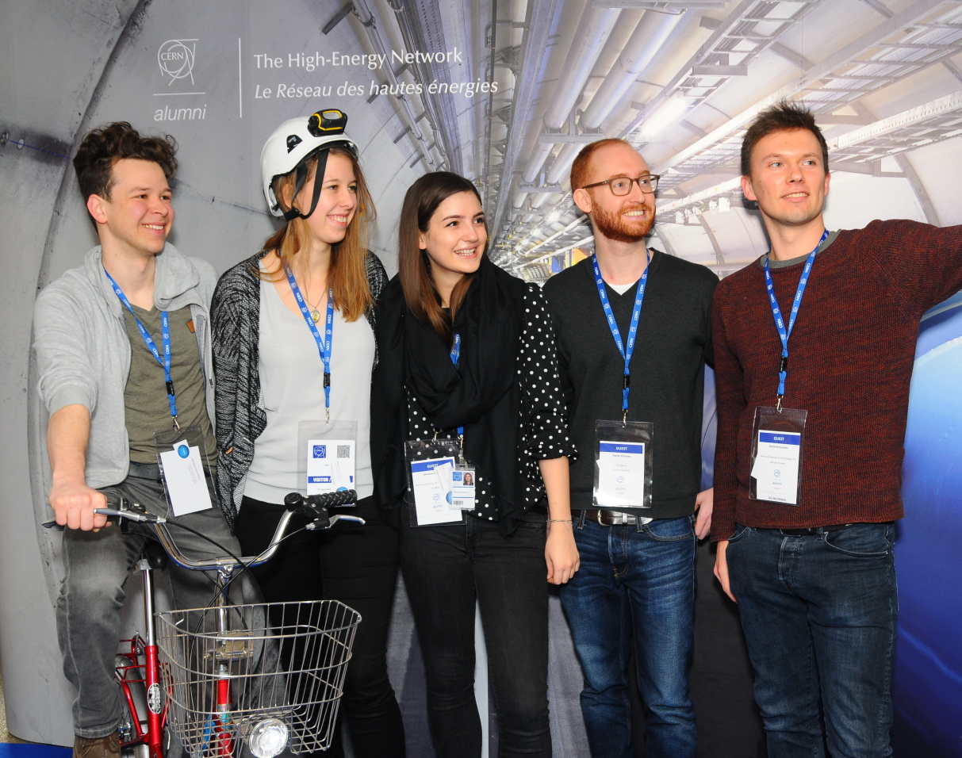
CERN Alumni Network
Launched in June 2017
6,950+ members
Goals:
Stay Connected
Demonstrate impact of professional CERN experience
Build network of ambassadors
Support early-careers

Slide 3
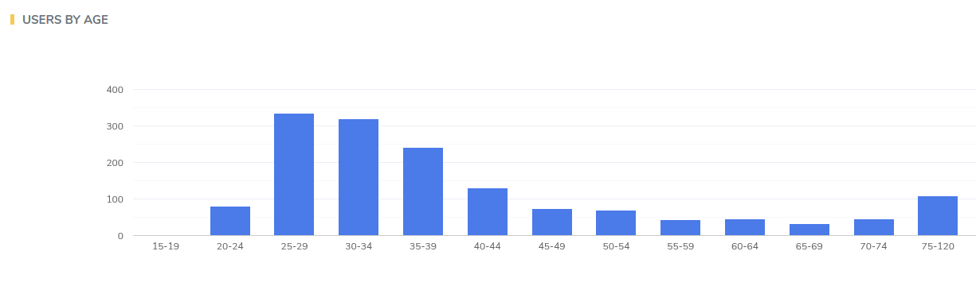
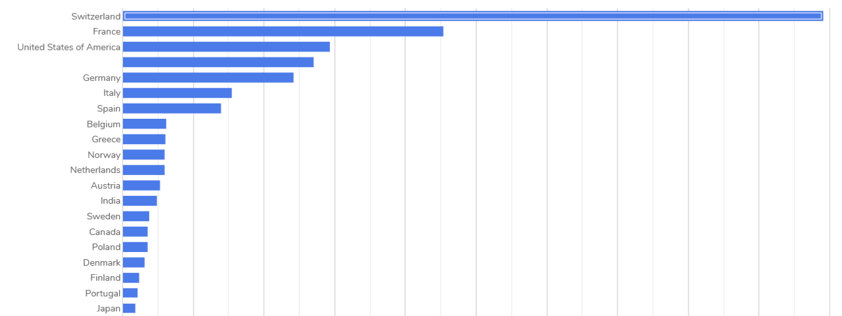

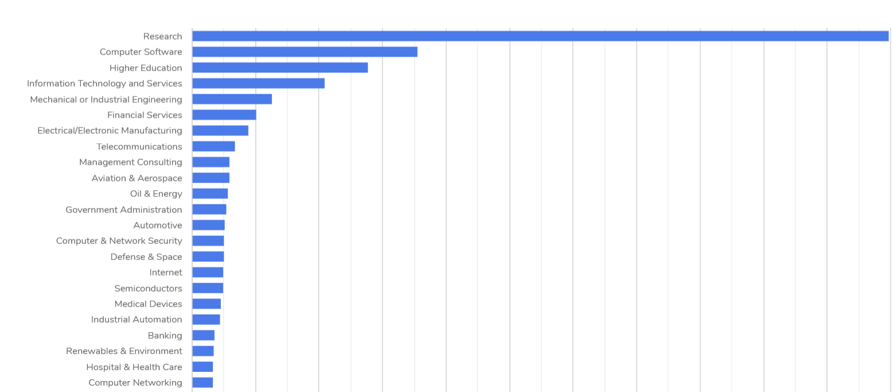
Composition of the Network
UK
UK

Slide 4
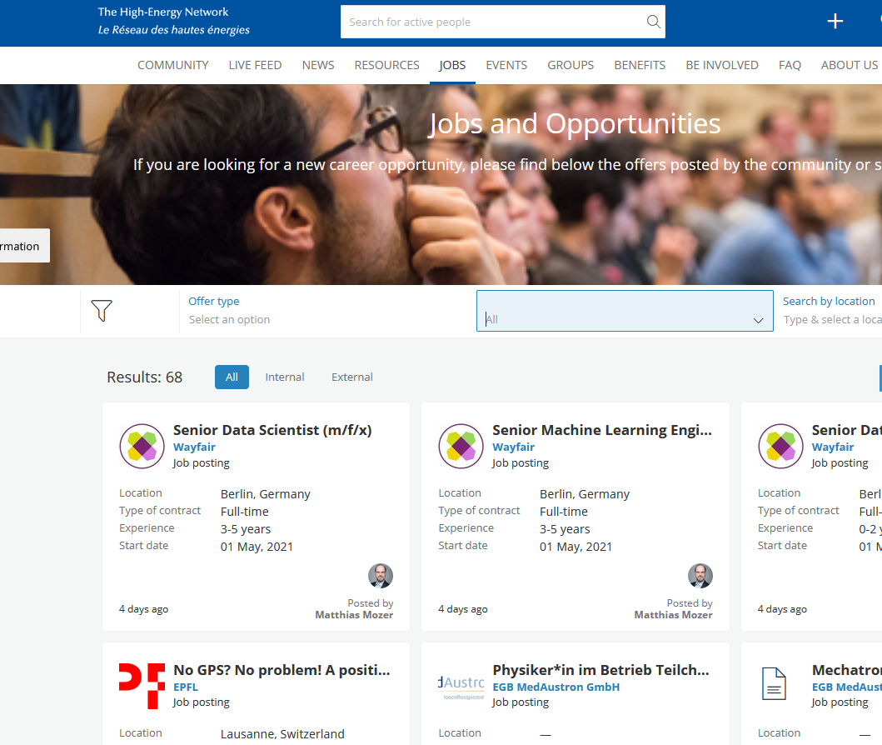
Recruiting from within the CERN Alumni Talent Pool

Slide 5
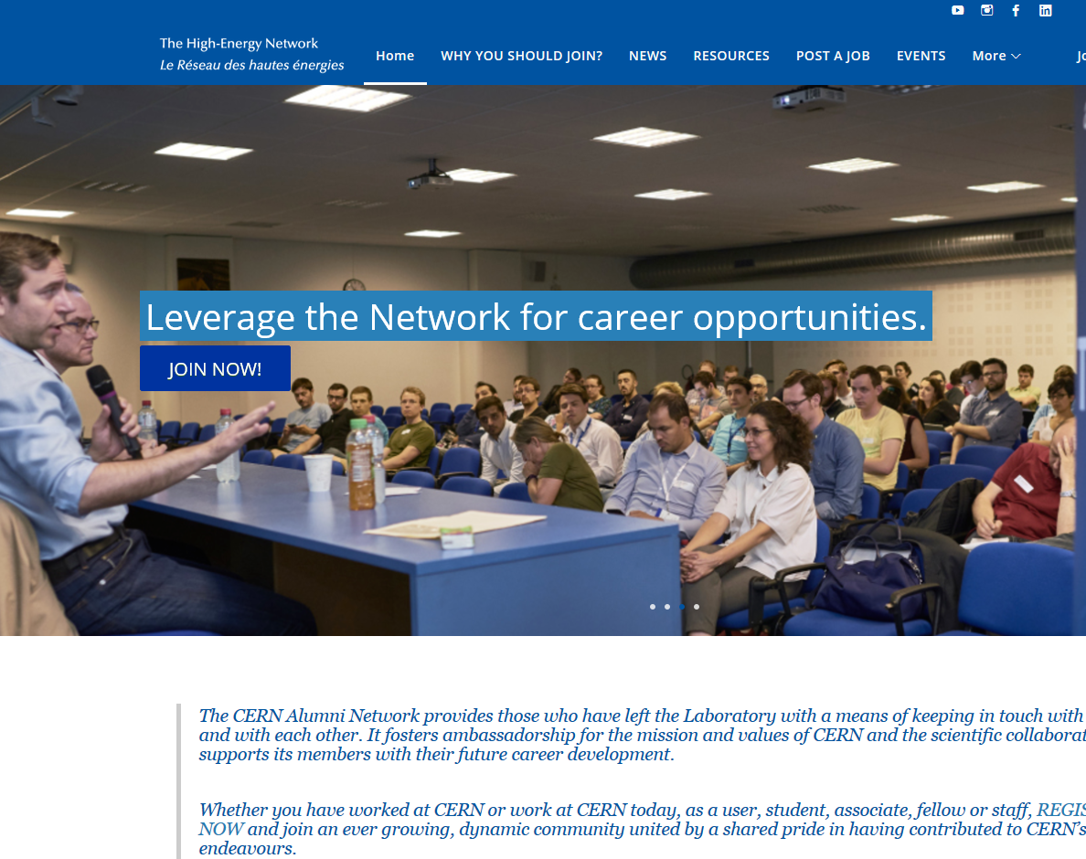
Recruiting from within the CERN Alumni Talent Pool
https://alumni.cern

Slide 6
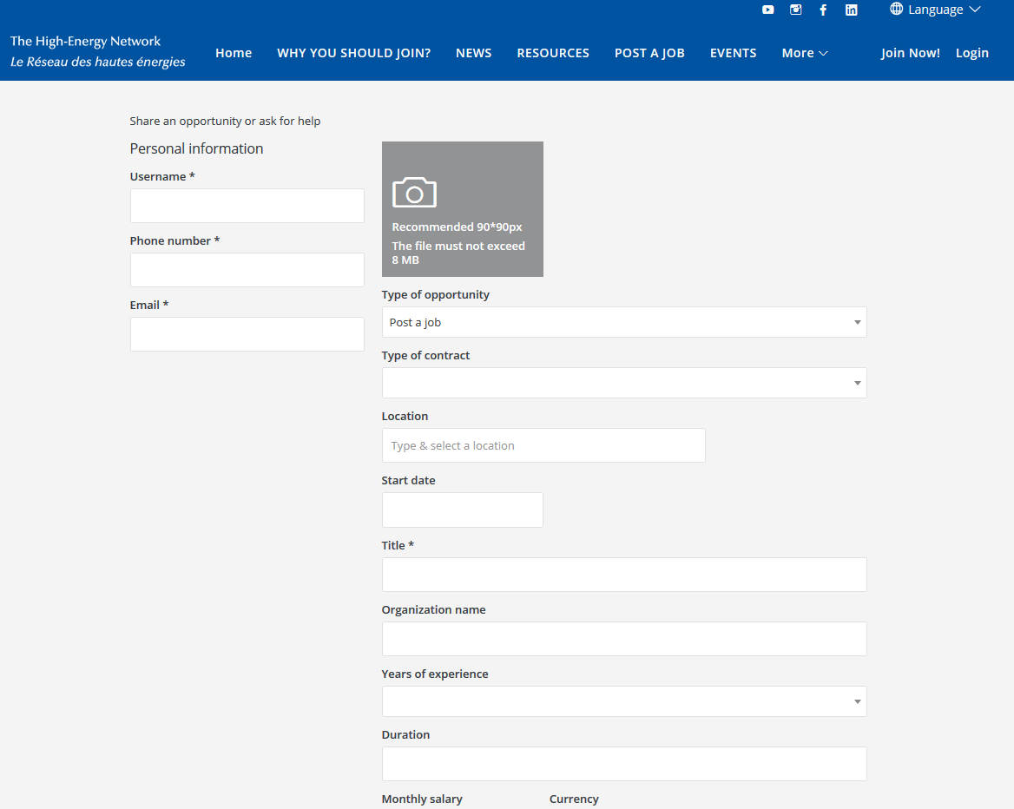
Recruiting from within the CERN Alumni Talent Pool
Please be as detailed as possible in the description
You decide
Your number
Your email
Keep for future connections & modifications

Slide 7
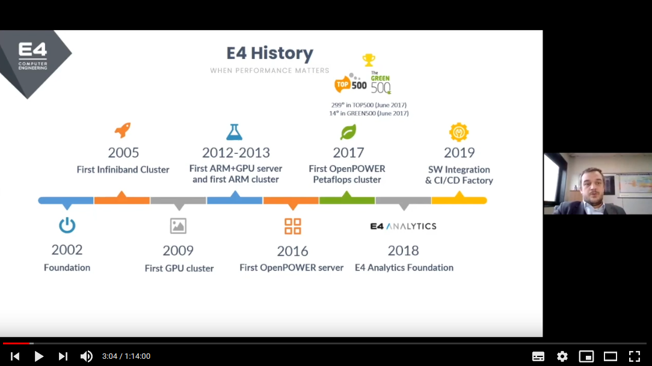
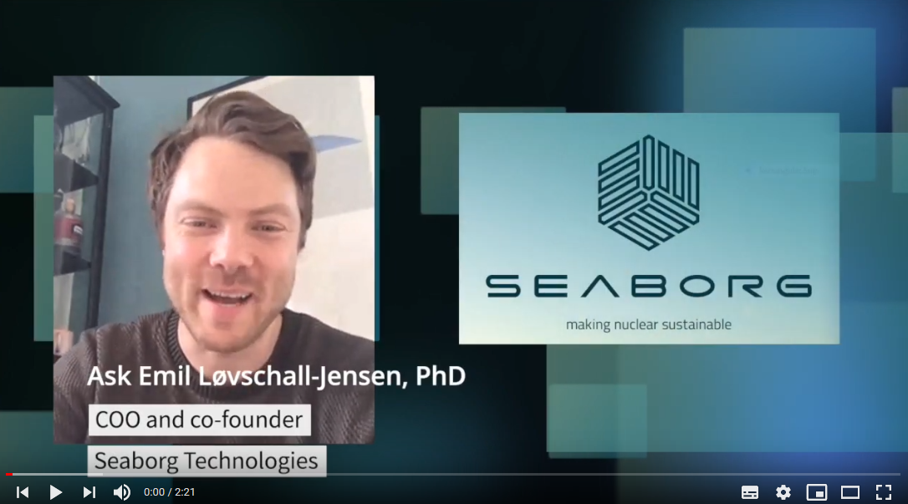

CERN Alumni Virtual Company Showrooms

Slide 8
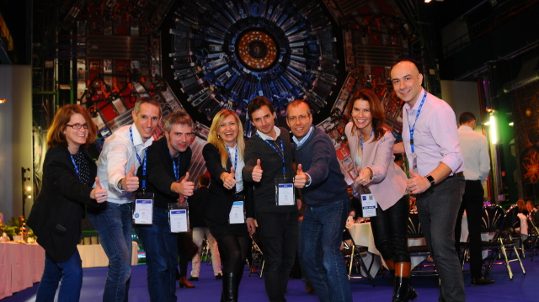
Contact: rachel.bray@cern.ch alumni.relations@cern.ch

