Slide 1
HPA section and Infor/EAMLight software
Definition of the needed procedures in the context of the HL-LHC project for the BE-GM-HPA section

Slide 2
Goal: Trace & Store data on equipment and steps
For HL-LHC, HPA section seeks to trace accurately the data concerning the assets and steps that are used in the project :
    Metrics need to be retrieved from those equipment during calibration for further calculation
    Trace what equipment, where, when and by whom it was installed is important to be able to understand the state of the sensor
    Understanding the steps for the lifecycle of the sensor for further optimized maintenance
    Saving the baseline and the realized workflows for a specific section of the tunnel, in order to re-use and analyze those data in the future
            Infor/EAMLight answers precisely to those needs

Slide 3
Assumptions
As we want to follow a quality assurance scheme, we want to maximize the possible collection of data without being too invasive and inefficient.
We agreed on the following (possible) assumptions:
Infor/EAMlight would be the main platform (if possible, the only one) for consistency and simplicity reasons to trace & Store any data
The tree of equipment dependencies will be created in advance, meaning all the equipment will have a specific location with parent and/or child components
Operators should fill all the WO while executing the task to maximize the accuracy and limit the loss of information

Slide 4
Main needs from Infor/EAMlight from assumption
Flexible: because some tasks involve listed (identified with barcode) true asset but some other involve only a location. The use of the software will also be used for more general task and eventually to track the general steps made at a specific location
Access monitoring: restricted modification for some users but also compatible with possible change if unexpected event happen and the structure cannot be respected anymore
Clear: Interface and workflows needs to be simple and linear for the operator because they will fill the WO in the tunnel (or on site)

Slide 5
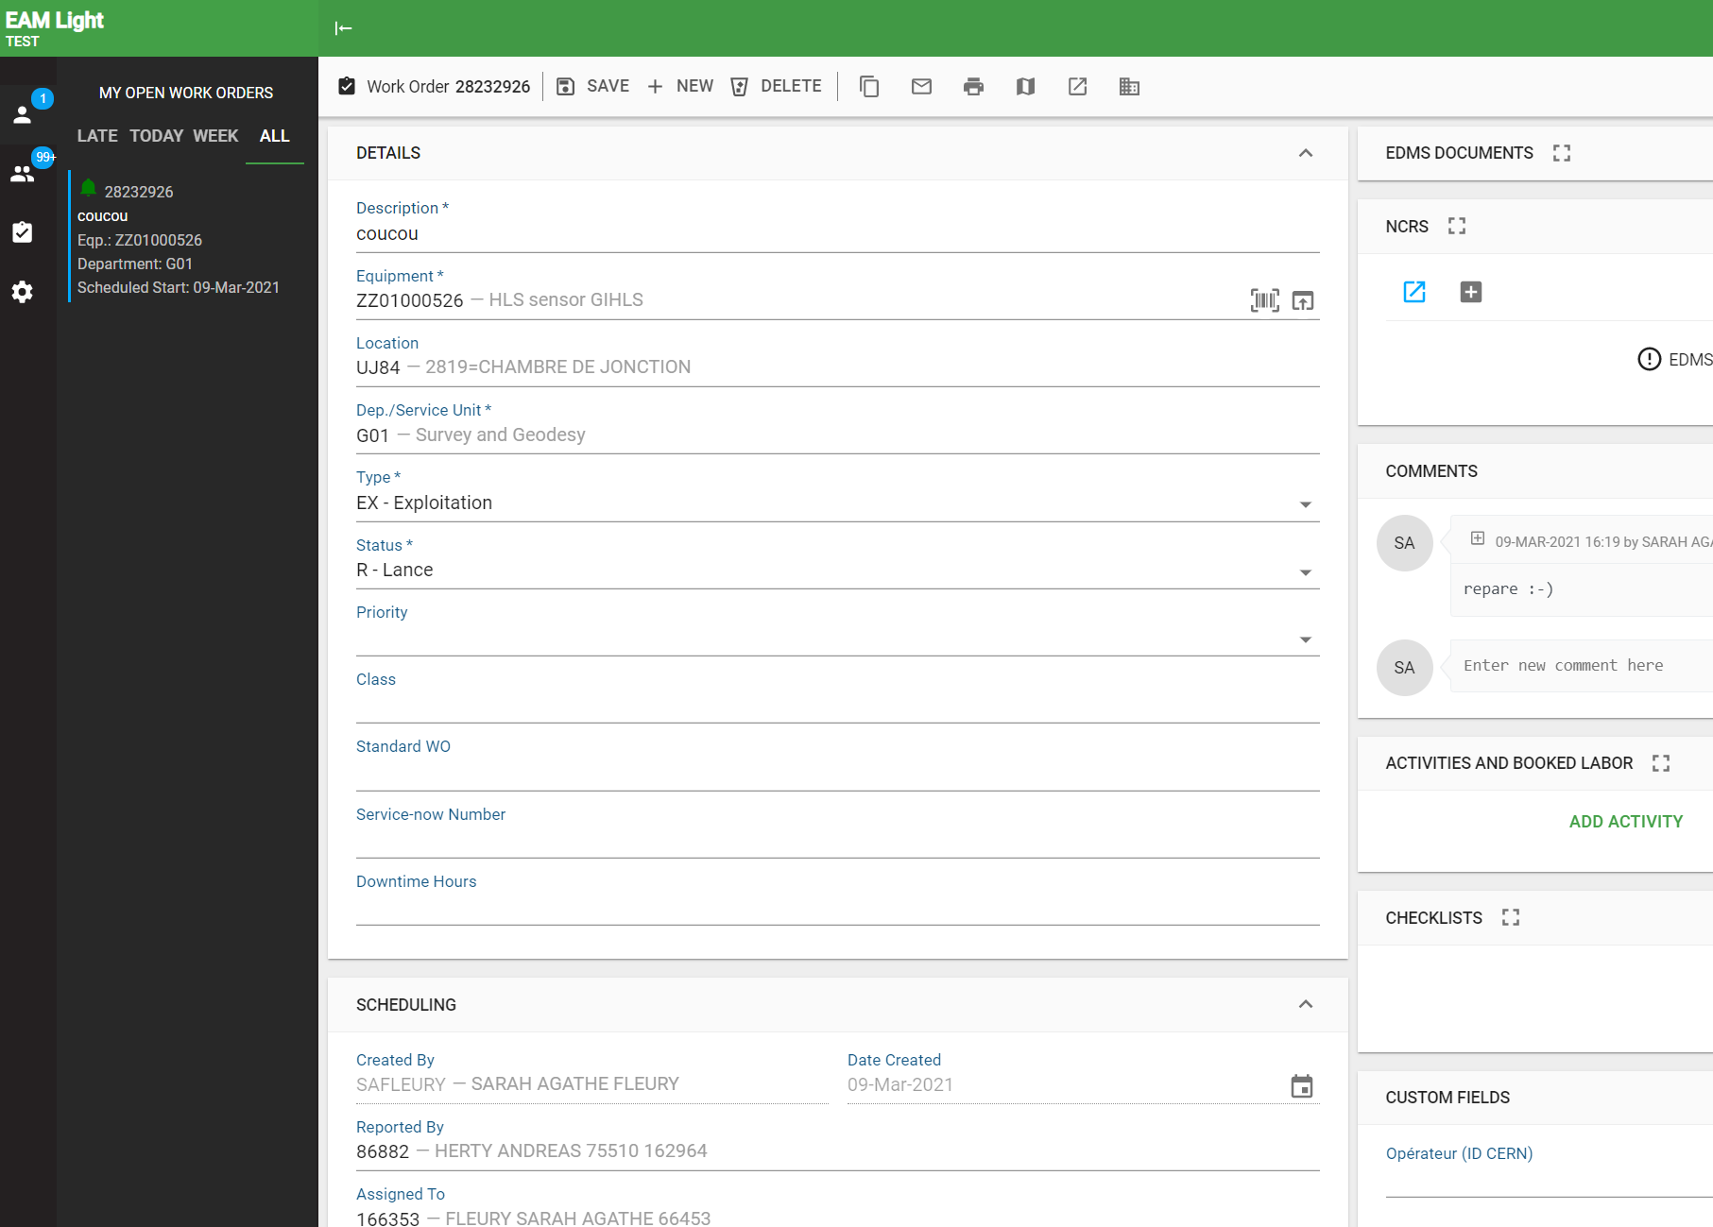
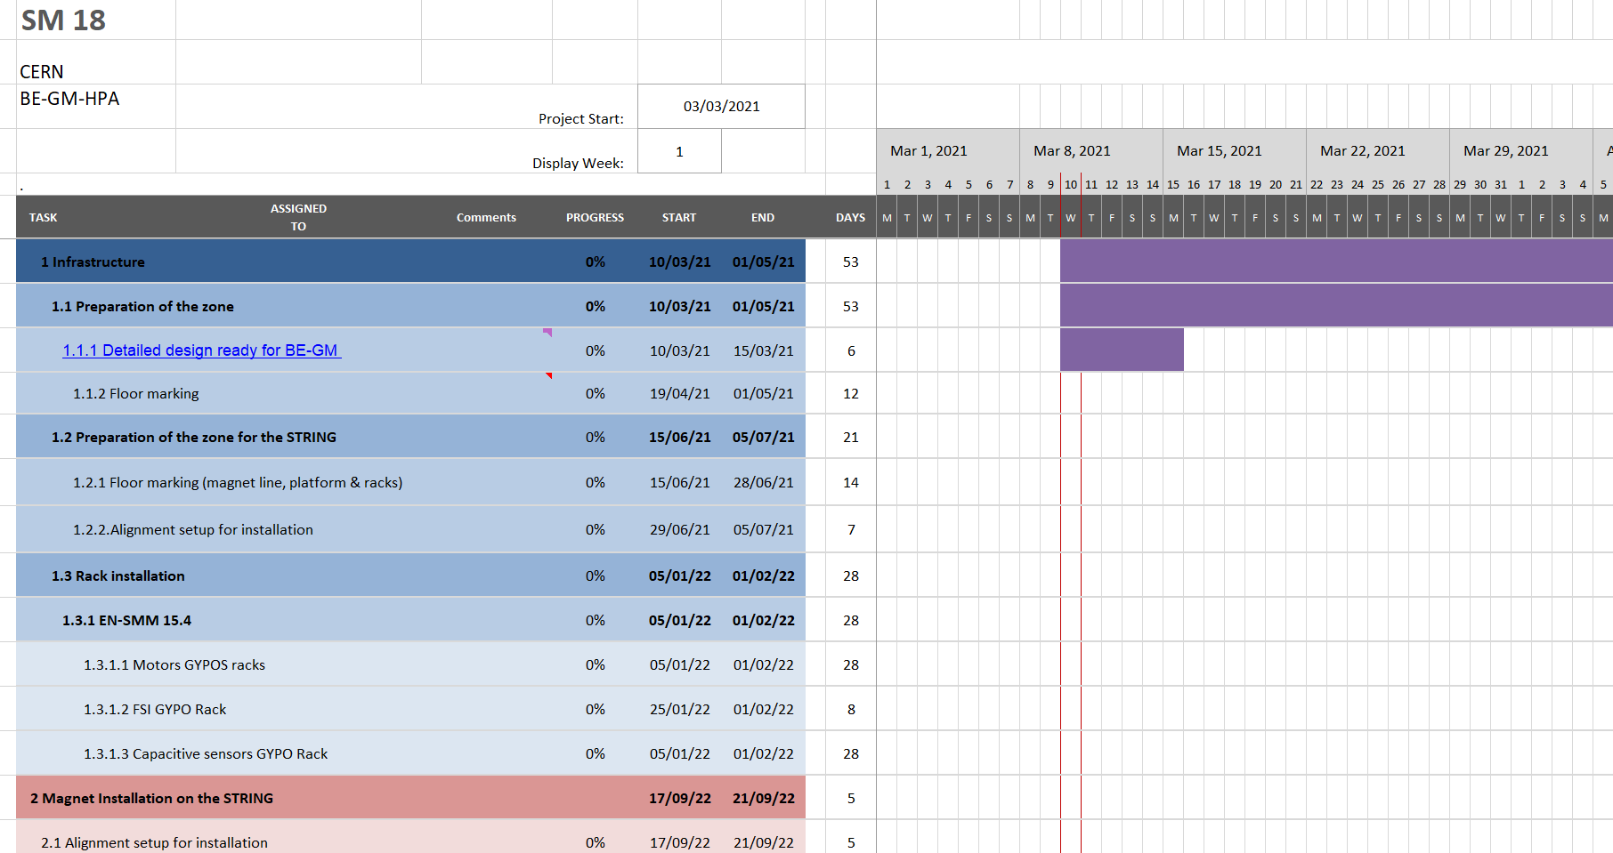
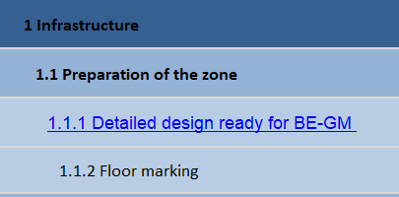

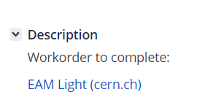
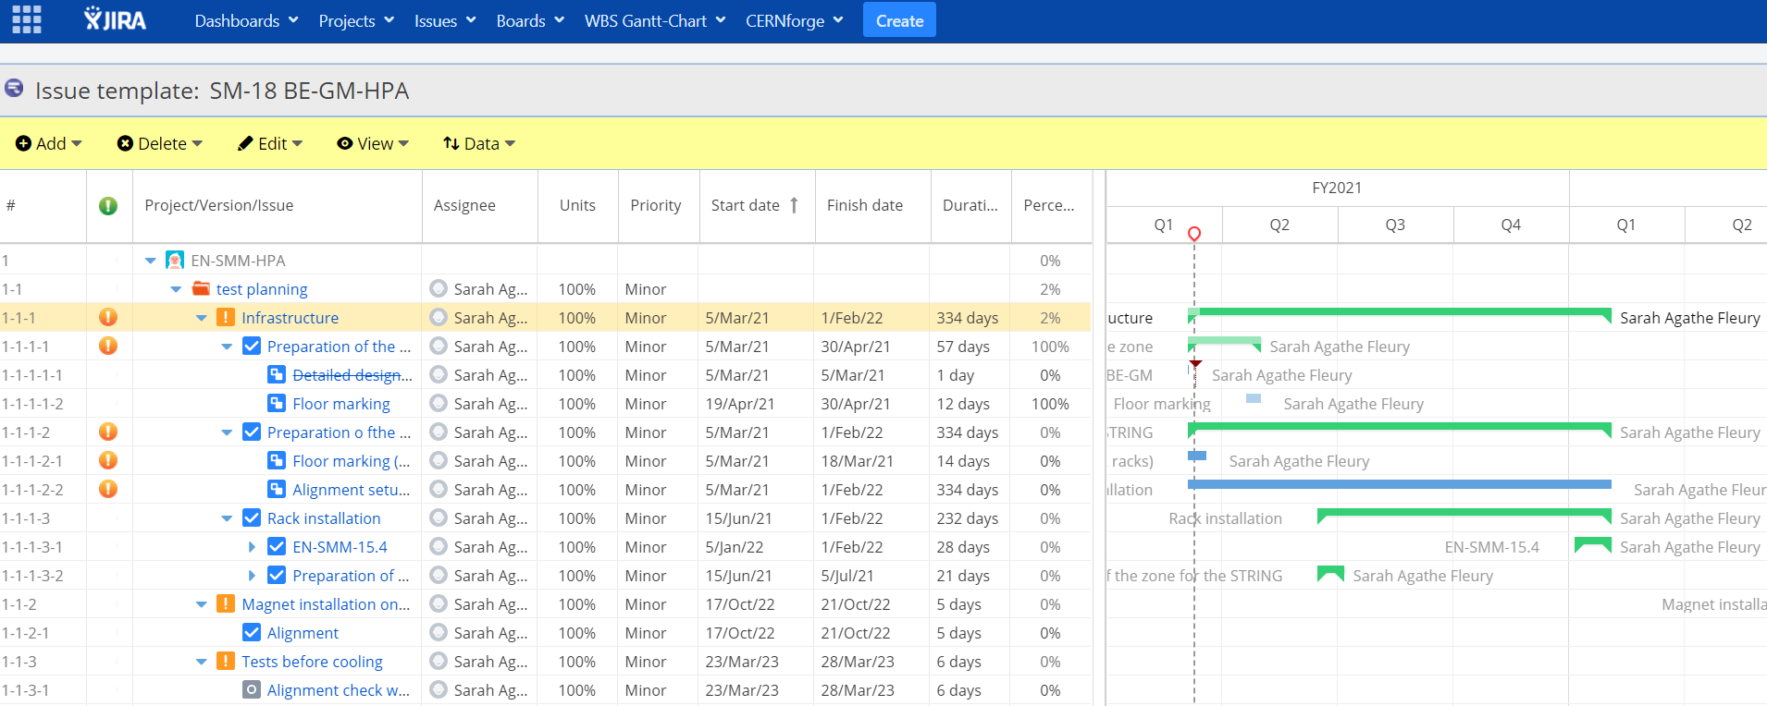
Current possible workflow
Operator looks at the numerical version of the planning
Click the link corresponding to the task
Open the EAM light ‘’main’’ or MEC work order
If not INFOR?
Task corresponding to a 2-4 hours slot
Contains several subtasks concerning specific equipment

Slide 6
Needs on different level
According to the information we are trying to enter or to retrieve, the needs are split into 3 categories:
Asset tab functionalities
Work order tab functionalities
Link between different work orders

Slide 7
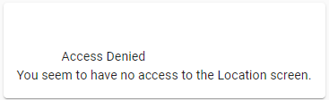
Asset tab needs
Location, status, department, state, history, edms doc …
See the location page with the corresponding WO assigned to it
Define different kinds of equipment with different metrics (and get rid of the non-used one) (like standard WO but standard equipment)
Asset tab functionalities
Notes:
See the location page with the corresponding WO assigned to it : able to store the workflows and retrieve them for a future project

Slide 8
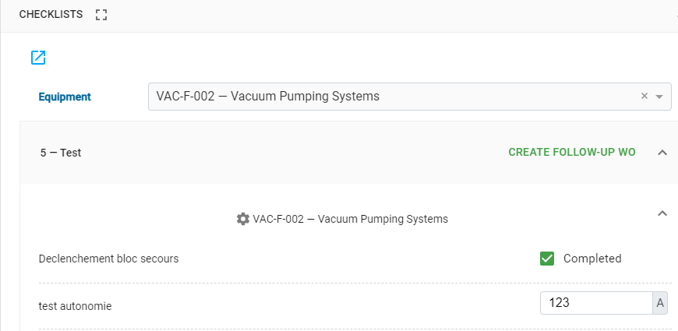
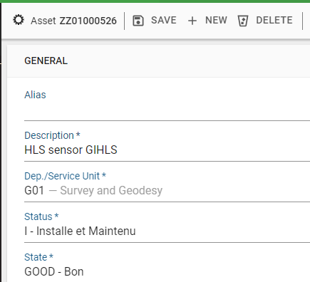
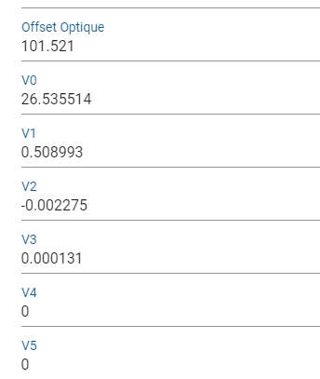
Work order tab needs
Perform the same task on different equipment: MEC WO
Perform a flow of activities to complete the task on one equipment: Task plan\Checklist
Store the data (retrieve from checklists) in the equipment database (MTF) to be able to make further calculation: link between input of checklist and equipment stored data
Work order tab functionalities

Slide 9
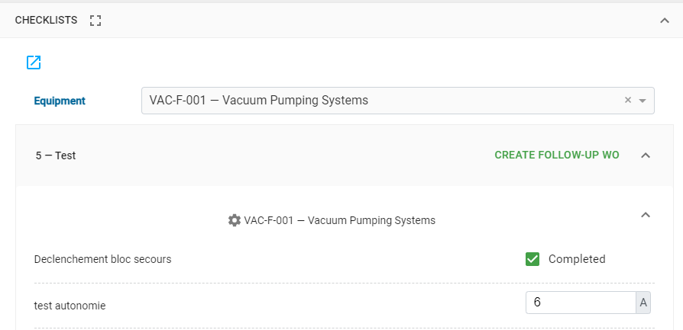

Work order tab needs
For more linear workflow, a validation/installation procedure (child/parent barcode check in checklists directly) to eventually
1. Pick the material in the storage
2. Execute the task
If predefined be able to search the parent support
If predefined structure: scan is correct, tick the box
Attached to: xxxx-x-xxxxx
If not predefined tree of dependencies, create the dependency in the history
Work order tab functionalities

Slide 10
Work order tab needs
Only some part of the WO can be modified by operator
Take a picture in MEC WO and, picture automatically sent to equipment page
Make a ticket to pick to right asset (like material part)
Work order tab functionalities

Slide 11
Links between different work orders needs
Perform different task on one equipment but not possible with activity because too long: Go for Routes
Link between different work orders

Slide 12
Scheduling Option
Gantt chart view
Ensure online access for operator that need to retrieve the information
Need to have task/subtask (=WO) to be able to group the activities of one half-day team together
Easy to modify planning (date => drag period)
If clicking on WO directly a link on EAM light?
Possible to export it on Excel ? or simpler virtual interface
Once task is marked as ‘T-Termine’ change color on the Gantt chart?
Limited access for modifying the planning

Slide 13


Main questions if not answered before
Possible to create the tree of dependencies in advance without meaning directly installation physically? : button dependencies/ storage location? Put simply installation in (manufacturing) WO
Since we want to track also the location workflows, is it relevant to put barcode ?
Notes:
Be able to predefine the location without meaning that the child component is already on the parent
Since we want to track also the location workflows, is it relevant to put barcode ? (for the installation or the validation procedure) Or possible to see WO linked to a place ?

Slide 14
Main questions if not answered before
Material part: possible to create pick-up ticket for asset linked to a MEC WO?
If operator need to change the parent/child component, possible to control automatically for example all changed ‘history’ of the day

