Slide 1
Linac4 FOM Report
B. Mikulec
for the Linac4 team

Slide 2
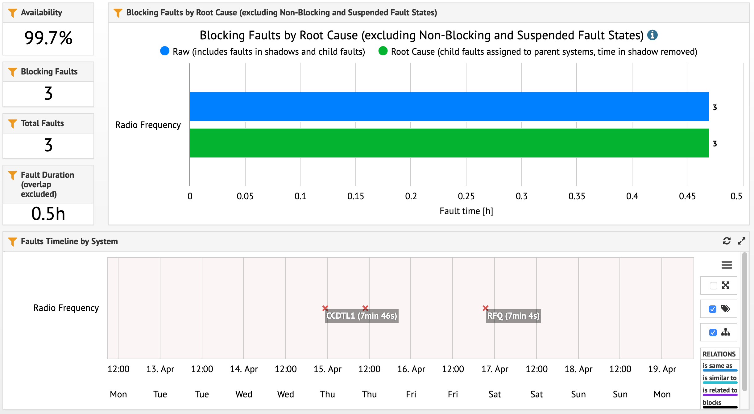
AFT
Excellent week!
Only 3 quick RF restarts:
  CCDTL1 arc detector main coupler, PIMS11 PLC control, RFQ reset after vac. spike

Slide 3
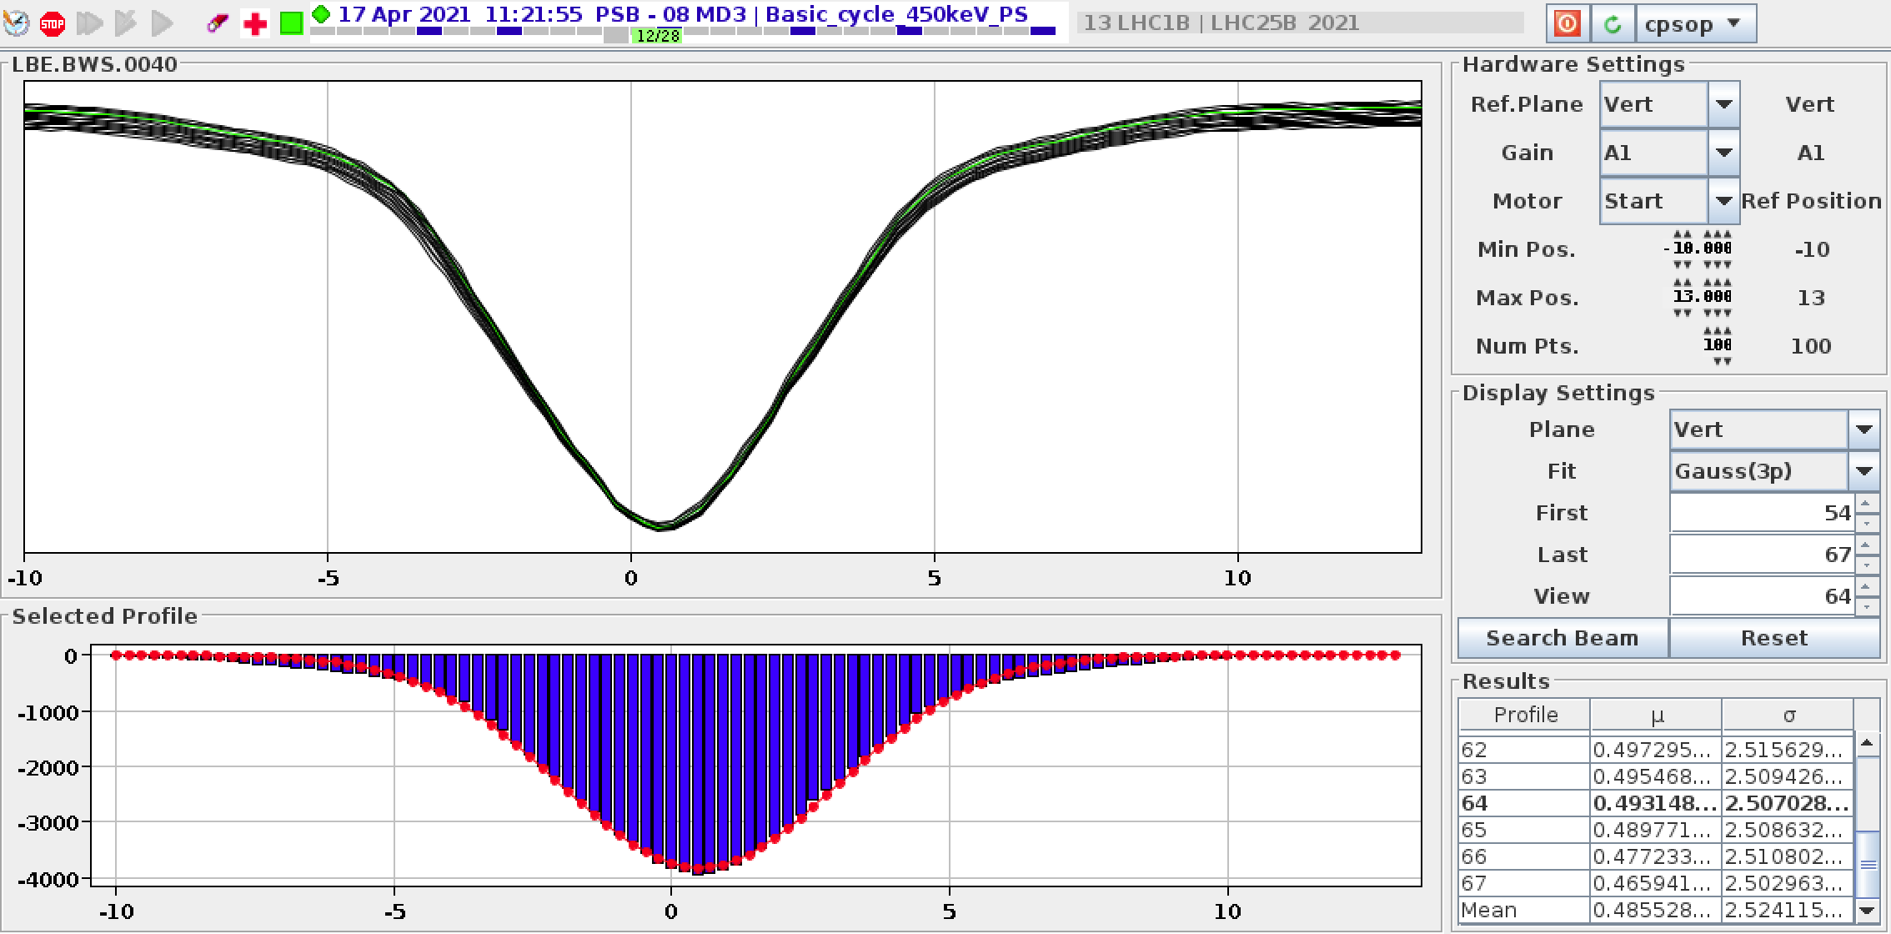
Special Activities
Fine-tuning of energy matching with PSB
  Optimised analysis in PSB
  Plan some MDs to understand potential drifts, systematic errors etc.
Profile measurements performed in LBE
  Being analysed by ABP
  Aim is to see if tails observed in vertical profile for LHC25 beam after injection could already come from the linac

