Slide 1



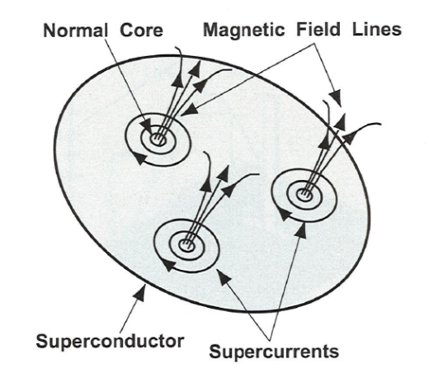
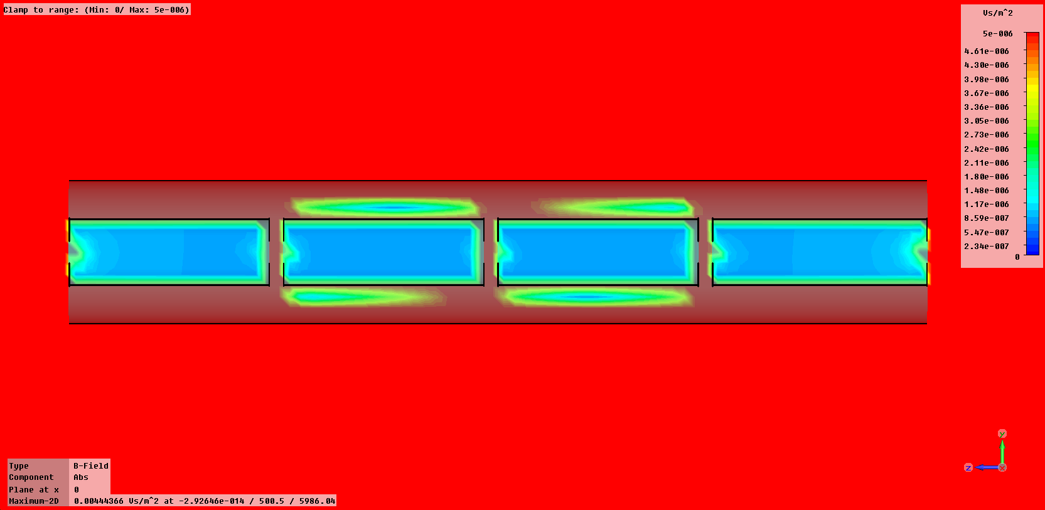


Magnetic shielding for SPL cavities
Electromagnetic Simulations
Tobias Junginger
Tobias.Junginger@quasar-group.org

Slide 2

Why do we need a Magnetic Shield?
1/9
H. Padamsee et al. RF Superconductivity for Accelerators
for RRR=300
Tobias.Junginger@quasar-group.org

Slide 3
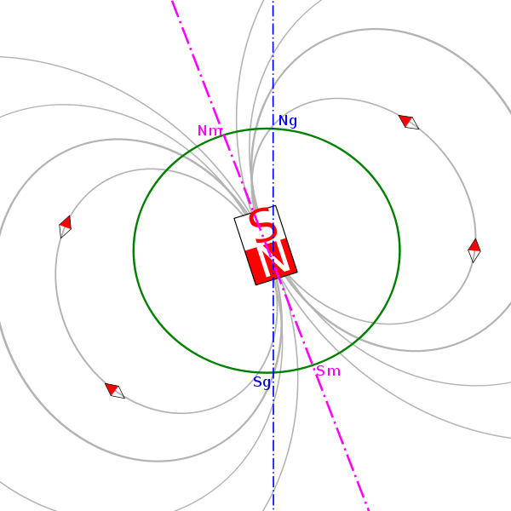
Assumptions
2/9
Assumptions
  - SPL goes straight from the
  South to the North
  (worst case)
  Magnetic field 48 μT
    Vertical 44 μT
    Horizontal 20 μT
Requirement
- Less than 1 μT on
cavity surface
http://nl.wikipedia.org/wiki/Gebruiker:JrPol
Tobias.Junginger@quasar-group.org

Slide 4
Shielding Factors of an Open Cylinder
3/9
3
Bigger cavities need thicker shields for same field!
Longer cylinders shield the longitudinal field
less effective
Shielding of horizontal field
is harder than of vertical
S: Shielding factors
μ: Permeability of material
d: Thickness of sheet
D: Diameter of cylinder
L: Length of cylinder
N: Demagnetization coefficient

Slide 5
Solutions found by other labs
4/9
DESY (TTF)
  1 mm Cryoperm Shield attached to helium tank
  Remagnetisation of soft iron vacuum vessel
PEFP/SNS
  Two amumetal magnetic shields
    Inner shield attached to helium vessel
    Outer shield attached to support structure
TRASCO
  1 mm Cryoperm shield inside the helium tank
S-DALINAC
  Vertical - 0.1 mm sheets of cryoperm
  Horizontal - Solenoid
Four questions: - Active or passive shield?
- One or two shields?
- Where to put the shield?
- Which material?
Tobias.Junginger@quasar-group.org

Slide 6
My Solution
5/9
Four questions: - Active or passive shield?
- One or two shields?
- Where to put the shield?
- Which material?
One inner shield per cavity
  Horizontal field is harder to shield
  Demagnetization factor decreases quadratically with length
  Around inner thermal shield
    As close as possible to the cavity (more effective and less expensive)
    End caps necessary between every cavity
Longer cylinders shield the longitudinal field
less effective
Tobias.Junginger@quasar-group.org

Slide 7
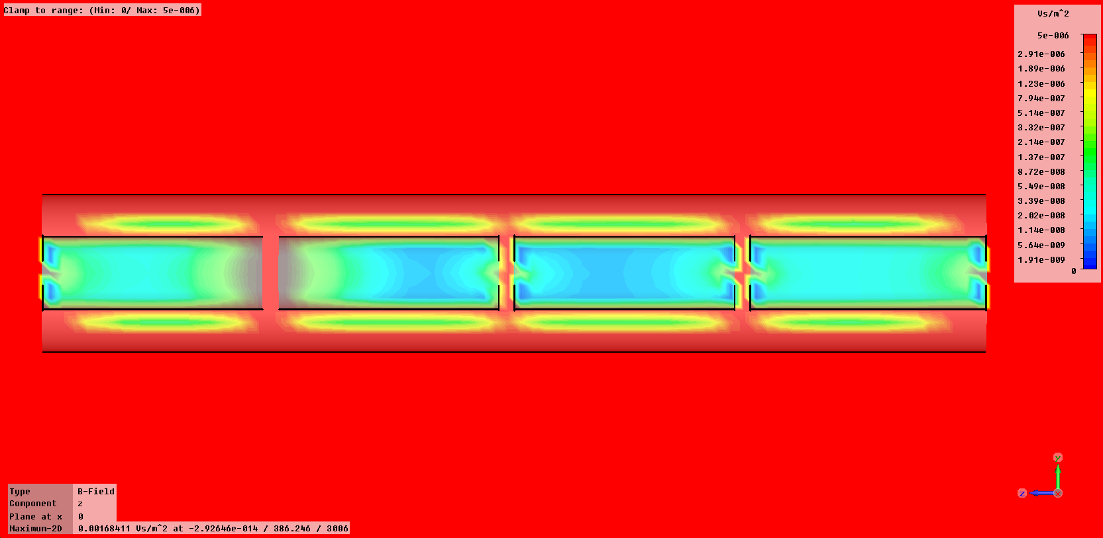
Solutions found by other labs
6/9
End caps necessary between every cavity!
No end caps here
Tobias.Junginger@quasar-group.org

Slide 8
My Solution
7/9
Four questions: - Active or passive shield?
- One or two shields?
- Where to put the shield?
- Which material and thickness?
One inner shield per cavity
  Horizontal field is harder to shield
  Demagnetization factor decreases quadratically with length
  Around inner thermal shield
    As close as possible to the cavity (more effective and less expensive)
  End caps necessary between every cavity
Two passive shields
  Outer shield helps to reduce the fields especially between two cavities
Amumetal or Cryoperm inside, Mumetal outside
  For realistic μ_{r} values a thickness of 1 mm outside and 2 mm inside sufficient
Tobias.Junginger@quasar-group.org

Slide 9
My Solution
8/9
Numerical model has been crosschecked with simplified analytical expression
Numerical value for magnetic field in the middle of one cavity only 4 % higher
d=2 mm, μ_{r}=13300
d=1 mm, μ_{r}=54700
μ_{r} values taken from TESLA-Report 1994-23, measured on test cylinders
Tobias.Junginger@quasar-group.org

Slide 10
My Solution
9/9
Four answers: - Passive shields
- Two shields
- One inner shield per cavity,
one outer shield per module
- 2 mm Cryoperm or Amumetal inside
1 mm Mumetal outside
Tobias.Junginger@quasar-group.org

Slide 11
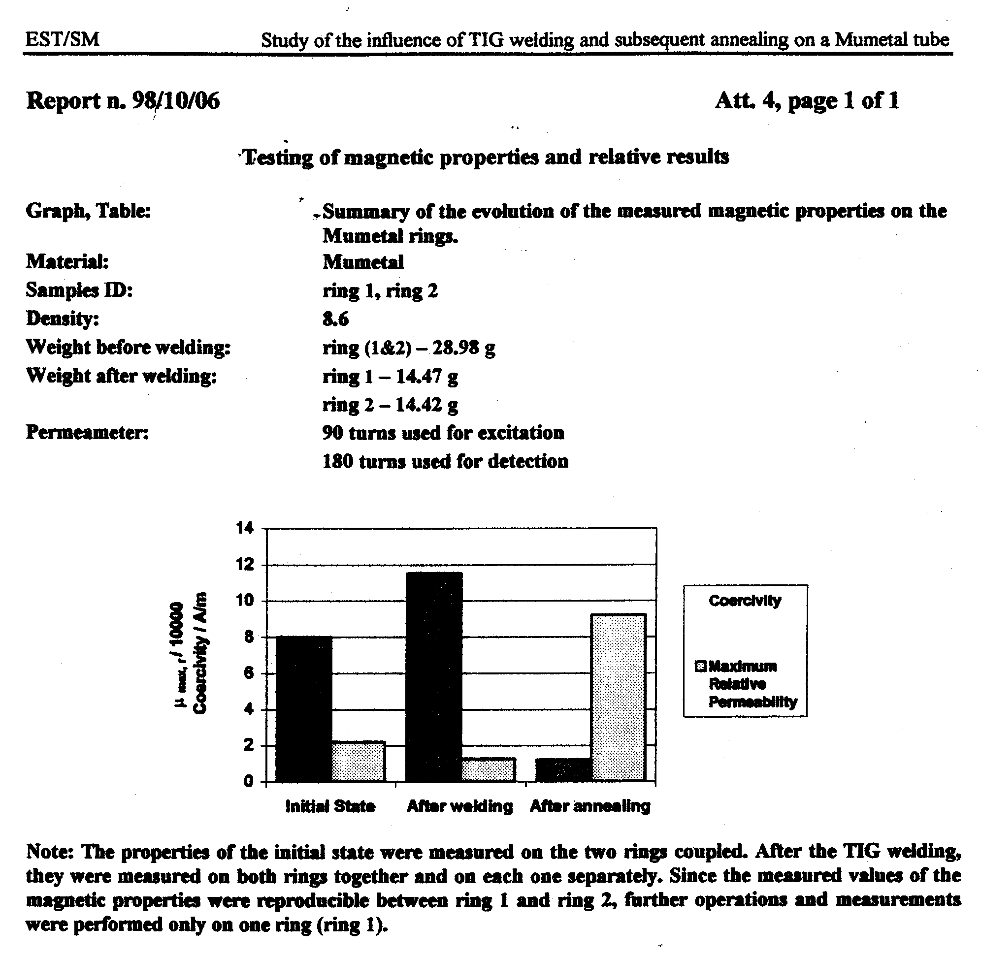
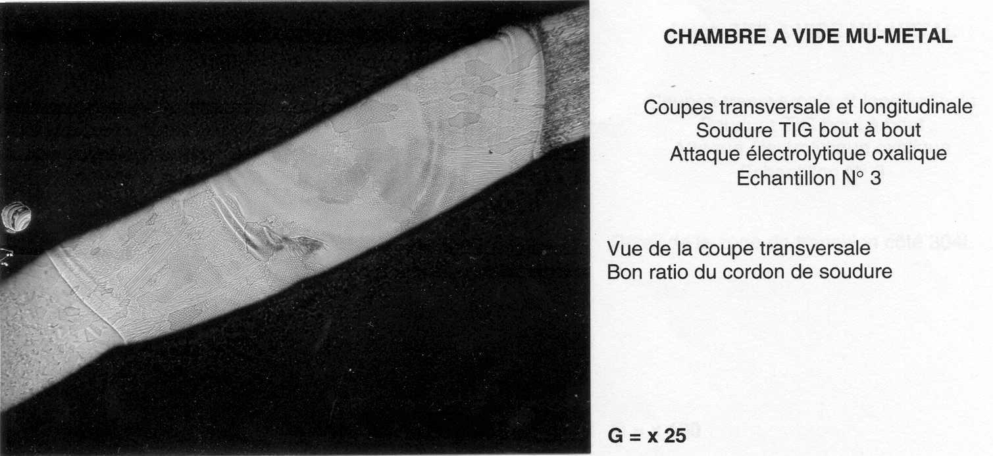
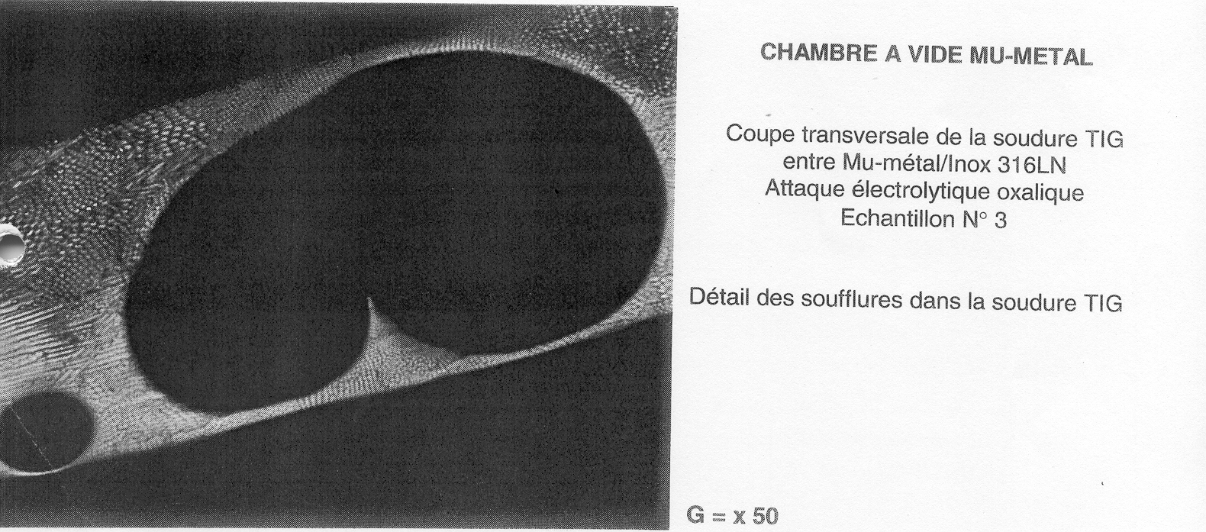
Application of mumetal: LHC septa chambers
S. Sgobba – 3rd SPL Collaboration Meeting

Slide 12
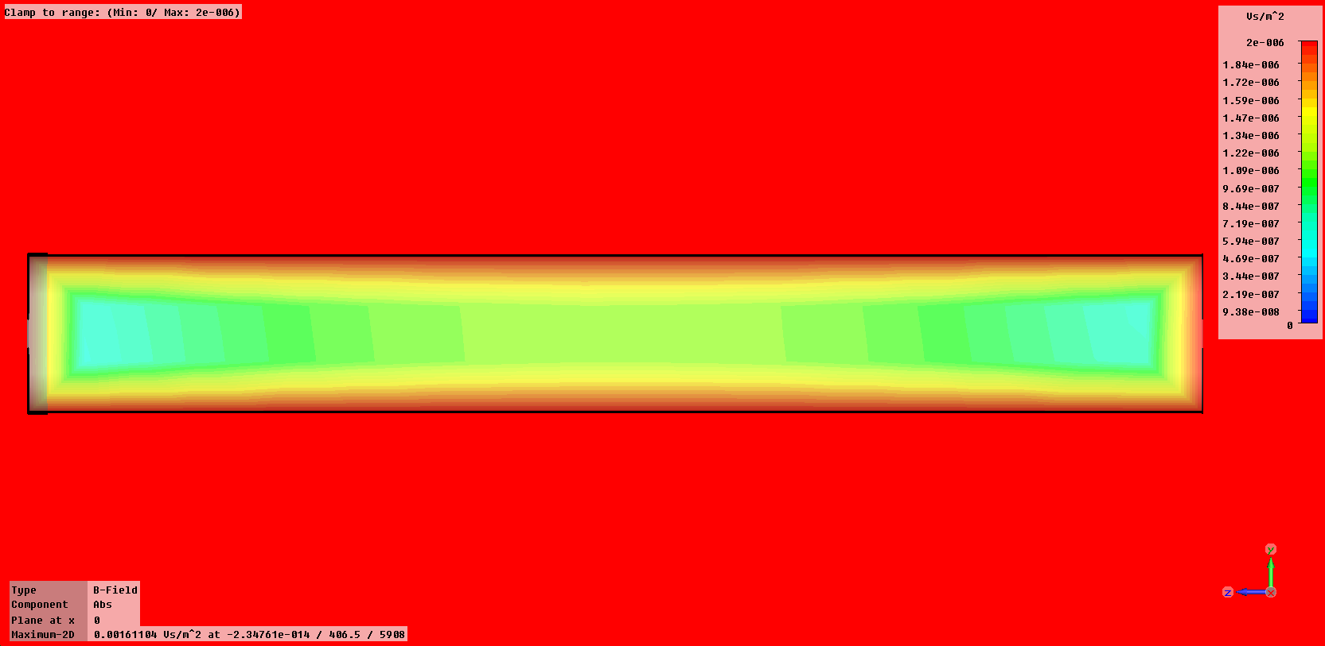
Microwave Studio simulation – Whole Module
13
Numerical model has been crosschecked with simplified analytical expression
Numerical value for magnetic field in the middle only 4 % higher
End Cap
Magnetic Shield
Area of Interest
μ_{r}=50000
d= 3 mm
If the whole cryomodule shares one shield a maximum field
value of approximately 1 μT can be achieved for μ_{r}=50000 and d=3 mm
Tobias.Junginger@cern.ch

Slide 13
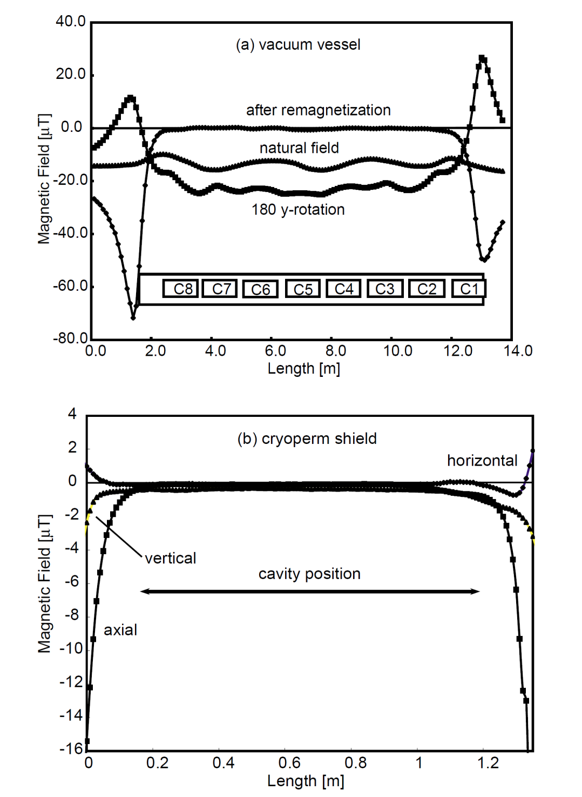
Solutions found by other labs - DESY
Tobias.Junginger@quasar-group.org

Slide 14
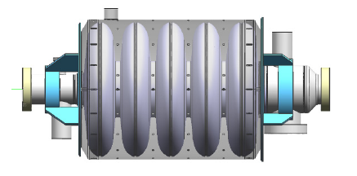
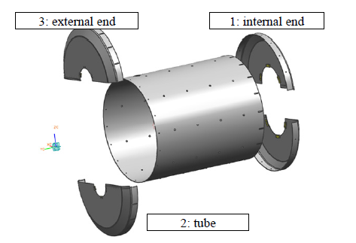
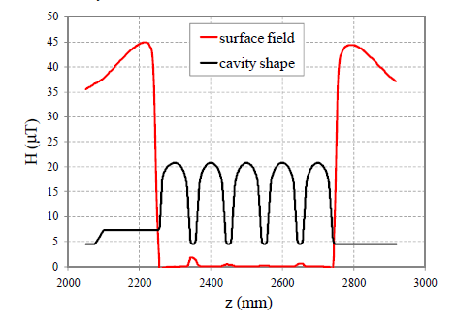
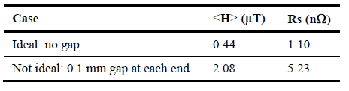
Solutions found by other labs - TRASCO
30 μT field parallel to beam axis
1 mm thick cryoperm 10 shield (μ_{r}=150000)
Two shields have already been produced
and their shielding performance will be
measured
Tobias.Junginger@quasar-group.org

Slide 15
Needed Material
Material: Cryoperm 10
Thickness of sheet: 1 mm
206 Cavities
500 m² sheet
4.5 t of material (σ=9 kg/l)
450 kCHF (100 CHF/kg)
Tobias.Junginger@quasar-group.org

Slide 16
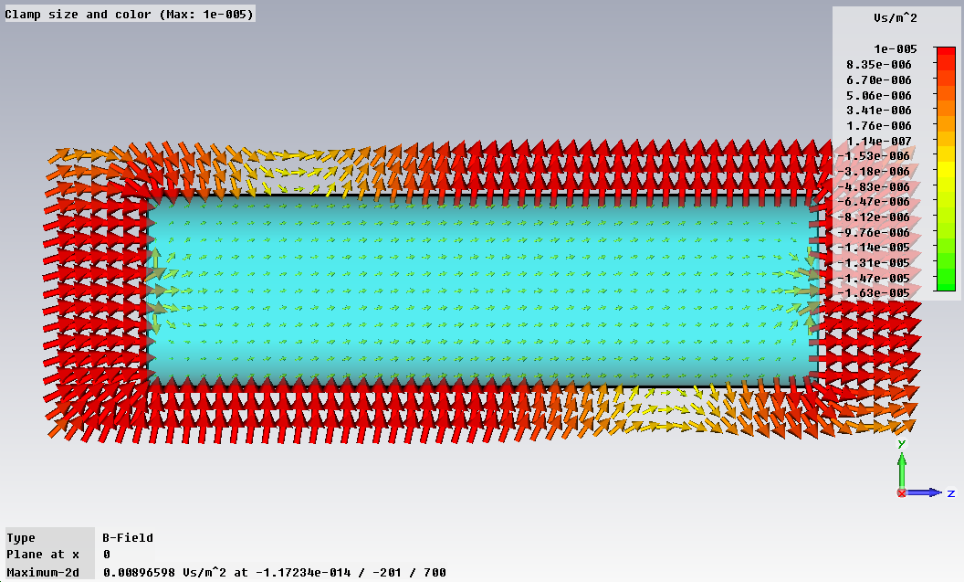
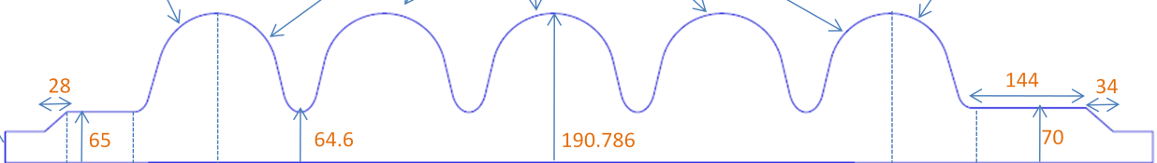
Microwave Studio simulation
Area of Interest
Tobias.Junginger@quasar-group.org

Slide 17
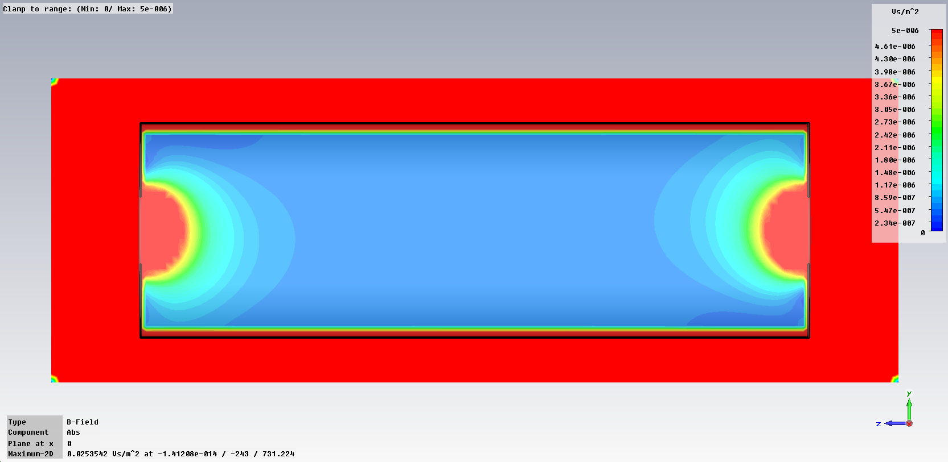
Microwave Studio simulation
Magnetic Shield
Area of Interest
d=3mm
μ_{r}=42000
Tobias.Junginger@quasar-group.org

Slide 18
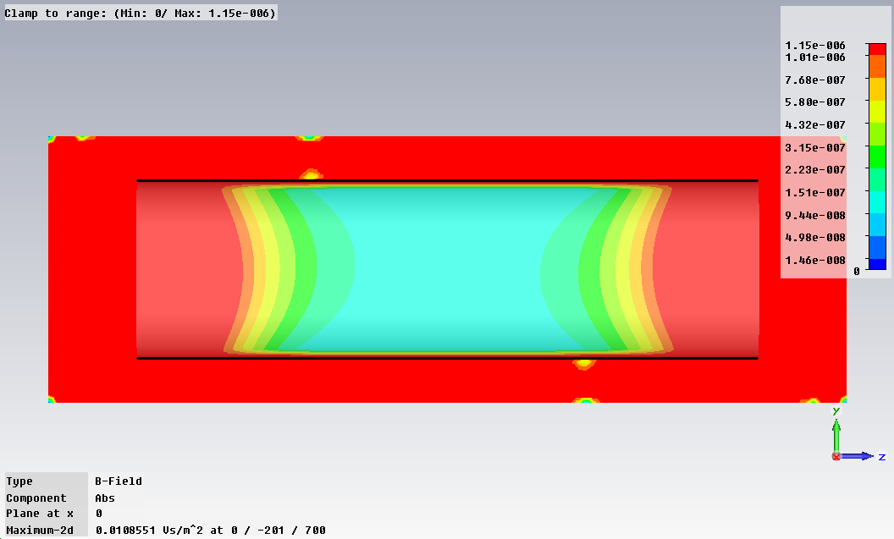
Microwave Studio simulation
Magnetic Shield
μ_{r}=100.000
Tobias.Junginger@quasar-group.org

Slide 19
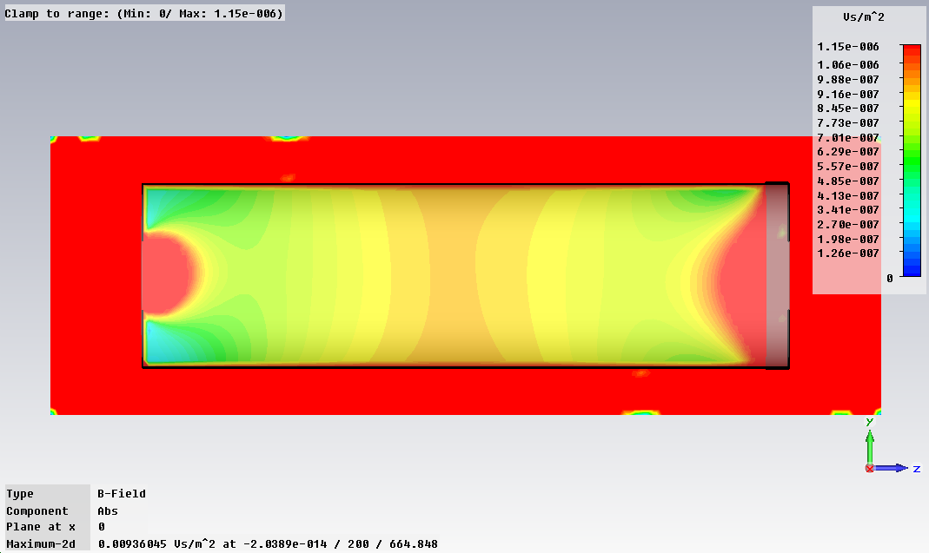
Microwave Studio simulation
Magnetic Shield
Area of Interest
No GAP
1mm GAP
μ_{r}=10890
Tobias.Junginger@quasar-group.org

Slide 20
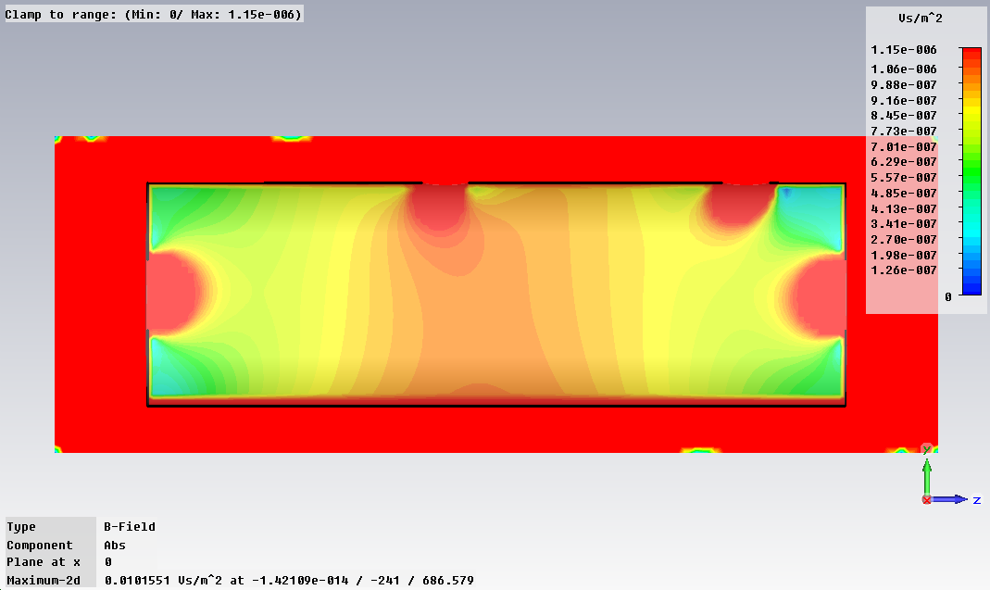
Microwave Studio simulation
Magnetic Shield
Area of Interest
μ_{r}=10890
Tobias.Junginger@quasar-group.org

Slide 21
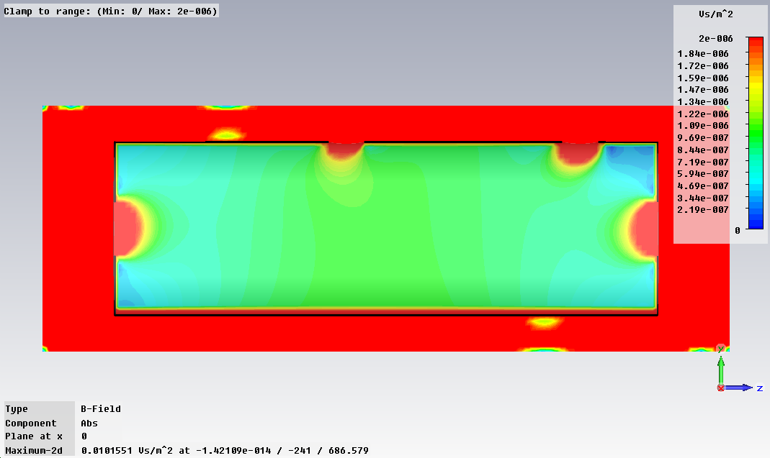
Microwave Studio simulation
Magnetic Shield
Area of Interest
μ_{r}=10890
Tobias.Junginger@quasar-group.org

Slide 22
Conclusions
μ_{r} = 42.000 needed for the whole temperature
range for 3 mm sheet
End caps are necessary
A gap of a few millimetres between end caps
and cylinder can be tolerated
Holes lead to higher field values than 1μT in
spots of approximately their size
My recommendations:
  External Shield of Cryoperm (3 mm)
  As close as possible to the helium tank
  Annealing of tubes and end caps
Tobias.Junginger@quasar-group.org

