Slide 1


Investing in Big Science
Rolf Heuer
Emmanuel Tsesmelis
Perspectives on Big Science and the Question of Justice
22 April 2021
Accelerating Science and Innovation
Notes:
1

Slide 2
Investing in Science and Technology
Which type of research to support?
Basic – Applied ?
Small scale – Large scale ?
Individual – International ?

Slide 3
Investing in Science and Technology
Which type of research to support?
Basic – Applied ?
Small scale – Large scale ?
Individual – International ?
the scale appropriate for the
research to be carried out

Slide 4
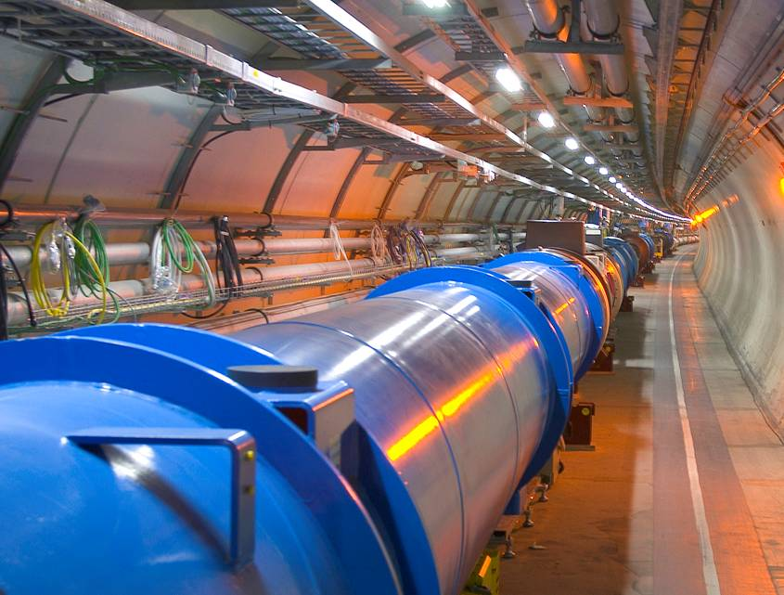
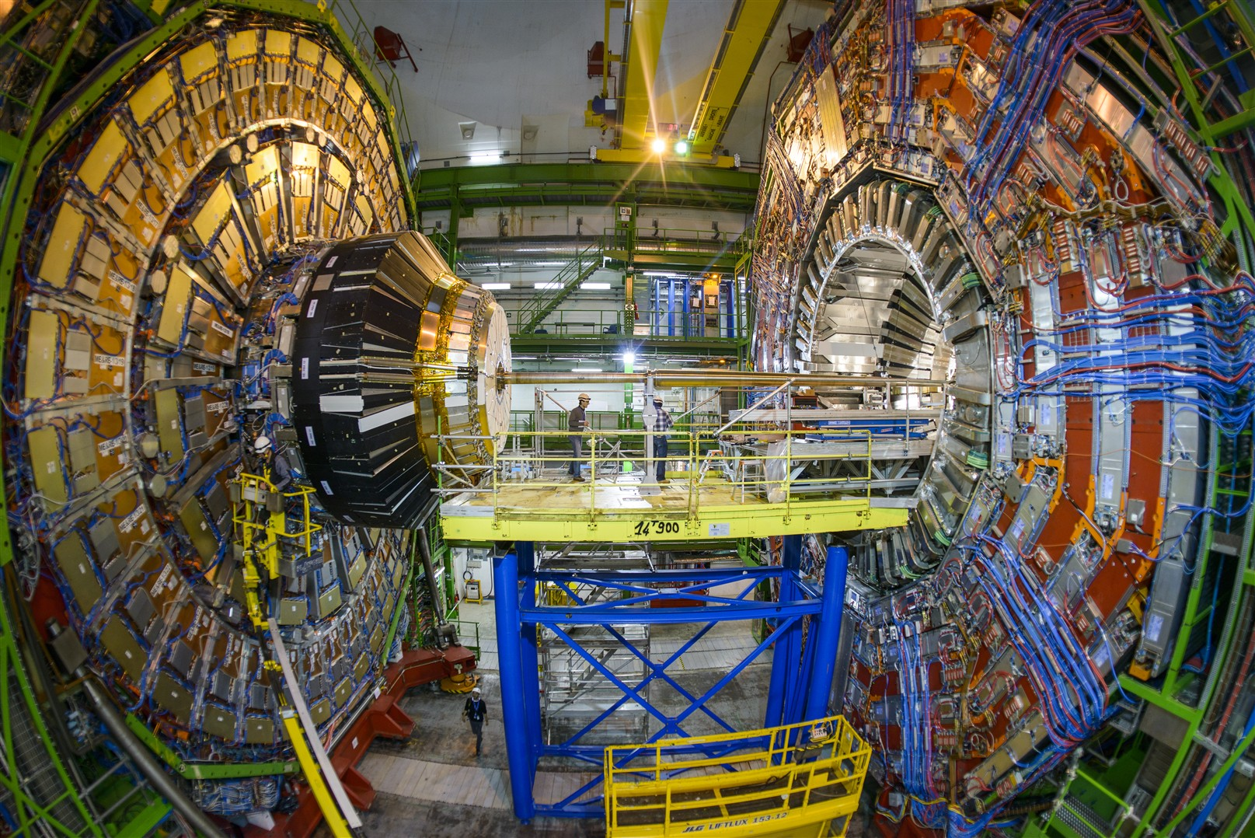
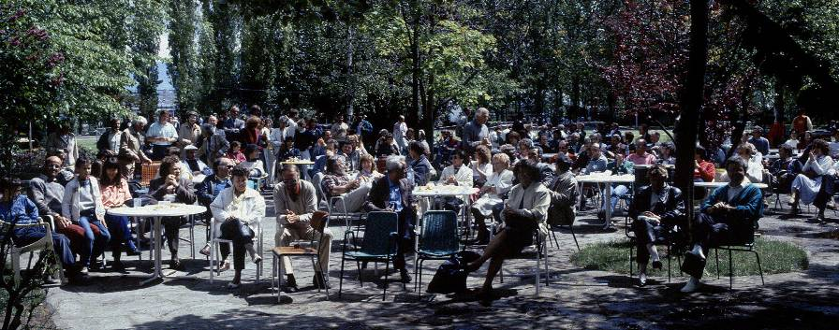
The role of Big Science:
– innovate, discover, publish, share
…what is its role for Society ?

Slide 5
Big Science
generates Knowledge
thereby creating educated minds
generates Innovation
thereby changing society
can generate Disruptive Innovation
thereby transforming society

Slide 6
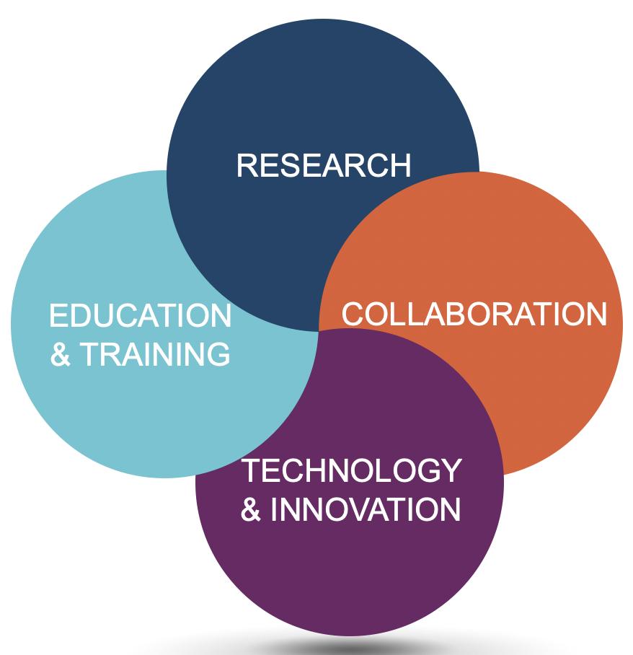
Four Pillars Underpin Big Science

Slide 7
CERN & Large-scale Science Projects
Address
- Fundamental science questions at the forefront of
research and technology.
Require
- Large and sustained infrastructures.
- Global collaboration on long time scales.
Provide
- Unique equipment.
- Challenging requests for high technology & innovation.
- Stimulating ideas which in turn attract good people.
- Occasion to bring people together via collaboration.

Slide 8
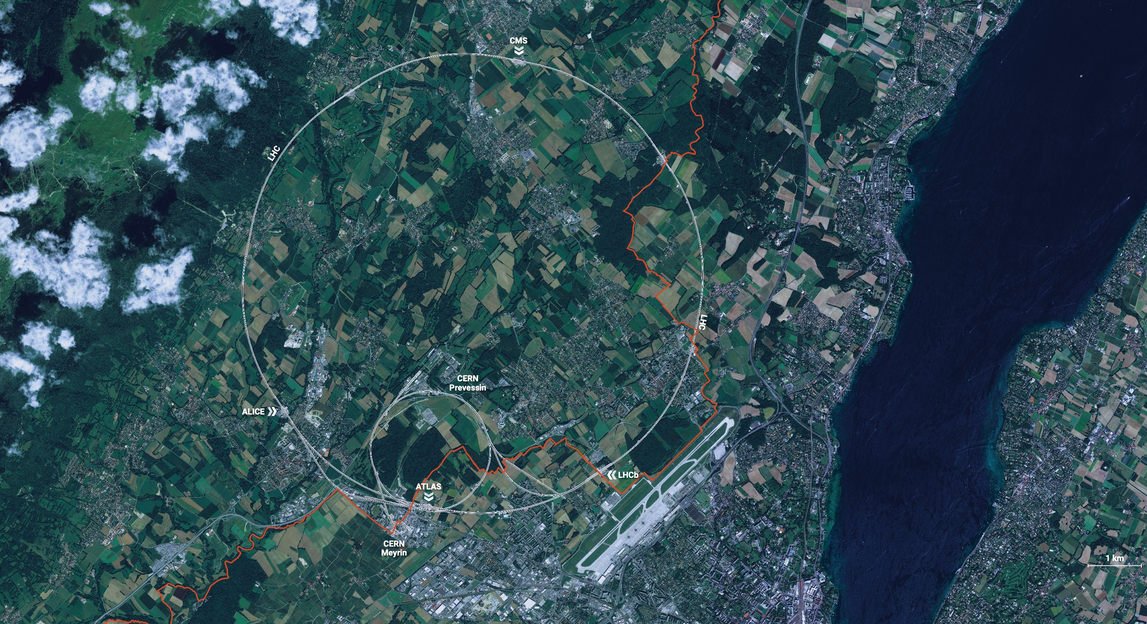
I. Research
CERN is the world’s biggest laboratory
for particle physics.
Its goal is to understand
the most fundamental
particles and laws of the universe.

Slide 9
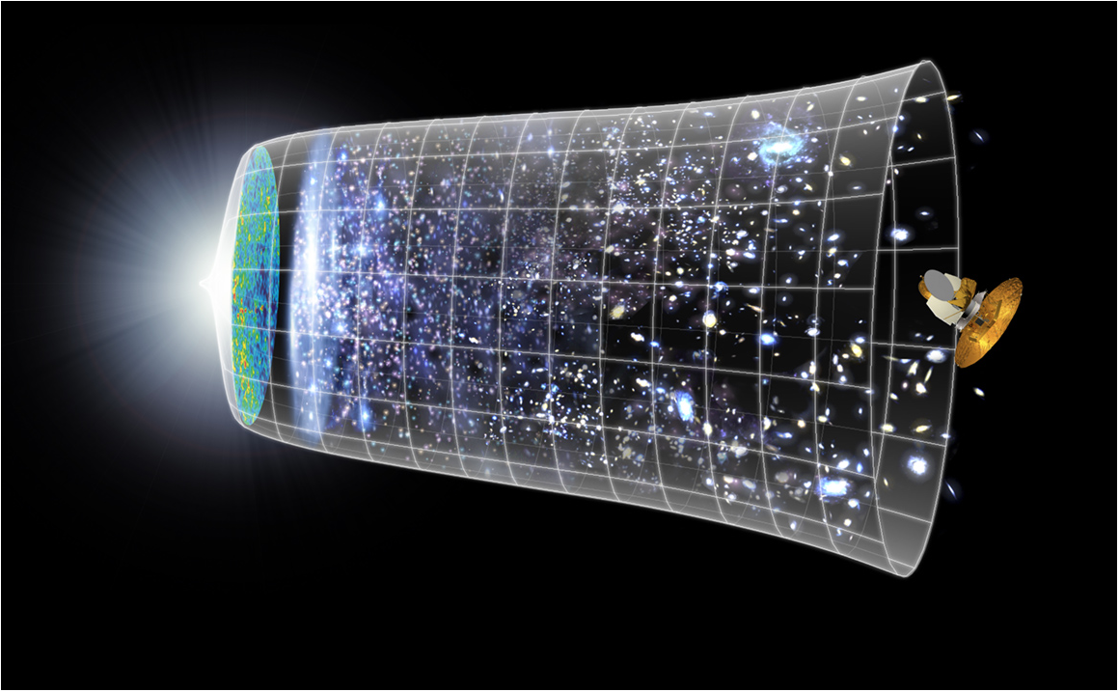
Scientific Challenge
to understand the very first moments of our Universe after the Big Bang
Big Bang
WMAP
13.8 Billion Years
Today
10²⁸ cm

Slide 10
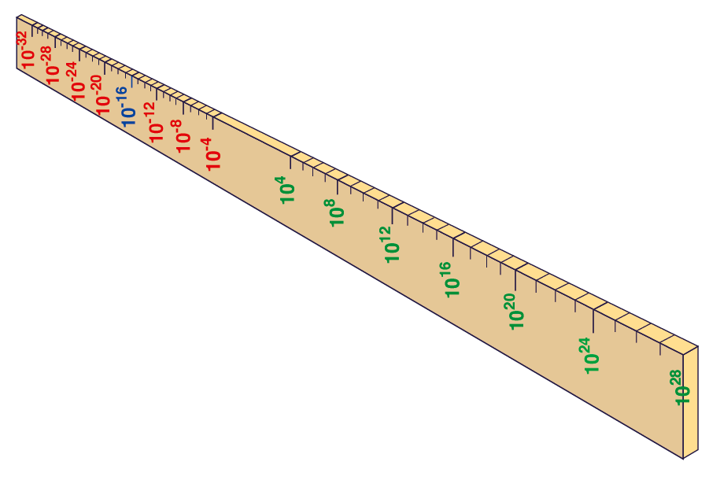
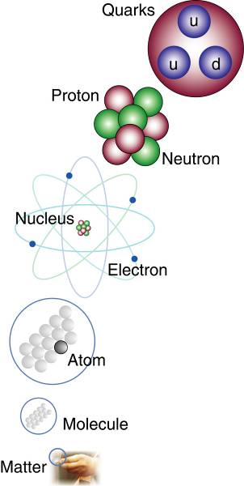



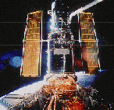
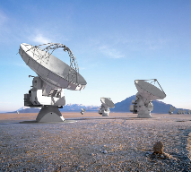
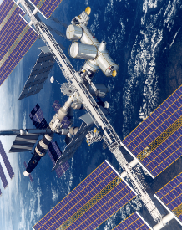
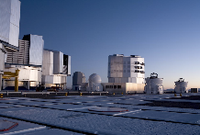
Big Bang
Proton
Atom
Radius of Earth
Earth to Sun
Radius of Galaxies
Universe
LHC
Super-Microscope
Hubble
ALMA
cm
Study physics laws of first moments after Big Bang
Increasing Symbiosis between Particle Physics,
Astrophysics and Cosmology
AMS
VLT
Notes:
10
60 Grössenordnungen

Slide 11
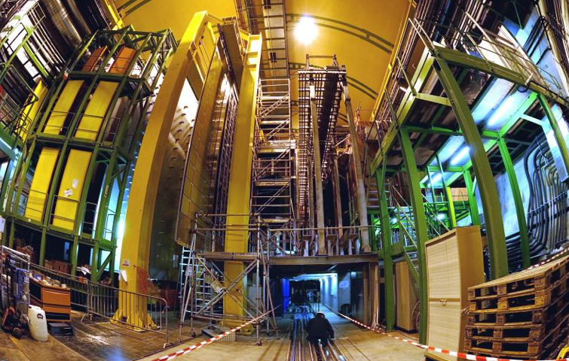


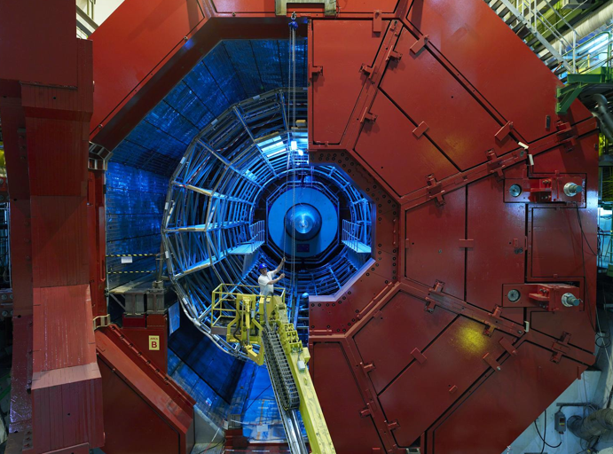

2010: a New Era in Fundamental Science
LHCb
CMS
ATLAS
Exploration of a new energy frontier
in p-p and Pb-Pb collisions
ALICE
LHC ring:
27 km circumference
Notes:
11

Slide 12
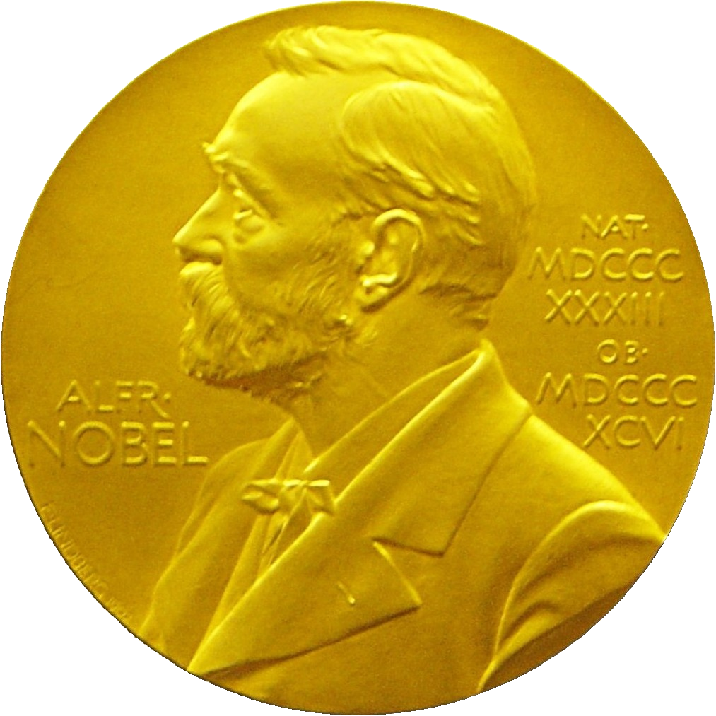
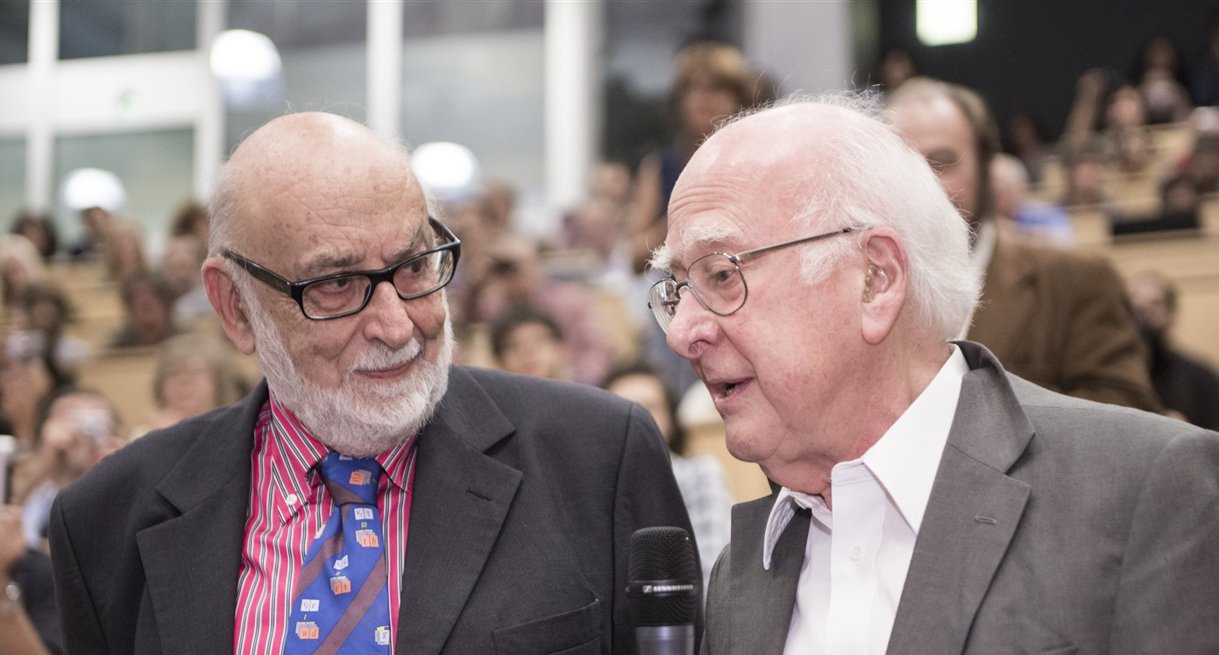
Discovery 2012, Nobel Prize in Physics 2013
The Nobel Prize in Physics 2013 was awarded jointly to François Englert and Peter W. Higgs "for the theoretical discovery of a mechanism that contributes to our understanding of the origin of mass of subatomic particles, and which recently was confirmed through the discovery of the predicted fundamental particle, by the ATLAS and CMS experiments at CERN's Large Hadron Collider”.

Slide 13
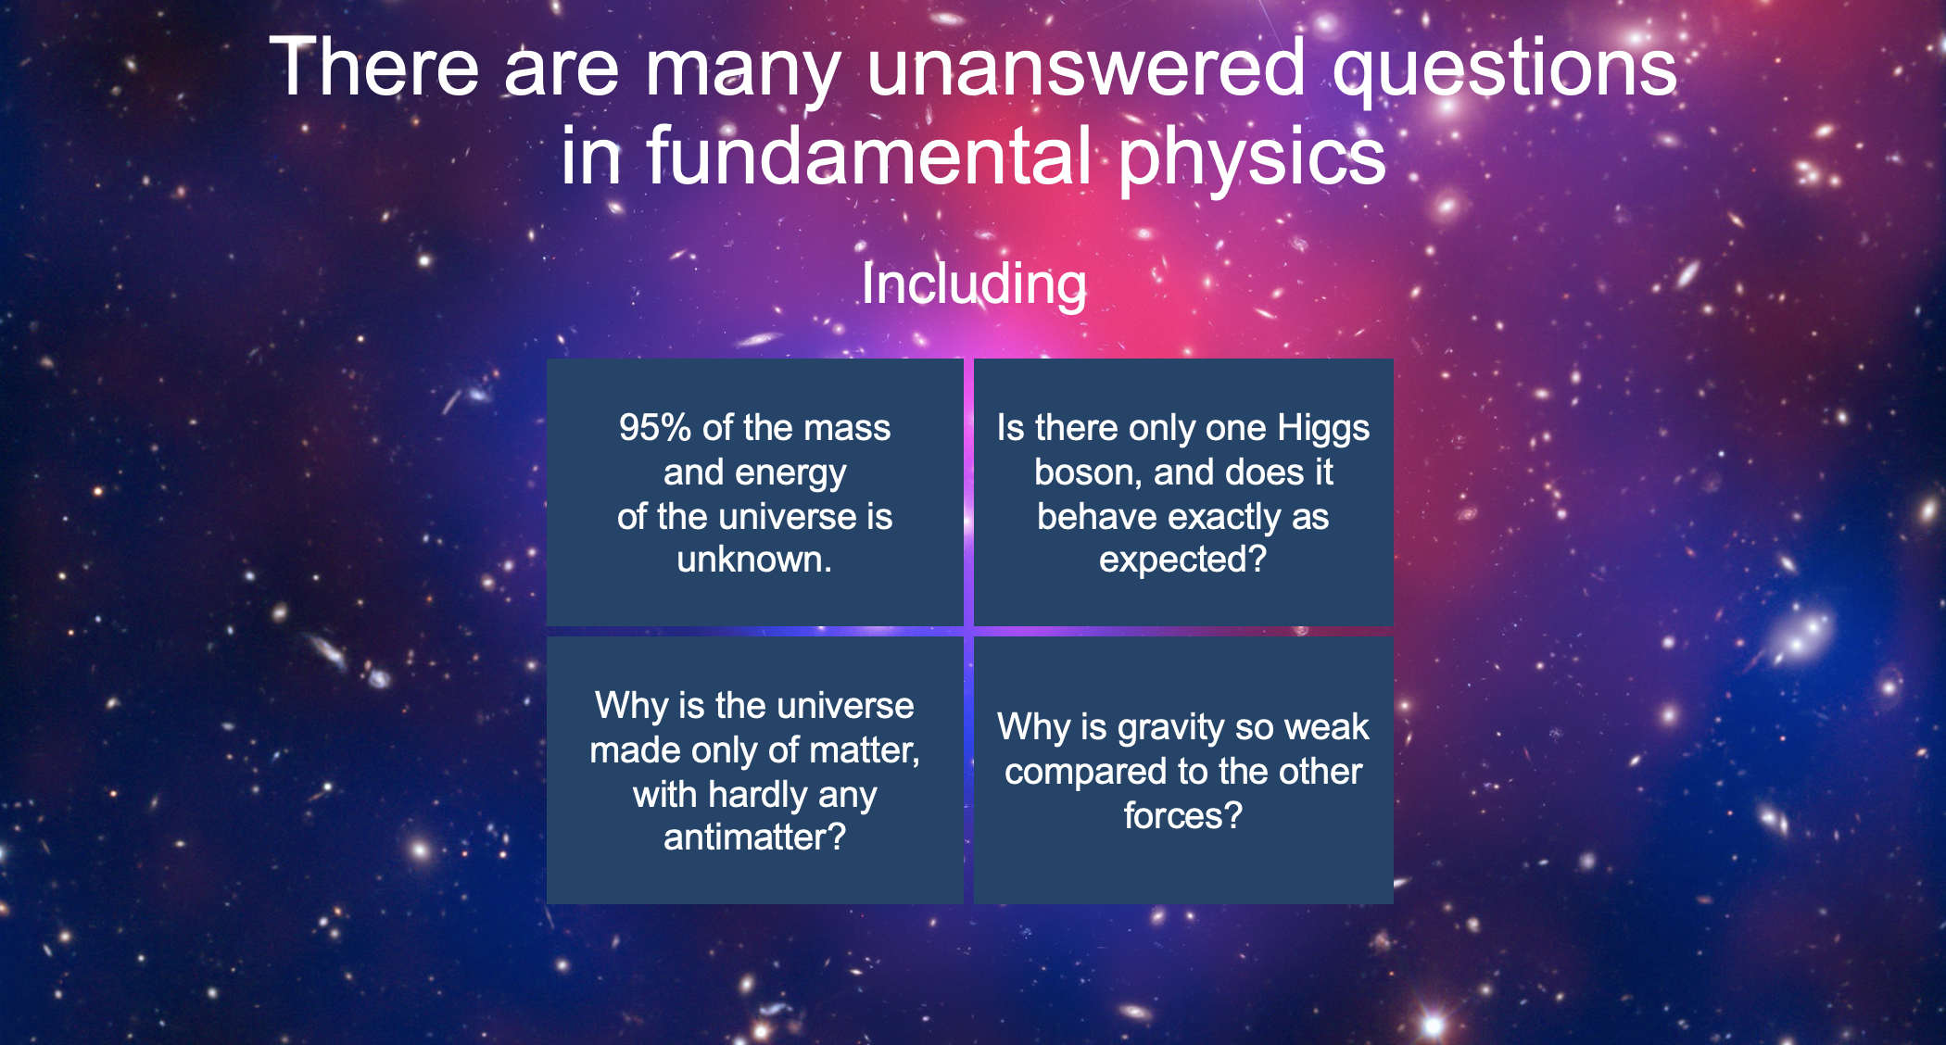
Unanswered Questions in Physics

Slide 14
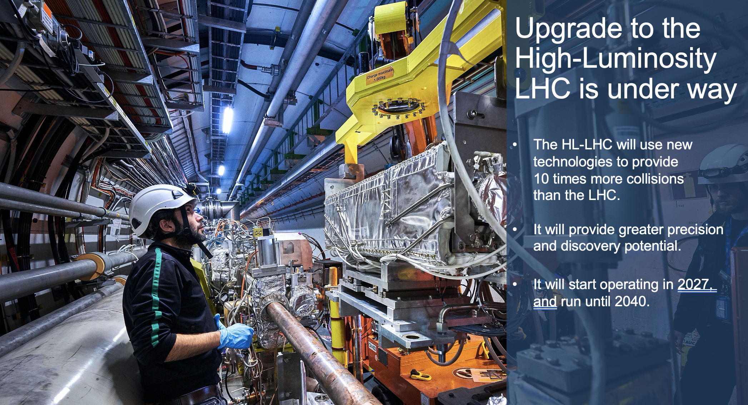
The High-Luminosity LHC (HL-LHC)

Slide 15
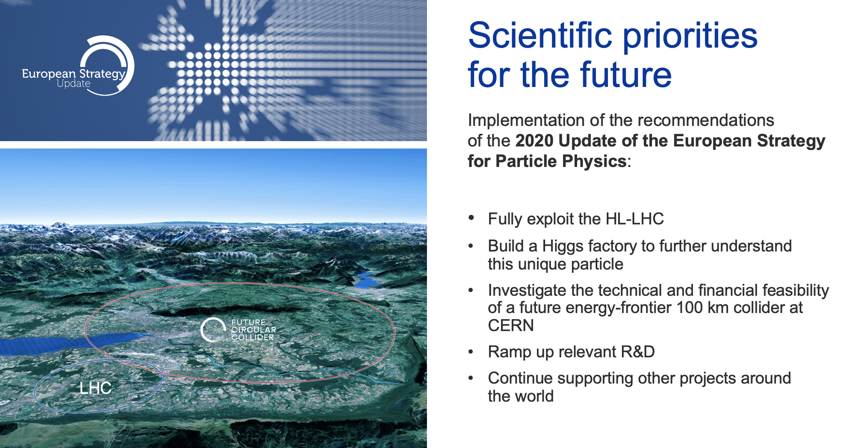
Scientific Priorities for the Future

Slide 16
Key issue: Scientific Instrumentation
Cutting-edge science relies on cutting-edge instrumentation
need to develop new technologies and techniques
significant market for high-tech industry
high initial costs and long time scales
→ strengthen the relations between RIs and
industry in the field of scientific instrumentation
→ promote knowledge and technology transfer

Slide 17
Investing in Science and Technology
Which type of research to support?
Basic – Applied ?
Small scale – Large scale ?
Individual – International ?

Slide 18
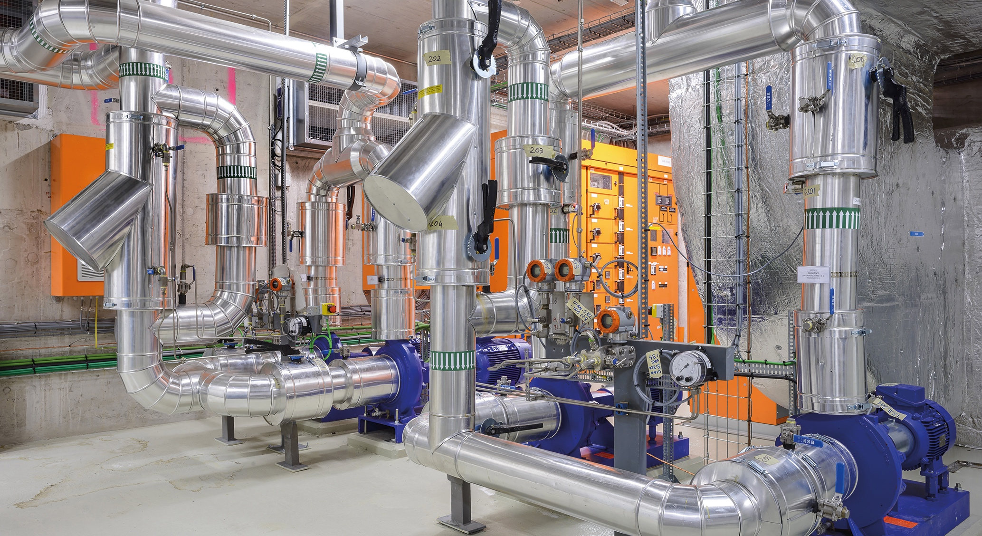
II. Technology and Innovation

Slide 19
Science and Technology
Investments in Science and Technology in the past have laid the basis for our society today, for our well-being today.
Investments in Science and Technology today will lay the basis for our society tomorrow, for our well-being tomorrow.

Slide 20
Primary Motivation for Research: CURIOSITY
Results of Research:
  Fundamental research → Applied research
  Knowledge/Know-how → Application / Use
  Culture → Technology
Primary aim of fundamental research – KNOWLEDGE/KNOW-HOW
Primary aim of applied research – APPLICATION/USE
Fundamental & applied research are inseparably connected.

Slide 21

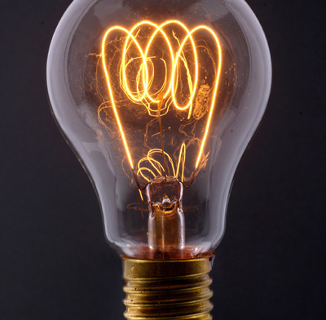
An Example…
…certainly not to light bulb.
Where do detailed studies on a candle lead to…?
Need fundamental research to discover electricity

Slide 22
Fundamental Research
Fundamental research results in gain of knowledge/know-how.
But also results in applications
  Time frame and areas of application are not predictable.
Fundamental research
  Is innovation.
  Needs innovation.
  Drives innovation.

Slide 23
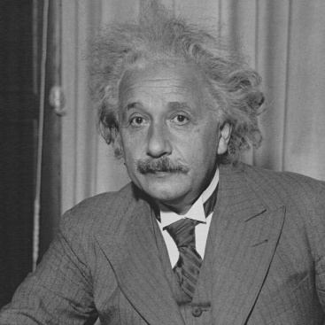
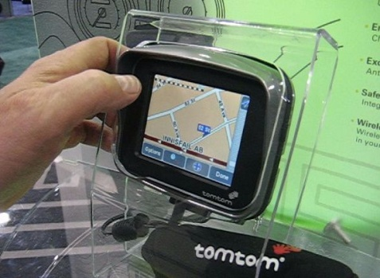
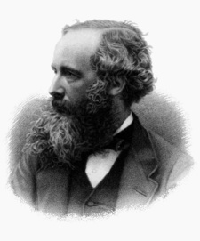
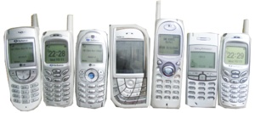
Fundamental research has always been a driver for Innovation
Relativity
GPS
100% SCIENCE
A. Einstein
GSM
Electromagnetism
100% SCIENCE
J.C. Maxwell

Slide 24
Investing in Science and Technology
Example of innovation through the interplay between (basic and applied) science and technological developments:

Slide 25
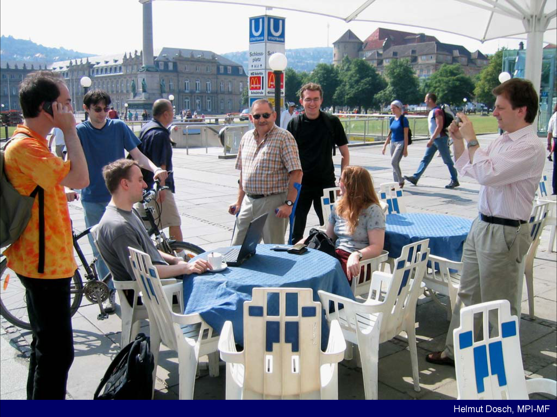
On a typical day somewhere in the world….
On a typical day in Europe …..

Slide 26
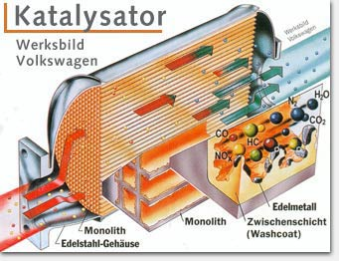
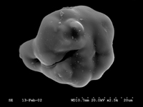
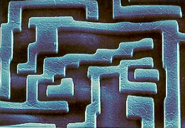
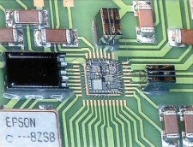
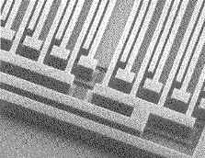
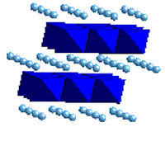
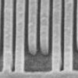
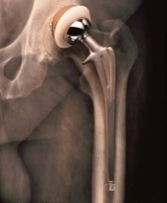
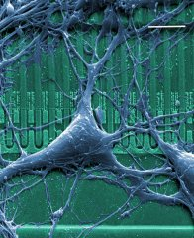
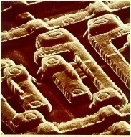
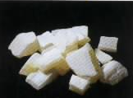
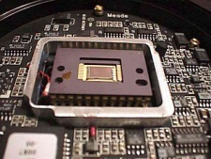
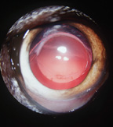
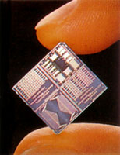
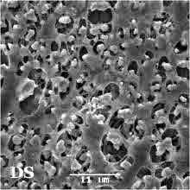
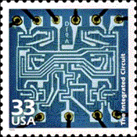
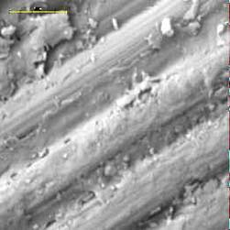
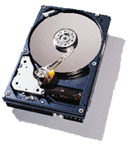
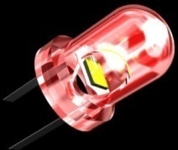
Catalyzer
Nanoparticles
Air Bag
Accelaration Sensors
MEMS
Cosmetics
TiO₂ Nanoparticle
GPS Navigation
Functional Materials
Pace Maker
Li-Batteries
New Materials for Energy
Mobile Phone
SAW Structures
Artificial Hips
Biocompatible
Materials
Glasses and Coatings
Optical Materials
UV Filter
Digital Camera
CCD Chip
Artificial Lens
Biocompatible
Polymers
Exact Time via satellite
Semiconductíng devices
Micro-Batteries
Intelligent Credit Card
Integrated Circuits
Bike Frame
Carbon Fibres
Composite Materials
GMR Read Head
Magnetic
Multilayers
LED Display
Photonic Materials

Slide 27
Large-scale Science Projects
Address
- fundamental science questions
at the forefront of research and technology
Provide
- unique equipment
- stimulating ideas which in turn attract good people
- occasion to bring people together
- challenging requests for high technology and innovation

Slide 28
Innovation in Fundamental Research
Large scientific projects stimulate innovation
  Space : Apollo missions, Space Station,
  Pioneer/Voyager Missions
  Particle Physics : accelerators in general
    at CERN : LEP, LHC
Pushing the frontiers of technology. CERN examples:
  Superconductivity, magnets, cryogenics, vacuum, survey/metrology.
  Transport and installation of heavy equipment.
  Solid-state detectors resistant to high-intensity radiation.
  Large-scale industrial control systems.
  Electronic and information systems.
  Project management and co-ordination.

Slide 29
Investing in Science and Technology
All science must be supported, don’t distinguish between basic and applied research, it’s
science, it is research
Criteria: Excellence

Slide 30
Investing in Science and Technology
Example of innovation through the interplay between (basic and applied) science and technological developments:
Medical Applications

Slide 31
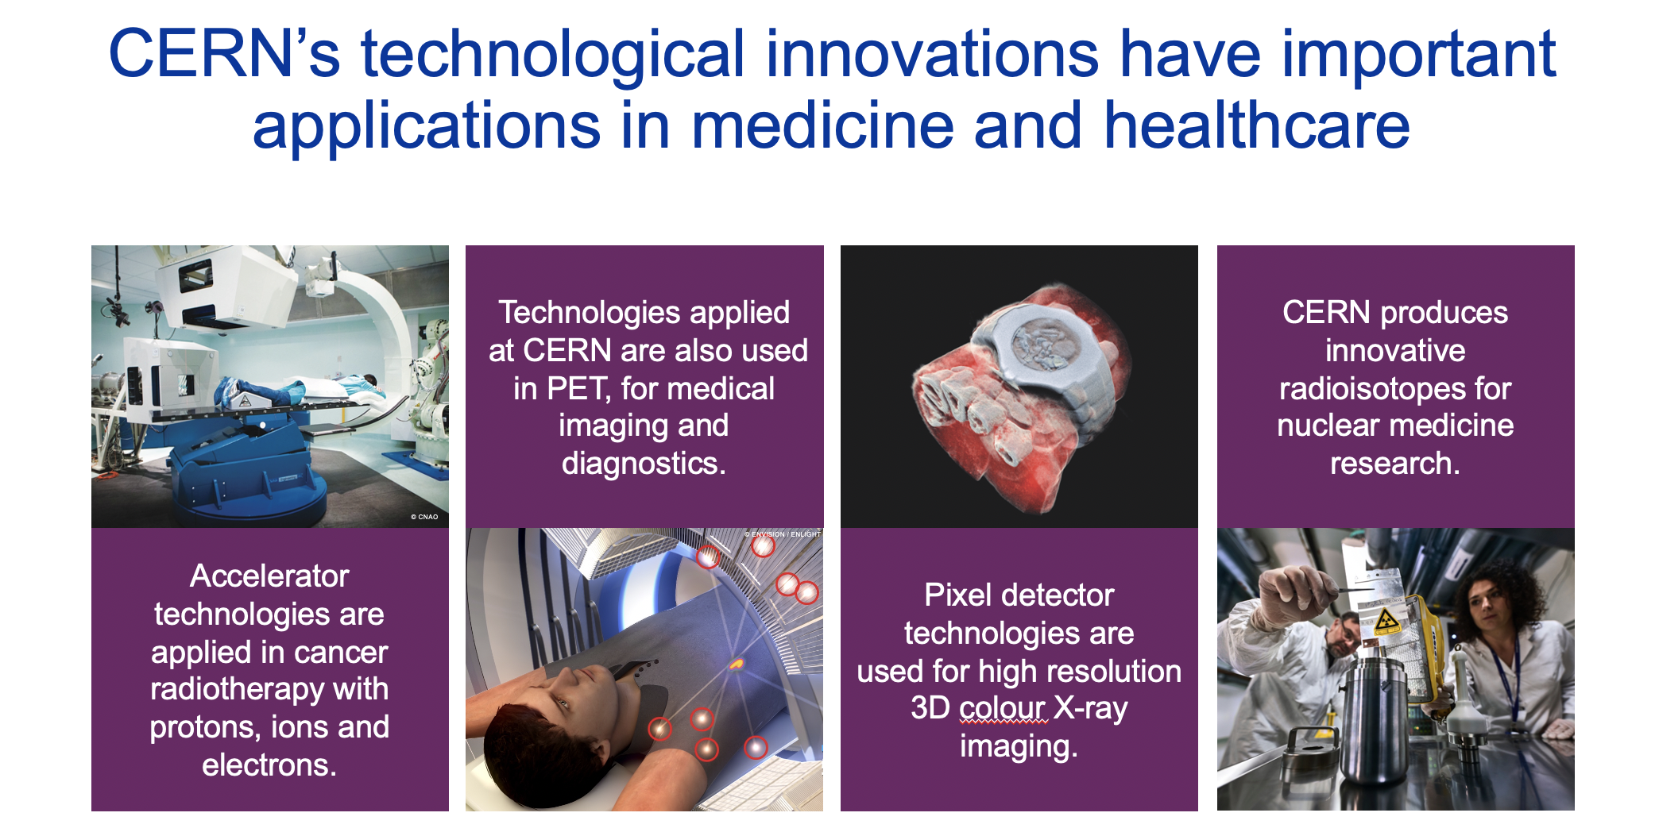
Applications in Medicine & Healthcare

Slide 32
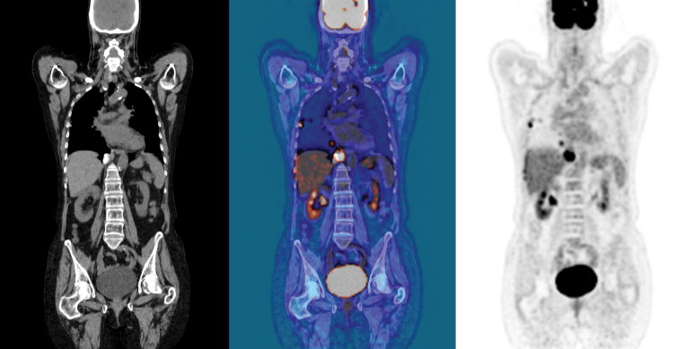
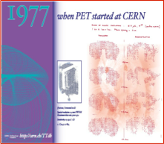
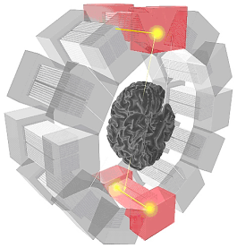
Medical diagnosis using Antimatter
“See more and better” with less radiation dose
Positron- Emission-Tomography
CT
CT+PET
PET
prediction and
discovery of
Antimatter
new PET Generation
(cristals from LHC
detectors)
1900
1925
1950
1975
2000
45 years
Basic Research
Technology

Slide 33
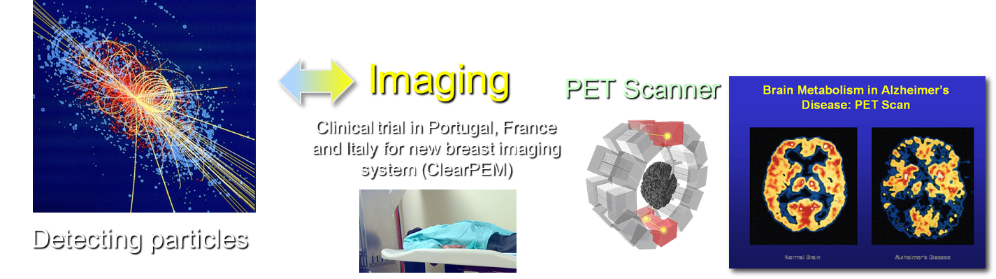




Medical Application as an Example of Particle Physics Spin-off
Combining Physics, ICT, Biology and Medicine to fight cancer
Interplay between science and technology
over decades to improve human health
Hadron Therapy
Tumour Target
Leadership in Ion Beam Therapy now in Europe and Japan
Protons
light ions
Accelerating particle beams
~30’000 accelerators worldwide
~17’000 used for medicine
X-ray
protons
>100’000 patients treated worldwide (>45 facilities)
>50’000 patients treated in Europe (>14 facilities)
Notes:
33

Slide 34
Example of Disruptive Innovation
Large scale international research at CERN required a paradigm shift in communication between researchers:
In 1989 the World Wide Web was born at CERN and a few years later given to society, transforming our daily life.

Slide 35

The Worldwide LHC Computing Grid (WLCG)

Slide 36
The Virtuous Circle
Basic research ↔ Innovation ↔ Applied research
Synergy between research and innovation results not only in societal and economic impact but also, and very importantly, in the creation of enhanced opportunities for further developments.
This circle needs to remain strong, to be unbroken and to be supported over long term.
Key Message (I)

Slide 37
Key Message (II)
In today’s challenging period, all regions need to step up support for research and innovation in order to ensure, in a global competitive environment, the sustainable development of science and technology necessary for the upturn and growth of everybody’s economy.
Big Science
is vital for our society

Slide 38
Investing in Science and Technology
Which type of research to support?
Basic – Applied ?
Small scale – Large scale ?
Individual – International ?
the scale appropriate for the
research to be carried out
cooperation and competition are both vital for research

Slide 39
Essential Ingredients to Drive Innovation
A concrete project with ambitious goals and deadline.
Highly competent and motivated teams in all domains and at all levels.
Investment in training and education.
Open collaboration with competent partners
  Prestigious universities and research institutes.
  Industrial partners for key technologies.
  Learning from others, sharing the results freely.

Slide 40

III. Collaboration

Slide 41
CERN as an Example
CERN is an example of a unique international institute, a global research infrastructure, vital for large scale projects,
which in turn allow to support the sustainable development of science and technology necessary for the upturn and growth of everybody’s economy
But CERN is only strong through its close collaboration with national institutes

Slide 42
Large International Collaborations
  A place where people learn to work together.
  Collaboration and competition.
  Diversity: good opportunity to recognize differences, accept them and learn to use them.
  Influence the way of thinking & planning.
  Information sharing: role of computing in internationalization and communication.
  Experience can be used by individuals and in other fields.
→ management through ‘common goals’
→ management by ‘convincing partners’

Slide 43

CERN is a model for
open and inclusive collaboration

Slide 44

CERN: founded in 1954: 12 European States
“Science for Peace”
Today: 23 Member States
Employees: ~2 635 staff, 756 fellows
Associates: ~11 399 users, 1 687 others
Budget (2021) ~ 1 200 MCHF
Member States: Austria, Belgium, Bulgaria, Czech Republic, Denmark, Finland, France, Germany, Greece, Hungary, Israel, Italy, Netherlands, Norway, Poland, Portugal, Romania, Serbia, Slovak Republic, Spain, Sweden, Switzerland and
United Kingdom
Associate Members in the Pre-Stage to Membership: Cyprus, Estonia, Slovenia
Associate Member States: Croatia, India, Lithuania, Pakistan, Turkey, Ukraine
Applications for Membership or Associate Membership: Brazil, Latvia
Observers to Council: Japan, Russia, United States of America;
European Union, JINR and UNESCO
44
Notes:
44
----- Meeting Notes (09/01/2013 14:16) -----
nnn

Slide 45

Science is getting more and more global
Notes:
45
45

Slide 46
But there is more to it…..
Sustainable Development
needs trust,
trust between all people involved
Science for Peace

Slide 47


CERN
Conceived late 1940s – two aims:
Enable construction of a facility for (then) nuclear and (now) particle physics research beyond the means of individual members
Foster cooperation between peoples recently in conflict
SESAME
(Synchrotron-light for Experimental Science and Applications in the Middle East)
Conceived late 1990s – two aims:
Enable construction of a facility for a broad range of scientific
research beyond the means of individual members
- Foster cooperation between peoples

Slide 48
SESAME (Synchrotron-light for Experimental
Science and Applications in the Middle East)
SESAME is a synchrotron radiation facility in Allan (Jordan)
1) to promote scientific and technical excellence in the Middle East and beyond (and in particular to enable and achieve the return of scientists and engineers from the region)
Synchrotron radiation allows research in many areas, e.g. biology, physics, chemistry, archaeology, medicine, material science, environmental science, arts,…….
→ Building scientific capacity

Slide 49

SESAME is a synchrotron radiation facility in Allan (Jordan)
2) to build scientific and cultural bridges between different societies in the Middle East and beyond
International Cooperation as example of
peaceful cooperation
aaa
Pakistan

Slide 50
Key Message (III)
International collaboration is mandatory in many areas today, not only in science
- It needs trust between partners
- It needs commitment, and
sustainability from all partners
Science shows: It is possible

Slide 51

IV. Education, Outreach and Training

Slide 52
Key Issue: Outreach and Education
All countries need more scientists, engineers, staff, . . .
targeted outreach activities
encourage interest in careers in science
Society needs to realize and appreciate science
- bring innovative science and exciting results (achieved at
Research Infrastructures, Universities, etc), and their
application to societal challenges, to the notice of society,
and, in particular, to the schools

Slide 53





CERN Education Activities
Scientists at CERN
Academic Training Programme
Asia-Europe-Pacific School of High-Energy Physics
Fukuoka, Japan, 2012
Puri, India, 2014
2016 Beijing, China
2018 Quy Nhon, Vietnam
Latin American School of High-Energy Physics
Ibarra, Ecuador, 2015
San Juan del Rio, Mexico, 2017
Córdoba, Argentina 2019
Young Researchers
CERN School of High Energy Physics
CERN School of Computing
CERN Accelerator School
Undergraduates
Summer Students
Programme
CERN
School of Physics
Russia, September 2019
CERN Teacher Schools
International and National Programmes
Public visitors
150 thousand per year

Slide 54


CERN Teacher Programme

Slide 55


Summer Students 2019

Slide 56
Age Distribution of Scientists
- and where they go afterwards
27
Today:
>3000 PhD students
in LHC experiments
65
They do not all stay: where do they go?

Slide 57
Public Acceptance of Science
Society needs to realize and appreciate science
- Bring innovative science and exciting results (achieved at
Research Infrastructures, Universities, etc), and their
application to societal challenges, to the notice of society,
and, in particular, to the schools.
Key Message (IV)
Scientists need to be ambassadors of science

Slide 58

CERN Science Gateway

Slide 59

V. Concluding Remarks

Slide 60
Science and Technology in the Next Decades
with strong sustained support for research,
with trust developed and kept between all partners,
with international collaboration,
with scientists as ambassadors for peaceful cooperation
will pave the way towards
a sustainable future

Slide 61
And finally….
The relationship between basic research and sustainable progress is fundamental (contrary to common belief, technology does not sustain itself on the long term).
In a globalized world, knowledge is becoming the most important asset.
Developed countries are about to make a major strategic error by underestimating the value of fundamental research (whereas emerging countries are doing the opposite and catching up fast).

Slide 62

Last paragraph of the Editorial in
The Guardian, 4 March 2015,
on CERN/LHC

Slide 63
Thank You!
Accelerating Science and Innovation
Notes:
63

