Slide 1

Functional Requirements and Bus Bar Layout in WP6a
J. Fleiter, J. Hurte, A Ballarino
14th April 2021 Internal review of Busbars and splices, indico 1021628

Slide 2
Outline
Overview of the different circuits of WP6a
Bus bar layout in DFX
Bus bar layout in DFM
Functional requirements

Slide 3
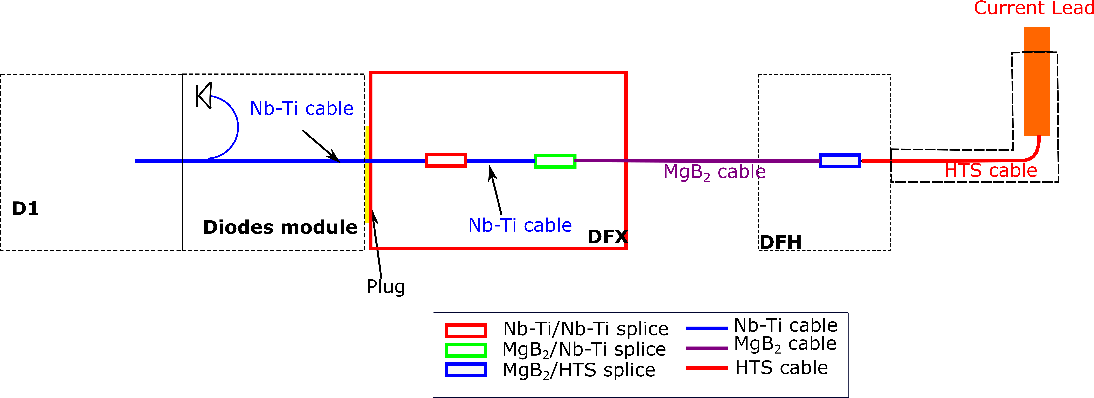
Overview of Electrical Circuits of WP6a
Two types of SC Link system:
Inner triplets: 19 branches of circuits
2 × 18 kA MQXF main circuit
3 × 7 kA MQXF trims
2 × 14 kA D1 circuit
12 × 2 kA MCBXF circuit
Matching sections: 10 branches of circuit
2 × 14 kA D2
10 × 0.6 kA MCBRD
Nb-Ti bus bar cables extension will be attached at the surface to the MgB₂ cables of the SC Link before qualification of the system
WP6
WP6
WP3
WP3

Slide 4
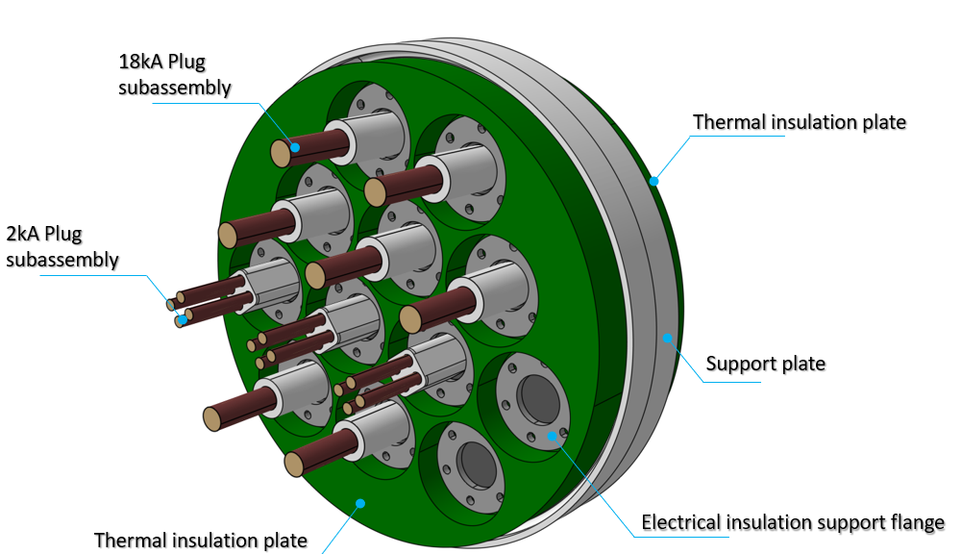
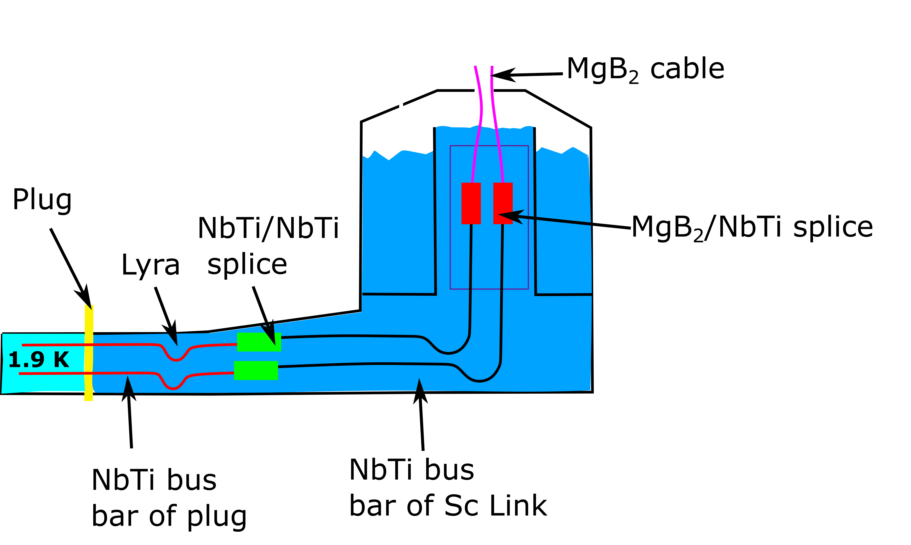
Bus Bar Layout in DFX and DFM
The Sc Link systems will be equipped at the surface with Nb-Ti bus bar extension
The MgB₂/Nb-Ti splices of the SC Link will be qualified in SM18
For the test in SM18 the Nb-Ti bus bar extensions equipping the SC Link systems will be shorted at 4.3 K
Shorts among SC link bus bars (SM18 qualification) will be removed prior to installation
During installation in the machine, the SC link bus bars will be spliced in situ to the bus bar of the lambda plate
The DFX/DCM lambda plate equipped with the 19 bus bars
https://indico.cern.ch/event/1021629/
DFX

Slide 5
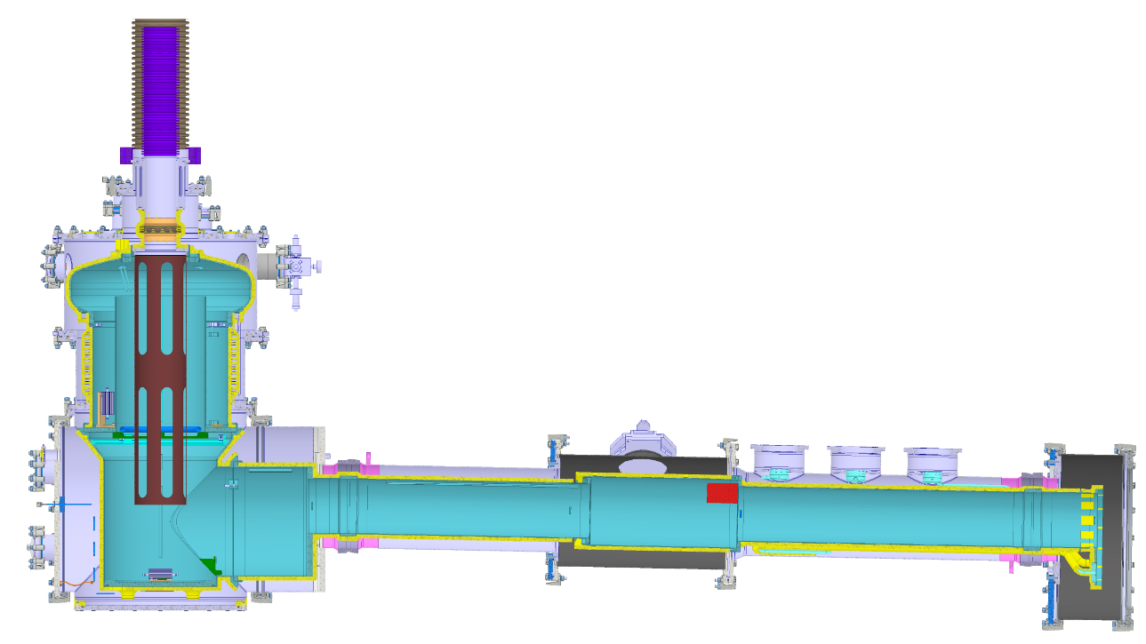
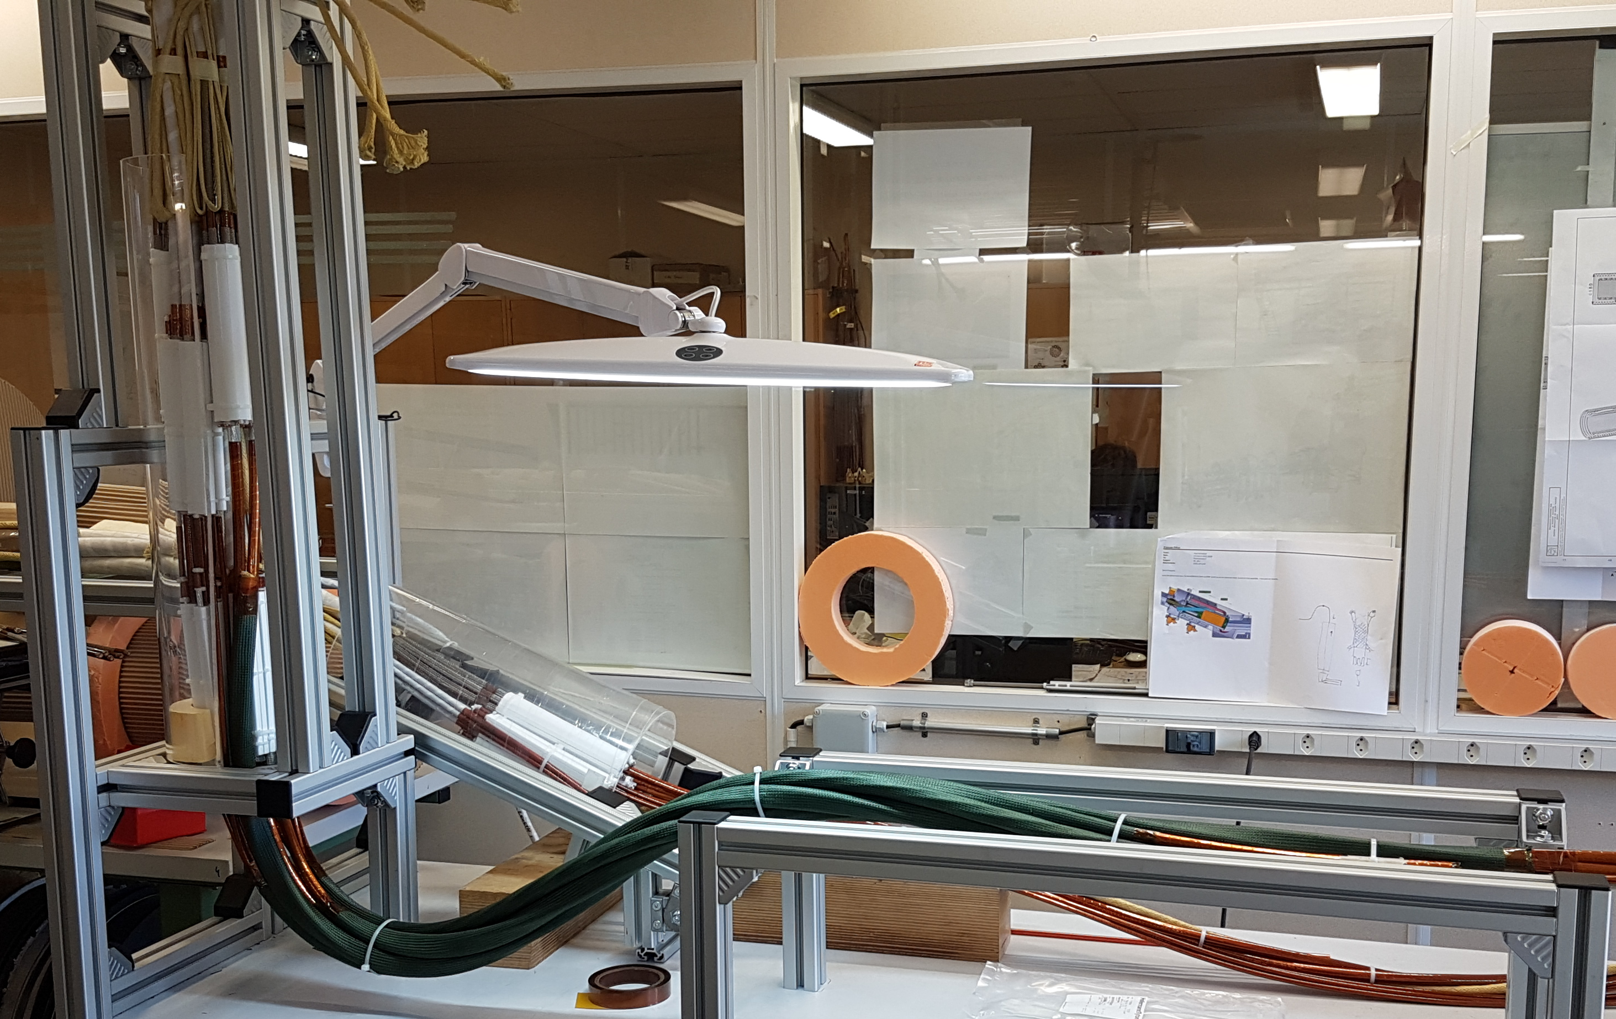
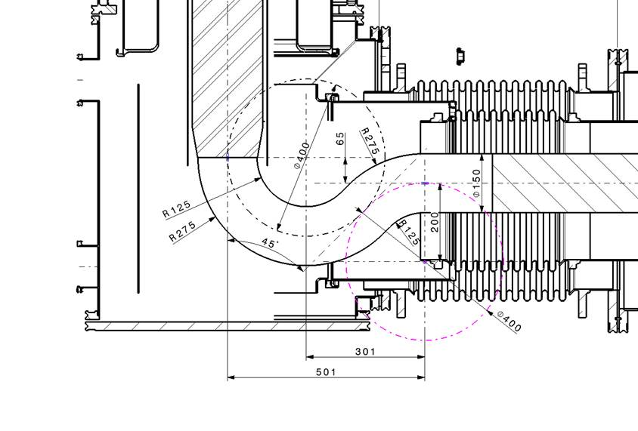
Routing of Nb-Ti Bus Bar in DFX
The vertical to horizontal transition of the bus bar has a double bend S shape for allowing He vessel sub-modules integration and acts as a Lyra
Space reservation for bus bars in the S shape: 150 mm in diameter, minimum bending radius of 125 mm (median bending radius of 200 mm)
MgB2-NbTi splices
NbTi-NbTi splices
Plug
4 m
2.5 m

Slide 6
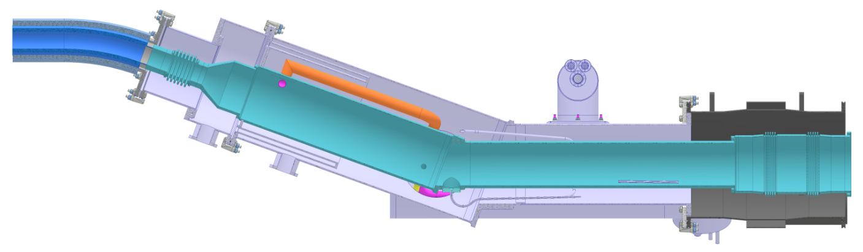
Routing of Bus Bar in DFM
The bus bar in the DFM will undergo a single 30 deg bend
Lyra will be formed to absorb displacement of MgB₂ splices
Space reservation for bus bar is > 150 mm diameter
MgB2-NbTi splices
MgB₂ cables
NbTi-NbTi splices
Plug
NbTi bus bars of Sc Link
2.5 m

Slide 7
Bus Bar Topology for DFX and DFM
Two options were considered at the preliminary stage of the design
Rutherford cables:
Single or pair of Rutherford cable stabilized with Sn-Ag.
Additional copper shunt provided if not enough in the cable
Cables available and well known
Quite Easy to bend out of the plane
Easy to splice
Very difficult to bend in the plane
Require Sn-Pb or Sn-Ag stabilization
Require insulation to be performed once shaped
Round bus bars
Round cables made from LHC NbTi strands
Cables not existing, need development
Easy to bend in any direction
Easy to splice
Doesn’t require Sn-Ag stabilization
Cable are already insulated
=>Round bus bars selected for their flexibility in all directions and their as-built topology that doesn’t require stabilization and insulation after shaping
For the sake of standardization, only two types of bus bars are considered for WP6A:
18 kA for MQXF D1 and D2 circuits (total of 9 current lines per IP side)
2 kA for MCBXF and MCBRD (total of 20 current lines per IP side)

Slide 8
Requirements for the Nb-Ti Bus Bars of WP6a
Operating temperature of 4.3 K
Transport nominal current with temp margin of at least 2.5 K at peak field of 2 T
Incorporate sufficient Cu to not exceed 100 K during quench
Be immersed in LHe
Be round to allow easy bending in all directions
Have low splice resistance to other Nb-Ti bus bar <1 nΩ
Fulfil the voltage insulation requirements of the different circuits
Be flexible enough to allow their routing (and formation of a lyra)
Be mechanically maintained to avoid movement during powering of the circuit and/or transient on other circuits
Equipped with voltage taps for electrical protection
Provide continuity of Cu stabilizer at interconnects

Slide 9
Requirements for the Nb-Ti Bus Bars of WP6a

Slide 10
Summary
The SC Links require round Nb-Ti bus bars for the DFX and DFM
Two types of round bus bars are required:
18 kA rated cable for MQXF, D1 and D2
2 kA rated cable for MCBXF and MCBRD
Functional requirements of the bus bars
Ultimate design current 18 kA and 2 kA
Temperature margin of 2.5 K (Top = 4.3 K)
Hot spot temperature less than 100 K on Sc Link bus bar

