Slide 1

Nb-Ti Round 18 kA and 2 kA Bus Bar Design, Procurement and Qualification Design of Other Bus Bars and Magnet “Leads”
J. Fleiter, S. C. Hopkins, J. Hurte, A. Ballarino
14th April 2021 Internal review of Busbars and splices, indico 1021628/

Slide 2
Outline
Functional specification of round bus bars
Design of 18 kA and 2 kA Nb-Ti round bus bars
Assemblies of 2 kA and 18 kA round bus bars
Procurement and qualification
Design of other busbars and magnet “leads” (Rutherford SC cable)

Slide 3
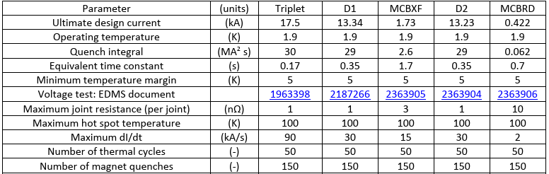
Recap of Specification for Round Bus Bars
WP3 specification
WP6 specification
Two variants of round bus bar were considered: 18 kA and 2 kA. They were designed for an operating temperature of 6.8 K and a peak field on conductor of 2 T

Slide 4
Minimum SC and Cu Cross-Sectional Area
Bus bars shall by design transport 17.5 kA and 1.7 kA at 6.8 K with 2 T peak field
Minimum cross-section of SC estimated using Luca’s I_{c} fit for LHC Type 01 strands (515 A @1.9 K and 10 T) [LHC IT-2472 and LHC Proj. Rep. 358].
At 6.8 K and 2 T, J_{c}=1620 A/mm² for LHC Type 01 wire, the minimum cross-sectional area of Nb-Ti is therefore:
11 mm² for 18 kA cables
1.1 mm² for 2 kA cables
The minimum cross-section of Cu not to exceed 100 K during quench of the bus bars. It was estimated with a detection time of 0.4 s and in adiabatic conditions (without He) but considering the SC cross-sectional area (11 mm² for 18 kA and 1.1 mm² of 2 kA):
43 mm² for 18 kA cables
7 mm² for 2 kA cables

Slide 5
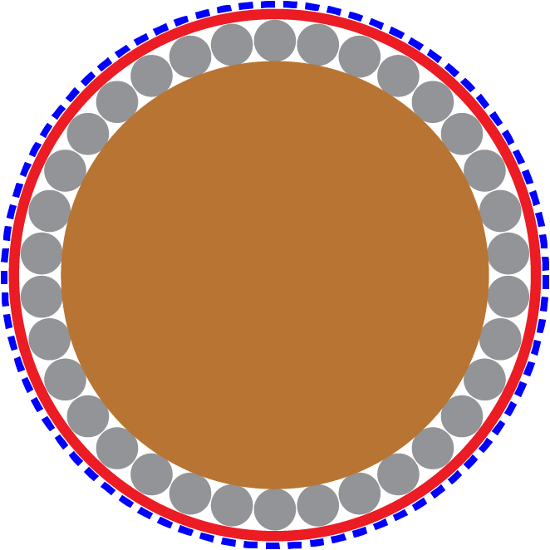
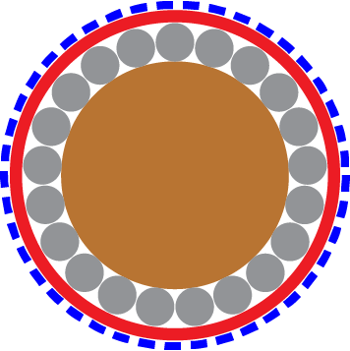
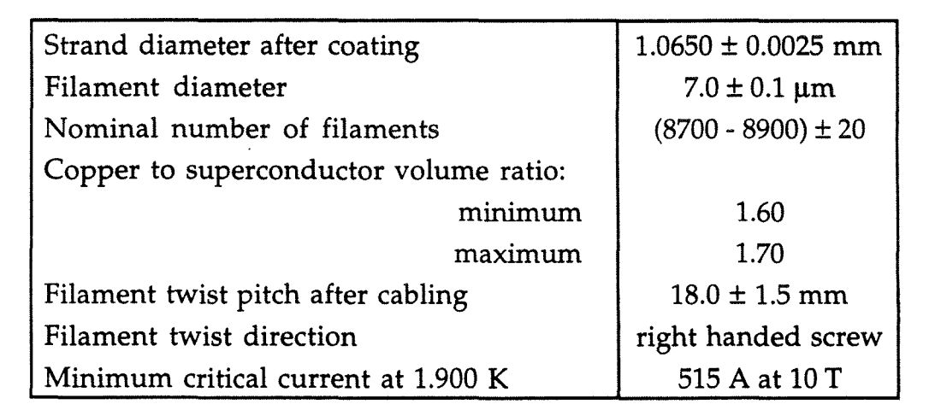
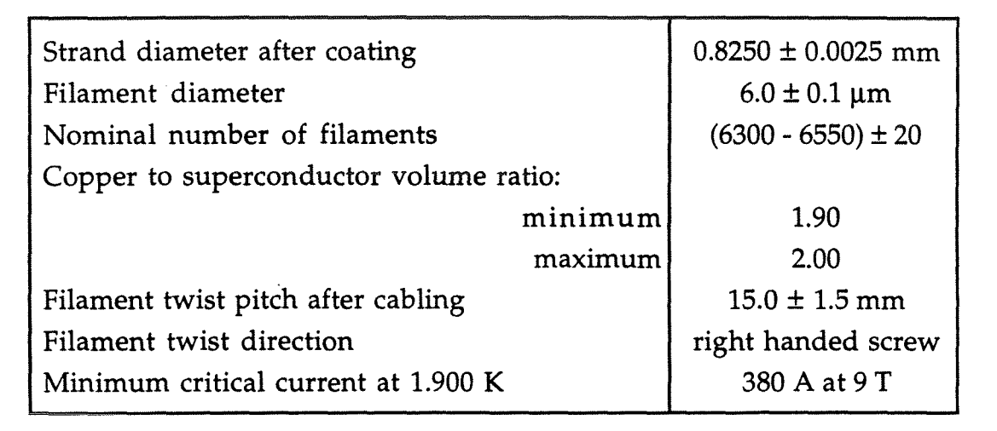
Bus Bar Geometry: Use of the SC Link Layout
Use of design, materials and cabling experience from SC Link Project
Round topology selected for ability to bend in all directions
Single layer of strands selected to promote balanced current distribution and simplify splices
One layer of SC strands helically wound around a copper multi-strand core
Geometries of SC Link bus bar:
18 kA cable: 34 LHC type 01 strands (Ø=1.07 mm) around a 10.9 mm diameter multifilamentary core
2 kA cable : 21 LHC type 02 strands (Ø=0.825 mm) around a 4.9 mm multifilamentary diameter core for MCBXF and MCBRD magnets
Nb-Ti wire, type 01
18 kA cable
Copper core
Spec of LHC type 01 strand LHC IT-2472
Spec of LHC type 02 strand LHC IT-2471
2 kA cable
Nb-Ti wire, type 02

Slide 6
Expected Performance of the 18 kA and 2 kA Bus Bars
Nb-Ti wire, type 01
18 kA cables @ 2T
Critical current:
4.3 K: 63 kA (3.6 × I ultimate)
1.9 K: 102 kA (5.8 × I ultimate)
T_{cs} 6.86 K
2 kA cables @ 2T
Critical current:
4.3 K: 22 kA (12.8 × I ultimate)
1.9 K: 35 kA (20.8 × I ultimate)
T_{cs} 7.8 K
18 kA cable
Copper core
Nb-Ti wire, type 02
2 kA cable

Slide 7
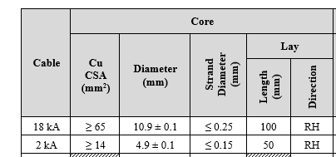
Copper Core
Made from tin-coated Electrolytic Tough Pitch (ETP) copper strands, or an equivalent grade, with a RRR of 60 or more in the completed cable
Copper strands right hand twisted, with a pitch of 100 mm for 18 kA and 50 mm for 2 kA cables
The copper cross-sectional area is ≥ 65 mm² for the 18 kA cables and ≥ 14 mm² for the 2 kA cables
The outer diameters are about 10.9 mm (18 kA) and 4.9 mm (2 kA)
In each piece length of cable, the core will be continuous, with no joints

Slide 8
SC Layer
The superconducting strands are helically wound around the copper core, with a left-hand pitch (150 mm for 18 kA and 75 mm for 2 kA)
The strands will be arranged uniformly around the core in a single, well-packed layer without crossovers
Minimum bend radius applied on the strands during cabling of 30 mm
For cabling operations, a planetary machine will be used, the specified twist pitch will be achieved without applying additional torsional forces to the cabled components. We know at least one industrial cabling site able to produce what is specified – the one producing the SC Link round MgB₂ cables
No lubricants other than ethanol – if needed - will be used during production
Nb-Ti wire, Type 01
18 kA cable
Copper core
Nb-Ti wire, Type 02
2 kA cable

Slide 9
Insulation Scheme and Protective Sheaths
Electrical insulation of bus bars provided by two layers of polyimide Kapton® (see next slide)
Insulated cables enclosed in a protective sheath, protecting from external abrasion and ensuring the mechanical integrity and stability of the cable
Sheath manufactured from an electrically insulating material
Sheath will provide full coverage of insulation
Sheath thickness not exceeding 1 mm
Insulation layout similar to what is already implemented in the MgB₂ SC cables
18 kA cable
Sheath
Insulation
2 kA cable

Slide 10
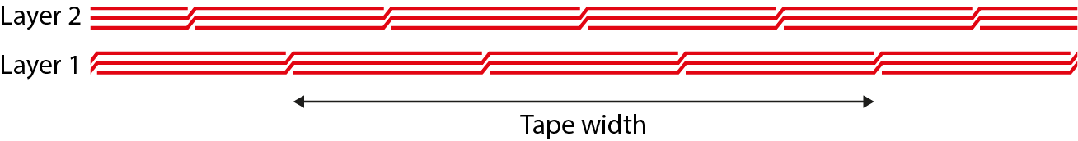
Bus Bar Insulation
Electrical insulation of bus bars provided by two layers of polyimide Kapton®
Polyimide film: 50 µm thick and at least 15 mm wide for 18 kA cables and 10 mm wide for 2 kA cables;
Each layer wound with an overlap of two-thirds of the tape width between turns, such that the nominal layer thickness is triple the tape thickness;
Each layer consists of a single continuous length of polyimide tape, with no joints, discontinuities or local repairs within a cable piece length;
The first layer applied with a left-hand lay direction;
The second layer offset from the first layer along the length of the cable by one-sixth of the tape width;
The second layer applied with a right-hand lay direction.

Slide 11
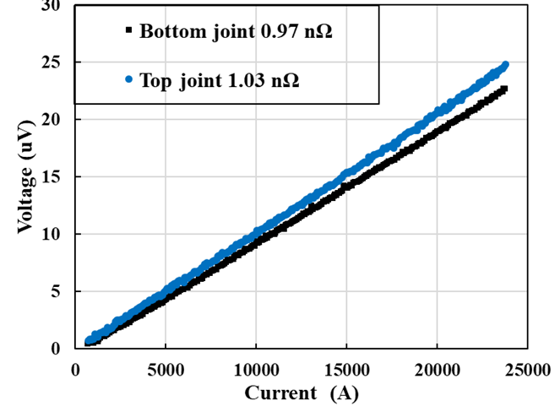
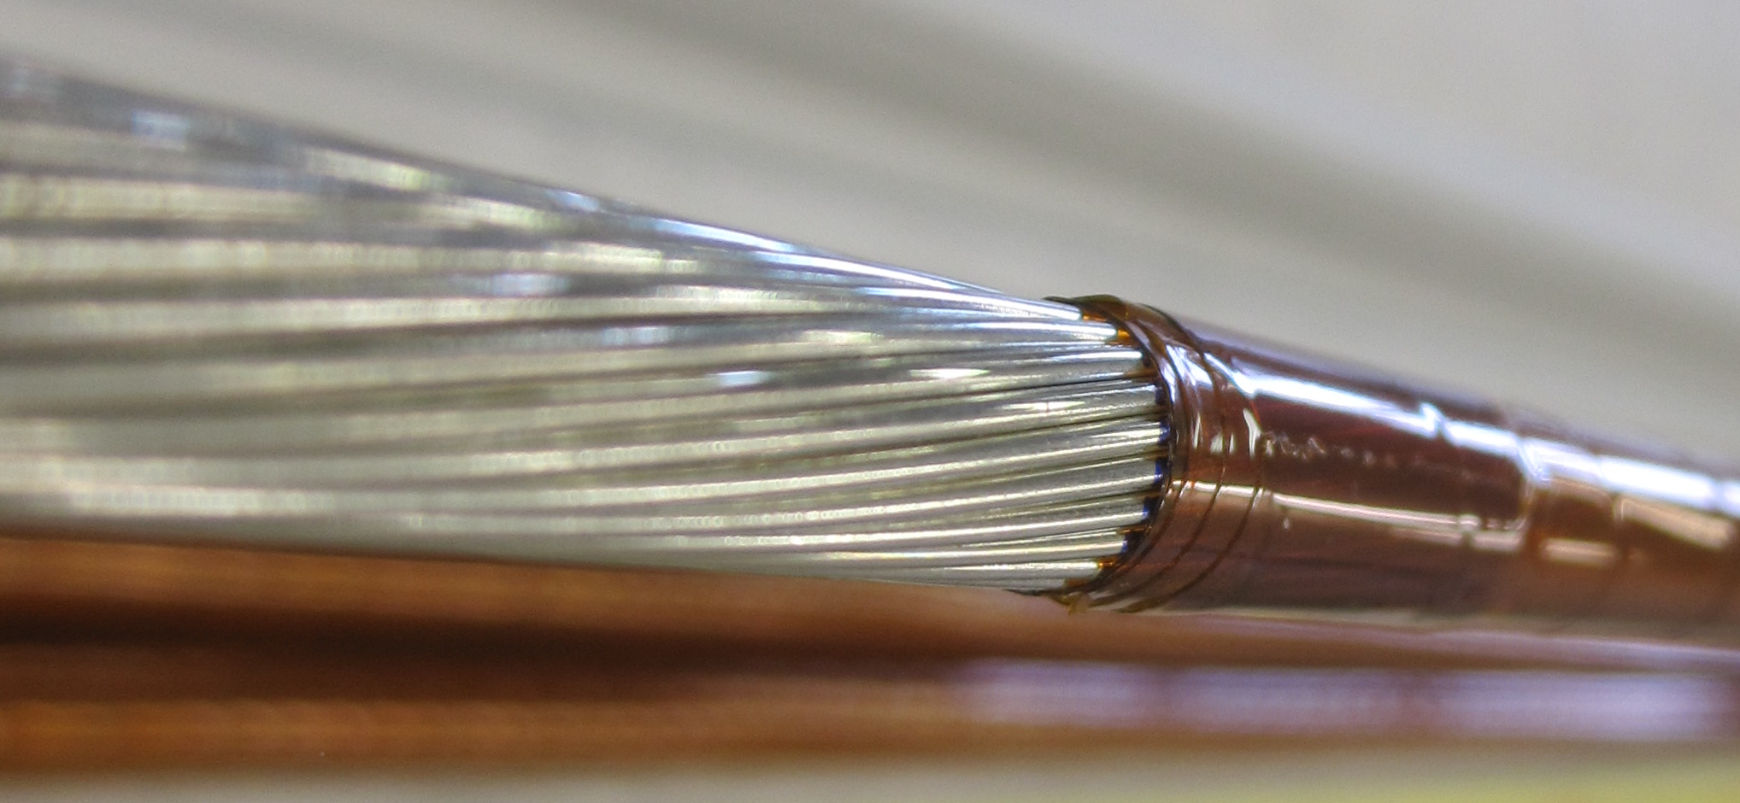
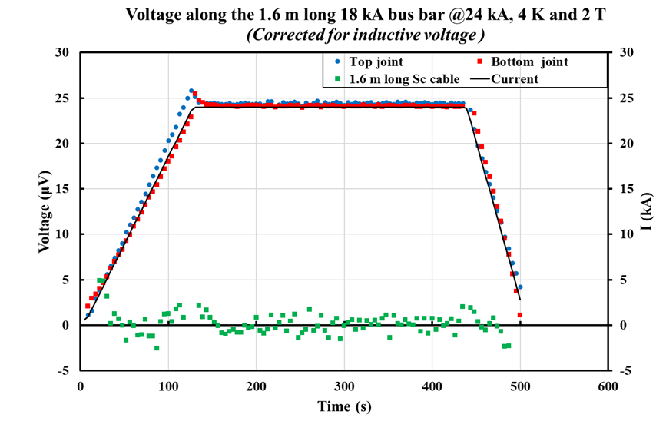
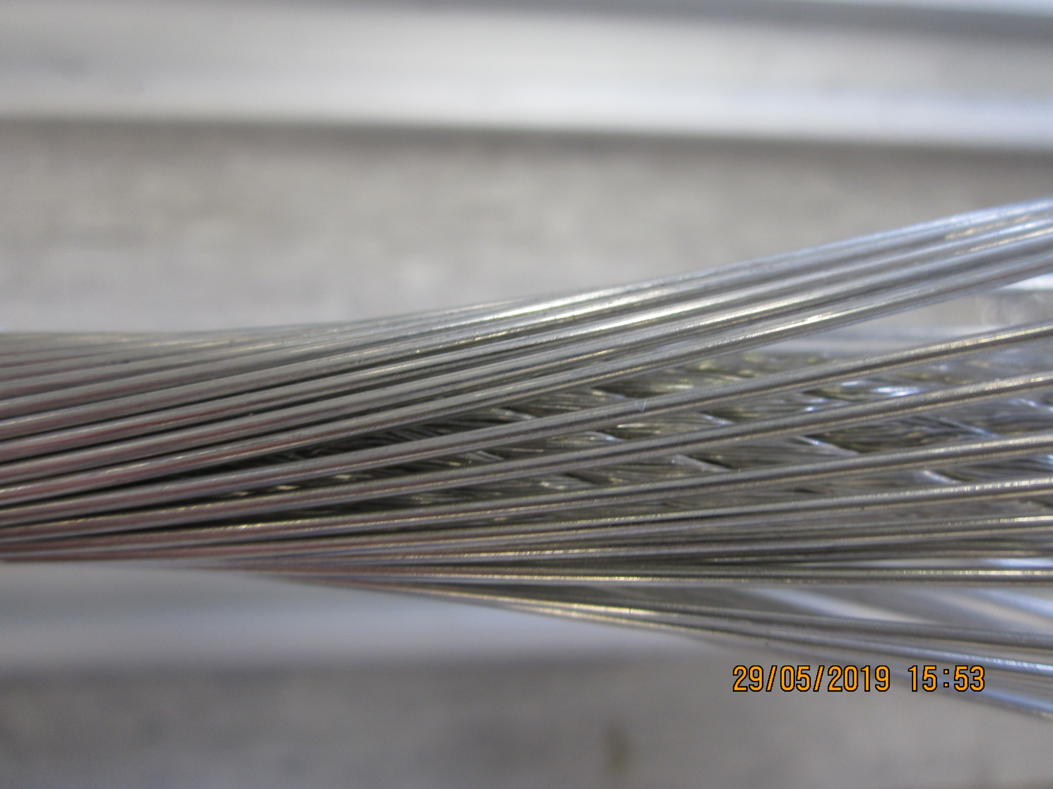
Measured performances of proof of concept 18 kA and 2 kA Bus Bars
Voltage across 18 kA splice
Proof of concept cables (hand made) characterized in FRESCA test station at 4.3 K vs external field in the range 0-2 T
18 kA cables 35 LHC Type 01 pitch of 200mm => run to 24 kA @ 2.4 T=> reduction of 1 strand to reduce pitch
2 kA cables 21 LHC Type 02 pitch of 130 mm=> run to 10 kA @ 2.3 T
Splice resistance of 1 nOhm
18 kA bus bar
2 kA bus bar

Slide 12
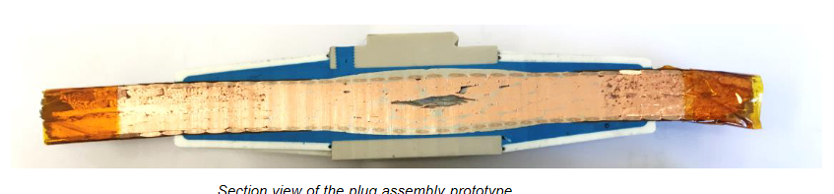
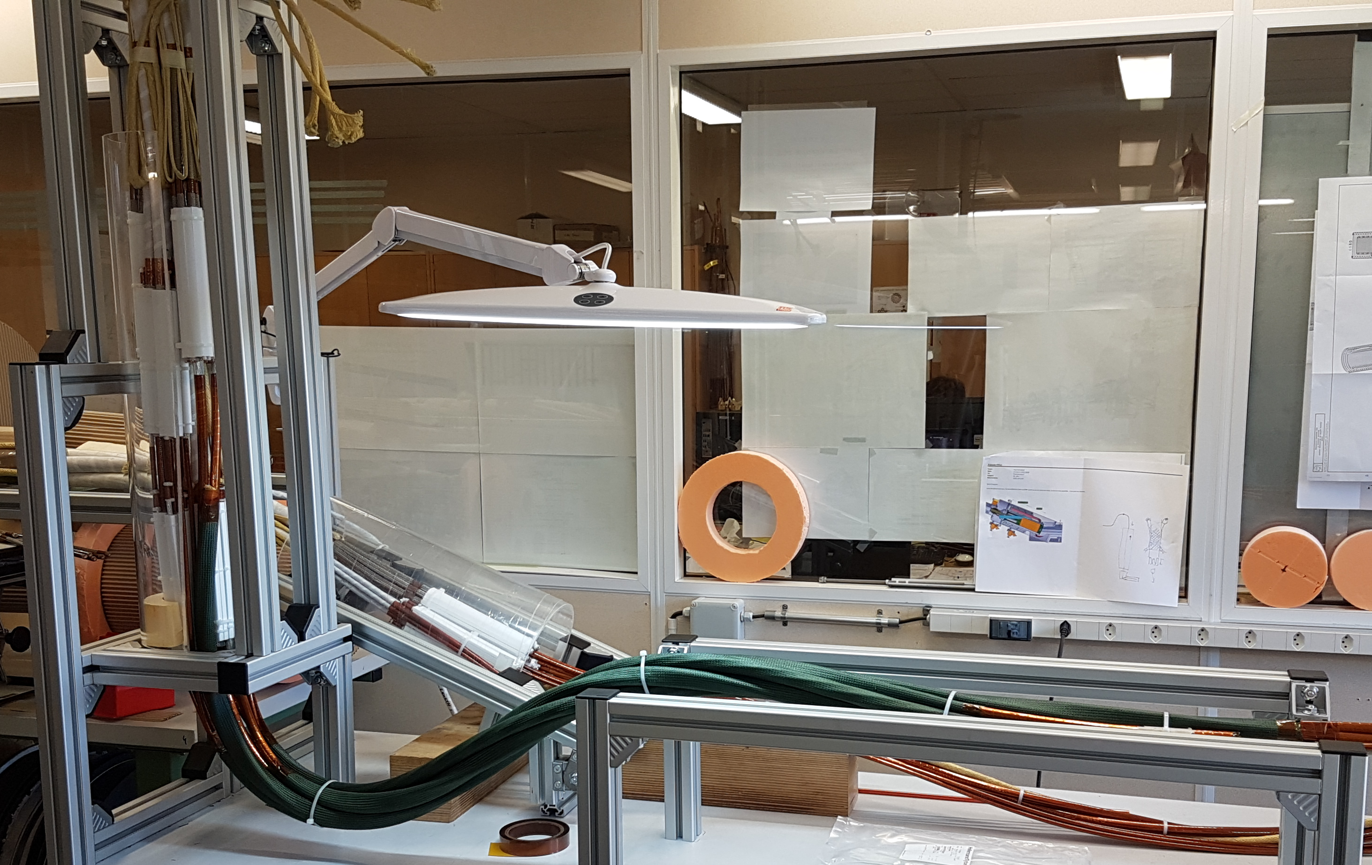
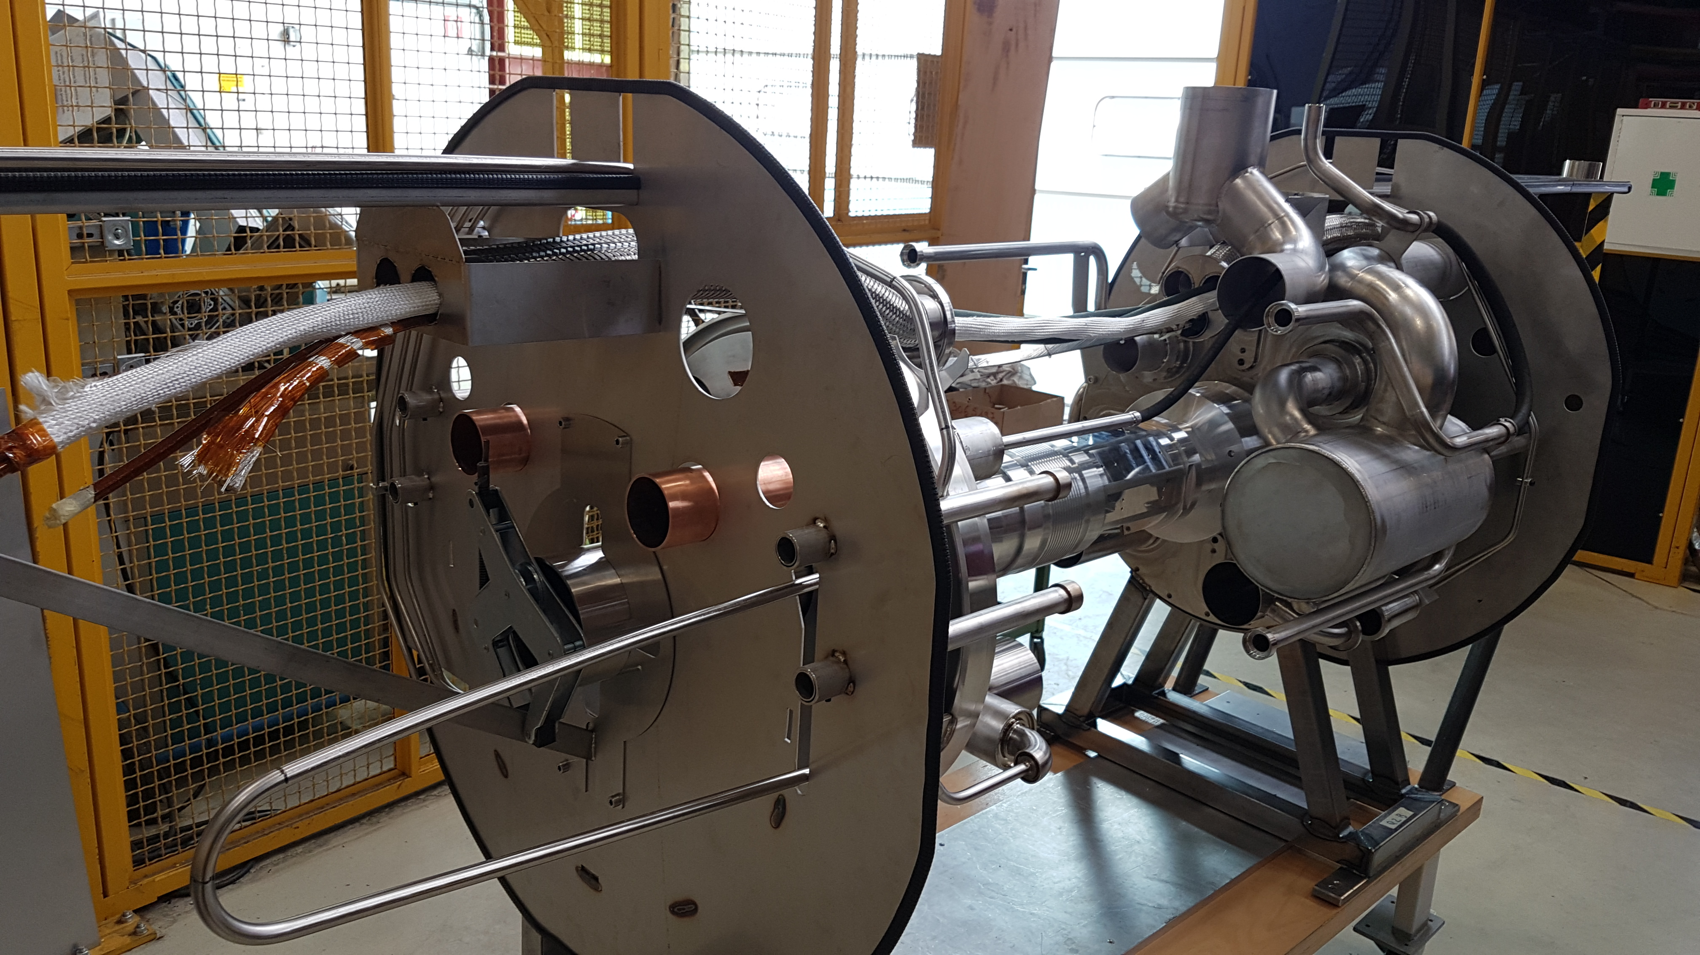
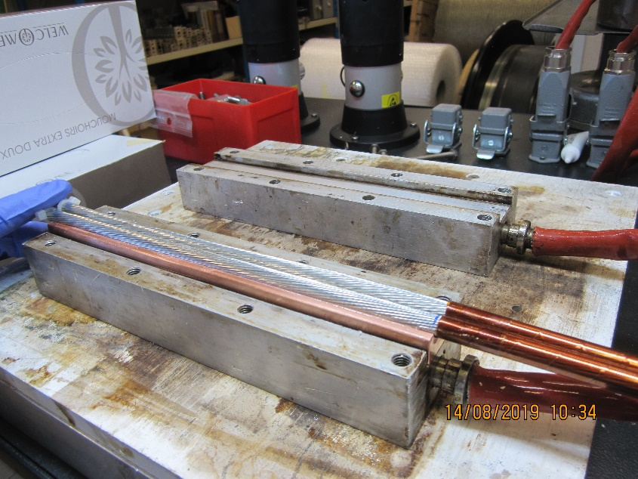
Production (hand made) of demonstrators of 18 kA and 2 kA bus bars
Several 3 m long bus bar 2 kA and 18 kA cables produced by hand to:
Measure their electrical performances at 4.3 K
Perform assembly of cables and routing studies in DFX and DFM
Perform routing studies in N1 and N2 lines
Produce prototype of plugs
Section view of prototype plug
Y. Leclercq
Splicing of 2 kA cables
(FRESCA J. Hurte
Routing of bus bars in N line
H. Prin
DFX routing J. Hurte

Slide 13
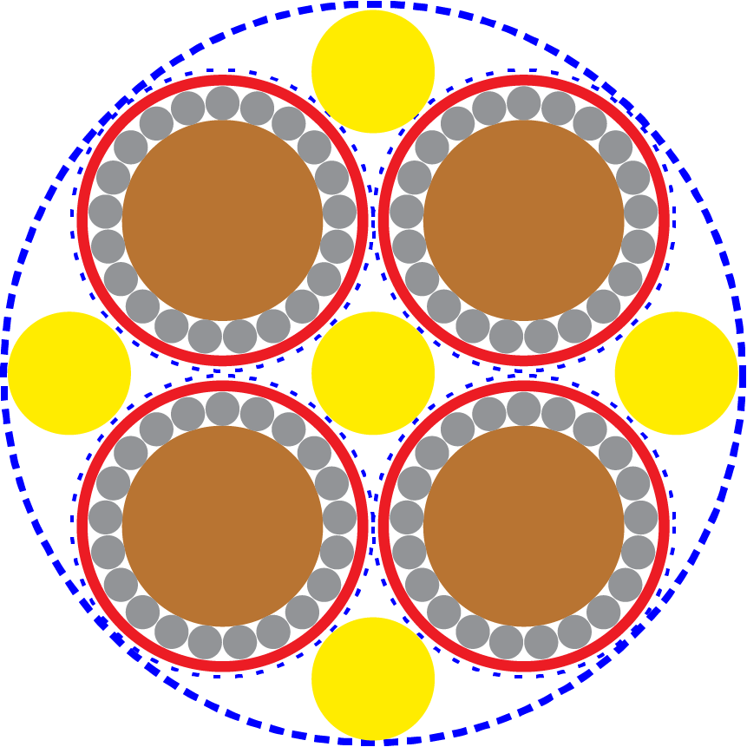
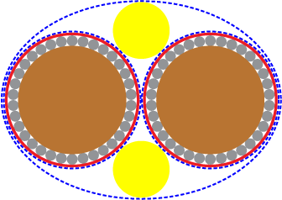
Assemblies of 2 kA and 18 kA Cables
For WP3, assemblies of individual 18 kA and 2 kA cables are required for routing in the N1 N2 lines (see slides from Herve):
4 × 2 kA cables
2 × 18 kA cables
Bus bar assembled on a planetary machine with a right-hand pitch, pitch to be confirmed
Fillers and core
To obtain a rounded topology, appropriately sized fillers from Kevlar® yarns will be used
Appropriately sized core may also be included (8 kA cable)
In each piece length, any core or fillers shall be continuous, with no joints.
Separators:
Insulating material may be introduced to separate constituent cables from each other, to aid the relative motion of adjacent constituent cables, preventing interfacial adhesion between sheaths. Nomex is used for this purpose in SC Link cables.
External sheath to protect the cable and ensuring the mechanical integrity and stability of the cable
2 kA cable
Separator (§)
Filler (§ 3.4.4)
Sheath (§ 3.4.2)
4 × 2 kA cables
2 × 18 kA cables

Slide 14
Procurement of Round Bus Bars
Technical Specification document ready. Specification committee meeting to be scheduled after this review, followed by invitation to tender
A contract could be placed by summer to produce single 18 kA and 2 kA cables and assemblies of cables, with approximate quantities:
1.5 km of 18 kA cable
0.7 km of 2 kA cable
1.0 km of 4×2 kA cable
0.5 km of 2×18 kA cables
CERN provides the Nb-Ti wires
The production parameters will be refined iteratively with trial deliverables and validated in prototype production
Series production will cover the needs for the String test and HL-LHC
First unit lengths of series cables by end 2021

Slide 15
Qualification of Round Bus Bars
QC tests performed at the contractor’s premises (based on those performed for the MgB₂ cables)
On-line measurement during cabling and insulation stage:
tensile force applied on strands, insulation and cables, twist pitch at start and end of UL
external diameter of the cable and non-circularity
insulation tested continuously online at ≥10 kV DC with a spark tester in accordance with IEC 62230 or an equivalent standard
Insulation tests on completed cables at ≥10 kV DC and room temperature
Tests performed at CERN
Insulation tests, both in the conditions above and in cryogenic (operating) conditions;
Electrical measurements under cryogenic conditions, including measurements of extracted strand I_{c} to identify any degradation resulting from the cabling procedure (few strands for each cable unit length);
Microscopy of the cable cross-section to check for wire distortion;
Measurements of the cable dimensions;
Measurements of the twist pitch;
In contribution to the bus bar project, measurement of splices.

Slide 16
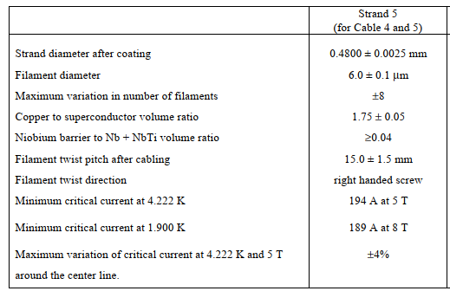
Design of Flat Bus Bars and Magnet Leads
LHC IT-2472
MQXF leads (no keystone) (production completed)
34 LHC Type 01 strands
Width 18.15 mm
Mid Thickness 1.92 mm
Pitch of 125 mm
13 kA leads (type 02 LHC) (stock available)
36 LHC Type 02 strands
Width 15.10 mm
Mid Thickness 1.48 mm
Keystone 0.9 degrees
Pitch of 100 mm
MCBXF (type 05 HL-LHC) (production ongoing)
18 HL-LHC Type 05 strands
Width 4.37 mm
Mid Thickness 0.845 mm
Keystone 0.67 degrees
Pitch of 33 mm
LHC IT-2471
LHC IT-2631

Slide 17
Summary
Two geometries of round bus bars were defined:
18 kA: 34 LHC Type 01 strands (OD=13 mm)
2 kA: 21 LHC Type 02 strands (OD=7 mm)
T_{cs} of 6.8 K for 18 kA cable and 7.8 K for 2 kA cable
Hot spot temperature less than 100 K for both cables
Dielectric insulation by means of two layers of Kapton®
Protective sheath, protecting from external abrasion and ensuring the mechanical integrity and stability of the cable
Production plan presented, deliveries by end Q4 2021
Qualification plan presented shared between QC tests at supplier premises and at CERN (performed by CERN)
Design of flat bus bars finalized, and some of them already produced.

