Slide 1
Busbars, internal routing, supports and expansion loops
H. Prin
  E. Todesco, R. Principe, J. Fleiter
  IT quads: R. Bossert (FNAL), A. Temporal for the integration
  D1: T. Nakamoto (KEK), Y. Leclercq, D. Duarte Ramos
  D2: O. Id Bahmane for the integration
  MCBXFA/B: J.-C. Perez, F. Toral
  MCBRD: G. Kirby, A. Musso
Busbars and Splice Review 14/04/2021
https://indico.cern.ch/event/1021628/

Slide 2
Outline
Powering Circuits Overview
  18kA Main Circuit & Trims for the Inner Triplet
    Layout and Routing for the flat and round busses
    Supporting
    Expansion loops
  13kA Circuits for the D1 Separation Dipole
  2kA Circuits for the IT Orbit Correctors
  120 and 200A for the CP HO Correctors
  13kA and 600A Circuits for the D2 cold mass
Busbars and related components Drawing Status
Lessons learnt form LHC

Slide 3
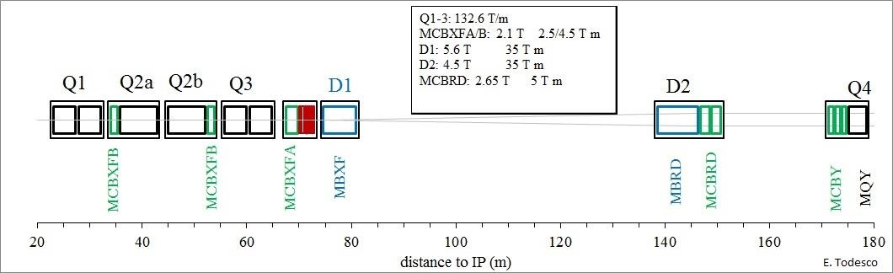
Powering Circuits Overview
18kA IT MQXFA/B Quadrupoles Circuit 2 busses
2kA IT Trim Circuits 2+1 busses
DFX
DSHx Link
13kA D1 MBXF Separation Dipole Circuit 2 busses
2kA IT MCBXFA/B Orbit Correctors Circuits 3x 4 busses
13kA D2 MBRD Separation Dipole Circuit 2 busses
DFM
DSHm Link
600A D2 MCBRD Orbit Correctors Circuits 2x 4 busses
120 & 200A CP HO Correctors Circuits 9x 2 busses
Local powering through conduction cooled leads

Slide 4
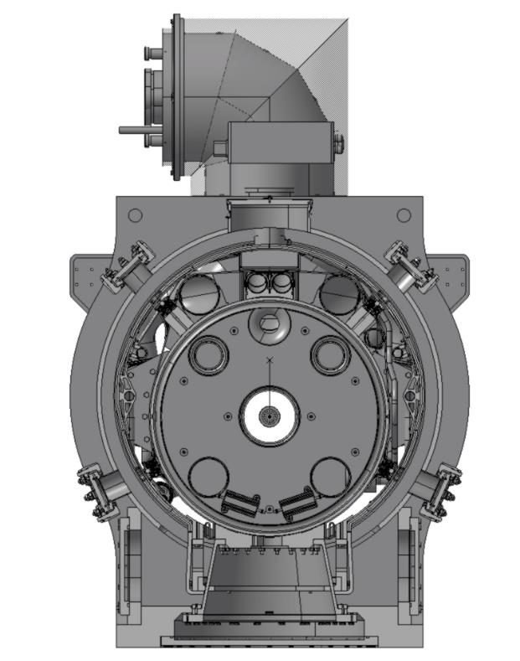
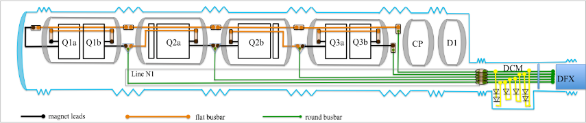
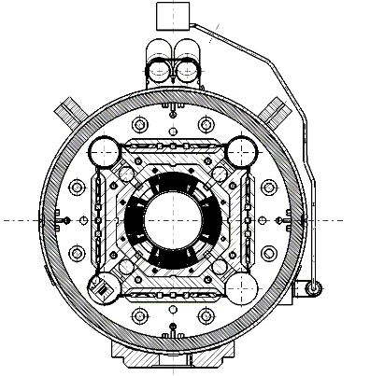
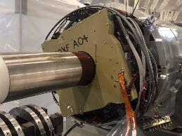
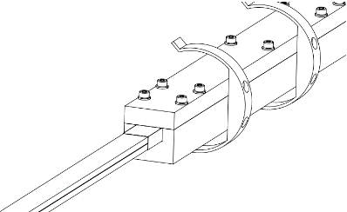
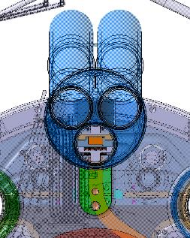
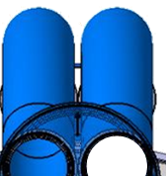
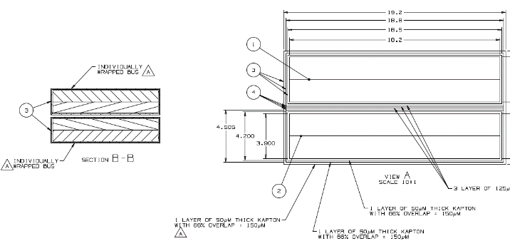

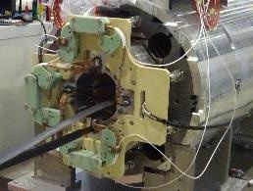
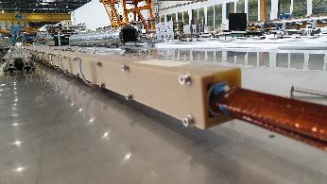
18kA Main Circuit & Trims for the Inner Triplet
Layout and routing
Magnet leads
Flat busbars
Round busbars
MQXFA “pizza box”
MQXFB connection box
(LHCLMQXF_E0009)

Slide 5
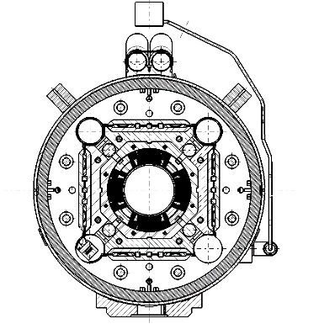
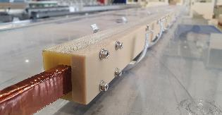
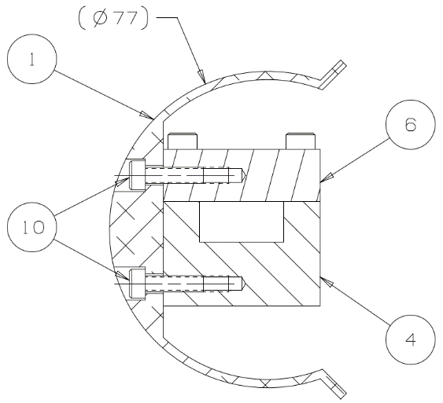
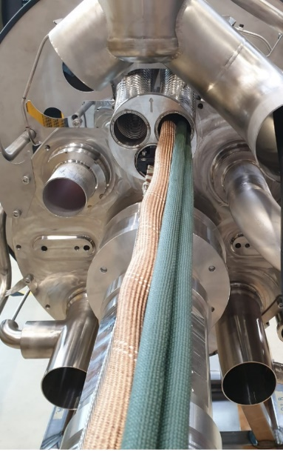
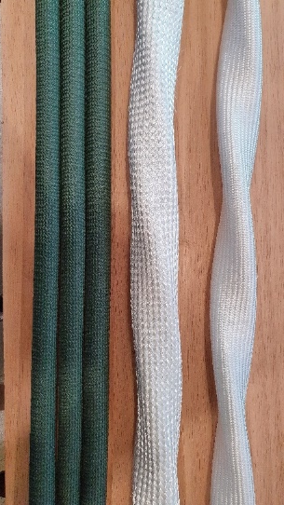
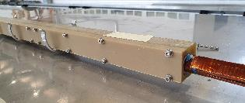
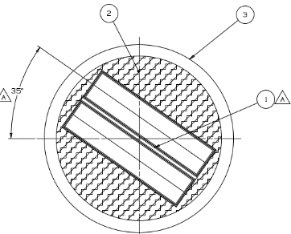
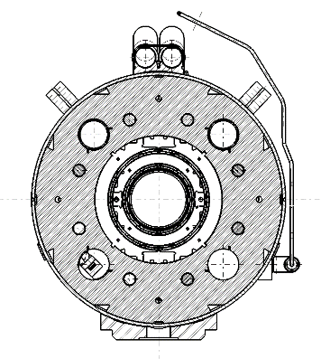
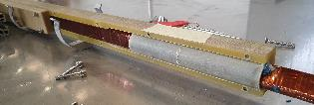
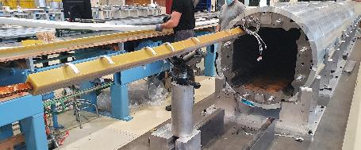
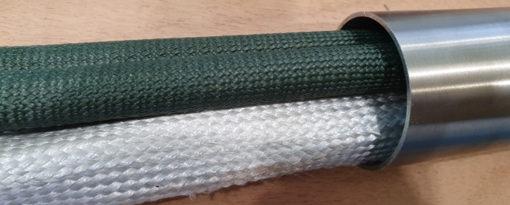
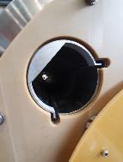
18kA Main Circuit & Trims for the Inner Triplet
Supporting
Flat busbars
Round busbars
G11 Bus Housing Cap
G11 Bus Housing Base
Al Bus Housing Clip
Styecast 2850FT blue epoxy
MQXFA/B
G10 tube
3x 18kA individual cables
2x 18kA twisted cables
+ core
2x 18kA twisted cables
Q2 Busses from FNAL
Samples from J. Fleiter and J. Hurte
Q2 Busses installation test in October 20
MCBXFB
3 individual + 2 twisted cables + core insertion test in April 21

Slide 6
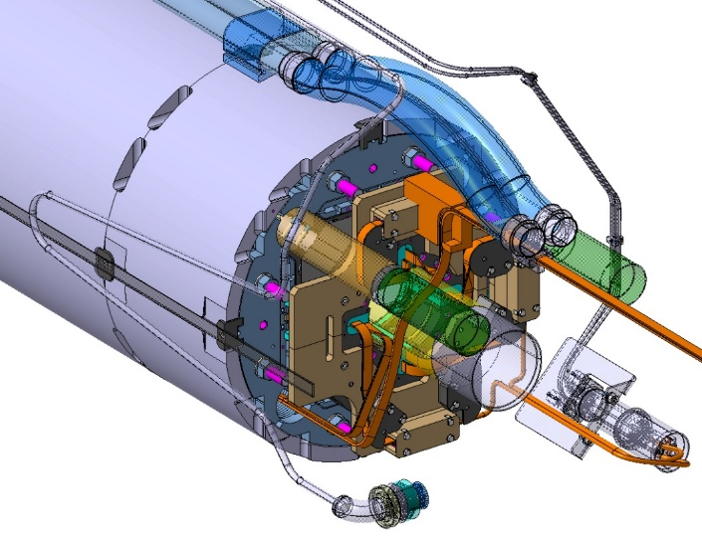
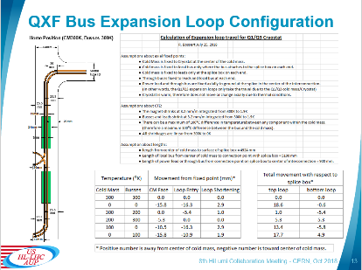
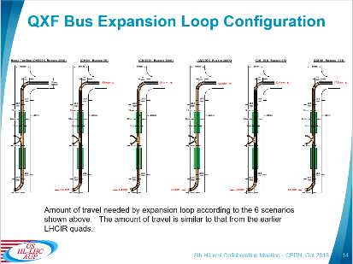
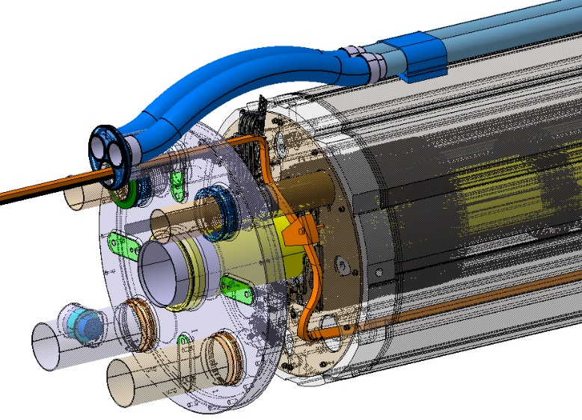
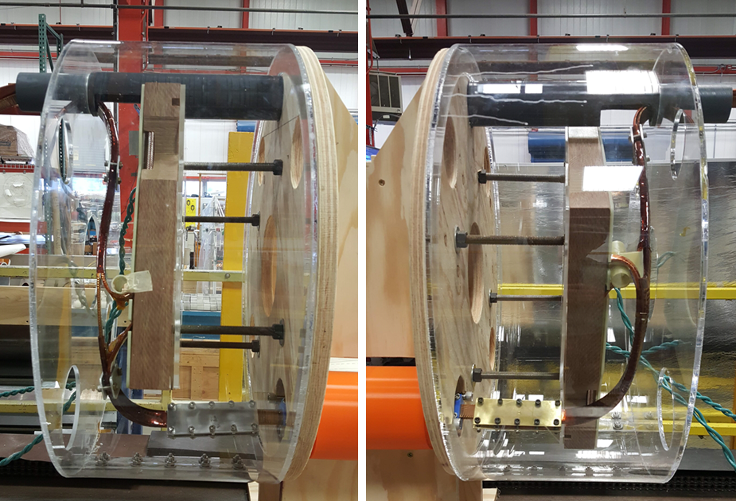
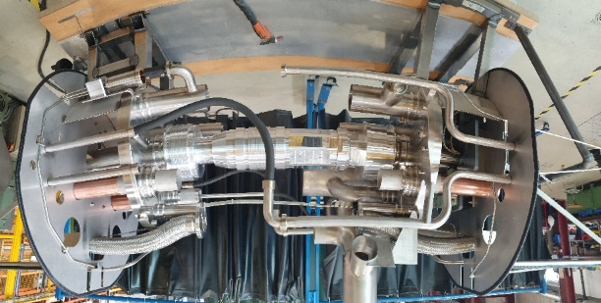
18kA Main Circuit & Trims for the Inner Triplet
Expansion Loops
Calculation of the expansion loop movements according to temperature assumptions presented during the 8th HiLumi Collaboration Meeting by R. Bossert and H. Prin (https://indico.cern.ch/event/742082/)
FNAL Cold mass leads and busbars mock-up
CERN Interconnection mock-up

Slide 7
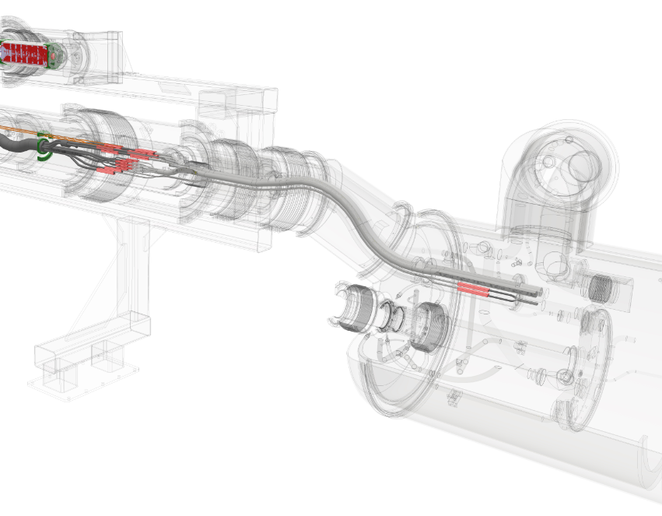
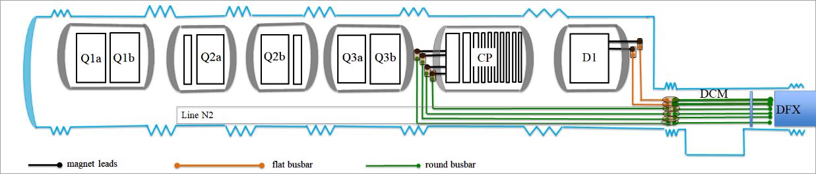
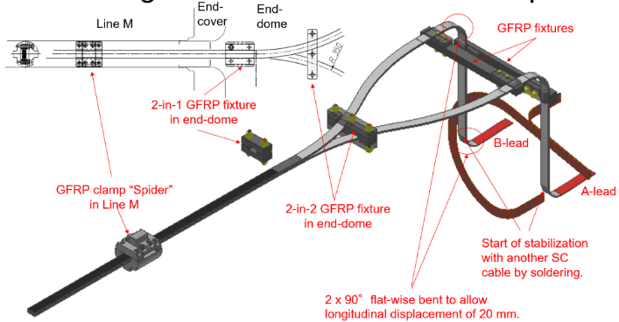
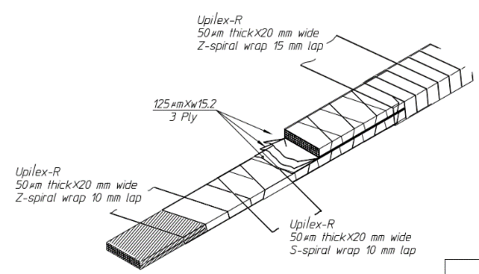
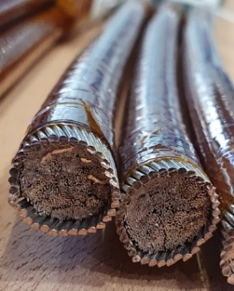
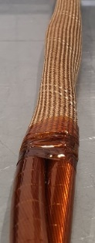
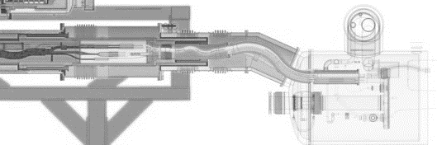
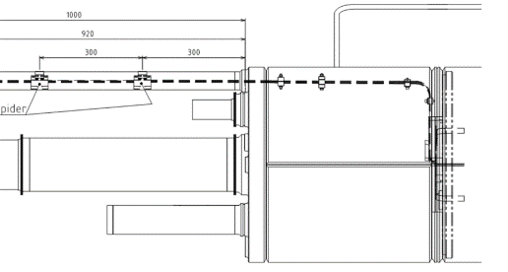
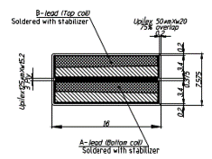
13kA Circuits for the D1
DCM
Courtesy of Yann Leclercq
Magnet leads
Flat busbars
Round busbars
D1 service module
18kA round busses twisted by pair
“S” shape expansion loop proposed by CERN
Holding fixtures along the routing
Supporting TDB

Slide 8
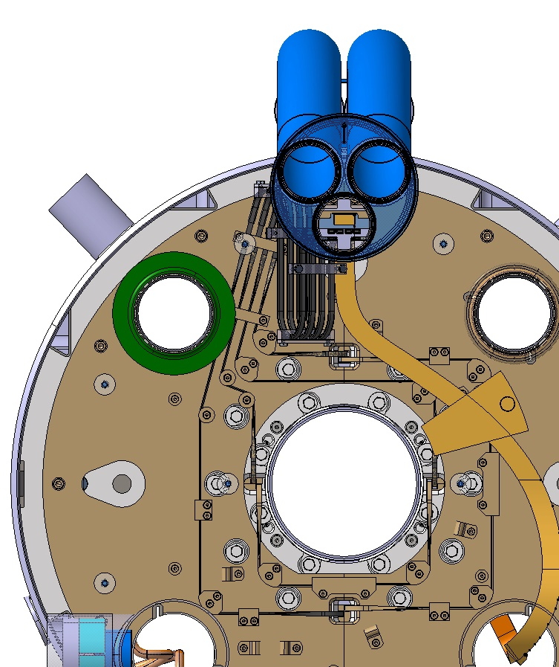
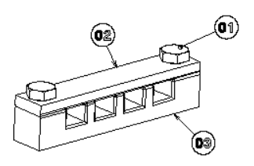
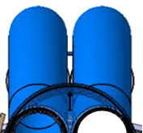
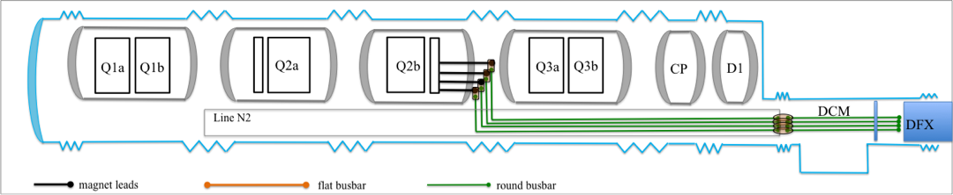
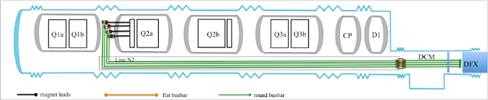
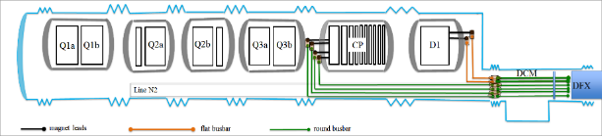
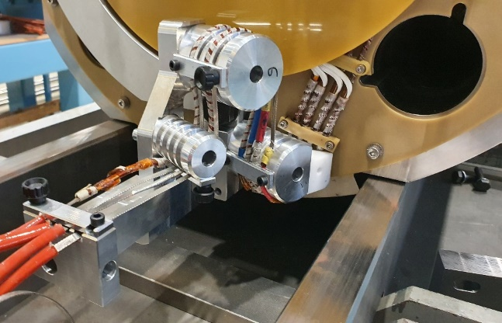
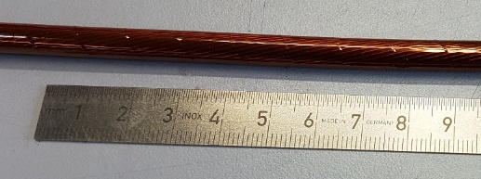
2kA Circuits for the IT Orbit Correctors
Leads holding fixtures
Magnet leads
Round busbars
MCBXFB lead forming tool in November 2020
Lyre shape expansion loop

Slide 9
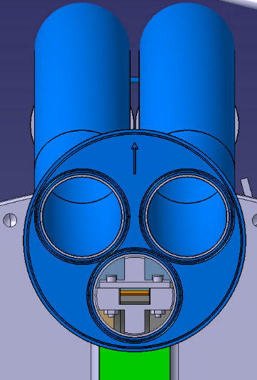
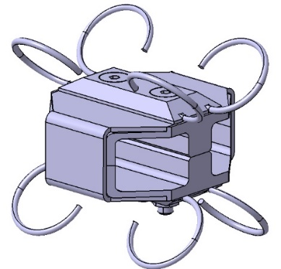
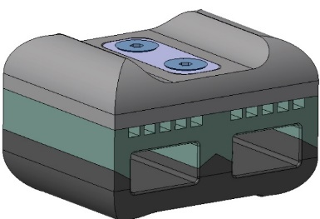


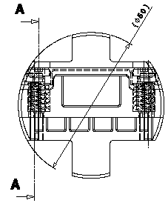





Busbar Cable Support/Spacer
LHC “Spider”
11T “Pipistrelle”
Q1/Q2/Q3 MQXFA/B CS
Q2/CP MCBXFA/B Corr CS
D1
?

Slide 10




120 and 200A for the CP HO Correctors
Conduction cooled leads
Plyospire sleeve
5 x LHC Sc 600A cable Ø5.6mm (4wires) for HO correctors
Splices between round cables and conduction cooled leads inspired from the ones used for the 60 and 120A orbit corrector circuits or the 230A trim leads in the 11T
Connection to magnet Sc leads
1st pair for MC_XF
2nd pair for MC_SXF
Connection to one of the
5 conduction cooled leads (Cu)

Slide 11









13kA and 600A Circuits for the D2 cold mass
Busbars for the cold test junction to the CFB in SM18
18kA round busses
MBRD leads
600A round busses
Round busbars
Magnet leads
Expansion loop
18kA round busbars
MBRD leads
Leads holding fixtures
MCBRD leads
600A round busbars

Slide 12
Busbars and related components
Drawing Status
 | Q1/Q3 | Q2 | CP | D1 | D2
3D models and integration | ✓ | ✓ | June 2021 | ✓ | ✓
Subcomponents fabrication drawings | ✓ | ✓ | June 2021 | ✓ | ✓
Cold mass Integration drawings | ✓ Under revision | July 2021 | July 2021 | ✓ cold mass Extension to DCM Sep 21 | July 2021
Interconnection 3D models | Nov 2021 |  |  |  | July 2021
Interconnection drawings | Dec 2021 |  |  |  | Aug 2021

Slide 13
Lessons learnt from LHC
Issue in the LHC | Mitigation for HL-LHC
Busses alignment in the splices | Round cable cross section Cable flexibility
Sharp edges | Chamfered or rounded corners in particular inside the end covers
Busbars proximities with other equipment (MB busses/MCS, SSS busses/HX tube, spools/shell…) | Volumes for MQXFA and B expansion loops increased by moving the connection boxes towards the magnets. Very comfortable for the other magnets. Checks on mock-ups
Spider legs | Spacers design inspired from one used in the present LHC Inner Triplet No metallic contact to ground Centring system using springs
Lorentz forces in the connection cryostat and the splices | 18kA busses of the main circuit are twisted from the DCM up to Q3 Holding fixtures are distributed along the magnet lead path and the splice insulation boxes
N-line filling factor in the DS | Insertion easier without core associated to the twisted pair NOMEX, Basalt or Siligaine sleeves rather than glass fibre (toughness, friction)
SSS series 500 busbars length adjustment | Cable cutter to adjust flat and round cables rather than milling machine on surface or saw and file in the tunnel for the copper stabiliser
600A and 6kA cable metallic sleeves | Except the existing 600A busses used inside the CP and the D2, all cables will be delivered insulated without metallic braid

Slide 14
Summary
Busbars typology and routing is clearly defined
  Designed to minimise the number of splices and the ergonomic during installation,
  Integration according to the HL-LHC WP3 Bus Bars technical specification and conceptual lay out (edms 2029211) and compliant with the splice catalogue study (edms 2492410 see Rosario’s talk).
Magnet lead routing and integration is discussed and agreed with the Project Engineers and external collaborators.
Round busbars insertion test inside the N-line is conclusive for 18kA at the moment
  4x 2kA insertion test to be performed
  It needs to be realised along the IT full length (~52m)
Supporting inside the CP and between the D1 and DFM will be finalised in June 21.
Busbars integration drawings in the cold masses will be completed in July 21, interconnection ones for the tunnel (and the string) by the end of the year.
No show stopper identified

Slide 15
Spare slides

Slide 16
Material and Presentation Library
Quadrupoles and orbit correctors bus bars routing along the inner triplet string (WP3 Meeting 2015-12-10)
https://lhc-div-mms.web.cern.ch/lhc-div-mms/tests/MAG/docum/hilumi/Presentations/2015-12-10_hp_busbar.pptx
Quadrupoles and orbit correctors bus bars routing (MQXF Workshop at CERN 2016-02-03)
https://indico.cern.ch/event/478951/
Q1/Q2/Q3 Bus bar outstanding issues: https://indico.cern.ch/event/946104/
Room for the bus bar expansion loop: https://indico.cern.ch/event/746549//
Q1/Q3 bus work update: https://indico.cern.ch/event/805403/
Third Lead (CM Meeting 2019-01-18): https://indico.cern.ch/event/790483/
Busbars in D2 cold mass and cryostat (WP3 Meeting 2020-04-22) https://indico.cern.ch/event/910314/
Superconducting Bus Bars Inside Cryostats (Int. Review of the HL-LHC Magnet Circuits 2019-09-09): https://indico.cern.ch/event/835702/contributions/3503952/
Nb-Ti busbars design and interfaces (7th HiLumi Collab Meeting) https://indico.cern.ch/event/647714/contributions/2646576/
Expansion loops (8th HiLumi Collab Meeting): https://indico.cern.ch/event/742082/contributions/3141508/
Q2 busbars drawing folder: https://edms.cern.ch/document/2515485/
Busbars installation procedure (FNAL): https://indico.cern.ch/event/963060/
LHC 13 kA circuit Risk Analysis https://edms.cern.ch/document/1144154

Slide 17





Busbars Layout Summary in the Inner Triplet
18kA round busbars for the quads and trim leads (N1)
2kA round busbars for the orbit correctors (N2)
N1
N2
MQXFA/B quad lead
+ 18kA flat bus (M)
M
MCBXFA/B orbit corrector leads (M)
Ø139.7mm
120 and 200A HO correctors conduction cooled current leads
600A round busbars for the 120 and 200A HO correctors (L1/L2)
18kA flat busses

Slide 18
18kA Flat Busbars
19.2 mm
18.2 mm
3.9 mm
9.78 mm
975 µm
3.9 mm
1 layer of 50 µm thick Kapton with 75% overlap = 200 µm
3 layers of 125 µm thick Kapton = 375 µm
1 layer of 50 µm thick Kapton with 66% overlap = 150 µm
1 layer of 50 µm thick Kapton with 66% overlap = 150 µm

Slide 19


D1 leads and 13kA Flat Busbars

Slide 20


LMQXFA (Q1/Q3) extremities (Mock-up)

Slide 21


LMQXFA (Q1/Q3) extremities (Prototype)
LMQXFA01 Qa end
LMQXFA01 Qb end

Slide 22


LMQXFB (Q2) Cold Mass Extremities

Slide 23


MQXFB connection box displacement in 2018 to gain volume for the expansion loops

Slide 24

18 and 2kA round busses inside N1 and N2

Slide 25




18kA round busbars insertion test

Slide 27
D2 Cold Mass from Test to Tunnel configuration

Slide 28


LMBRD (D2) Busbars integration

Slide 29



CLIQ and k-mod Leads
CLIQ
K-mod
IFS

Slide 30


Interconnection Mock-up in LMF
LHCQQQIH0003

