Slide 1

HV insulation tests for WP3 busbars
A. Milanese, L. Grand-Clement
Acknowledgment: H. Prin, R. Principe, D. Tommasini
14 Apr. 2021

Slide 2
Introduction
HV tests to qualify the dielectric robustness of individual components (busbars in this case) before they become part of a system (cold mass or superconducting circuit in the tunnel)
Test voltage of component > final test voltage of system
Aim to intercept a faulty construction
Even more relevant considering
difficulty of repair in case of electric fault during operation
relative cost of busbars vs. final system
Same philosophy being applied to new generation of MQXFB QHs
few units already successfully tested at 10 kV

Slide 3
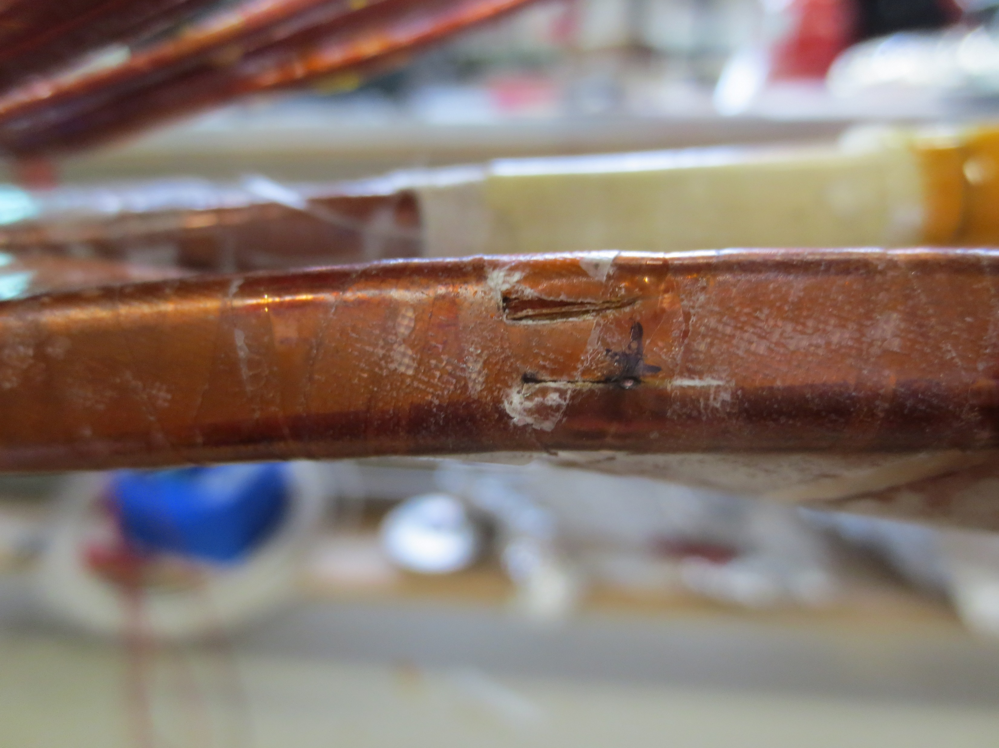
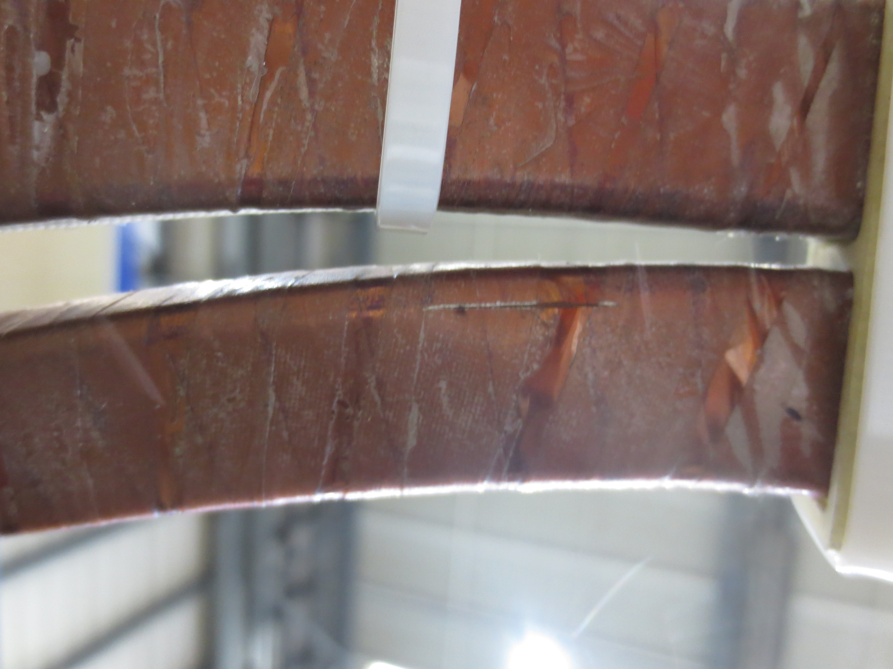
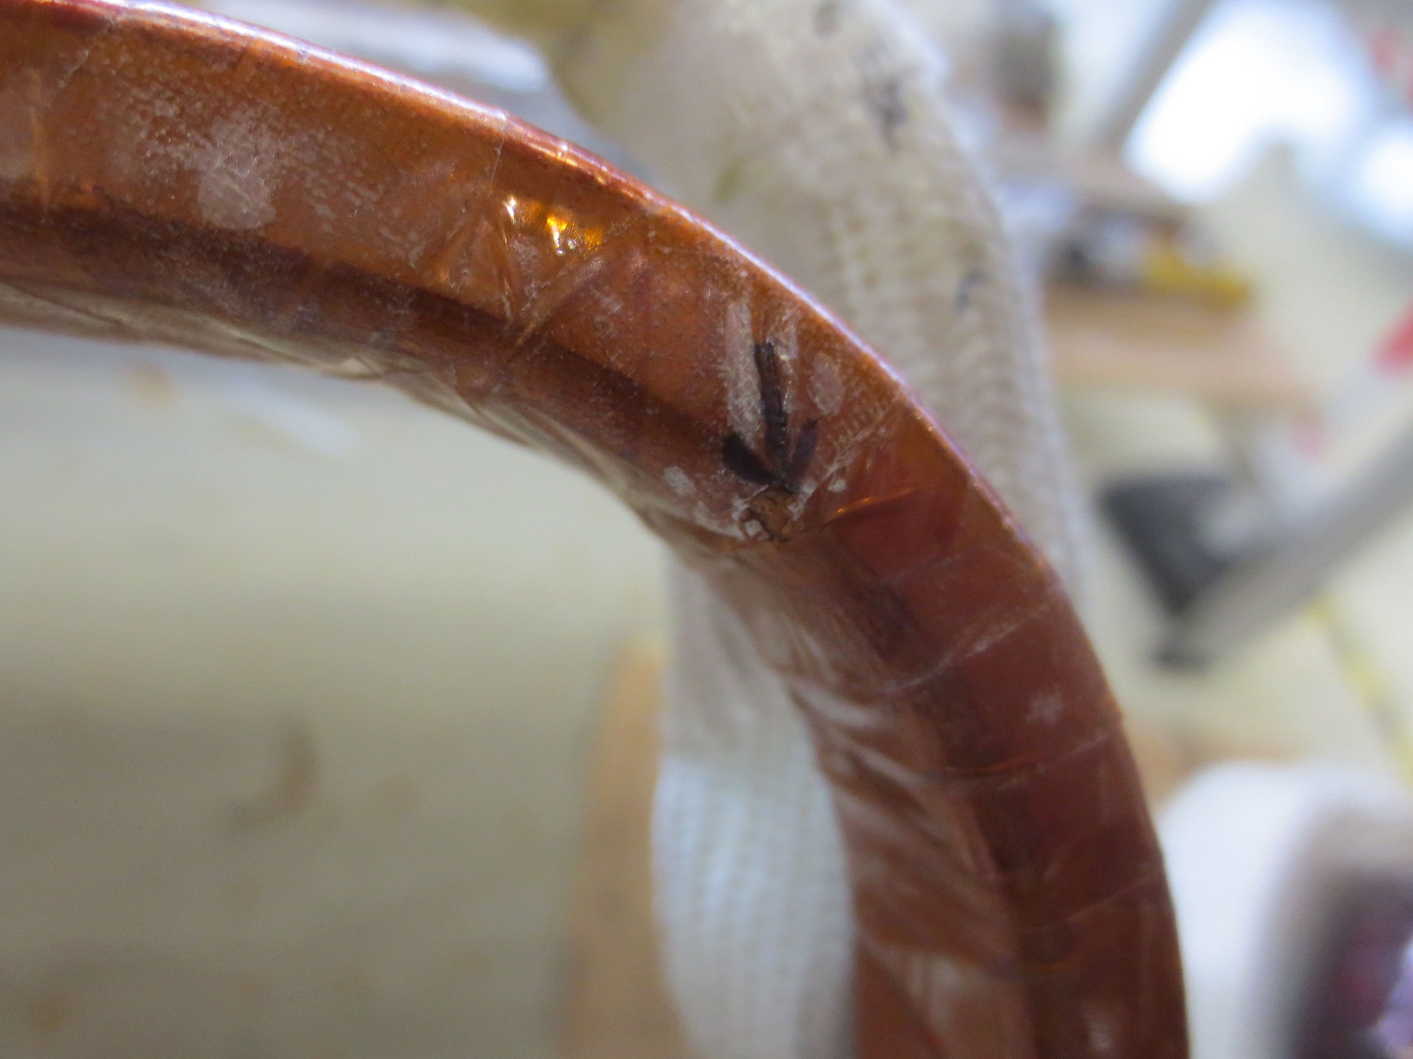
Cela est rare, mais cela arrive…

Slide 4
Scope of proposed HV tests
Several test objects
internal busbars MQXF
N1 line busbars MQXF, N2 line busbars MCBXF
busbars MCBRD
DCM/DFX busbars, DFM busbars
Three types of (routine) tests
before insertion in cold mass (or N lines or Λ plates)
after insertion in cold mass, before connection to magnets
after connection to magnets --- not covered here, as already part of other electrical test documents [though increased voltages across different circuits shall be added]
Tests at room temperature for virgin components
in air at atmospheric pressure
Type (as opposed to routine) tests could be relevant too
ex. breakdown in He gas on samples of internal MQXF busbars

Slide 5
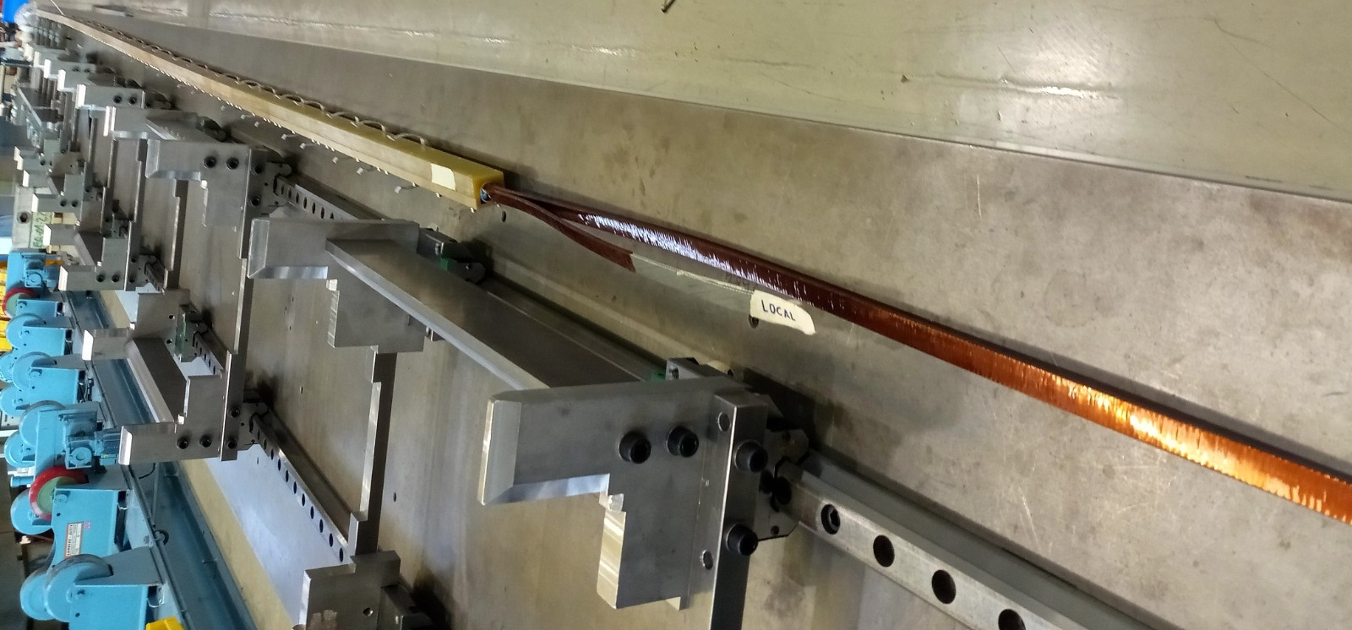
Internal busbars MQXF (18 kA)
E. Todesco
EDMS 2029211 v.0.7
Busbars provided by AUP
NbTi cable provided by CERN

Slide 6
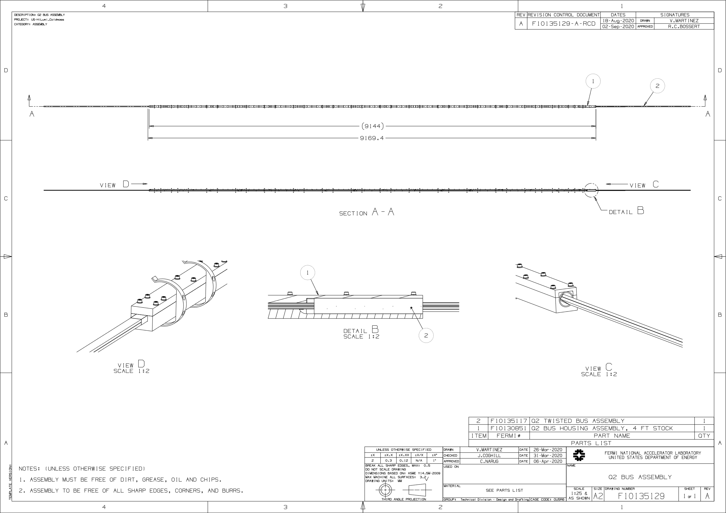
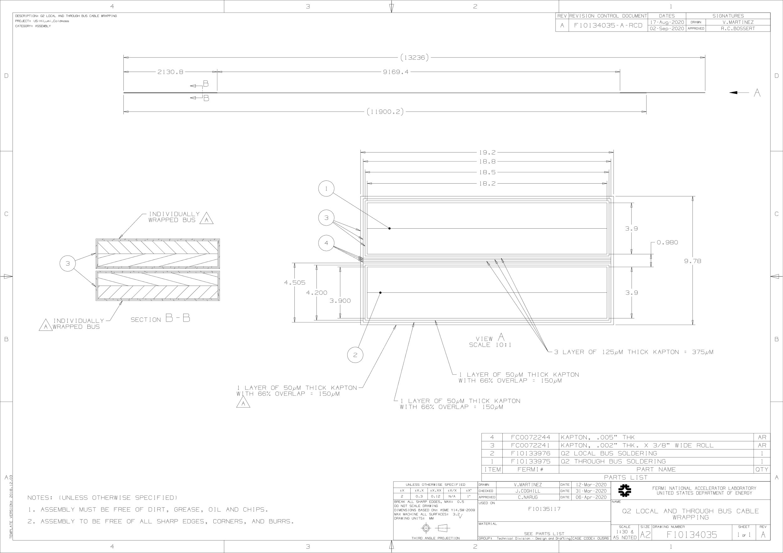
Internal busbars MQXF (18 kA)
FNAL drawings
EDMS 2515485
local bus and through bus
chassis = set of each metallic screw closing the housing + aluminium supports

Slide 7
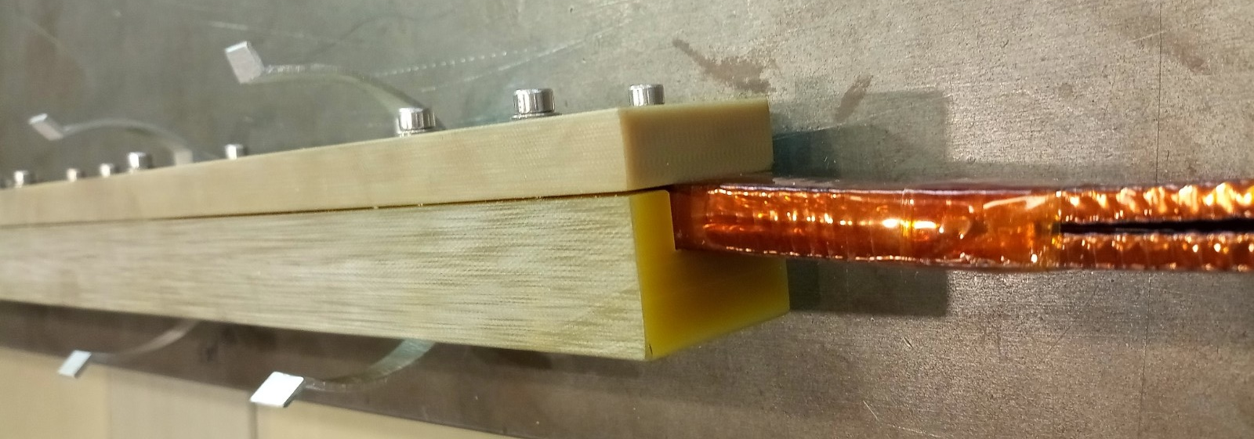
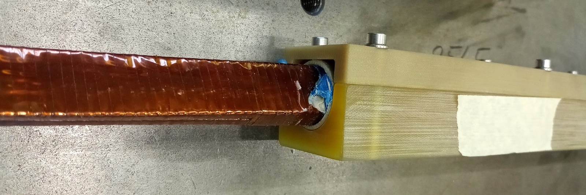
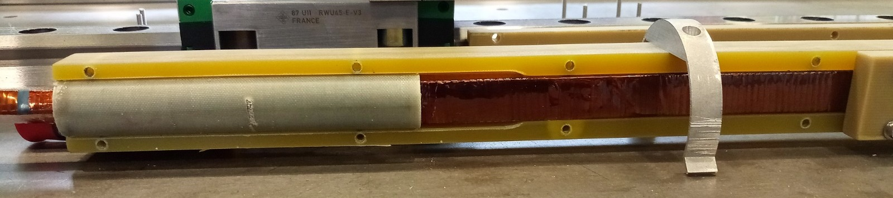
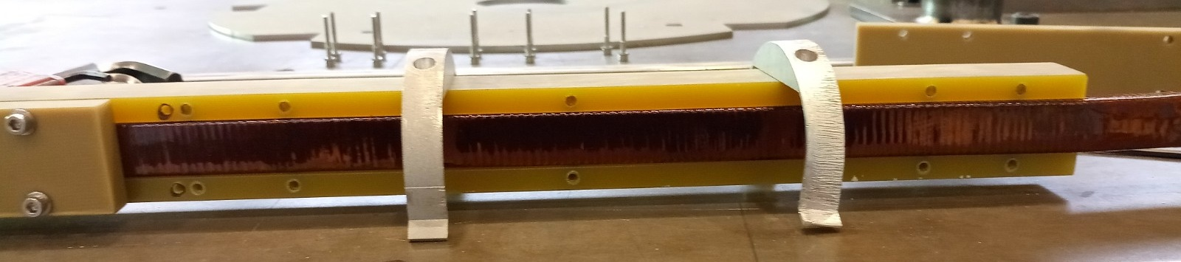
Internal busbars MQXF (18 kA)
Two units already delivered by AUP

Slide 8
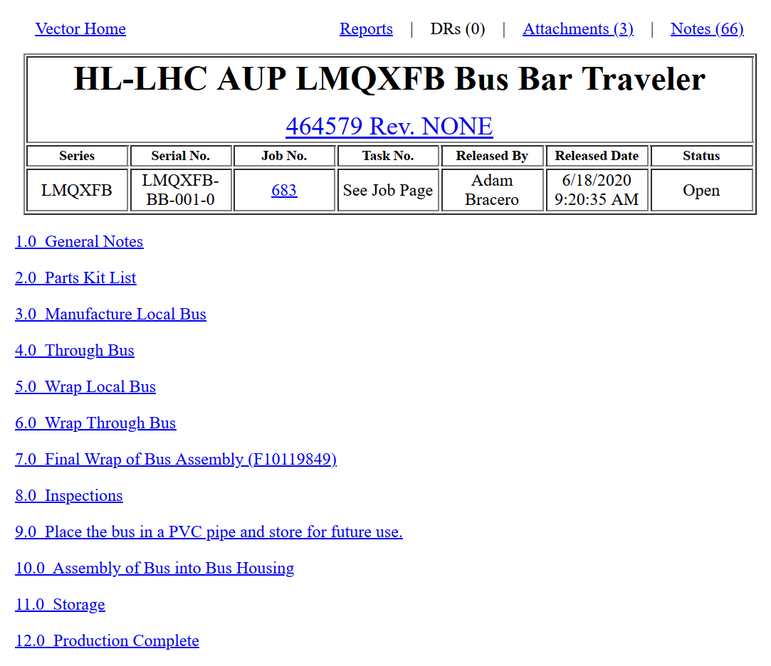

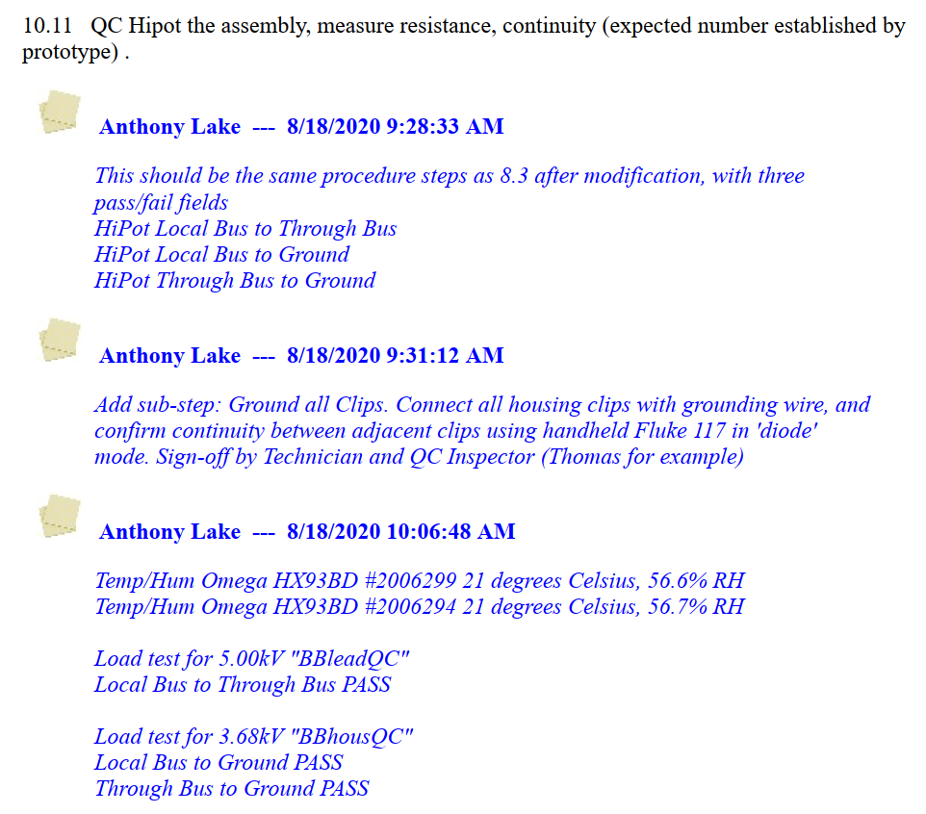
From the FNAL LMQXFB Bus Bar Traveler

Slide 9
Internal busbars MQXF (18 kA)
E. Todesco
EDMS 2029211 v.0.7
As received, before insertion into cold mass
5 kV bars to chassis
slightly higher than current (3.68 kV) used in FNAL for the housing, plus the chassis includes the housing clips and also the metallic screws
5 kV local bus to through bus, chassis grounded
After insertion into cold mass, after shaping the extremities but before connection to the leads
5 kV bars to cold mass (yoke and coils) grounded
5 kV local bus to through bus, cold mass (yoke and coils) grounded

Slide 10
N1 line busbars MQXF (18 kA)
E. Todesco
EDMS 2029211 v.0.7
Round cable being procured by TE-MSC-SCD
Insulation (2×3×50 μm of polyimide) and (non conductive) mechanical reinforcement
see presentation of J. Fleiter
Bundle of two for mains, single cables for trims
Non conductive sleeve put in place around the cables, but no support to hold them in N lines
see presentations of J. Fleiter and H. Prin

Slide 11
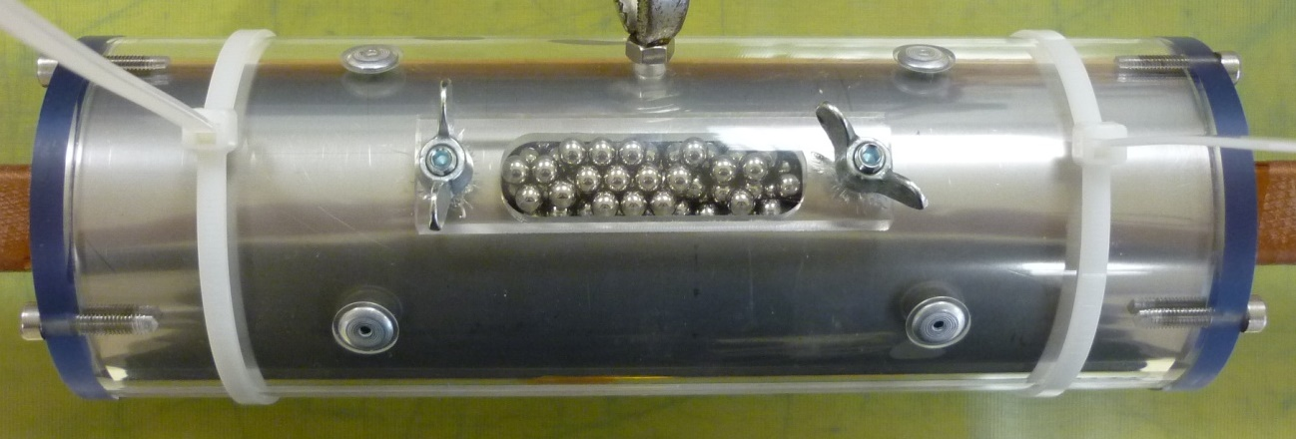
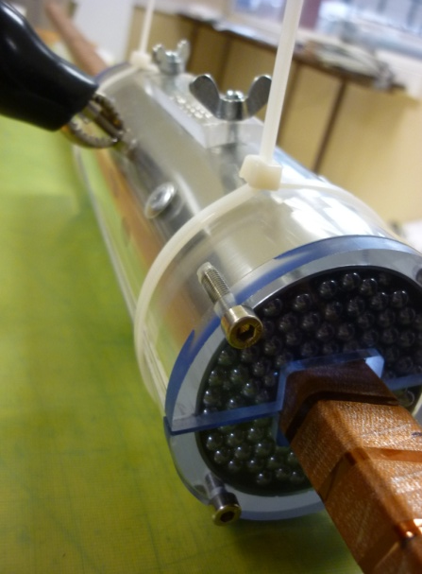
N1 line busbars MQXF (18 kA)
E. Todesco
EDMS 2029211 v.0.7
As received, before insertion into N lines
5 kV cable to cable for the bundle of two
5 kV cable(s) to external surface
external surface = bath of metallic balls (similar principle for LHC busbars) or Al foil (wrapped around the delivered cable)
insulation to be tested continuously online at 10 kV at cable production, see presentation of J. Fleiter
After insertion into N lines, before splicing
cables already bent
5 kV each cable to N line tube + all other cables grounded

Slide 12
N2 line busbars MCBXF (2 kA)
E. Todesco
EDMS 2029211 v.0.7

Slide 13
N2 line busbars MCBXF (2 kA)
Round cable being procured by TE-MSC-SCD
Insulation (2×3×50 μm of polyimide) and (non conductive) mechanical reinforcement
see presentation of J. Fleiter
Bundle of two × two for mains of vertical / horizontal corrector
As received, before insertion into N lines
5 kV each cable to all other cables (bundle of four)
5 kV cables to external surface
external surface = bath of metallic balls or Al foil (wrapped around the delivered cable)
insulation to be tested continuously online at 10 kV at cable production, see presentation of J. Fleiter
After insertion into N lines, before splicing
5 kV each cable to N line tube + all other cables grounded

Slide 14
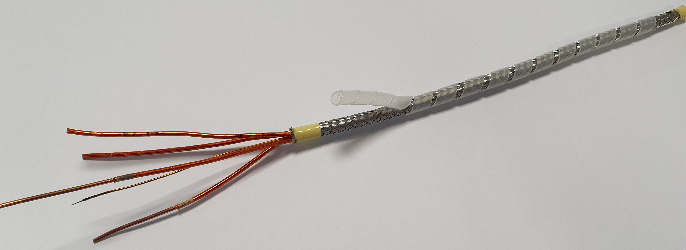
Internal / N line busbars MCBRD (600 A)
E. Todesco
EDMS 2029211 v.0.7
Bundles of 2 × 2 cables, provided by TE-MSC-SCD
same as used in LHC (orbit correctors, trim quads, etc.)
in a stainless steel sheath
internal part: in a goulotte
external part: protected in a PP pliozip and then inserted in a N line like tube

Slide 15
Internal / N line busbars MCBRD (600 A)
E. Todesco
EDMS 2029211 v.0.7
As received, before insertion into cold mass
5 kV each cable to external metallic sheath + all other cables (bundle of four) grounded
single cable recently tested at 10 kV
After insertion into cold mass, before splicing
5 kV each cable to cold mass (yoke and coils) + all other cables grounded

Slide 16
DCM/DFX busbars
E. Todesco
EDMS 2029211 v.0.7
only one case for MCBXF shown

Slide 17
DCM/DFX busbars and DFM busbars
Same round cable as for N lines
7 × 18 kA
5 for MQXFB (2 main + 3 trims)
2 for MBXF
3 × 4 × 2 kA
bundle of 4 for each MCBXF
As received, before preparation of the plugs
as before, this is a test of the individual cable or bundle of cables
After insertion into Λ plate
5 kV each cable (18 or 2 kA) to plate + all other cables grounded
particularly relevant for bundles of 4
Similar tests after welding of Λ plate in DCM
Cold diodes to be discussed
topic more for DCM review
DFM case similar
(simpler, no diodes and less plugs)

Slide 18
Other considerations and conclusion
Proper EDMS document to be prepared and approved
ex. Flowchart of the electrical tests throughout the production of LQMXFB, 2447487
consider type tests and production tests
detail voltage ramp, test durations and max. leakage currents
discuss possible dielectric resistance measurement at intermediate voltage before / after high voltage leakage current test
repairs in case of certain faults can be a possibility
acceptance test of various round cable to be discussed also according to design
Splices insulations
not covered separately, designed and executed to withstand test voltages as the corresponding circuit
Keep in mind in the design and inspections also LHC experience
13 kA busbars a bit too close to ground and experiencing thermal movements
recent reminders for MB and SSS 500…

Slide 19
References
2029211
HL-LHC WP3 Bus Bars technical specification and conceptual lay out
1963398
HL-LHC Electrical Design Criteria for the IT magnets
2187266
HL-LHC Electrical Design Criteria for the D1 dipole
2363905
HL-LHC Electrical Design Criteria for the MCBXF dipole corrector
2363904
HL-LHC Electrical Design Criteria for the D2 dipole
2363906
HL-LHC Electrical Design Criteria for the MCBRD dipole corrector
90327
Voltage withstand levels for electrical insulation tests on components and bus bar cross sections for the different LHC machine circuits
1158606
Procédure de test de l'isolation des bus bars après enrubannage

Slide 20
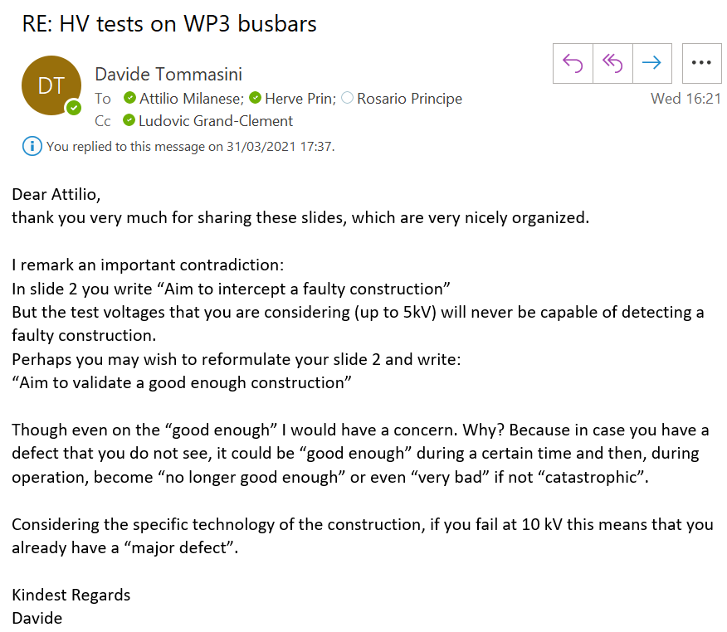
Are the test voltage levels appropriate?
5 kV 10 kV?
Ok in principle, though as a remainder LHC busbars were tested at 5 kV
Voltages across different circuits in close proximity (N lines) to be considered

Slide 21
Thank you

Slide 22
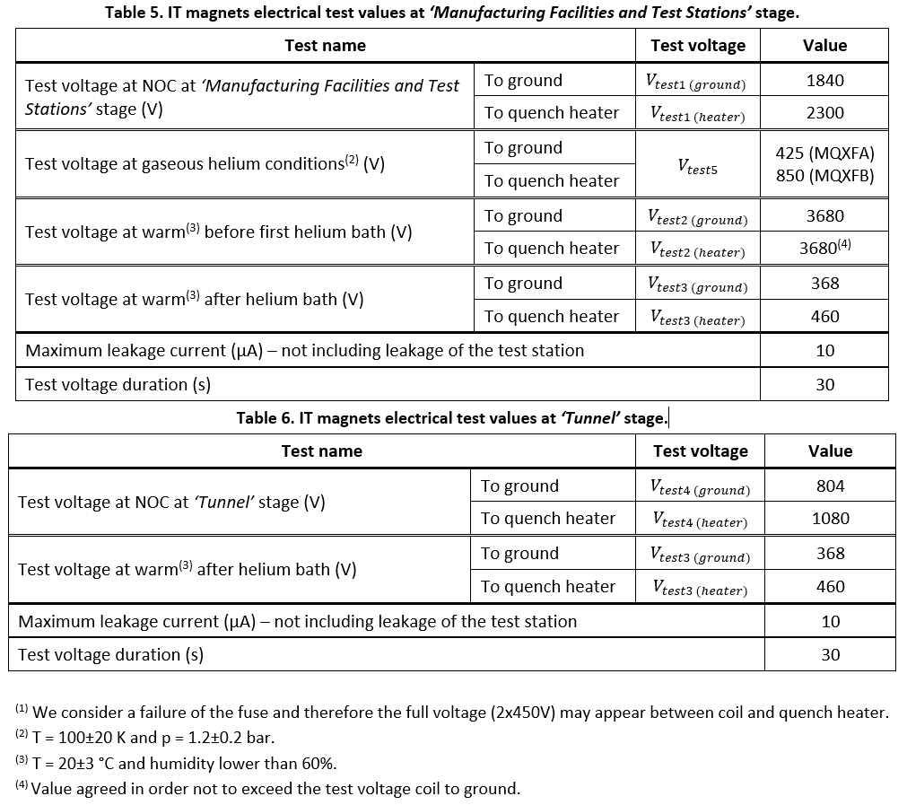
HL-LHC IT magnets

Slide 23
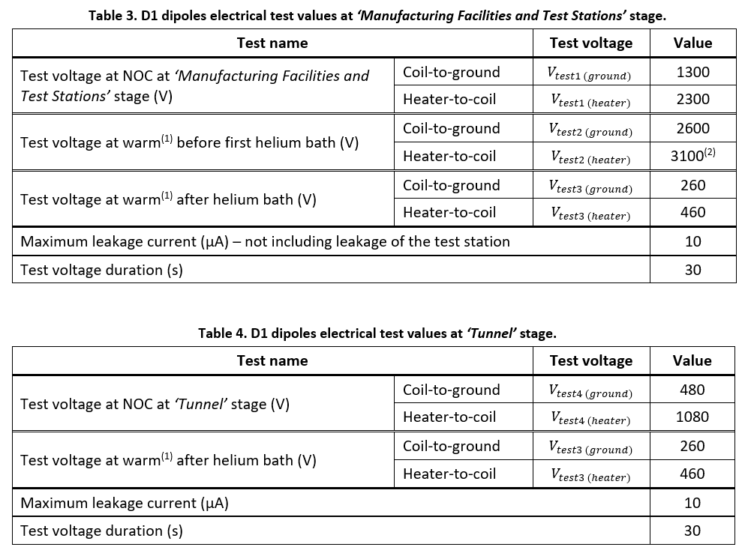
HL-LHC D1 magnets

Slide 24
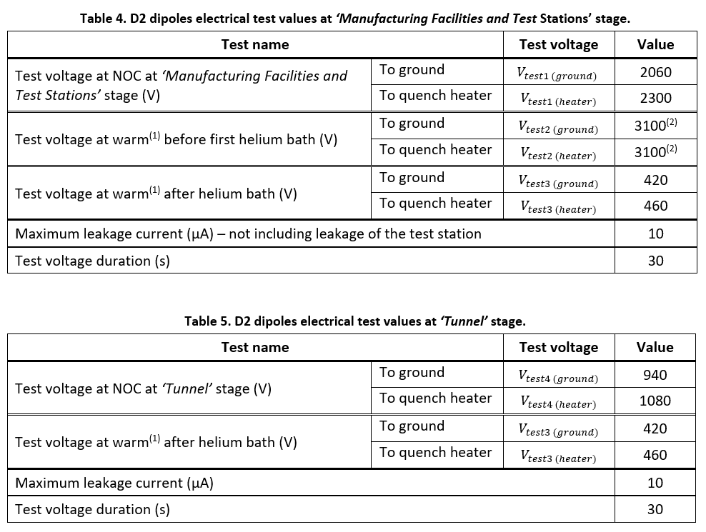
HL-LHC D2 magnets

Slide 25
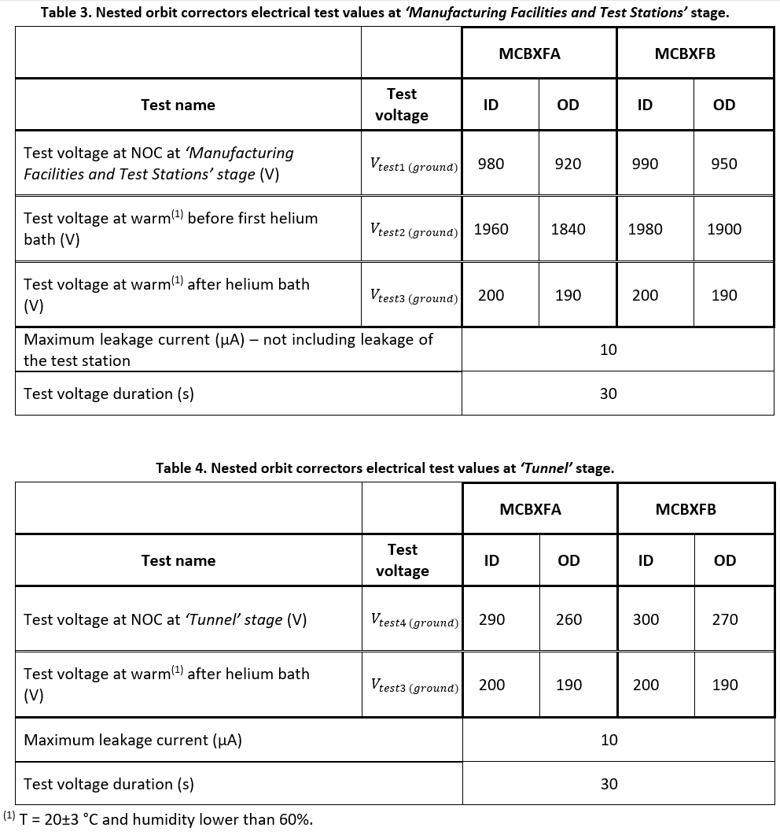
HL-LHC MCBXF magnets

Slide 26
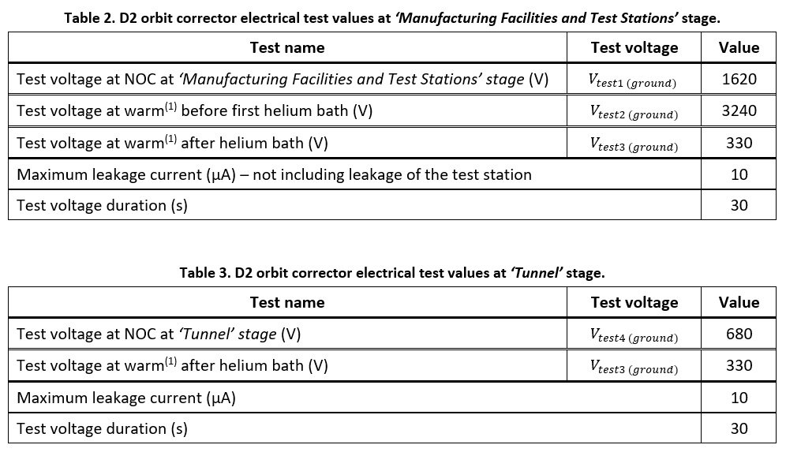
HL-LHC MCBRD magnets

