Slide 2
CERN-IPMC: Update status
xTCA Team Meeting
S. Baron, J.Mendez, R. Spiwoks

Slide 3
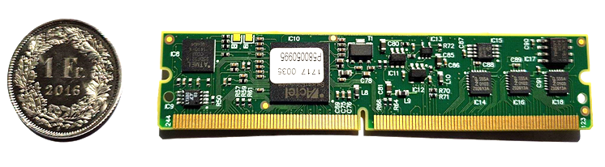
General overview
New hardware designed in 2019 (vers. 4)
  Compliant with original connector specification
  Add a third UART interface on pins 58 (Tx) /61 (Rx)
  Frame contract established and qualified
  Up to 1000 modules can be produced until end 2022
  Produced and qualified in Q4 2020 via the frame contract
Software moved to the latest version from Pigeon Point
  Porting from version 1.2 to 1.3

Slide 4
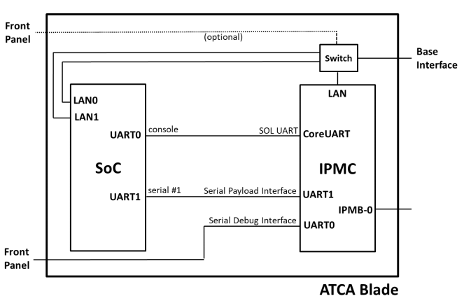
Hardware vers. 4
Possible configuration using all three interfaces:
Improve SoC < > IPMC connectivity
  Communication to get IPMC info and status to the SoC
  Based on UART interface – Payload Interface
  Allows getting blade position in a crate (used for HPM.3)
3 UART interfaces:
  Original UART port remains on pin 57 (Tx)/60 (Rx)
  Additional UART interface located on GPIO can be routed to:
    User I/O [0:1]
    User I/O [24:26]
  New UART interface on pins 58 (Tx) /61 (Rx)
  Allow enabling all of the UART features:
    Serial Debug Interface (SDI)
    Serial Over LAN (SOL)
    Payload Interface (PI)
  Configuration is made in XML configuration file (static)
Compliant with original connector specification
  Pin 58/61 were non-connected on previous versions
  Connectivity to new pins can be can be removed by taking off the 0 Ohm resistors

Slide 5
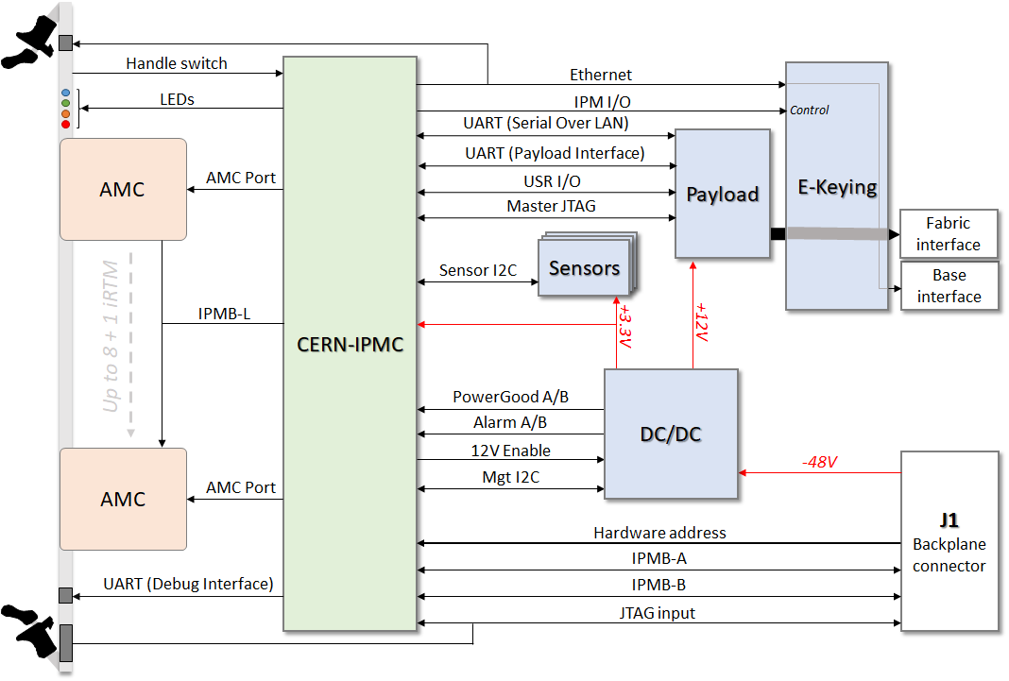
Typical use of the CERN-IPMC
HPM.3: Ethernet configuration via the IPMC.
  IP address depending on the blade position in
  the system and not on a MAC address
HPM.2: IPMI on LAN
  Allows getting the supervision system (e.g.: DCS) fully
  redundant.
  No need to handle differently communication via Ethernet
  or IPMB buses.
  Implement Serial Over LAN to redirect UART to Ethernet.
  A nice to have to communicate with a S.o.C.
HPM.1: Upgrade via IPMI
  Ensure stable configuration with image checker
  Implements automatic/manual rollbacks
  Keep of non volatile parameters
    E.g.: thresholds modified during a run are not updated by a
    reconfiguration.

Slide 6
Software porting to v.1.3
Based on latest version of the Pigeon Point solution:
  Fixes IPMB-0 bus instabilities that were observed by the L1Calo team
  Adds support for HPM.2 R1.1 and HPM.3 R2.0
  Stability improvement (e.g.: sensor interface updated, HPM.1 on power cycle issue…)
V.1.2 to v.1.3 “How to”:
  New configurations: UART, Non volatiles parameters (e.g.: sensor thresholds)
  Release note and how-to: https://gitlab.cern.ch/ep-ese-be-xtca/ipmc-project/-/tags/v.1.3

Slide 7
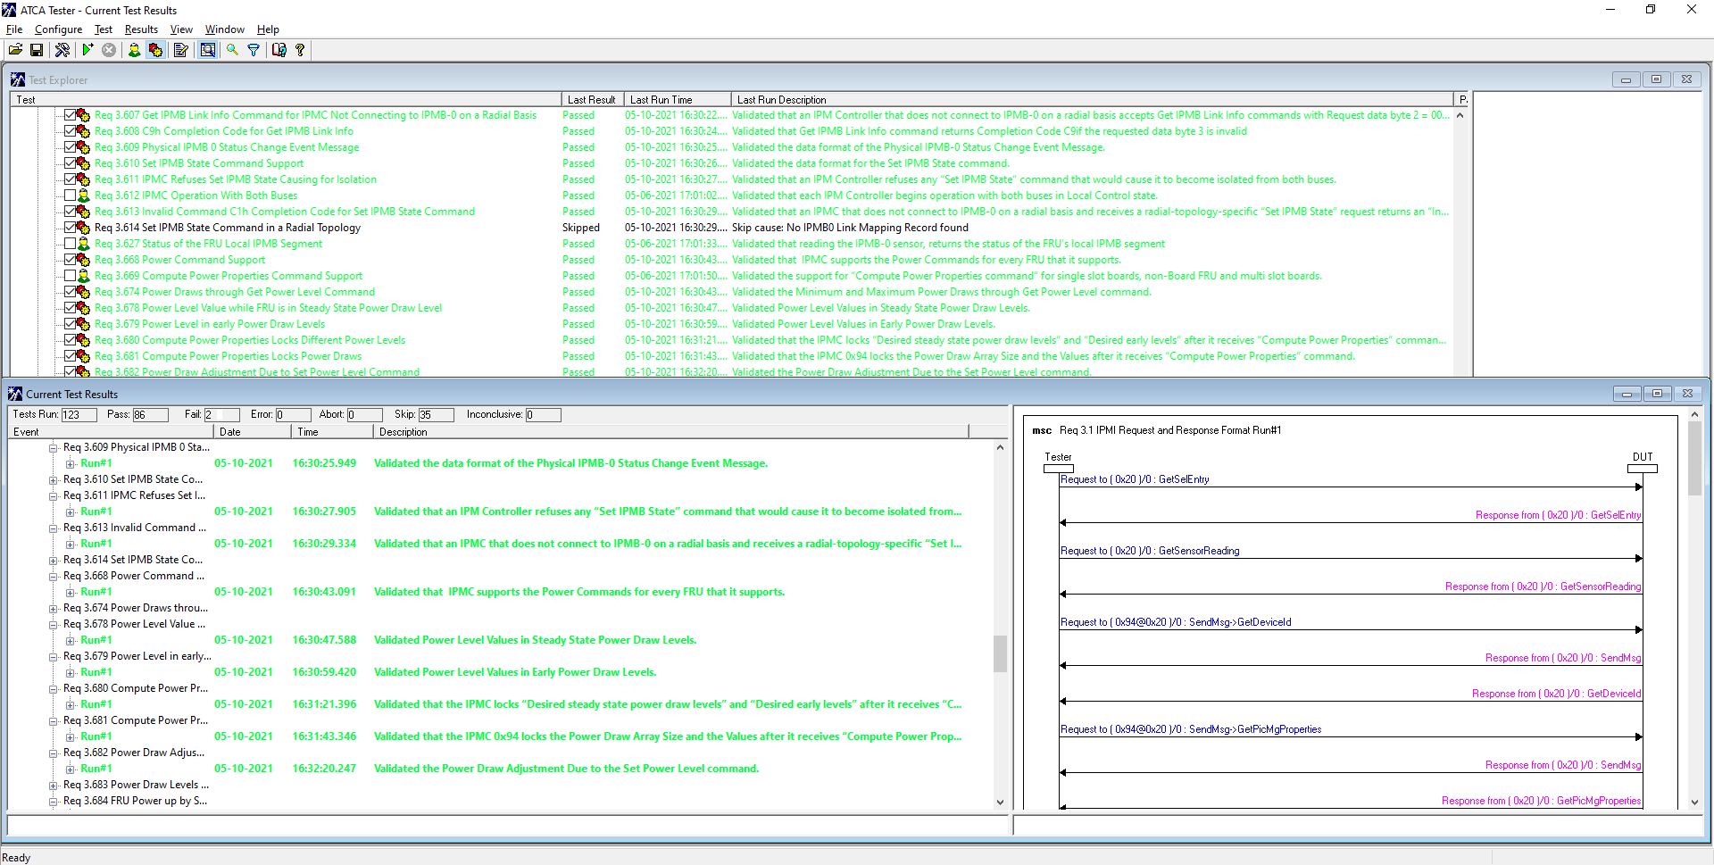
Software porting to v.1.3
Extensive tests performed:
  Active test ran for all of the interfaces during several hours/days
  Allowed finding conflicts on IPMB-L bus detected (issue was found on our MMC configuration)
  HPM.1 stability [Upgrades in a loop] (watchdog reset detection issue was fixed)
  Non-volatile parameters issue on HPM.1 upgrade (e.g.: IP address not reset to default)
  Compilation errors depending on UART configuration were solved by fixing the code
  TCP/IP issue on extensive use and add Linux support
  Tested with Polaris Tester:
    Number of tests: 123
    Passed: 86
    Failed: 2
      As the iRTM is emulated, it cannot be accessed by the Polaris tester
      without configuring the setup .. This was tested manually
    Skipped: 35
      AMC not implemented, e-keying not set

Slide 8
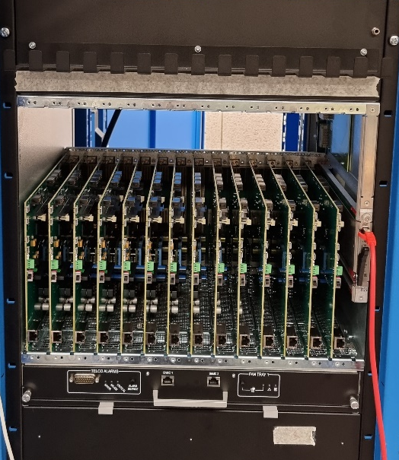
Software porting to v.1.3
Status
  Test performed locally with the CERN-IPMC tester
  Test performed by the ATLAS L1Calo team in real environment
  Additional test for sensor integration are on-going with the CMS DTH team
  Release note, including a guide for the software migration, was written
Plans (coming weeks)
  Accelerated aging using climatic chamber
  Fully populated crate using the tester
    Extensive polling of a large number of sensors
    ATCA Insertion/extraction emulation
    AMC/iRTM insertion/extraction emulation
Fully populated crate
with CERN-IPMC
devkit.

Slide 9
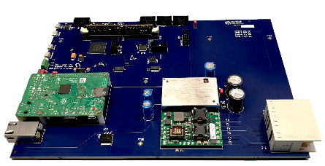
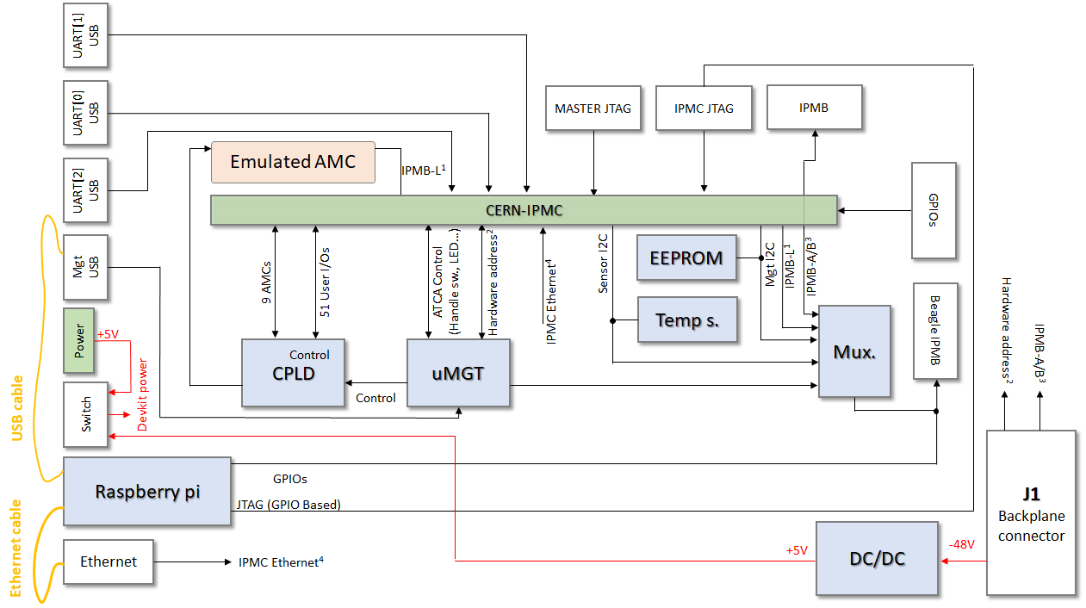
CERN-IPMC DevKit vers. 4
New development kit available
  ATCA form factor compliant (features a zone 1 connector)
  Powered from the backplane input
  Local control based on a raspberry pi
Can be used on a desk as well as in an ATCA shelf
Block diagram available in backup slides

Slide 10
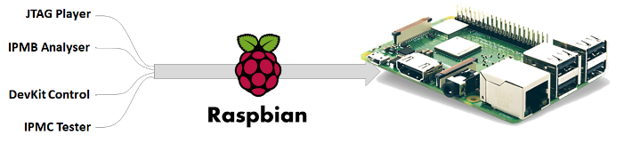
CERN-IPMC DevKit vers. 4
New features available
  Run on local Raspberry pi
  Based on Raspbian distribution (Linux)
  Need Ethernet and USB connectivity to the Ethernet and Management ports

Slide 11
CERN-IPMC DevKit vers. 4
JTAG Player
  Used to reset the CERN-IPMC to CERN default firmware
  Can be used to flash firmware upgrade according to the CERN-IPMC support team
  Only one command in raspberry terminal: jtag_player –reset
DevKit control
  Allows configuring the test setup via the command line interface of the raspberry pi
  One command per action - e.g.: devkit_ctrl -a SETHA -v 0x43
  Implements all of the actions supported by the devkit controller
IPMC Tester
  Allows running a full hardware test for a CERN-IPMC
  Using it reconfigures the module with the CERN default firmware
  Generates a report and a log file, which can help debugging a module

Slide 12
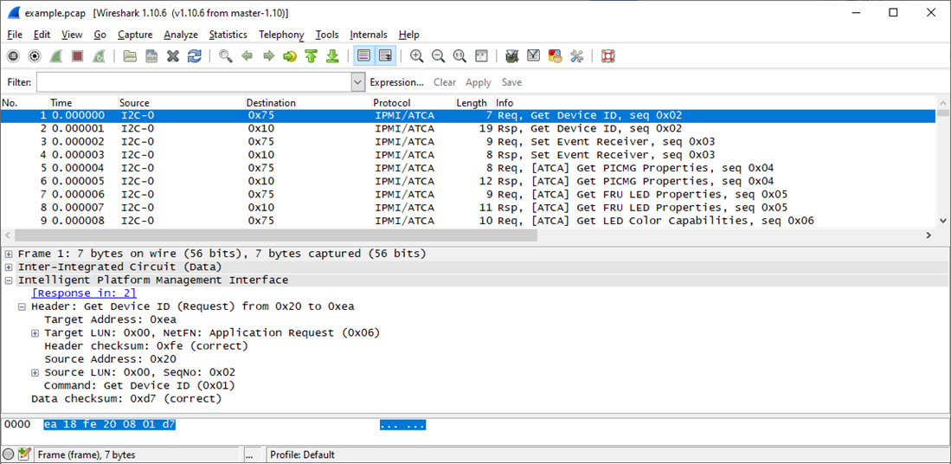
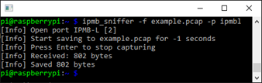
CERN-IPMC DevKIT vers. 4
IPMB Analyser
  Captures IPMB-A, IPMB-B or IPMB-L packet and format them for Wireshark
  Only one command in raspberry terminal: ipmb_sniffer -p <port> -o <output file>

Slide 13
CERN-IPMC DevKit vers. 4
IPMC Tester
  Testing improvement: automatic module flashing via raspberry pi interface
    Was originally done manually
    Avoid operator intervention and make the test fully automatic
  Reports automatically generated
  Test can be executed externally (allow user to test their own hardware)

Slide 14
CERN-IPMC Distribution
Stock:
  V3: 63
  V4: 64

Slide 15
CERN-IPMC Distribution

Slide 16
Summary
New hardware version
  Produced using a frame contract allowing the production of up to 1000 IPMCs until end 2022
  First modules produced in November 2020
  Can be ordered on https://cern-ipmc.web.cern.ch/order
    need of V4 shall be specified as V3 are also still available
Software upgrade:
  Porting to the latest version of the Pigeon Point solution
  Improve stability and has been extensively tested
  Released and documented
  Available through remote compilation since January
New development kit available
  ATCA standard compliant for in-crate use
  Adds functionality based on raspberry pi controller
  First prototype arrived at CERN in November
  Final version received in March and successfully tested
  Available for purchase (1500 CHF)
  Currently used in 3 institutes

Slide 17
UART[1]
USB
UART[0]
USB
MASTER JTAG
IPMC JTAG
IPMB
Emulated AMC
UART[2]
USB
IPMB-L¹
CERN-IPMC
GPIOs
EEPROM
Mgt
USB
Sensor I2C
I²C Select
Mgt I2C
IPMB-L¹
ATCA Control
(Handle sw., LED…)
IPMB-A/B³
9 AMCs
51 User I/Os
Hardware address²
IPMC Ethernet⁴
Temp s.
Mux.
I2C OUT
Hardware address²
+5V
Power
CPLD
uMGT
IPMB-A/B³
Devkit power
Control
USB cable
Switch
J1
Backplane connector
Raspberry pi
GPIOs
JTAG (GPIO Based)
Ethernet cable
DC/DC
-48V
Ethernet
IPMC Ethernet⁴
+5V

