Slide 1
ATCA IT Outcome and Common Procurement

Slide 2
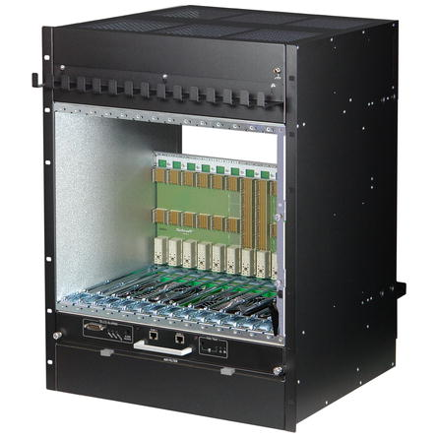
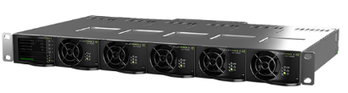
Procurement and maintenance framework key objectives
Target
      Total estimated needs
        ATLAS: 100 - 130 units
        CMS: 100 - 130 units
      Technical requirements: No change compared to the original price enquiry for limited quantities.
  Total estimated : 250 shelves
  Blanket purchase contracts
  For both, ATCA shelves and AC-DC rectifier units
  Covering procurement and maintenance over long term
ATCA shelf
14 ATCA slots w. RTM
Vertical (or Horizontal) cooling
DS or FM topology
40G backplane (100G optional TBC)
Bussed IPMB (Radial upon request)
1 Shelf man. Included (PP ShMM 700)
- 48Vdc rectifier system
Up to 18 kW max output pwr
(w. expansion unit)
9 kW with N+1 redund. (one 1U unit)
Based on 5 pwr bricks
Single bulk power output
Ctrl module (SNMP over eth.)
https://espace.cern.ch/ph-dep-ESE-BE-ATCAEvaluationProject/Procurement/SitePages/Home.aspx

Slide 3
Procurement process and status
Status of MS + IT process for the ATCA shelves
First draft of MS documents April 2020
Finalisation of MS documents End April
Technical auditing Mid May
Dispatch of MS documents Mid May
First draft of IT documents Beginning July
Finalisation of IT documents End July
Specification Committee date Mid August
Dispatch of IT documents Mid August
Submission deadline for bidders Mid September
Date of FC meeting Dec 2020
Blanket contract start date Jan 2021
PE for the AC-DC rectifier system
Technical specification ready August 2020
Dispatch of PE documents Mid September
Submission deadline for bidders Mid October
Blanket contract start date Jan 2021

Slide 4


Outcome of the IT-4604 (shelf) and DO-32713 (rectifier)
Selected companies
ATCA shelf: nVent (Schroff)
  Power rectifier: Eltek
  No change compared to the original price enquiry for limited quantities.
  DCS integration
ATCA shelf: Remote control via the Schroff shelf manager (ShMM 700 based)
  Power rectifier: Remote control via “smartpack” control module over snmp
  (warning: no On/Off capabilities)
Schroff/nVent ATCA shelf
Eltek - 48Vdc rectifier system

Slide 5
Procurement framework for ATCA shelf and - 48V rectifier
New procurement framework
Based on blanket framework contracts
  Ok for large quantities over long term (10+ years)
Purchase orders placed in common at the end of every quarter
  Requests to be submitted via dedicated online DB
  Fixed negotiated prices (subject to yearly price indexation linked to local cost of living)
  TID (money transfer) to a common account prior to common PO (DAI)
  Equipment tracked in the DB from common PO on
Goal: Same procedure as for ordering VME crates today
User issues request via DB
TID (money transfer) by ESE
ESE issues Common PO (once TID is signed, quarterly)
User can pickup its units from the ePool reception
PO: purchase order

Slide 6
Procurement framework for ATCA shelf and - 48V rectifier
Main contractual conditions
Delivery lead-time: 10 weeks from ordering date*
Warranty duration: 2 years from delivery date
Long term maintenance:
  Fixed repair prices for every type of equipment (independent from the failure reason)
  Subject to a 3 months repair warranty
  Fixed verification prices for every type of equipment
  Mostly applied in case of «no fault found»
Faulty equipment: «fault report» to be registered in the DB prior to equipment return at the ePool reception
  Subject to budget code registration. But DAI is issued only if equipment is out of warranty
* : Delivery lead-times of Eltek PS subject to important increase due to Covid related factors. Users knowing their procurement plans please communicate them to me asap. Eltek will book production slots accordingly.

Slide 7
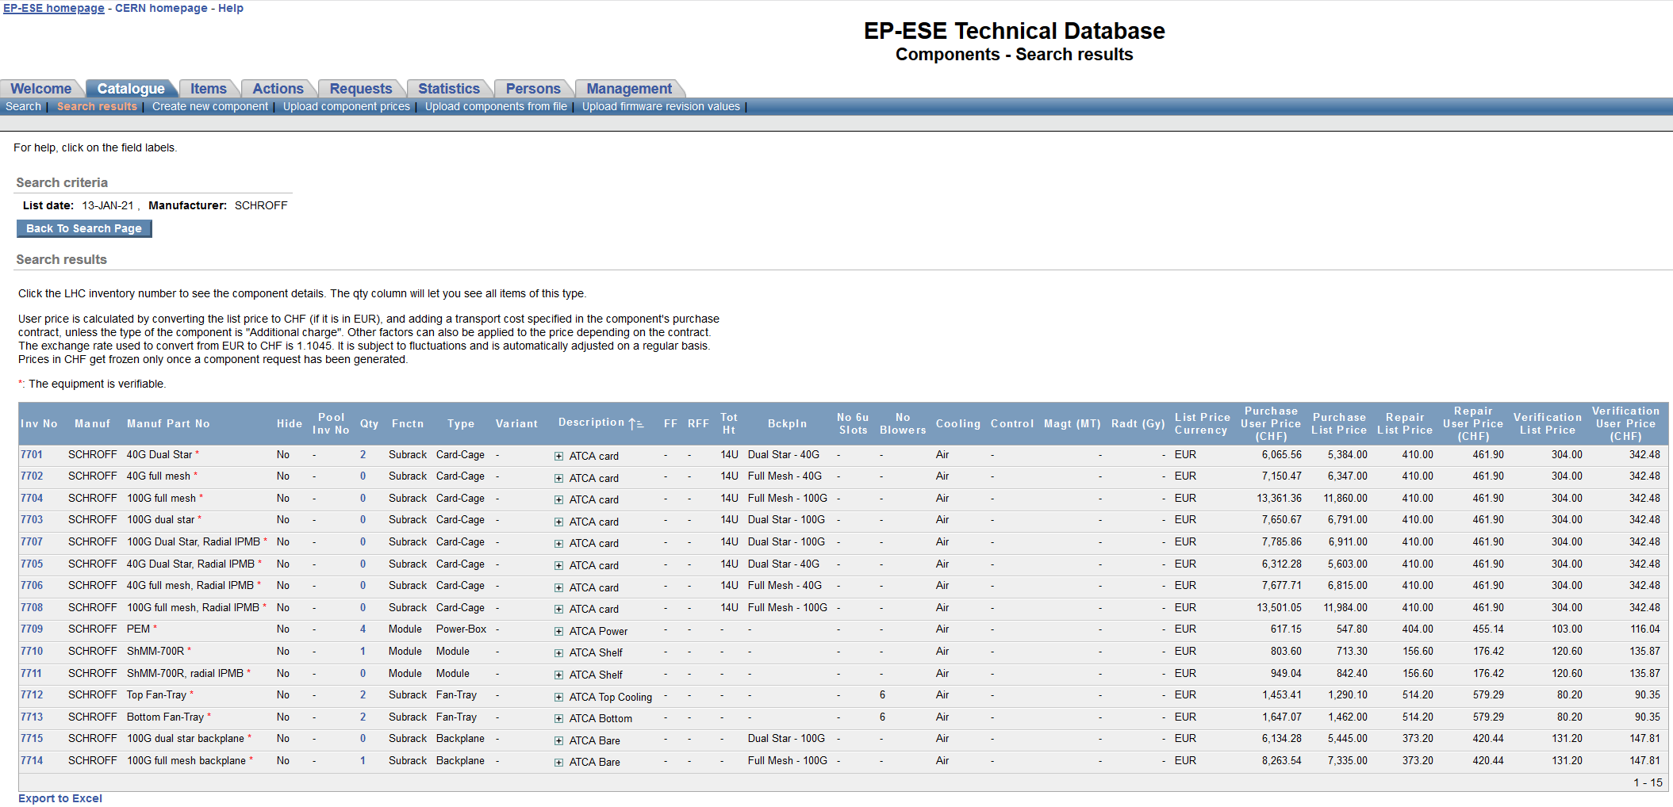
Integration in the existing PS & crate technical DB
Purchase orders placed in common at the end of every quarter:
  Requests to be submitted via online DB
  TID (money transfer) to a common account prior to common PO (DAI)
  Equipment tracked in the DB from common PO on

Slide 8
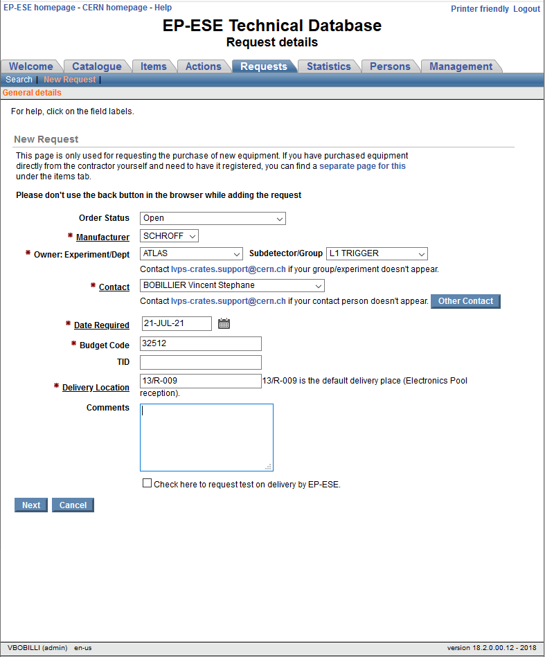
Equipment request using the DB
Simple request workflow
User issues request via DB
Link to the technical database: https://aisdb.cern.ch/pls/htmldb_aisdb_prod/f?p=117
Under the Welcome page, «ordering equipment» click «new request»
In case of trouble/questions, please contact:
lvps-crates.support@cern.ch
TID (money transfer) by ESE
ESE issues Common PO at the end of every quarter
(once TIDs are all signed)
User can pickup its units from the ePool reception
(for large quantities internal transport service is to be used)

Slide 9
Reception tests upon delivery
Test on delivery
Reception test can be requested by the users at the time of the purchase request via the technical DB (subject to additional delivery delay of 1-2 weeks)
Depending on the batch size, only sample testing will be performed (10% but at least 1 unit /batch)
The reception test consists in a basic functional test:
  Visual inspection
  Powering, checking of all fans
  Module insertion (in one slot), recognition (by the ShMM) and activation
Delivery of large quantities
Delivery of large size batches (> 10 units) will be subject to internal transport directly to the experiment/user premises
In this case sample testing (if so requested) will be performed at the user’s premises

Slide 10
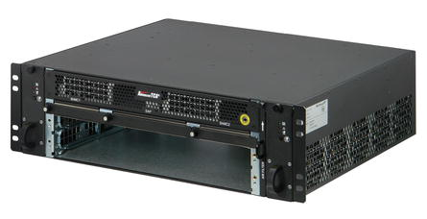
User support
Manufacturer documentation
nVent/Schroff: https://schroff.nvent.com/en-us/products/advancedtca-systems
Eltek: https://ideltaemeapartners.deltaww.com/docsharing/Documents/
(User: v-lvps-crates Password: R$MZcBhB)
Support provided by the PS & crate service
Free of charge verification tests of full shelf systems and/or modules (to be requested via the DB)
Remote support by email
Testing of ATCA blades in reference shelf system
Mini shelves available from the ePool
2 slots Schroff shelves available from the ePool for rental (w. integrated AC-DC)
https://aisdb.cern.ch/pls/htmldb_aisdb_prod/f?p=189:7:::NO:RP:P7_ITEM:0530

Slide 11
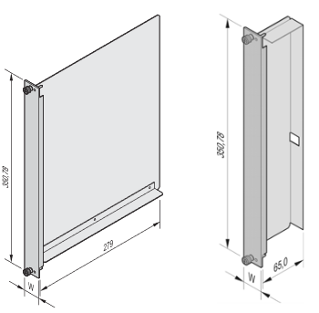
Accessories
Filler modules/panels
Needed in unused slots (air cooling efficiency)
Available from the CERN stores
  Front panel, AdvancedTCA Air Deflector 280mm, with air baffle SCEM: 06.61.81.407.9
  Rear panel, AdvancedTCA Air Deflector 70 mm, with Air baffle SCEM: 06.61.81.409.9
Cabling
Mains connection and -48 Vdc link between the rectifier and the shelf
A solution is currently being investigated by CMS (with help from BE-EA)
Highly rack integration dependant. To be investigated by the end-users.

Slide 12
Thanks for your attention

Slide 13
Useful links
Technical database: https://aisdb.cern.ch/pls/htmldb_aisdb_prod/f?p=117
SharePoint page about the ATCA equipment procurement:
https://espace.cern.ch/ph-dep-ESE-BE-ATCAEvaluationProject/Procurement/_layouts/15/start.aspx#/SitePages/Home.aspx
In case of questions, contact: lvps-crates.support@cern.ch

