Slide 1
Introduction to WP7: Advanced accelerator and gantry design
WP7 Coordinator: Maurizio vretenar, CERN
Deputy Coordinator: ELENA BENEDETTO, SEEIIST

Slide 2
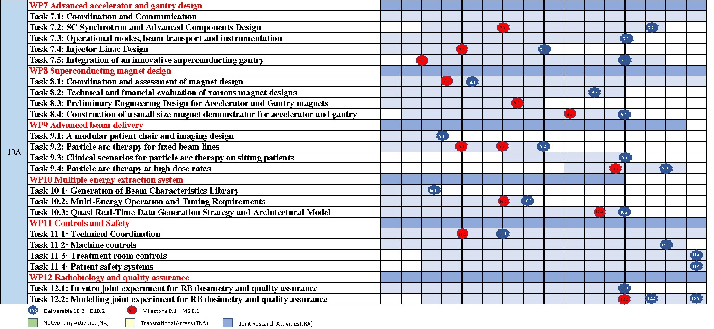
HITRI+ WP7 Structure and Timeline
Y1 Y2 Y3 Y4
PR1 PR2 PR3
WP7 to be completed in 3.5 years (30 September 2024)
WP7 receives an EC funding of 735,000 EUR (the highest in HITRI+) and counts on an equivalent amount of matching resources, to produce 3 Milestone Reports and 4 Deliverable Reports. Additionally, it will contribute to 3 Periodic Reports and to the Final Report.

Slide 3
WP7 – The Consortium
2 large scientific laboratories
2 particle therapy centres
1 (new) research institution
1 university
1 SME
from 6 European countries
Excellent blend of competences and expertise
7 partners:
CERN: WP Coordination, contribution to synchrotron, gantry and linac design
SEEIIST: Task leader for synchrotron design and beam transport, contribution to linac and gantry design
CNAO: Task leader for gantry design, contribution to synchrotron and beam transport design
Bevatech GmbH: Task leader for linac design
MedAustron: contribution to synchrotron, beam transport, and gantry design
Riga Technical University: contribution to gantry mechanical design
GSI: internal communication and support to coordination
duration:
3.5 years
GSI, CNAO and MEDA contribute with internal resources only (no EC contribution)

Slide 4
WP 7 – Management structure
WP Coordinator: M. Vretenar, CERN
Deputy WP Coordinator: E. Benedetto (SEEIIST)
Task Leaders:
 | Task | Task Leader
7.1 | Coordination and communication | M. Vretenar, CERN
7.2 | SC Synchrotron and advanced components design | E. Benedetto, SEEIIST
7.3 | Operational modes, beam transport and instrumentation | M. Sapinski, SEEIIST
7.4 | Injector linac design | U. Ratzinger, Bevatech
7.5 | Integration of an innovative superconducting gantry | M. Pullia, CNAO

Slide 5
WP 7: Ambitions (from proposal)
 | Technology | Present state of the art | Objectives (Technological breakthroughs)
1 | Lattice for superconducting synchrotron | Preliminary designs were developed, using ideal magnets. | Define a complete layout with injection, extraction, acceleration, based on magnets with ≥3 T dipole field and 1 T/s ramp rate, which can accelerate 10¹⁰ carbon ions to 430 MeV/u.
2 | Techniques for high-intensity operation | Present ion therapy centres operate with maximum 10⁹ carbon ions per pulse. | Develop multi-turn and/or charge exchange injection schemes that can be applied to normal conducting and superconducting synchrotrons to increase the ion intensity by an order of magnitude.
3 | Beam transport and instrumentation | Different beam transport lines are built with limitations in size or performance. | Define an optimised beam transport layout with minimum length that allows achieving the required beam parameters at irradiation point. Define and standardise the instrumentation required.
4 | Injector linac | A common injector linac design at 7 MeV/u exists, developed in the 90’s. | Design a new linac injector with higher accelerating gradient (3-4 MeV/m) and lower cost than the standard design, which can operate at 10% duty cycle for parallel production of therapeutic radioisotopes.
5 | Superconducting ion gantry | Only one SC gantry developed in Japan, some studies in Europe. | Develop the integrated design (mechanical drawings) of a superconducting gantry with weight lower than 100 tons and length below 16 metres.

Slide 6
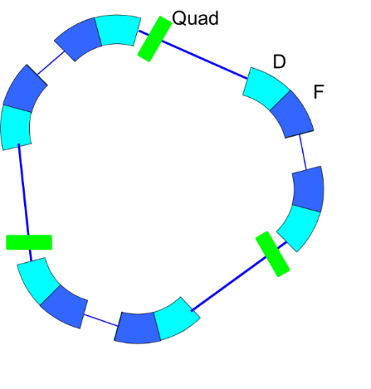
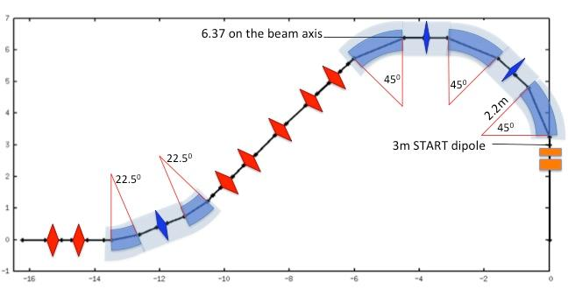
WP7 Objectives
• To design solutions that could improve performance of the existing accelerators for heavy ion research and therapy: multiturn injection for higher beam intensity, improved extraction and beam transport – in particular for new FLASH therapy modality, and new linac injector for higher intensity and parallel production of isotopes for research and therapy.
• To combine these accelerator solutions with the superconducting (SC) magnets developed in WP8 to develop the advanced conceptual design of a compact and innovative SC heavy ion synchrotron for cancer research capable of operating with multiple ion species, from protons to argon as required for research projects, particularly helium, carbon and oxygen.
• To propose a simplified version of this compact SC accelerator (with single- or double-ion operation at fixed parameters) as the reference for a new generation of compact ion therapy accelerators to be built by European industry to address the global ion therapy market.
• To convert the most promising of the existing conceptual designs for superconducting gantries into a detailed technical design integrating all components including diagnostics and beam delivery, and prepare for a final industrialisation and production phase by European industry.

Slide 7
Task 7.2 - SC Synchrotron and Advanced Components Design (SEEIIST, CERN, CNAO, MEDA) – Task Leader: E. Benedetto
Sub-Task 7.2.1, Lattice for a SC synchrotron: definition of an appropriate lattice using the SC magnet design defined in WP8, including modelling of magnets and particle tracking for long-term stability (SEEIIST, CERN).
Sub-Task 7.2.2, Multi-turn injection in resistive and SC synchrotrons: conceptual design of the multi-turn injection of 10¹⁰ ions per pulse into a reference synchrotron with resistive magnets, and in the SC synchrotron (SEEIIST, CERN, CNAO).
Sub-Task 7.2.3, Extraction and beam transport: conceptual design of slow and fast extraction for different treatment options and for experimental research, in coordination with beam transport and delivery teams, for a synchrotron with resistive magnets and with SC magnets (SEEIIST, CERN, CNAO).
Sub-Task 7.2.4, Longitudinal and transverse beam dynamics studies and assessment: preliminary analysis of acceleration, collective effects, space charge, intra-beam scattering and collimation (SEEIIST).

Slide 8
Task 7.2 - SC Synchrotron and Advanced Components Design (SEEIIST, CERN, CNAO, MEDA) – Task Leader: E. Benedetto
Resources and procedures:
Joint initiatives: NIMMS@CERN, UK (magnets, optics) and AUS universities (optics).
CERN: E. Benedetto, M. Sapinski (extraction), R. Taylor (extraction and optics)
MedAustron and CNAO: collaborating on operational aspects (multiturn injection), theoretical R&D
CNAO: SC-magnet modelling, collimation/fluka
MedAustron: MT injection, extraction
Open to additional collaborations

Slide 9
Task 7.3 - Operational modes, beam transport and instrumentation (SEEIIST, CERN, CNAO, MEDA) – Task Leader: M. Sapinski
Sub-Task 7.3.1, Operational modes: identification of specific requirements and challenges in operation due to switching between therapy and research operation modes (for the sources, injector linac, ring and transfer lines) (SEEIIST, CNAO, MEDA).
Sub-Task 7.3.2, Beam transport lines: definition of improved layouts of the transport lines to the experimental and clinical treatment areas, with special attention to safety due to switching between the 2 modes, e.g. beam-dump, shielding (SEEIIST, MEDA, CNAO).
Sub-Task 7.3.3, Beam instrumentation and QA: identification of advanced beam instrumentation options and of their possible application to present and future medical synchrotrons (SEEIIST, MEDA).

Slide 10
Task 7.3 - Operational modes, beam transport and instrumentation (SEEIIST, CERN, CNAO, MEDA) – Task Leader: M. Sapinski
Resources and procedures:
M. Sapinski (SEEIIST), student (layout v2)
MedAustron and CNAO (experience)
Instrumentation and QA: concept of instrumentation starting from DLR (2nd stage, adding FLASH), need more discussion. Minimum requirements for SEEIIST. Outside of the box for FLASH. Wishlist for future instrumentation.

Slide 11
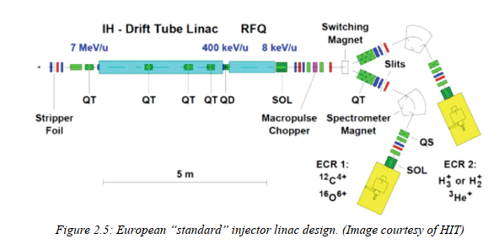
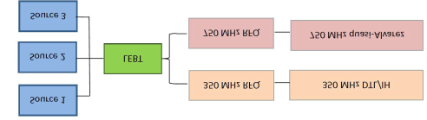
Task 7.4 - Injector Linac Design (BEVA, CERN, SEEIIST).
Task Leader: U. Ratzinger
analysis of heavy ion source options for high ion intensity and selection of new designs to improve performance of present and future ion therapy and research infrastructures;
conceptual design of a 325 MHz 10 MeV/u multiple ion injector: stripping energy optimisation, RFQ energy, RF system design, accelerating structure design and preliminary beam optics design. Comparison with layout, cost and performance of a 217 MHz injector with improvements against the existing standard injector;
detailed design of the preferred option (325 MHz or 217 MHz), with final beam optics design and overall design of RF accelerating structures, of amplifier system, and of instrumentation layout. Analysis of the impact on the design of a double operation mode, for injection into the synchrotron and using additional beam pulses for production of experimental radioisotopes for imaging and therapy.

Slide 12
Task 7.4 - Injector Linac Design (BEVA, CERN, SEEIIST).
Task Leader: U. Ratzinger
Resources and procedures:
Bevatech: Benjamin (cavity design), beam dynamics expert
Energy: space charge is not an issue, for C it is better staying at lower energy. 7 MeV/u or 5 MeV/u? Stripping efficiency to be checked. Amplifier is an issue.
Need a dedicated meeting to define the energy and current of the linac, for: injection, therapy RI, short-life PET, and the beams: carbon, helium (2+), protons.
Need collaboration with Wienander on EBIS (CERN). Information on ECR sources (panteknik and Catania). Holger.
Mariusz: low-energy, matching into the RFQ
CERN: Maurizio + optics for 325 MHz option.

Slide 13
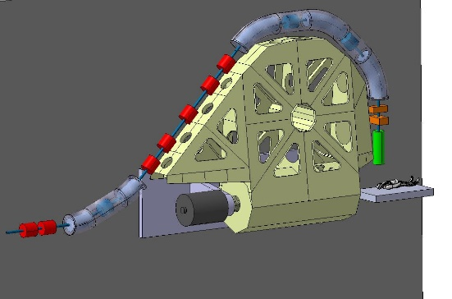
Task 7.5 - Integration of an innovative superconducting gantry: optics, mechanics, beam delivery (CNAO, CERN, SEEIIST, MEDA, RTU). Task Leader: M. Pullia
The «SIGRUM» SC gantry
Examination and comparison of the different existing conceptual gantry designs and selection of the most promising option.
Sub-Task 7.5.1, Basic structure and mechanical design: After having identified the baseline conceptual design, the mechanical structure and the technical solutions of the beam transport and the magnets will be investigated in detail. This sub-Task will start from a general mechanical and optics design of the gantry to integrate actual magnet designs, beam instrumentation, dose delivery, cryogenics aspects, etc. into a detailed mechanical design. (CNAO, RTU, CERN).
Sub-Task 7.5.2 Simulation of optics, scanning techniques: Global simulation and optimisation of the gantry considering optics, magnets, power converters, beam diagnostics, mechanics, dose delivery. The design shall be flexible enough to adapt the gantry optics to the existing and future facilities, and to be easily industrialised and reproduced in several units.

Slide 14
Task 7.5 - Integration of an innovative superconducting gantry: optics, mechanics, beam delivery (CNAO, CERN, SEEIIST, MEDA, RTU). Task Leader: M. Pullia
Resources and procedures:
CNAO: 4 people part-time (Enrico, Marco, Simone, Alessio) + expertise for dose delivery, clinical, bioengineer, ..
SEEIIST: Elena (overall design)
RTU: mechanical engineering – Luca Piacentini starting in September (PhD in Riga), Toms (part time), Andris,...
CERN: co-supervision of student (Diego), others.
MedAustron: Very welcome, limited in resources but interest is there. To be discussed.

Slide 15
WP7: 4 Deliverables and 3 Milestones
M7.1 | Choice of conceptual design and basic parameters of the innovative superconducting gantry | 7 | 6 | Report
M7.2 | Selection of basic linac design: frequency, layout | 7 | 12 | Report
M7.3 | Definition of key parameters for the superconducting synchrotron, including magnet field and type | 7 | 18 | Report
September 2021
March 2022
September 2022
March 2023 - Bevatech
March 2024 - SEEIIST
March 2024 - CNAO
July 2024 - SEEIIST

Slide 16
WP7 – Meetings and Communication
Proposal:
- 4 WP meetings per year (every 3 months). Two options:
  We work per Task and we divide as 2 WP meetings per year (before the General Assembly meetings) and 2 Task meetings per year.
  We work per WP and we have only common WP meetings
In terms of tools, we have Indico for the meetings (ask Valerie for support), a CNAO tool for document sharing, and Valerie will keep up to date the mailing list.
- next meeting: early July (by Task or by WP?)

