Slide 1
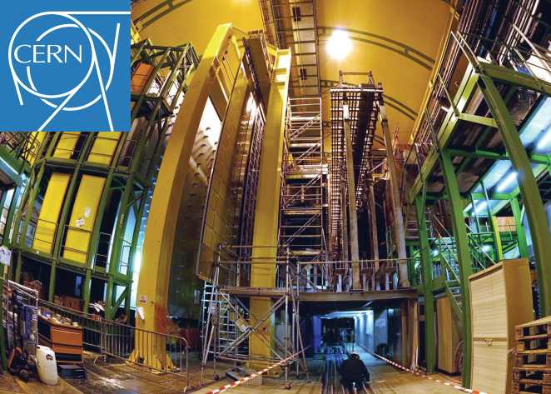

Options for alternate radiators for LHCb-RICH system
CERN: Mini-Workshop on gas transport parameters
for present and future generation of experiments
On behalf of LHCb-RICH group
S.Easo
22-04-2021

Slide 2
Outline
Studies done by Olav Ullaland
Start of investigations to use CO₂ in RICH2
Impact of potential usage of SiPM in the future
Exploring non-gaseous radiators
Summary

Slide 3
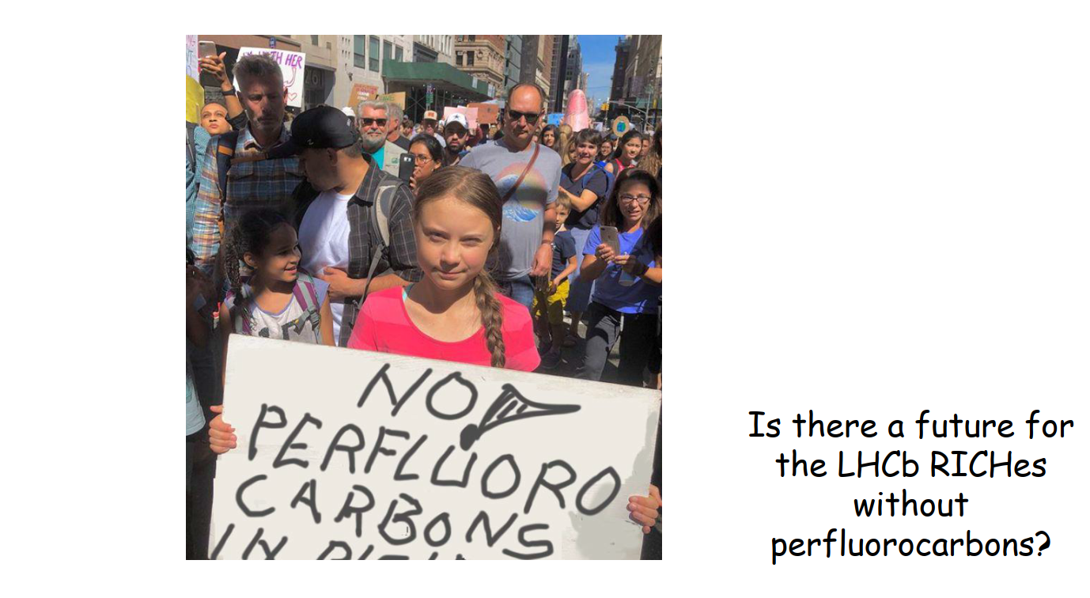
Investigations in the past
From O. Ullaland

Slide 4
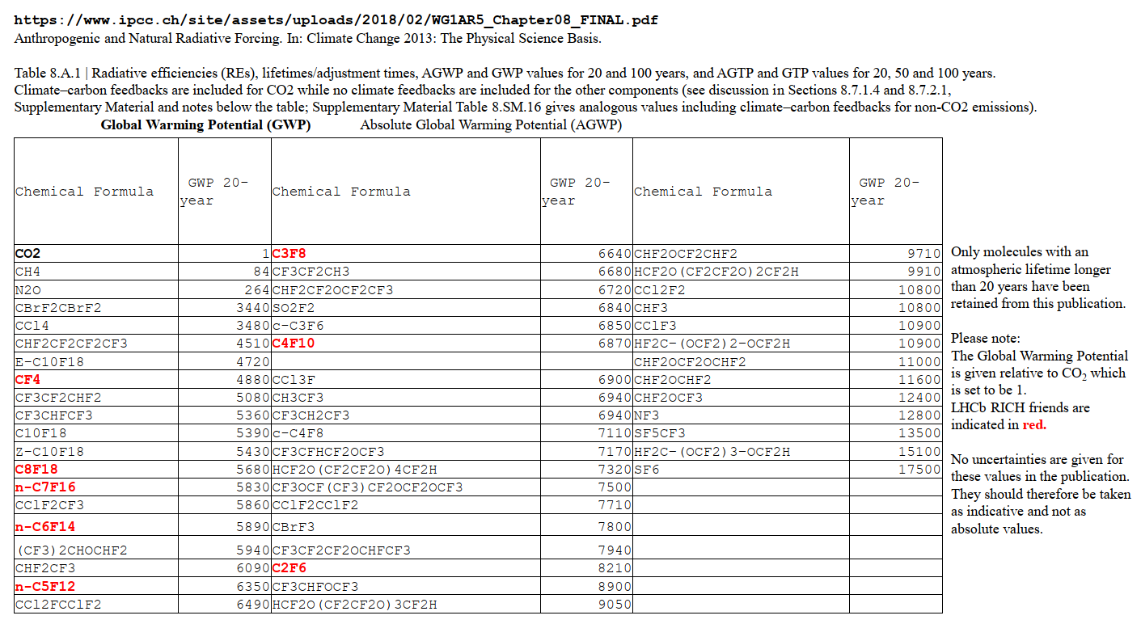
Investigations in the past
From O. Ullaland
C₄F₈O is also ruled out, since it has a large GWP 12000 (100-year time horizon).

Slide 5
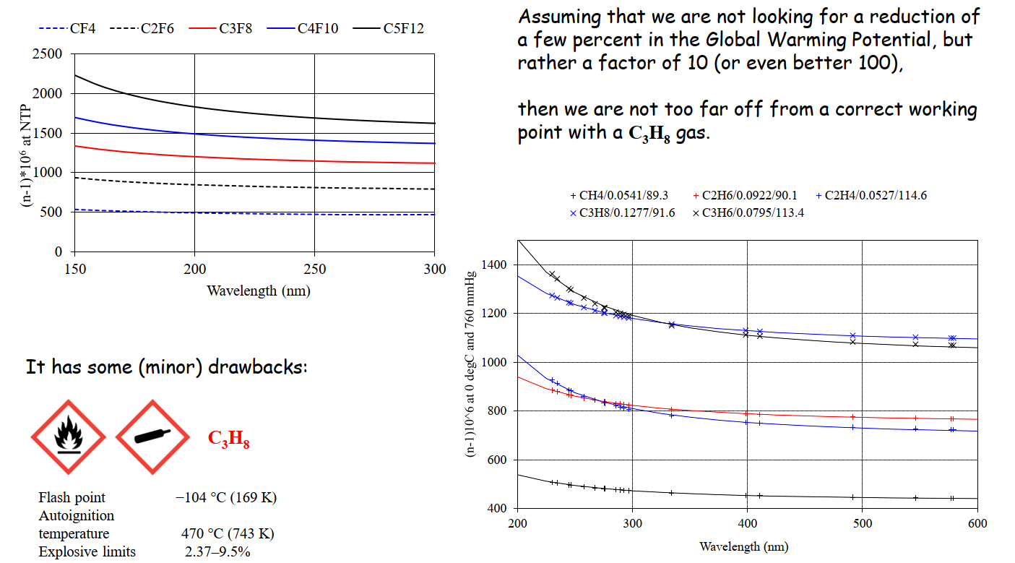
Investigations in the past
From O. Ullaland
Fluorocarbon gases : RICH1
Propane: cooking gas
Hydrocarbon gases : RICH1

Slide 6
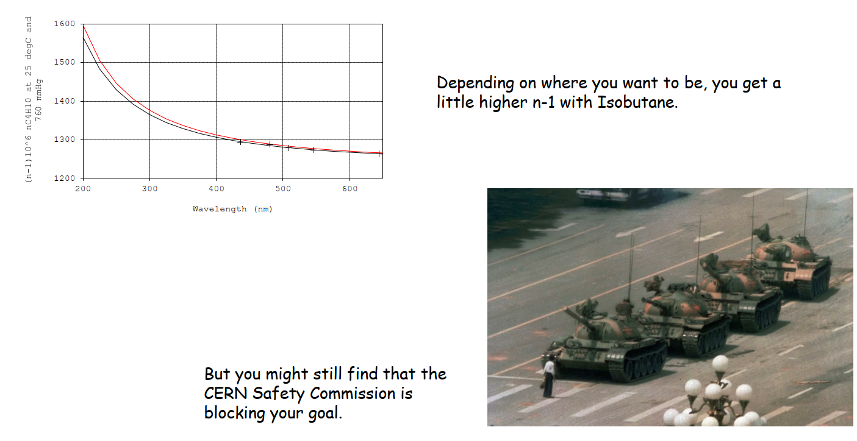


Investigations in the past
From O. Ullaland
C₄F₁₀ vs C₄H₁₀ : RICH1
C₄H₁₀ :
C₄H₁₀:
Isobutane : GWP = 3.3
Used as a refrigerant
Risk of explosion

Slide 7
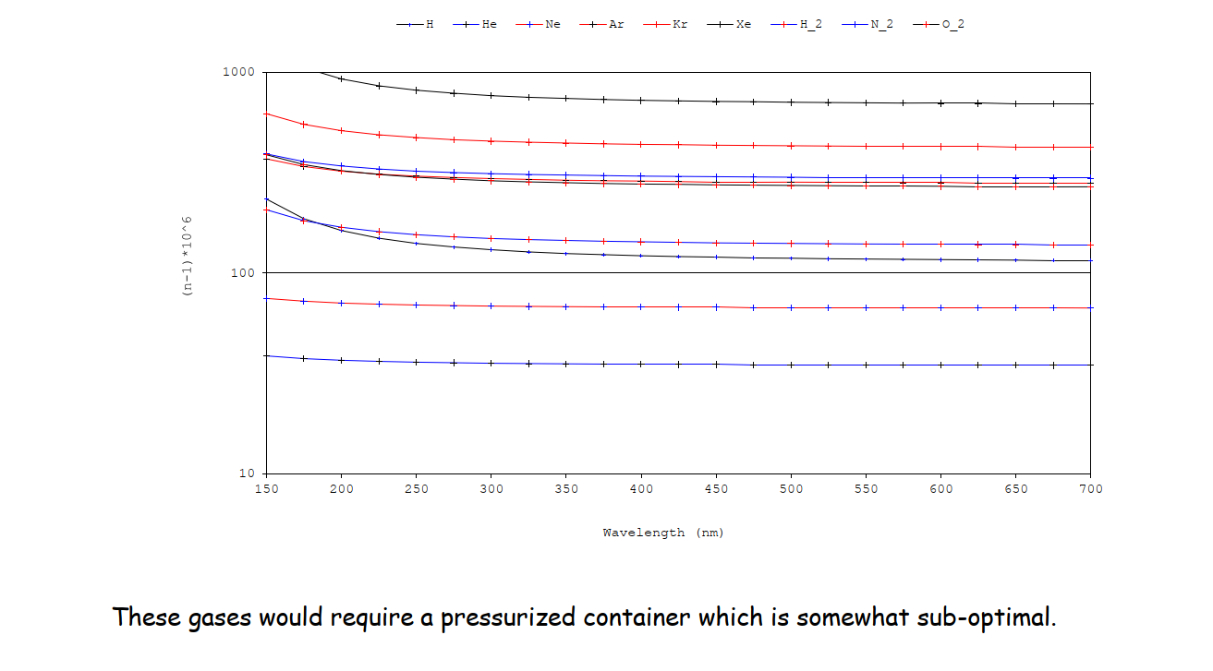
Investigations in the past
Gases without Carbon
From O. Ullaland
(for RICH1 )
(n-1)
For RICH2, it would be a very low pressure container, which is also not a good idea.
∝

Slide 8
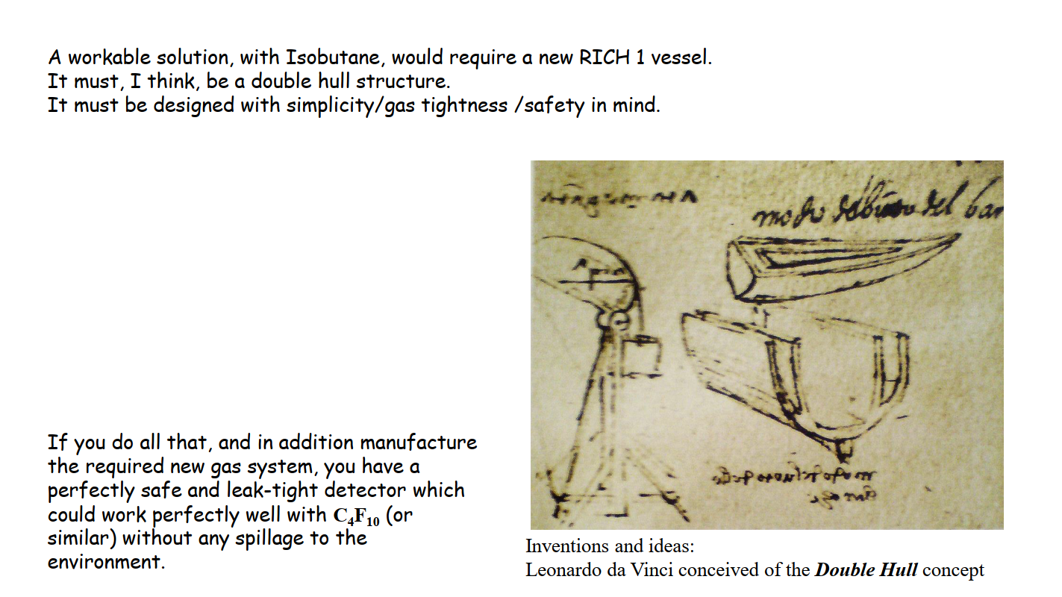
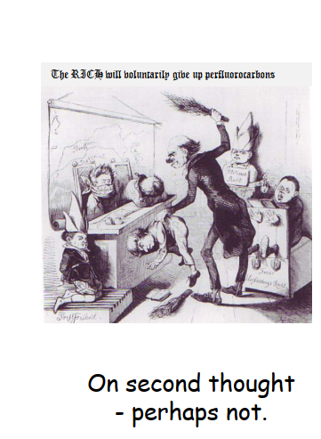
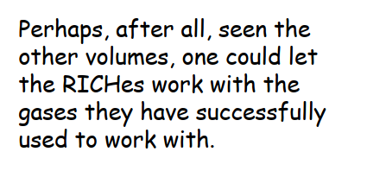
Investigations in the past
From O. Ullaland
In the future, the gas tightness of the enclosures will be further improved.
In such a system, the gas loss is negligible; it may happen only during gas purification.

Slide 9
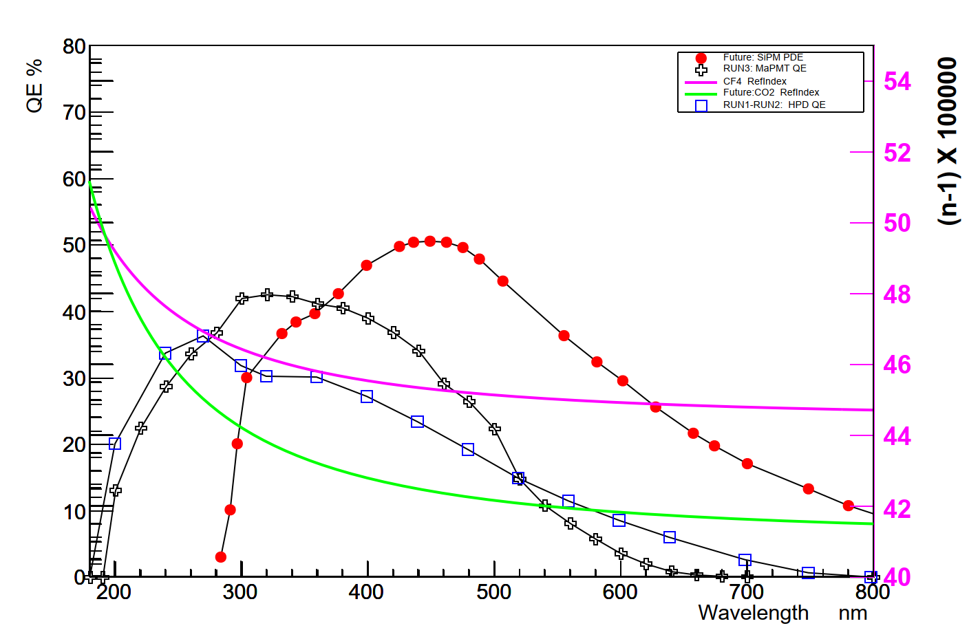
Exploring usage of CO₂ in RICH2
RICH2
RICH2: RUN3
Preliminary
Nominal single photon resolution (in mrad) | MaPMT; CF₄ | MaPMT: CO₂
Chromatic | 0.34 | 0.53
Overall | 0.50 | 0.66
Yield | 34 | 33
CO₂ expected to have a worse chromatic error contribution than CF₄
Simulation studies expected to be performed to evaluate the effect, from CO₂.

Slide 10
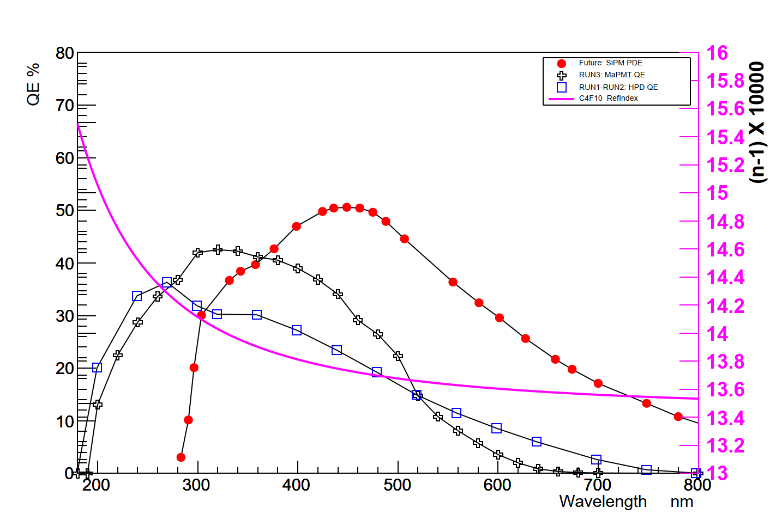
Usage of SiPM in the future
RICH1
SiPM can reduce the chromatic error and increase the yield. This is expected for LS4.
We hope that the gains obtained from using SiPMs are not lost with a change of the gas radiator.
For single photon detection, dark counts are to be kept at the level of 100 kHz/mm²
This requires SiPM to be operated near -100 ⁰C.
One needs to ensure that radiator gas does not liquefy when using SiPM.
(The gas radiator is separated from SiPM region by a thin quartz window )

Slide 11
Non-gaseous radiators in the future
Aerogel:
It is planned to test improved versions of aerogel.
However with n ~ 1.03, this is for the momentum range below 10 GeV/c.
This may also require modification of the optics.
Novel materials:
R & D starting in designing thin radiators made of photonic crystals (or meta-materials) , with desired n.
There are many challenges involved in producing such materials with low chromatic error and high yield.
Ref: Nature Physics 14, 816-821 (2018).

Slide 12
SUMMARY
Many options for replacing the current radiators with eco-friendly gases were investigated by Olav Ullaland.
One of those options is to have a pressurized, leak tight container to use isobutane for RICH1.
His general conclusion was to keep the current gases, unless a fantastic new option comes up in the future.
In the future we plan to further improve the gas tightness of the gas enclosures.
Usage of CO₂ in RICH2 is being investigated
We plan to continue the search for eco-friendly gases which can be used as radiators in the RICH detectors.
Any information related to this topic is quite welcome.
In the future, new photon detectors like SiPM can reduce the chromatic error.
In parallel , usage of non-gaseous radiators are also being explored

