Slide 1
Magnetic measurements of MCBY corrector magnet
A. Chmielinska, L. Fiscarelli
FiDeL meeting, 26 March 2021

Slide 2
Test program at 4.5 K
Standard test cycles:
Standard cycle in AP2, no current in AP1 (2h)
Standard cycle in AP2, nominal current in AP1 (2h)
Standard cycle in AP2, negative nominal current in AP1 (2h)
Standard cycle in AP1, no current in AP2 (2h)
Standard cycle in AP1, nominal current in AP2 (2h)
Special test cycles:
Special cycle “MCBYV.4L1.B1” in AP1, special cycle “MCBYH.4L1.B2” in AP2 (4h) [6016]
Special cycle “MCBYV.B4R1.B1” in AP1, special cycle “MCBYH.B4R1.B2” in AP2 (4h) [6016]
Special cycle “MCBYV.4L1.B1” in AP1, special cycle “MCBYH.4L1.B2” in AP2 (2h) [7300]
Special cycles for the validation of the ROXIE model:
Special cycle “ROXIE1” in AP2, no current in AP1 (3h)
Special cycle “ROXIE2” in AP2, no current in AP1 (2h)
Cycles not performed due to issues with the rotating shaft in AP1 after the cool down.

Slide 3
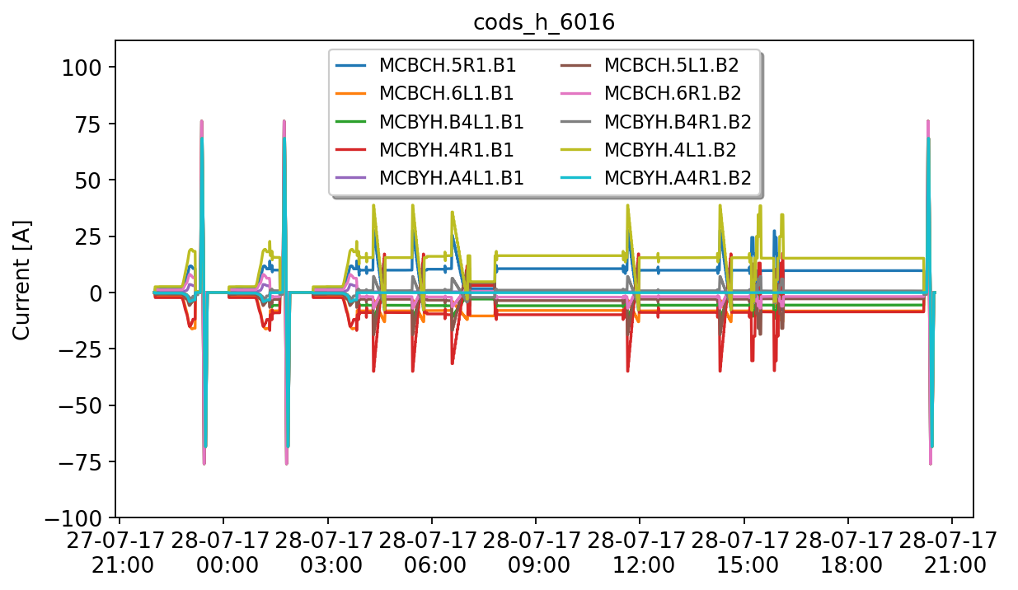
Fill 6016 (h plane)
We selected 2 MCBY cycles with the highest and the lowest current amplitude.

Slide 4
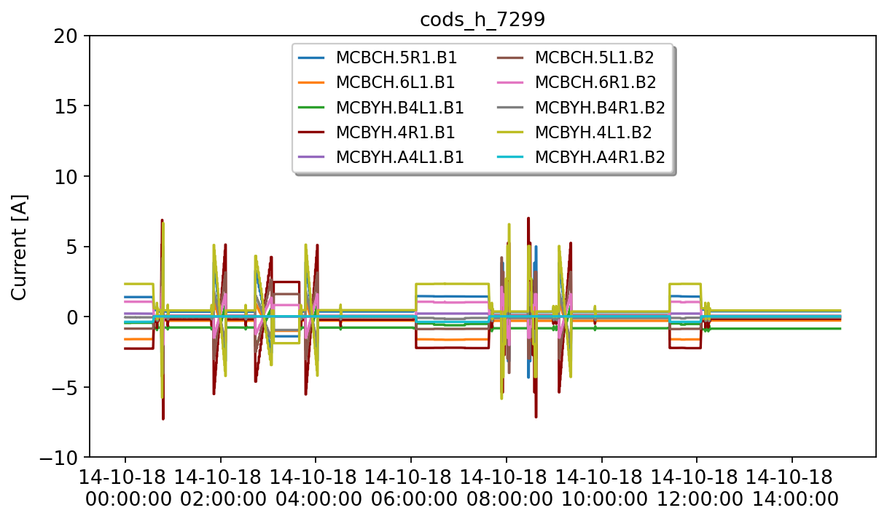
Fill 7300 (h plane)
(fill 7299+7300)
We selected 1 MCBY cycle with the second-highest current amplitude.

Slide 5
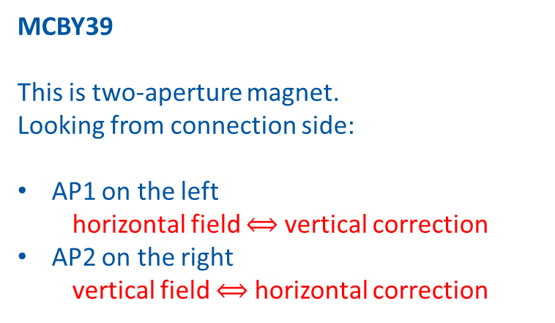
Field direction: convention
MCBY39
This is two-aperture magnet.
Looking from connection side:
AP1 on the left
horizontal field $⟺$ vertical correction
AP2 on the right
vertical field $⟺$ horizontal correction

Slide 6
Standard test cycles

Slide 7
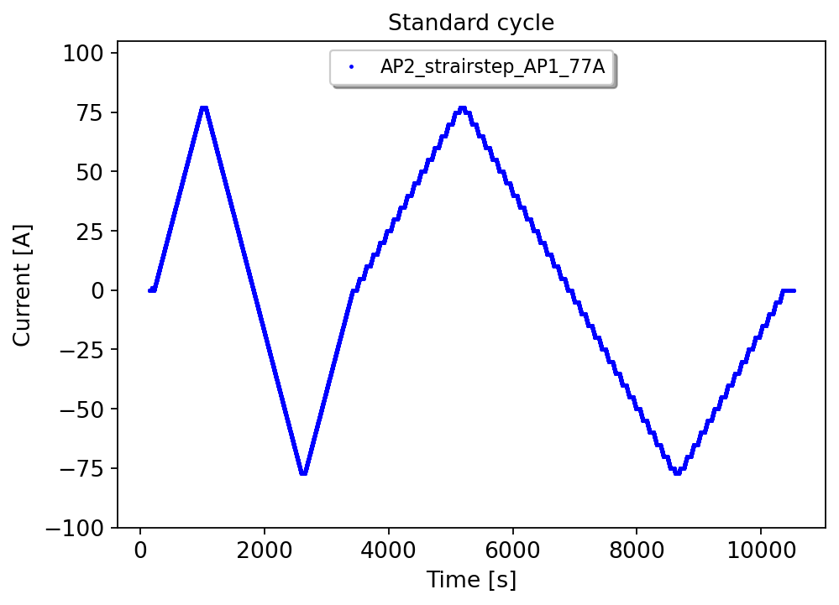
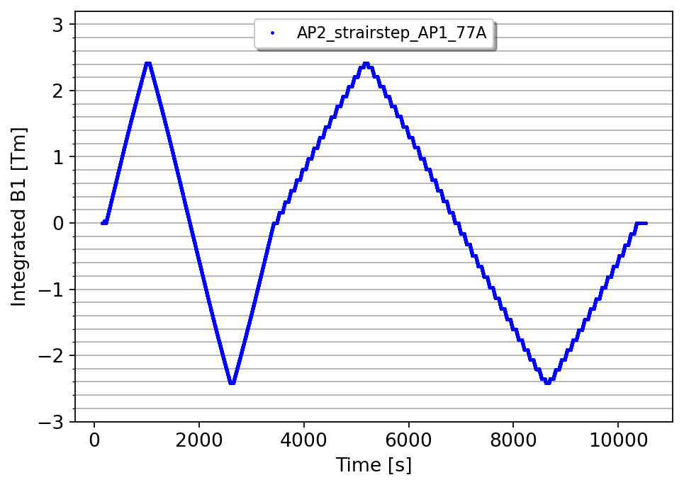
Reference standard test cycle
2. Standard cycle in AP2, positive nominal current in AP1 (Reference)
Nominal field: 2.41 Tm at 77 A
Pre-cycle up to nominal current (77 A) followed by a stair step profile,
The magnetic field is measured with high accuracy (10⁻⁴) at the plateaus.

Slide 8
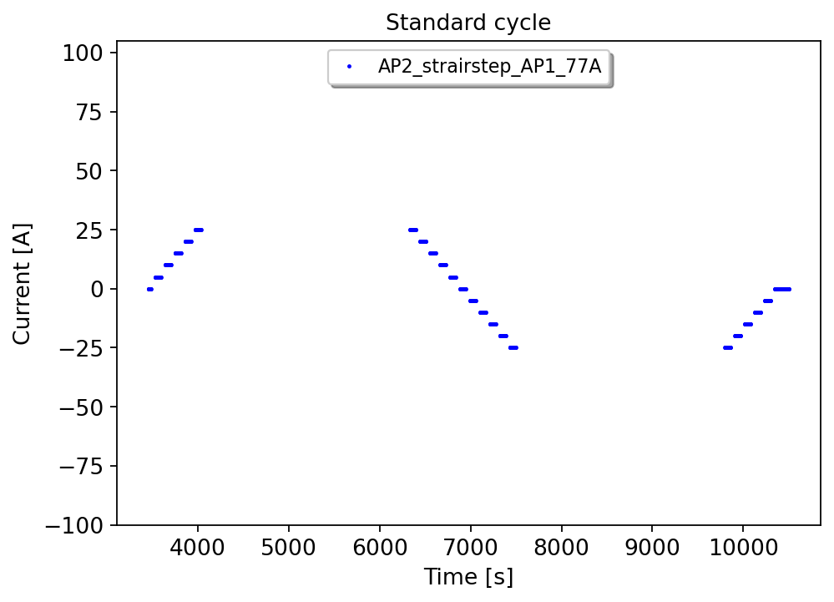
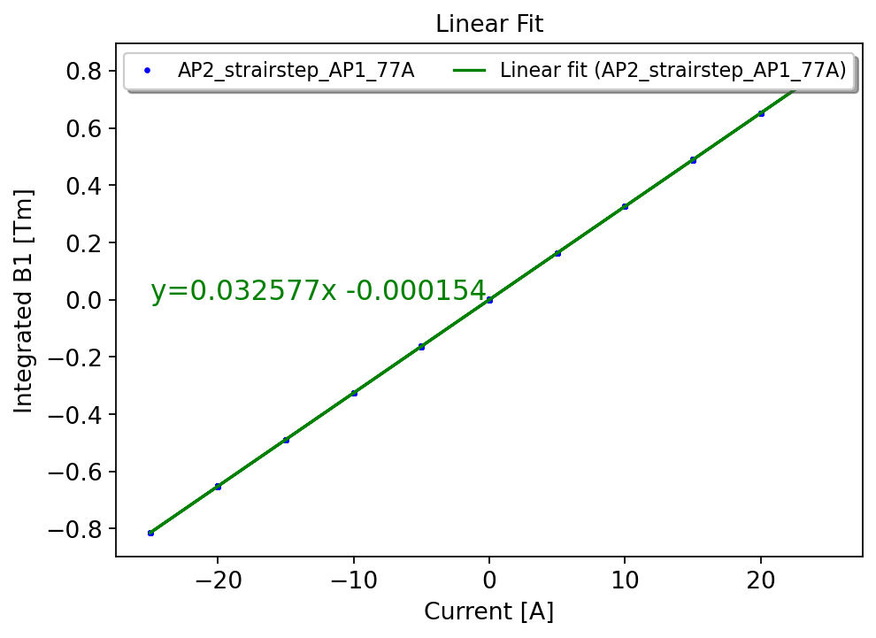
Linear fit
2. Standard cycle in AP2, positive nominal current in AP1 (Reference)
A linear fit is computed from the datapoints within linear range below saturation (±25A),
From the full set of datapoints, a non-linearity is retrieved as residual of the linear fit.

Slide 9
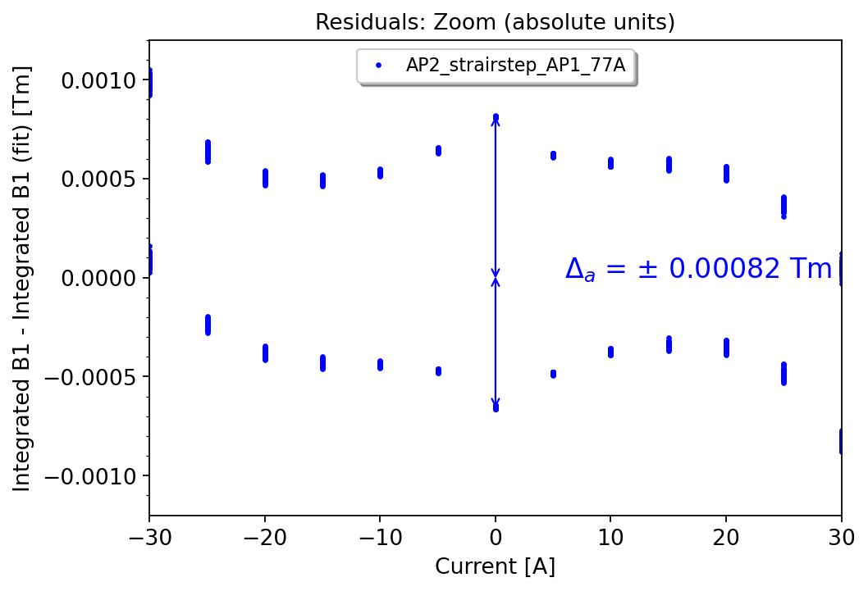
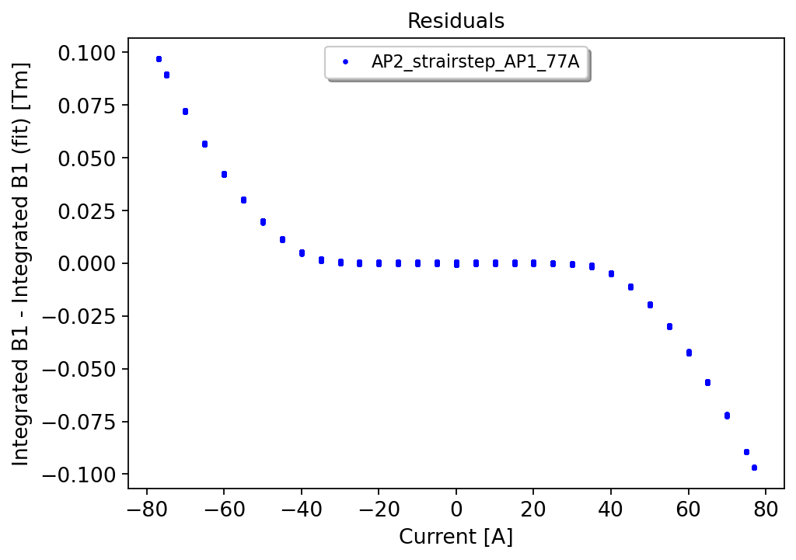
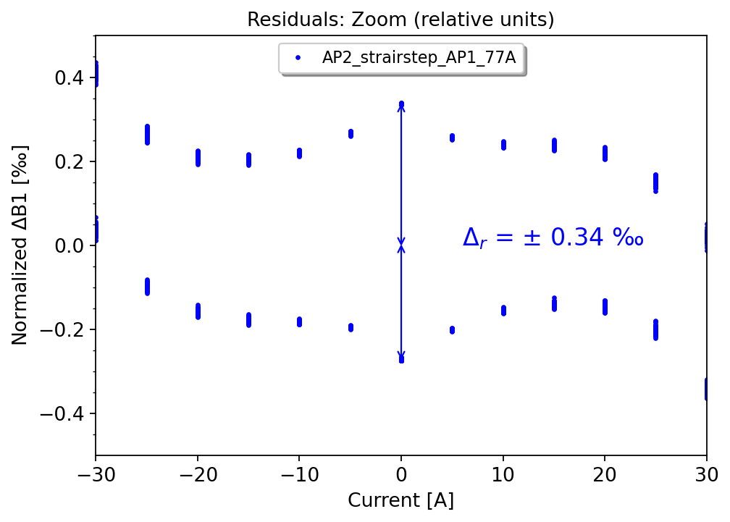
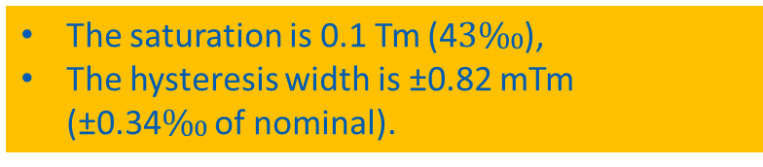
Reference standard test cycle
2. Standard cycle in AP2, positive nominal current in AP1
The saturation is 0.1 Tm (4$3\text{‰}$),
The hysteresis width is ±0.82 mTm (±0.34‰ of nominal).

Slide 10
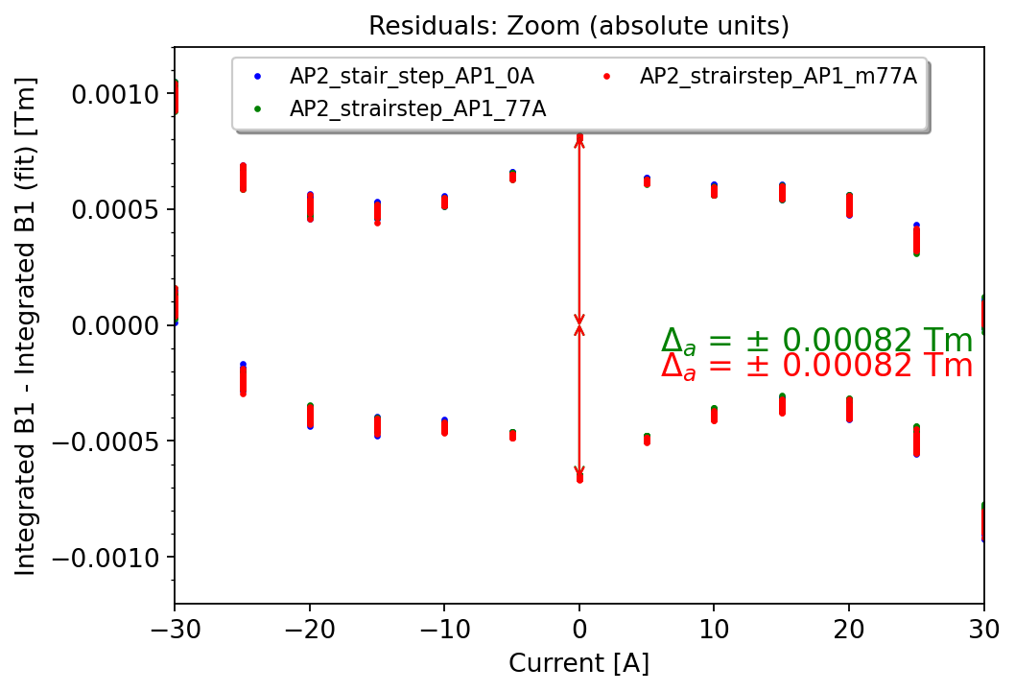
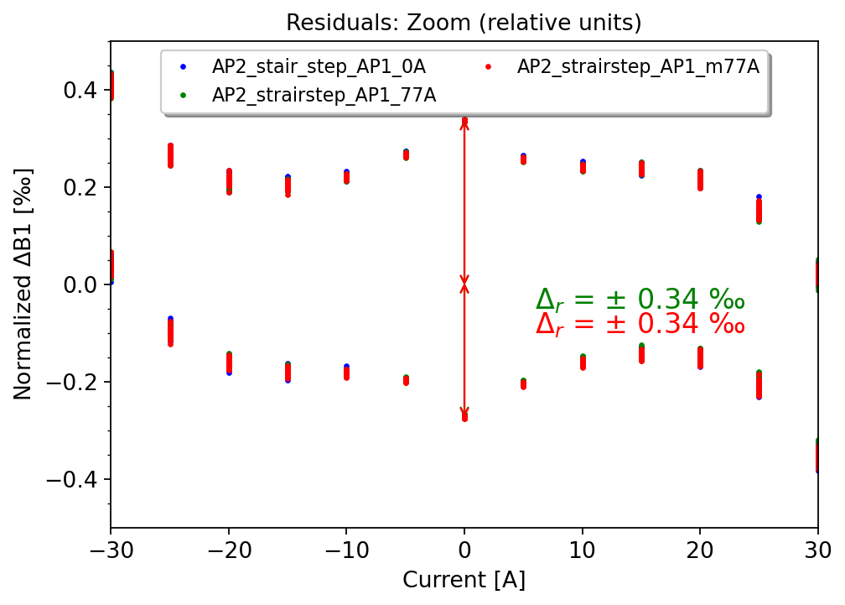
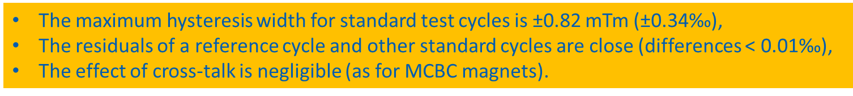
Other standard test cycles
Standard cycle in AP2, no current in AP1
Standard cycle in AP2, positive nominal current in AP1 (Reference)
3. Standard cycle in AP2, negative nominal current in AP1
The maximum hysteresis width for standard test cycles is ±0.82 mTm (±0.34$\text{‰}$),
The residuals of a reference cycle and other standard cycles are close (differences < 0.01$\text{‰}$),
The effect of cross-talk is negligible (as for MCBC magnets).

Slide 11
Special test cycles

Slide 12
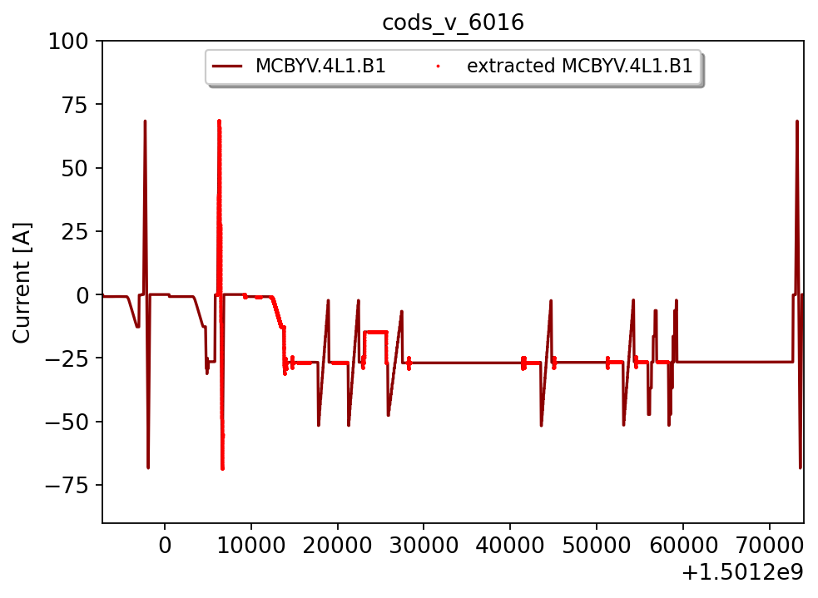
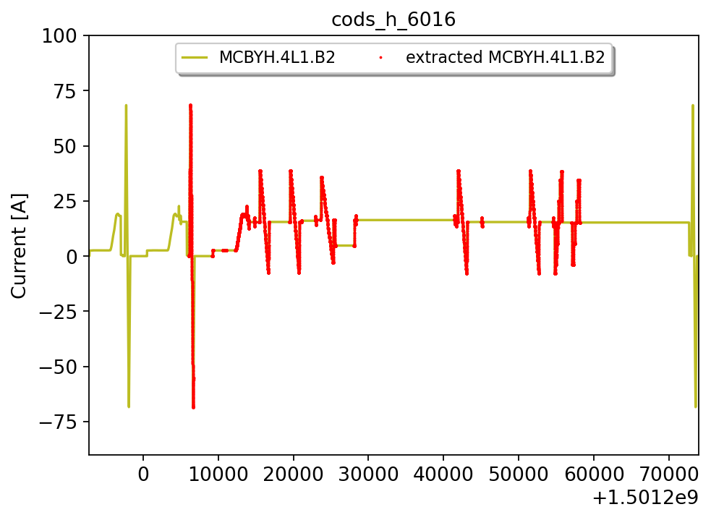
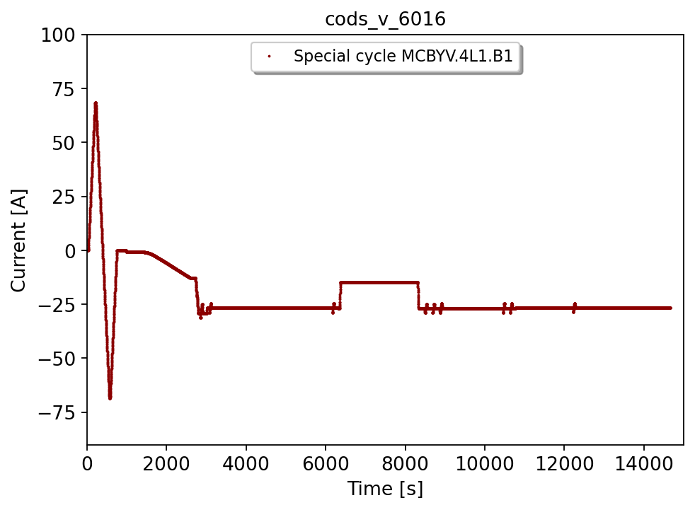
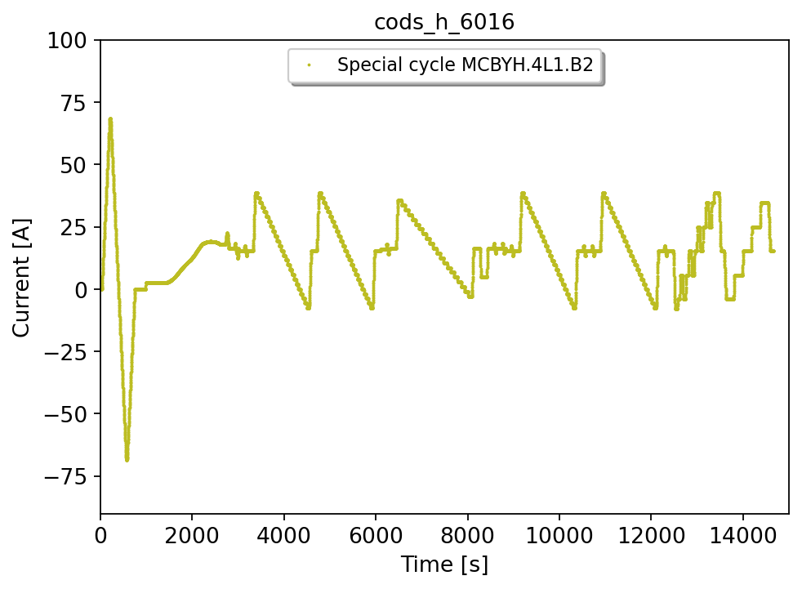
Special test cycle 1: MCBYV.4L1.B1 / MCBYH.4L1.B2 (fill 6016)

Slide 13
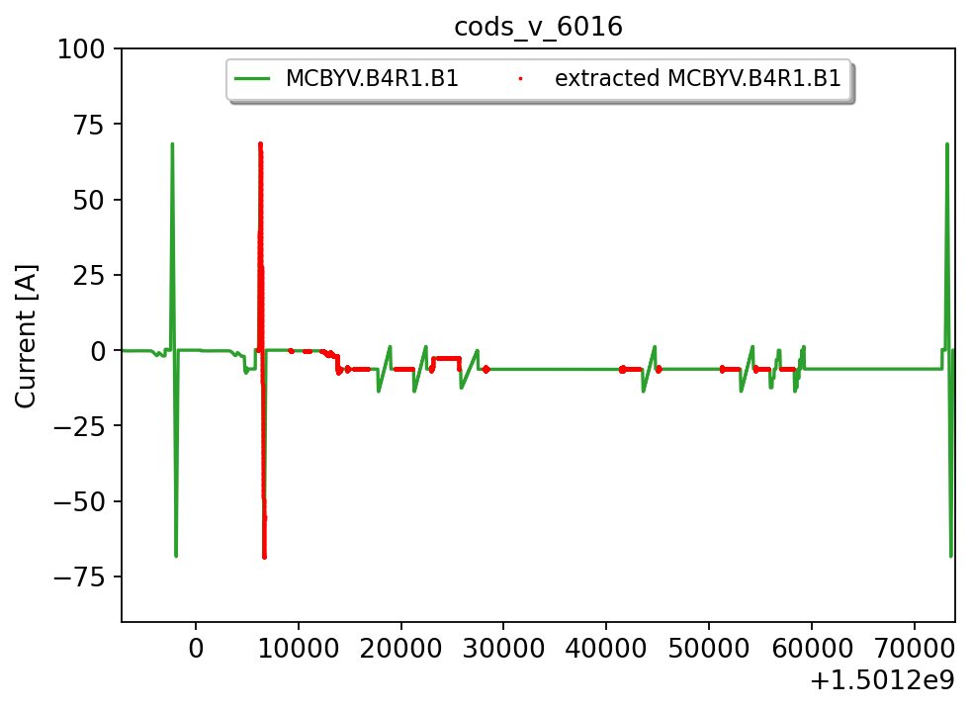
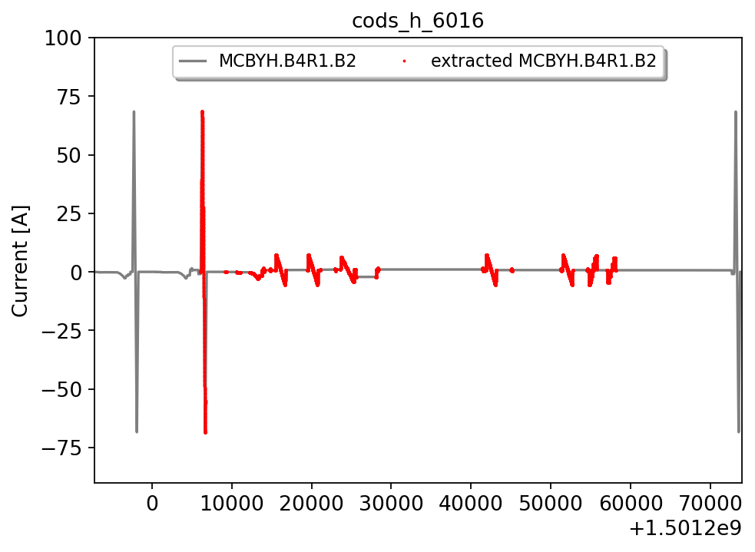
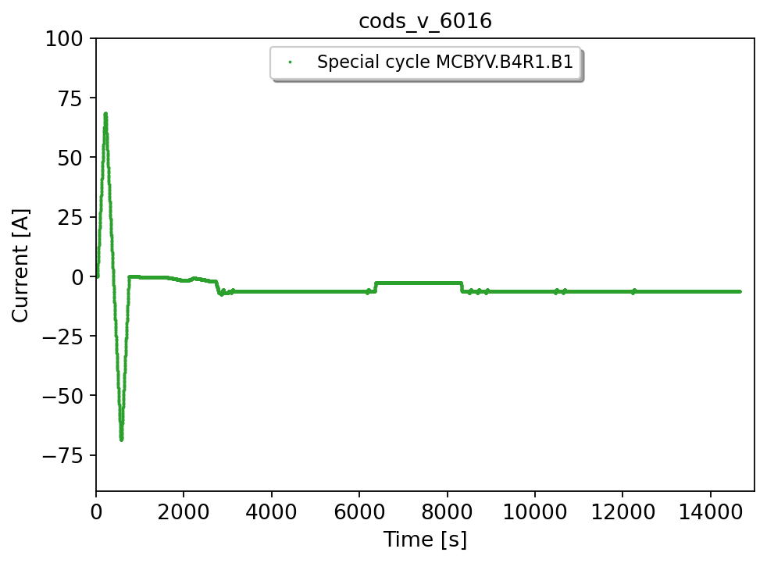
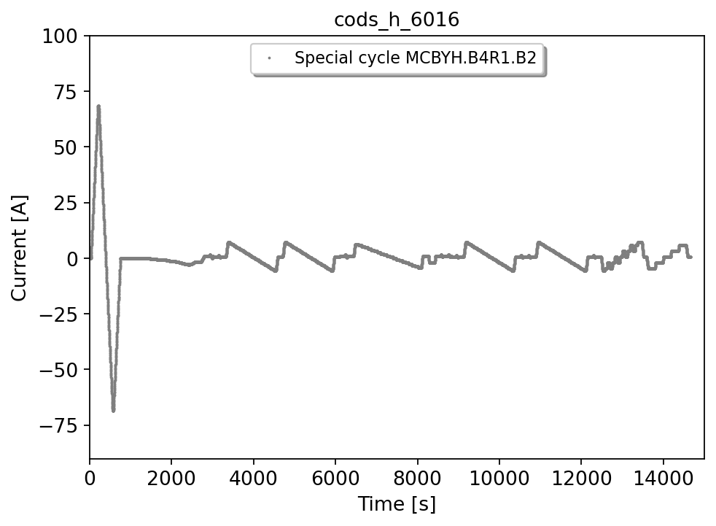
Special test cycle 2: MCBYV.B4R1.B1 / MCBYH.B4R1.B2 (fill 6016)

Slide 14
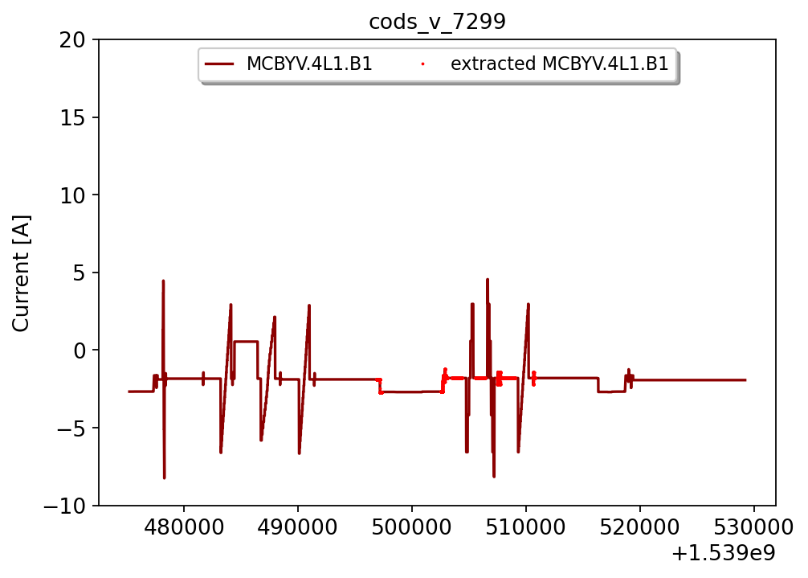
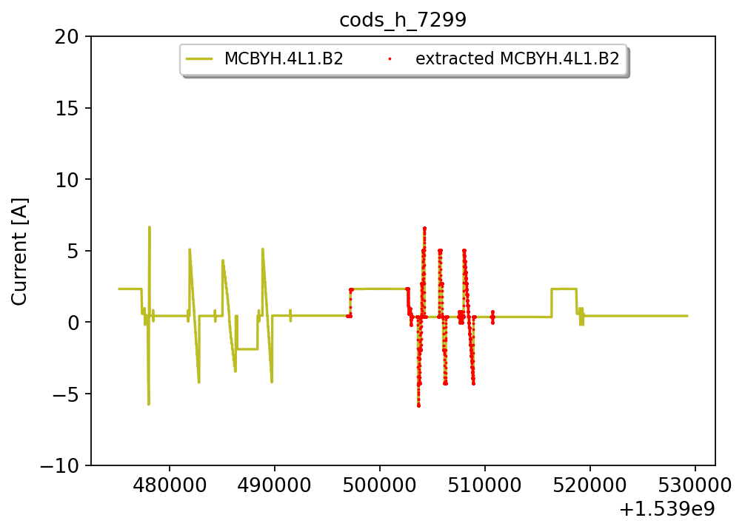
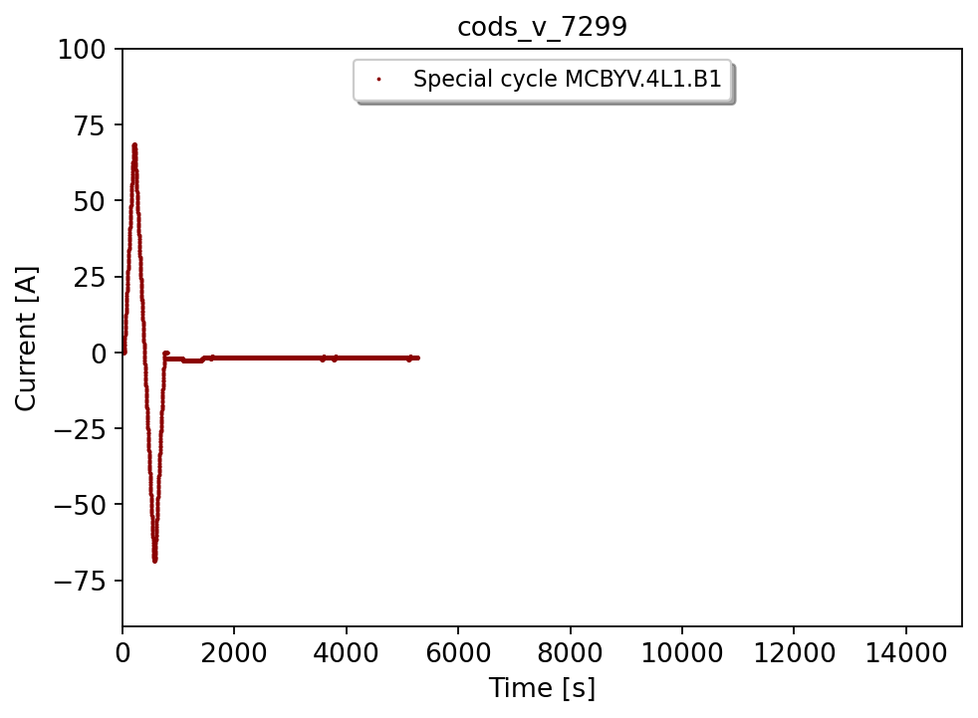
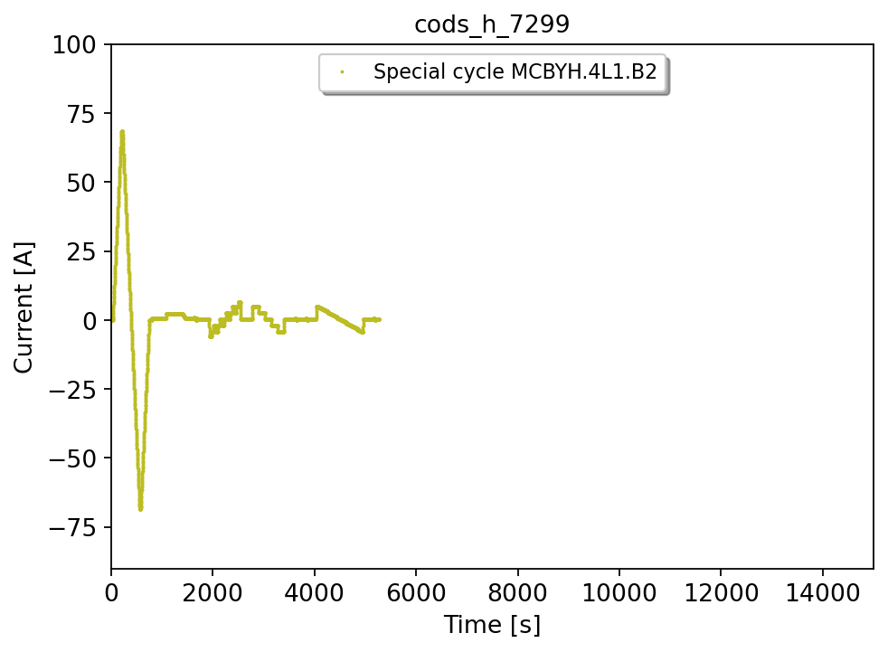
Special test cycle 3: MCBYV.4L1.B1 / MCBYH.4L1.B2 (fill 7300)
+ precycle added
+ precycle added

Slide 15
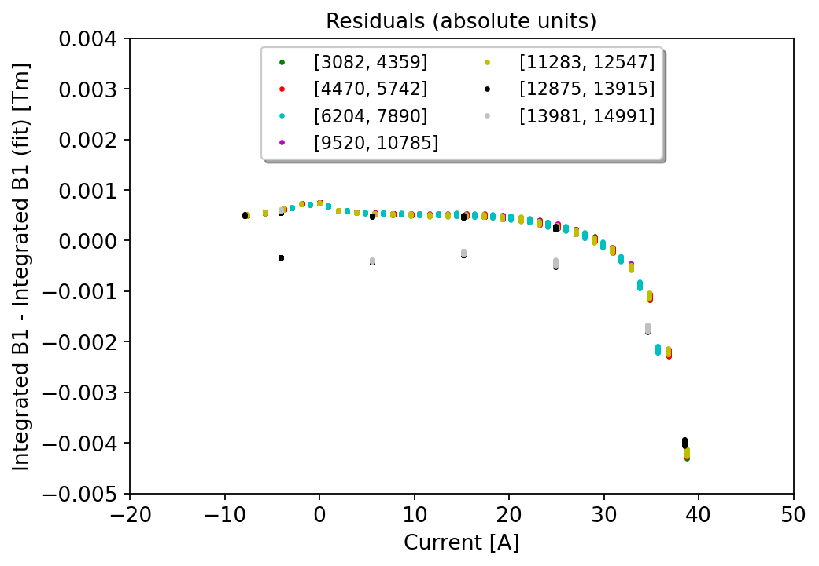
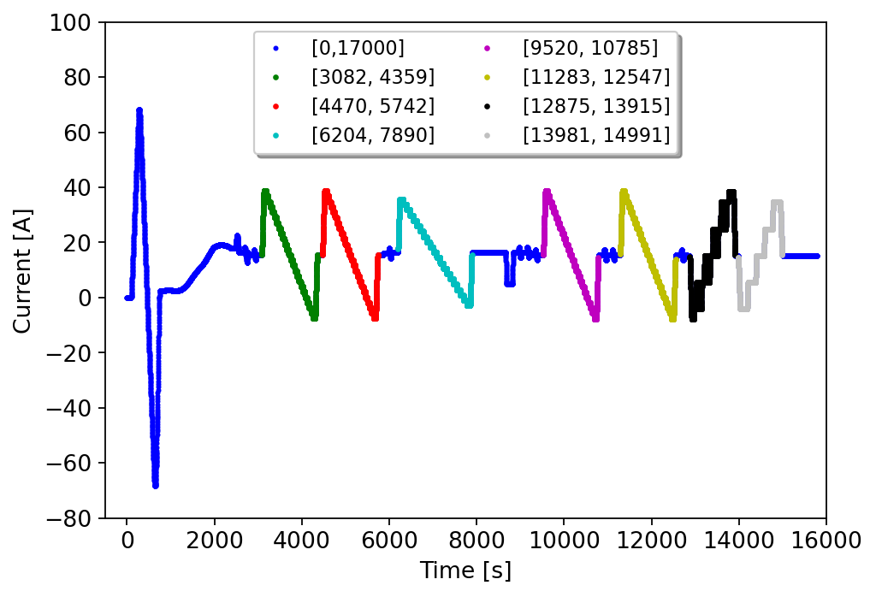
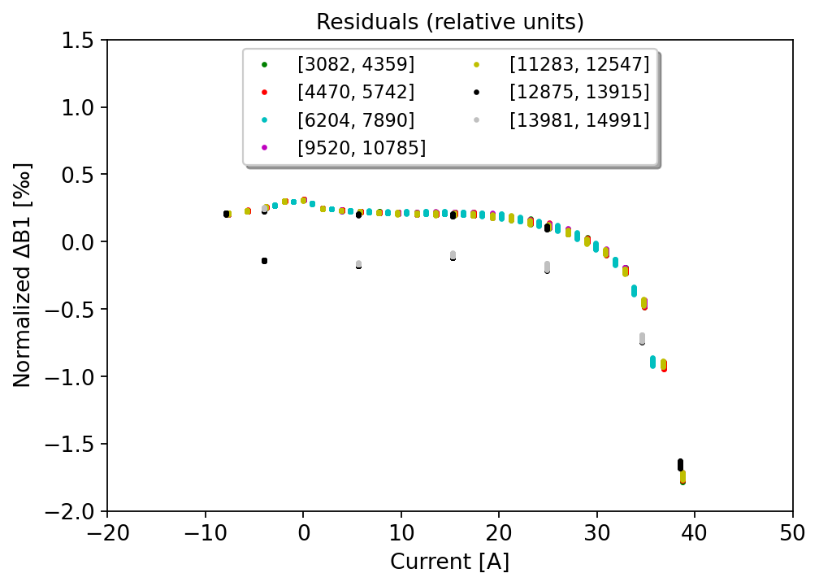


Special cycle 1
$$∆_{a}^{ } =0.00508 Tm$$
$$∆_{r}^{ } =2.11 \text{‰}$$
“Standard” vdM scans: 1,2,4,5
Other scans: 3,6,7
A non-linearity due to the change of magnetization branch is observed.
The maximum width is ∼5 mTm (2.1$1\text{‰}$).

Slide 16
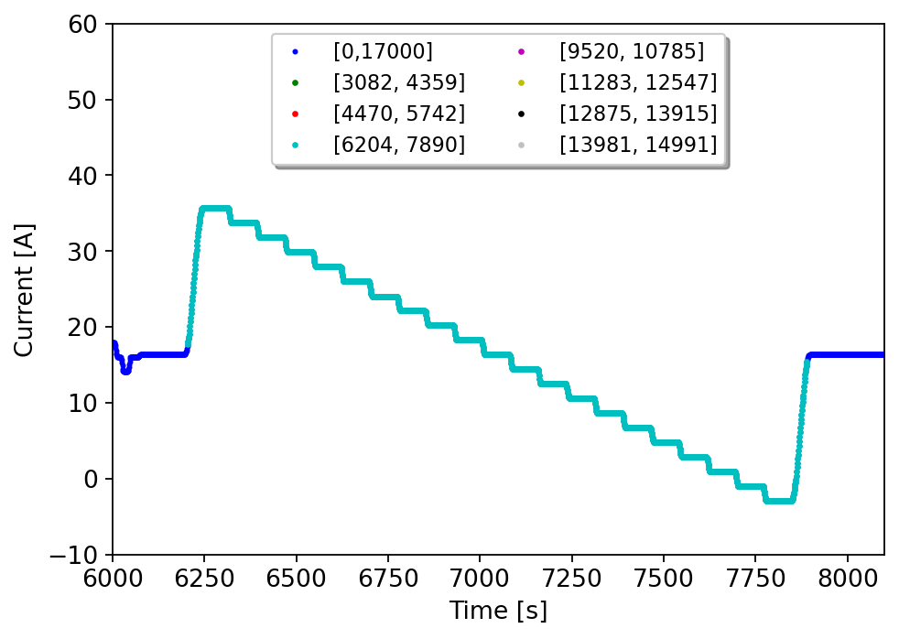
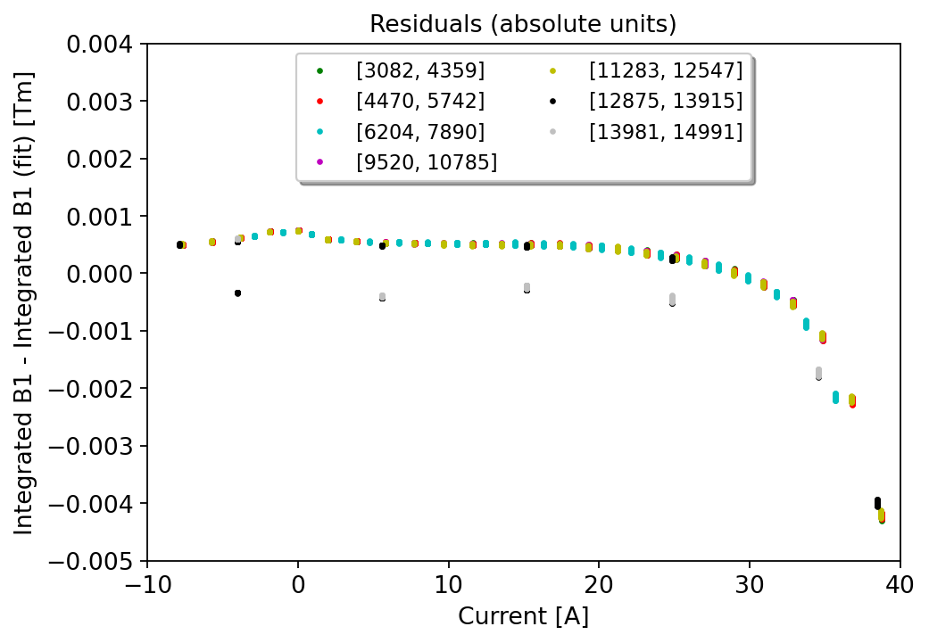
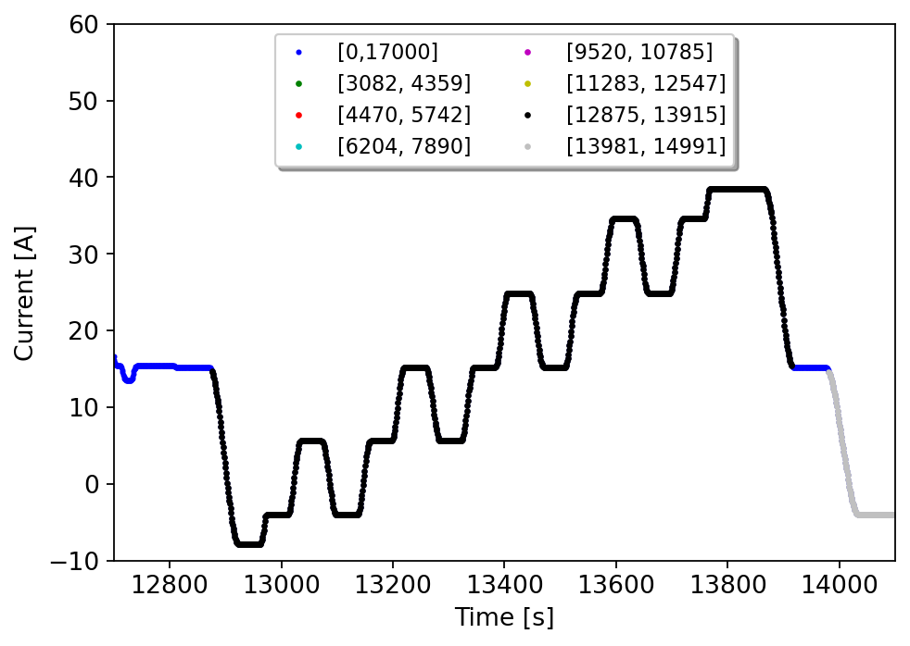
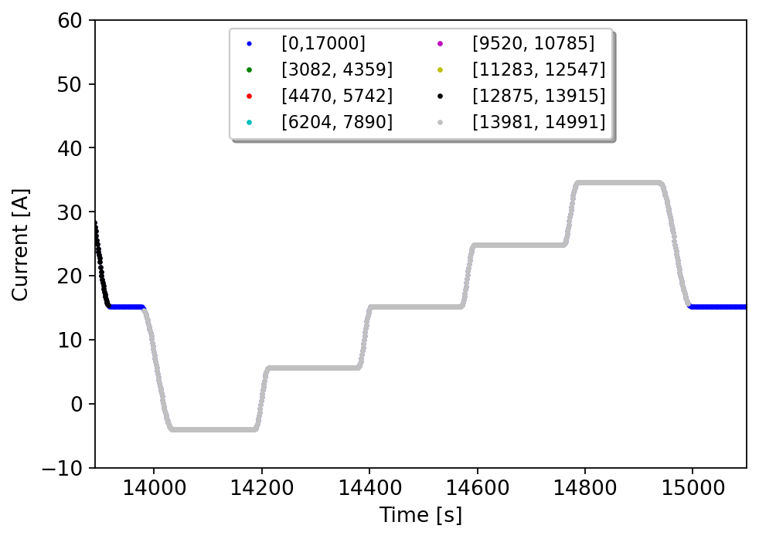
Special cycle 1
Scans 3,6,7:
“Standard” vdM scans: a transition from the lower magnetization branch to the upper magnetization branch is observed (current ramp down).
Scan 3: the residuals follow the same path as “standard” vdM scans, except above 30A.
Scan 6: entire “minor magnetization loop” is scoped due to current ramp ups/ramp downs.
Scan 7: a transition from upper magnetization branch to the lower magnetization branch is observed (ramp up of the current).

Slide 17
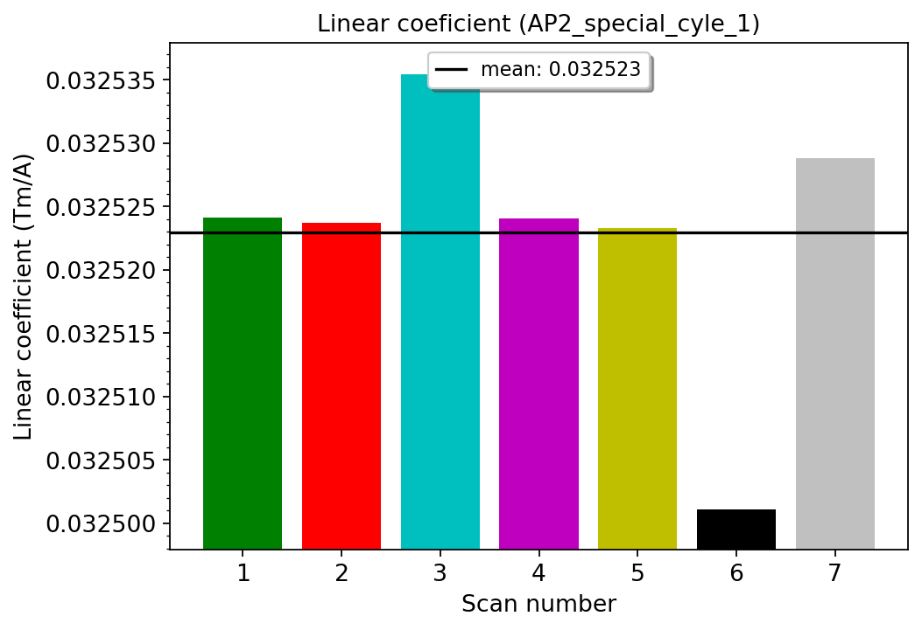
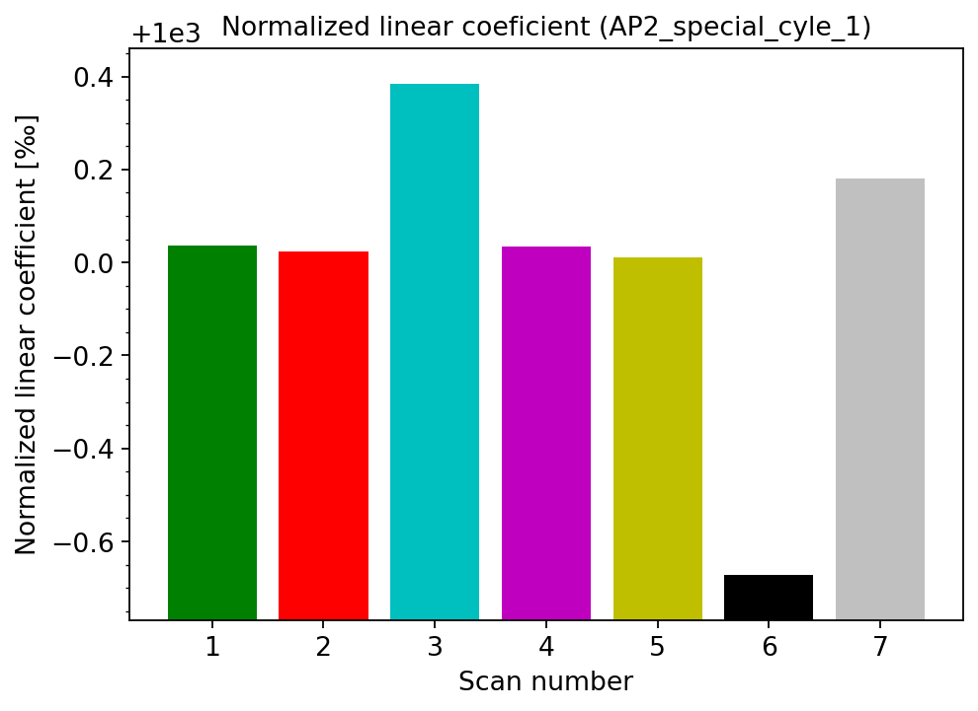
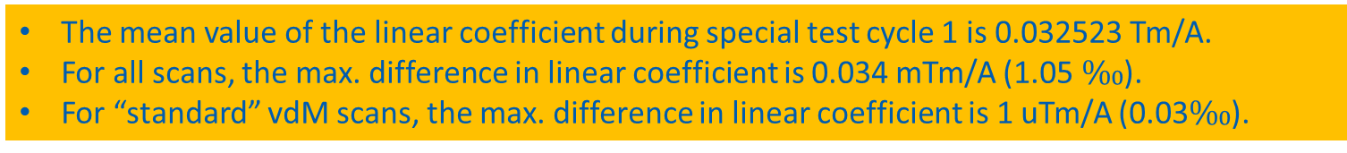
Special cycle 1: reproducibility of the linear coefficient
The mean value of the linear coefficient during special test cycle 1 is 0.032523 Tm/A.
For all scans, the max. difference in linear coefficient is 0.034 mTm/A (1.05 $\text{‰}$).
For “standard” vdM scans, the max. difference in linear coefficient is 1 uTm/A (0.03$\text{‰}$).

Slide 18
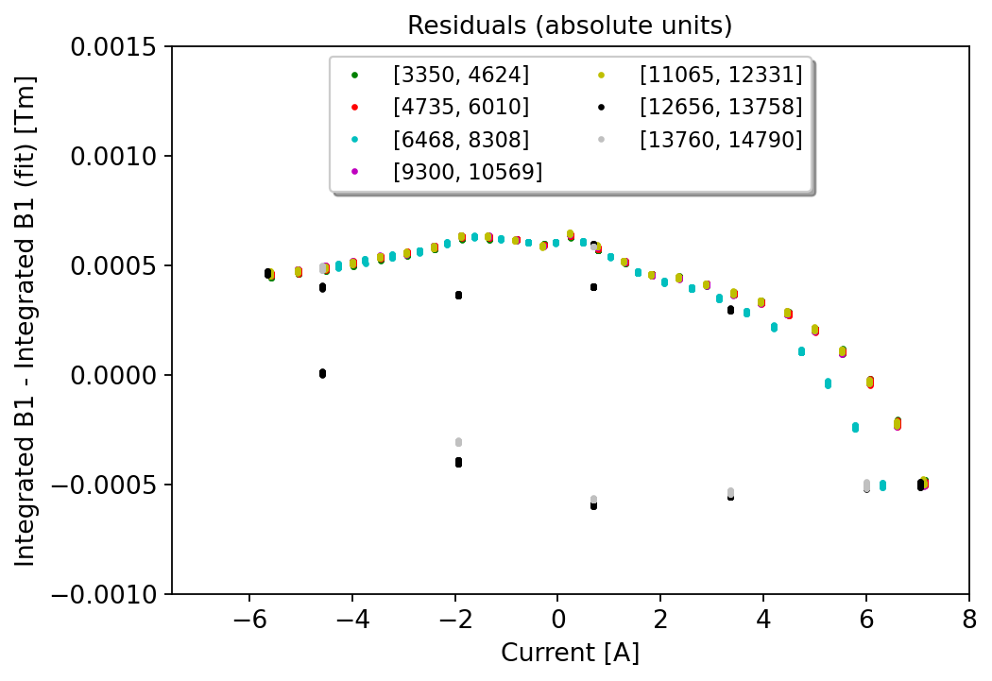
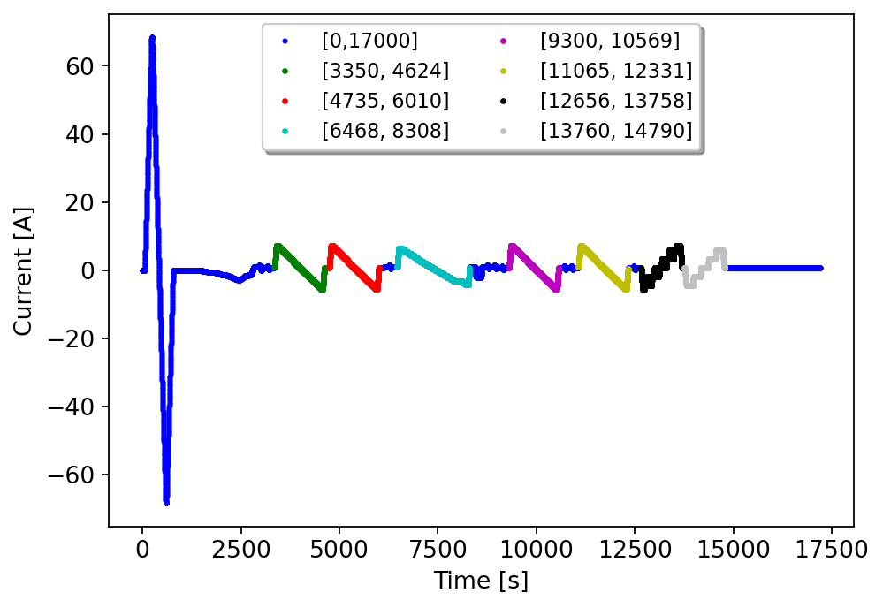
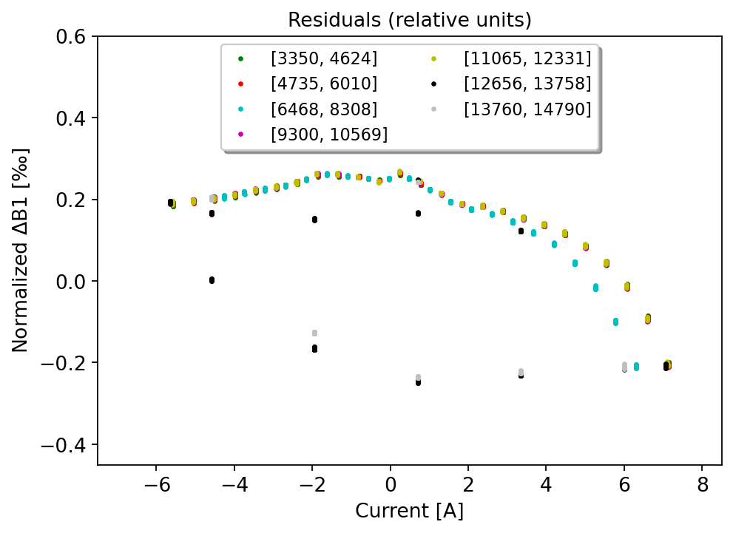


Special cycle 2
$$∆_{a}^{ } =0.00122 Tm$$
$$∆_{r}^{ } =0.51 \text{‰}$$
“Standard” vdM scans: 1,2,4,5
Other scans: 3,6,7
A non-linearity due to the change of magnetization branch is observed.
The maximum width is ∼1 mTm (0.5$1\text{‰}$).

Slide 19
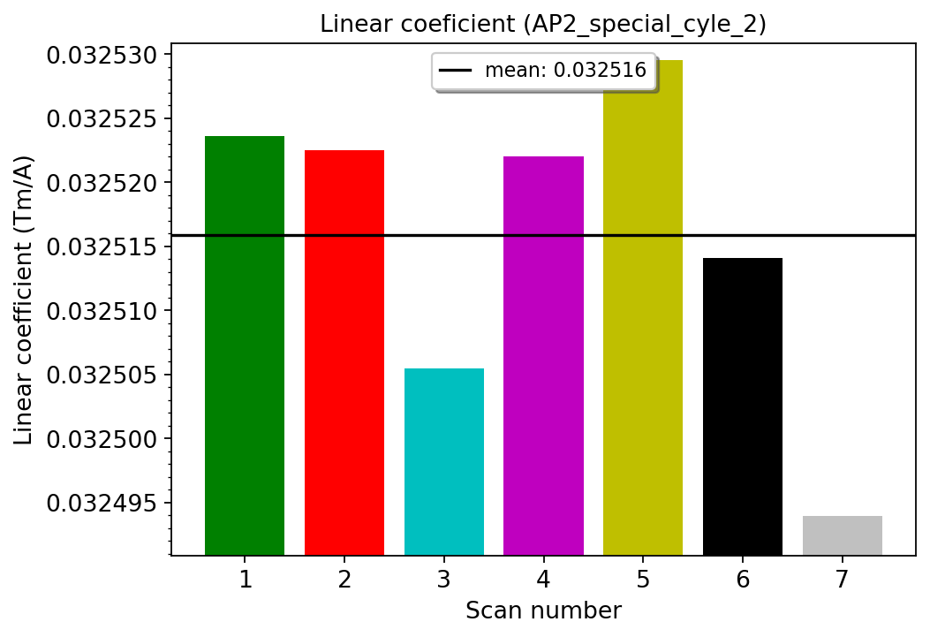
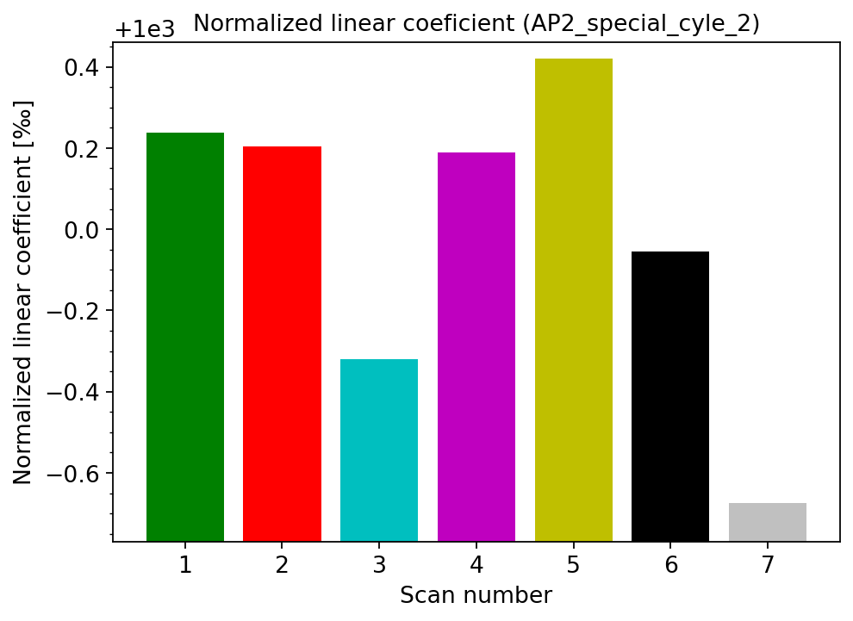
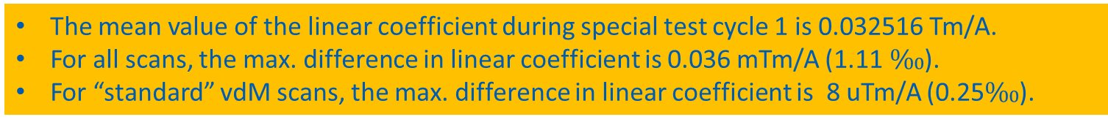
Special cycle 2: reproducibility of the linear coefficient
The mean value of the linear coefficient during special test cycle 1 is 0.032516 Tm/A.
For all scans, the max. difference in linear coefficient is 0.036 mTm/A (1.11 $\text{‰}$).
For “standard” vdM scans, the max. difference in linear coefficient is 8 uTm/A (0.25$\text{‰}$).

Slide 20
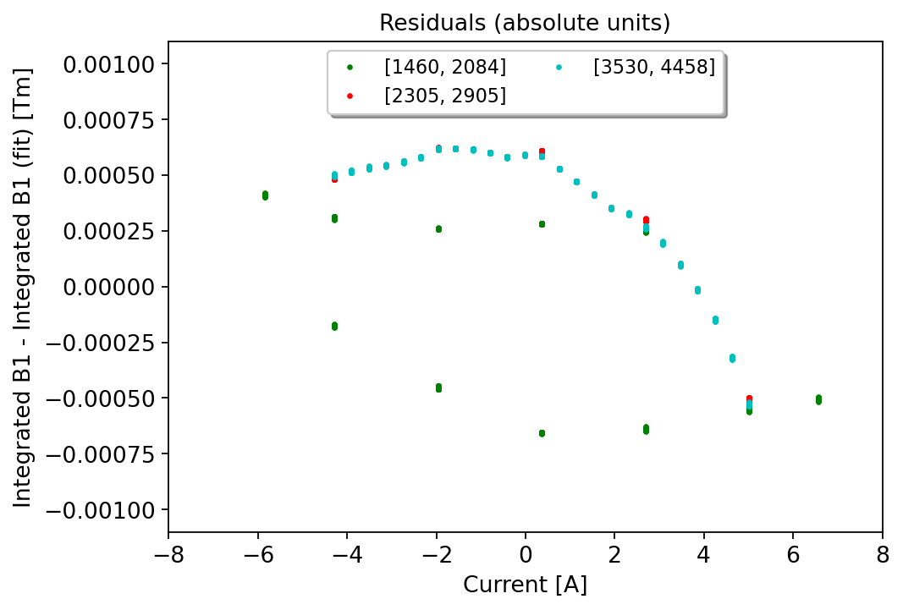
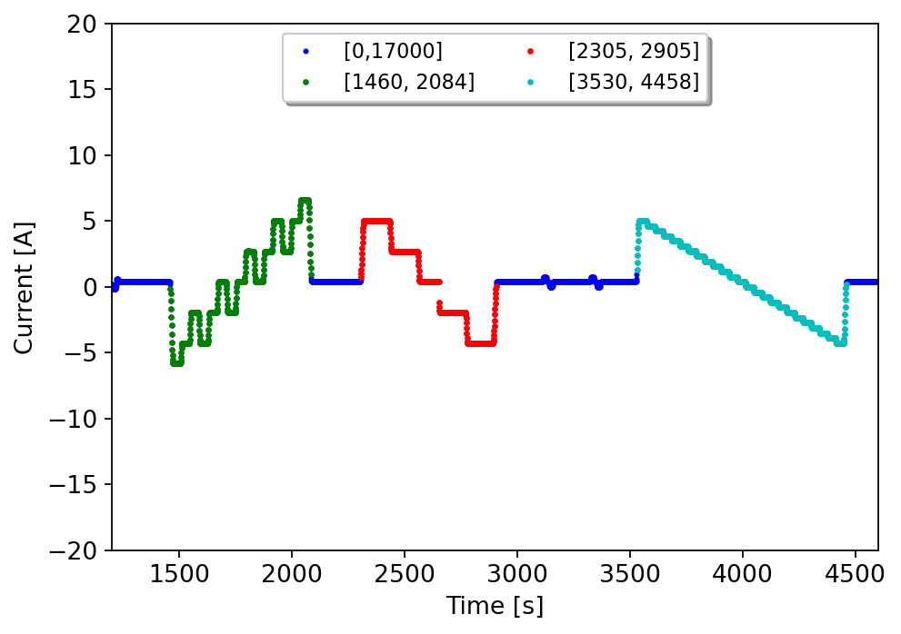
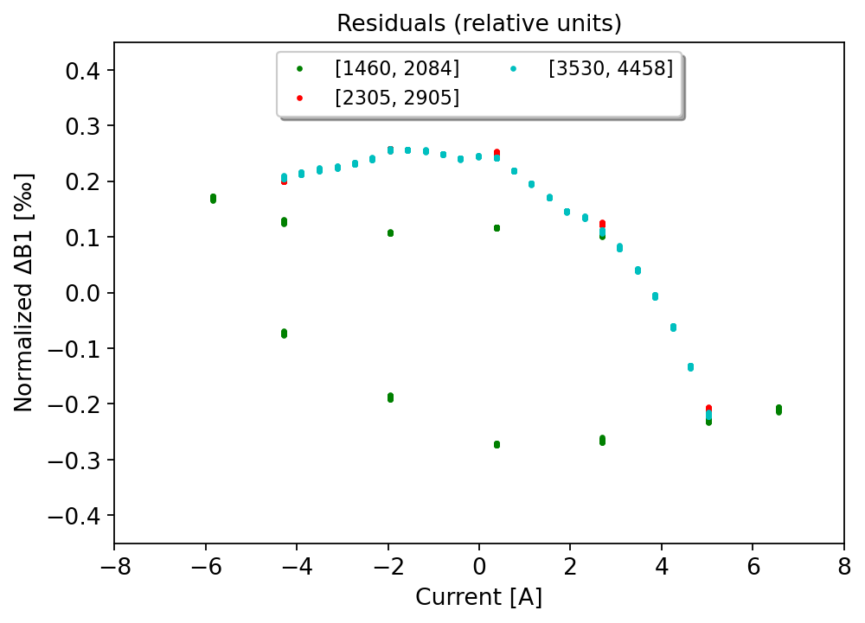


Special cycle 3
$$∆_{a}^{ } =0.00128 Tm$$
Non-standard scans: 1,2,3
$$∆_{r}^{ } =0.53 \text{‰}$$
A non-linearity due to the change of magnetization branch is observed.
The maximum width is ∼1 mTm (0.5$3\text{‰}$).

Slide 21
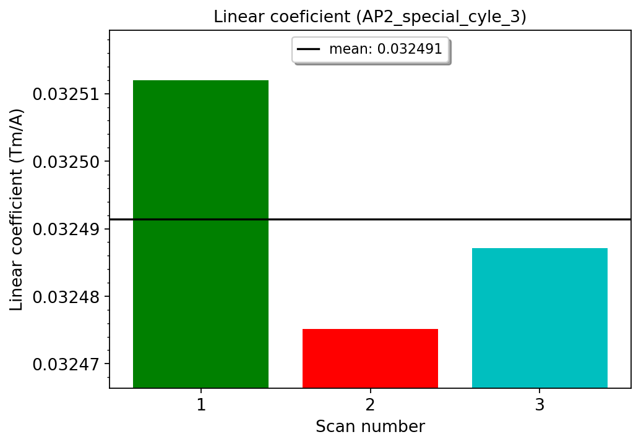
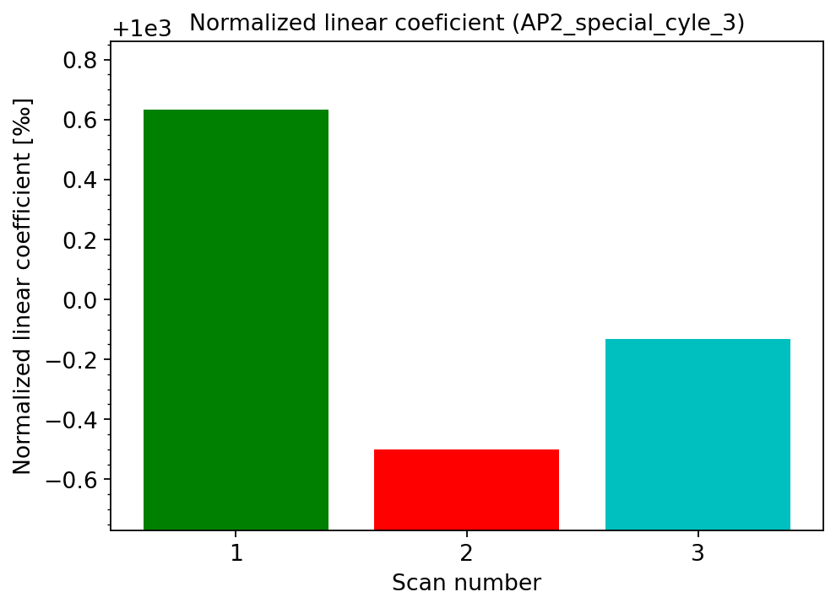
Special cycle 3: reproducibility of the linear coefficient
The mean value of the linear coefficient during special test cycle 1 is 0.032491 Tm/A.
For all scans, the max. difference in linear coefficient is 0.037 mTm/A (1.14 $\text{‰}$).

Slide 22
Comparison between standard and special
test cycles

Slide 23
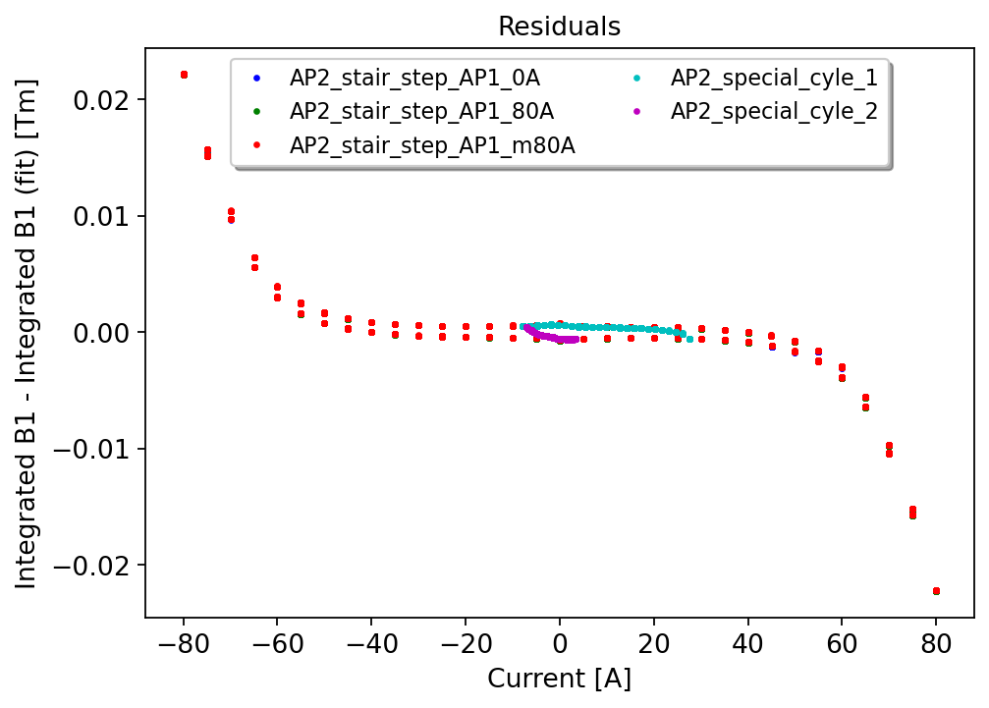
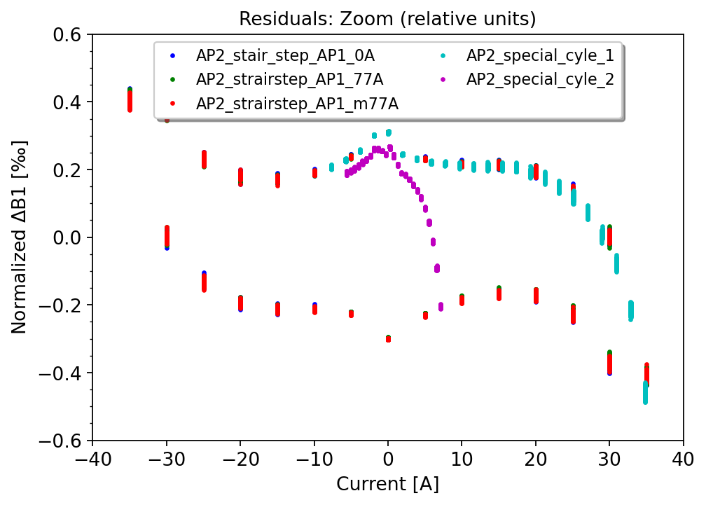
Comparison: special cycles 1&2
The maximum width of non-linearity during vdM scans is always within the full hysteresis width obtained by ramping up/down to nominal level (“major magnetization loop”).
The transition from one branch to the other for the vdM scans occurs faster for low amplitude cycles (“minor magnetization loops”).

Slide 24
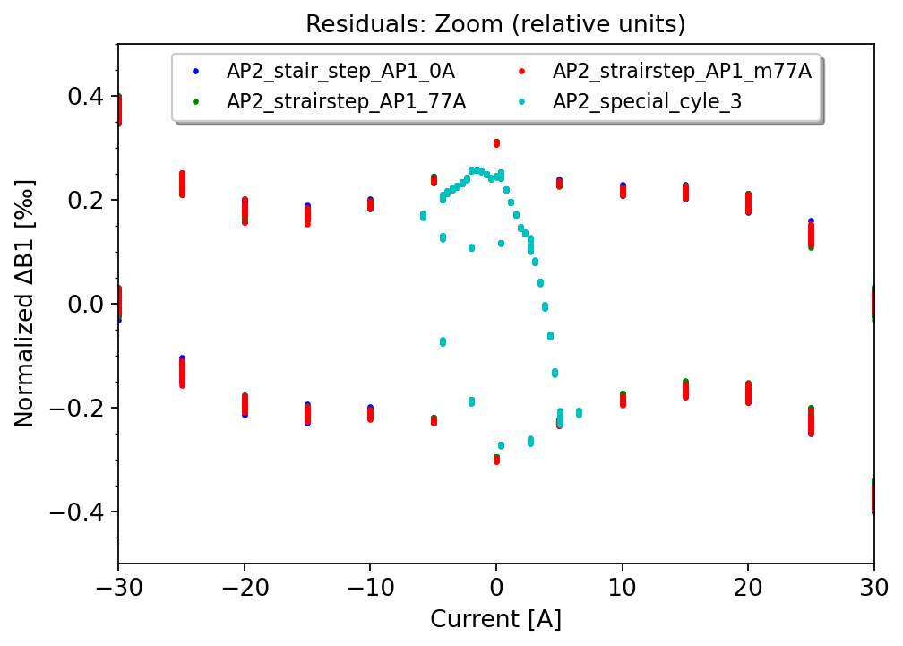
Comparison: special cycle 3
The max. width of non-linearity during non-standard scans is always within the full hysteresis width obtained by ramping up/down to nominal level (“major magnetization loop”).
The transition from one branch to the other during scans is the main source of non-linearity (“minor magnetization loops”).

Slide 25
FiDeL model

Slide 26



Mathematical description
Static components [5]:
Geometric:
DC magnetization:
Saturation:
4. Residual magnetization:
$$B_{m}^{Geometric}= γ_{m}^{Geometric}I,$$
$B_{m}^{DC_Magnetization}= μ_{m}^{ }\left|I\right|{\left(\frac{I_{inj}}{\left|I\right|}\right)}^{2−p_{m}}{\left(\frac{I_{c}−\left|I\right|}{I_{c}−I_{inj}}\right)}^{q_{m}}$ ${\left(\frac{{T_{c0}}^{1.7}−{T_{ }}^{1.7}}{{T_{c0}}^{1.7}−{T_{meas}}^{1.7}}\right)}^{h_{m}},$
$B_{m}^{Saturation}= \sum_{i=1}^{N}{σ_{m}^{i}}IΣ\left(I, S_{m}^{i},I_{0m}^{i},I_{nom}\right),$
$Σ\left(I, S_{ }^{i},I_{0}^{i},I_{nom}\right)=−\frac{1}{2}\left[1+\operatorname{erf}\left(S\left(\frac{\left|I\right|−I_{0}}{I_{nom}}\right)\right)\right],\operatorname{erf}\left(x\right)=\frac{2}{\sqrt{π}}\int_{0}^{x}{e^{−t^{2}}dt,}$
where:
$B_{m}^{Residual}= ρ_{m}^{ }\left|I\right|{\left(\frac{I_{inj}}{\left|I\right|}\right)}^{r_{m}}$.
The fitting coefficients are used for the operation.
Note: this notation will be used throughout these slides.

Slide 27
MCBY hysteresis

Slide 28



The original fit from 2009 (1)
The measurement campaign of MCBY correctors took place in 2009 (at 1.9K) [6],
The original fit obtained using the FiDeL formalism includes only the two main contributions: (1) geometric and (3) saturation:
+
=

Slide 29




The original fit from 2009 (2)
Parameter | Value for B1/TF Original fit from 2009
$$y$$ | 0.03260
$$σ^{1}$$ | 0.00213
$$S^{1}$$ | 3.19
$$I_{0}^{1}$$ | 70.66
$$σ^{2}$$ | 0
$$S^{2}$$ | 0
$$I_{0}^{2}$$ | 0
$${\left[1\right]: B}_{m}^{Geometric}= γ_{m}^{Geometric}I,$$
${\left[3\right]: B}_{m}^{Saturation}= \sum_{i=1}^{N}{σ_{m}^{i}}IΣ\left(I, S_{m}^{i},I_{0m}^{i},I_{nom}\right),$ $Σ\left(I, S_{ }^{i},I_{0}^{i},I_{nom}\right)=−\frac{1}{2}\left[1+\operatorname{erf}\left(S\left(\frac{\left|I\right|−I_{0}}{I_{nom}}\right)\right)\right], \operatorname{erf}\left(x\right)=\frac{2}{\sqrt{π}}\int_{0}^{x}{e^{−t^{2}}dt.}$\

Slide 30


Relative error
Relative error definition:
$∆_{r}=\frac{Measured B \left[Tm\right]−Model \left[1,2,3,4\right][Tm]}{Nominal integrated field \left[Tm\right]}$ $∙{10}^{2}$
The original fit is accurate within +/- 0.16%,
The discrepancy is mainly due to the saturation at high field,
The magnetization is within +/- 0.03% at low field.

Slide 31




Improved fit: approach 1
Geometric Contribution (FiDeL),
DC Magnetization Contribution (FiDeL).
Saturation Contribution (FiDeL),
Parameter | Value for B1/TF Improved fit
$$y$$ | 0.03258
$$u$$ | 0.00009
$$p$$ | 0.96
$$q$$ | 1.99
$$h$$ | 2.00
$$σ^{1}$$ | 0.00129
$$S^{1}$$ | 3.61
$$I_{0}^{1}$$ | 69.47
$$σ^{2}$$ | 0.00036
$$S^{2}$$ | 6.92
$$I_{0}^{2}$$ | 45.71
$${\left[1\right]: B}_{m}^{Geometric}= γ_{m}^{Geometric}I,$$
${\left[2\right]: B}_{m}^{DC_Magnetization}= μ_{m}^{ }\left|I\right|{\left(\frac{I_{inj}}{\left|I\right|}\right)}^{2−p_{m}}{\left(\frac{I_{c}−\left|I\right|}{I_{c}−I_{inj}}\right)}^{q_{m}}$ ${\left(\frac{{T_{c0}}^{1.7}−{T_{ }}^{1.7}}{{T_{c0}}^{1.7}−{T_{meas}}^{1.7}}\right)}^{h_{m}},$
${\left[3\right]: B}_{m}^{Saturation}= \sum_{i=1}^{N}{σ_{m}^{i}}IΣ\left(I, S_{m}^{i},I_{0m}^{i},I_{nom}\right),$ $Σ\left(I, S_{ }^{i},I_{0}^{i},I_{nom}\right)=−\frac{1}{2}\left[1+\operatorname{erf}\left(S\left(\frac{\left|I\right|−I_{0}}{I_{nom}}\right)\right)\right].$

Slide 32

Improved fit: approach 1
The hysteresis of MCBC magnets can be modelled using static components from FiDeL,
The improved fit (more complex) is accurate within +/-0.05%: the highest discrepancy is due to saturation,
The magnetization is within +/-0.009%.

Slide 33






Improved fit: approach 2
Geometric Contribution (FiDeL),
Saturation Contribution (FiDeL),
DC Magnetization Contribution (alternative model from E. Todesco).
Parameter | Value for B1/TF Improved fit
$$y$$ | 0.03258
$$σ^{1}$$ | 0.00129
$$S^{1}$$ | 3.61
$$I_{0}^{1}$$ | 69.47
$$σ^{2}$$ | 0.00036
$$S^{2}$$ | 6.92
$$I_{0}^{2}$$ | 45.71
$$a$$ | 0.00042
$$b$$ | 0.00174
$$c$$ | 3.93
$${\left[1\right]: B}_{m}^{Geometric}= γ_{m}^{Geometric}I,$$
${\left[3\right]: B}_{m}^{Saturation}= \sum_{i=1}^{N}{σ_{m}^{i}}IΣ\left(I, S_{m}^{i},I_{0m}^{i},I_{nom}\right),$ $Σ\left(I, S_{ }^{i},I_{0}^{i},I_{nom}\right)=−\frac{1}{2}\left[1+\operatorname{erf}\left(S\left(\frac{\left|I\right|−I_{0}}{I_{nom}}\right)\right)\right],$
$${\left[5\right]: B}_{m}^{DC_Magnetization}=−\operatorname{sgn}\left(\frac{dI}{dt}\right)\left(a+\frac{b}{I+c}\right)L for I>0,$$
$${ B}_{m}^{DC_Magnetization}=−\operatorname{sgn}\left(\frac{dI}{dt}\right)\left(a−\frac{b}{I−c}\right)L for I<0, where L=0.9.$$

Slide 34

Improved fit: approach 2
The hysteresis of MCBC magnets can also be modelled using geometric (1) and saturation (3) term from FiDeL and DC magnetization model from E. Todesco (5),
The new fit is accurate within +/-0.05% (the highest discrepancy is due to saturation),
The magnetization is within +/-0.005%.

Slide 35

Fitting parameters (1)
Parameter | Value for B1/TF Improved fit | Value for B1/TF Original fit from 2009 | Component
$$y$$ | 0.03258 | 0.03260 | Geometric
$$u$$ | 0.00009 | 0 | DC Magnetization (FiDeL)*
$$p$$ | 0.96 | 0
$$q$$ | 1.99 | 0
$$h$$ | 2.00 | 0
$$σ^{1}$$ | 0.00129 | 0.00213 | Saturation
$$S^{1}$$ | 3.61 | 3.19
$$I_{0}^{1}$$ | 69.47 | 70.66
$$σ^{2}$$ | 0.00036 | 0
$$S^{2}$$ | 6.92 | 0
$$I_{0}^{2}$$ | 45.71 | 0

Slide 36


Fitting parameters (2)
Parameter | Value for Bm/TF Improved fit | Value for Bm/TF Original fit from 2009 | Component
$$a$$ | 0.00042 | 0 | DC Magnetization (E. Todesco)
$$b$$ | 0.00174 | 0
$$c$$ | 3.93 | 0
$$ρ_{ }^{ }$$ | 0 | 0 | Residual Magnetization
$$r$$ | 0 | 0
$$\left(∗\right) for improved fit:$$
$$I_{nom}^{ }=77A$$
$$I_{inj}^{ }=5A$$
$$I_{c}^{ }=15000A$$
$$T_{c0}^{ }=9.5K$$
$${T=T}_{meas}^{ }=4.5K$$

Slide 37

Summary (1)
Magnetic measurements have been carried out in order to characterize the hysteresis of MCBY magnets.
The hysteresis width at zero current, for standard test cycles up to nominal, is ±0.82 mTm (±0.34‰ of nominal).
The effect of cross-talk is negligible, as it yields a maximum change of the transfer function smaller than 0.01‰ of nominal.
The non-linearity swing during analyzed cycles occurs due to the change of the magnetization branch and it is:
5.08 $\text{mTm}$ (2.11‰) (special cycle 1)
1.22 mTm (0.51$\text{‰}$) (special cycle 2)
1.28 mTm (0.53$\text{‰}$) (special cycle 3).

Slide 38

Summary (2)
The reproducibility of the linear fit among vdM scans is below 0.0$3\text{‰}$ during special cycle 1 and below 0.25$\text{‰}$ during special cycle 2. For all cycles, the maximum difference in linear coefficient is 1.14$\text{‰}$ (during special cycle 3).
The maximum width of non-linearity during “standard” and “non-standard” scans is always within the full hysteresis width. However, a transition from up to down branch of magnetization requires attention.
The original FiDeL fit from 2009 is accurate within ±0.16% on the full range and ±0.03% at low field.
The original fit can be improved by a factor of ~3 by modifying the saturation component and by adding the DC magnetization contribution (adding complexity).

