Slide 1
USE OF MQM AND MQY AT LOW CURRENTS FOR TOTEM
CERN, 26th March 2021
E. Todesco
CERN, Geneva Switzerland

Slide 2
TOTEM SETTING
MQM

Slide 3
TOTEM SETTING
MQM at 200-220 A can have 0.5% variations (depending on precycle)

Slide 4
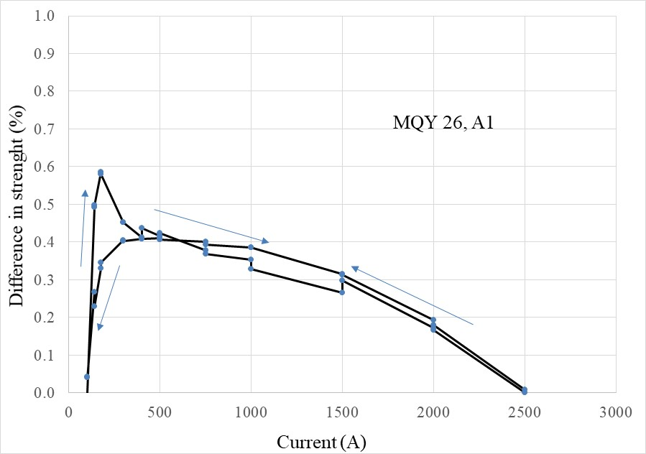
TOTEM SETTING
MQY

Slide 5
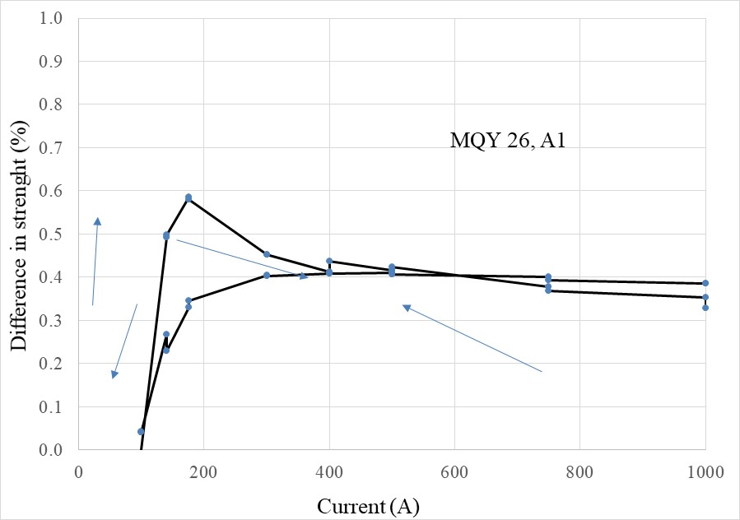
TOTEM SETTING
MQY: around 150-170 A one can have a 0.5 % error

Slide 6
TOTEM SETTING
MQY: around 150-170 A one can have a 0.5 % error

