Slide 1
MICE Computing and Software
Looking into the future
David Colling
Imperial College London

Slide 2
Outline
I have 30mins but very few slides.
This is because I want to leave time for discussion.
If there is no discussion we get to go to coffee early
In future CM I will give detailed technical talks, this is about the “shape of the plan”.
I am still learning about MICE

Slide 3
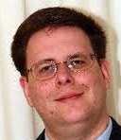
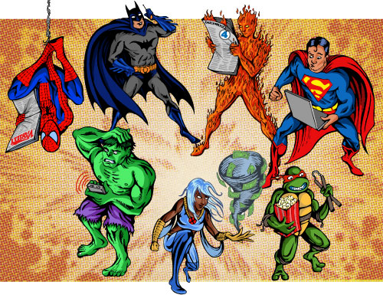

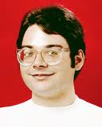
The story so far...
A vast amount of work has been done by a variety of people in the different areas.
MICE was never meant last a long time
This has been a time of superheroes...

Slide 4
What do you do when superheroes hang up their cloaks?
You resort to process and structure to enforce best practise
We need to:
  Have resilient working system – that copes with failure
  Safe data
  A system that can stand a superhero getting a huge teaching load, becoming a teacher or writing a best selling SciFi book...

Slide 5
The Process
We introduce coding standards
We introduce testing (code and system)
We introduce resilience wherever we can (VMs can help)
We introduce regular release cycle
We have code and service ownership
We need to keep what is good, improve what is less good, ditch what bad – and there is some bad and some known problems.

Slide 6
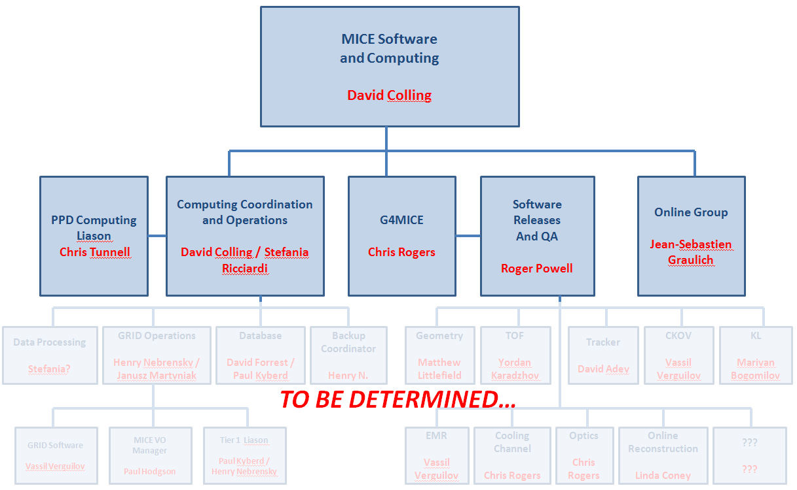
The New Structure
Production Manager
Detector expert
Job descriptions circulated soon!

Slide 7
So what now?
We have most of the new structure in place.
We are producing plans in the different areas
We think we know most of the problems/issues
We are losing key people
We need new people – so sign up now even if you are not a superhero
We have time but need to do a good job

