Slide 1
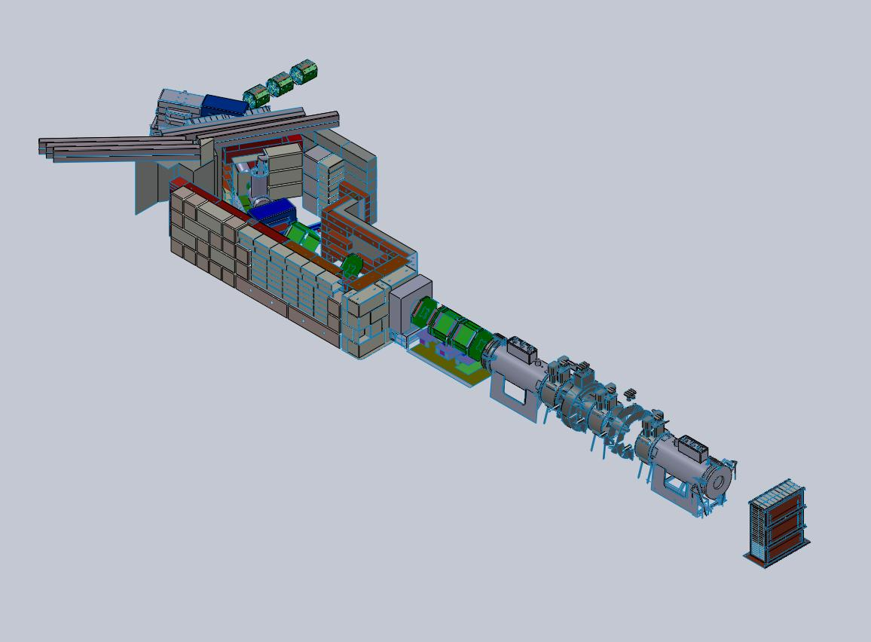



G4MICE Geometry
This presentation will describe the state of each element in the beam line with regards to the current update being undertaken.
Firstly, it will describe everything that has been done to each element to this date and also future improvements which will be made to each element.
Secondly, the simulation as a whole will be discussed with regards to the x, y and z positions of all the elements relative to the MICE Centre and future work needed to update this.
CM 28 Sofia
M. Littlefield

Slide 2
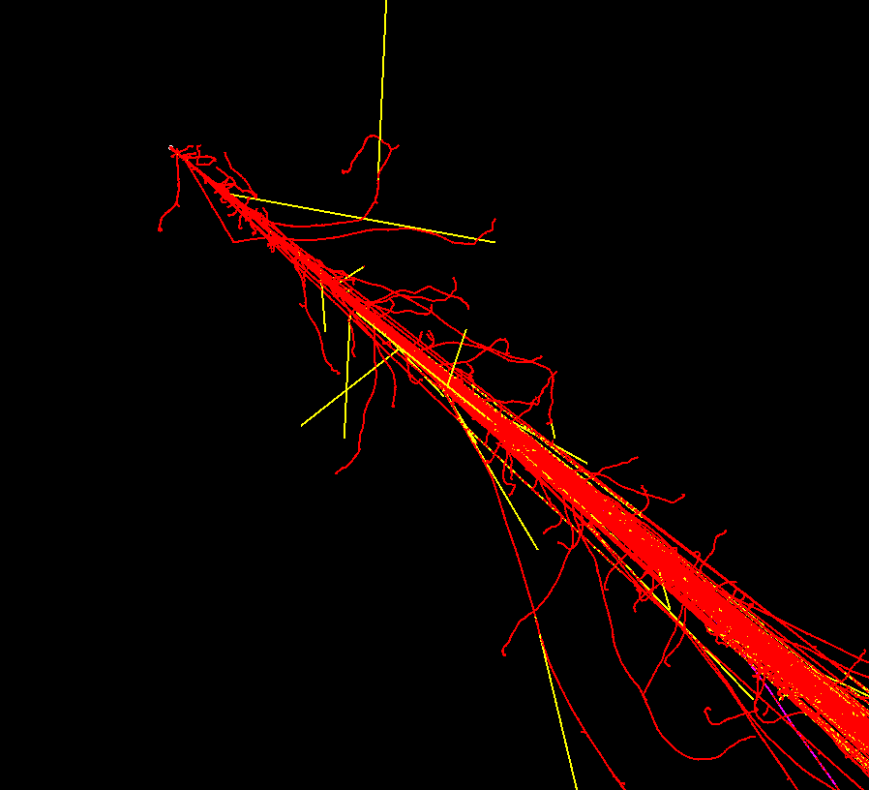
Beam Production
Current State:
The beam is currently being modelled as a multivariate Gaussian beam of pions
Future Work:
We would like to implement a G4BL style parameterised beam line which;
Tracks secondaries of all flavours from target
Fills Q1 aperture
Has a user defined momentum distribution
This needs new code
CM 28 Sofia
M. Littlefield

Slide 3
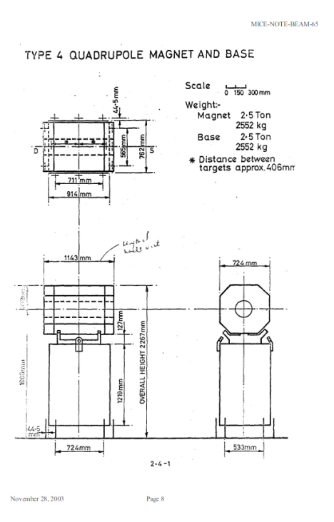
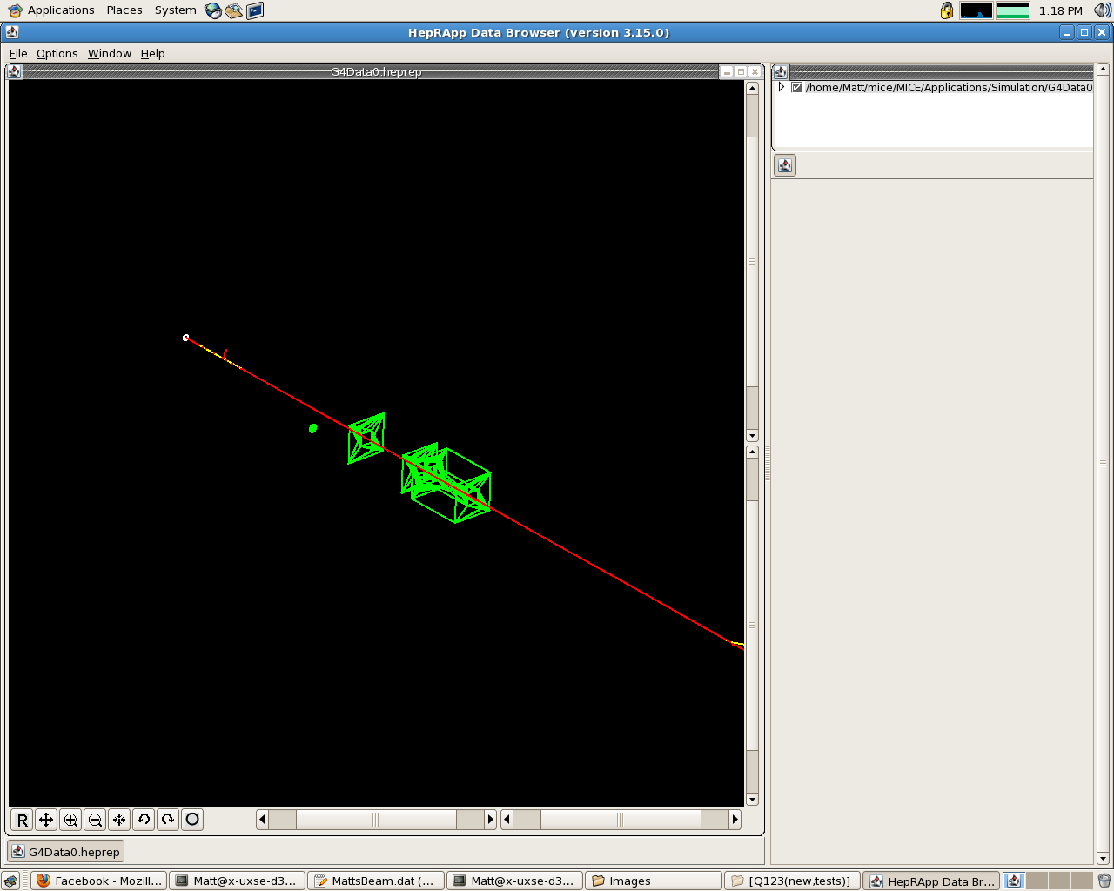
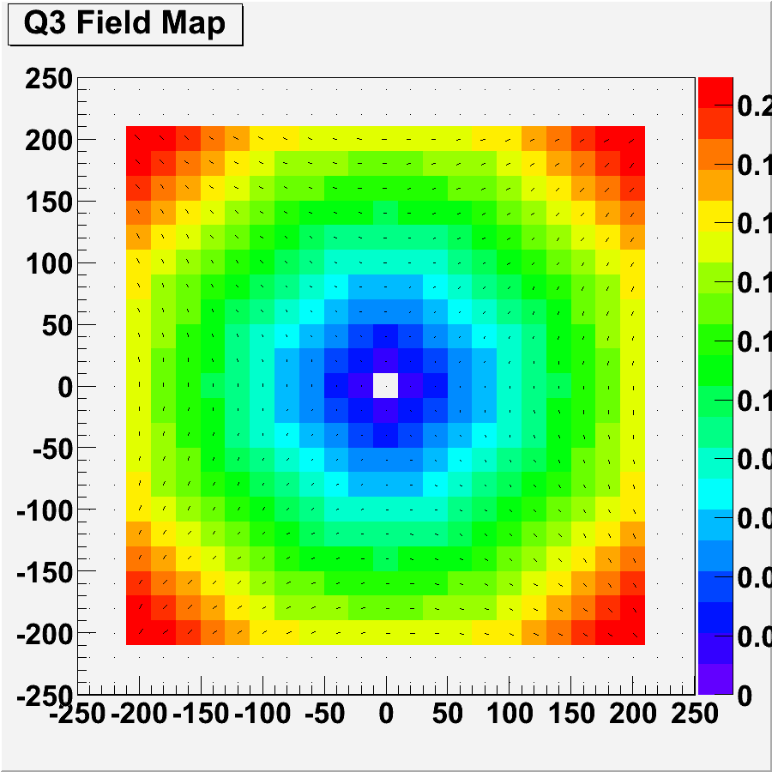
Q123
Current State:
Quads dimension have been changed according to MICE-Note Beam 65 (will be improved further)
The field maps of the quads have been improved to match opera field maps
Future Work:
Minor changes to the field maps could be implemented due to the irregular shape of the aperture
This however is low priority as the field map and G4MICE model is very good
Left: Technical Drawings from Note 65
Right: Old version of G4MICE model
Furthest Right: Field map
Y position (cm)
Magnetic Field (Tesla)
X position (cm)
CM 28 Sofia
M. Littlefield

Slide 4
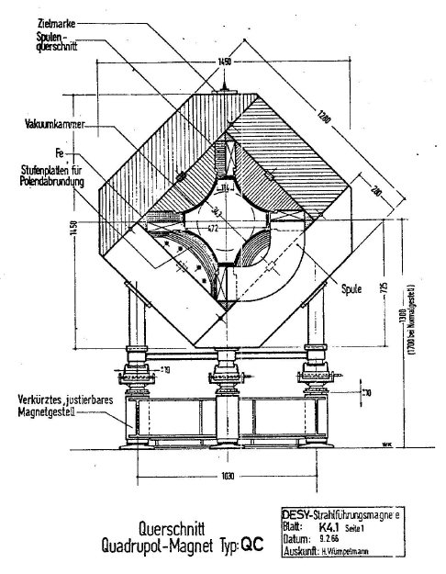
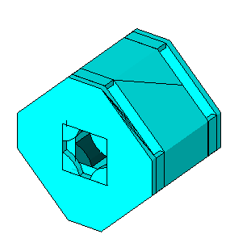
Q456/789
The other quads in the beam line are in the same state as Q123
G4MICE model
Technical Drawing taken from Note 65
CM 28 Sofia
M. Littlefield

Slide 5
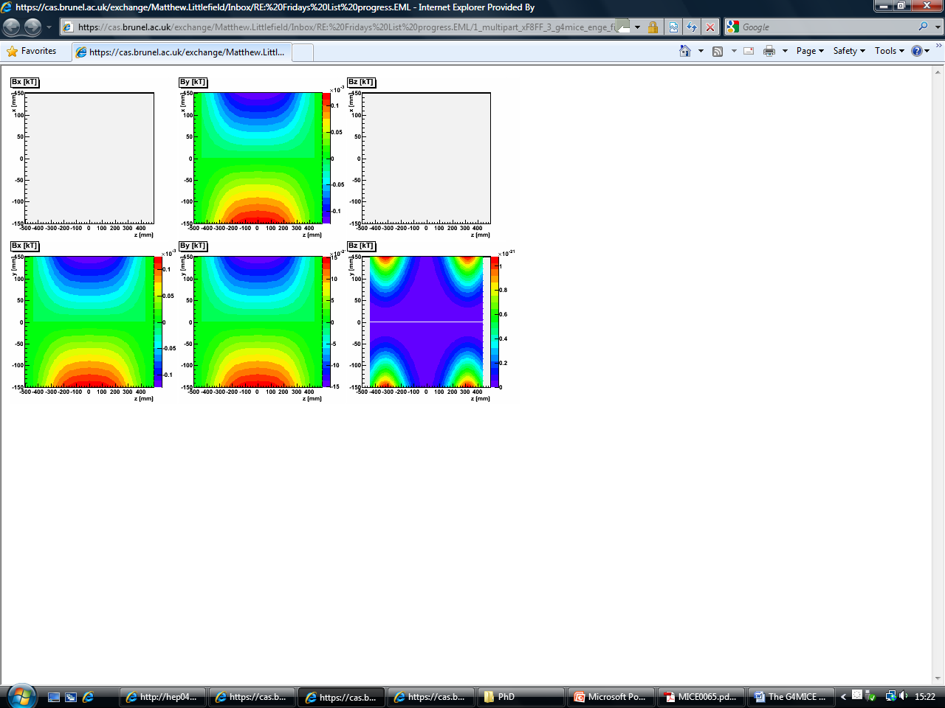
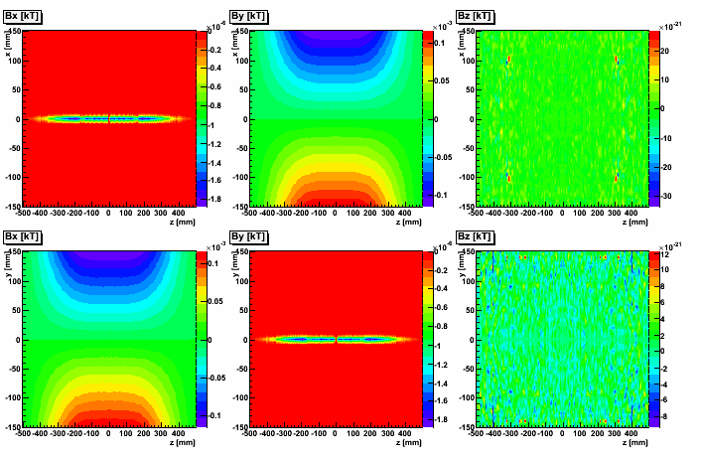
Q456/789 Field Maps
Field map taken from G4MICE
Field map taken from Opera
Images from Chris Rogers
CM 28 Sofia
M. Littlefield

Slide 6
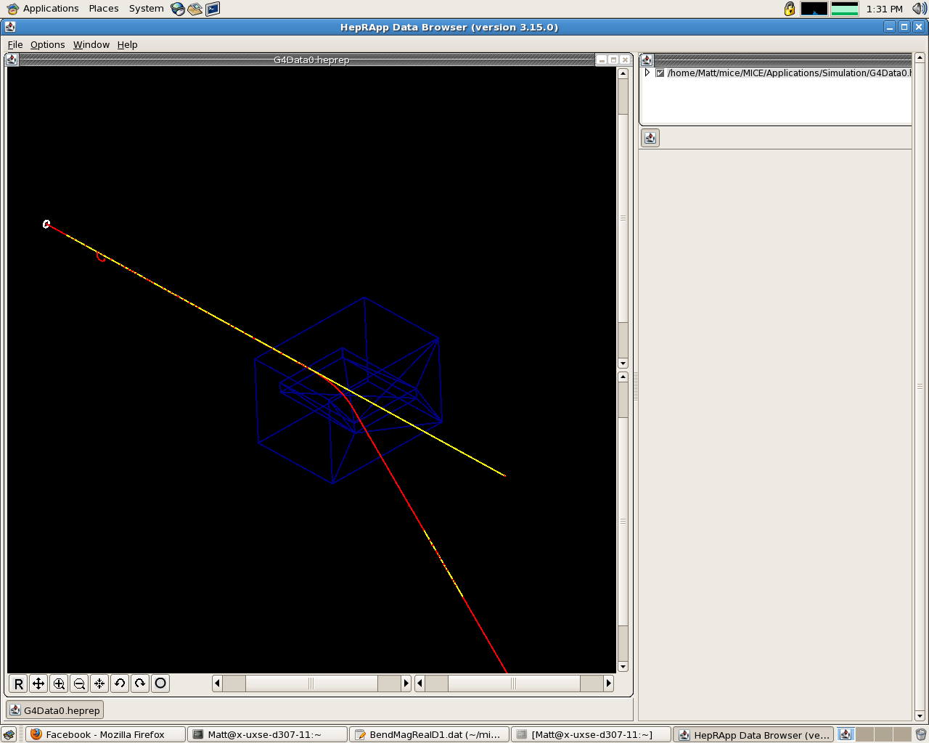
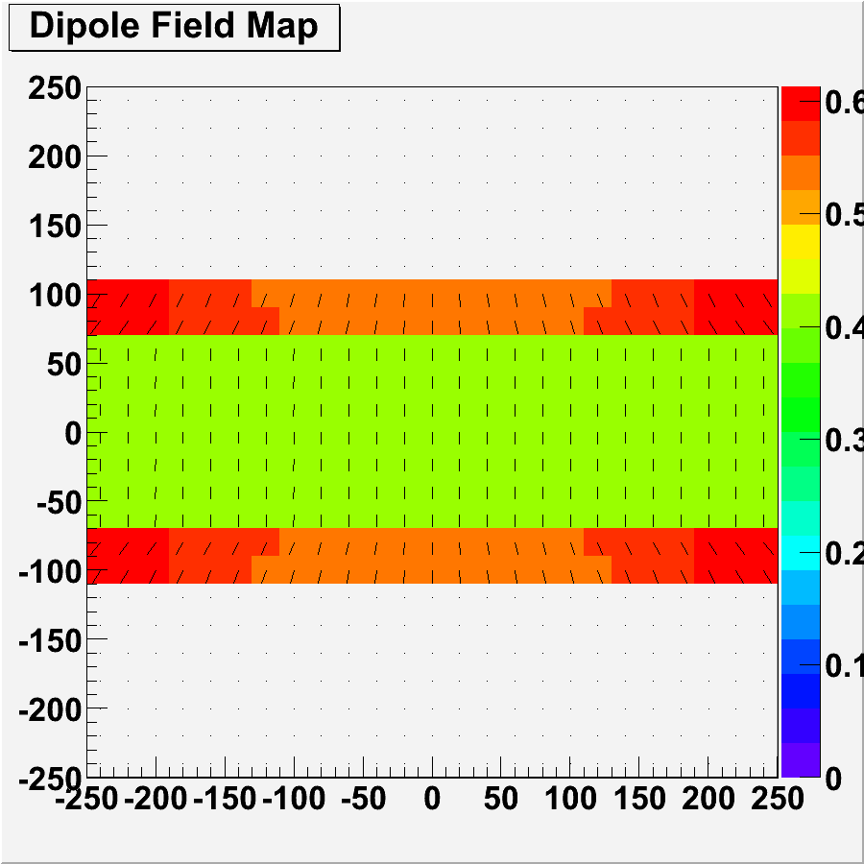
D1/2
Current State:
Dimensions have been changed to match information in MICE Note Beam65
Field maps have been updated via reading in a text file of the field taken from G4BL
Y position (cm)
Magnetic Field (Tesla)
Model of D1/2
X position (cm)
Field map taken from G4MICE
Future Work:
All of the improvements made will be verified.
CM 28 Sofia
M. Littlefield

Slide 7
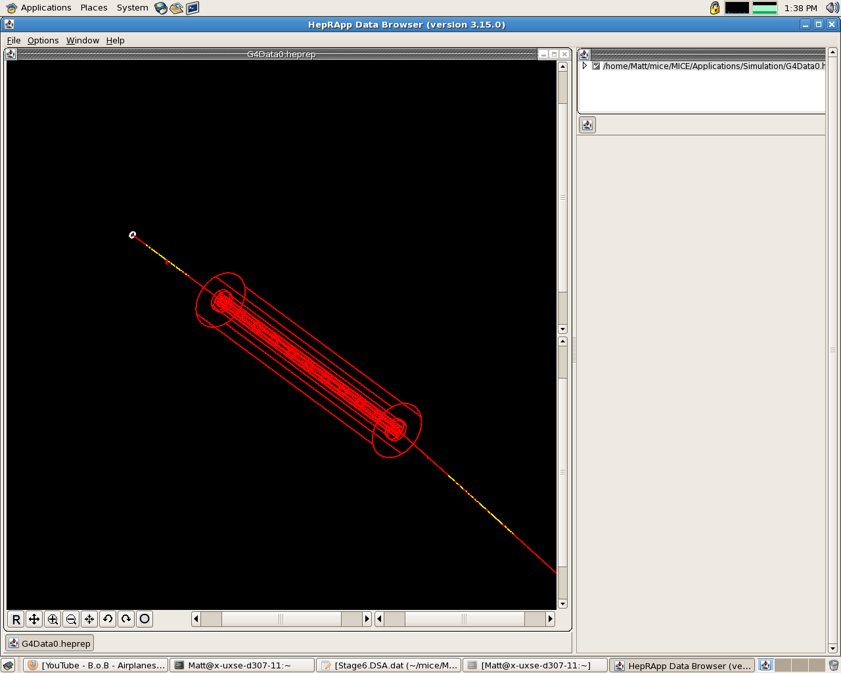
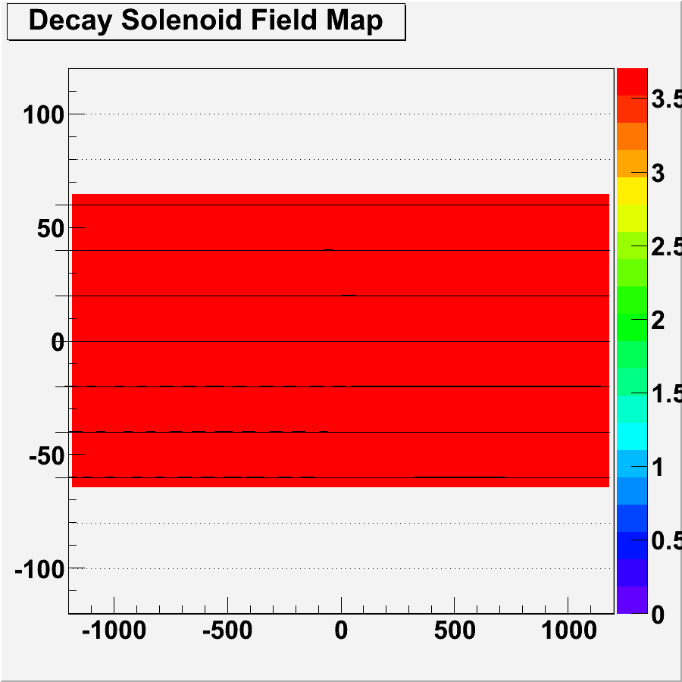
Decay Solenoid
Current State:
Dimensions changed to match information in MICE Note Beam 65
DS now models 10 coils inside the DS rather than 1
Field maps have been updated via reading in a text file of the field taken from G4BL
Left: Model of DS
Right: Field map
Y position (cm)
Magnetic Field (Tesla)
Future Work:
All of the improvements made will be verified
Checks will need to be made to the dimensions of the DS as the Mylar glass plate (on each end) and the vacuum inside have not been modelled
This is because the information in the MICE note is not clear
Z position (cm)
CM 28 Sofia
M. Littlefield

Slide 8
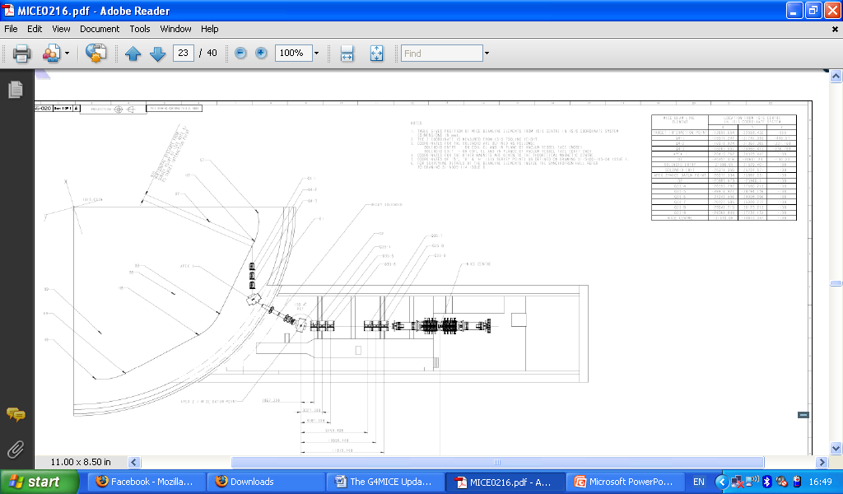
CM 28 Sofia
M. Littlefield

Slide 9
Simulation
Current State:
x, y and z positions of all elements have been updated according to information taken from the last survey
Most elements have had geometries and field maps updated to match reality more closely
Future Work:
Sanity checks on dipoles and also gather more information of geometries (D1, DS)
Comparisons between G4MICE and G4BL of each element will be made, mainly tracking particles through each element (already begun)
The field application will be made improve to check the value for Maxwell2 (numerical divergence of the B-field vector) across each element to check if they are physical (finished needs to be verified)
Some minor improvements to code e.g. Killing of stray particles, improving simulation speed
Add TOFs, GVAs etc (anything else in the beam line)
CM 28 Sofia
M. Littlefield

Slide 10
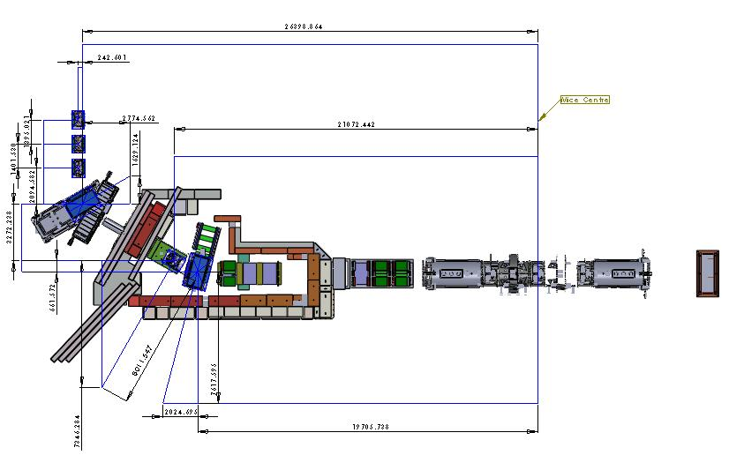
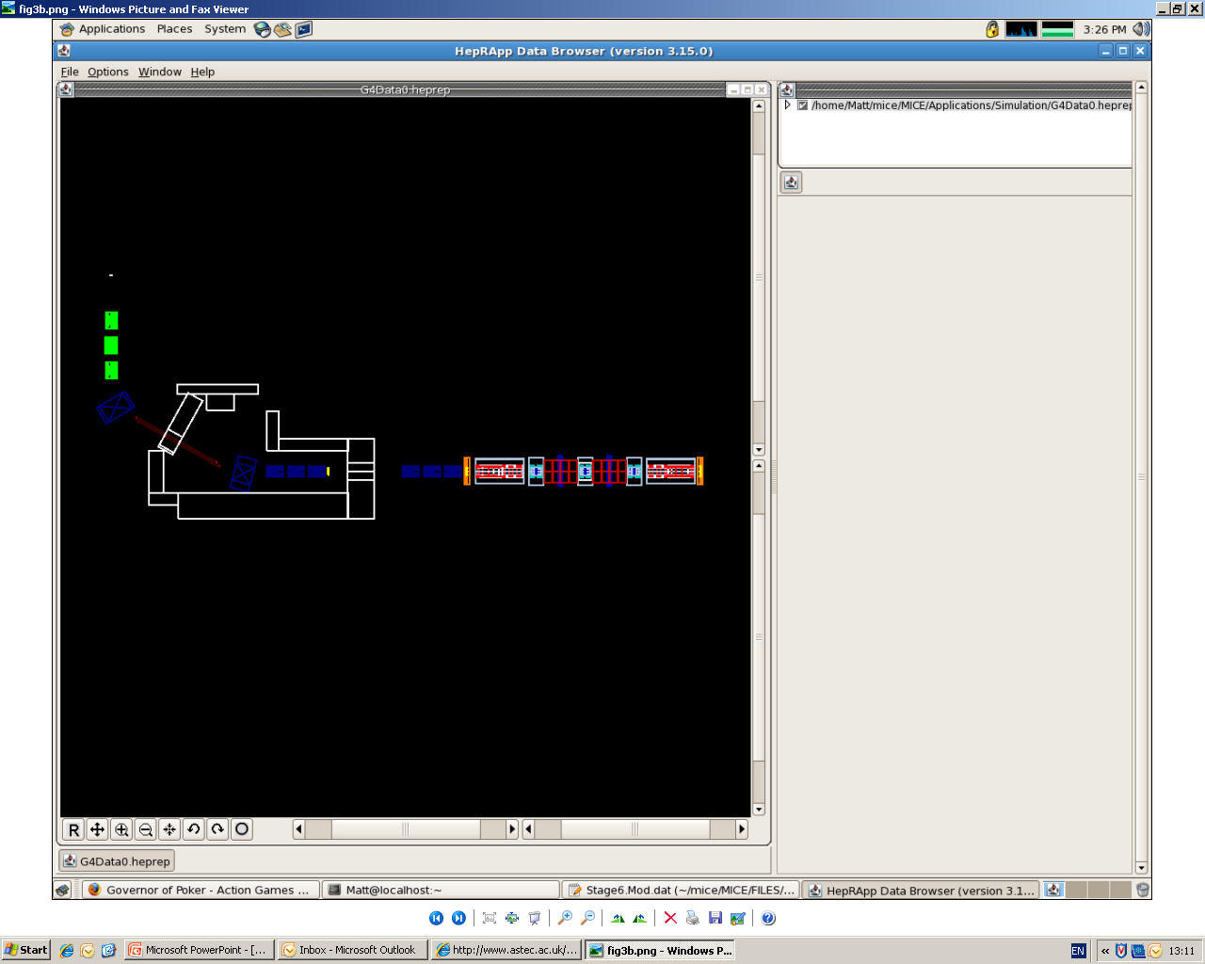
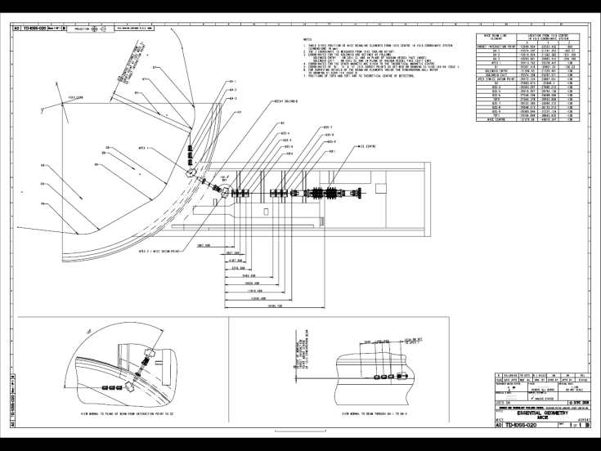
Summary
The elements have had the dimensions altered to match the information in the MICE note. Field maps have been changed and read into the simulation from text files taken from G4 Beam Line which provides accurate models of the fields seen in reality. Finally the positions of all the elements have been updated but still need to be verified.
Left Upper: CAD Model of MICE Hall
Left Lower: Survey of MICE Hall
Right: G4MICE Model of MICE Hall
CM 28 Sofia
M. Littlefield

Slide 11

Any Questions?
Thank You for Listening
Matthew.Littlefield@brunel.ac.uk
CM 28 Sofia
M. Littlefield

