Slide 1
Target:
— on behalf of the ‘Target Team’.

Slide 2
Contents:
Target operation 2009 to 2010
Beam loss and activation of ISIS
Magnetic analysis and mapping
Progress on mechanical assembly
Electronics and DAQ
Schedule
Conclusions

Slide 3
Operation 2009 to 2010
Target:

Slide 4
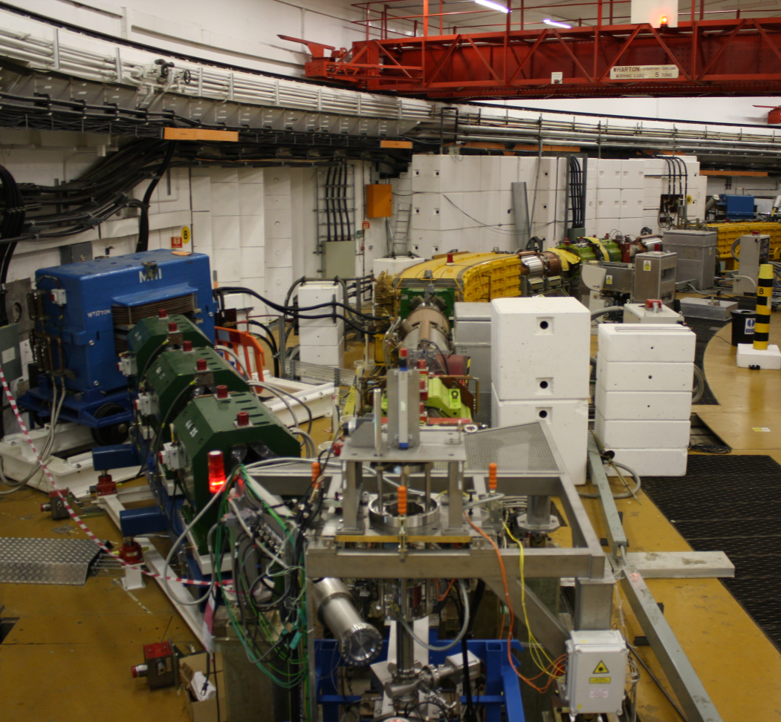
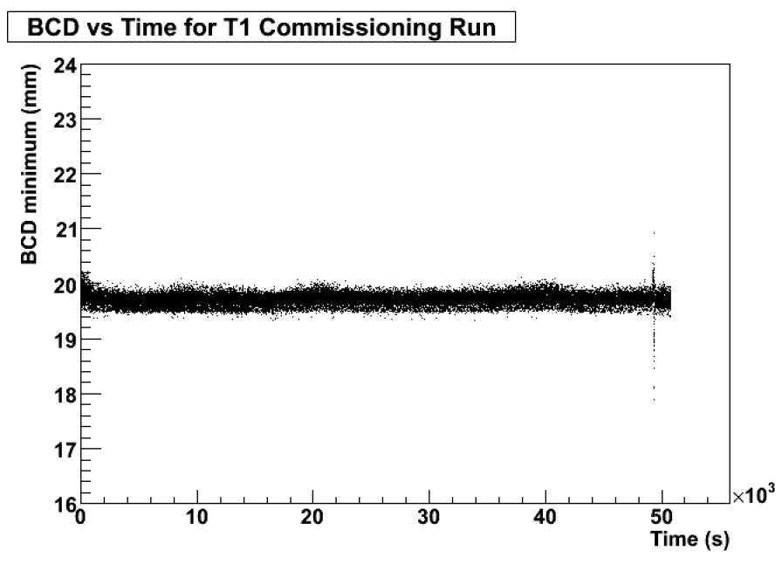
T1: target installed in ISIS:
Installed in ISIS 25th August 2009:
  Followed successful test in R78 – 50k good dips

Slide 5
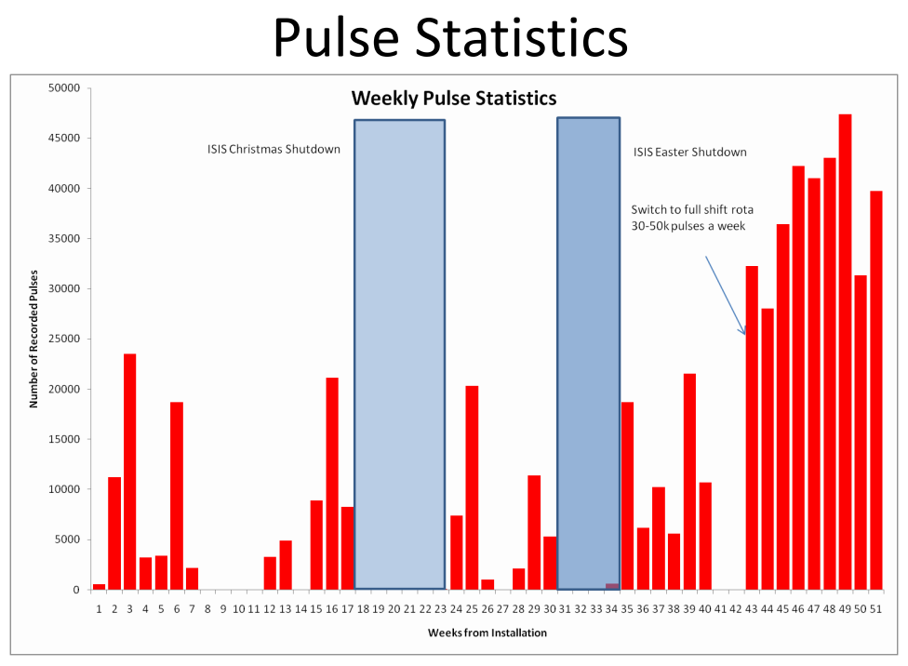
P. Hodgson

Slide 6
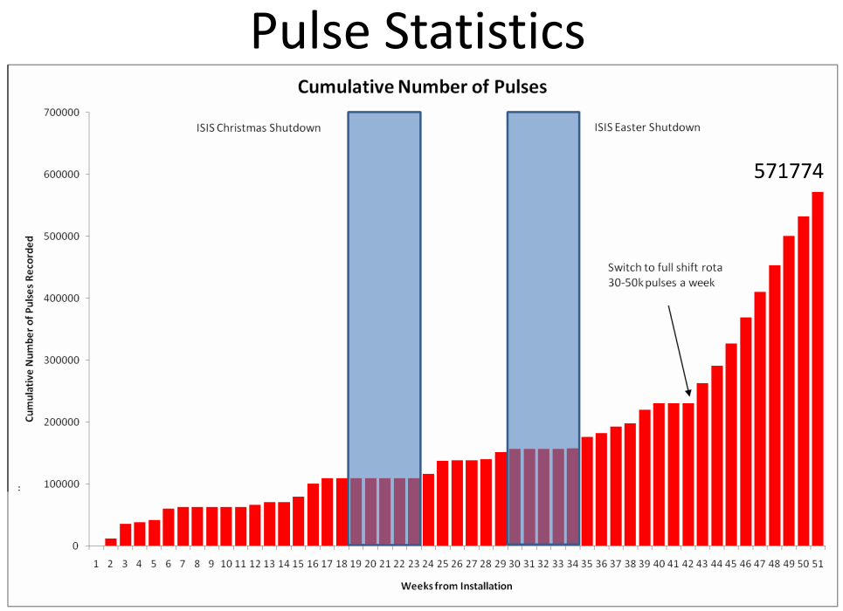
P. Hodgson

Slide 7
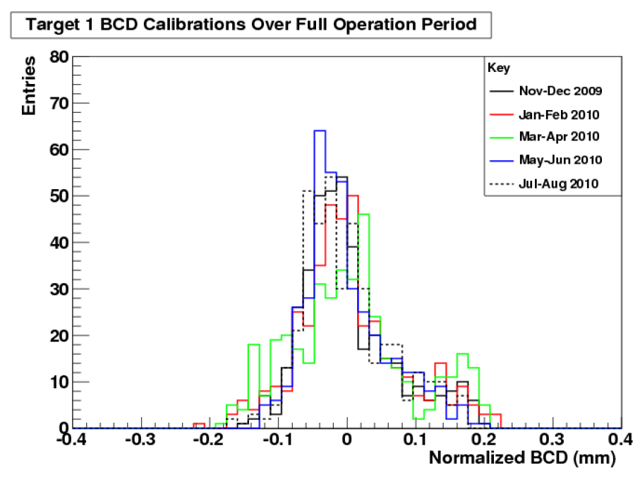
Target integrity test; history:
P. Hodgson
No evidence of degradation over year’s running

Slide 8
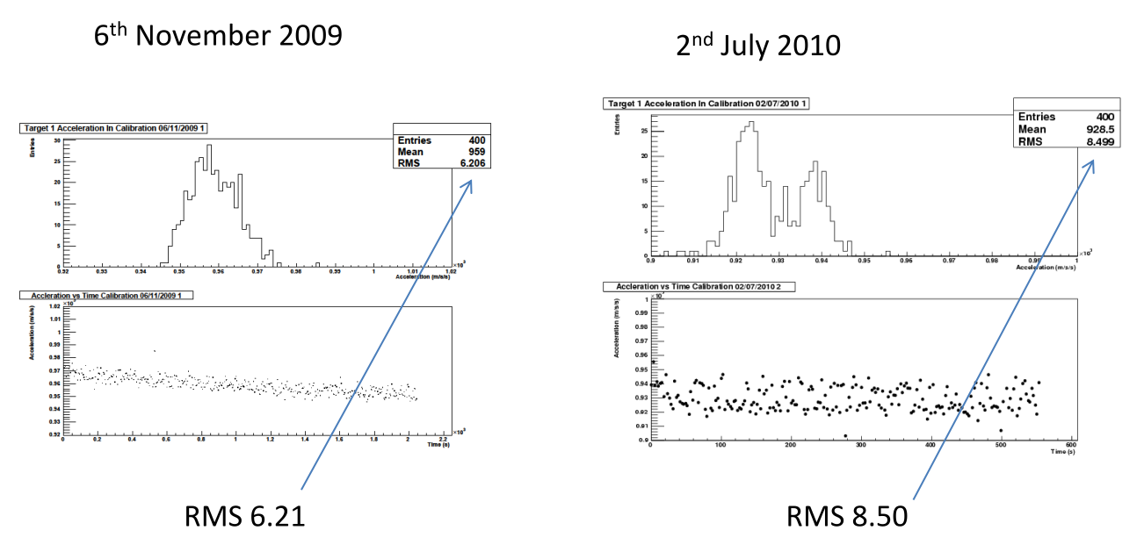
In more detail: acceleration:
P. Hodgson
Slight difference Nov09 to Jul10:
  Do not believe behaviour indicates imminent issue

Slide 9
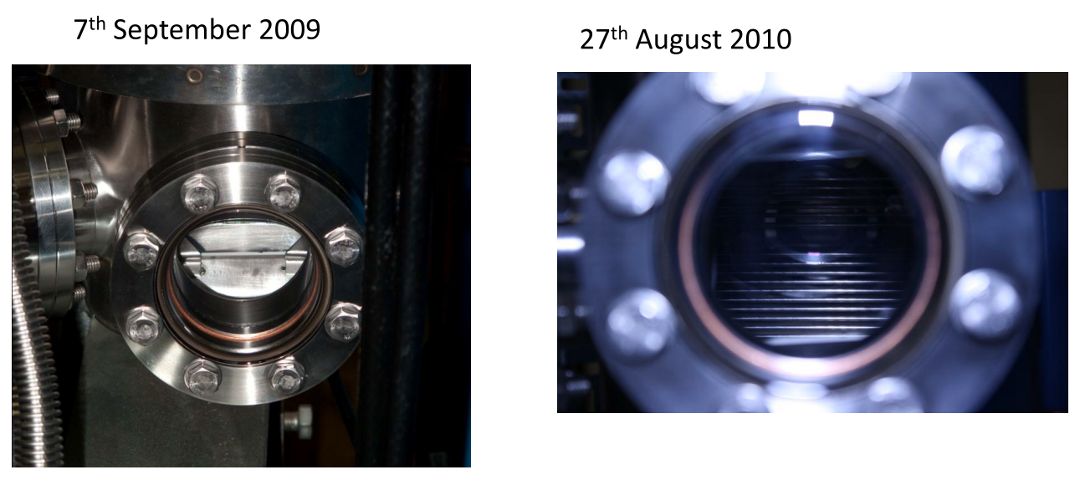
Visual inspection:
No sign of dust or debris

Slide 10
Target in ISIS, conclusions:
Total of more than 620k dips:
  571.8k in ISIS
Excellent performance; routine data taking
No evidence of wear either by direct inspection or through Paul Hodgson’s analysis

Slide 11
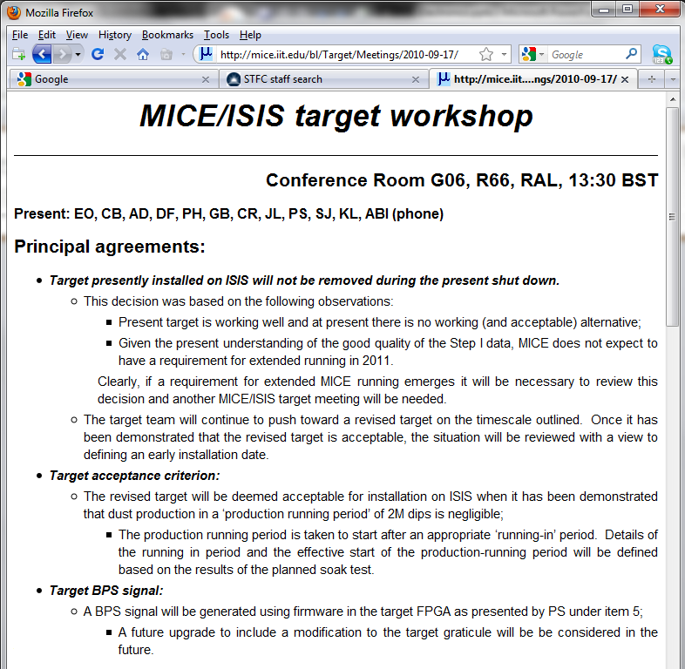

Slide 12
Beam loss and activation of ISIS
Target:

Slide 13
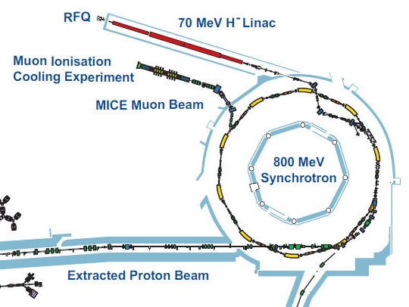
8
7

Slide 14
Pattern of loss around ISIS:
D. Findlay
MICE target induces beam loss around ISIS

Slide 15
Activation of ISIS:
D. Findlay
No evidence (yet) of increased dose due to MICE running

Slide 16
Total loss versus loss close to MICE target:
Extrapolation of total loss to:
  5 V·ms @ 1 Hz implies 69% increase of total loss over loss when MICE target is not running
Such an increase is not acceptable to ISIS.
Mitigations:
  Beam bump (Dean Adams);
  Increased acceleration
  Revised target geometry or material
Implies an ongoing programme of:
  Beam-loss vs particle rate measurement and simulation
  Development of target system and mechanics
D. Findlay

Slide 17
Magnetic analysis and mapping
Target:

Slide 18
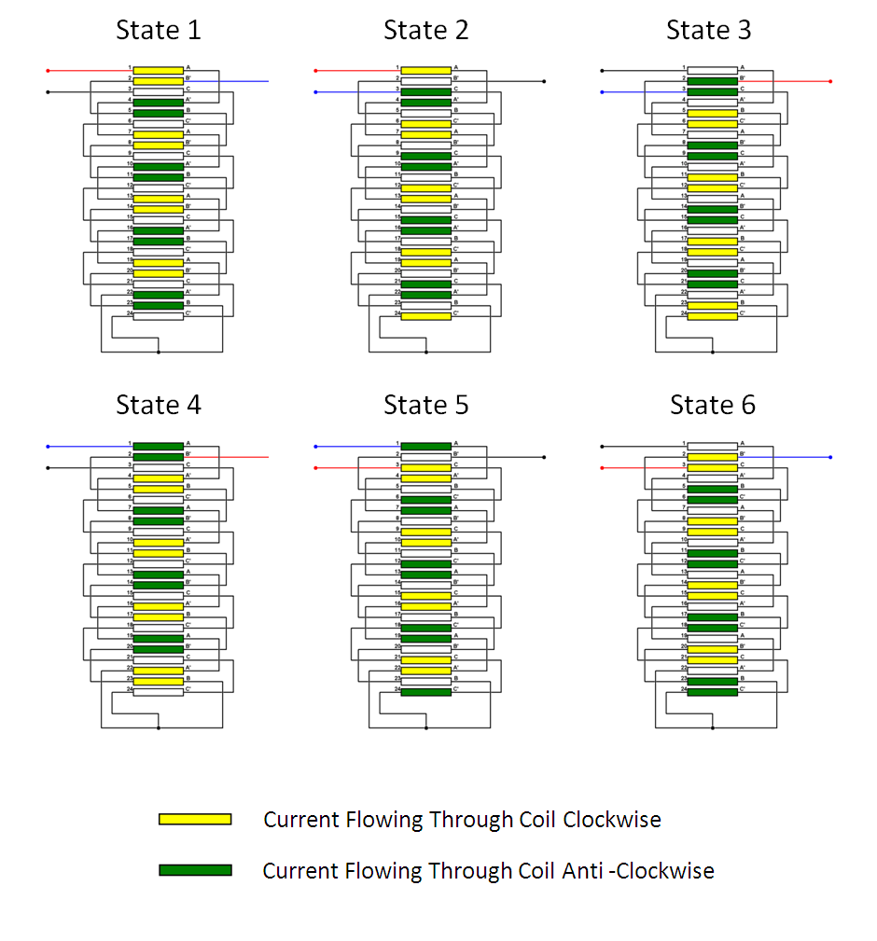
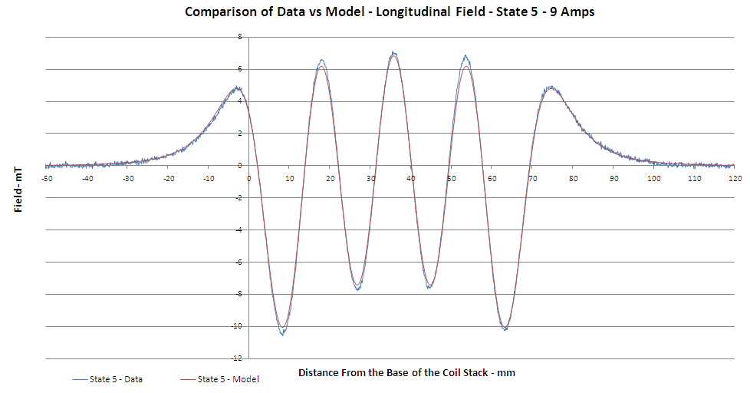
Magnetic investigation of T2 stator:
P. Smith
Status at CM27:
  Measurement of T2 stator by E. Longi using Diamond magnetic measurement rig indicated offset of magnetic axis from position of mechanical axis
Delay in repeating measurement owing to Diamond shutdown work
Mitigation:
  Develop own magnetic QA rig:
    Partially set up in R9
      Will complete, presently on hold
  Repeat magnetic measurements at DL using light-source magnetic measurement rig there:
    Ben Shepherd is making the measurements for us

Slide 19
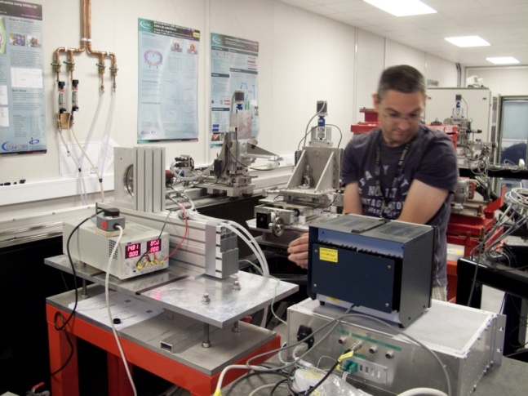
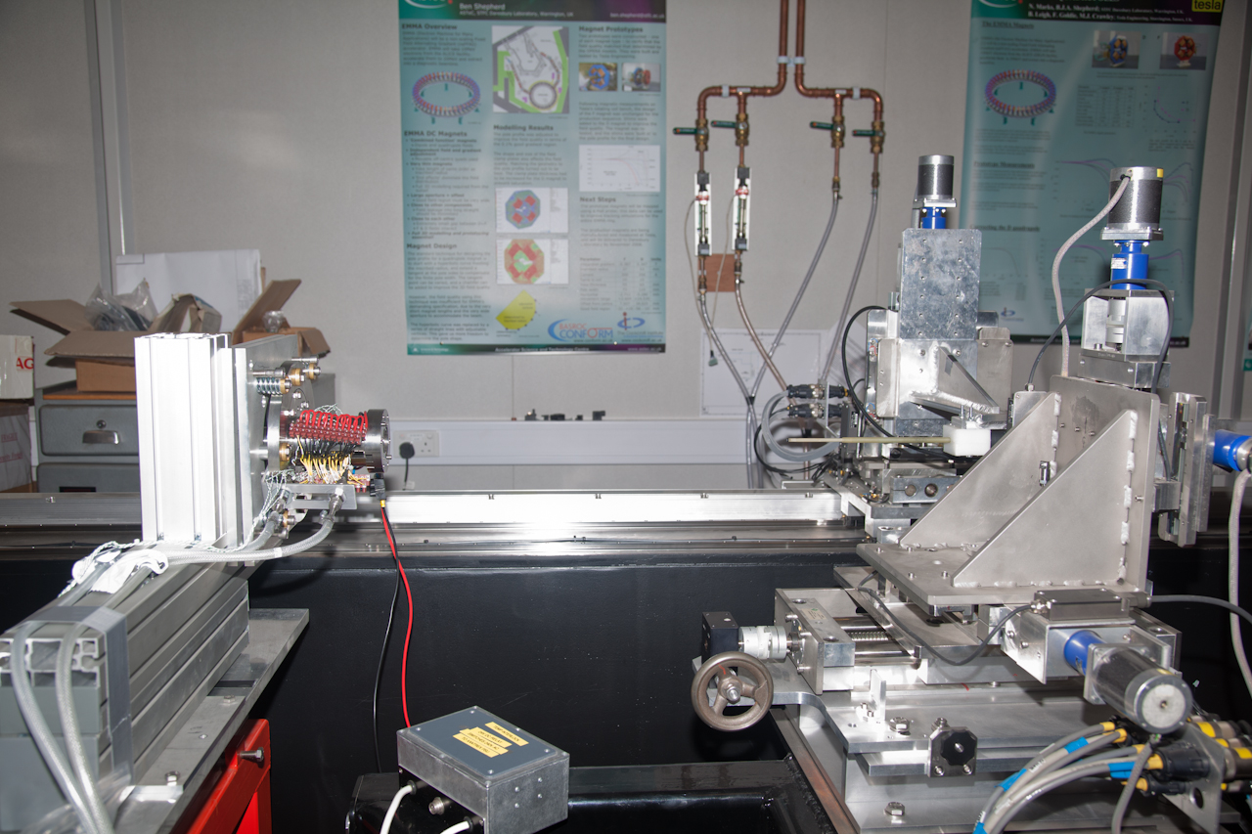
Magnetic measurement set up in DL:
P. Smith,
G. Barber

Slide 20
Alignment and set up:
P. Smith,
G. Barber, R. Hare
Optical survey telescope used with custom bearing inserts to align mechanical axis of stator to axis of linear stage:
  Alignment good to ~100 µm over 1.8 m
    Total length of stator 180 mm
      Alignment therefore good to 10 µm over stator
Map magnetic field in coordinate system with z axis aligned with mechanical axis
  Will give accurate measurement of offset of magnetic axis

Slide 21
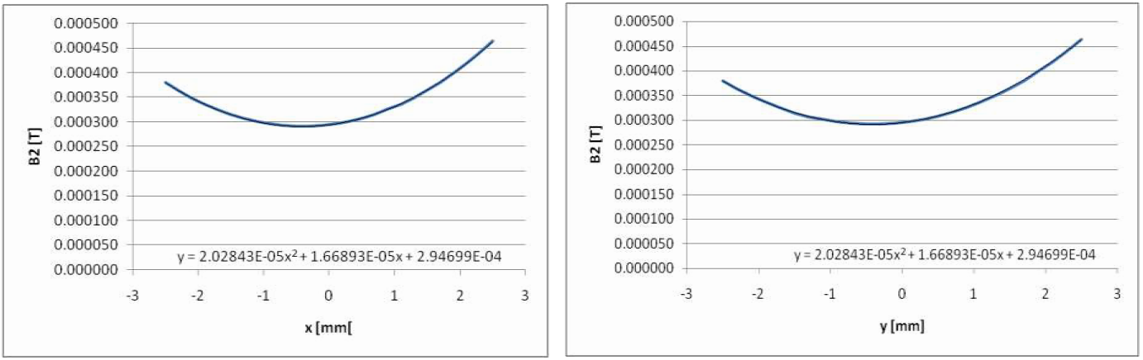
Results of first scan:
Only one phase so far
B_{z}
B. Shepherd

Slide 22
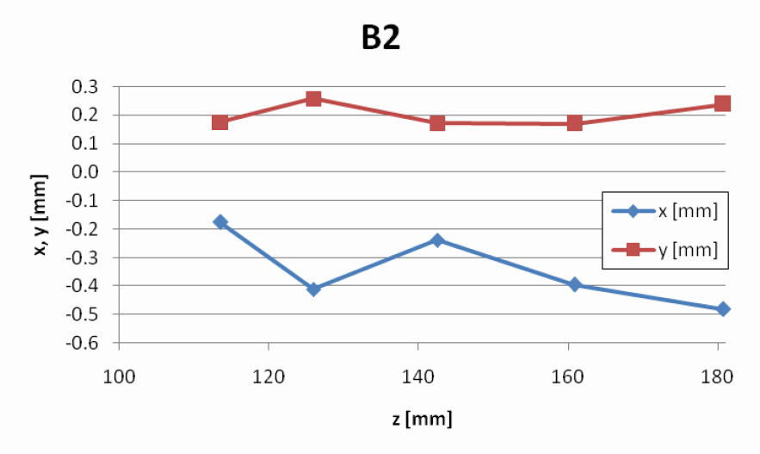
First estimation of magnetic axis:
B. Shepherd
Possible inconsistency
of minimum of B_{x} and B_{y}
with that of B_{z} under
investigation
B_{z}
Measurements at DL
appear to show more
variability with position
along stator axis.
Under investigation
Next steps:
  Consistency checks:
    Repeat measurements with stator rotated by 180⁰
    B_{z} minimum consistent between all three phases?
    Minimum of B_{x} and B_{y} consistent with minimum B_{z}?
    Re-check mechanical axis

Slide 23
Planning for magnetic measurement and refit:
This week (i.e. in parallel with CM28) complete magnetic measurements;
  And document
Meeting planned for 11Oct10 to review measurements and decide where to position bearings:
  Risk:
    If there were to be a large variability in the position of the magnetic axis along ‘z’ – might be hard to define position
Decision on position will allow re-assembly of T2:
  Estimated time: ~2 weeks
Also developing plans for:
  Measurement of individual coils and permanent magnets
  Purchase of more permanent magnets
    Consider larger diameter to increase force (i.e. acceleration)
  Design of new coils
    Better control of relative position of magnetic and mechanical axis

Slide 24
Progress on mechanical aspects
Target:

Slide 25
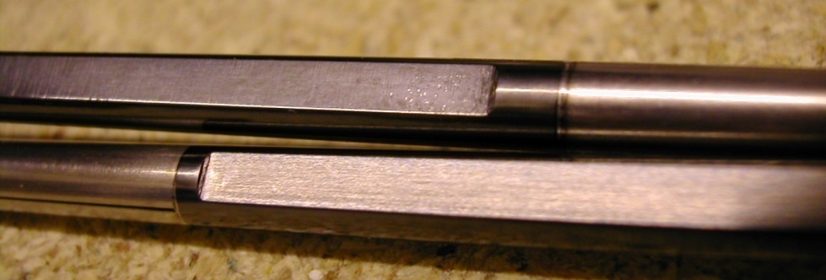
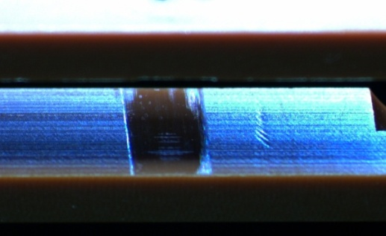

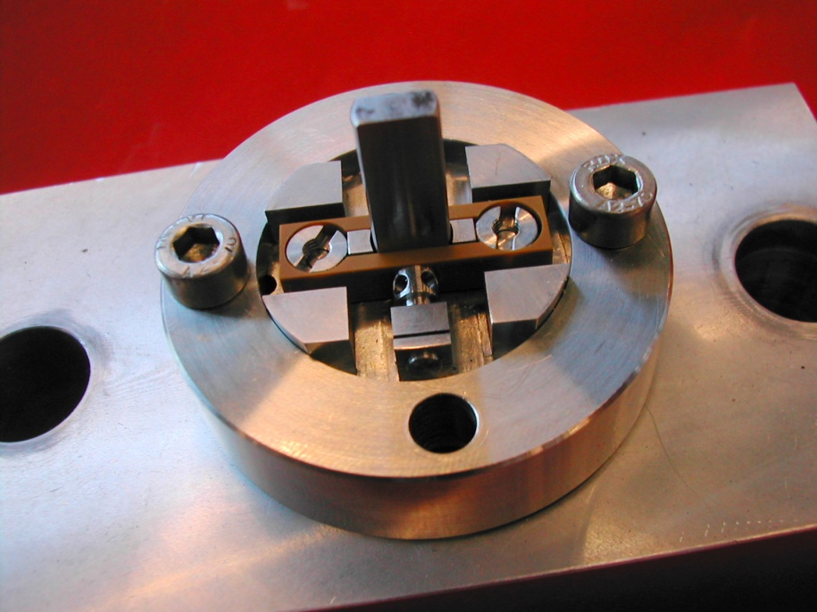
Mechanical progress: dust:
J. Tarrant
Reducing dust at source:
  Polish both flats at top of shaft and round lower shaft
  Burnishing surfaces to size:
    Burnishing tests of round and flat Vespel bearing surfaces carried out:
      Wear induced with burnishing tools too slow
      Option of accelerated wear (stone) risks contamination
    Therefore have specified a ‘running-in period’
      Length to be determined empirically
New

Slide 26
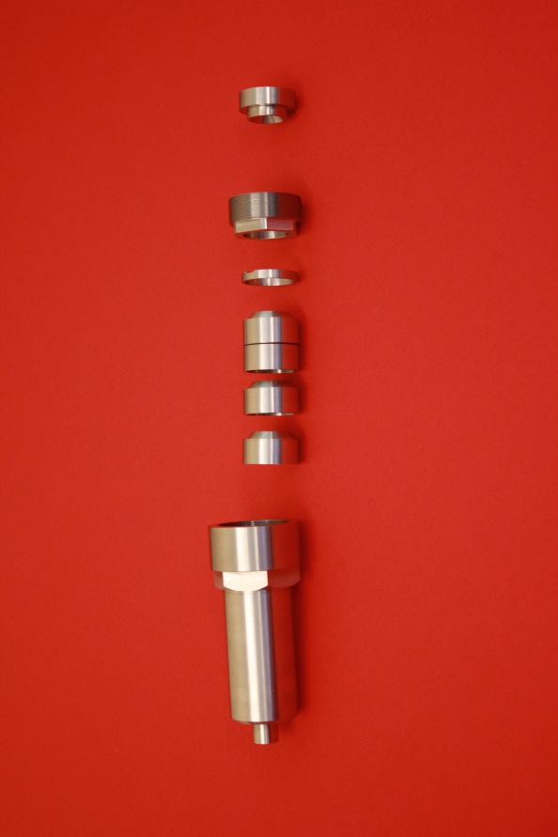
Mechanical progress: dust:
J. Tarrant
Dust management: ‘dust catcher’:

Slide 27
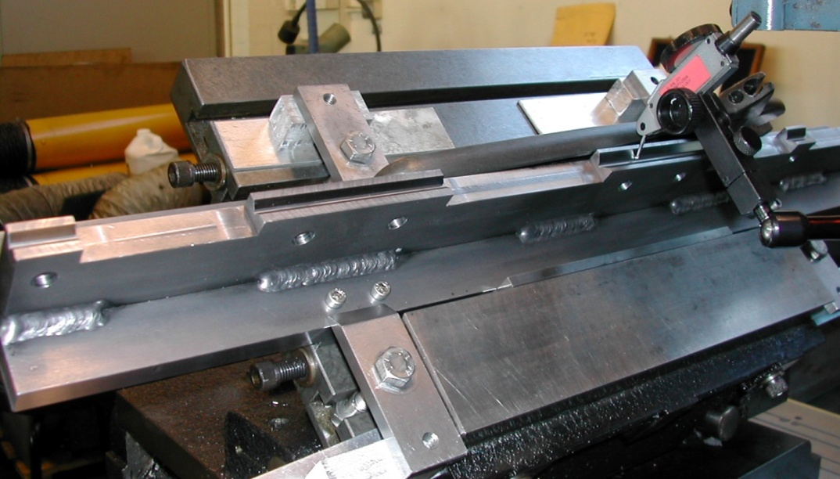
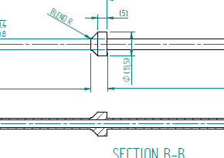
Mechanical progress:
J. Tarrant
Shaft manufacture:
  Stress relief, annealing, straightening jig manufactured;
  Lower stop now integrated on shaft;
    EDM drilled + wire eroded bore in 330mm long Ti
    Rough machined lower shaft, next steps:
      Heat treat & re-inspect (distorted?)
      EDM & wire cut bore
      Final machine & polish
    More costly but more robust & accurate + less risk

Slide 28
Electronics and DAQ:
Target:

Slide 29
Electronics
J. Leaver, P. Smith
Phase 1 Upgrade – Target Controller [complete]:
  This controller was not soak tested in R78 as planned due to delay in obtaining magnetic measurements. The phase 1 target controller has temporarily been taken back to Sheffield to obtain some running data on an older target.
  We are using this opportunity to do some soak testing of the controller.
Phase 2 Upgrade - Electronics
  The purpose of the Phase 2 electronics is to integrate much of the peripheral target electronics onto PCB’s and to add some low level functionality that will enable the system to be more easily managed by an expert (no additional user functions)
  Phase 2 has, until recently, progressed to plan. The recent additional requirement to provide ISIS with a firmware BPS (Beam Protection Signal) on the new controller has slightly delayed the phase 2 timetable.
  A revised timetable sees the phase 2 work to be completed by May 2011 (Originally March 2011)

Slide 30
Electronics:
J. Leaver, P. Smith
Phase 2 electronics will consist of 3 PCBs:
  Daughter Card A: Optical Amplifiers + DAC
  Daughter Card B: Drivers + Interlocks
  Power Supply
Currently implementing 1 & 3

Slide 31
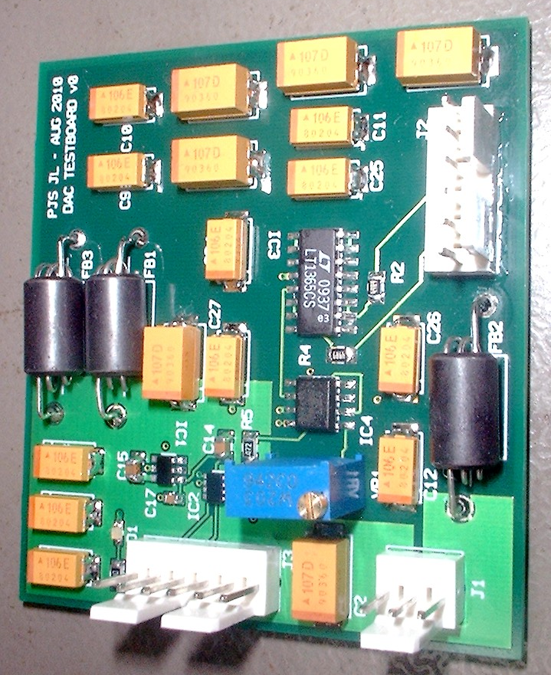
Daughter card A: Optical Amplifiers+DAQ:
Single channel Optical Amplifier test circuit has been designed
  Will be prototyped on Veroboard before integration with final system
DAC test board has been produced
  Successfully demonstrated FPGA control via SPI interface
J. Leaver, P. Smith

Slide 32
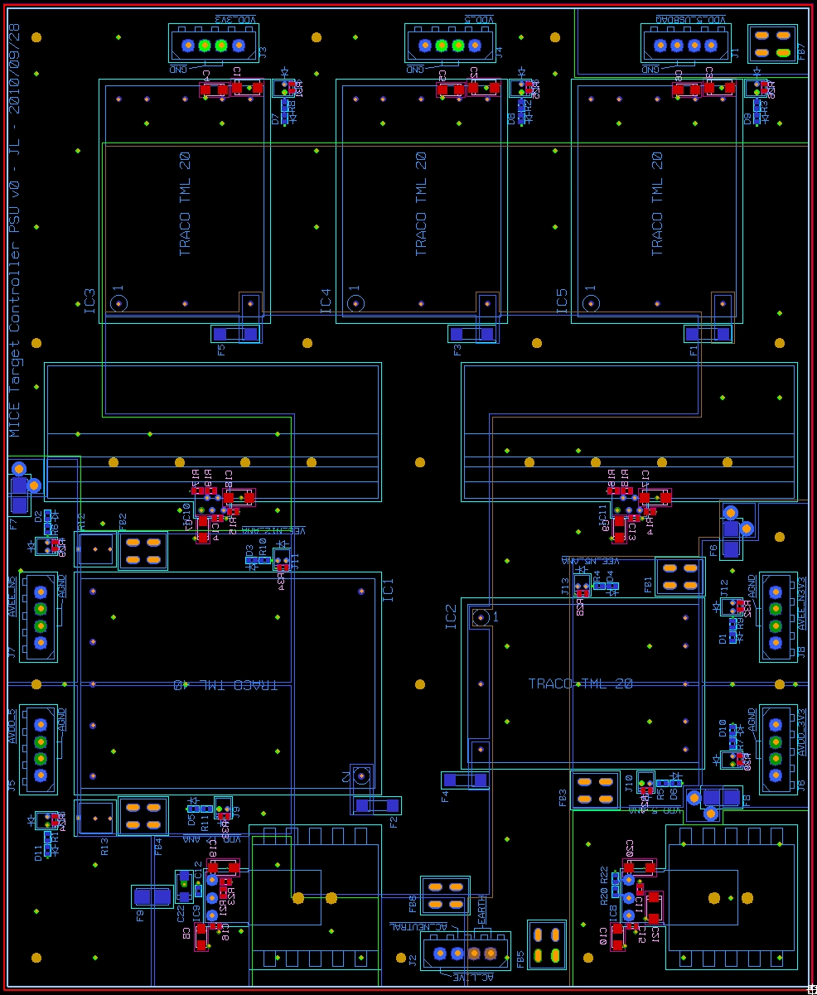
Power Supply:
J. Leaver, P. Smith
PCB layout complete
Provides:
  Digital:
    2 x 5V (4A each)
    3.3V (4.5A)
  Analogue (low noise):
    +/- 5V (1A each)
    +/- 3.3V (1A each)
Will be sent for manufacture within 1-2 weeks

Slide 33
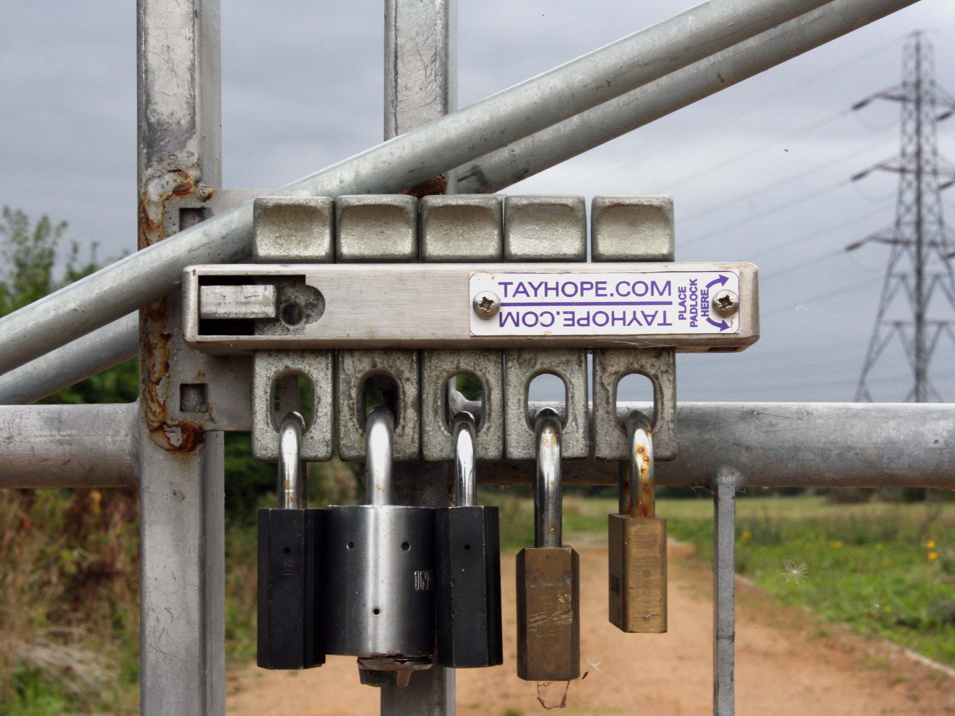
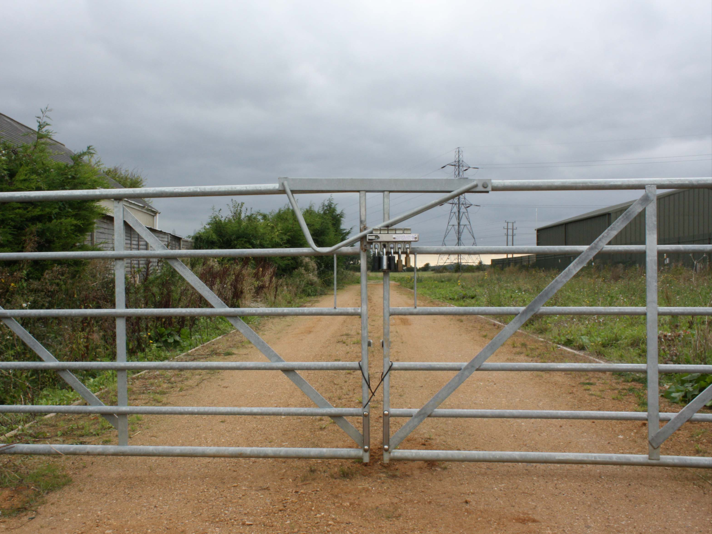
For Yagmur ...
... It could be worse!

Slide 34
BPS:
J. Leaver, P. Smith
Target BPS mtg between MICE target electronics experts and ISIS BPS experts, 04Aug10 concluded that:
  MICE target system will generate BPS signal from firmware in Phase I controller upgrade;
    Target bad signal generated from:
      Beam-centre distance out of tolerance;
      Start time or duration of dip out of tolerance;
      Start position and BPS hold position out of tolerance;
BPS upgrade is now included in the target DAQ/controls schedule:
  Specification document drafted;
  First steps in development of firmware taken

Slide 35
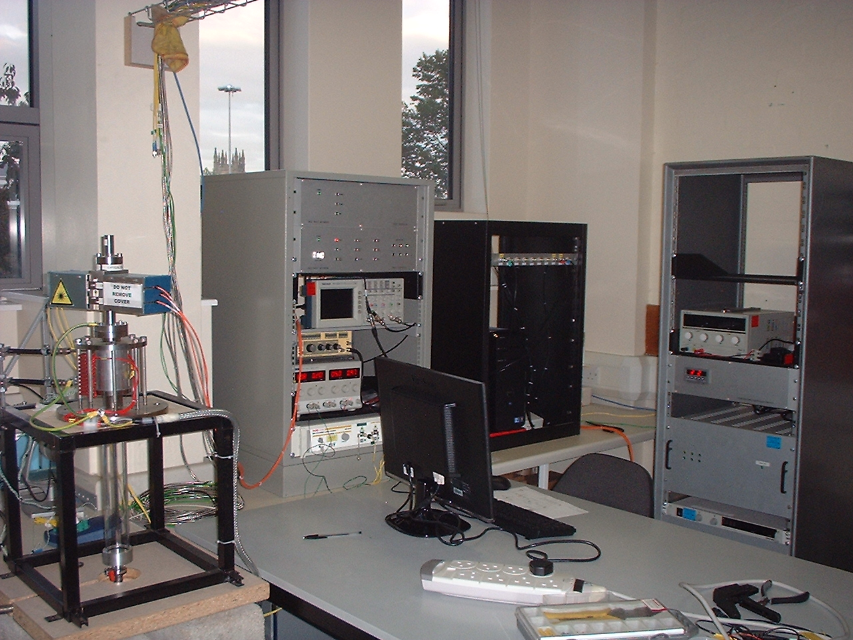
J. Leaver, P. Smith
DAQ &
Target Control PC and DAQ electronics
New Target
Controller
Target (Older design)
Target PSU
And Temp Monitoring
Target User Interface!
Target Setup at Sheffield for a soak test of the new target controller and to generate some data for the BPS implementation

Slide 36
Schedule:
Target:

Slide 37
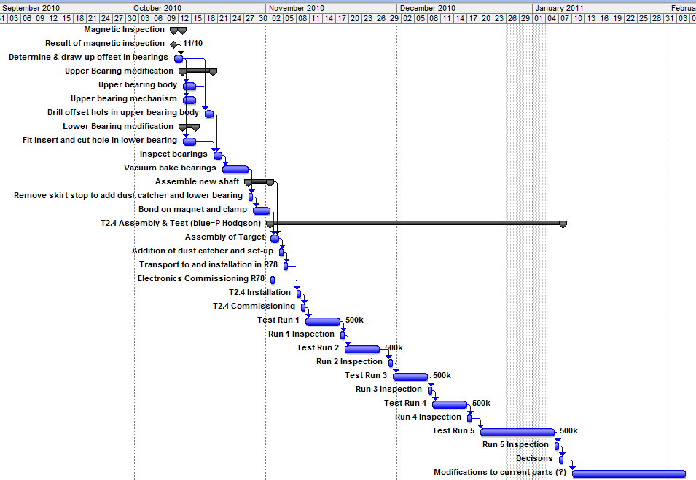
T2: re-assembly and test:
Decision points

Slide 38
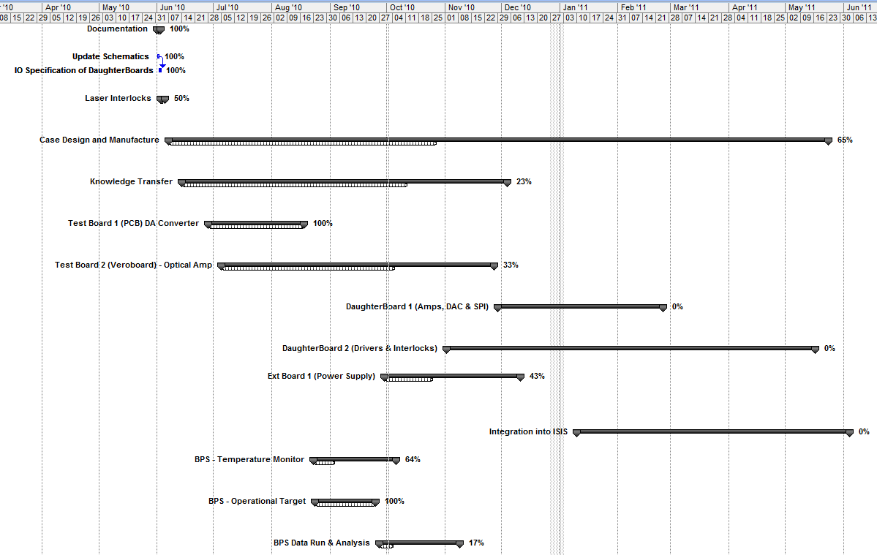
DAQ and control:

Slide 39
Conclusions:
Target:

Slide 40
Conclusions:
Frustrating period following initial success in measuring magnetic properties of T2 stator
Believe that we’re back on track now:
  Magnetic measurements taking place in DL now;
  Review/decision point 11Oct10 for drilling of new bearings;
    If positive, expect T2 under soak test ~end October
DAQ/control upgrade going well:
  Additional work added to plan to implement BPS
With reliable target in our hands, will move to define ongoing development plan

