Slide 1
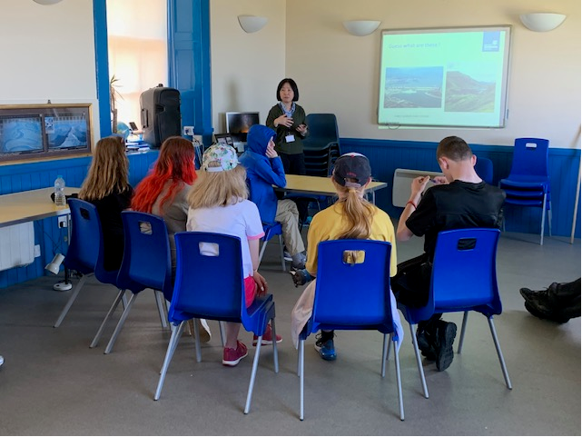

Principles for building diversity through inclusive outreach: an exploration through case studies
Dr Jane Essex, FRSC
Wendy Sadler, MBE, FInstPhys
jane.essex@strath.ac.uk & sadlerwj@Cardiff.ac.uk

Slide 2
By the end of this session, you will have
Exemplified and evaluated four approaches to more inclusive STEM outreach
Considered the principles behind the implementation of intentionally inclusive outreach
Considered some of the barriers that may be encountered in the implementation of intentionally inclusive outreach
Anticipated timings:
Description of four case studies 50 minutes
Break 10 minutes
Discussion in groups 20 minutes
Plenary 10 minutes

Slide 3
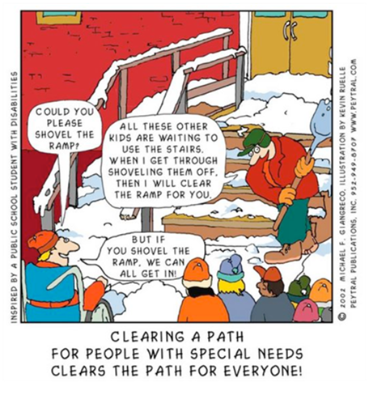
What do we mean by inclusion?
Inclusive design aims to remove the barriers that create undue effort and separation. It enables everyone to participate equally, confidently and independently in everyday activities. (Design Council website)

Slide 4
Are there any learners who can’t benefit from STEM?
No. ‘….there was no evidence at all to suggest science, presented in a suitably modified format, is unsuitable for any learner'. (Essex, 2020: 554)
Benefits include skills development (following instructions, rehearsing communication skills, numeracy, thinking skills, social skills) (Essex, 2018; Essex, 2020)
Increased awareness of employment and leisure choices
The status of science is seen as a huge benefit IF it’s the right sort of science (Essex, 2018)

Slide 5
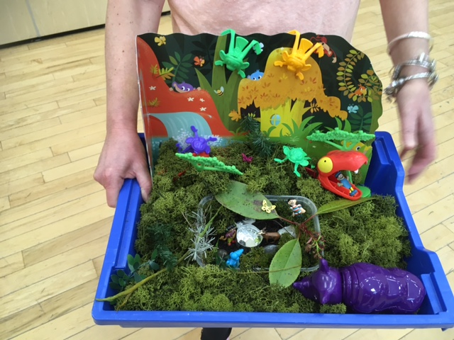
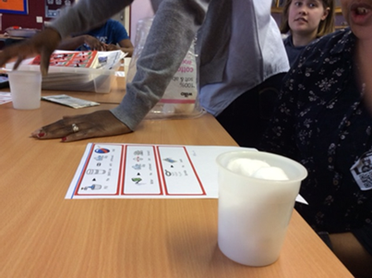

Case study 1: A very special school
Who is under-represented? Pupils with PMLD/CASN
Why are they under-represented? Exemption from National Curriculum expectations; lack of staff expertise/ confidence; mistaken belief that specialist resources were necessary
What do they hope to get from participation? Enjoyment, transferable skills
What did I do? Observed, waited to be allowed to participate, gave curricular advice, provided practical resources, observed
How well did the initiative work? Very well! Higher attainment outcomes, uncovered unrecognised capacities in staff and pupils, provided new ways of assessing pupil capacity. Now bidding to the Royal Society for further funding
Work conducted with funding from the RSC’s Outreach Fund

Slide 6
Inclusion requires identification and mitigation of potential barriers. Here they included:
Science and maths are hard: abstract ideas, technical language, multiple concepts needed at once, dependence on prior understanding
Some participants may have limited verbal capacity: they may need items coding symbolically or representing photographically . They can demonstrate learning through behaviours (Brooke and Solomon, 2001; Essex, 2020).
Some participants have shorter attention spans than you might expect; break activities down into smaller ‘chunks’. (Essex, 2021).
Poor memory and reduced processing capacity cause problems. (Essex, 2021). Keep instructions as brief as possible, no more than three things at a time, please.
Participants can do higher order thinking (application, evaluation, synthesis of ideas) but not reliably, be prepared to ‘scaffold’ or break down ideas into smaller bits
Many participants don’t investigate in the way you expect, they work very empirically (Essex, 2020)
Some participants find the unfamiliarity overwhelming; have a breakout room, or a quiet corner (with Molymod or Lego), or allow camera and mic to be off.
Some participants may have problems with manipulating apparatus; unbreakable where possible, low hazard and small amounts are recommended (Essex, 2021)
Social interactions cause a high level of concern, allow time to resolve these (Essex, 2021, in press). But many love meeting a ‘real scientist’ & rate it as the best thing about the day
Most staff/ family working with these young people are not scientists and are not confident about doing science (Essex, 2020). Providing a teacher’s sheet may help!

Slide 7

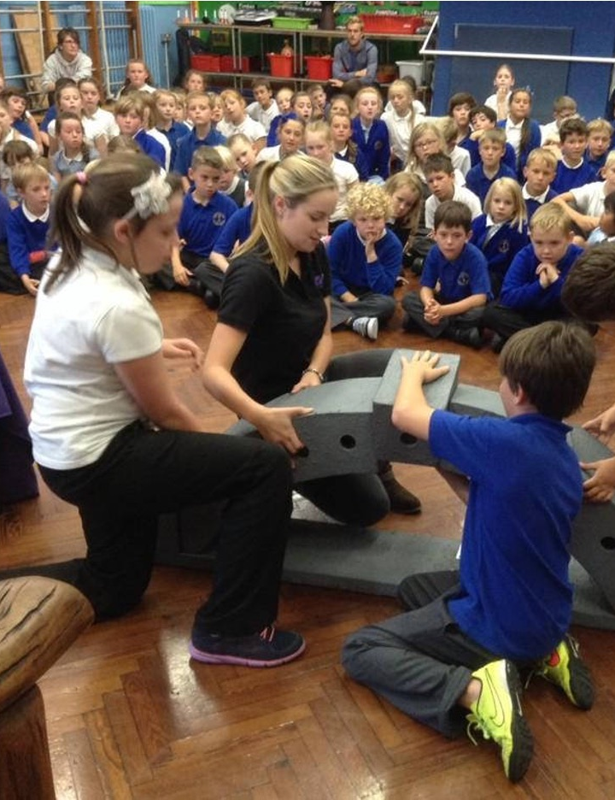
Case study 2
Who wants to be a superhero?
How do role models in outreach affect attitudes to STEM Careers
Wendy Sadler, Cardiff University & Science Made Simple
@wendyjsadler
@scimadesimple
Caption

Slide 8

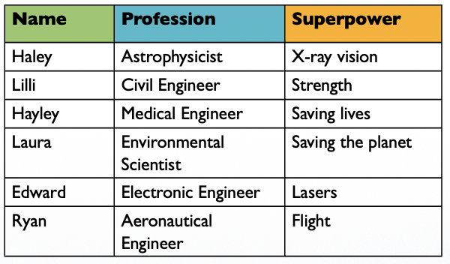
What was done
Primary school careers in STEM event (show)
Year 5-6 (age 9-11)
Six role models - four female
Pre and post test
Word association
Which role models they have things in common with/would like job

Slide 9
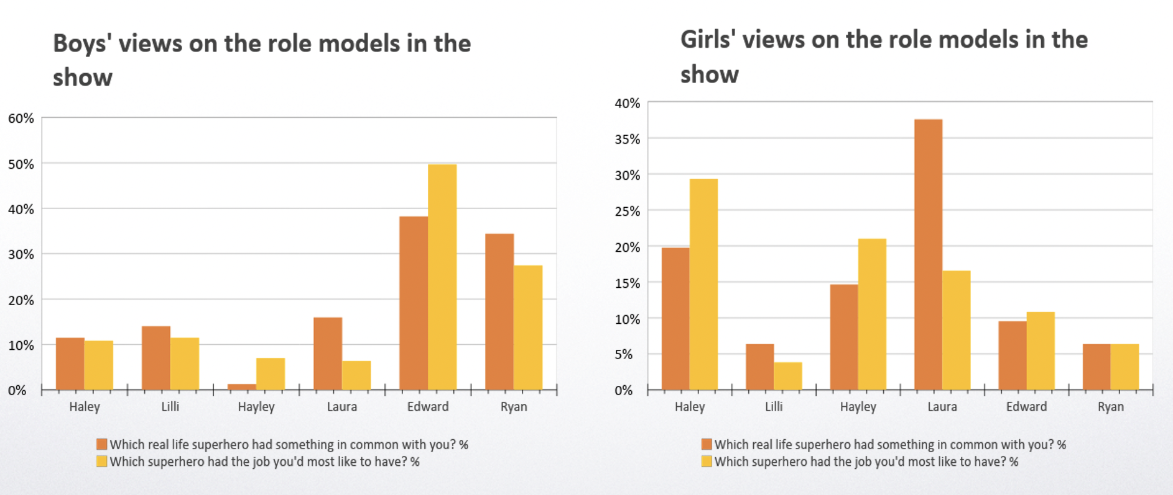
Key findings

Slide 10
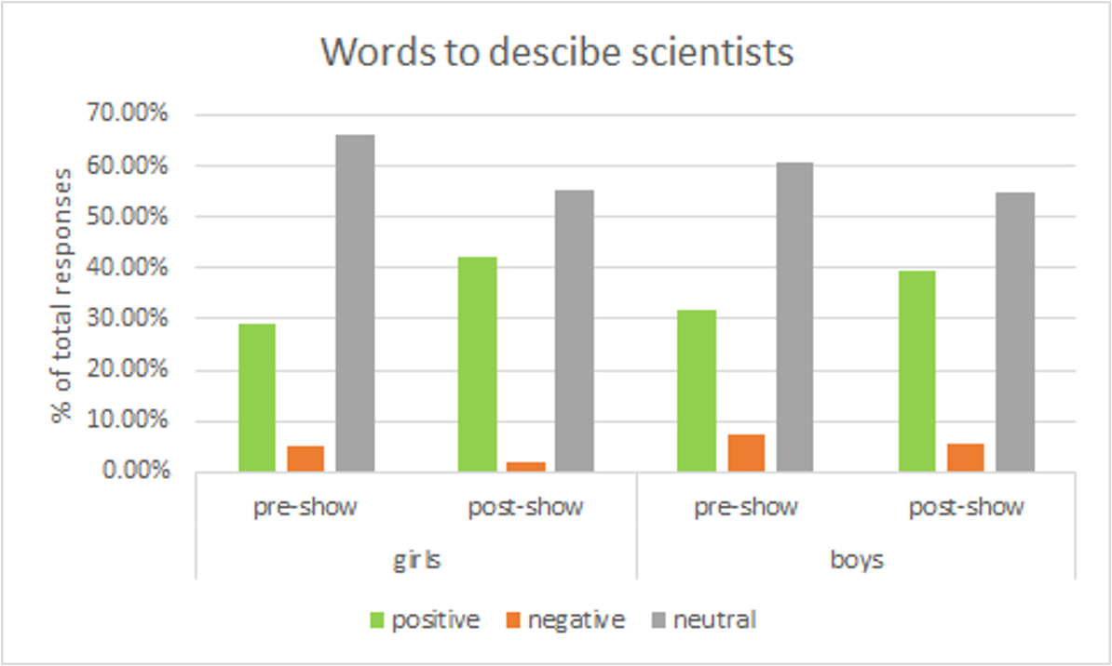
Key findings
All more career positive after show but increase bigger for girls
More positive words after the show and less negative
Danger is off-putting
Those who know a scientist or engineer more likely to want the career

Slide 11

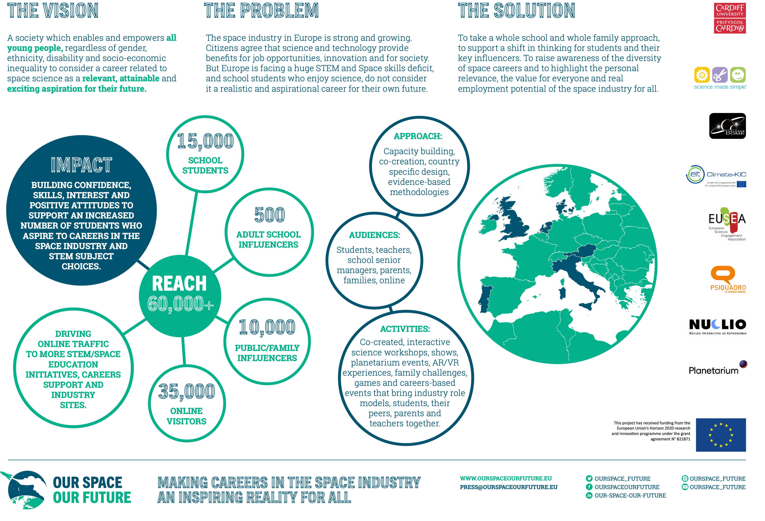
Case study 3
Reaching more diverse schools

Slide 12
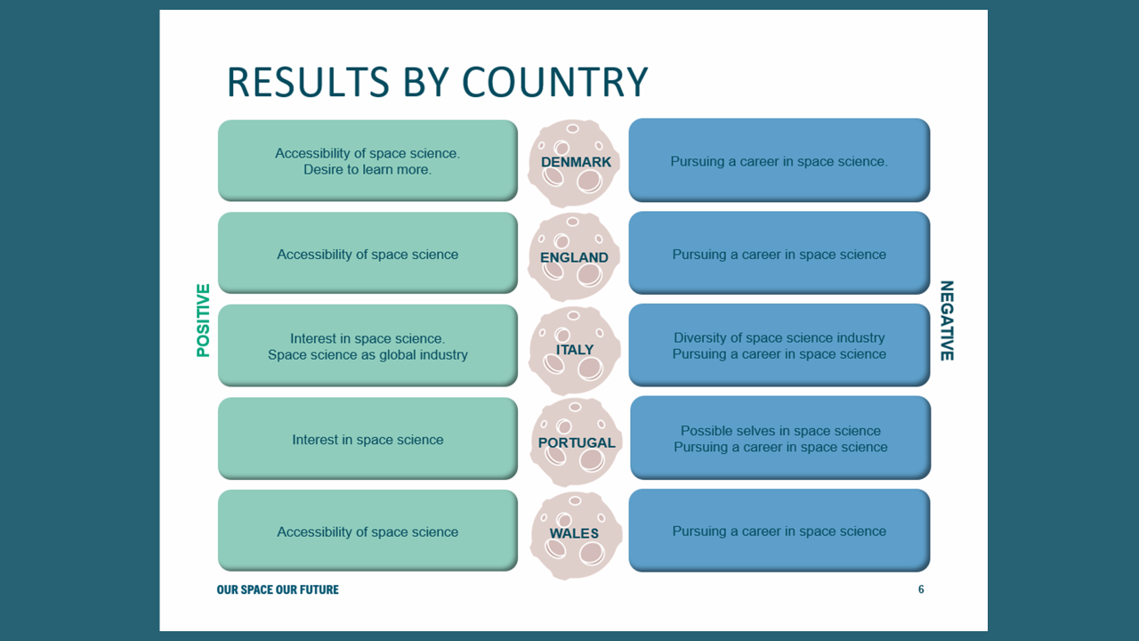
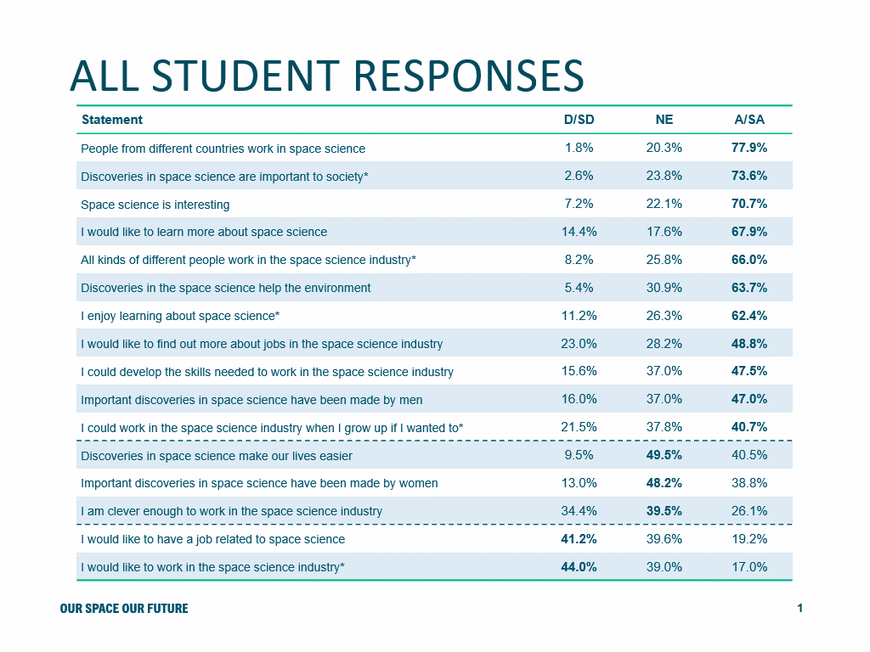

Slide 13
Case study4: Sustainable STEM, sustainable communities
Who is under-represented? Those living on poverty, those with learning disabilities and colleagues under-represented on ESPRC bids (LGBTQi, people of colour, women)
Why are they under-represented? Pupils, for reasons described previously. Staff because of lack of confidence, lack of contacts, lack of infrastructure
What do they hope to get from participation? Experience of being part of a successful bid writing team; experience of communicating with an unfamiliar audience.
What did I do? Invited 9 academics in STEM subjects to contribute a teaching/ activity session to a five day summer school for learners with ASN, in an area of high deprivation.
How well did the initiative work? Anecdotal evidence is very positive from both groups. Evaluation and write up yet to be undertaken.

Slide 14
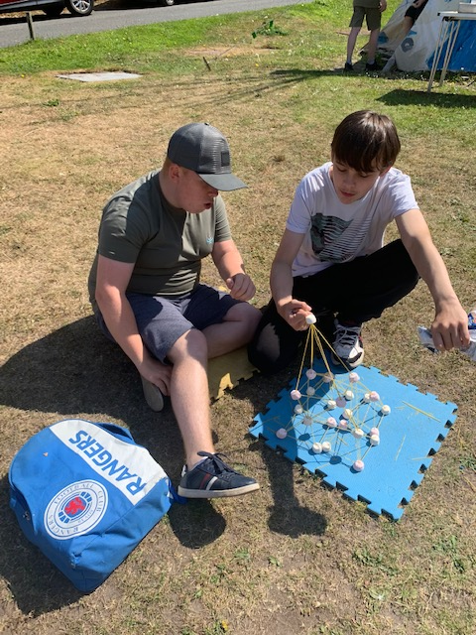
Does ‘hard to reach’ really mean ‘we don’t know how to engage’?
Identify barriers: concern about being ridiculed, inability to provide a packed lunch, need for a place to undertake personal care during the day (Essex, 2018)
Think about the opportunities inherent in their situation: few if any alternative invitations, unmet needs for involvement, status (Essex, 2018)
Be aware of ‘hidden signals’ e.g. what you call the event. How can potential participants know that you are doing more than merely being legally compliant? What do your means of recruitment say about the event?
Think about what aspects of your message are core and what can be compromised? e.g. empirical evidence, technical vocabulary, high levels of numeracy?

Slide 15
Group discussions
In your group, discuss which under-served audiences you would like to reach.
Think about why, what barriers you perceive, what mechanisms could you use to make it happen, what experience you would like to offer participants.
How different is the proposed outreach from your usual outreach practices?
Are there any other questions to pose about the proposed inclusive provision?
How might you evaluate the impact of your provision?
What educational or other values underpin your proposed provision?

Slide 16
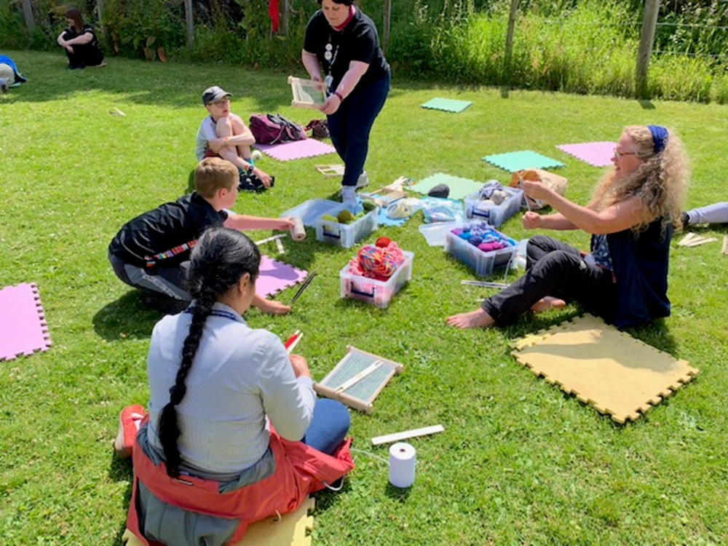
Plenary and overarching considerations

Slide 17
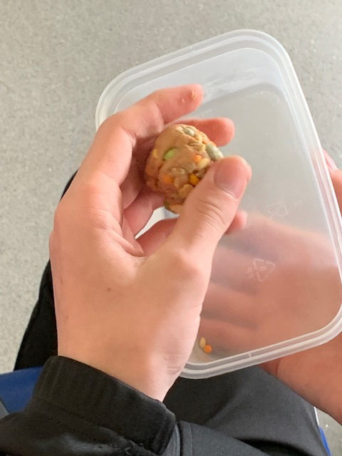
The principles of inclusion are universal
Learner-centred, not teacher-focused
Draws on learners’ aptitudes, interest, strengths
Generally constructivist, allowing for diverse approaches and solutions
Builds flexibility in from the start of the planning process
Does not see difference as a problem but an asset
High expectations coupled with commensurate support, if needed/ wanted

Slide 18
Limitations and opportunities
Diverse notions of inclusion
When outreach blends into public engagement, different conceptualisations
Lack of staff confidence with an unfamiliar audience
Access to target audience, facilitating enrolment
Funding, may need/ be able to get different sources
Will it ‘count’ as impact for institution?
Limits of protected characteristics approaches to inclusion, inclusion is NOT simply ticking a checklist!

Slide 19
Benefits to STEM communicators of working inclusively
You are likely to get uptake because there may be less competition in this sector of the market and the gatekeepers (parents, teachers) are reassured by an explicitly inclusive approach.
You don’t really know your subject deeply until you can make it accessible without loss of significance!
A fantastic way to extend the impact & reach of your work
You will be hugely appreciated.
The creativity and laterality of diverse participants; many volunteer to come back year after year
Opens up new collaborations (and, possibly, new funding streams)
Opens your eyes to new ways of learning, even if you’re a highly experienced public engagement practitioner (Brooke and Solomon, 2001)

Slide 20
References
Brooke, H. and Solomon, J. (2001) Passive visitors or independent explorers: Responses of pupils with severe learning difficulties at an interactive­ science­ centre. International Journal of Science Education, 23, 941–53.
Essex, J. (2020). Towards truly inclusive science education: A case study of successful curriculum innovation in a special school, Support for Learning, 35 (4), 542-558.
Essex, J. (2018). Why ‘science for all’ is only an aspiration: staff views of science for learners with Special Educational Needs and Disabilities, Support for Learning, 33, 1, 52-72.
Essex, J. (2021) A small-scale empirical study of the barriers in the curriculum and pedagogy of school science for students with learning difficulties (in press, open to offers!)
Villanueva, M.G., and Hand, B. (2011). Science for All: Engaging Students with Special Needs in and About Science, Learning Disabilities Research and Practice, 26 (4), pp.233-240 Retrieved from: https://doi.org/10.1111/j.1540-5826.2011.00344.x
Sadler, W.J. (2017) Gender role models in STEM: Inspiration or Threat? https://orca.cardiff.ac.uk/116281/1/Role%20model%20article%20STEMforYouth.pdf
Herman, Clem; Kendall-Nicholls, Jane and Sadler, Wendy (2018): People Like Me Evaluation report http://oro.open.ac.uk/57966/

