Slide 1
Report on lens design and electron beam dynamics
ARIES WP16 meeting
20 Apr 2021
S. Artikova, K. Ulrichs-Schulte, D. Ondreka

Slide 2
Contents
E-lens conceptual design
Electron beam transport simulation
Setup (gun solenoid only) and current extraction
Electron beam acceleration process (space charge)
Space charge potential
Ongoing work: to analyze the results from SEE simulation
optimize the collector and repeller electrode positions
correction coils

Slide 3
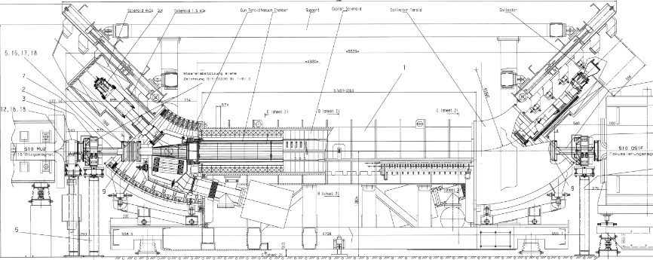
SIS18 electron cooler

Slide 4
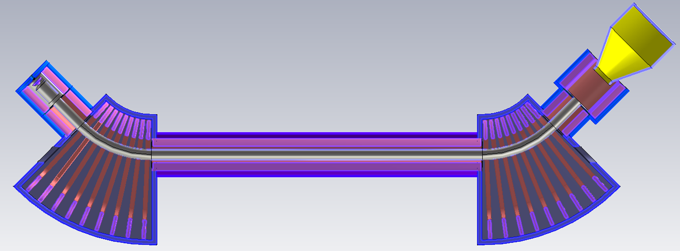
Electron lens design
3 solenoids with identical coils
2 toroidal section with identical (9) coils
main solenoid
pre-collector solenoid
collector
cathode
anode
beampipe
grounded electrode
ceramic insulator

Slide 5
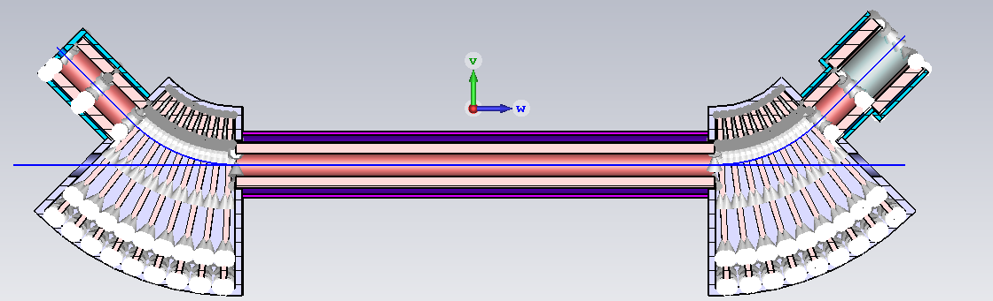
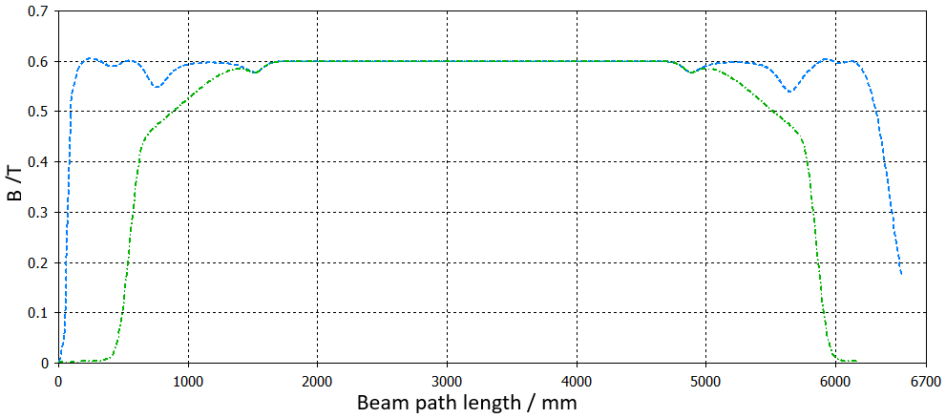
Magnetic field 0.6T
electron path
ion path

Slide 6
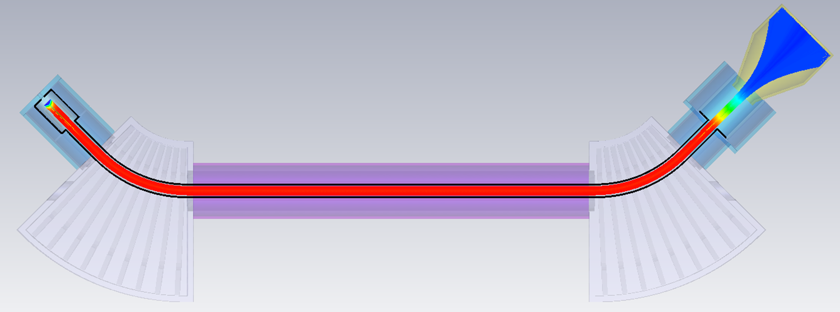
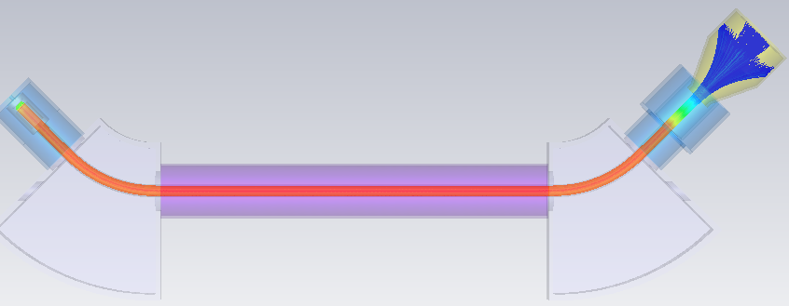
Electron beam transport simulation
without space charge
simulation
time has to
be increased
with space charge

Slide 7
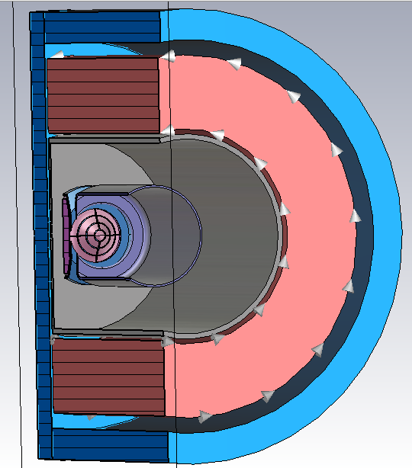
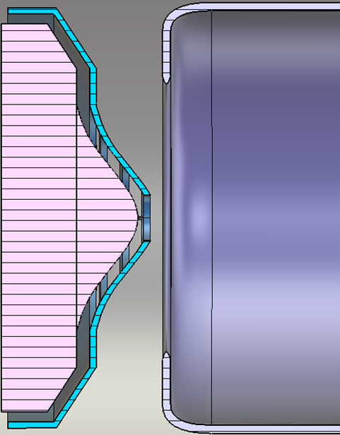
Setup: gun solenoid (only)
iron cover for shielding
coil
beampipe
cathode
anode
grid

Slide 8
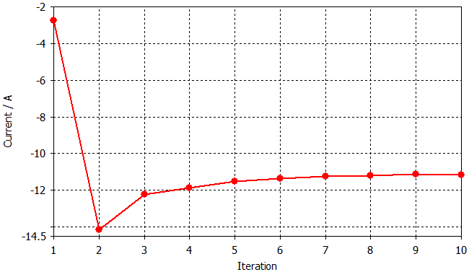
Source current: 11 A
the solver iteratively repeats an electrostatic calculation and then tracks the particles until the desired accuracy of the space charge deviation between two successive iterations is reached.
Notes:
Iterative gun solver algorithm is activated. Thus the tracking solver does not just track the particles once through the computational domain. Instead, the solver iteratively repeats an electrostatic calculation and then tracks the particles until the desired accuracy of the space charge deviation between two successive iterations is reached.

Slide 9
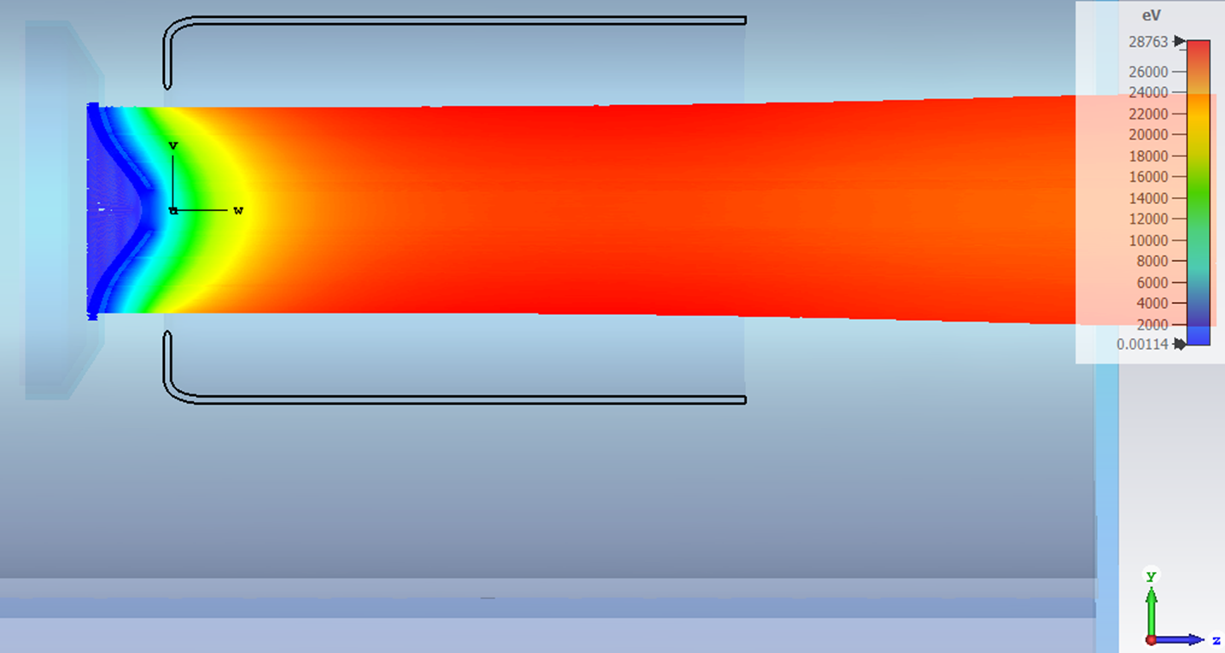
Electron beam trajectories

Slide 10
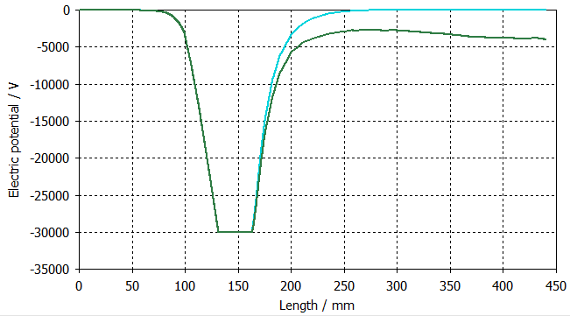
Potential vs. path
position where electron beam reaches acceleration
potential w/o e⁻ beam
potential with e⁻ beam
position of cathode
cathode thickness is 31.6 mm
Notes:
In mathematics and computational geometry, a Delaunay triangulation (also known as a Delone triangulation) for a given set P of discrete points in a general position is a triangulation DT(P) such that no point in P is inside the circumcircle of any triangle in DT(P)

Slide 11
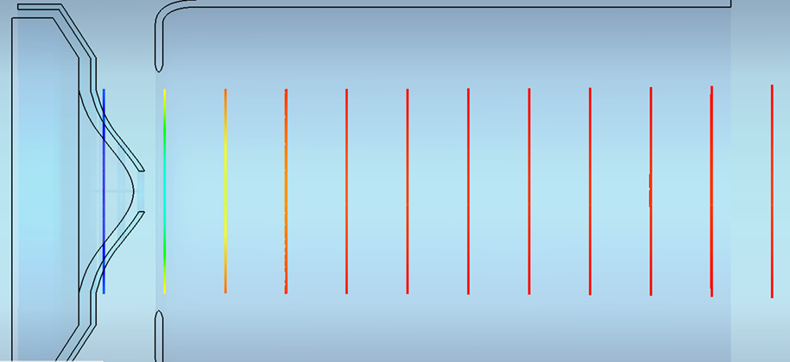
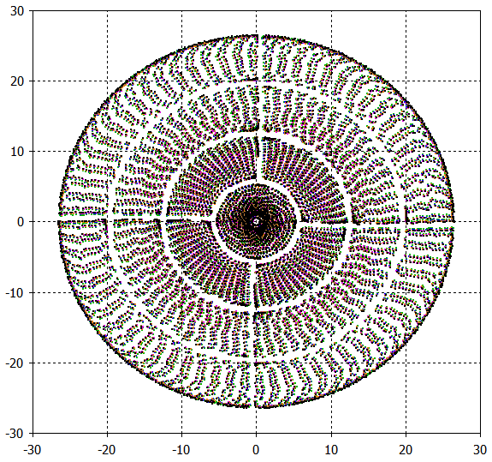
2D virtual beam monitors
x /mm

Slide 12
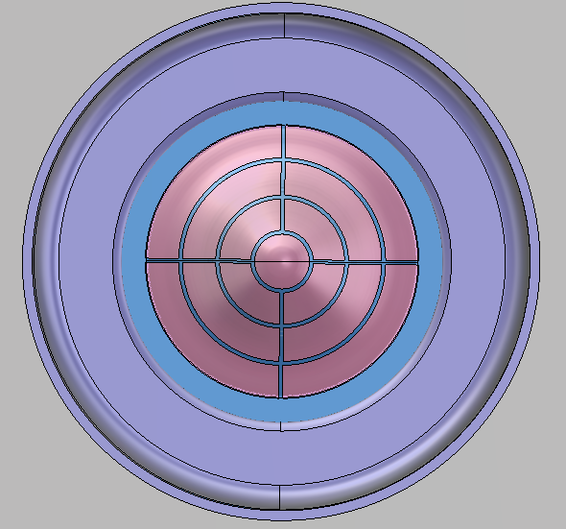
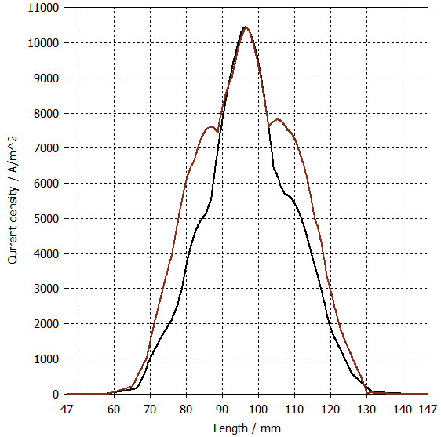
Current density
longitudinal position of current monitor

Slide 13
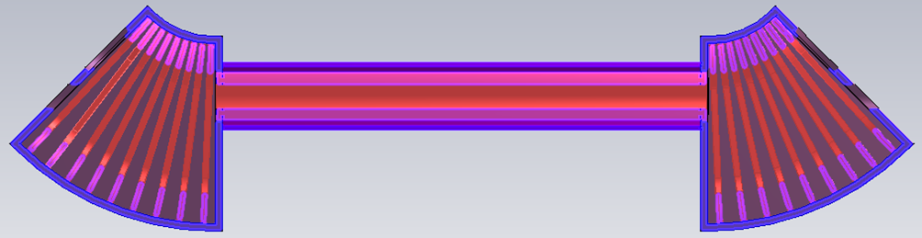
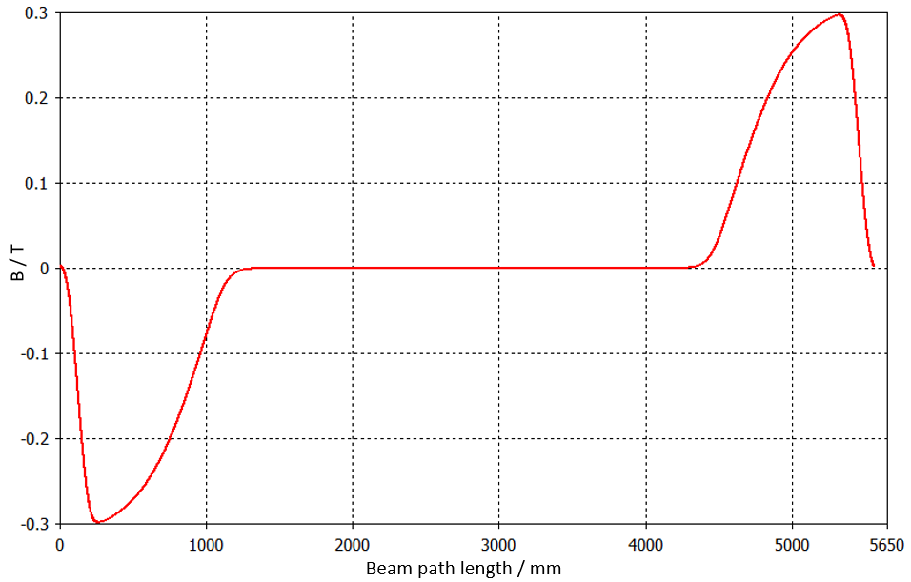
Transverse magnetic field along ion path
ion path
B_{y} /T

Slide 14
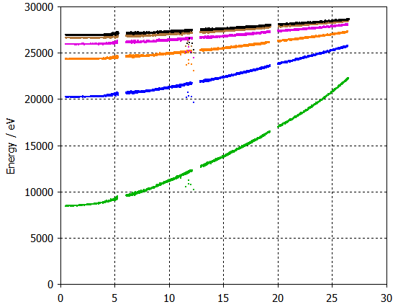
Energy vs. beam radius (mm)

Slide 15
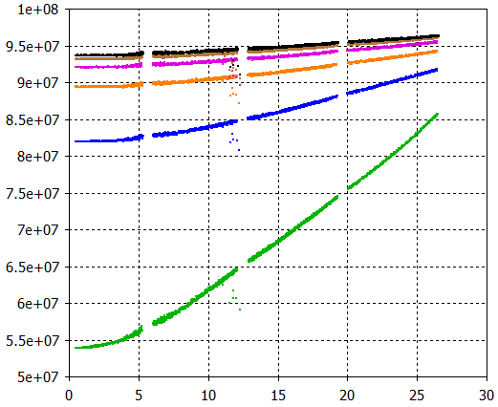
Velocity (m/s) vs. beam radius (mm)

Slide 16
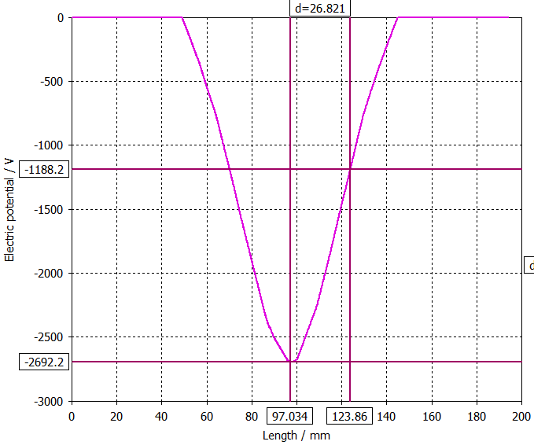
Space charge potential of electron beam
particle position at the edge of beam
beam center

Slide 17
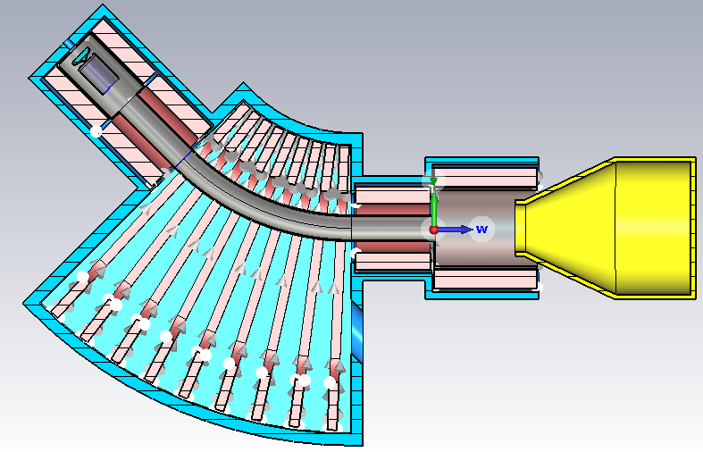
Setup for collector design and SEE simulation

Slide 18
Thank you for your attention!

Slide 19
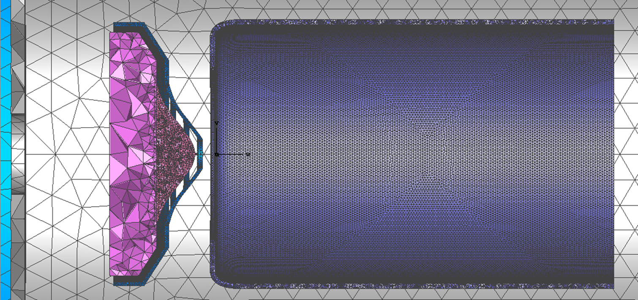
Mesh: a Delaunay triangulation

