Slide 1


Differentiable Programming for Experimental Design
Louvain-la-Neuve, September 8, 2021
White Paper
Tommaso Dorigo
INFN, Sezione di Padova

Slide 2
White Paper on Differentiable Programming for Experimental Design
This is a MODE collaboration activity – we are hereby hijacking a piece of this morning session to discuss our business
not by accident: you could be an author of this paper if you join MODE
In our mind, this will be a comprehensive look (review-style) of the ongoing efforts in this direction, and a plan of research activities
The document is already partly drafted, but we need significant additional effort and some commitment to finalize it.

Slide 3
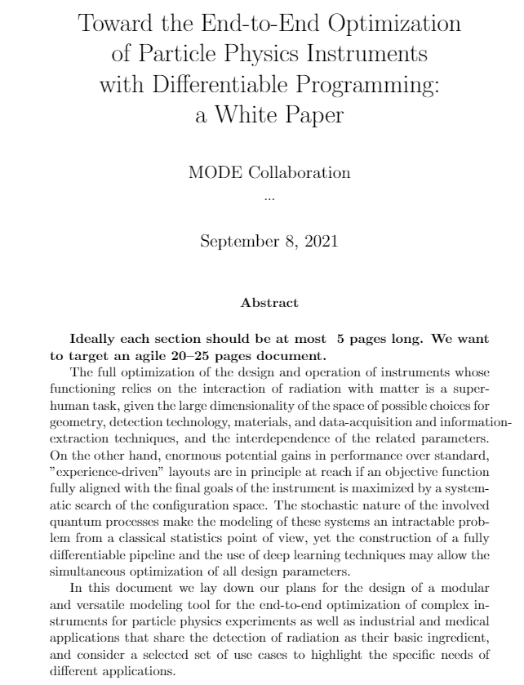
Present status of the document
We have an overleaf shared document which we have been drafting intermittently
We target the journal Reviews in Physics, or similar (bonus of above: no fee)

Slide 4
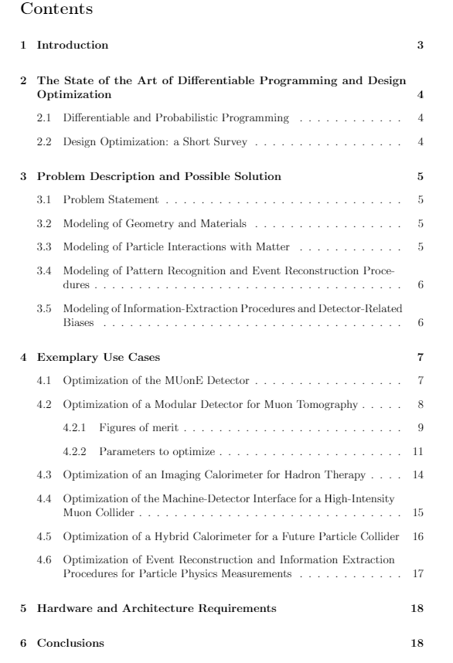
Present status of the document
Divided in 6 sections
Content list of section 4 is still tentative - we will populate it with applications we care to describe, and on which we foresee future activities

Slide 5
We need an opt-in system to take care of the sections to be drafted
Section 1: (intro) partly written, should be easy to finalize
Section 2 (state of the art in CS): need volunteers to take on, break down in subsections, and do drafting / coordinate
Section 3 (problem description and possible solutions): also need volunteers to coordinate revision and drafting of what is missing
Section 4 (use cases): we have good text on Muography (thx Andrea), we need to focus on a couple of interesting exemplary other cases, and identify contributors
Section 5 (hardware and architecture req’s): also in need of a couple of volunteers
Not going to start polling the audience or twist arms, but I believe this should be seen as a great opportunity – the effort is small, as the length of the paper is constrained and we only need to produce summaries of ideas.

