Slide 1


RF Systems I
H. Damerau
CERN
Introduction to Accelerator Physics
3 October 2021

Slide 2
Copyright statement and speaker’s release for video publishing
The author consents to the photographic, audio and video recording of this lecture at the CERN Accelerator School. The term “lecture” includes any material incorporated therein including but not limited to text, images and references.
The author hereby grants CERN a royalty-free license to use his image and name as well as the recordings mentioned above, in order to post them on the CAS website.
The author hereby confirms that to his best knowledge the content of the lecture does not infringe the copyright, intellectual property or privacy rights of any third party. The author has cited and credited any third-party contribution in accordance with applicable professional standards and legislation in matters of attribution. Nevertheless the material represent entirely standard teaching material known for more than ten years. Naturally some figures will look alike those produced by other teachers.

Slide 3
Outline
Introduction
Choice of parameters
  Frequency and voltage
RF cavity parameters
  Shunt impedance, beam loading, power coupling
Power amplifiers
  Tube or solid state
  Local feedbacks
Longitudinal beam control system
  Building blocks: RF source and receiver
  Phase, radial and synchronization loops
Summary

Slide 4
Introduction

Slide 5
Introduction
Beam
The radiofrequency (RF) system transforms a string of magnets into an accelerator
Cavity most is the most visible part of an RF system
  On top of the RF system food chain
  Interacts directly with beam
Cavity
Power amplifier
Low-level RF
system
What is below?
How are RF signals generated which make the beam feel comfortable?
Beam

Slide 6
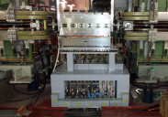
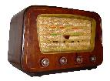
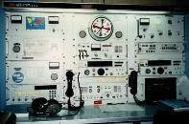
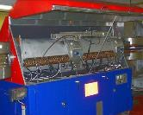
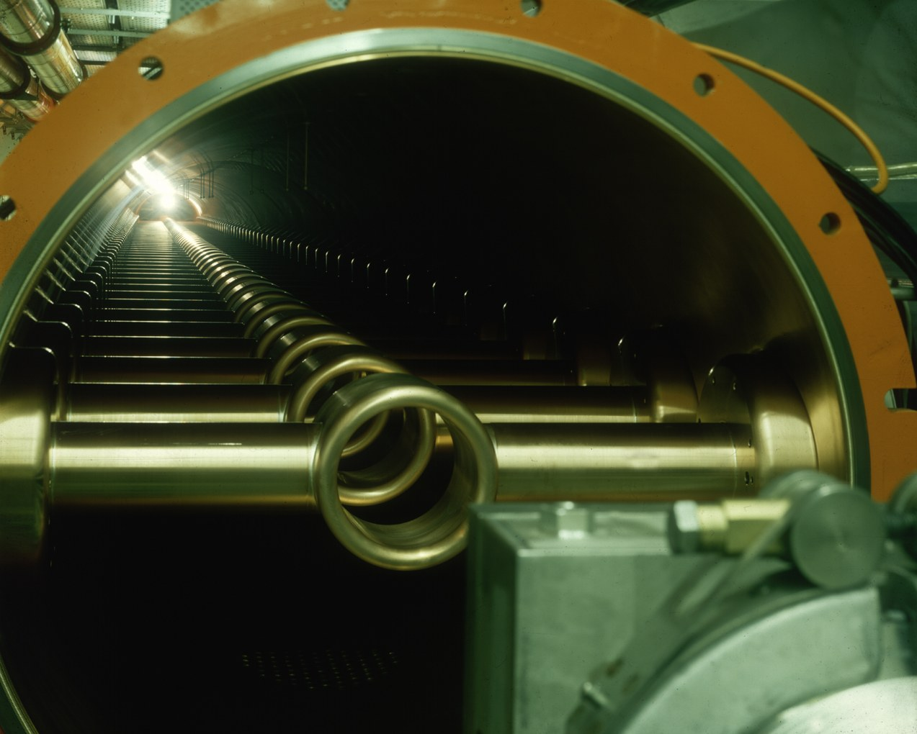
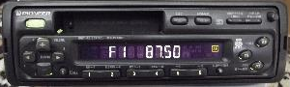

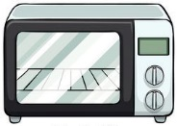
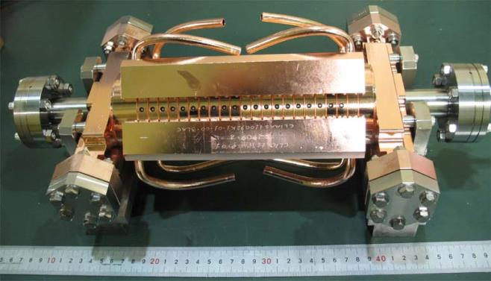

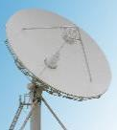
Frequency and wavelength ranges
PS longitudi- nal damper
100 kHz
3 km
Long wave
1 MHz
300 m
PS main RF system
Medium/ short wave
10 MHz
30 m
100 MHz
3 m
SPS 200 MHz
1 GHz
30 cm
VHF
10 GHz
3 cm
100 GHz
3 mm
Microwave links
CLIC 12 GHz

Slide 7
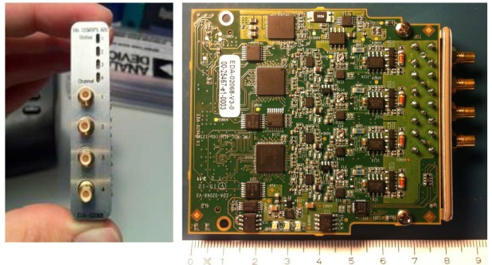
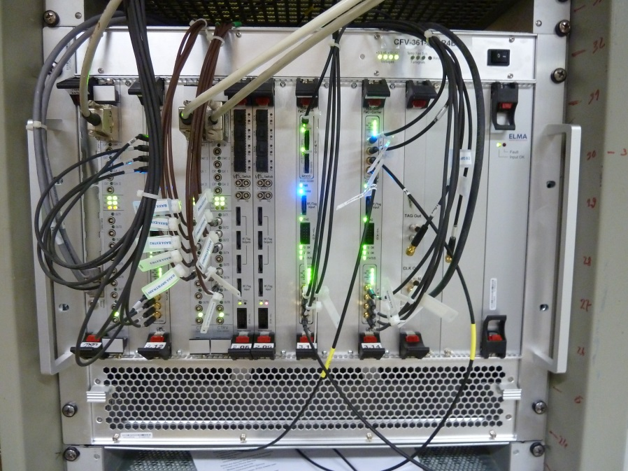
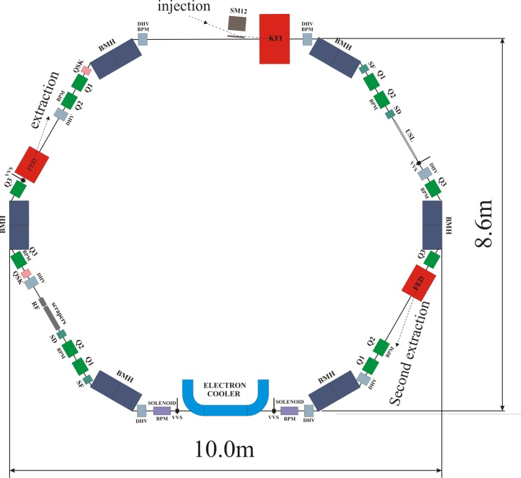
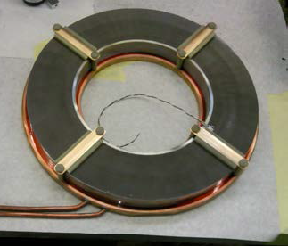
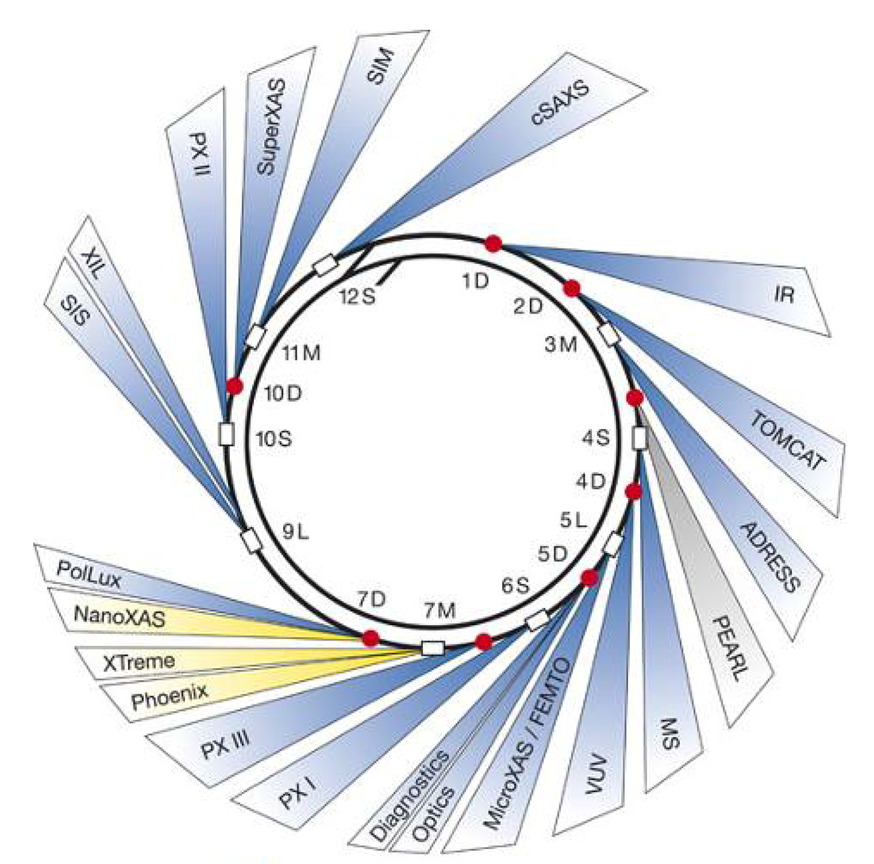
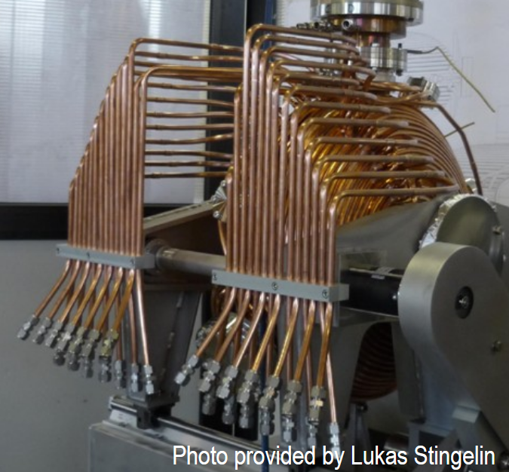
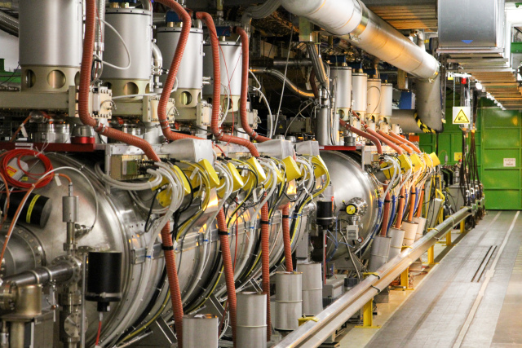
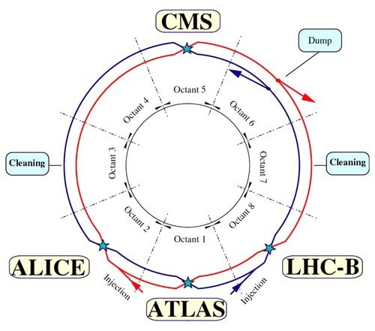
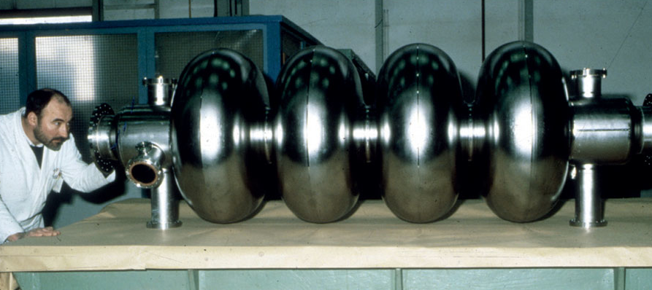
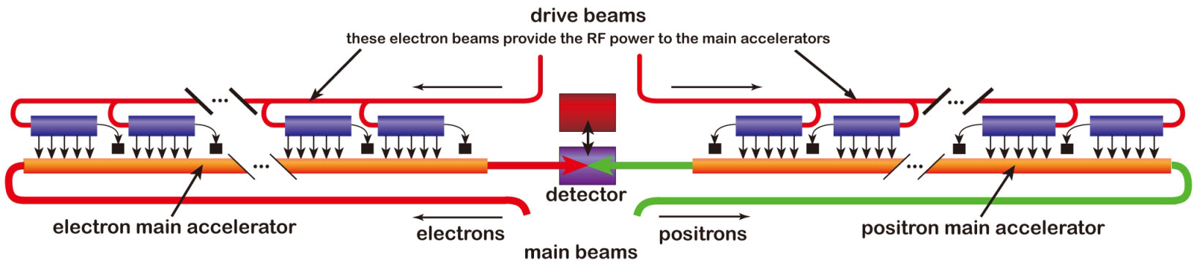
Amplitude ranges
Signals from beam pick-ups
1 μV
1 mV
Cooled hadron beams (ELENA)
LLRF systems
Low/Medium energy hadron RF
1 V
Electron light
sources
SLS
1 kV
1 MV
LHC: 16 MV
LHC
1 GV
LEP: 3.6 GV total
ILC and CLIC: several TV

Slide 8
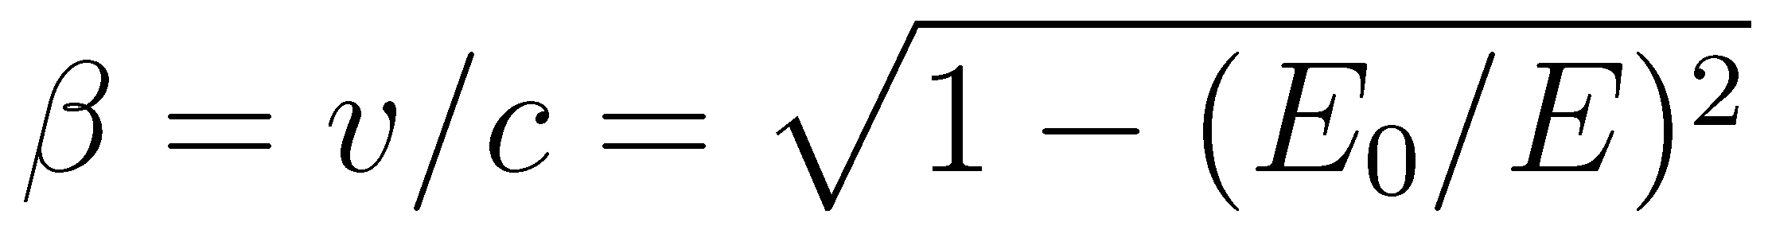
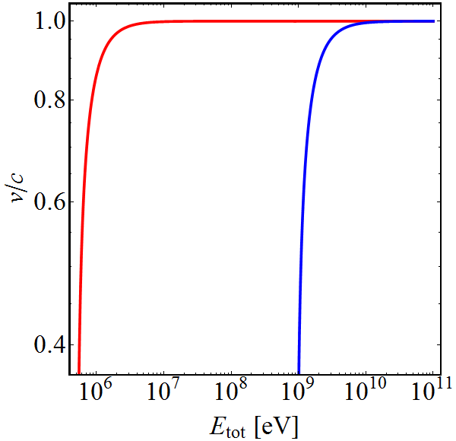
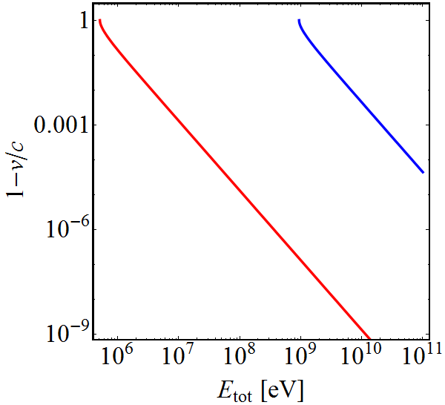

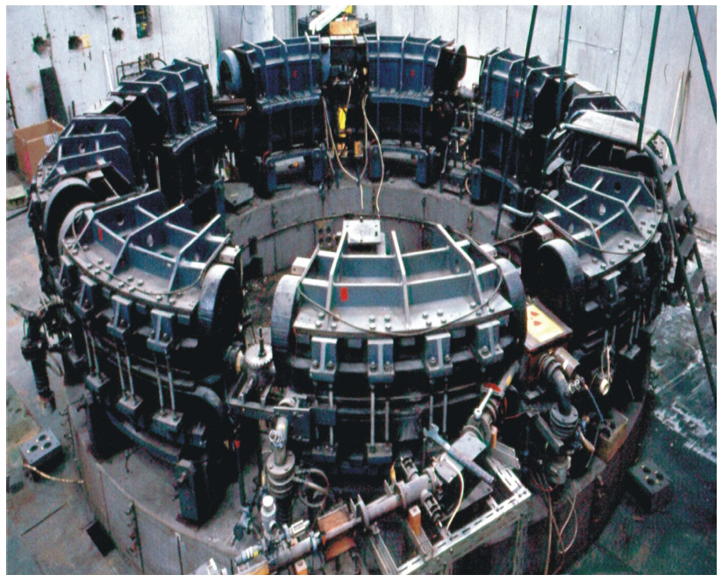
Particle velocity
Particle velocity depends on its type:
Old television set (30 kV): Electrons at 30% of c₀
            Protons just at 0.7%
Small synchrotron (500 MeV): Electrons at 99.99995%
              Protons at 75.8%
Most electron accelerators at ‘fixed’ frequency
e⁻
p⁺
e⁻
p⁺

Slide 9
Parameter choices

Slide 10

RF system for high-energy accelerators
Accelerator type
Linear
Circular
(single pass)
(multi-pass)
Electron
Hadrons
Electron
Hadrons
Compensate synchrotron radiation losses
Sweep frequency with beam
Maximum RF voltage, constant velocity
Maximum RF voltage, variable velocity
*
*Exceptions (rare) exist

Slide 11
Choice of frequency (range)

Slide 12
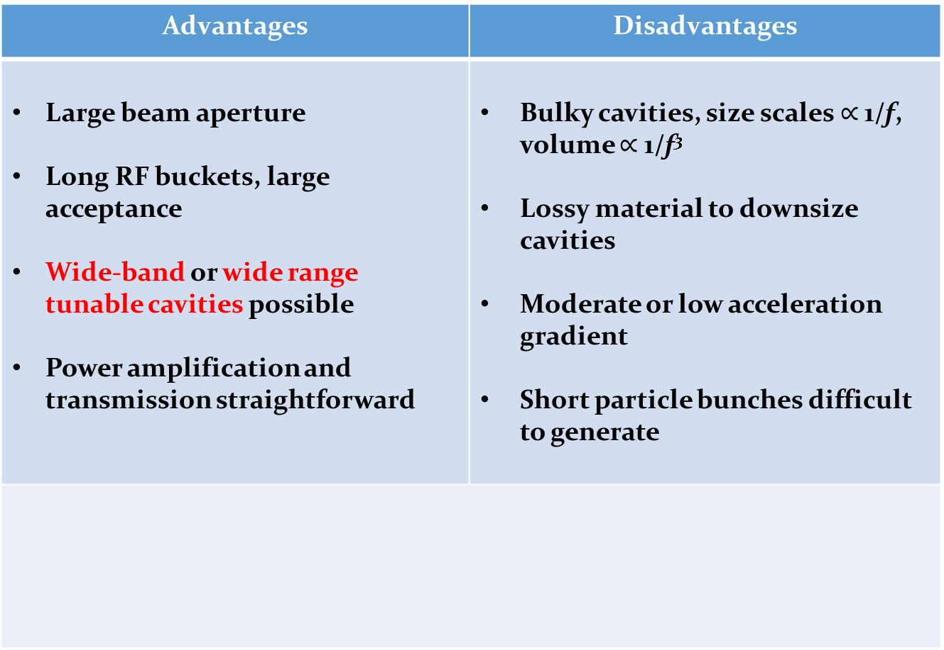
Why choose a low RF frequency?
Advantages | Disadvantages
Large beam aperture Long RF buckets, large acceptance Wide-band or wide range tunable cavities possible Power amplification and transmission straightforward | Bulky cavities, size scales $∝$ 1/f, volume $∝$ 1/f³ Lossy material to downsize cavities Moderate or low acceleration gradient Short particle bunches difficult to generate
  Some hadron linear accelerators
  Cyclotrons
  Low- and medium energy hadron synchrotrons
  RF frequencies below
  ~200 MHz for

Slide 13
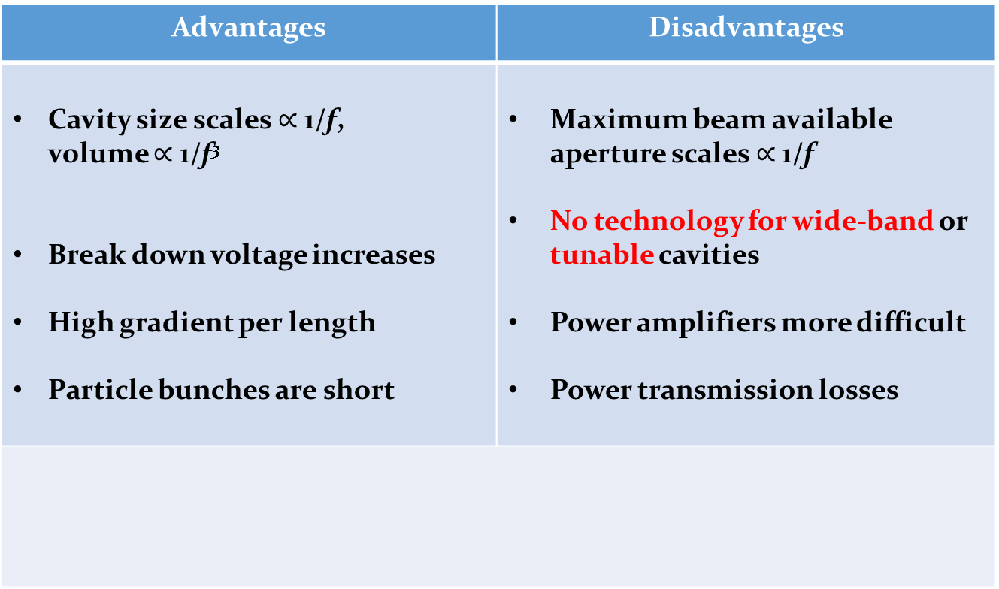
Why choose a high RF frequency?
Advantages | Disadvantages
Cavity size scales $∝$ 1/f, volume $∝$ 1/f³ Break down voltage increases High gradient per length Particle bunches are short | Maximum beam available aperture scales $∝$ 1/f No technology for wide-band or tunable cavities Power amplifiers more difficult Power transmission losses
  Linear accelerators
  Electron storage rings
  High energy hadron storage rings
  RF frequencies above
  ~200 MHz used for

Slide 14
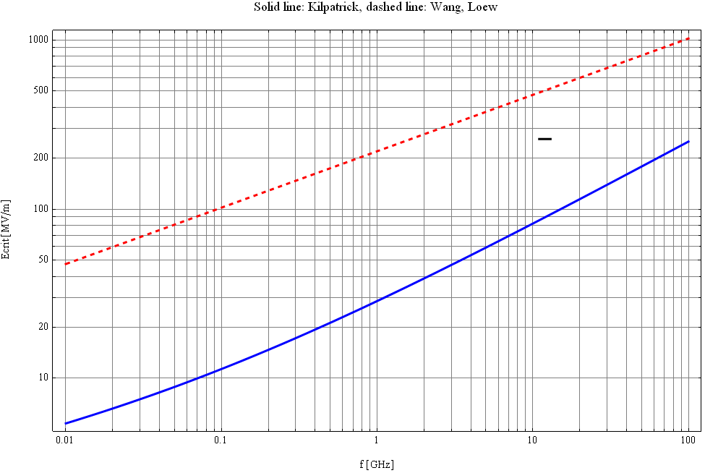
Limits to maximum gradient
Surface electric field in vacuum
1000
500
Wang & Loew,
SLAC-PUB-7684, 1997
200
100
E_{crit} [MV/m]
50
Kilpatrick 1957,
f in GHz, E_{crit} in MV/m
20
10
0.01
0.1
1
10
100
f [GHz]
High frequencies preferred for large gradient
E. Jensen

Slide 15
Some standard frequencies
If exact RF frequency not critical, choose standard value
Off-the-shelf RF components easily available in frequency ranges used by industry
Exchange of developments and equipment amongst research laboratories
Accelerator | Frequency
Hadron synchrotrons (PSB, PS, JPARC RCS, MR) | <10 MHz
Hadron accelerators and storage rings (RHIC, SPS) | ~200 MHz
Electron storage rings (LEP, ESRF, Soleil) | 352 MHz
Electron storage rings (DORIS, BESSY, SLS,…) | 499.6…499.8 MHz
Superconducting electron linacs and FELs (X-FEL, ILC) | 1300 MHz
Normal conducting electron linacs (SLAC) | 2856 MHz
High-gradient electron linac (CLIC) | 11.99 GHz

Slide 16
RF voltage

Slide 17

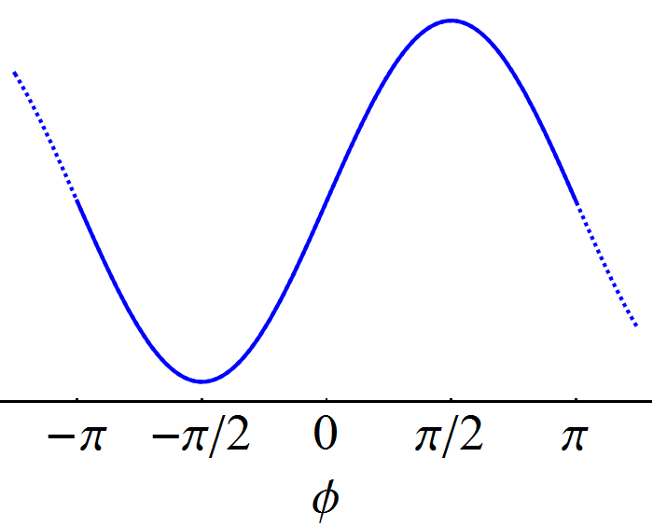


Minimum voltage requirement
RF system expected to provide given energy gain
On-crest acceleration
Used in some linear accelerators
Insufficient in a circular accelerator
More voltage provided to avoid on-crest acceleration
Off-crest acceleration
Needed for circular accelerator
Higher voltage for given energy gain
→

Slide 18
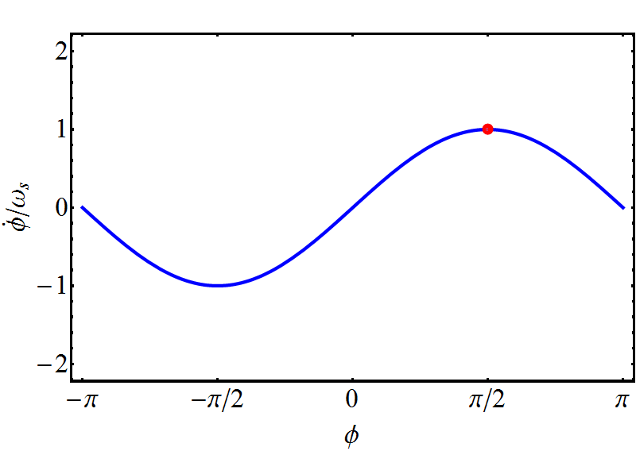
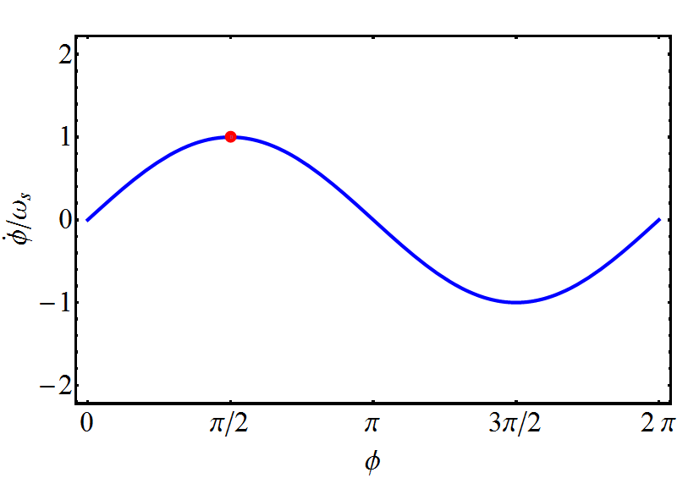
Bucket area dependence on stable phase
In a circular accelerator the area in energy-time phase space (bucket area) depends on the stable phase
Below transition, φ_{S} = 0…90°
Below transition, φ_{S} = 90°…180°
Typical synchronous phase with respect to 0° or 180°
  Hadron accelerators: < 40°
  Electron storage rings: ~ 20°

Slide 19
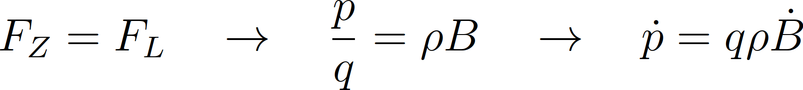
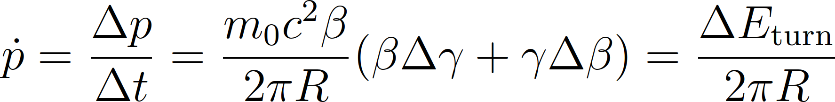
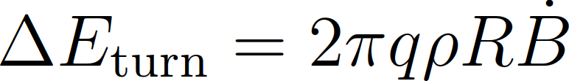
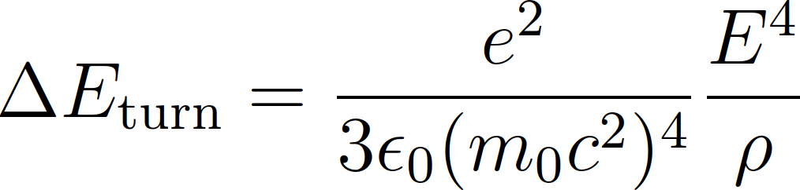
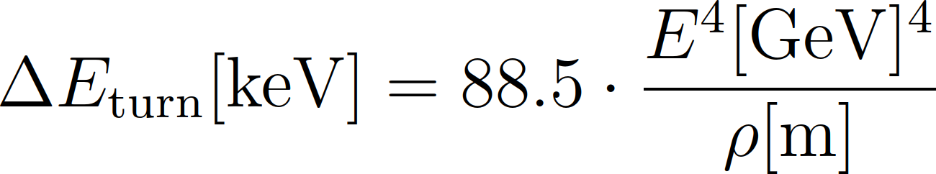
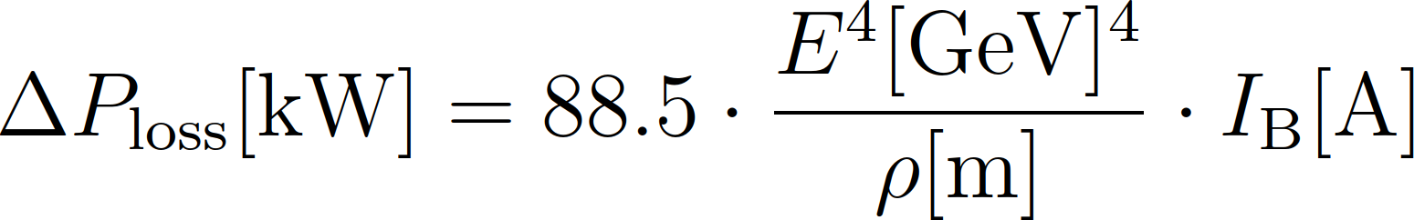
Minimum voltage requirement (circular)
The RF system must compensate
Energy gain per turn due to changing magnetic field
Energy loss, e.g., due to synchrotron radiation (electrons)
(m_{p}/m_{e})⁴ = 1836⁴ ~ 1.1 ∙ 10¹³ times less for protons

Slide 20
RF system overview
Beam
Cavity
Convert RF power into longitudinal electric field
Amplify low-power signal from beam control to kW, MW or GW
Provide RF signals with correct frequency, amplitude and phase
Power amplifier
Low-level RF
system
Beam

Slide 21
RF system overview
Beam
Cavity
Convert RF power into longitudinal electric field
Amplify low-power signal from beam control to kW, MW or GW
Provide RF signals with correct frequency, amplitude and phase
Power amplifier
Low-level RF
system
Beam

Slide 22
RF cavity

Slide 23
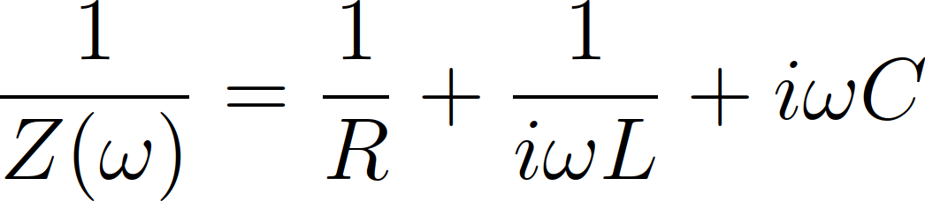
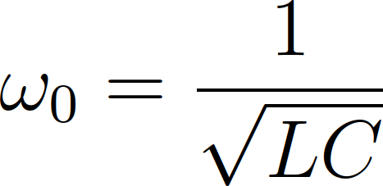
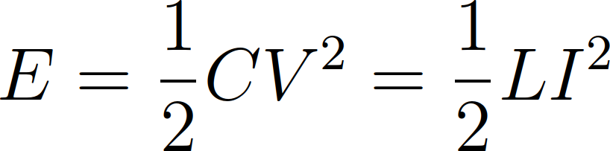
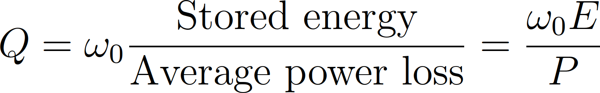
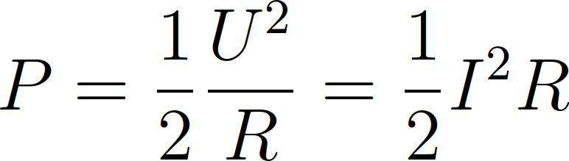
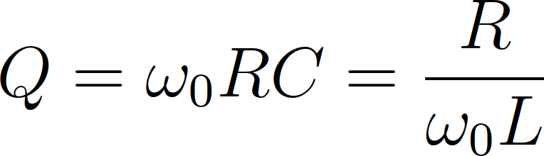
Cavity parameters
The resonance of a cavity can be understood as simple parallel resonant circuit described by R, L, C
L
R
C
Z(ω)
with

Slide 24
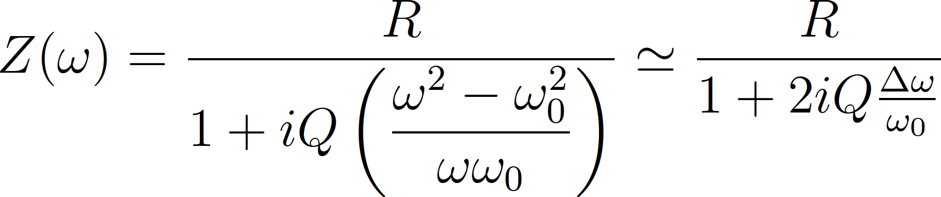
Cavity parameters
The resonance of a cavity can be understood as simple parallel resonant circuit described by R, L, C
Resonant circuit can also be described by R, R/Q, ω₀ or any other set of three parameters
L
R
C
Z(ω)
with

Slide 25
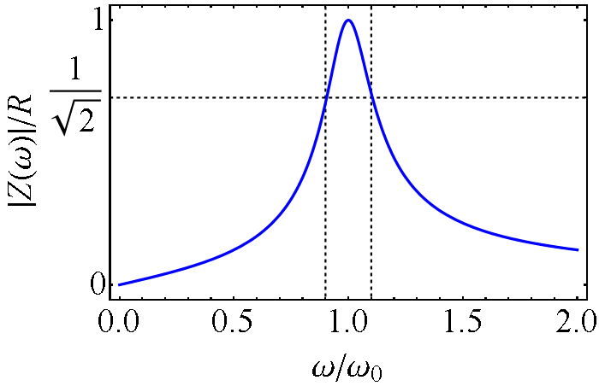
Cavity parameters
The resonance of a cavity can be understood as simple parallel resonant circuit described by R, L, C
Resonant circuit can also be described by R, R/Q, ω₀ or any other set of three parameters
L
R
C
Z(ω)
Δω

Slide 26
Cavity parameters
Most common choice by cavity designers ω₀, R, R/Q – why?
Resonance frequency, ω₀
  Exactly defined for given application, e.g. hf_{rev}
Shunt impedance, R
  Power required to produce a given voltage without beam
“R-upon-Q”, R/Q
  Defined only by the cavity geometry
  Criterion to optimize a geometry
  Detuning with beam proportional to R/Q

Slide 27
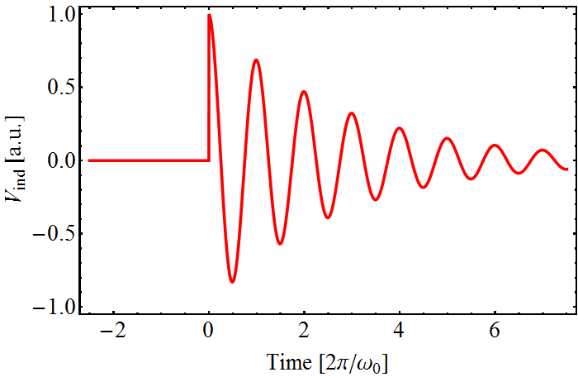

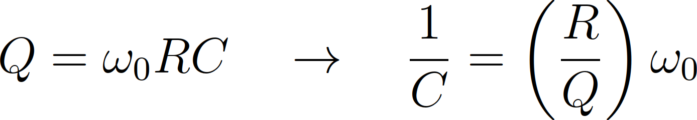
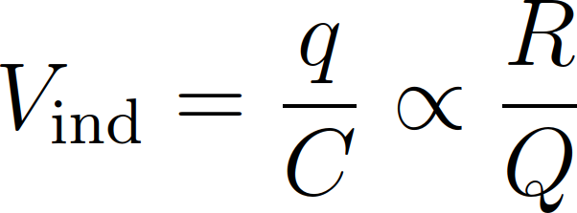
Why R/Q?
Charged particle experiences cavity gap as capacitor
Cavity geometry with small R/Q to reduce beam loading
Cavity
Beam induced voltage
q

Slide 28
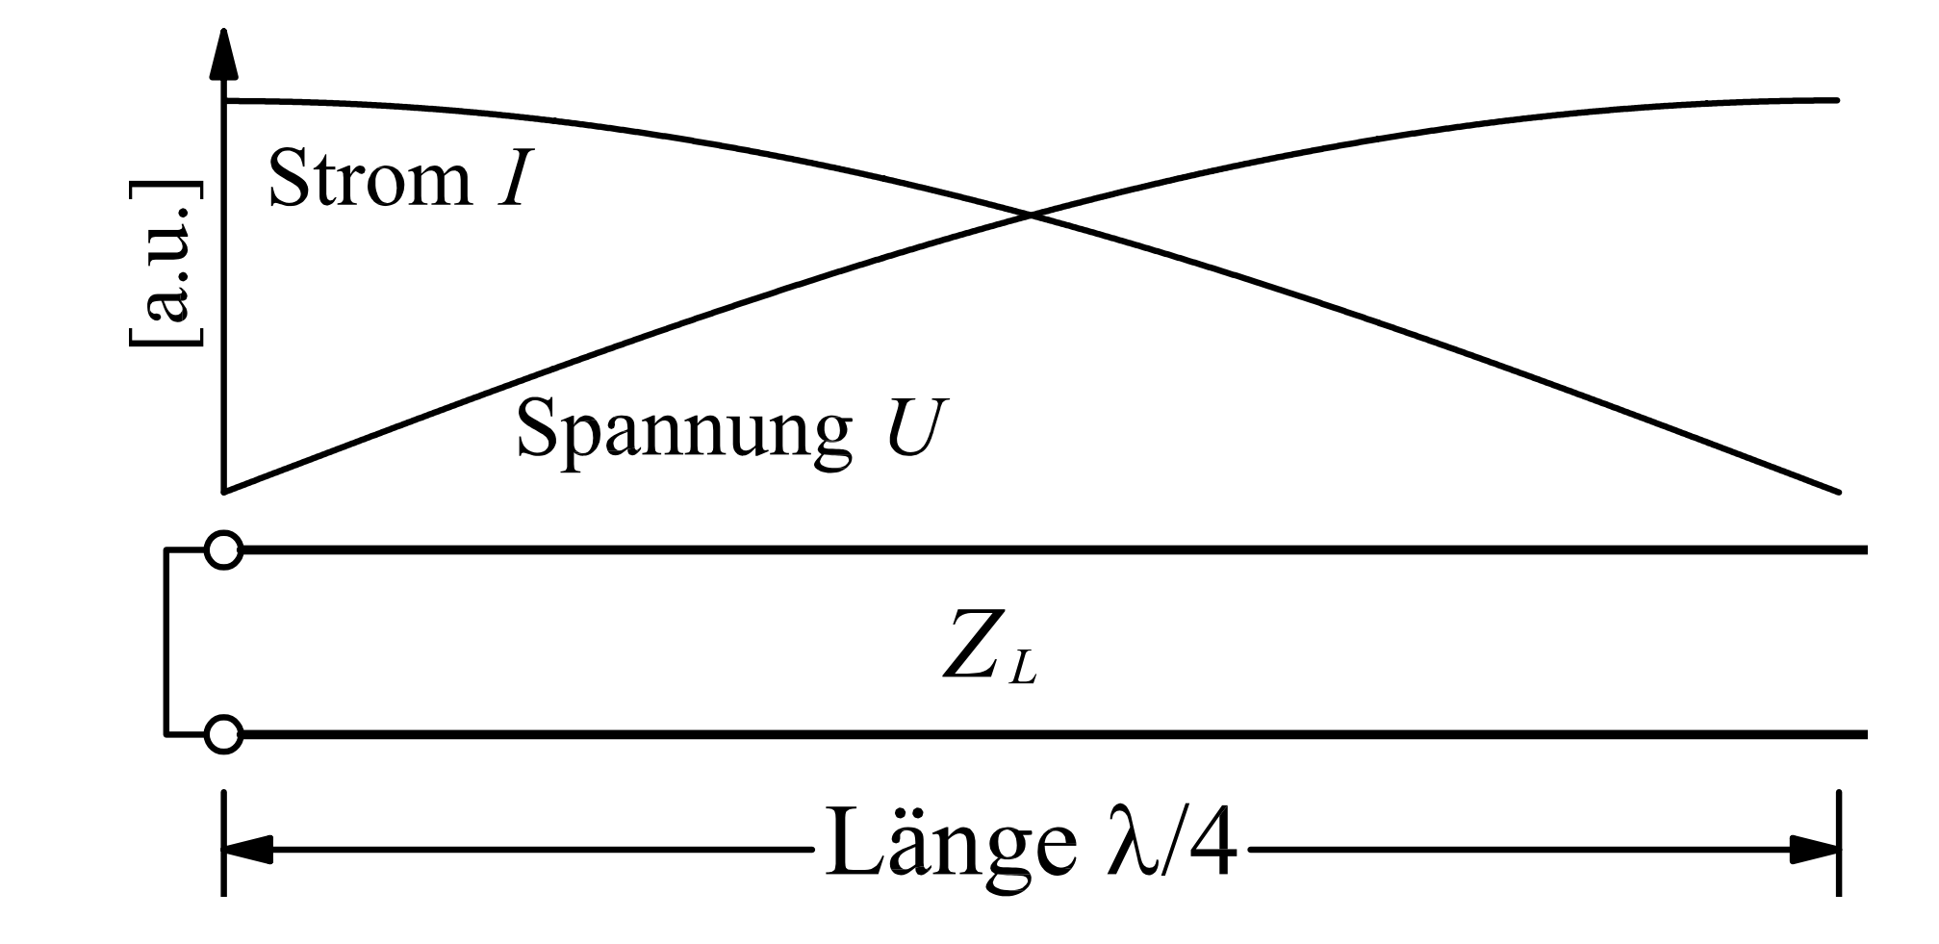
RF cavities in low frequency range
RF wavelength large below ~10 MHz: >30 m
Would need huge cavities → too large for accelerators
Line resonators: λ/4 resonator
  Short circuit on one side → Voltage is zero
  Open end on other → No current but voltage
Why is this resonator so common in particle accelerators?
Voltage
Current
Z(ω)
Transmission line, impedance Z_{L}
Short-
circuit
λ/4 length

Slide 29
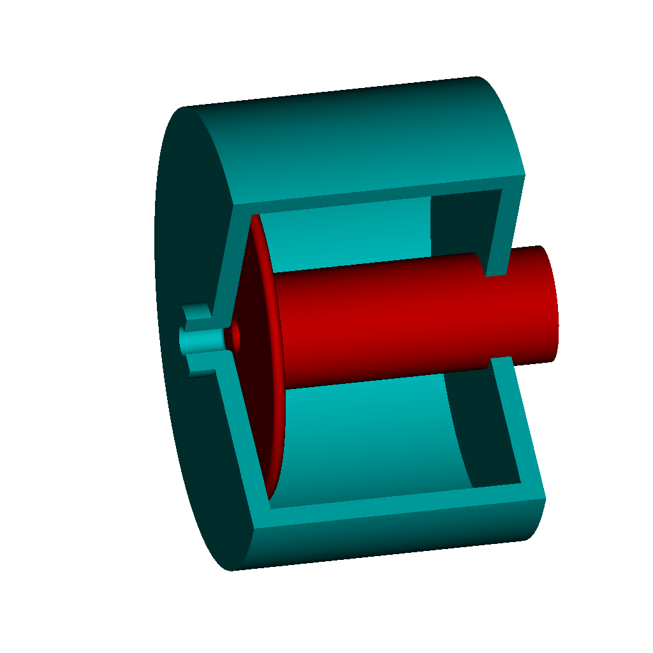
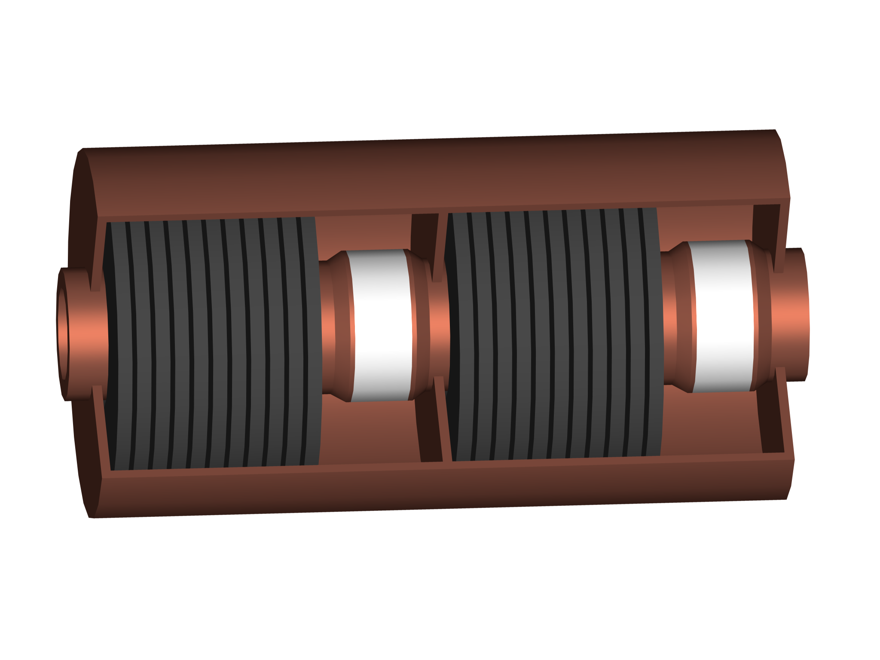
RF cavities in low frequency range
Coaxial structure with inner conductor as beam pipe
Z(ω)
Beam axis
Short-
circuit
Accelerating gap, isolated
Still rather long geometry, 7.5 m at 10 MHz
Add capacitive or inductive shortening
Plate
capacitor
Ferrite
inductivity

Slide 30
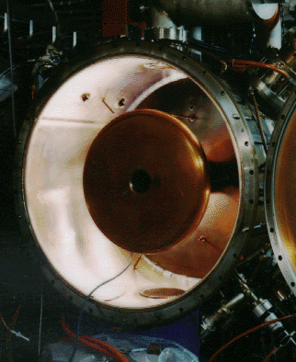



Capacitive loading
Add capacitor at gap of cavity to shorten the resonator
NSLS, 52.88 MHz
DESY PIA, 10.4 MHz, inner cond.
Outer cond.
~1 m
M. Nagl
ACOL, 9.53 MHz
Significantly reduces cavity size
Fixed frequency only
Small losses due to capacitor
Cavity in vacuum

Slide 31


Inductive loading
Inductive loading with magnetic material shortens resonator from tens of meters to a device, lossy though
CERN PSB Finemet cav., 0.6-18 MHz
CERN PS, double gap, 2.8-10 MHz
M. Paoluzzi
Additional advantage: permeability of ferrite can be controlled by DC bias current → variable inductivity
  Cavity with programmable resonance frequency
  Essential for hadron acceleration in low-energy accelerators

Slide 32


Tunable cavities at higher frequencies
Remove inductive or capacitive loading
SSC Low Energy Booster,
~47 MHz to 60 MHz
FNAL Booster 2nd harmonic,
76 MHz – 106 MHz, 100 kV
R. L. Madrak, IPAC16, p. 130
C. C. Friedrichs et al., PAC91, p. 1020
Upper frequency limit for cavities with large tuning range

Slide 33



Further increase frequency
Remove inner conductor from coaxial set-up
The resonator becomes a pill-box cavity
The basis for cavity resonators
Beam axis
DORIS cavity
Electric field, TM₀₁₀-mode
Magnetic field, TM₀₁₀-mode
Beam axis
E. Jensen

Slide 34



Example: 400 MHz cavities in LHC
Reduce beam loading in RF cavities
Shunt impedance, R, low for small R/Q with normal conducting cavities → superconducting cavities in LHC
Bell shape: R/Q ~ 44 Ω, 400 MHz
2×8 cavities, 5.3 MV/m
~o

Slide 35



RF cavities in linear accelerators
Beam only passes once → Maximize gradient
Many accelerating cells to best reuse RF voltage
Cavity is the contrary to ‘one size fits all’
Many, many more variants
SuperHILAC, ~70 MHz, Berkley
CLIC, 12 GHz, ~100 MV/m

Slide 36
Coupling power
into a cavity

Slide 37



Coupling power into a cavity
Attack inductivity or capacitance of resonator, or combined
Coupling loop forms transformer with resonator inductivity
L
R
C
RF power
L_{c}
M
Main coupler
PSI cyclotron
~1 MW at 50 MHz
A. Rodchenko
L. Stigelin

Slide 38

Coupling power into a cavity
Attack inductivity or capacitance of resonator, or combined
Capacitive divider to gap to
transform generator impedance
to cavity shunt impedance
Beam also couples
capacitively via the gap
L
R
C
C_{c}
Beam
RF power
Coupler of CERN PS 40 MHz
Coupler forms one half of capacitor with the gap

Slide 39


Capacitive (electric) coupling
Coupling through an electric antenna
Electrical coupler to space
Power coupler of LHC cavities
300 kW at 400 MHz
https://en.wikipedia.org/wiki/Transmitter_Solt
2 MW at 540 kHz
Coupler antenna transmits directly into the cavity

Slide 40
RF system overview
Beam
Cavity
Convert RF power into longitudinal electric field
Amplify low-power signal from beam control to kW, MW or GW
Provide RF signals with correct frequency, amplitude and phase
Power amplifier
Low-level RF
system
Beam

Slide 41
Power amplifiers

Slide 42





How much power is required?
Power to accelerate beam → Wanted
Compensate beam-induced voltage → Refl. P
Compensate electrical losses in cavity → Heat
Compensate electrical losses in distribution → Heat
(ideally)

Slide 43

Power amplifiers
Basically
P_{out} = g ∙ P_{in} or V_{out} = $\sqrt{g}$ ∙ V_{in}
The ideal power amplifier
  Large bandwidth: amplifies all frequencies equally
  No saturation, infinite power
  Zero delay
  No added noise
  Unconditionally stable and resistant to reverse power
  Radiation-hard
Unfortunately such a device has not been invented yet
Let us have a look at some real amplifiers

Slide 44
Basics of grid tube
From diode to tetrode amplifier
Vacuum tube
Heater + Cathode
  Heated cathode
    Coated metal, carbides, borides,…
  thermionic emission
  Electron cloud
Anode
Diode
U_{a}*
anode
e-
e-
e-
e-
I_{a}
e-
e-
e-
e-
e-
e-
e-
Cathode and filament
*For tube amplifier designs voltages are named U instead of V
E. Montesinos

Slide 45
Basics of grid tube
From diode to tetrode amplifier
Vacuum tube
Heater + Cathode
  Heated cathode
    Coated metal, carbides, borides,…
  thermionic emission
  Electron cloud
Anode
Diode
U_{a}
anode
I_{a}
e-
e-
e-
Cathode and filament
E. Montesinos

Slide 46
Basics of grid tube
From diode to tetrode amplifier
Triode
  Modulating the grid voltage proportionally modulates the anode current
  Transconductance
    Voltage at grid
    Current at anode
  Limitations
    Parasitic capacitor from anode to control grid (g1)
    Tendency to oscillate
U_{a}
anode
e-
e-
e-
e-
U_{g1}
control grid
e-
e-
e-
Cathode and filament
E. Montesinos

Slide 47
Basics of grid tube
From diode to tetrode amplifier
Tetrode
  Screen grid
    Positive (lower anode)
    Decouple anode and g1
    Higher gain
  Limitations
    Secondary electrons
    Anode treated to reduce secondary emission
U_{a}
anode
e-
e-
e-
e-
U_{g2}
Screen grid
U_{g1}
Control grid
e-
e-
e-
e-
e-
Cathode and filament
E. Montesinos

Slide 48
Tetrode based power amplifier
Example of SPS 200 MHz amplifier, tetrode RS2004
Very simplified block diagram
Grounded screen grid
RF out
U_{a}
Anode
RF in
U_{g2}
Screen grid
U_{g1}
Control grid
Cathode and filament
E. Montesinos

Slide 49



Example: Tetrode amplifier driving SPS RF
Two transmitters, 2 × 1 MW at 200 MHz (almost continuous)
Eight tetrodes per amplifier
In operation since 1976
RS2004 tetrode
Amplifier trolley
Complete transmitter
E. Montesinos

Slide 50

Tetrode amplifier driving PS RF
Frequency range 2.8…10 MHz, ~60 kW per cavity, 11 units
Space constraints to have amplifier installed below cavity
Tetrode is obvious choice
  High power in small volume
  Operates in radioactive environment
Amplifier trolley

Slide 51
Basics of linear beam tube
Klystron: a complete mini-accelerator
U_{beam}
Klystrons velocity modulation
  Converts the kinetic energy into RF power
Vacuum tube
Electron gun
  Thermionic cathode
  Anode
Electron beam
Drift space
Collector
e- constant speed until the collector
Collector
Drift Space
Electron Gun
U_{anode}
Cathode and filament
E. Montesinos

Slide 52

Basics of linear beam tube
Klystron: a complete mini-accelerator
U_{beam}
Cavity resonators and drift
RF input cavity (Buncher)
  Modulates electron velocity
Drift space
  Faster electrons catch up
  Slower electrons fall behind
RF output cavity (Catcher)
  Resonating atsame frequency
  as input cavity
  At place where electrons are maximally bunched
  Kinetic energy converted into voltage and extracted
Cavity
Coupling
loop
U_{anode}
Cathode and filament
Beam
line
Accelerating
gap
E. Montesinos

Slide 53
Basics of linear beam tube
Klystron: a complete mini-accelerator
Cavity resonators and drift
RF input cavity (Buncher)
  Modulates electron velocity
Drift space
  Faster electrons catch up
  Slower electrons fall behind
RF output cavity (Catcher)
  Resonating atsame frequency
  as input cavity
  At place where electrons are maximally bunched
  Kinetic energy converted into voltage and extracted
E. Montesinos

Slide 54





Example: Klystrons driving accelerators
2 × 8 cavities, each driven by separate 400 MHz klystron, 330 kW
First klystron amplifiers powering a hadron collider
Significantly more
power was required
to feed LEP (until 2000)
About 50 MW CW was
installed at 352 MHz
12 GHz pulsed klystron for CLIC
50 MW in 1.5 μs
E. Montesinos
G. McMonagle

Slide 55
Basics of RF solid state amplifiers
In a push-pull circuit the RF signal is applied to two devices
  One of the devices is active on the positive voltage swing and off during the negative voltage swing
  The other device works in the opposite manner so that the two devices conduct half the time
  The full RF signal is then amplified
Needs two different type of devices
V_{DC}
NPN BJT
V_{in}
V_{out}
PNP BJT
BJT: Bipolar Junction Transistor
E. Montesinos

Slide 56

Basics of RF solid state amplifiers
Another push-pull configuration is to use a balun (balanced-unbalanced)
  Power splitter, equally dividing the input power between the two transistors
  Balun keeps one port in phase and inverts the second port in phase
Since the signals are out of phase only one device is On at a time
This configuration is easier to manufacture since only one type of device is required
Vdc
0 ⁰
NPN BJT
0 ⁰
Input balun
(Unbalanced-Balanced)
Output balun
(Balanced-Unbalanced)
V_{in}
V_{out}
180 ⁰
180 ⁰
NPN BJT
NXP Semi-
conductors AN11325
2-way Doherty amplifier with BLF888A
E. Montesinos

Slide 57





Example: Soleil 45 kW, 352 MHz
Electron storage ring running at 352 MHz
DU1029UK
330 W amplifier module
600 W, 300 V_{DC}/30 V_{DC} converter

Slide 58



Example: Soleil 45 kW, 352 MHz
Large scale solid state amplifier installations
45 kW per tower (2004 and 2007)
150 kW per tower (2012)
Requires a series of power combiners to moderate power per amplifier module to several tens of kilowatts
E. Montesinos

Slide 59



Example: BESSY II
500 MHz solid state amplifiers: 4 × 80 kW for storage ring,
40 kW for booster synchrotron
Amplifier modules
80 kW unit
Combiner
Power per module limited by RF transistors
Increasing with modern semiconductor devices
B. Schriefer

Slide 60

Example: SPS
200 MHz solid state amplifiers: 2 × 1.6 MW peak power,
2 × 16 towers per amplifier
From LLRF
1.6 MW at cavity input
1/16 splitter
80 modules per tower, 1280 modules with 5120 transistors
per amplifier
Presently the largest RF installation in a particle accelerator
E. Montesinos

Slide 61
RF power amplifier
Power capability of commercially available amplifier types
E. Jensen

Slide 62
How to choose the right RF amplifier?
Prefer tube amplifier, when | Prefer solid-state amplifier, when
Amplifier must be installed in the accelerator tunnel Expecting important spikes from beam induced voltage Large output power of a single device is required, without combiners Not much space is available High peak power in pulsed mode Amplifier must be compact and/or close to cavity | Amplifier can be located in non-radioactive environment Circulator can be installed to protect the amplifier Delay due to unavoidable combiner stages is little issue Sufficient space can be made available Continuous operation Amplifier can be separate from the cavity
Mostly no hard criteria → decide on case by case basis

Slide 63
Summary
RF system parameters
  Choose frequency and voltage wisely
Parameters of RF cavities
  R, R/Q
  No ‘one-size fits’ all
Power amplifier
  Ideal amplifier does not (yet) exist
  Tube or solid-state based
Feedbacks and longitudinal beam control
  Make the beam feel comfortable in bucket
  Beam phase, radial and synchronization loops

Slide 64
RF Systems II
H. Damerau
CERN
Introduction to Accelerator Physics
4 October 2021

Slide 65
Copyright statement and speaker’s release for video publishing
The author consents to the photographic, audio and video recording of this lecture at the CERN Accelerator School. The term “lecture” includes any material incorporated therein including but not limited to text, images and references.
The author hereby grants CERN a royalty-free license to use his image and name as well as the recordings mentioned above, in order to post them on the CAS website.
The author hereby confirms that to his best knowledge the content of the lecture does not infringe the copyright, intellectual property or privacy rights of any third party. The author has cited and credited any third-party contribution in accordance with applicable professional standards and legislation in matters of attribution. Nevertheless the material represent entirely standard teaching material known for more than ten years. Naturally some figures will look alike those produced by other teachers.

Slide 66
Outline
Introduction
Choice of parameters
  Frequency and voltage
RF cavity parameters
  Shunt impedance, beam loading, power coupling
Power amplifiers
  Tube or solid state
  Local feedbacks
Longitudinal beam control system
  Building blocks: RF source and receiver
  Phase, radial and synchronization loops
Summary

Slide 67
RF system overview
Beam
Cavity
Convert RF power into longitudinal electric field
Amplify low-power signal from beam control to kW, MW or GW
Provide RF signals with correct frequency, amplitude and phase
Power amplifier
Low-level RF
system
Beam

Slide 68
Local feedbacks

Slide 69
Reduction of cavity impedance
Energy transfer from cavity to beam, but from beam to cavity
Both, RF generator and beam can induced voltage in cavity
Reduce beam induced voltage by reducing R, but not efficient
  Obviously needs more power → $$$
Feedback to decrease the apparent impedance for the beam
  Use amplifier to counteract beam induced voltage
L
R
C
Drive
Final amp
Beam
I_{G}
I_{B}

Slide 70

Reduction of cavity impedance
Energy transfer from cavity to beam, but from beam to cavity
Both, RF generator and beam can induced voltage in cavity
Compare drive signal (no beam) with gap (beam and generator)
Amplify inverted difference
V
FB ret.
L
R
C
-
+
Final amp
Beam
+
I_{G}
I_{B}
Drive

Slide 71

Example: 10 MHz RF system in CERN PS
Transfer function with and without feedback
Feedback gain of 24 dB
Equivalent impedance, Z_{eq}(ω)reduced
Impedance for amplifier remains unchanged, Z(ω)
~24 dB
Gain [dB]
Cavity, amplifier with feedback
Z(ω)
Z_{eq}(ω)
Frequency [MHz]
Why not further reduction with more gain?
Subtraction of gap voltage and drive signal imperfect due to
  Delay of cables and amplifier
  Parasitic resonances of amplifier and cavity system
  Bandwidth ↑ ↔ Achievable gain ↓

Slide 72

Example: 10 MHz RF system in CERN PS
  10 + 1 ferrite loaded cavities, tunable from 2.8…10 MHz
FB ret.
- Fast wide-band feedback
around amplifier (internal)
→ Gain limited by delay
+
Final amp.
Beam
+
1-turn delay feedback
Drive

Slide 73
Example: RF feedback with 1-turn delay
  10 + 1 ferrite loaded cavities, tunable from 2.8…10 MHz
FB ret.
- Fast wide-band feedback
around amplifier (internal)
→ Gain limited by delay
+
Final amp.
Beam
- 1-turn delay feedback
→ High gain at n × f_{rev}
+
1-turn delay feedback
Drive

Slide 74




Example: RF feedback with 1-turn delay
Reduce cavity impedance beyond stability limit of wide-band FB
Open/closed loop transfer functions
Spectrum at cavity gap return
Feedback off
Feedback on
10 dB/div
10 dB/div
h_{RF}=8
h_{RF}=8
D. Perrelet
Log. Amplitude [dB]
Log. Amplitude [dB]
Frequency [MHz]
Frequency
Frequency
Important additional impedance reduction
Clever usage of beam periodicity in circular accelerator
Frequency [MHz]

Slide 75
RF system overview
Beam
Cavity
Convert RF power into longitudinal electric field
Amplify low-power signal from beam control to kW, MW or GW
Provide RF signals with correct frequency, amplitude and phase
Power amplifier
Low-level RF
system
Beam

Slide 76
Global feedbacks
Low-level RF beam control

Slide 77
Longitudinal beam control
Local feedbacks → Act on individual RF stations
Global feedbacks → Act on all RF stations simultaneously
Δφ
2
τ₁₂
From beam control
RF source
τ₂₃
Δφ
1
Δφ
3
Time of flight compensation
τ₃₁
RF distribution to compensate time of flight between stations
Beam control drives all stations like a single one

Slide 78
Basic building blocks

Slide 79


Measure phase differences
Two signals at different frequencies ω₁ and ω₂
Phase difference, Δφ, between both signals changes linearly
Ambiguity to distinguish between Δφ = -π, π, -3π, 3π,...
Saw-tooth in phase means constant frequency difference
Equivalence of frequency and phase
↔

Slide 80





Mixer or multiplier
Example: analogue 4 quadrant multiplier and low pass filter
Signals:

Slide 81

Mixer or multiplier
Example: analogue 4 quadrant multiplier and low pass filter
Signals:
Remove ripple → Low-pass filter

Slide 82

How to detect phase differences?
Example: analogue 4 quadrant multiplier and low pass filter
Signals:
Phase discriminator in approximately +/-90° range
Remove ripple → Low-pass filter
Relative: arbitrary shift by 90°

Slide 83
RF sources

Slide 84



RF sources
What finally generates the RF signal to power amplifier and cavity?
Need an RF source!
Electron accelerators
  Off-the-shelf high-performance laboratory generators
  as reference: BESSY SR, CERN CTF3
  Dedicated commercial fixed-frequency sources with
  low phase noise: free electron lasers, CERN AWAKE
Proton accelerators
  Special sweeping RF sources, controlled by
  beam-based loops: mostly in-house developments

Slide 85



Noisy RF signals
Degradation of signal quality due to noise
  Amplitude and/or phase jitter
What is the difference between a coherent signal and noise?
Amplitude of coherent, quasi monochromatic signal (at 200 MHz) is independent of observation bandwidth
Incoherent noise power (dominated by spectrum analyzer front-end amplifier/mixer) is proportional to bandwidth
Thermal noise power
Noise
Noise

Slide 86




Analysis of phase noise
Compare noise power with carrier power as reference
Ratio of carrier to noise: dBc
Bandwidth Δf = 1 Hz for normalization
Δf
Noise power density
Its integral is the phase jitter and using
the jitter in time becomes

Slide 87




Typical phase noise plots
Measure phase noise of a synthesized lab generator
Frequency range | Δt_{rms} [fs]
10…100 Hz | 12.4
100 Hz …1 kHz | 5.4
1…10 kHz | 5.4
10…100 kHz | 11.1
100 kHz…1 MHz | 13.0
Total | 31.0
Note: jitter values can be added as square root of quadratic sum
Convenient split to relevant ranges

Slide 88




Variable frequency: direct digital synthesis
Generate (almost) any frequency starting from a given clock frequency, f_{clk}
Digitally programmable in frequency
RF signal
Digital data
f_{clk}
Phase accumu-lator
sin
Frequency word
sin/cos
look-up
t
cos
φ
t
2^{n} adder
t

Slide 89

Variable frequency: direct digital synthesis
Generate (almost) any frequency starting from a given clock frequency, f_{clk}
Digitally programmable in frequency
and phase
RF signal
Digital data
Phase offset word
f_{clk}
Phase accumu-lator
sin
Frequency word
CORDIC
t
cos
φ
φ
t
2^{n} adder
t
t
COordinate Rotation
DIgital Computer
Two output signals with ideal 90° phase shift
Output signals are digital data streams

Slide 90
Receivers

Slide 91


I/Q representation of signals
Any signal can be represented by amplitude A and phase φ
In phase, I and quadrature, Q describe the same signal
Avoids phase discontinuities at 0, 2π, …
A
Q
φ
I

Slide 92








Signal receivers
Radio with listens to beam or cavity signals
Listens to amplitude and phase
With ω_{in} ≈ ω_{LO} input signal is down-converted to base-band
Resulting I/Q vector rotates slowly with ω_{in} - ω_{LO}
I
Q
I
Q

Slide 93
Digital receivers
No conceptual difference between analogue and digital
Digitization can be performed at any level
Analog down-conversion of I and Q, then digital processing
High input frequencies beyond ADC sampling rates
ADC
I
Q
I
Q
ADC

Slide 94
Digital receivers
No conceptual difference between analogue and digital
Digitization can be performed at any level
Analogue mixers become digital multipliers
All digital receiver
Theoretically perfect I/Q symmetry
I
Q
ADC
I
Q

Slide 95
Vector modulator

Slide 96

Invers receiver: vector modulator
Convert I/Q data into modulated RF signal
I
DAC
Q

Slide 97
Inverse receiver: vector modulator
Convert I/Q data into modulated RF signal
Perfect I/Q symmetry difficult to achieve
Up-conversion of digital signal to a high RF frequency
I
DAC
Q
DAC

Slide 98
Beam phase loop

Slide 99

Electronic phase-locked loop
Frequency re-generation and multiplication
Voltage controlled oscillator (VCO) locked in phase to input
Loop filter, H(ω)
f_{in}, φ_{in}
Δφ
VCO
f_{out}, φ_{out}
~φ_{in} - φ_{VCO}
φ_{VCO}
1
n
RF
Slow signal
Fixed phase relationship: φ_{out}/n – φ_{in} = const.
Optional divider: f_{out} = n · f_{in}

Slide 100
Beam phase loop
RF cavity
RF
Phase pick-up
Slow signal
h f_{rev} (digital)
Δφ
Power amplifier
Beam phase
Cavity phase
f_{RF}
DDS
Digital synthesizer
Synchronous phase, φ_{s}
+
Loop filter
φ_{err} ~Δf
-
h · f_{rev}, from B, p

Slide 101
Beam phase loop
RF cavity
RF
Phase pick-up
Slow signal
h f_{rev} (digital)
Δφ
Power amplifier
Beam phase
Cavity phase
f_{RF}
DDS
Digital synthesizer
Synchronous phase, φ_{s}
+
Loop filter
φ_{err} ~Δf
Loop corr.
-
f_{out} = f_{in} ± Δf
Precision VCO
h · f_{rev}, from B, p
Phase-locked loop with beam phase as reference for RF system

Slide 102

Beam phase loop
RF cavity
RF
Phase pick-up
Slow signal
h f_{rev} (digital)
Δφ
Power amplifier
Beam phase
Cavity phase
f_{RF}
DDS
Digital synthesizer
Synchronous phase, φ_{s}
+
φ_{err} ~Δf
Move the wave!
-
Loop filter
Loop corr.
f_{out} = f_{in} ± Δf
Precision VCO
h · f_{rev}, from B, p
Fast control of RF frequency to cavities, but no slow corrections

Slide 103


Effect of beam phase loop at injection
Example: Injection of a bunch from PS Booster into PS
90° error, phase loop off
90° error, phase loop on
Essential in hadron accelerators to keep RF locked to beam
How does this look like in longitudinal phase space?

Slide 104


Effect of beam phase loop at injection
Essential in hadron accelerators to keep RF locked to beam
Bunch in rigid bucket, no loop
Injection with phase loop
Even large transients (injection, transition) are controlled
Only minor longitudinal perturbation

Slide 105

Beam phase loop during acceleration
What happens with phase loop during acceleration?
During plateaus the phase between RF and beam is either
0° or 180°
Fast phase changes well handled, but need slow frequency correction
Radial or synchro-nization loop
Restart acceleration
End of acceleration
Acceleration to intermediate plateau
Δφ
1.48 s
Intermediate
plateau
Transition
Injection
Ejection

Slide 106
Radial loop

Slide 107

Radial loop
Beam
RF
Slow signal
Digital signal
Hybrid
Δ
Σ
DDS
Δ/Σ
ΔR
±Δf
Reference magnet
B+
B
h·f_{rev}
B-
f_{rev}
Slow correction of average RF frequency
Frequency program

Slide 108



Radial loop
Slow correction of RF frequency to keep beam centred
Why needed at all with arbitrary
precision synthesizers driving the RF system?
At transition energy
  Longer path of higher energy particle compensated by higher velocity
  No revolution frequency change for energy offset
Need beam-based
frequency correction

Slide 109
Synchro(nization) loop

Slide 110
Beam phase loop
RF cavity
RF
Phase pick-up
Slow signal
h f_{rev} (digital)
Δφ
Power amplifier
Beam phase
Cavity phase
f_{RF}
DDS
Digital synthesizer
Synchronous phase, φ_{s}
+
Loop filter
φ_{err} ~Δf
Loop corr.
-
f_{out} = f_{in} ± Δf
Precision VCO
h · f_{rev}, from B, p
Fast control of RF frequency to cavities, but no slow corrections

Slide 111
Synchronization loop, internal reference
RF cavity
RF
Phase pick-up
Slow signal
h f_{rev} (digital)
Δφ
Power amplifier
Beam phase
Cavity phase
f_{RF}
DDS
Δφ
f_{RF, ref.}
Synchronous phase, φ_{s}
+
Loop filter
φ_{err} ~Δf
Loop corr.
Loop filter
Ref.
DDS
-
h · f_{rev}, from B, p
Avoids noise from radial detection when not crossing transition

Slide 112
Synchronization loop, external reference
RF cavity
RF
Phase pick-up
Slow signal
h f_{rev} (digital)
Δφ
Power amplifier
Beam phase
Cavity phase
f_{RF}
DDS
Δφ
f_{RF, ref.}
Synchronous phase, φ_{s}
+
Loop filter
φ_{err} ~Δf
Loop corr.
Loop filter
-
f_{RF, ref} from another accelerator
h · f_{rev}, from B, p
Synchronize between accelerators for transfer

Slide 113



Before synchronization
Simple test case of circumference ratio 2: C₂ = 2C₁
Target accelerator is master at transfer
Target accelerator is master at transfer
Synchronize both accelerator to force: f_{rev,1} = 2f_{rev,2}

Slide 114

After synchronization
Simple test case of circumference ratio 2: C₂ = 2C₁
Source or target accelerator is master at transfer
Revolution frequencies coupled: f_{rev,1} = 2f_{rev,2}
Ready to extract during every turn of the target accelerator

Slide 115
Summary
RF system parameters
Parameters of RF cavities
Power amplifier
Local feedbacks
  Direct and 1-turn delay feedback
Building blocks of low-level RF systems
  Phase comparison, RF sources and receivers
Basic global feedback loops
  Beam phase, radial and synchronization loops
Make the beam feel comfortable!

Slide 116
A big Thank You
to all colleagues providing support, material and feedback
Maria-Elena Angoletta, Philippe Baudrenghien, Thomas Bohl, Giorgia Favia, Jörn Jacob, Erk Jensen, John Molendijk, Eric Montesinos, Gerry McMonagle, Mauro Paoluzzi, Damien Perrelet, Bernhard Schriefer, Lukas Stingelin, Fumihiko Tamura, Frank Tecker, Daniel Valuch and many more…

Slide 117
Thank you very much for your attention!

Slide 118
References
D. Boussard, Design of a Ring RF System, CERN SL/91-2 (RFS, rev.), 1991, http://cds.cern.ch/record/1023436/files/CM-P00065157.pdf
E. Montesinos, Accelerators for Medical Applications - Radio Frequency Powering, CERN-2017-004-SP, http://cds.cern.ch/record/2315172/files/1804.08535.pdf
R. Garoby, Low level rf building blocks, CERN-1992-003, 1991, http://cds.cern.ch/record/225609/files/CM-P00059483.pdf
J. W. Wang, G. A. Loew, Field Emission and RF Breakdown in High-Gradient Room-Temperature Linac Structures, SLAC-PUB-7684, 1997, http://www.slac.stanford.edu/cgi-wrap/getdoc/slac-pub-7684.pdf
W. D. Kilpatrick, Criterion for vacuum sparking designed to include both rf and dc, Rev. Sci. Instrum. 28 (1957), 1957, http://inspirehep.net/record/44645

Slide 119



Normalized Hamiltonian representation
For a single harmonic RF system
with it becomes
using
this simplifies to

Slide 120


Cascaded integrator-comb filter (CIC)
Efficient implementation of low pass filter
Standard form with sampling rate decimation: f_{clk} → f_{clk}/d
Comb stages
Integrator stages
#1
#n
#1
#n
z⁻¹
…
z⁻¹
z⁻¹
…
z⁻¹
-
-
f_{clk}
F_{clk}/d
+
+
+
+
+
+
n: filter order
d: decimation ratio
Easy to implement in programmable logic: no multipliers
Only adders and shift registers

Slide 121


Cascaded integrator-comb filter (CIC)
Why particularly interesting for circular accelerators?
Choose clock frequency, f_{clk} = 2^{m} f_{rev} and decimation d = 2^{m}
Notches at all multiples of f_{rev} except zero
Linear phase φ(f) → filter behaves like a constant delay
Ideal low-pass filter in digital receivers
  Filter selected multiple of f_{rev} while suppressing all others
Amplitude
Phase
Example:
f_{clk} = 128f_{rev},
d = 128,
n = 3

Slide 122


Transmission of reference signals
Thermal drift of long coaxial cables or optical fibres
Thermal coefficient of
delay:
RG223 coaxial cable
Lutes/Diener, NASA TDA Progress Report 42-99
Example: 2 km long RG223 cable with ~10 μs delay
ΔT of only 1° C (room temperature) changes delay by ~0.5 ns
1.8° at 10 MHz (CERN PS), but 73° at 400 MHz (LHC)
Optical fibres are typically 10…100 times more stable
What to do if this is still not sufficient?

Slide 123



Simple synchronization process
Move beam to off-momentum (B const.):
  Well defined frequency difference between accelerators
Measure azimuth error, when beam at correct azimuth
  Close synchronization loop
  Moves beam to ref. momentum
f_{rev} (h = 1)
Δφ
Beam azimuth
(from phase loop)
Ref. azimuth (from master divider)
Act on f_{RF} of slave
Bunch should be here
Δφ
Locked!
200 ms

