Slide 1
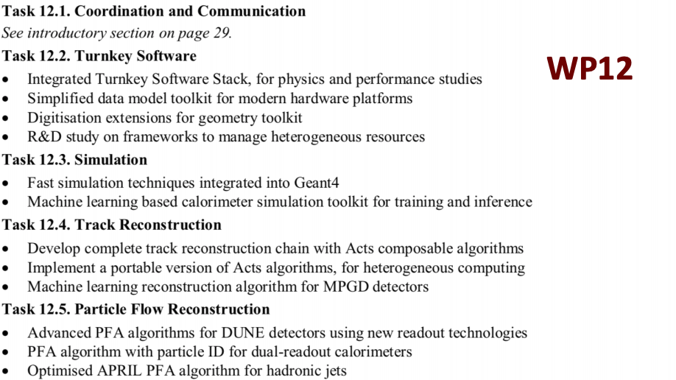

Slide 2
12.4 track reconstruction
INFN sites: Bologna, Ferrara, LNF, Torino
Contact person: Gianluigi Cibinetto (Ferrara)

Slide 3
Development of Machine Learning algorithms for Micro Pattern Gaseous Detectors
Task timeline and deliverables
Timeline and task: 4 years
  First year: uRWELL simulation → cluster reconstruction GEM and uRWELL.
  Second year: development of track finding
  Third year: track cleaning and refinement
  Fourth year: application to IDEA detector pre-shower and muon → optimization
Deliverables
  A scientific paper describing the performed activity and the results.
  An open-source software suite for training and testing ML algorithms with MPGD data and simulations.

Slide 4
Simulation and ML development
For triple-GEM, we developed a parametric simulation which takes into account diffusion, transparency, gain, induction and readout electronics.
We tuned it to test beam data → both charge and time readout for CoG and uTPC cluster reconstruction.
Goal I: extend the simulation to other MPGD detectors.
Goal II: develop general purpose Machine Learning tracking algorithms.
R. Farinelli and L. Lavezzi, RD51 coll. Meeting - Oct 2019
B. Liu et al., CHEP2018
Simulation and ML algorithms can be developed in the general framework

Slide 5
The group
The group
  INFN Bologna: main sub-task → porting and integration with IDEA general framework
  INFN Ferrara/Torino: MPGD parametric simulation, uTPC development and ML algorithms
  INFN Frascati Laboratory: responsible for uRWELL technology and test beam data
  INFN Ferrara/Torino and IHEP (Beijing): tracking and ML development

