Slide 1
Diversity & Inclusion Programme
Induction 2021
Kristine Kotte-Eriksen diversity-and-inclusion.web.cern.ch
Notes:
https://diversity-and-inclusion.web.cern.ch/

Slide 2

CERN Core Value
Diversity & Inclusion at
CERN is based on the three principles of :
appreciating differences, fostering equality,
promoting collaboration
CERN's Diversity value

Slide 3
Diversity = No.1 most appreciated workplace attribute
Mission/ Scientific Contribution
Pride
Benefits and
Remuneration
Diversity
Diversity | 256
Mission/Scientific Contribution | 251
Other | 187
Colleagues and Collaboration | 132
The work itself | 131
Work environment | 83
Challenges | 78
Technologies | 63
Benefits and Remuneration | 57
Pride | 32
Technologies
Other
Challenges
Colleagues
The work
itself
CERN Staff Survey 2019

Slide 4
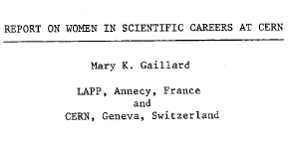
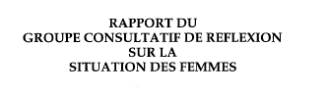
1983
1992
1996
Creation of an Equal Opportunity Office
First E.O and non discrimination statement published
History of
D&I at CERN
2010
Introduction of Code of Conduct
Creation of the Ombuds role
Professionalization of the Harassment resolution process
Diversity Office and Policy created
2012
2019
Diversity & Inclusion Programme

Slide 5

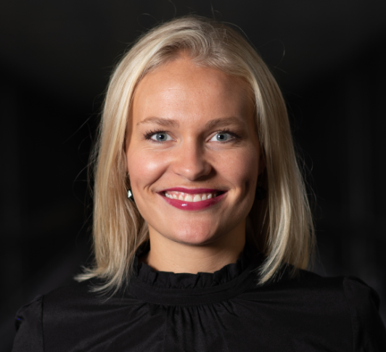
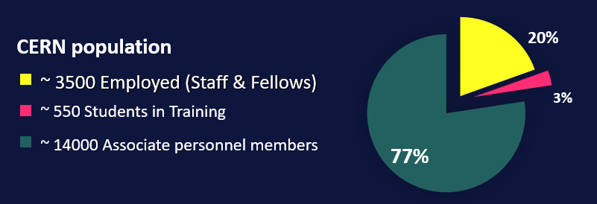
The D&I Team
Louise Carvalho
D&I Programme Leader (50%)
Legal Adviser (50%)
Kristine Kotte-Eriksen
D&I Analyst (100%)

Slide 6
The Diversity & Inclusion Programme aims to
enable, inspire and motivate our diverse personnel to create an inclusive and collaborative work culture.

Slide 7
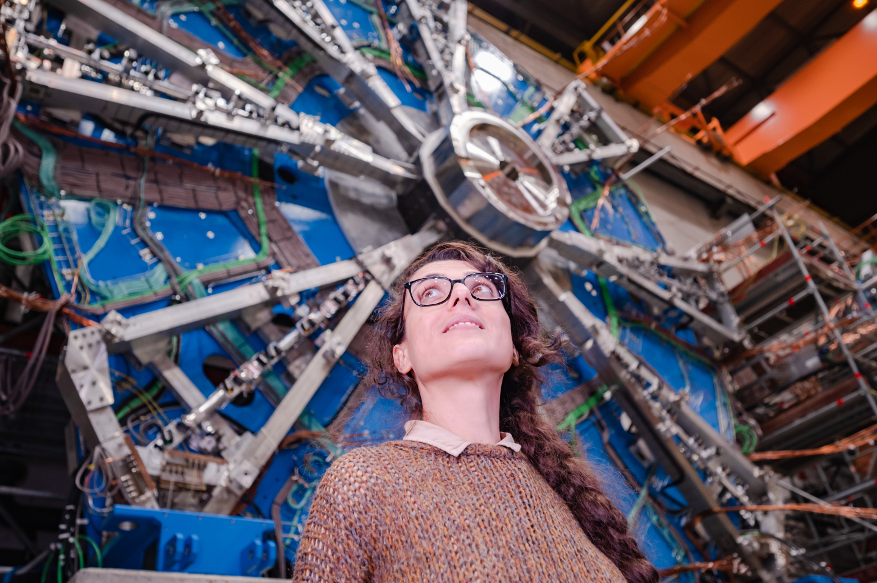
The Diversity & Inclusion Programme
25 by ’25
Diversity Roundtable
Inclusive workplace
Family support
Anti-Harassment
Notes:
We have an advisory role within the Organization

Slide 8


Slide 9
25 by ’25 - Why now?
As an International Organisation, we need to reflect the diverse communities of our Member States
The context:
“The particle physics
community commits to
placing the principles of
equality, diversity & inclusion
at the heart of all the
physics community’s
activities.”
- ESPP 2020 update
Gender Equality Plans
EC requirement for
Horizon Europe projects.
Applicable to all public
research organisations.
The business case:
Companies with more diverse management teams have 19% higher revenues due to innovation.
- BCG 2018
Notes:
Having a gender equality plan (GEP) is now an eligibility criterion for participation in Horizon Europe projects, applicable to all public research organisations.
Diversity ranked No.1 workplace attribute in the 2019 Staff Survey

Slide 10
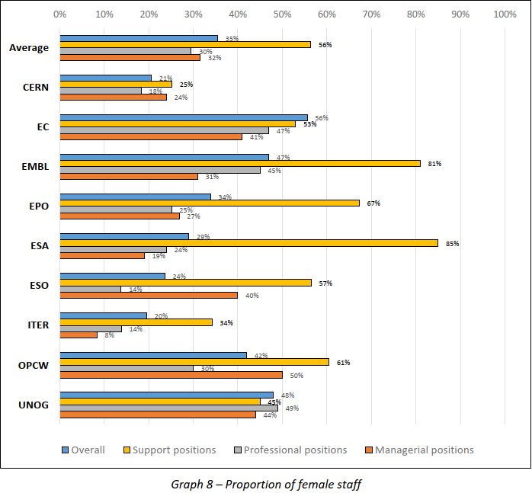
Female staff in comparator IGOs support, professional, and managerial positions
Overall average
> 25%:
  EC: 56%
  UNOG: 48%
  EMBL: 47%
  OPCW: 42%
  EPO: 34%
  ESA: 29%
< 25%:
  ESO: 24%
  CERN: 21%
  ITER: 20%
Source: OECD (SIRP) D&I Survey 2021

Slide 11
25 by ’25 strategy
GENDER target
NATIONALITY indicator
Goal: 25% women MPEs by 2025
Goal: more balanced MS return
25%
in 2025
25 %
indicator
21%
Identify nationality clusters above 25%
With particular focus on women in STEM
With particular focus on under-represented MS

Slide 12
25 by ’25: why targets?
Targets accelerate the process
Leadership-led
Measured CERN-wide, collaborative
“Excellence” and diversity are not mutually exclusive
Any measured improvement = success

Slide 13
25 by ’25 Next Steps
1. ED Endorsement and Commitment
Q1, March 2021
2. DH to designate diverse focal point(s)
Q2
3. Department - tailored “Fitness plans” ready
Q2 – Q3
4. IR & HR: 25 by ’25 Comms Strategy
Q2 - Q3
5. Regular reporting, adjusting, & engage the Experiments
2021 to 2025
2021→
→ 2025
Notes:
4 TBA including HR. (-DG unit)

Slide 14
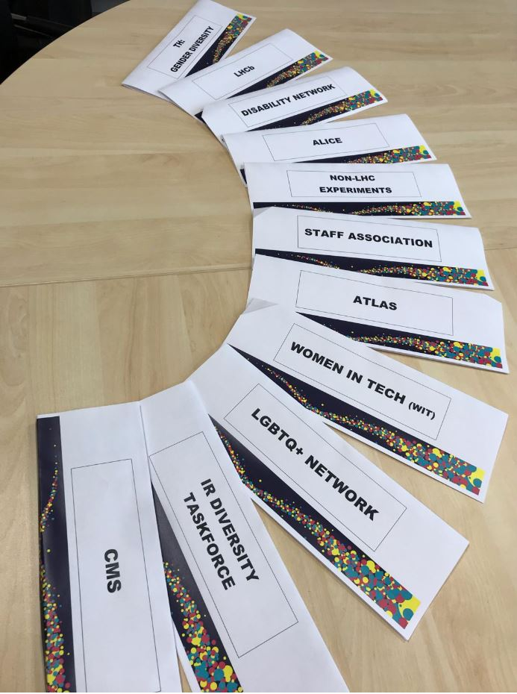
The
Diversity
Roundtable

Slide 15
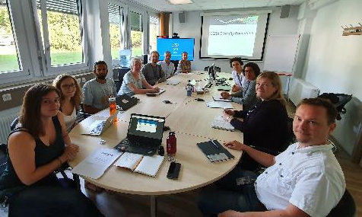

The Diversity Roundtable
Diversity Roundtable Recommendations “wholeheartedly” approved by the
DG 2020
Making CERN’s Science Gateway accessible and inclusive.
Gender-inclusive language for Staff Rules and Regulations.
Extension of Fellow’s employment contract following maternity leave.
ATLAS, ALICE, CMS, LHCb
LGBTQ Network
Women in Technology Network
Disability Network
TH Diversity & gender representative
International Relations taskforce
Staff Association
Chaired by D&I Programme
Notes:
Barriers: D&I Reporting, bring the activists to the table

Slide 16
Inclusive workplace
Inclusion

Slide 17



Your life @CERN brochure
Inclusion
Click here for brochure

Slide 18

Disability inclusion
Inclusion
Short-term internship for STEM students with disabilities
“This was an excellent experience. We have benefited not only from a smart and very productive student but also from integrating a co-worker with special needs into the team. It was a good change for the team (even though they might not have noticed) and definitely a good challenge for me.”
- Supervisor, Experimental Physics

Slide 19


Visible, tangible change
NEW official CERN lanyard
Moving, vibrant, merging particles reflecting diversity & inclusion at CERN
Available in building 55.

Slide 20
Spouse / partner support
Partner
support
Notes:
https://diversity-and-inclusion.web.cern.ch/anti-harassment

Slide 21
Spouse / partner support
Partner
support
Spouse Welcome brochure
*Staff, Fellows, Administrative, Technical and Doctoral students
International Dual Career Network (IDCN)
https://diversity-and-inclusion.web.cern.ch/spousesupport

Slide 22



What you can expect from IDCN
Partner
support
An ally in your professional Swiss journey.
Help decoding Swiss job market and culture.
Enhance your visibility to top employers in the region.
To be in contact with other spouses in your same situation.
Opportunity to volunteer.
Find a job for you.
Do networking for you.
Website: www.idcn.info
LinkedIn: IDCN Lake Geneva Region

Slide 23
Anti-Harassment Support Structures
Anti-Harassment
Handling your concern in full confidentiality | Contact Information Building-floor-office location | Listening | Mediation | Advice &/or Guidance | Receipt of formal complaint; Investigation; Disciplinary action
Ombud’s Office | ombuds@cern.ch 500-1-04 |  |  | 
Social Affairs Service | social.affairs@cern.ch 33-1-38 |  |  | 
Medical Service | medical.service@cern.ch 57-1 |  |  | 
HR Adviser (Staff) or HR Coordinator (Fellows, Trainees, Students) | cern.ch/hr/hr-key-contacts 5-1 & 5-2 |  |  | 
Staff Association | staff.association@cern.ch 64-R-010 |  |  | 
Your Department Head, or Head, Human Resources | (name)@cern.ch, or hr-dept.head@cern.ch |  |  |  | 
Harassment Investigation Panel (HIP) | HIP Chairperson HIP.Chair@cern.ch |  |  |  | 
All members of personnel (incl. Users)
Staff, Fellows, Trainees,
Students*
*Students: TECH, ADMIN, DOCT, Short-Term
Internship programmes coordinated by CERN HR

Slide 24
From embedding to mainstreaming
Embedding D&I in Staff Recruitment and Sourcing Policy
Embedding D&I principles in training modules
D&I topics included in Staff & Fellow Survey
Phonebook: new version more inclusive
D&I advisory role:
Recent media events
Hearing impairment inclusiveness in online conferences and meetings

Slide 25
Additional Resources
Ombuds Office
HR Key Contacts
Anti-Harassment Policy
Social Affairs Service
Medical Service
Psychologist
LGBTQ CERN
Disability Network
Staff Association
D&I Newsletter
Mission/ Scientific Contribution
Pride
Benefits and Remuneration
Diversity
Tech- nologies
Other
Challenges
Colleagues
The work itself

Slide 26
Thank you!

