Slide 1
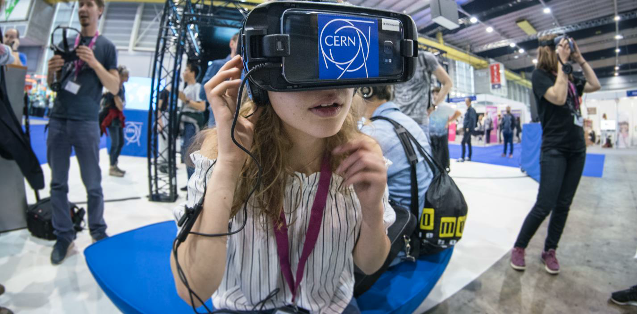
Education, Communications and Outreach
(IR-ECO)
Connecting the dots 14.09.2021

Slide 2
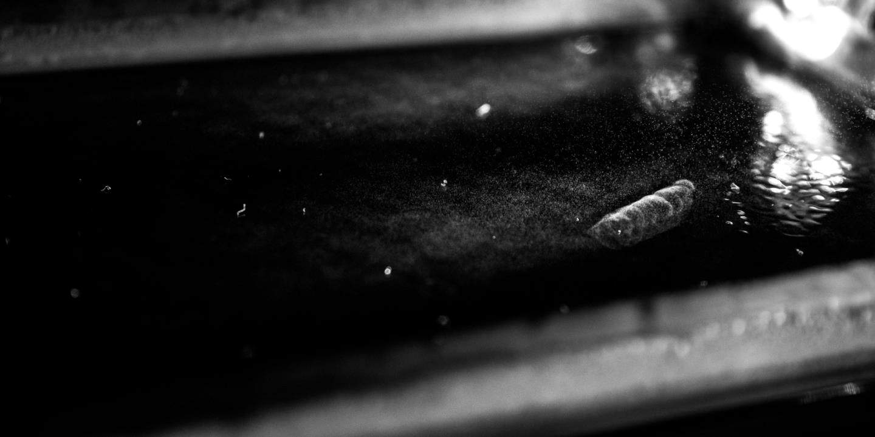
Four pillars underpin CERN’s mission
•Research
•Technological innovation
•International collaboration
•Education and training
The pillars are the platforms for CERN communications and outreach.
We have great stories to tell about all four pillars! Take part!

Slide 3
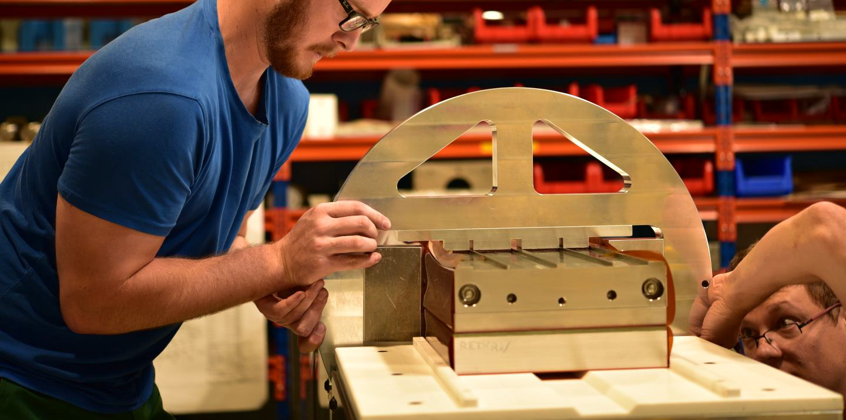
WHY DO WE COMMUNICATE?
•Support for CERN
•Awareness and engagement with
CERN’s activities and their impact on
society
•Attract future generation of physicists
and engineers
•Be a voice for the value of
fundamental research
•Community-building

Slide 4
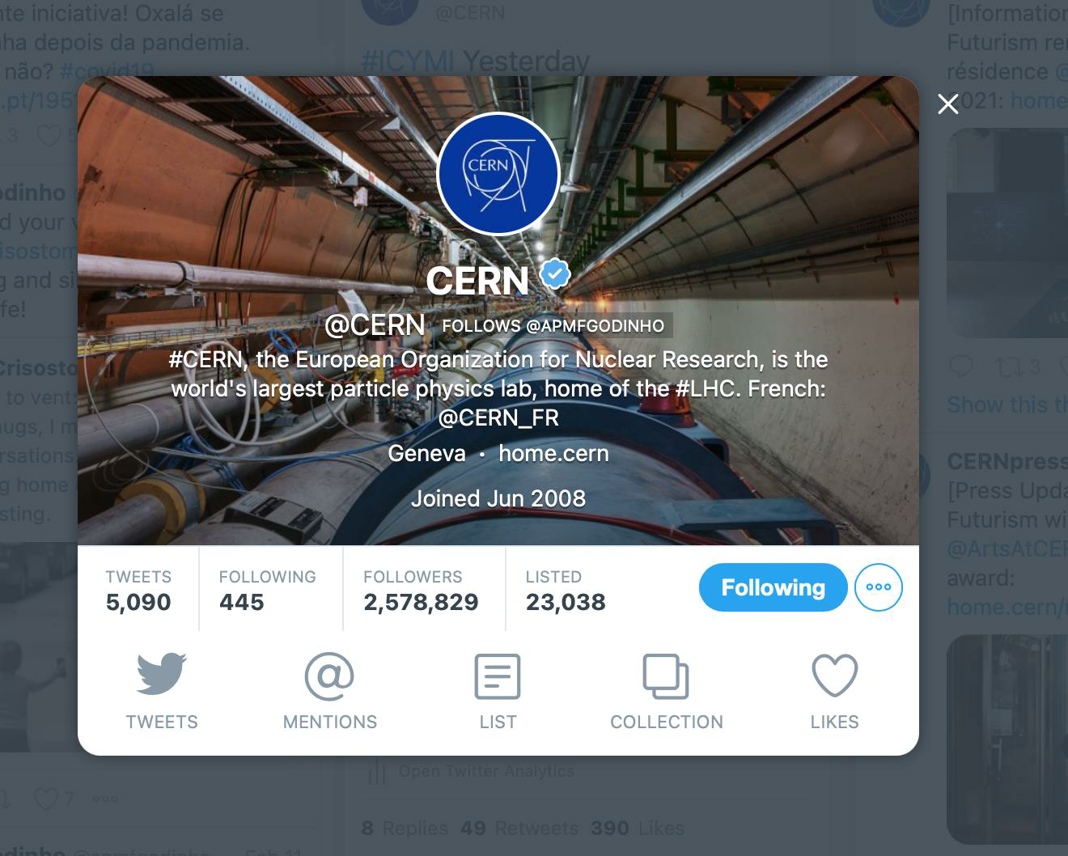
HOW DO WE COMMUNICATE?
Digital channels
-home.cern & other .cern websites
-CERN Bulletin
-CERN Courier
-Twitter
-Facebook
-Instagram
-YouTube
-LinkedIn
Take part!
•Follow CERN
•Be a digital ambassador
•Share your stories with us
http://cern.ch/go/social-media-guidelines

Slide 5
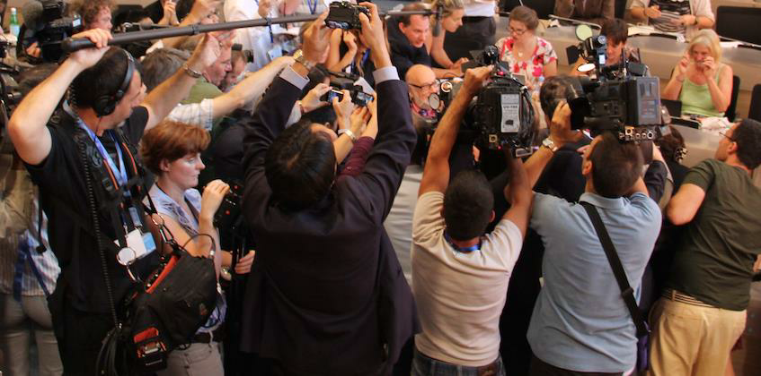
HOW DO WE COMMUNICATE?
Via the media
-Media relations
-Press releases/updates on physics
results and more
-On-site media visits
-Media training
-Identifying media ambassadors
Take part!
•Share stories with news value with us
•Do media training
•Become a media ambassador
https://press.cern

Slide 6
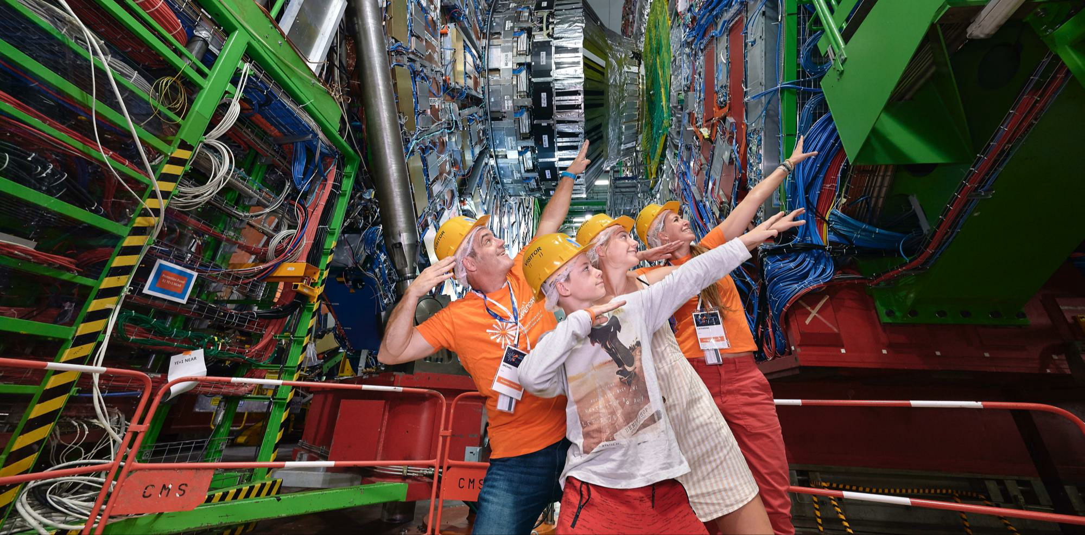
HOW DO WE COMMUNICATE?
The power of face-to-face
-Guided tours (150K visitors/year)
-Public events @CERN (Open Days,
Researchers’ Night, Sparks!)
-Going out into the local community
(schools, local events)
-S’Cool LAB workshops for high-
schools
-Teacher programmes
Take part!
https://visit.cern
https://cern.ch/scoollab
https://voisins.cern
https://sparks.cern
•Be a CERN guide (tours & exhibition)
•Volunteer for events
•Be a S’Cool LAB tutor

Slide 7
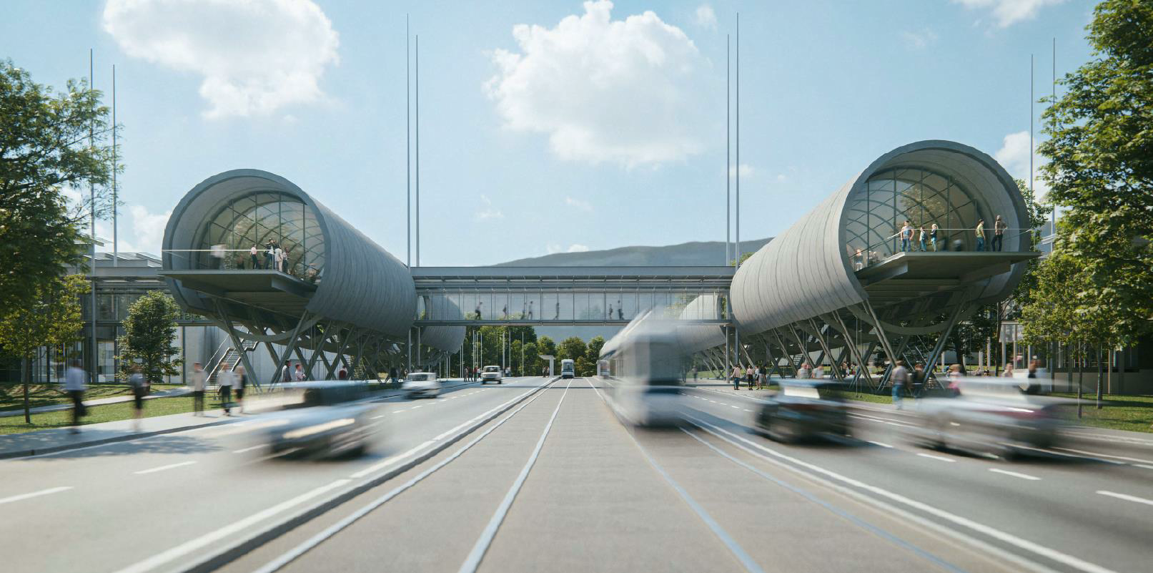
HOW DO WE COMMUNICATE?
CERN Science Gateway
•CERN’s new education and outreach
centre
•For audiences aged 5+
•Immersive exhibitions, education labs,
events and science shows
•Opening 2022/2023
https://videos.cern.ch/record/2145952
Take part!
•Contribute ideas for exhibitions,
education programmes, science shows
•As volunteer guides, tutors, exhibition
floor staff https://sciencegateway.cern
Ana Godiho & James Gillies

Slide 8
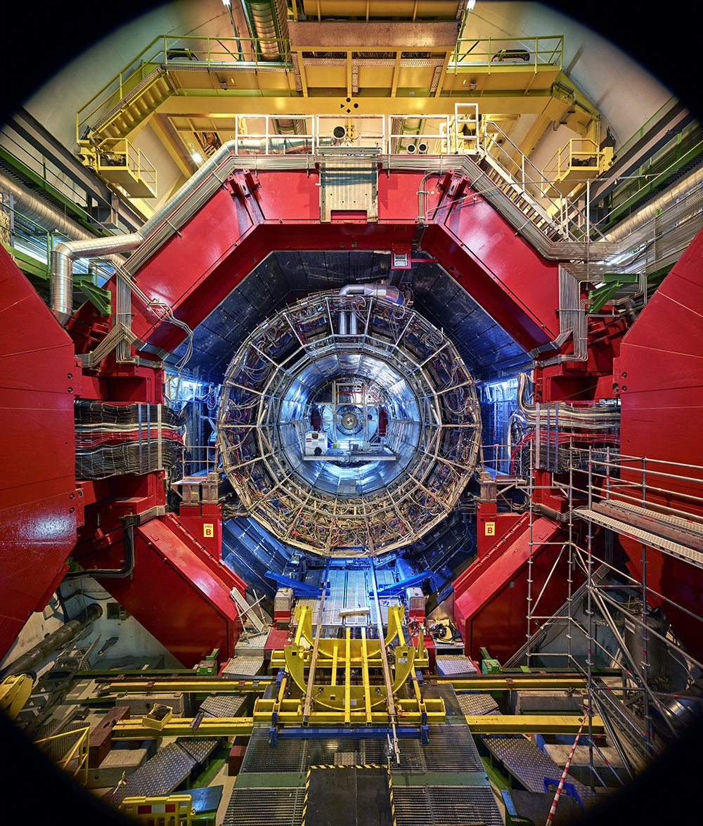
ARTS AT CERN
    10 years fostering dialogue between art and physics based on CERN’s Cultural Policy
Artists across all creative disciplines are invited to experience the way the big questions about our universe are pursued by fundamental science.
Our goals are to inspire significant exchanges between art & physics, and to participate in an international cultural community eager to connect with CERN.
ALICE experiment, by artist Thomas Struth. Art Basel (2019).
Ana Godiho & James Gillies

Slide 9
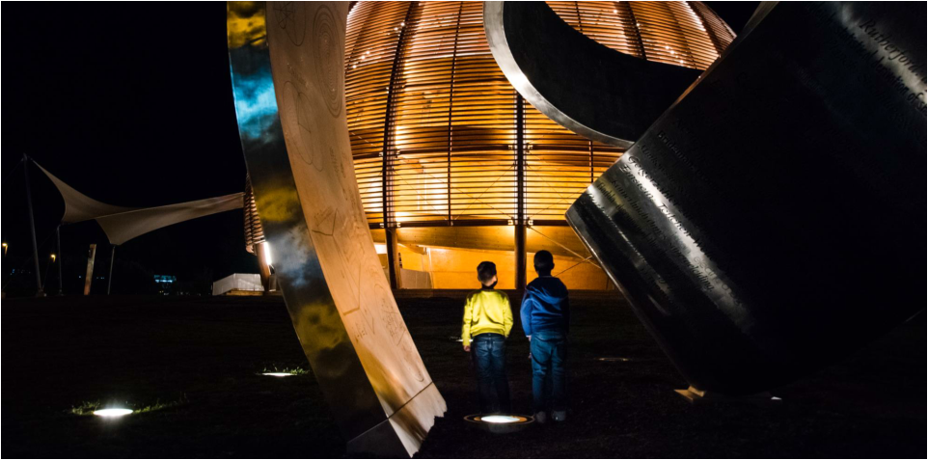
HOW TO CONTACT ECO?
Submit a story for the CERN website or
social media: http://cern.ch/go/submit-a-story
CERN guides: cern.ch/guides
Outreach volunteers (check Bulletin
announcements)
S’Cool LAB tutors:
https://cern.ch/scoollab/cernies
https://cern.ch/communications

