Slide 1

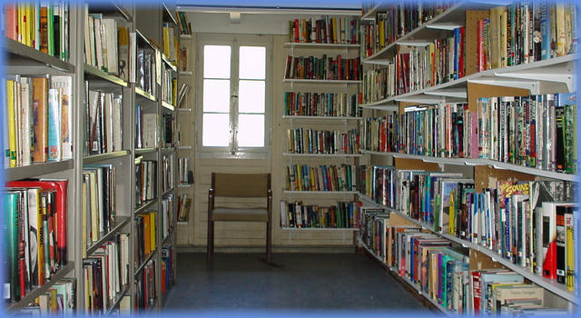
CERN’s unique library of books in English

Slide 2
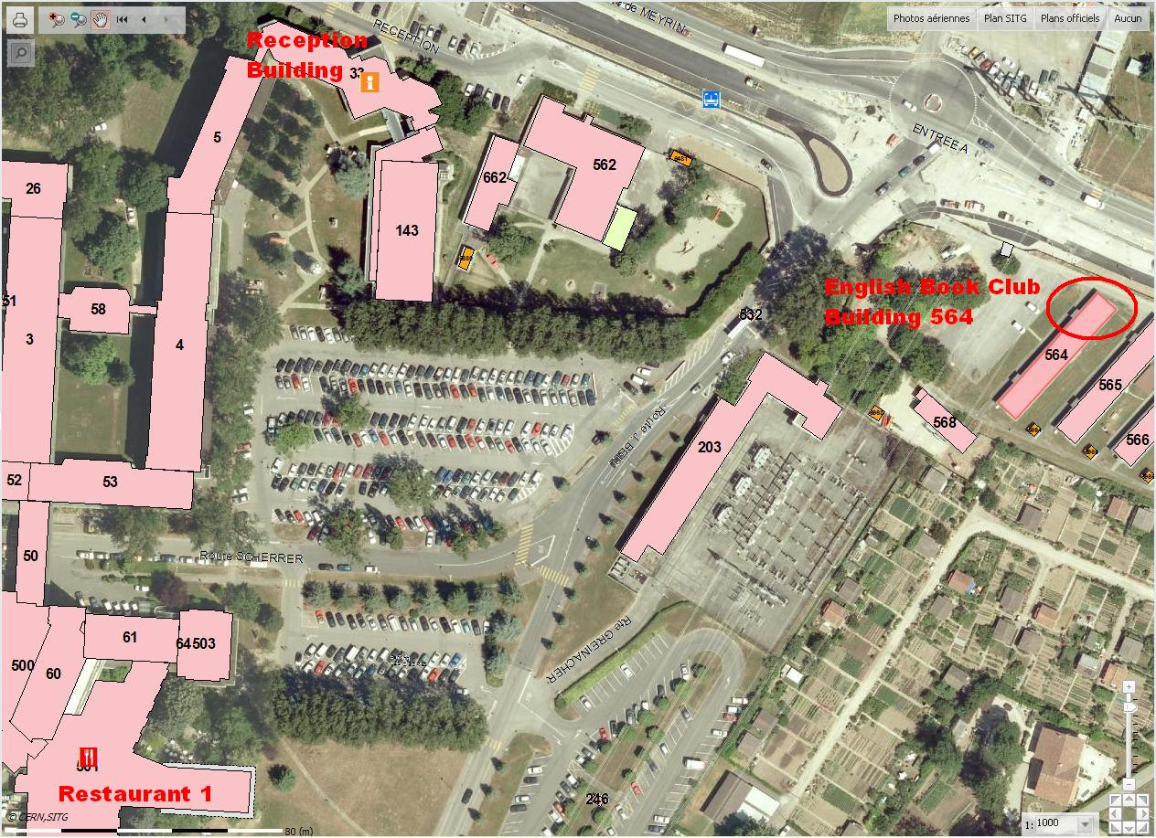
The annual membership fee for CERN staff is an unbeatable 30 CHF (or 20 CHF for Staff Association members).
Enjoy our book collection, gain access to over 4 500 books in English located in Barrack 865 on the Meyrin site, take part in our book selection meetings and have a say in our new acquisitions.
https://englishbooksatcern.wordpress.com/
On-line list : https://www.librarything.com/catalog/EBCERN
Or call: the President John Pym john.pym@cern.ch (73554)
or the Secretary Kate Whalen kate.whalen@cern.ch (71256)

Slide 3
Our motto:
Just read !

