Slide 1
CERN's accelerator complex
Connecting the dots…
Rende Steerenberg
16 November 2021

Slide 2

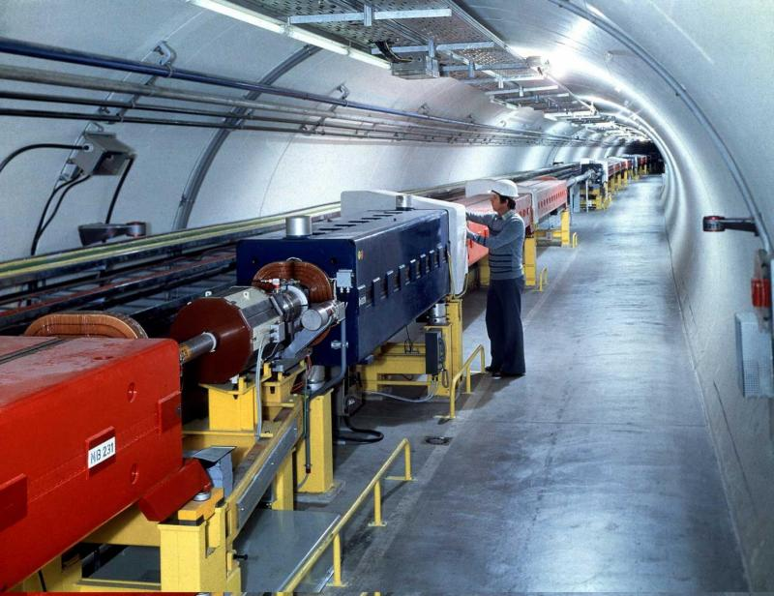
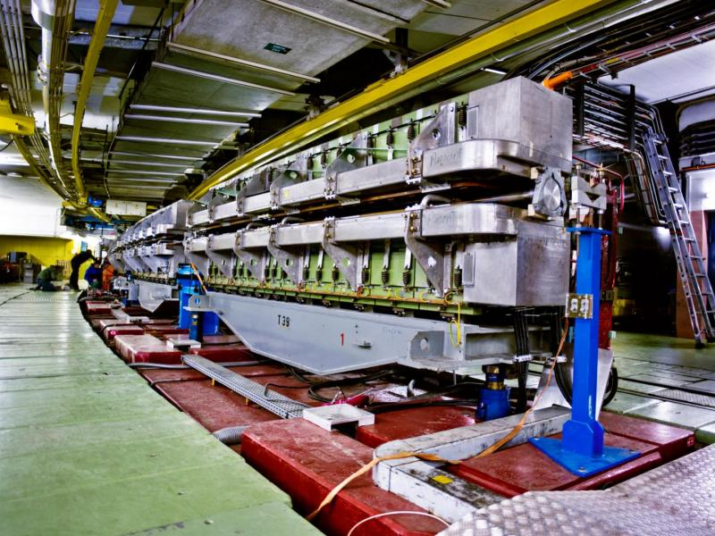
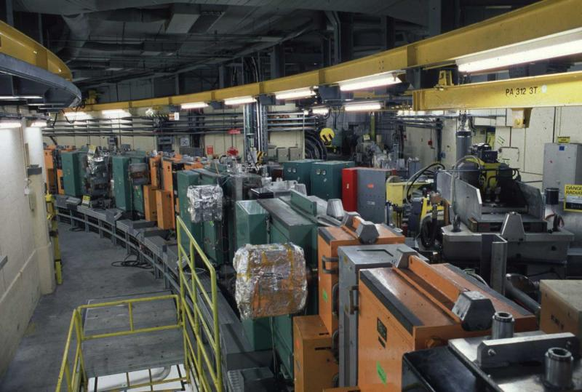
Content
The CERN Accelerator Complex
Cycling the Accelerators & Satisfying Users
The Main Ingredients of an Accelerator

Slide 3
Content
The CERN Accelerator Complex
Cycling the Accelerators & Satisfying Users
The Main Ingredients of an Accelerator

Slide 4
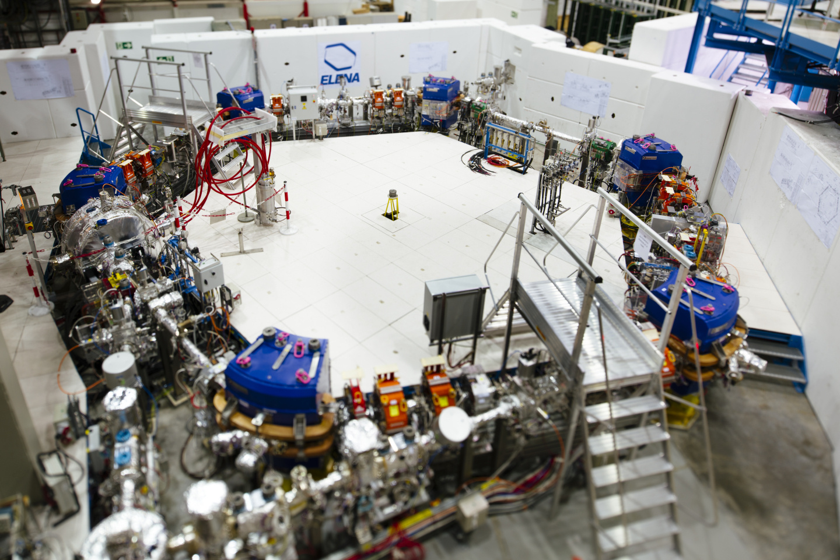
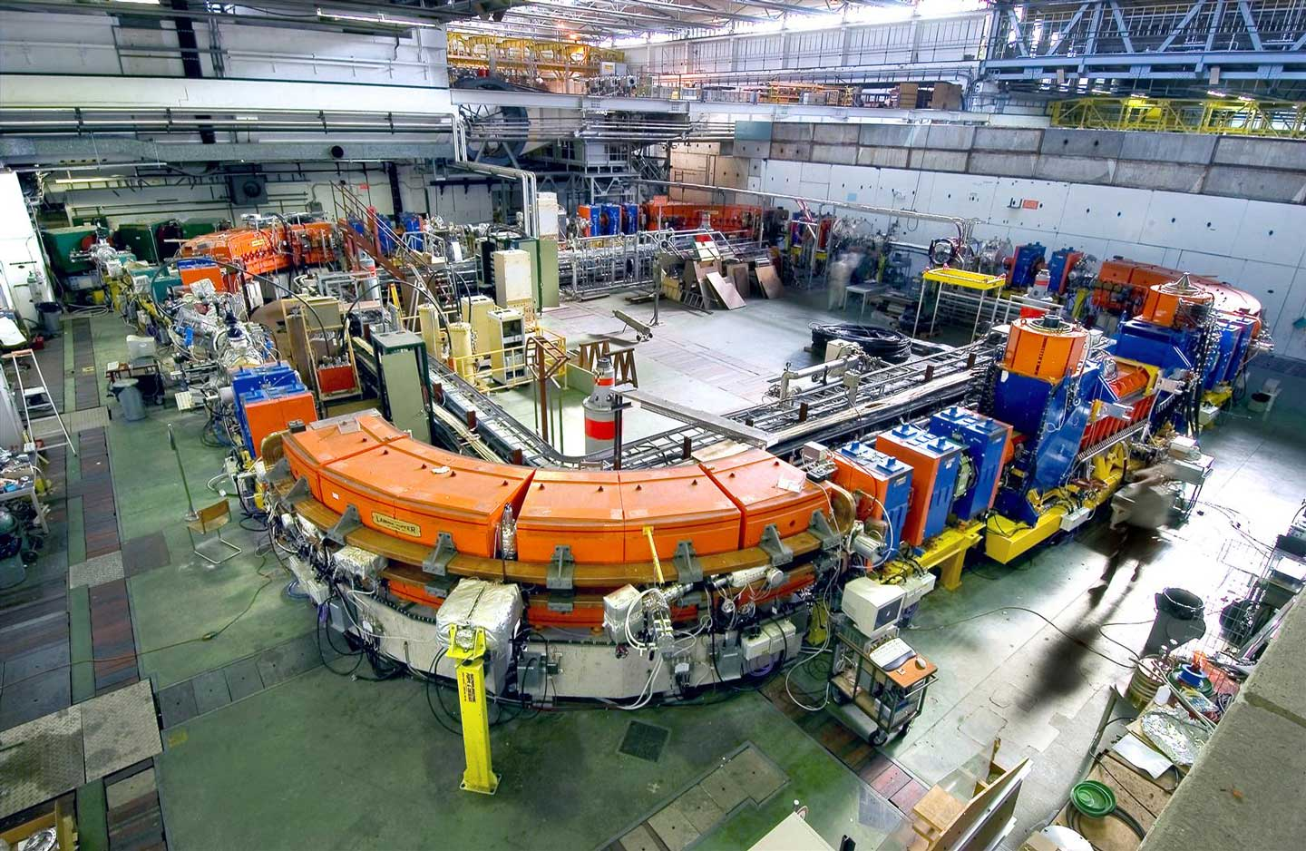
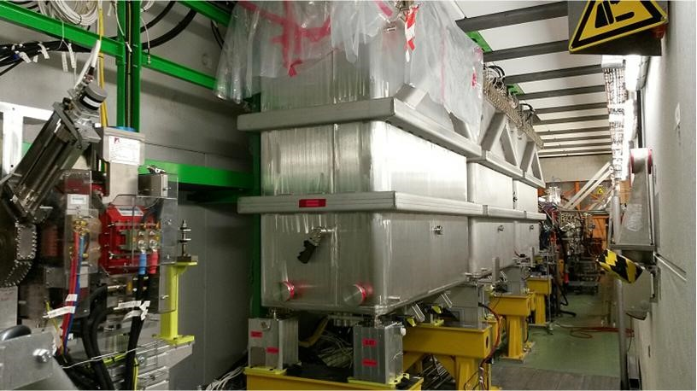
The CERN Accelerator Complex

Slide 5
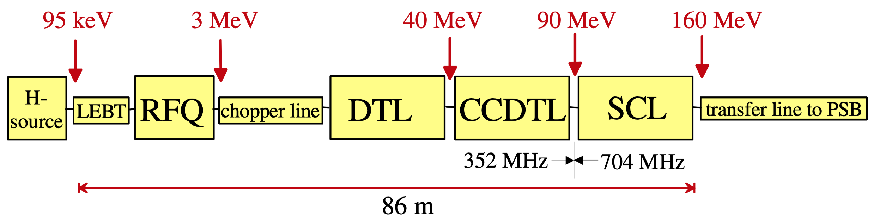
Linac 4
H⁻ ion source at 95 keV
Accelerates beam up to 160 MeV
The chopping scheme allows removing some of the Linac bunches to make the beam fit into the PS Booster RF buckets
Pulse rate 1.2 s

Slide 6
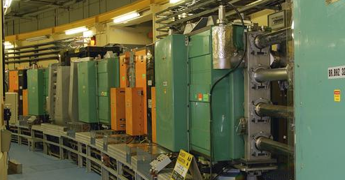
PS Booster
1st Synchrotron with 4 superposed rings
Circumference of 157 m
Proton energy from 160 MeV to 2 GeV
Can cycle every 1.2 s
Each ring will inject over multi-turns, using charge exchange injection
Before stripping foil
Behind stripping foil
x’
x’
+
+
-
+
+
+
+
+
-
-
-
+
+
+
+
-
+
+
-
+
+
+
+
+
+
-
+
-
+
x
+
+
+
+
+
x
+
-
+
+
+
+
-
+
+
+
+
+
-
+
+
+

Slide 7
The CERN Accelerator Complex

Slide 8
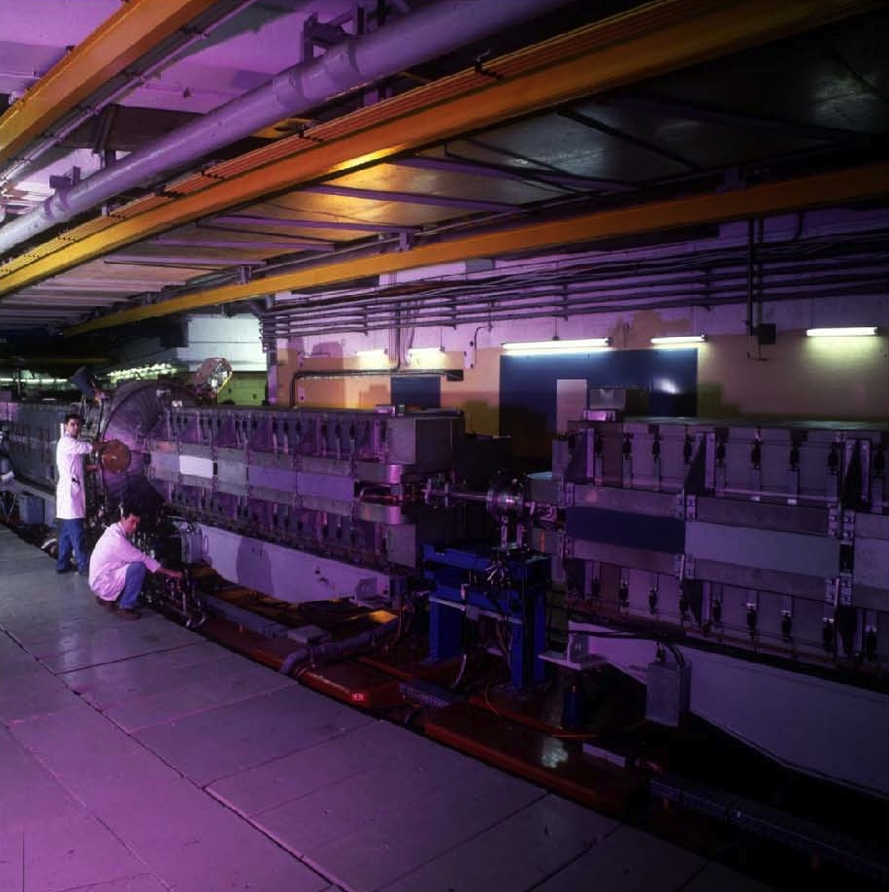
PS
The oldest operating synchrotron at CERN
Circumference of 628m
  4 x PSB circumference
Increases proton energy from 2 GeV to max. 26 GeV
Cycle length ranges from 1.2s to 3.6s
Many RF systems allow for complex RF gymnastics
Various types of extractions:
  Fast extraction
  Multi-turn extraction (MTE)
  Slow extraction

Slide 9
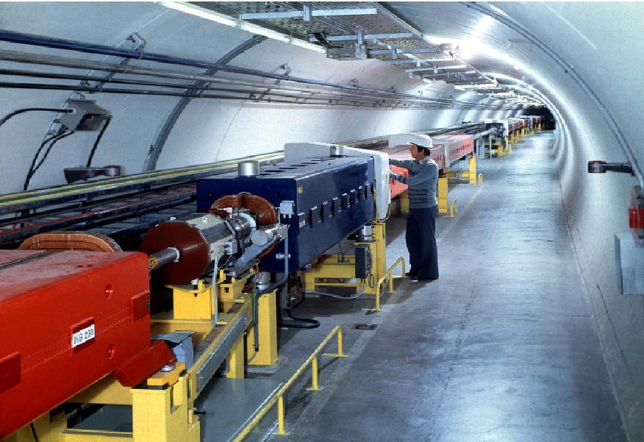
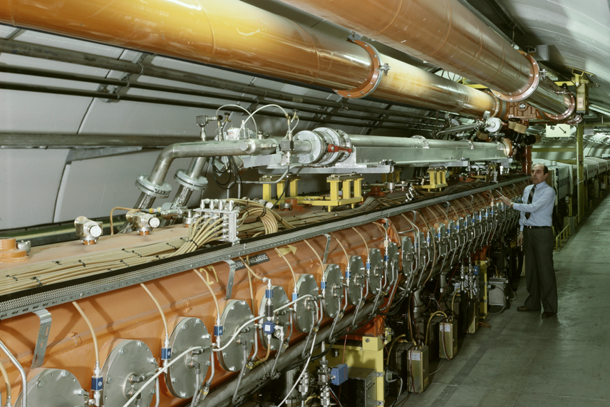
SPS
The first synchrotron in the chain at ~30m under ground
Circumference of 6.9 km
  11 x PS circumference
Increases proton beam energy up to 450 GeV with up to ~5x10¹³ protons per cycle
Provides slow extracted beam to the North Area
Provides fast extracted beam to LHC, AWAKE and HiRadMat

Slide 10
The CERN Accelerator Complex

Slide 11
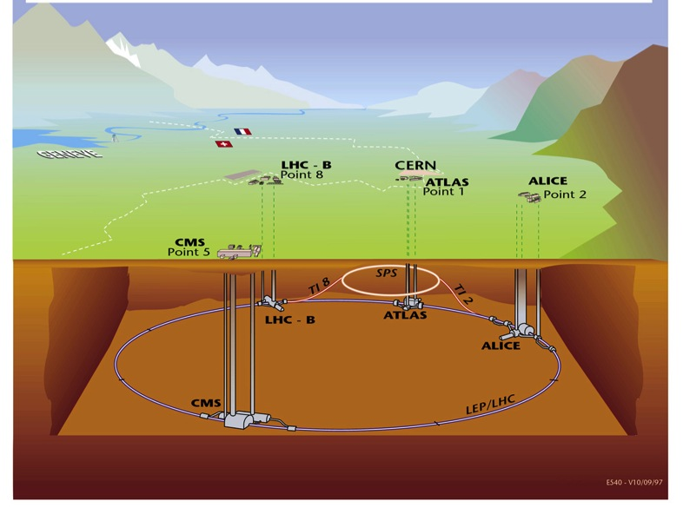
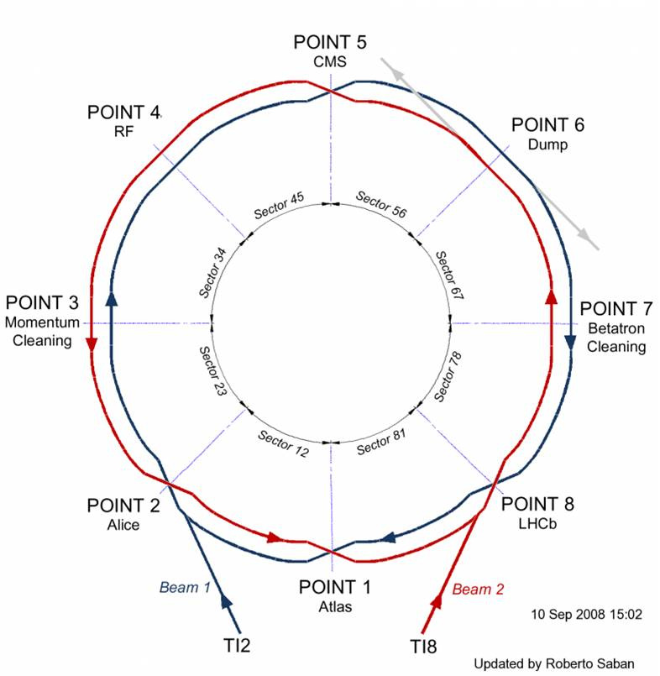
LHC
Situated on average ~100 m under ground
Four major experiments
Circumference 26.7 km
Two separate beam pipes going through the same cold mass 19.4 cm apart
150 tons of liquid helium to keep the magnets cold and superconducting

Slide 12
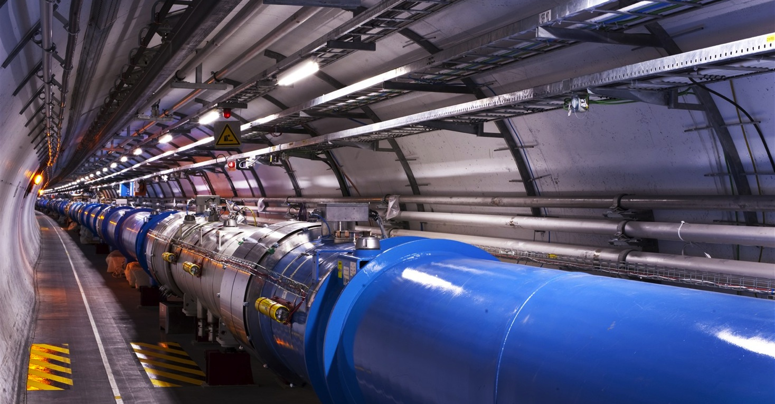
LHC
1232 main dipoles of 15 m each that deviate the beams around the 27 km circumference
858 main quadrupoles that keep the beam focused
6000 corrector magnets to preserve the beam quality
Main magnets use superconducting cables (Cu-clad Nb-Ti)
12’000 A provides a nominal field of 8.33 Tesla
Operating in superfluid helium at 1.9K

Slide 13
Content
The CERN Accelerator Complex
Cycling the Accelerators & Satisfying Users
The Main Ingredients of an Accelerator

Slide 14
The LHC Cycle
= Field in main magnets
= Beam 1 intensity (current)
= Beam 2 intensity (current)
Time
6.5 TeV
450 GeV
Injection
Ramp
Squeeze
&
Adjust
Stable beams for physics
Dump
&
Ramp down

Slide 15
Filling the LHC & Satisfying Fixed Target users
To LHC clock-wise or counter clock-wise
= Field in main magnets
= Proton beam intensity (current)
450 GeV
= Beam transfer
SPS
26 GeV
PS
1.4 GeV
PSB
1.2 seconds
Time

Slide 16
Content
The CERN Accelerator Complex
Cycling the Accelerators & Satisfying Users
The Main Ingredients of an Accelerator

Slide 17

The LEIR Accelerator as Example
Building 150

Slide 18
Make Particles Circulate
Main Dipoles
Main Dipoles
Main Dipoles
Main Dipoles

Slide 19
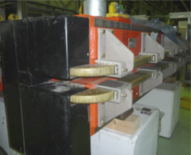
Deviating Charged Particles
Moving charged particles are deviated
in a magnetic field
Magnetic Lorentz Force:

Slide 20
Oscillatory Motion in the Horizontal Plane
Two charged Particles in a homogeneous magnetic field
Horizontal motion
Particle B
Particle A
Horizontal
displacement
0
Machine circumference
2π
Particle B
Particle A
Different particles with different initial conditions in a homogeneous magnetic field will cause oscillatory motion in the horizontal plane → Betatron Oscillations

Slide 21
Oscillatory Motion in the Vertical Plane
The horizontal motion seems to be “stable”…. What about the vertical plane ?
Many particles many initial conditions
Vertical
displacement
→ s
Many different angles

Slide 22
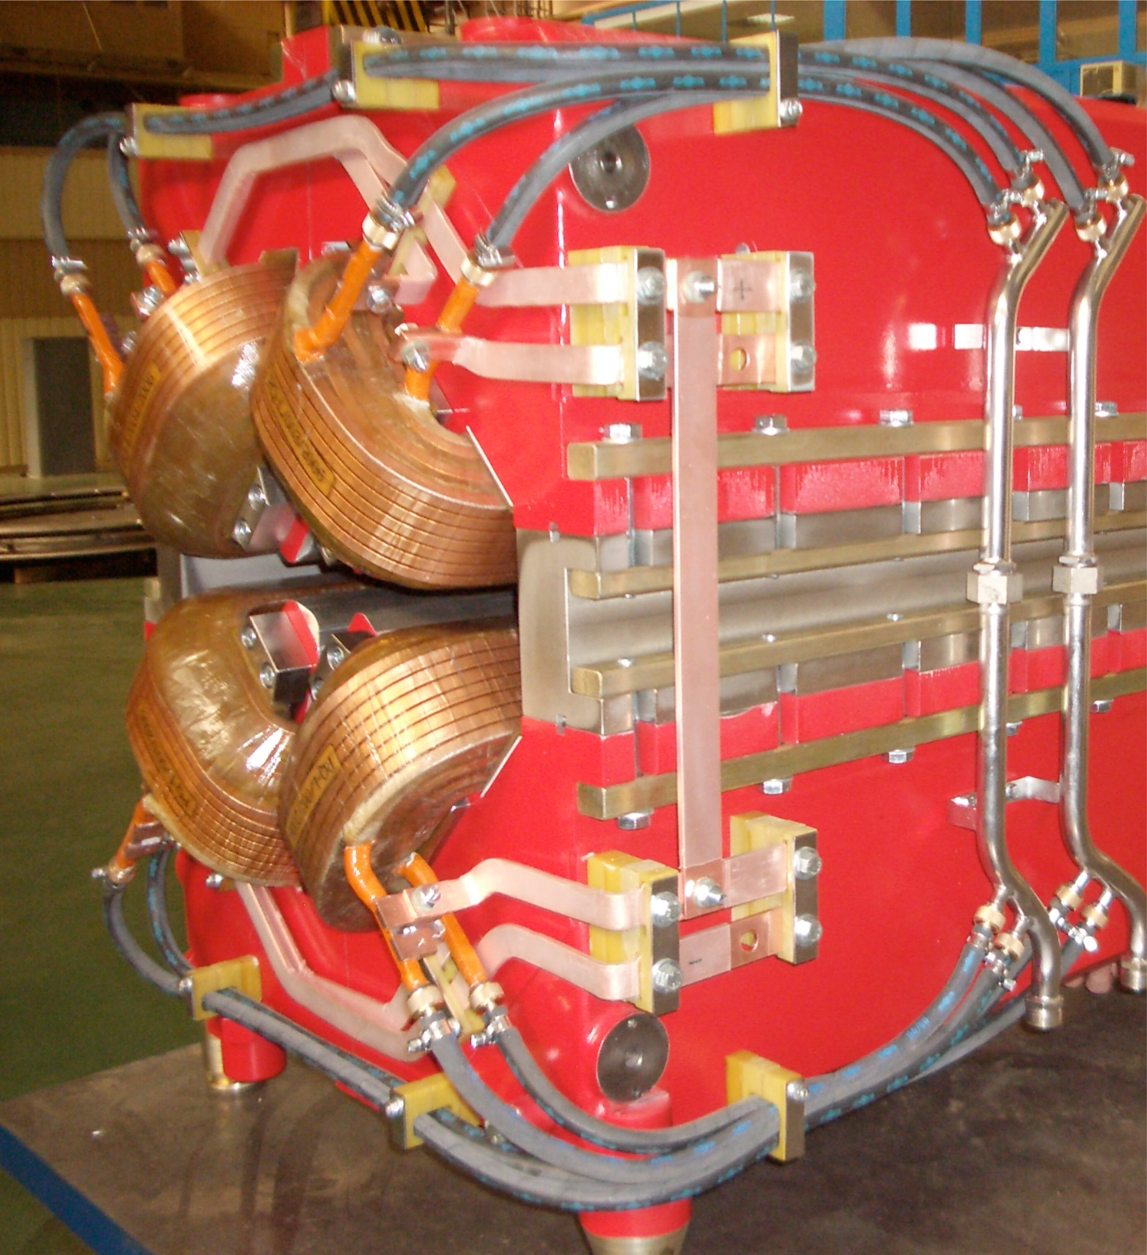
Focusing Particle Beams, a bit like a lens
Force on particles
Focusing Quadrupole
Rotated by 90º
De-focusing Quadrupole
QF
QD
QF

Slide 23
Focusing Particle Beams in LEIR
Main Dipoles
Main Dipoles
Main Dipoles
Quadrupoles

Slide 24
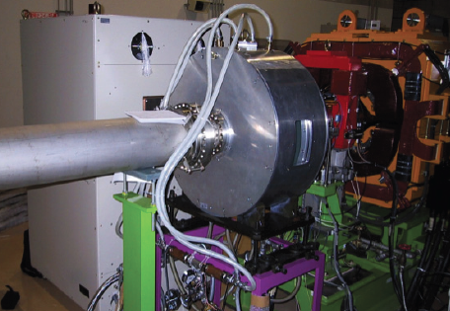
Accelerating Particles, Using Electrical Fields
Accelerating
Cavity

Slide 25
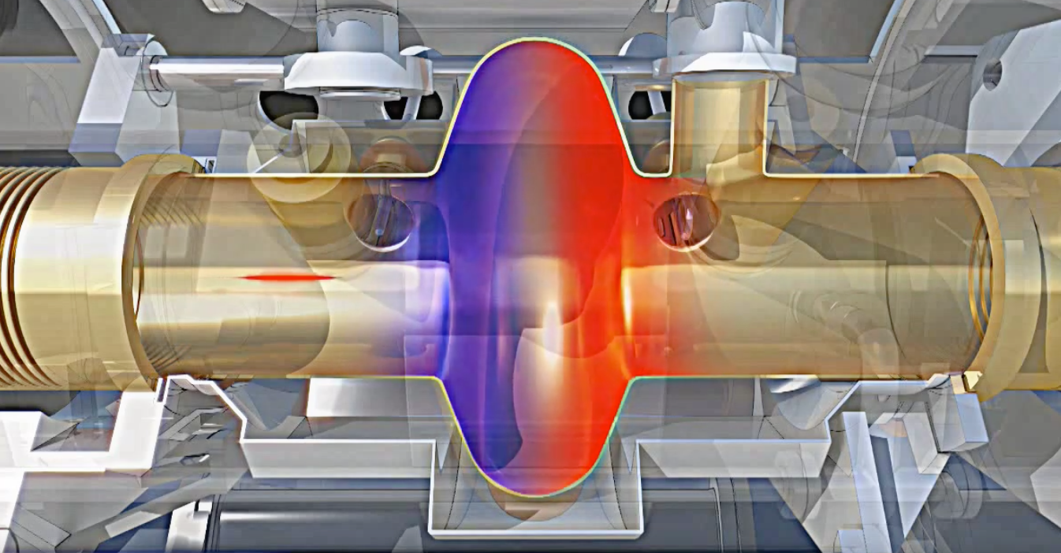
Radio Frequency Cavity
Charged particles are accelerated by a longitudinal electric field
The electric field needs to alternate with a harmonic of the revolution frequency

Slide 26
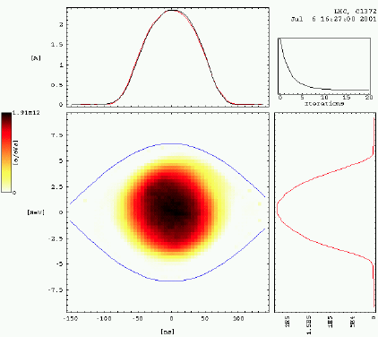
….and quite some more…
Beam instrumentation to measure beam properties
  Beam intensity
  Beam size
  Luminosity
Possible limitations
  Machine imperfections
  Collective effects and instabilities

Slide 28
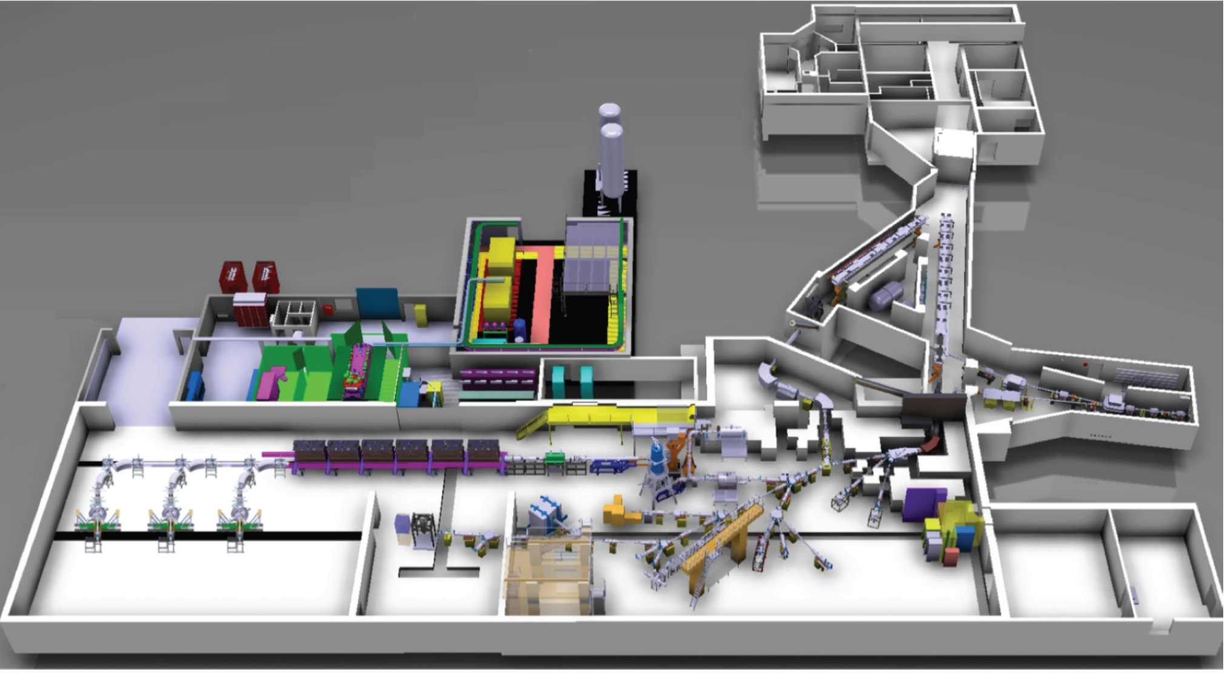
ISOLDE / HIE-ISOLDE
The PSB proton beam impinges on a target producing a range of isotopes
Two mass separators (GPS & HRS) allow selection of isotopes
The post acceleration of isotopes is being extended
  REX, normal conducting accelerating structures
  HIE-ISOLDE, super conducting LINAC

Slide 29
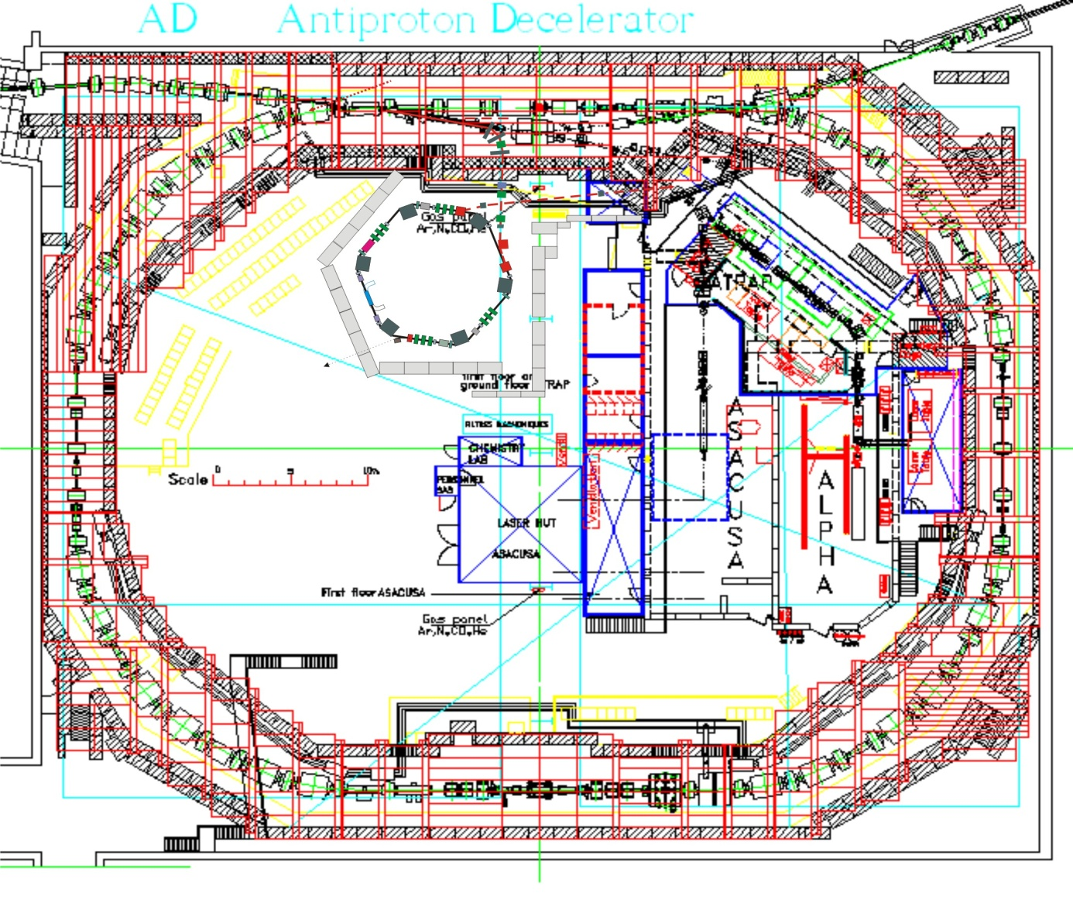
AD-ELENA
Receives fast extracted proton beam from PS at 26 GeV/c on a target
Every million protons yields about one usable antiproton at 3.5 GeV/c.
AD decelerates beam in stages down to 5.3 MeV
ELENA will further decelerate down to 100 keV
Experiments:
  ASACUSA, ALPHA, AEGIS, BASE, GBAR

Slide 30
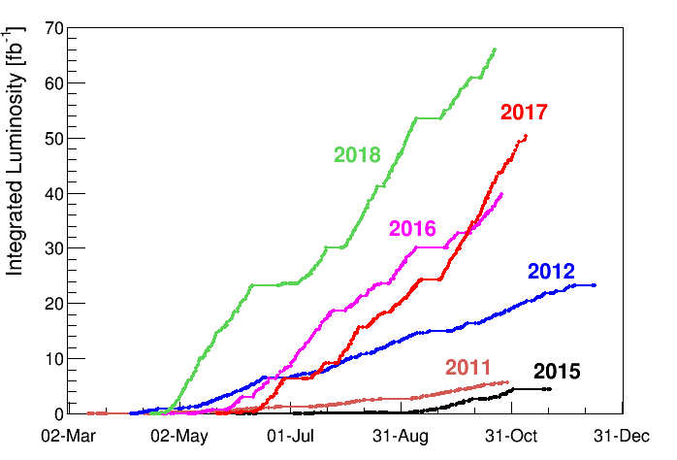
LHC: Luminosity
Number of bunches
Intensity per bunch
Geometrical
Correction
factors
Beam dimensions
Maximise Luminosity:
Bunch intensity
Transverse beam size
Beam size at collision points (optics functions)
Crossing angle
Machine availability

