Slide 1
Basic considerations on beam losses at e+ target
Riccardo Zennaro:: Paul Scherrer Institute
FCC-ee Injector review, 19 April 2021

Slide 2
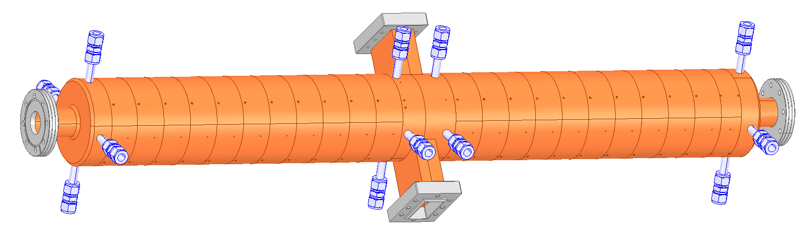
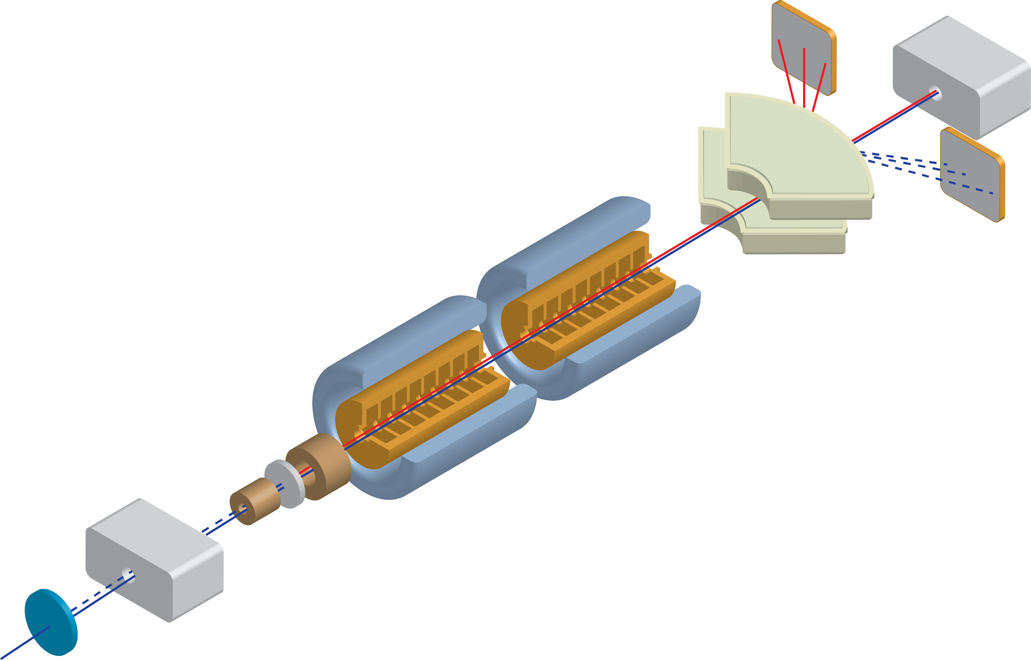
Schematic Layout of the e+ production @ PSI
S-band SW p mode cavity
40 mm aperture, 15 MW @ 18 MV/m (b=2)
Assumptions for ASTRA computation:
6 GeV drive beam
1.5 mm σ
SC AMD 5.1 T @ target
0.7 T NC solenoids
W target 5 X₀
Yield @ target 13.8
Geant4 e+ & e- distribution at target courtesy of Iryna Chaikovska
target
e- 6 GeVSwissFEL drive beam

Slide 3
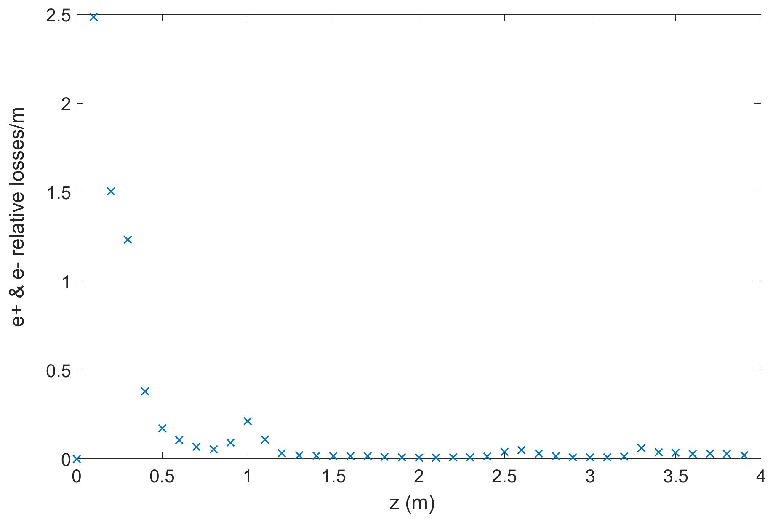
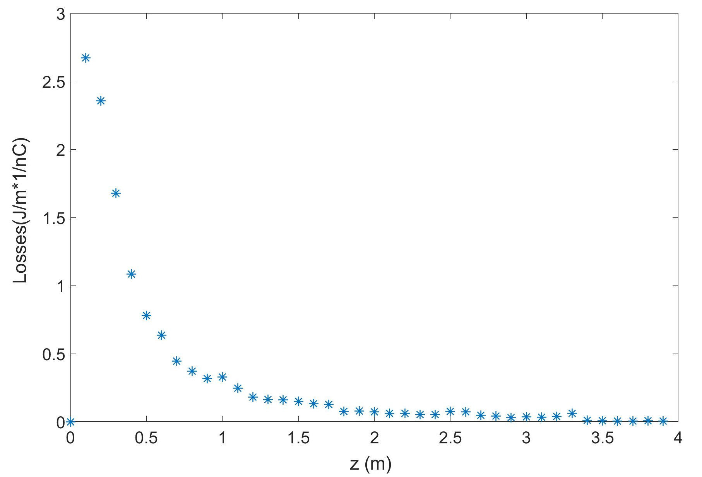
ASTRA simulation: e- & e+ losses vs. z
~35% e- & e+ at 1st cavity output
~45% lost in the cavity region
~0.96 J/nC (drive beam) in 1st cavity (*)
(*) this is the beam energy lost in the region of the 1st cavity not the beam energy deposited in the 1st cavity

Slide 4
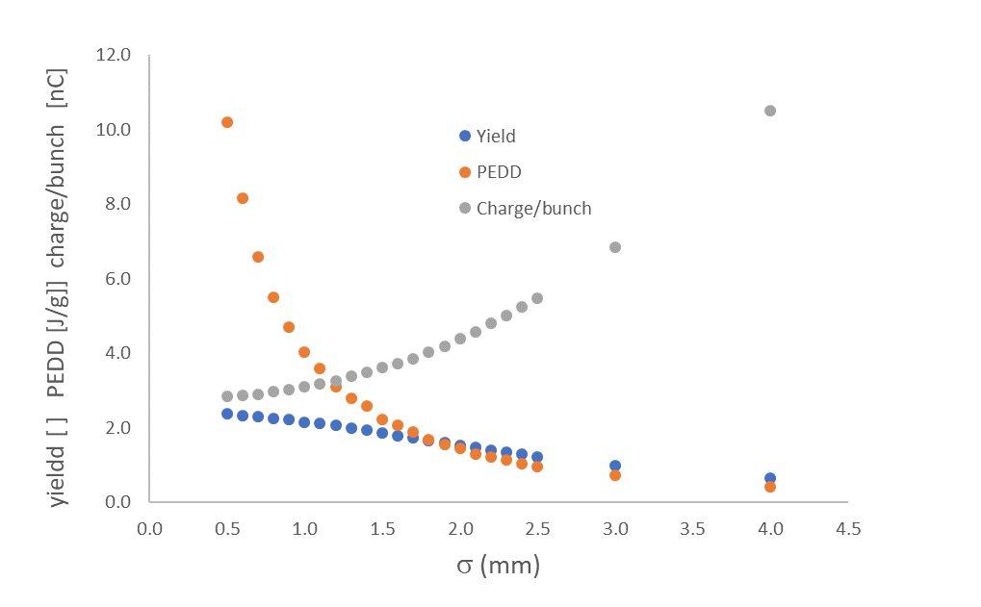
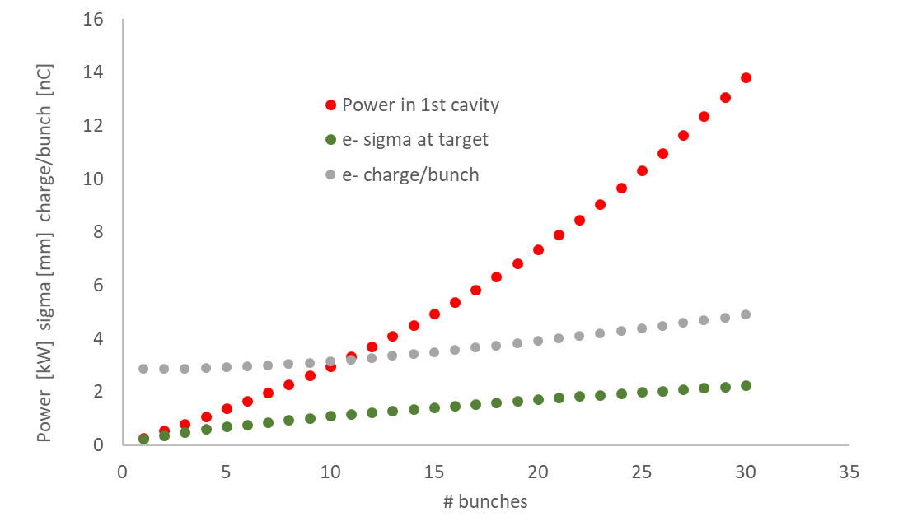
Beam power losses estimation for max. PEDD
Assumptions & conditions:
4.2*10^10 e+/bunch goal
0.96 J/nC beam losses in 1st cavity (previous slide)
max. 35 J/g condition on PEDD
Data courtesy of Iryna Chaikovska (5 X₀ W 6 GeV)
Large amount of bunches requires large sigma of the drive beam size at the target to keep the PEDD at acceptable levels, as a consequence the yield is reduced and the required charge/bunch increased
2 bunches 0.5 kW
30 bunches 14 kW
For comparison:
average RF power in 1st cavity 5 kW

