Slide 1
Present status and upgrade plan of the Positron source
2021/4/15
Y. Enomoto

Slide 2
Outline
Requirement and issues
Present status
Short term (Near future) plans
Mid term plans
Long term plans (Beyond 4 nC / bunch)
Major upgrade was done in 2020
→ Most of the problems so far were solved
Now, it’s time to consider next steps

Slide 3
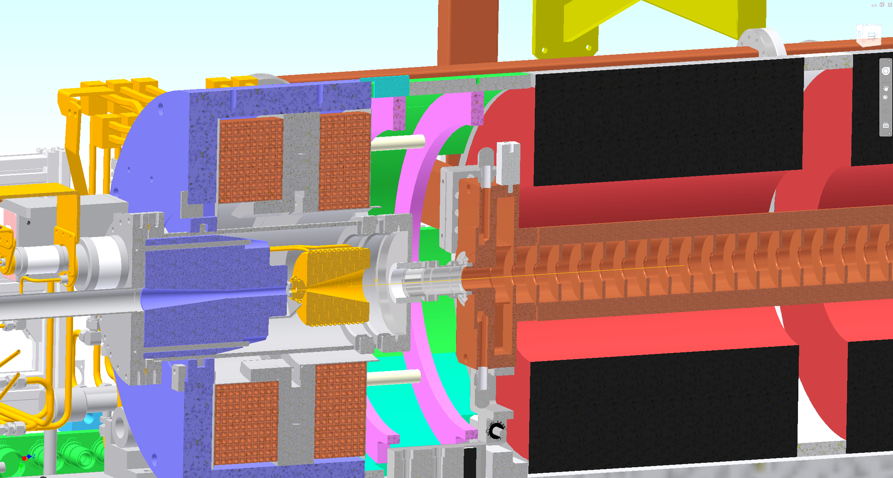
SuperKEKB positron source
FC head + BC + target = FC assembly
BC (bridge coil)
LAS (large aperture S-band)
W target
FC(flux concentrator) head
solenoid

Slide 4
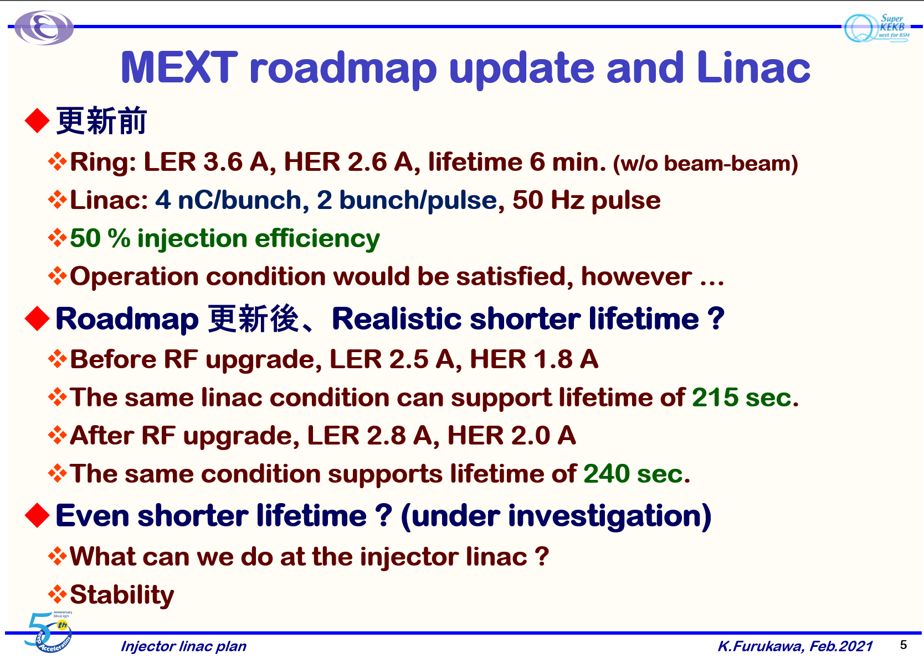
Injection requirement
Life in ring | 360 s
Current | 3.6 A
Injection bunch charge | 4 nC
Injection rate | 25 Hz x 2 bunch
Injection efficiency | 50 %
Circulation frequency | 10⁵
$$\frac{dI}{dt}=\frac{3.6 [A]}{360 [s]}=10 [mA/s]$$
$$4 \left[nC\right]×25 \left[Hz\right]×2 \left[bunch\right]×50\left[\%\right]×{10}^{5}\left[Hz\right]$$
$$=10 [mA/s]$$
K. Furukawa
Life time in the ring determines how much positron is needed.

Slide 5
Problems to be solved
Discharge of FC
  New material for FC
  Optimization of support structure (done before 2020)
  External circuit to reduce voltage (done before 2020)
  Longer pulse width (will be done after 2021)
Orbit correction in solenoid
  Steering coils
  BPMs

Slide 6
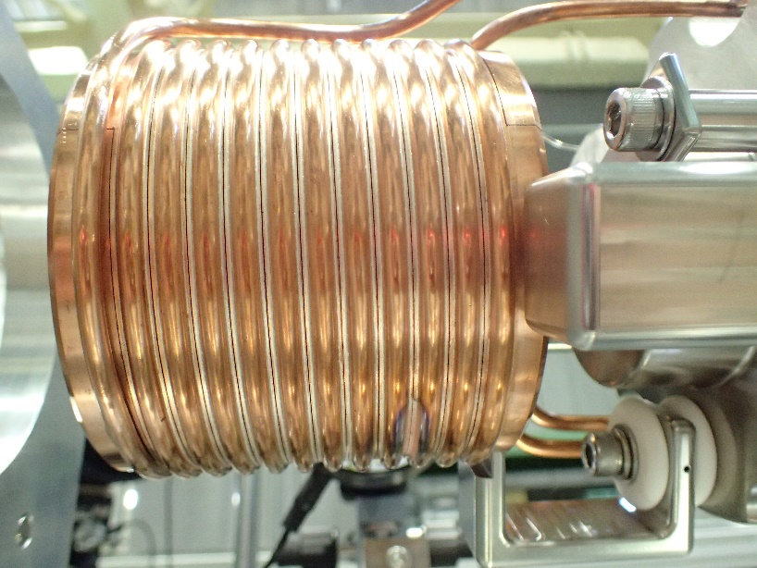
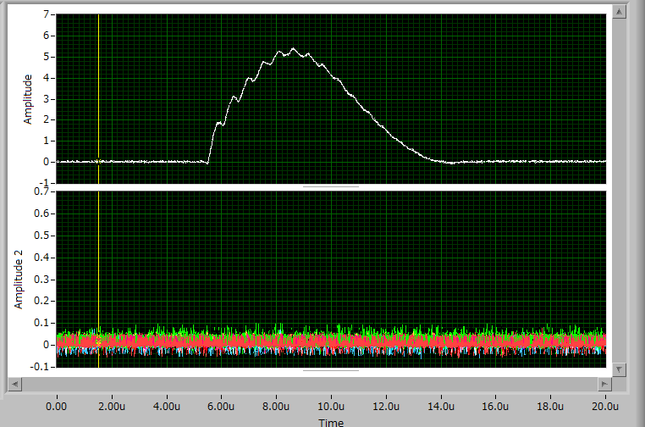
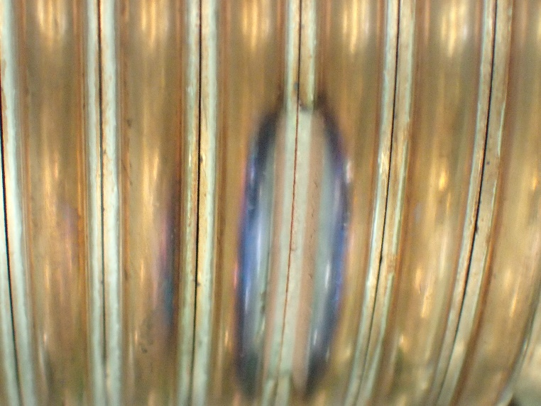
Discharge of the FC
1 kV / turn @ 12 kA operation 6 us pulse width
Slit gap = 0.2 mm
5 MV/m
FC current waveform measured by CT
FC current (kA)
6 us

Slide 7
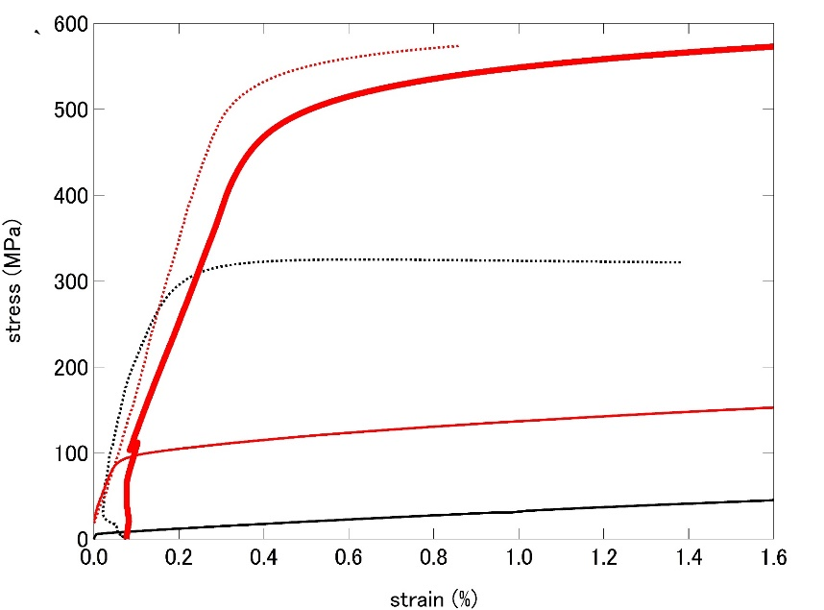
Yield strength
NC50
NC50 after aging
(precipitation hardening)
x40
C1020
NC50 after brazing
C1020 after brazing
Yield strength (MPa)

Slide 8
Assembly, base management (2021/1 ver.)
 | Phase 1 | Phase 2 | Phase 3 | 2019 Q4 | 2020 ab | 2020c | delivered | removed | present | Note
Assembly 1 |  |  |  |  |  |  | <2015 | 2017/3 | In tunnel
Assembly 2 |  |  |  |  |  |  | 2016/3 |  | In operation
Assembly 3 |  |  |  |  |  |  | 2017/11 |  | Test bench
FC base 1 |  |  |  |  |  |  | <2015 |  |  | Test
FC base 2 |  |  |  |  |  |  | <2015 |  |  | Test
FC base 3 |  |  |  |  |  |  | <2015 | 2017/3 | In tunnel
FC base 4 |  |  |  |  |  |  |  | 2018/9 | In tunnel
FC base 5 |  |  |  |  |  |  | 2016/7 | 2020/9 | In tunnel
FC base 6 |  |  |  |  |  |  | 2017/11 |  | Test bench | bad quality
FC base 7 |  |  |  |  |  |  | 2019/10 |  | Test bench (back up) | New material
FC base 8 |  |  |  |  |  |  | 2020/6 |  | In operation | Final version
FC base 9 |  |  |  |  |  |  | 2021/3 |  | Test bench | Saper for Final version
Material test started in 2018/10
in operation
spare
test bench

Slide 9
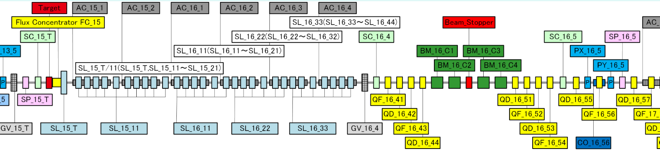
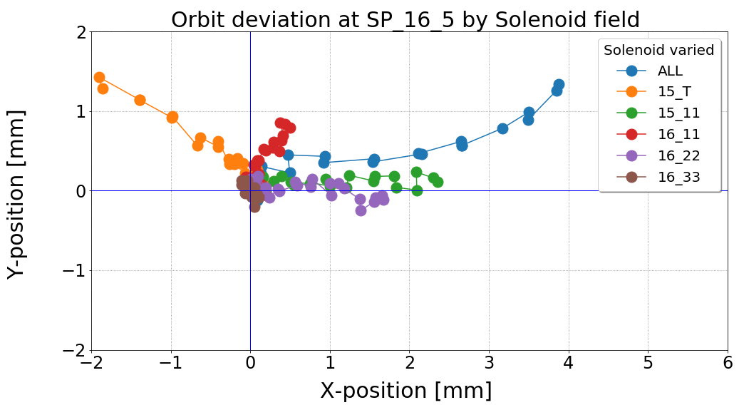
Orbit deflection in solenoid section
Measured by T. Kamitani
SP : BPM
SL : solenoid
QF/QD : quad
PX/PY : pusled steering
BM : bend
SC : screen
AC : acc. structure
Measurement of deflection amount of 3 GeV electron beam
by asymmetric field in solenoid section
1,Prepare ballistic beam between SP_15_T and SP_16_5
2,Energize a part of solenoid by
1/10* max. value step.
3, Monitor beam position at SP_16_5

Slide 10
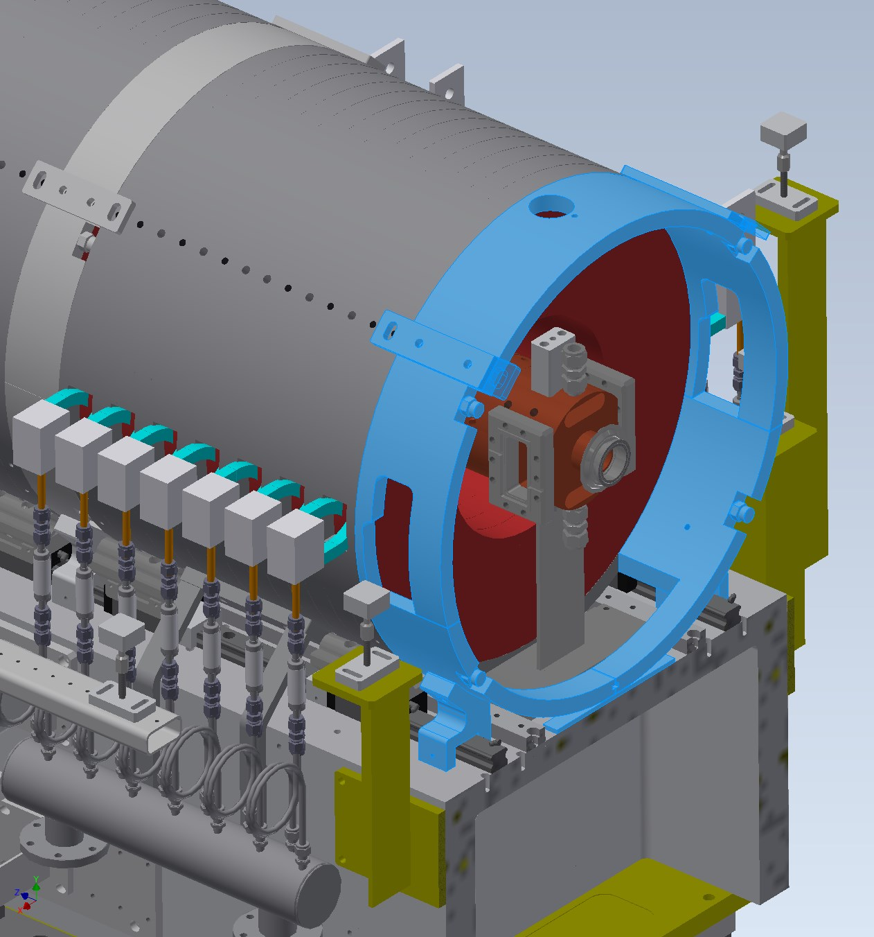
Asymmetry of magnetic connection
Iron yoke to connect flux of solenoid
need space for waveguide and support
Inner diameter of solenoid changes
Bx
By

Slide 11
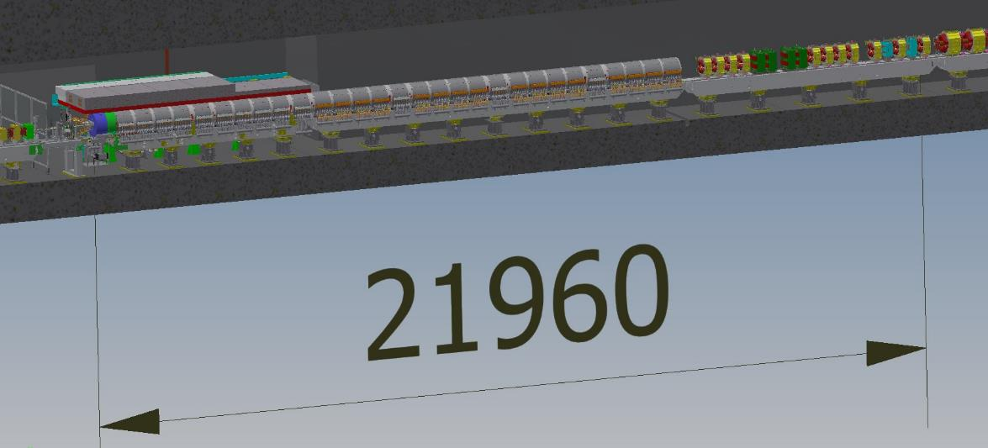
target
BPM and 1st steering
There were no BPMs and steerings for 22 m after the target

Slide 12
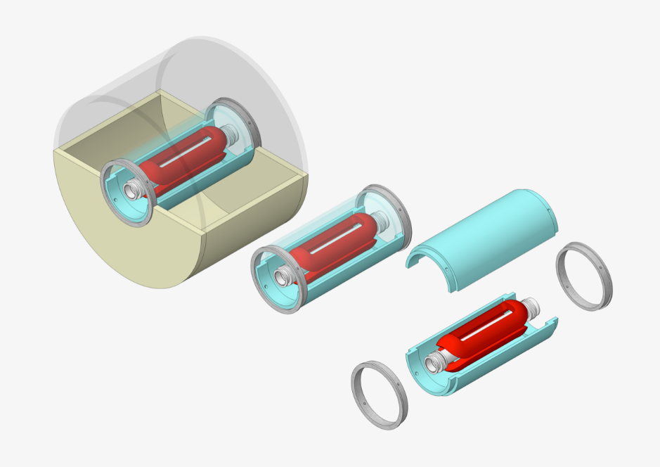
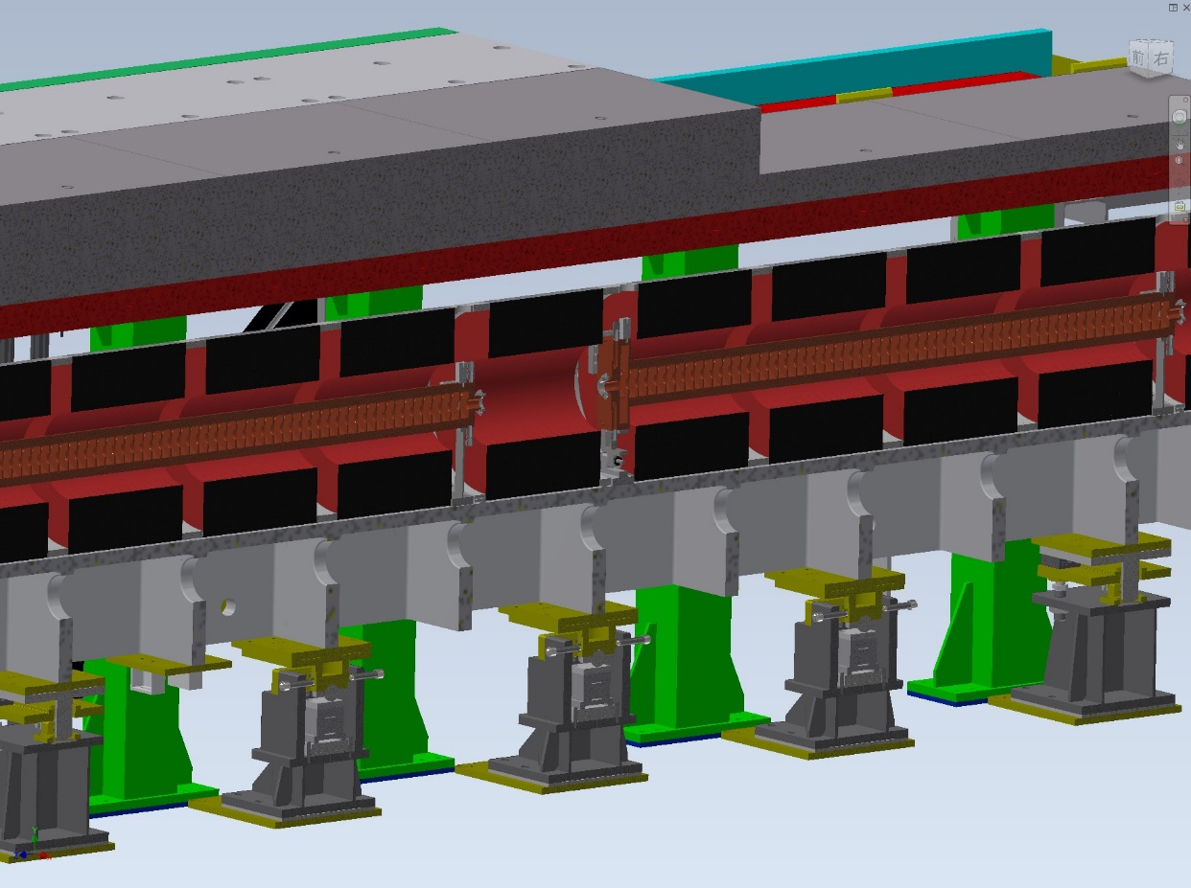
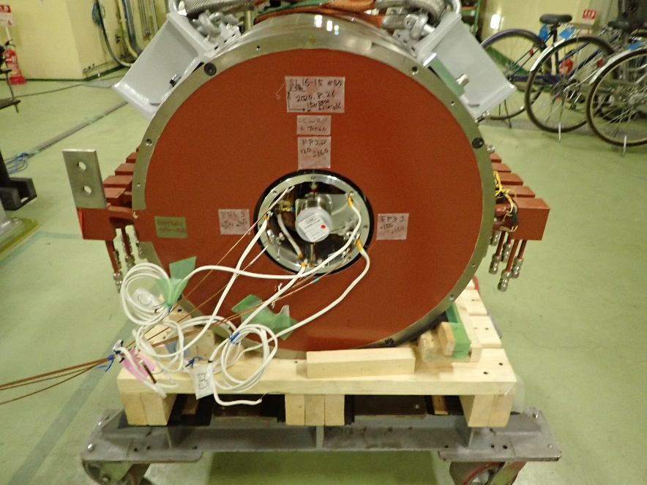
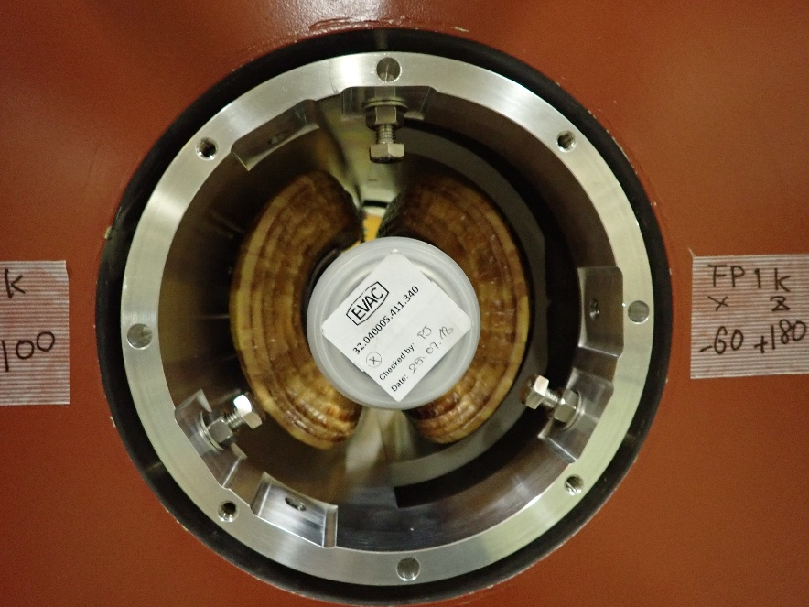
BPM and steering coils inside solenoid
Steering coil
support
BPM
K. Yokoyama and K. Kakihara

Slide 13
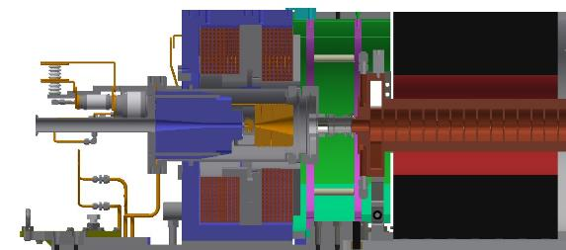
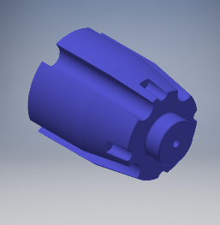
Orbit deflection by yoke
A Yoke to concentrate magnetic flux by the BC to the target
Asymmetric shape of yoke and saturation of magnetic field generate Bx, By inside yoke.
Simulation explain experimental results well.
Transvers magnetic field on beam axis (center) is not proportional to BC current.
If permeability is infinite, Bx, By is zero inside the yoke even if the shape is not symmetric

Slide 14
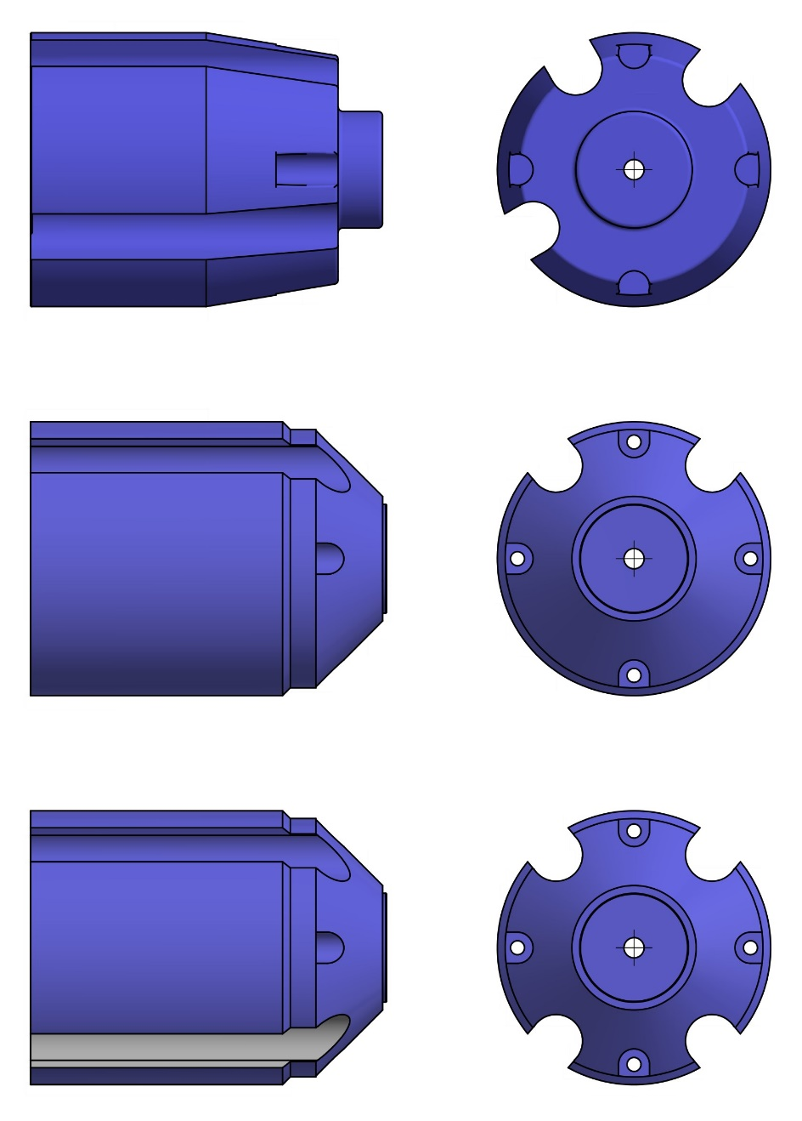
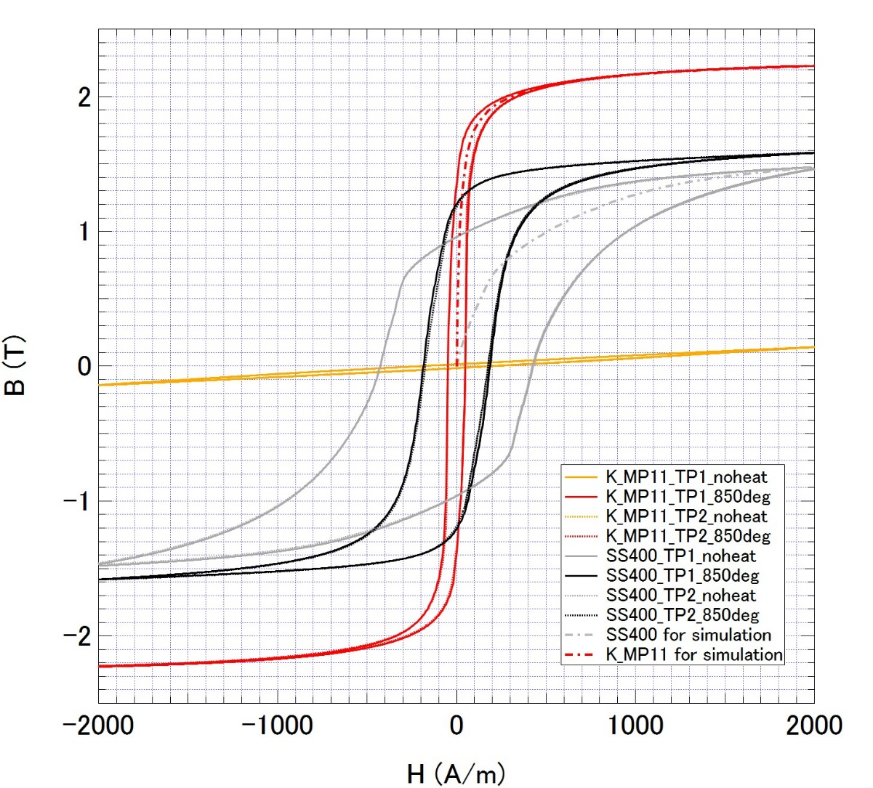
Upgrade the yoke
old
Shape was optimized
new
To increase Saturation magnetic flux density,
material was changed from
ordinary steel (SS400, 1.5 T) to
permendur (K_MP11, 2.2 T)

Slide 15
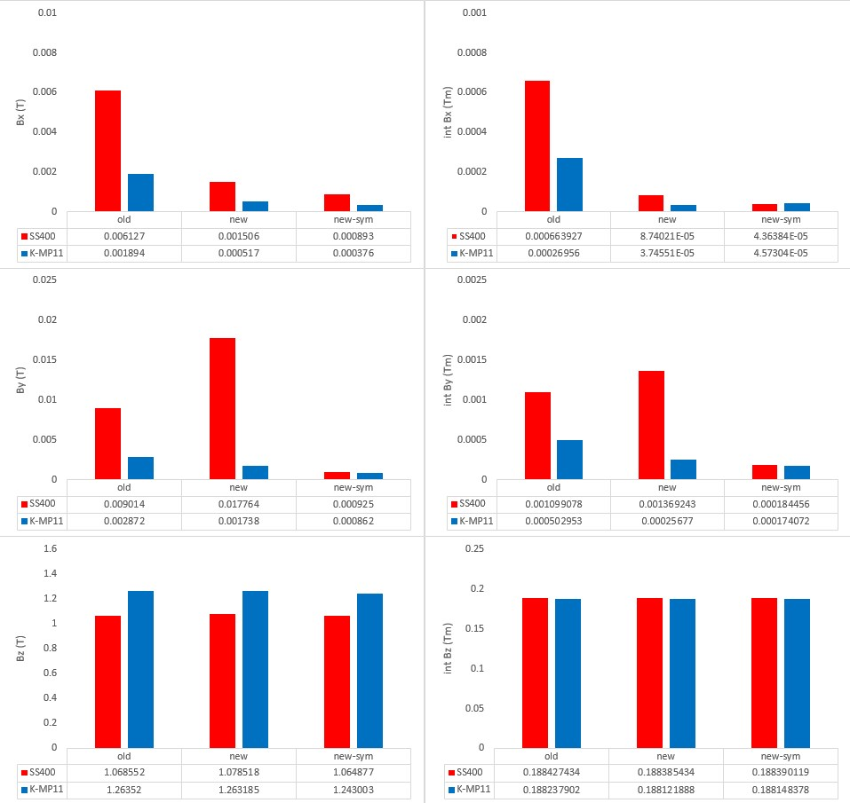
Peak value
Integrated value
X0.024
BC=650A
X0.158
X1.16

Slide 16
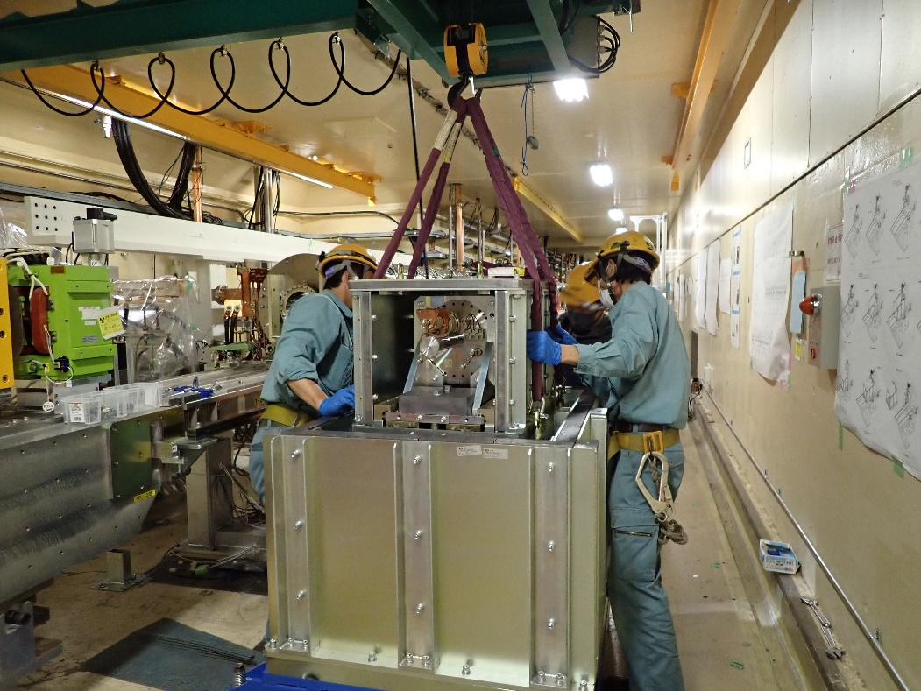
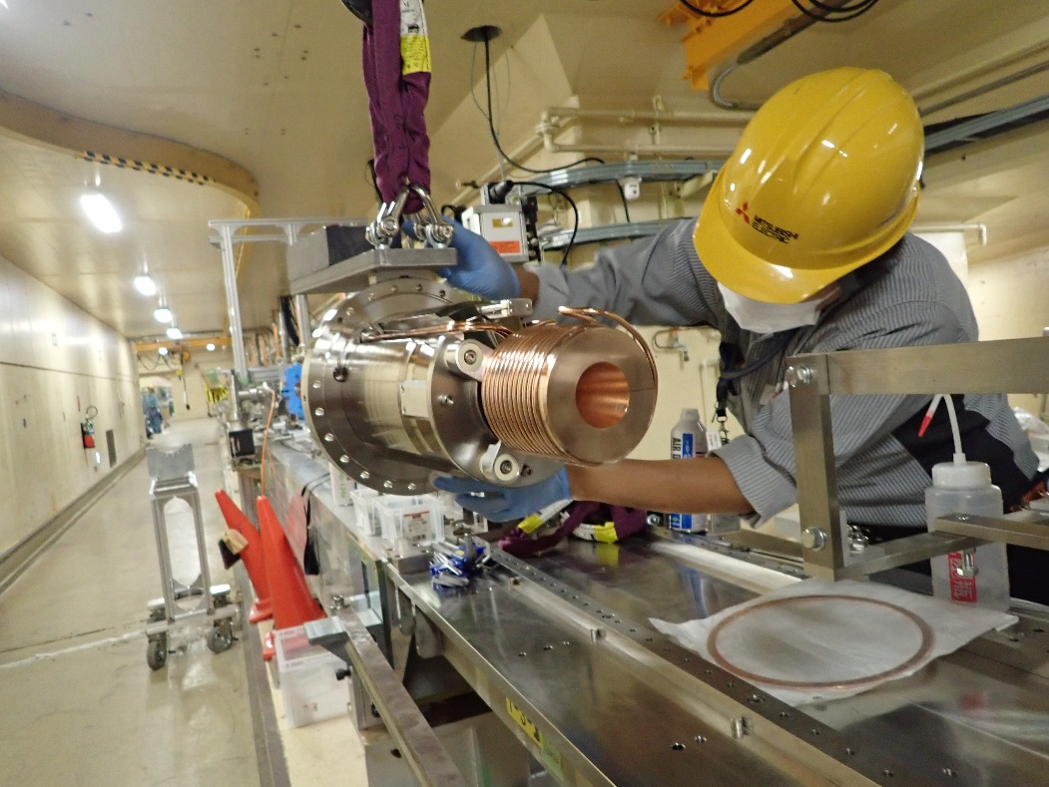
installation
Remove old positron source
During 2020 summer shutdown,
  A new FC
  Two fast BPMs
  Two ordinary BPMs
  One vertical steering coil
  Three horizontal steering coils
Install new positron source

Slide 17
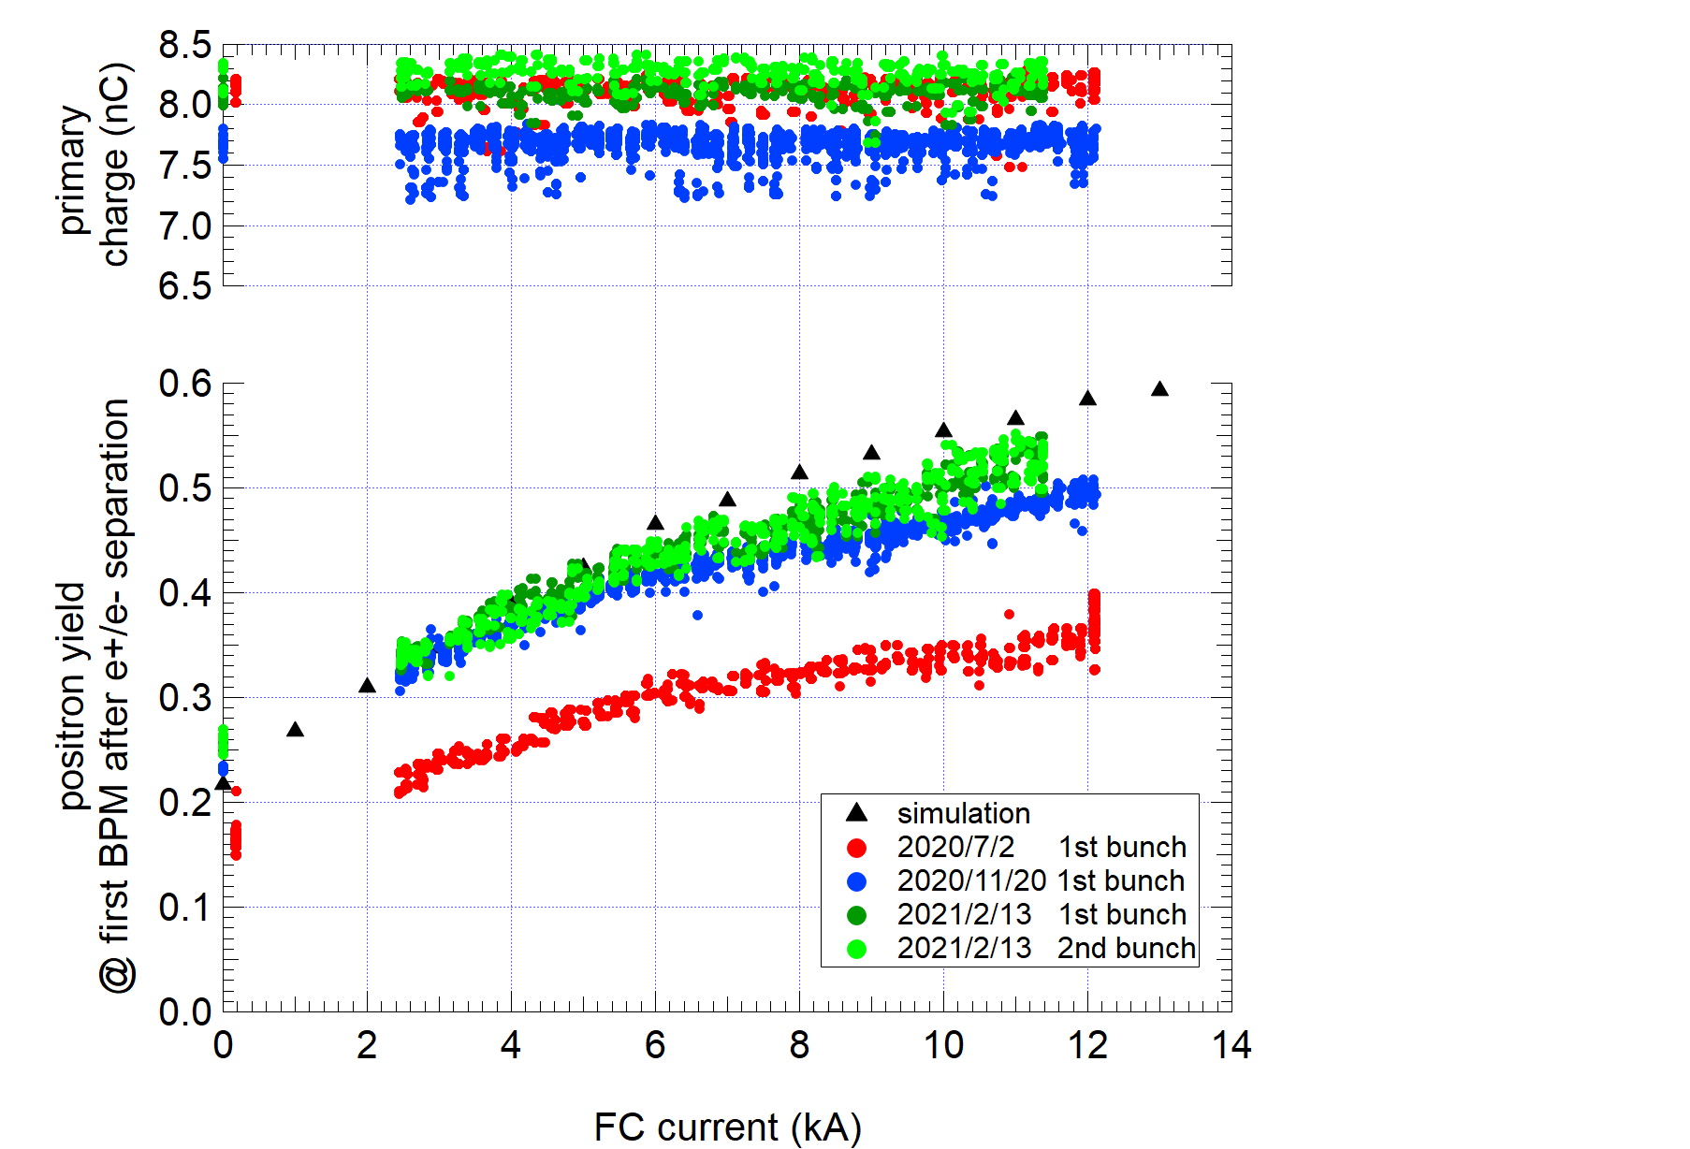
Positron yield vs FC current
Design (0.58)
Present
(Further tuning was done after this measurement. Now the yield almost reached design value. See next page)
Before upgrade
(To avoid discharge,
FC current was limited very low)

Slide 18
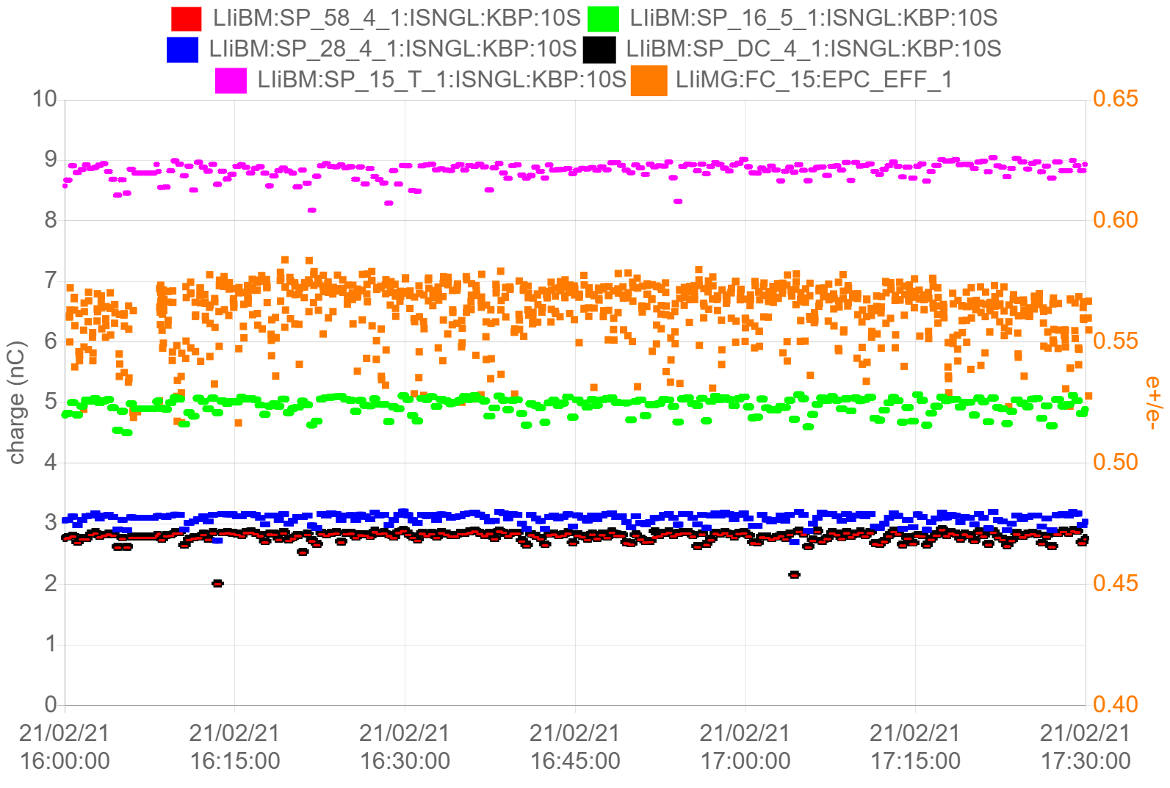
Recent status (2021a)
Primary beam
  90% (9 nC / 10 nC)
Positron yield（e+/e-）
  100% (0.58 / 0.58)
transport
  Assuming 5.8 nC (design value) @ first BPM after the target and present transport efficiency, charge @ Linac end is expected to be 3.3 nC.
  There is still room for improvement
Primary electron
e+/e- design
Before DR
First BMP after target
After DR
Linac end
Hardware upgrade
Further beam tuning
 | design | 2020ab | 2020c | 2021a | 2021a (10 nC, 0.58)
Energy (e-) | 3.5 GeV | 3.5 GeV | 3.5 GeV | 3.5 GeV
primary charge (e-) | 10 nC | 8.4 nC | 8 nC | 9 nC
e+/e- | 0.58 | 0.24 | 0.51 | 0.58
e+ @ first BPM after the target | 5.8 nC | 2.0 nC | 4.1 nC | 5.1 nC | 5.8 nC (assume)
e+ @ before DR | - | 1.6 nC | 2.5 nC | 3.2 nC | 4.2 nC
e+ @ after DR | - | 1.4 nC | 2.1 nC | 2.9 nC | 3.3 nC
e+ @ Linac end | 4 nC | 1.4 nC | 2.1 nC | 2.9 nC | 3.3 nC

Slide 19
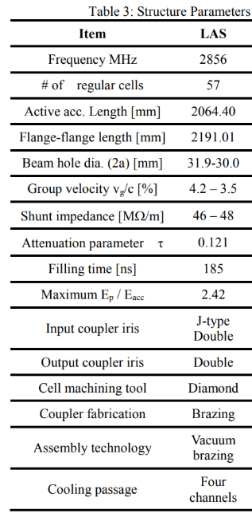
Gradient after the target
name | Design gradient (MV/m) | Operation gradient (MV/m) 2020/10/30 | Max gradient @ KLY power = 40 MW
AC_15_1 | 14.0 | 7.3 | 17.0
AC_15_2 | 14.0 | 7.3 | 17.0
AC_16_1 | 10.0 | 11.3 | 12.2
AC_16_2 | 10.0 | 11.3 | 12.2
AC_16_3 | 10.0 | 11.3 | 12.2
AC_16_4 | 10.0 | 11.3 | 12.2
Data from H. Ego
Due to the load problem, gradient of the first and second acc. structure after the target is low.
This may cause poor bunching which can be one of the reason for large beam loss during transportation to the DR.
https://www.pasj.jp/web_publish/pasj2014/proceedings/PDF/SAP0/SAP045.pdf
https://doi.org/10.18429/JACoW-IPAC2014-THPRI047

Slide 20
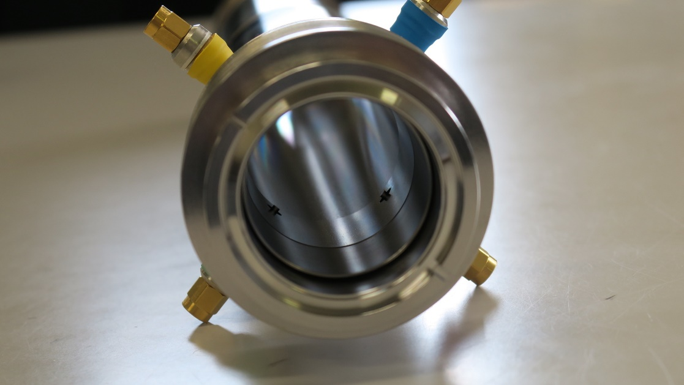
Fast BPM to decompose e+/e- in solenoid
e+/e- separation chicane
Steering coils
BPM
Fast BPM
175 ps
Simulation by F. Miyahara
electron
positron
Small antenna
To monitor positron in solenoid section, very fast response BPM was developed by
Monitor group (T. Suwada, F. Miyahara, A. Rehman)

Slide 21
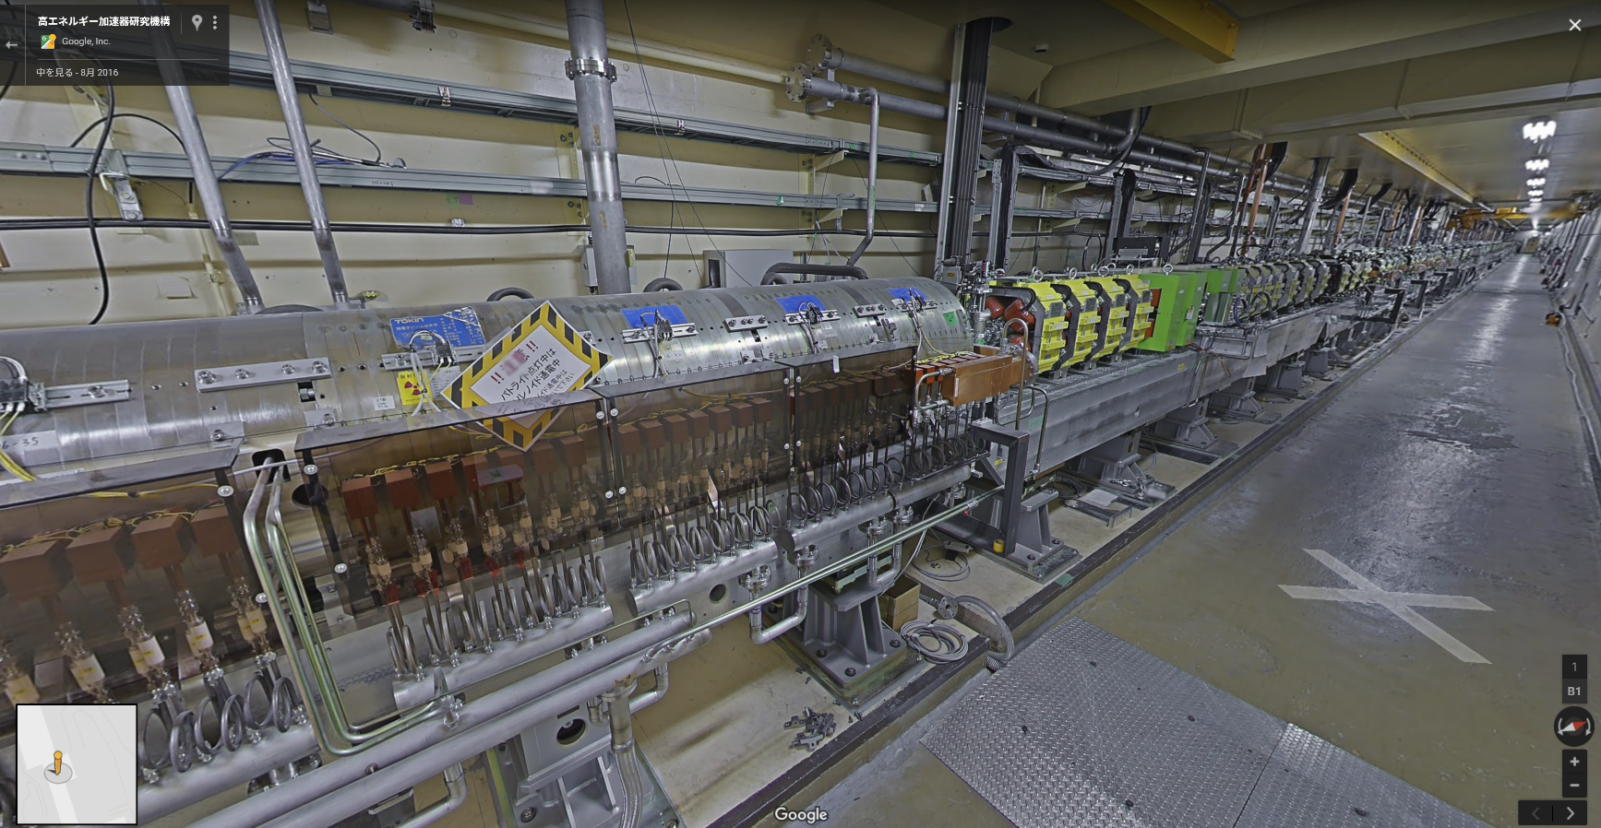
Transport between Target and DR
FC
+
target
solenoid
LAS
AC_15_1
AC_15_2
AC_16_1
AC_16_2
AC_16_3
AC_16_4
Normal
solenoid
Q
AC_17_1
AC_17_2
AC_17_3
AC_17_4
AC_18_1
AC_18_2
AC_18_3
AC_18_4
Quad section (115 m)
Solenoid section (15 m)
 | LAS | Normal S band
Acc. Gradient (MV/m) | 14/10 | 20
Aperture (mm) | 30 | 20
Electron / positron separator

Slide 22
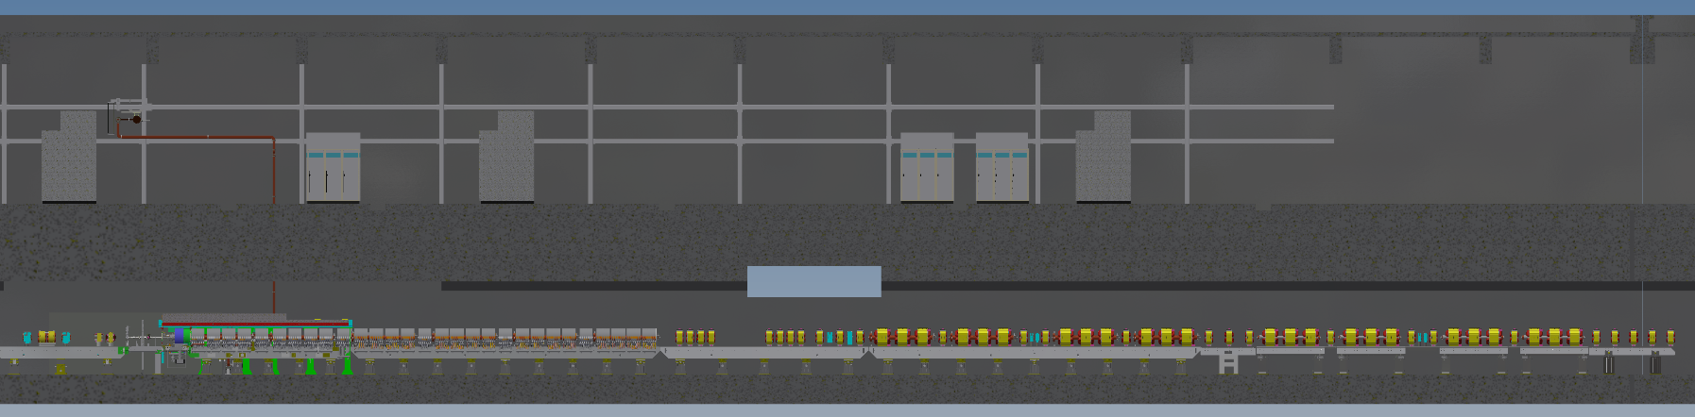
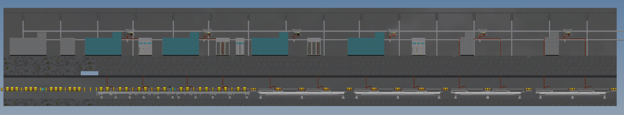
Transport between Target and DR – increase pulsed steering
Target & FC
15m long solenoid
About 100 Quad magnet
1.1 GeV @ DR
LAS x 10
Normal x 32
1-5
1-6
1-7
1-8
To dumping ring
2-1
2-2
2-3
2-4
2-6
2-7
2-8
10m
There are only 8 pulsed steering magnets. Others are DC magnets.
→Increase 6 pulsed steering magnets in 2021 summer shutdown.

Slide 23
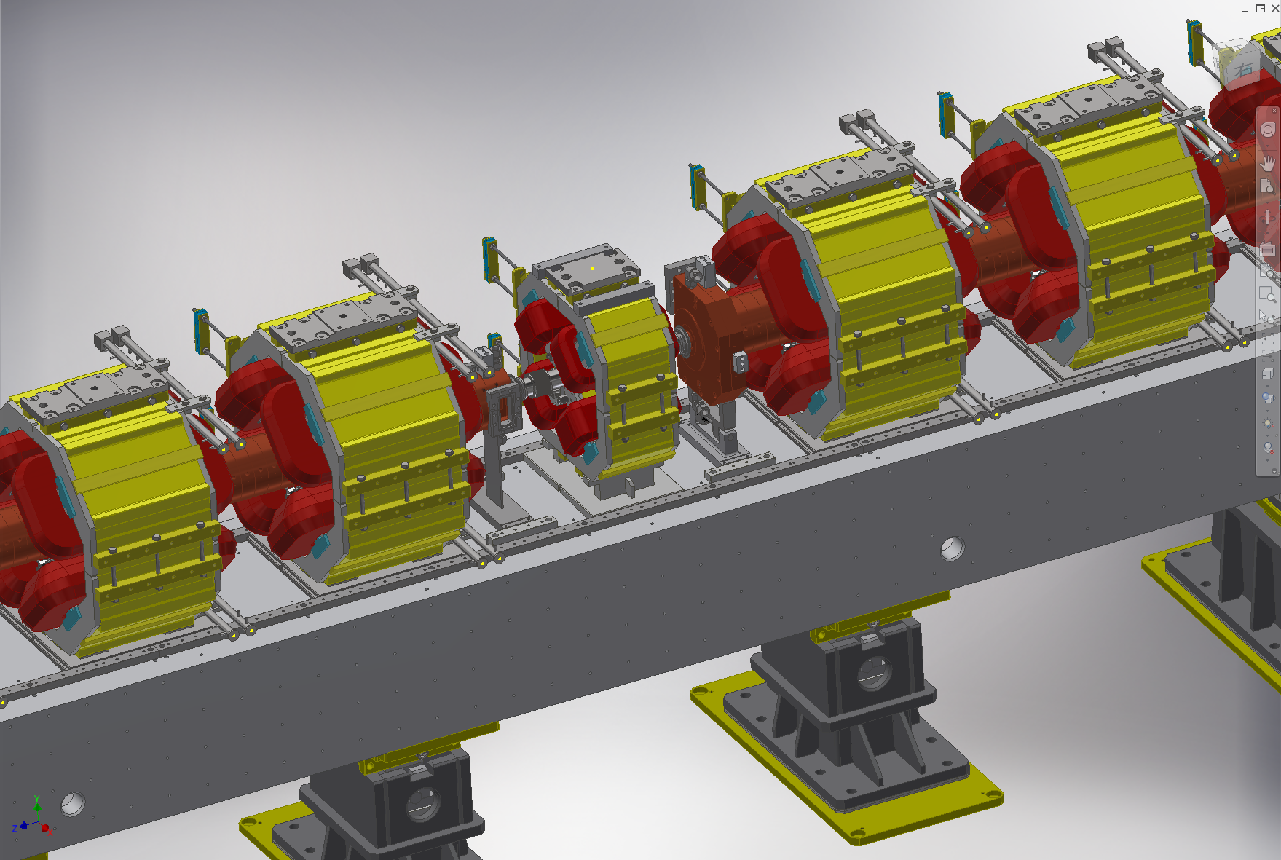
Transport between Target and DR – replace DC Q with pulsed Q
Surrounding Acc. Structure = impossible to be pulsed
Between Acc. Structure = possible to be pulsed

Slide 24
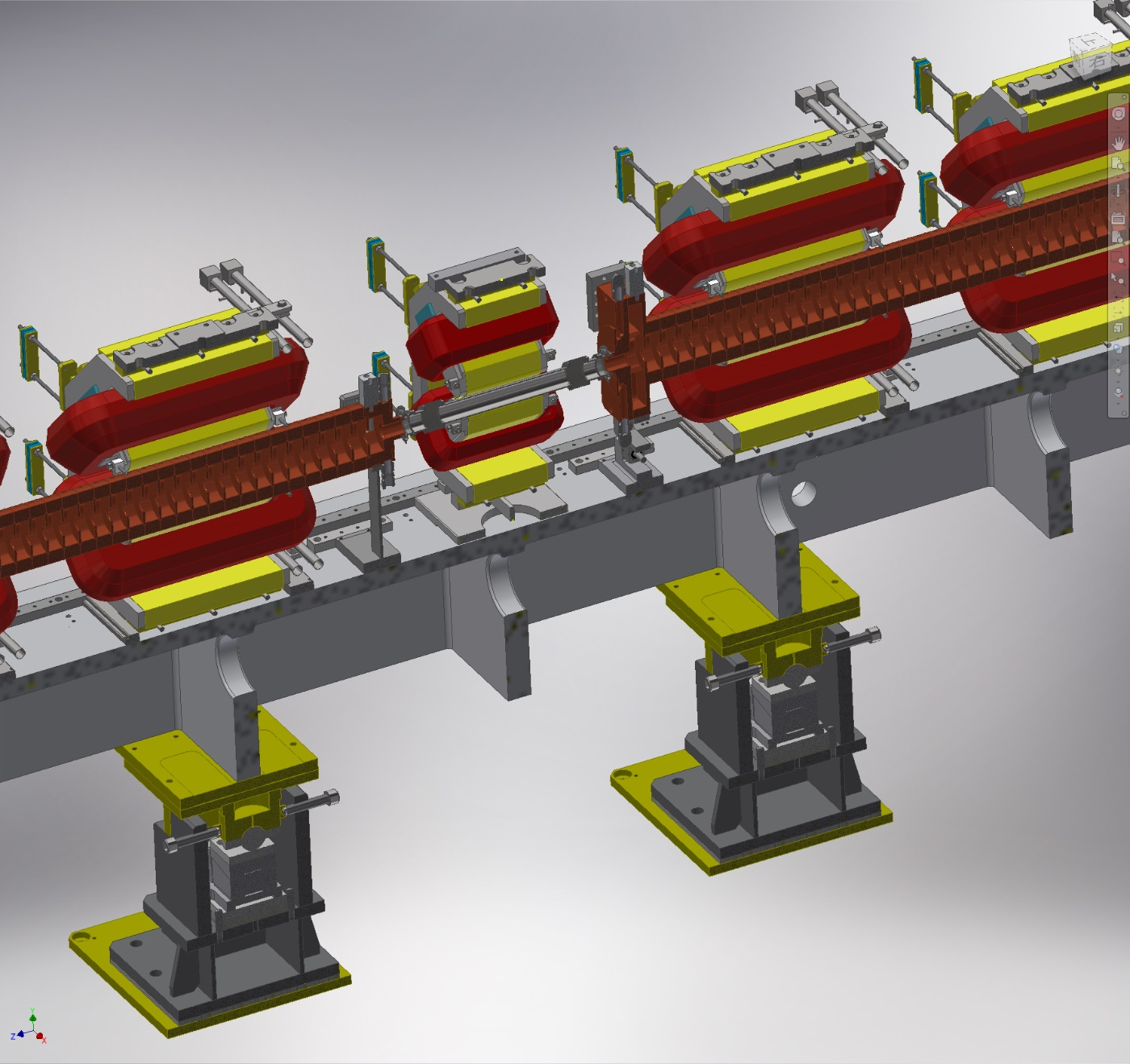
Transport between Target and DR – replace DC Q with pulsed Q
Surrounding Acc. Structure = impossible to be pulsed
Between Acc. Structure = possible to be pulsed
Replace several DC Q magnets with pulsed Q magnets (2022～).
Also important for preserving electron emittance.

Slide 25
Short term plans（1～2 years）
Major upgrade was done in 2020 summer shutdown
Increase positrons up to 4 nC by several minor improvements.
Now, it’s time to consider new strategy for long term goal.
Increase Acc. Gradient at 1-5 unit（H. Ego）
  New load for the Acc. structure（under development）
Install pulsed magnets between target and DR（T. Natsui、K. Yokoyama、Y. Okayasu、T. Kamitani、Y. Enomoto）
  Increase steering magnets（2021）
  Replace DC Q magnets with pulsed Q magnets（2022）
Fast BPM （T. Suwada、F. Miyahara、A. Rehman）
  Under test
Increase FC current（RF group）
  Thanks to new material, higher current operation may be possible.
    Stable operation has been confirmed up to13 kA at test bench.
  Upgrade of the power supply is necessary（2021～）
Increase primary electron charge（M. Yoshida）
  It’s not difficult to increase current by increasing heater current
  Dark current to the PF ring issue have to be solved

Slide 26
Mid term plan（2～3 years）
Optimization of FC shape
  (unofficial) collaboration with CERN
Moving target
Decrease distance between FC and the first acc. structure

Slide 27
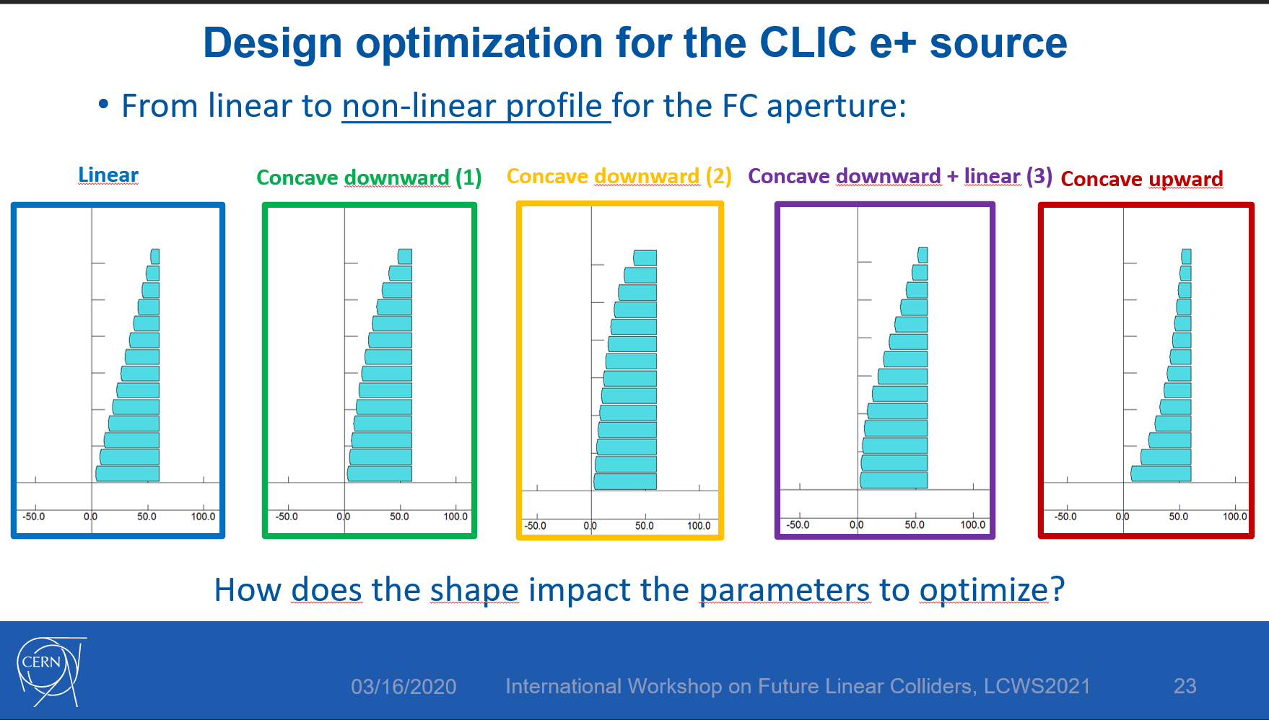
Optimization of FC shape
H. Bajas @ LCWS2021

Slide 28
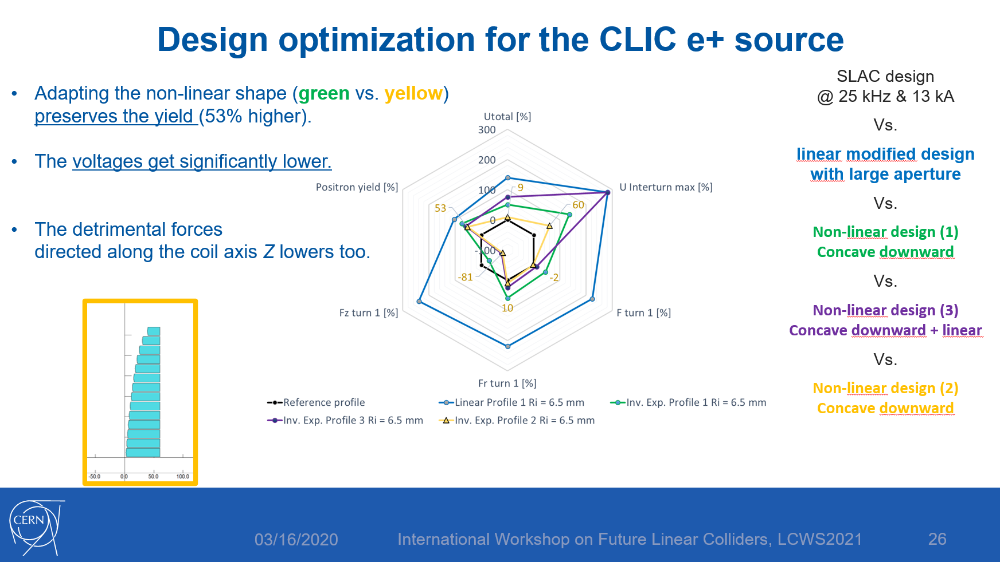
Optimization of FC shape
H. Bajas @ LCWS2021

Slide 29
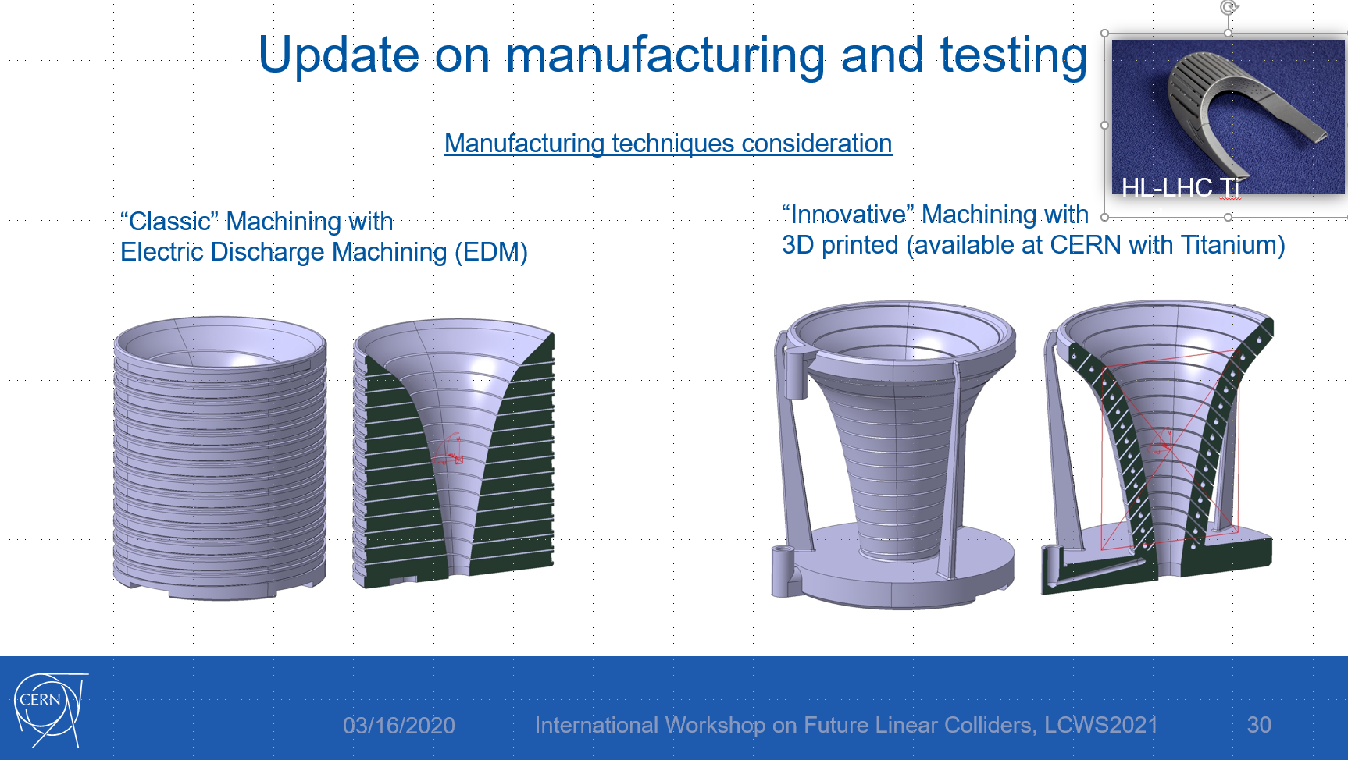
Optimization of FC shape
H. Bajas @ LCWS2021

Slide 30
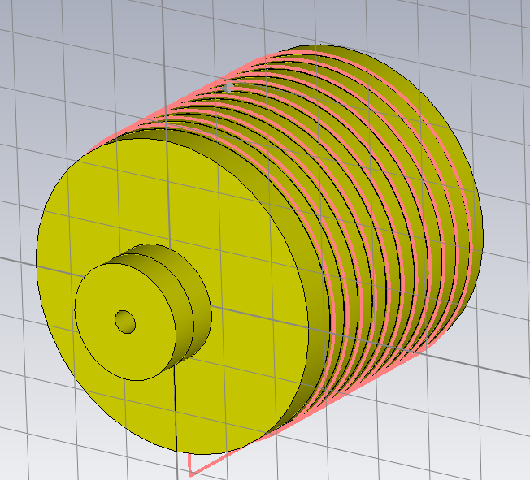
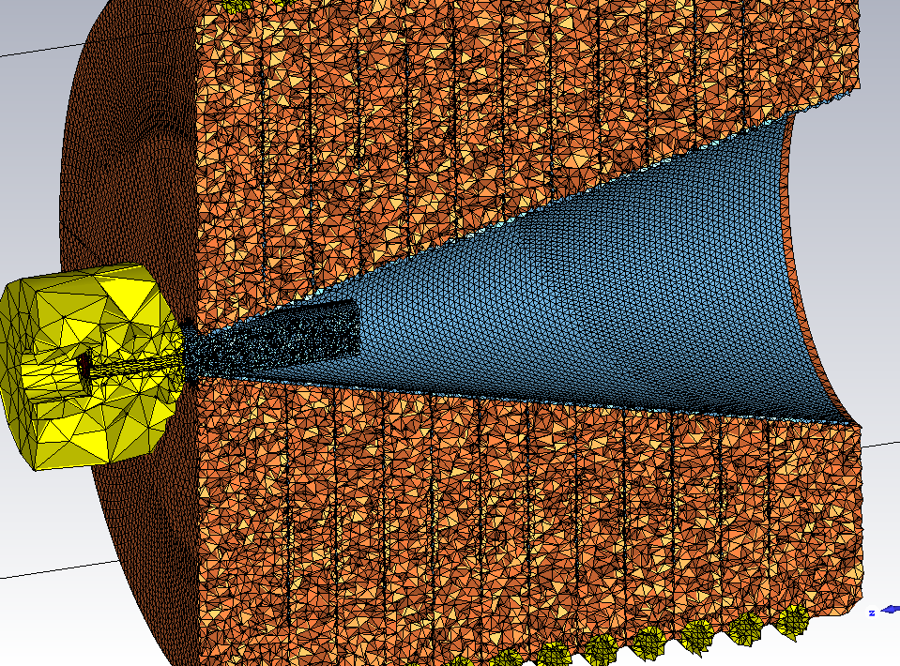
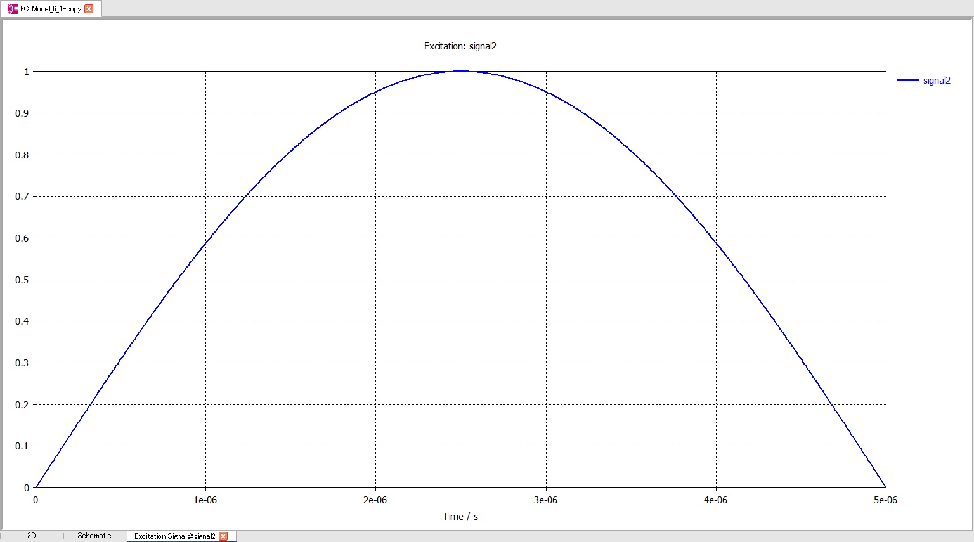
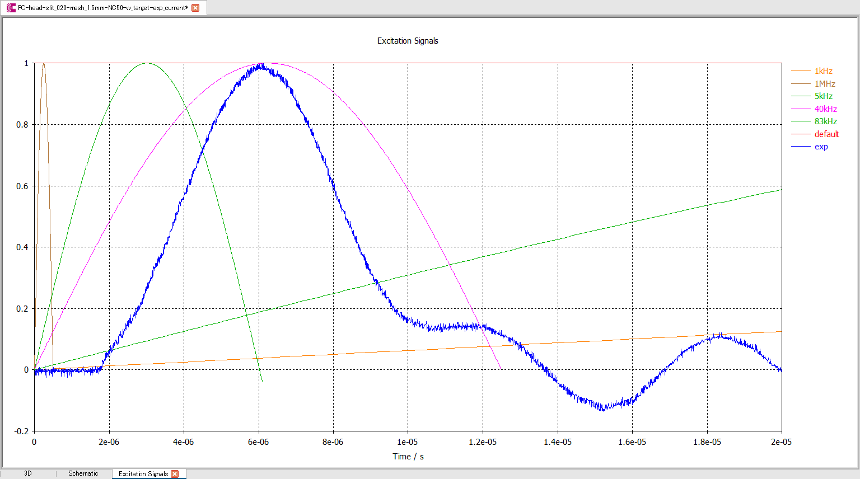
Magnetic field simulation
~ 2014
Now
Excitation current
Simulation using realistic model and measured current shape was established

Slide 31
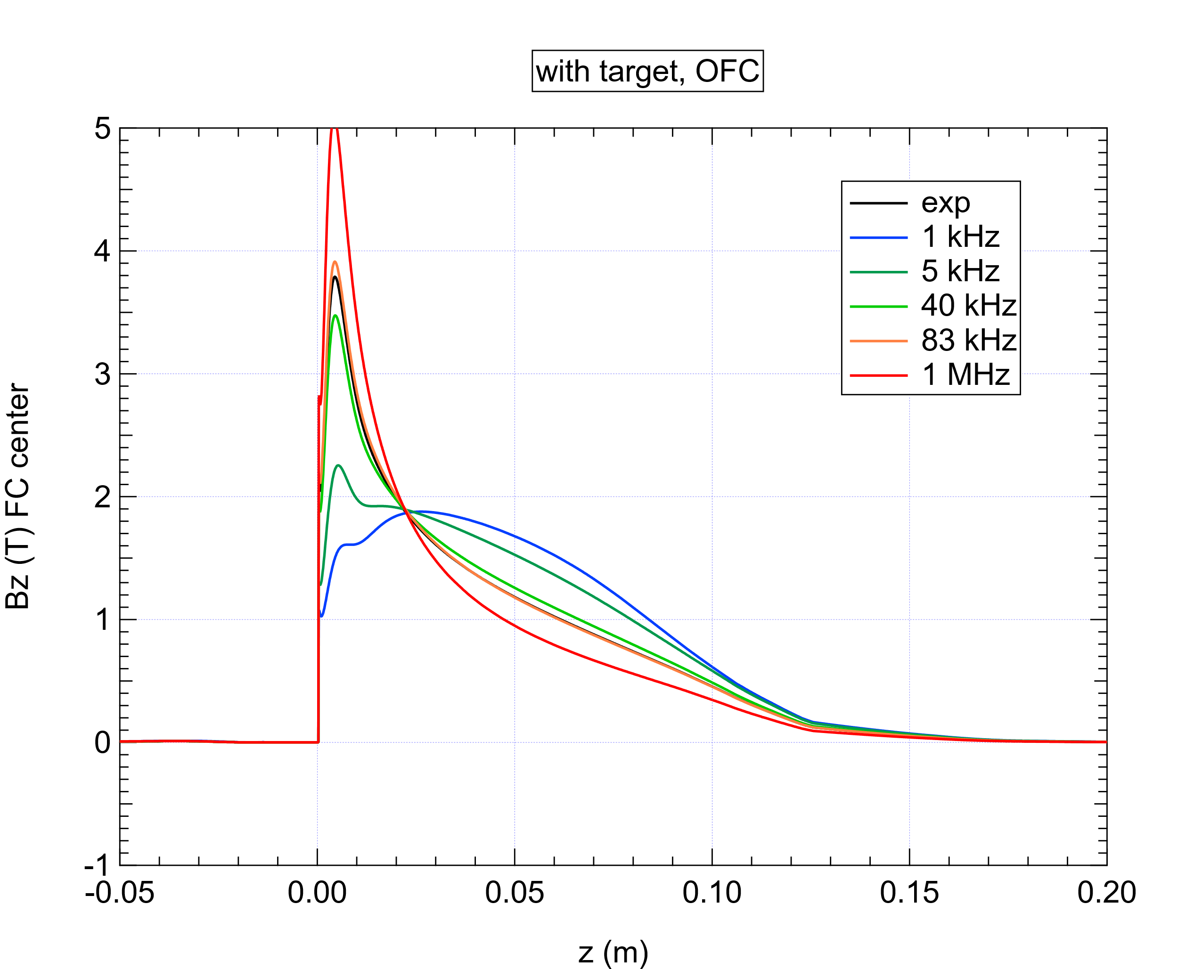
Pulse width dependence
Magnetic field shape is determined by skin depth
It is important to use realistic current waveform for simulation.
For fixed current
Pulse width | short | Long
Magnetic field | strong | weak
voltage | high | Low

Slide 32
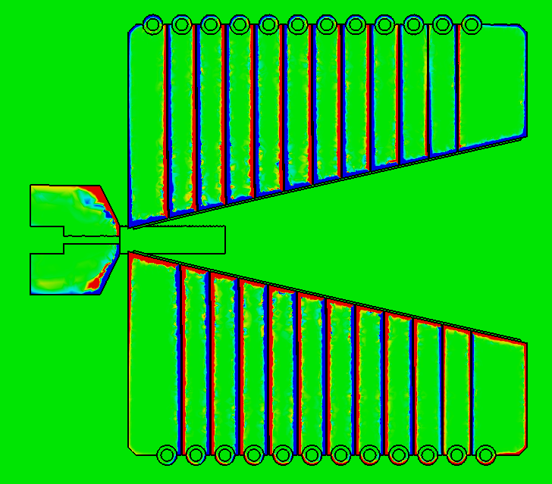
Conduction current distribution in FC
Jx : conduction current density in x direction
Plot Jx as a function of y
y
z

Slide 33
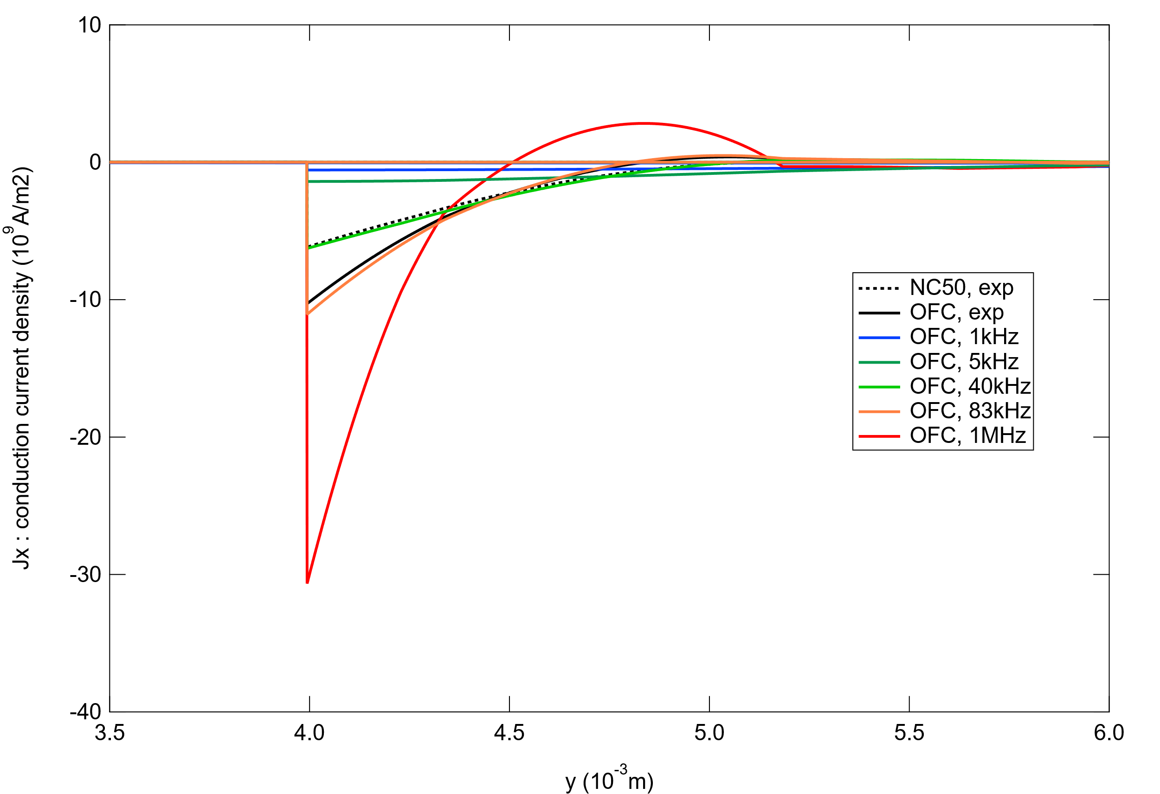
Jx vs y - pulse width dependence

Slide 34
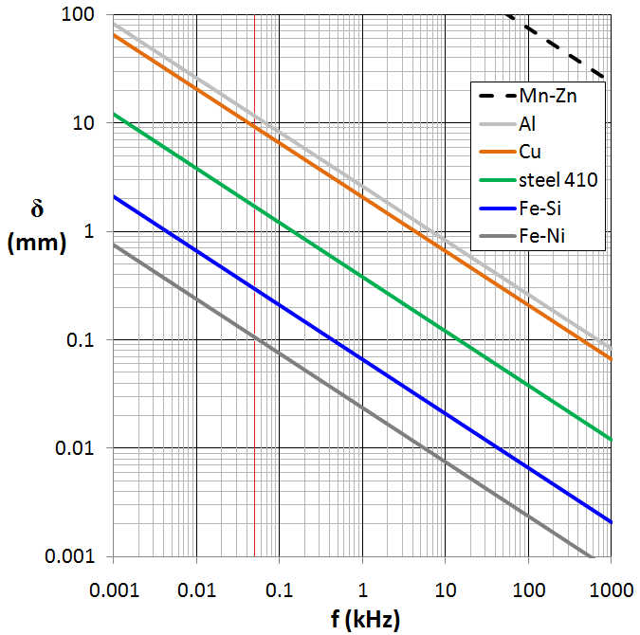
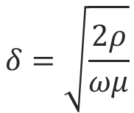
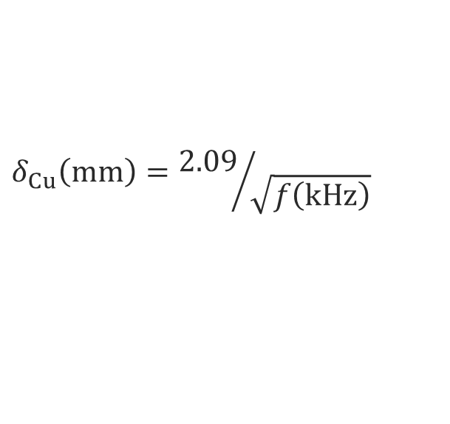
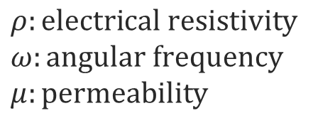
$$δ=\sqrt{\frac{2ρ}{ωμ}}$$
$$δ_{Cu}\left(mm\right)={2.09}/{\sqrt{f\left(kHz\right)}}$$
$$ρ:electrical resistivity$$
$$ω:angular frequency$$
$$μ:permeability$$
Frequency (kHz) | Skin depth(mm)
5 | 1.21
40 | 0.96
83 | 0.77
1000 | 0.43

Slide 35
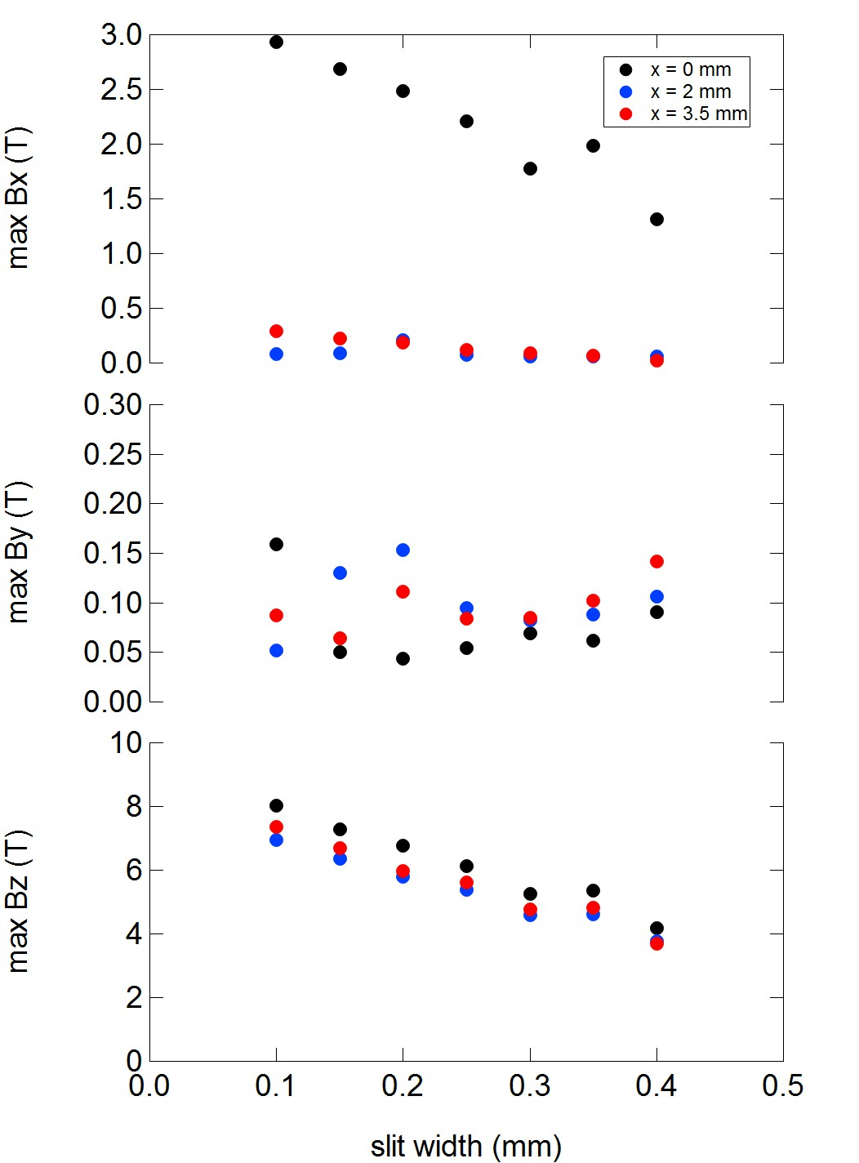
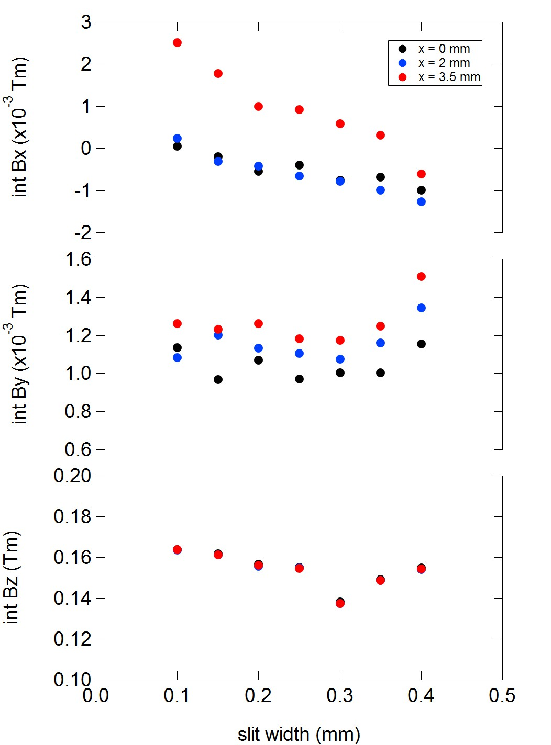
Slit width dependence of magnetic field

Slide 36
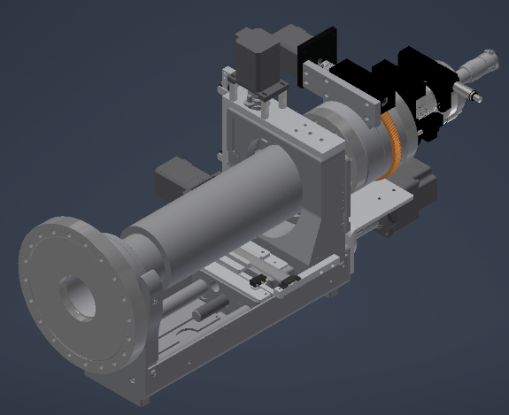
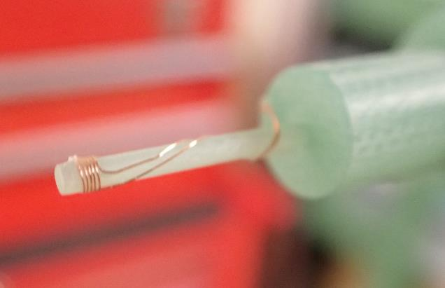
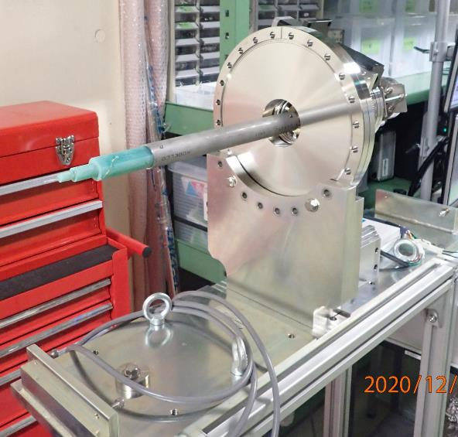
Magnetic field measurement
XYZ stage with motor drive
Rotary stage with motor drive
XYZ positions are monitored by linear gauge by 10um precision
Pick up coil is mounted on FRP rod.

Slide 37
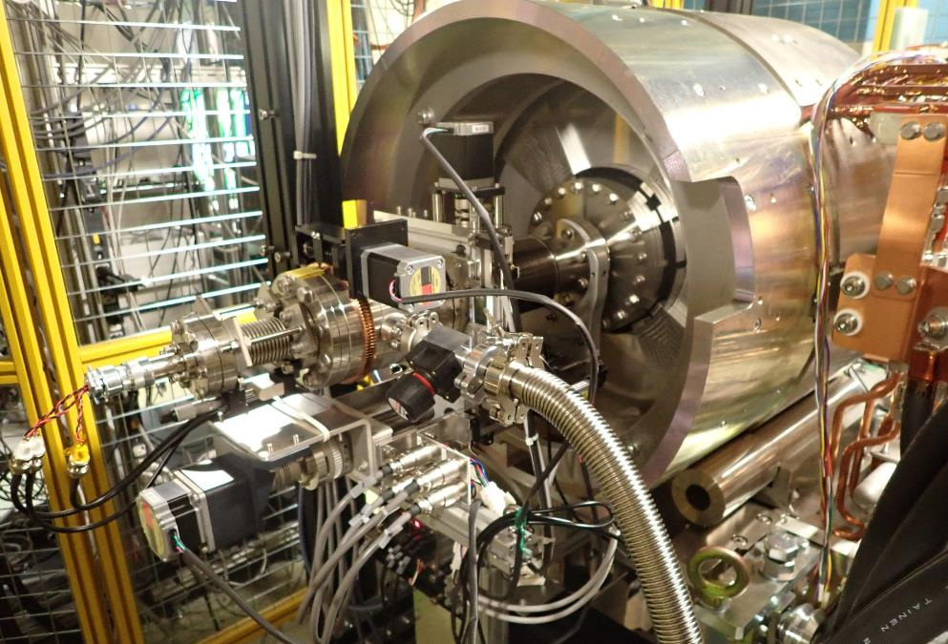
Looking from downstream side with the measurement system attached

Slide 38
Comparison between simulation and measurement

Slide 39
Mid term plan（2～3 years）
Optimization of FC shape
  (unofficial) collaboration with CERN
Moving target
Decrease distance between FC and the first acc. structure

Slide 40


Target detail
Target material : W
Target size : Φ4 x 14
Inserted in the pule Cu block
Connected by HIP process
X = 0 hole for electron
X = 2 center of the FC
X = 3.5 center of the W target
looking from downstream side
X = 0
Primary beam size ～ 1 mm

Slide 41

Improvement of positron yield by bringing the target and the FC to the beamline axis
Simulation by M. Fukuda
Bring to
center
Present
configuration
Injection beam size

Slide 42
Requirement for e+/e-
e+：center of the target and the FC should be coincide with the center of the beam line
e-：increase hole size for flexible beam tuning
To fulfill both requirements, moving target is needed
  Target is inserted to the beamline only when the beam mode is KBP
    Fast (< 20 ms) and flexible control is required not to restrict operation pattern.
  Rotating type：arrangement of cooling water is difficult
  Linear motion type： high acceleration → mechanical shock

Slide 43

Moving target – an idea
Guide by cam＋variable lift mechanism
  Cam shaft rotate at constant speed
  Increase lift only when the mode is KBP
  Minimize part which moves at high acceleration
  50 Hz = 3000 rpm
    Not unrealistic speed but careful evaluation of durability is important
If you have any ideas, please share them!!
https://gifmagazine.net/post_images/662332

Slide 44
Mid term plan（2～3 years）
Optimization of FC shape
  (unofficial) collaboration with CERN
Moving target
Decrease distance between FC and the first acc. structure

Slide 45



Beam loss between FC and the first Acc. structure
福田さんによるGEANTを使ったsimulation
Calculated by T. Kamitani
Most of the positrons are lost between the FC and the
first Acc. Strucure.

Slide 46

Beam loss between FC and the first Acc. structure
simulation by M. Fukuda
In this simulation, aperture of the duct is not taken into consideration,
which is the reason why the number of positron does not decrease around Z = 150 ~ 230

Slide 47



Input coupler
Layout of the SLC
In the SLC, distance between the FC and the first acc. structure is quite short.
In the SuperKEKB, the distance was determined taking workability into account ten years ago.
Experiences, records, tools and jigs on work around the target are accumulated
→New design to minimize the distance is possible now.
→Further reduction of the distance is possible, if the standing wave acc. structure is used, since the input coupler is able to be moved to downstream side.
Deterioration of the Acc. Structure by radiation is one of concern.
→easy replacement mechanism is desired.

Slide 48
Beyond 4 nC / bunch
If the 4 nC / bunch restriction is removed,
how much impact does it have on the long term (after upgrade of the QCS) operation?
Increase beam power of primary electron
  Increase energy
    Do not consider this time
  Increase bunch charge
    Electron gun at C sector (after the arc)
Increase capture efficiency
  Increase magnetic field (magnetic field ratio is also important)
    Superconducting magnet
  Increase aperture
    L band acc. structure

Slide 49
Beyond 4 nC / bunch
If the 4 nC / bunch restriction is removed,
how much impact does it have on the long term (after upgrade of the QCS) operation?
Increase beam power of primary electron
  Increase energy
    Do not consider this time
  Increase bunch charge
    Electron gun at C sector (after the arc)
Increase capture efficiency
  Increase magnetic field (magnetic field ratio is also important)
    Superconducting magnet
  Increase aperture
    L band acc. structure

Slide 50

Electron gun at C sector
New electron gun
target
☓ acc. distance between e gun and targe decrease → beam energy decrease
(half of present energy)
○ no arc section → energy spread is not important. Easy beam tuning
If it’s possible to deliver primary electron beam over 20 nC / bunch, total primary beam power increase
Concern about heat on target.
PEDD (Peak energy deposition density (J/g))
cooling power

Slide 51

PEDD（10 nC / bunch x2）
Simulation by Y. Morikawa
Distribution of energy deposition per pulse
Max. energy deposition along beam
axis per pules

Slide 52

PEDD（10 nC / bunch x2）
Simulation by Y. Morikawa
Empirical Criterion : PEDD < 35 J/g
If the value is larger than criterion, increase beam size on the target.

Slide 53

Cooling power and target temperature
25 Hz
KBP 2bunch
(total 11 nC @ SP_15_T)
Assume beam energy on target as 3.2 GeV
12.5 Hz
900W @ 25Hz 2bunch (11 nC total)
→temperature rise is 30 deg
→dumped power to the cooling water was 150 W
At 50Hz 2 bunch (20 nC in total),
beam power is 3600W
→temperature rise is 120 deg
5 Hz
Cooling power calculated from
cooling water temperature and flow
0 Hz
Empirical Criterion : If the beam power is < 10 kW, water cooled fixed targe works fine.

Slide 54
Beyond 4 nC / bunch
If the 4 nC / bunch restriction is removed,
how much impact does it have on the long term (after upgrade of the QCS) operation?
Increase beam power of primary electron
  Increase energy
    Do not consider this time
  Increase bunch charge
    Electron gun at C sector (after the arc)
Increase capture efficiency
  Increase magnetic field (magnetic field ratio is also important)
    Superconducting magnet
  Increase aperture
    L band acc. structure

Slide 55
Superconducting magnet
Replace FC with superconducting solenoid
  Flexible magnetic field profile
    Field at the entrance of the first acc. structure can be chosen freely
    High magnetic field at the exit surface of the target
      In the case of FC, B ≒ 0 due to eddy current
Increase magnetic field in the capture solenoid
  superconducting？

Slide 56




Principle of AMD
AMD : adiabatic matching device. FC is one type of AMD.
OHO’19
Velocity : v₁
r position : r₁
Angle : φ₁
Velocity : v₂
r position : r₂
Angle : φ₂
B₁
B₂ < B₁,
B_{２}
$$v_{1}=v_{2}$$
$$r_{2}=r_{1}\sqrt{\frac{B_{1}}{B_{2}}}$$
Angle and position can be adjusted
by the ratio of magnetic field.
$$φ_{2}=φ_{1}\sqrt{\frac{B_{2}}{B_{1}}}$$

Slide 57

Effect of eddy current on target
exit surface of the target
Max. magnetic field should be at the exit surface of the target.
However, distance between the FC and the target cannot be zero.
In addition, pulsed magnetic field induce eddy current on the targe surface which reduce magnetic field from the FC.
Positron from the target surface travels to some position non-adiabatically, then captured to the field line and moves adiabatically.
Effective max. magnetic field is the field where the positron is captured to the field line
I. Chaikovska, “Status of the FCC-ee positron source” LCWS2021

Slide 58


Simulation model With target
This taper is important to reduce eddy current on the target

Slide 59


Simulation model with Cu plate
Plate material : OFC
Distance between plate and FC : 2 mm

Slide 60

Target dependence
Eddy current on the target reduce magnetic field by FC

Slide 61
Consideration about superconducting magnet
Eddy current issue is avoided using DC magnet
  Increase effective max. magnetic field.
Superconducting magnet is necessary for generating a few Tesla DC magnetic field
  Present FC generate about 3.7 T at peak.
There are many things to do to operate superconducting magnet
  No infrastructure for cryogenics in the linac

Slide 62


Increase magnetic filed in Capture solenoid section
Simulation by M. Fukuda
Positron yield peak out around FC current is about 12 kA.
Field ratio may limit the yield
Increase the field in the following section will affect the yield.
Detailed simulation is planed.
0.4 - 0.5 T
Two types of solenoid coils are used
0 - 5 m : large inner diameter type
5 - 15 m : small inner diameter type

Slide 63
Beyond 4 nC / bunch
If the 4 nC / bunch restriction is removed,
how much impact does it have on the long term (after upgrade of the QCS) operation?
Increase beam power of primary electron
  Increase energy
    Do not consider this time
  Increase bunch charge
    Electron gun at C sector (after the arc)
Increase capture efficiency
  Increase magnetic field (magnetic field ratio is also important)
    Superconducting magnet
  Increase aperture
    L band acc. structure

Slide 64


Increase aperture and choice of frequency
Increase aperture
→decrease shunt impedance
→decrease acc. Gradient
→decrease is slower for longer wavelength
Aperture of normal acc. structure is 20 mm
Aperture of LAS (used for 10 acc. structure after the target) is 30 mm
Both of them are S-band.
L-band is preferable for further increasing aperture.
S. Tantawi., et al, “Distributed Coupling Accelerator Structures: A New Paradigm for High Gradient Linacs”, arXiv:1811.09925

Slide 65

L-band acc. structure
Prototype (8 years ago) stored in the linac tunnel

Slide 66
Summary
Major upgrade was done in 2020 summer
  Positron charge is increased to 2.9 nC / bunch.
  Increase positrons up to 4 nC by several minor improvements for the time being.
Summarize possible upgrade plans in short, mid and long term
  Is there demand beyond 4 nC?
In addition to members of the linac, collaboration with people from the future project are very important for discussion, simulation and compensation for lack of man power.
  ILC : M. Fukuda, Y. Morikawa (CASA, KEK)
  FCC-ee : I. Chaikovska (IJCLab)
  CLIC : H. Bajas (CERN)

