Slide 1
Simulation of Low Energy Beam Transport
Benjamin dedić, university of sarajevo

Slide 2
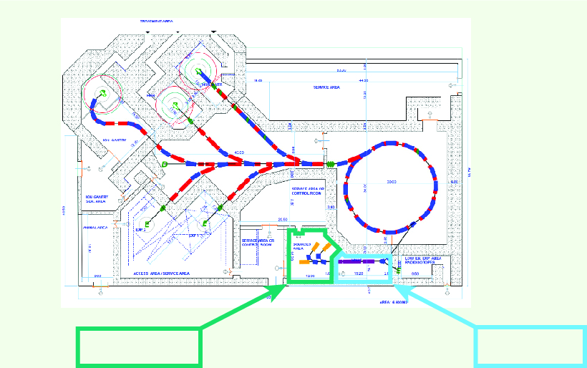
Introduciton
Ion Source(s)
RFQ
[1] Preliminary layout of SEEIIST facility,
The CERN Next Ion Medical Machine Study and the SEEIIST Project: towards a new generation of accelerators for cancer therapy, Maurizio Vretenar (CERN)

Slide 3
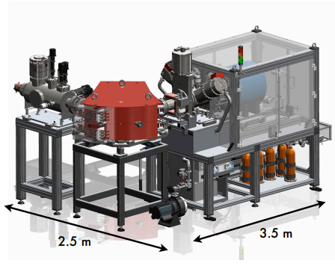
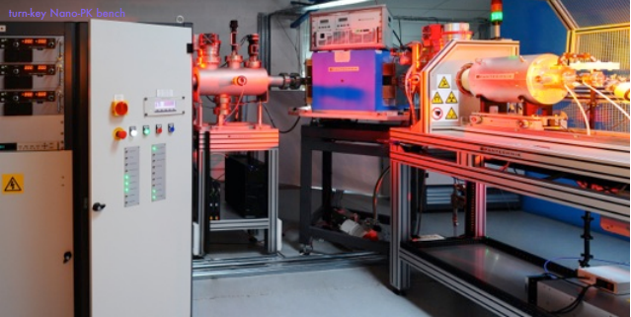
Introduciton
[2] Ion source bench – contains ion source, beam diagnostic and optical elements allowing to form the beam for further transport,
https://www.pantechnik.com/wp-content/uploads/2020/07/Supernanogan.pdf, Pantechnik

Slide 4
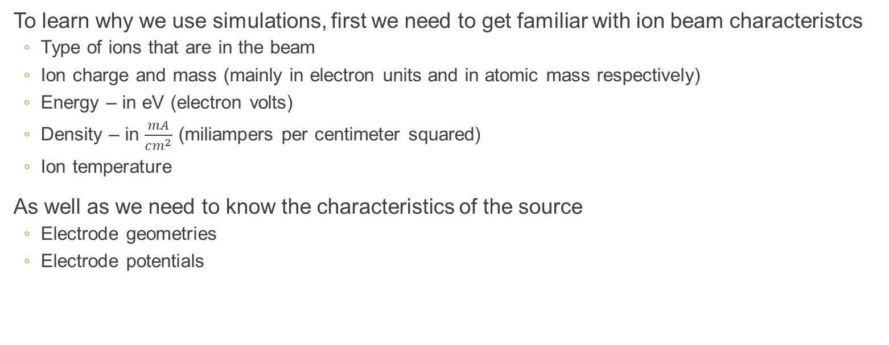
Ion beam simulation
To learn why we use simulations, first we need to get familiar with ion beam characteristcs
  Type of ions that are in the beam
  Ion charge and mass (mainly in electron units and in atomic mass respectively)
  Energy – in eV (electron volts)
  Density – in $\frac{mA}{cm^{2}}$ (miliampers per centimeter squared)
  Ion temperature
As well as we need to know the characteristics of the source
  Electrode geometries
  Electrode potentials

Slide 5
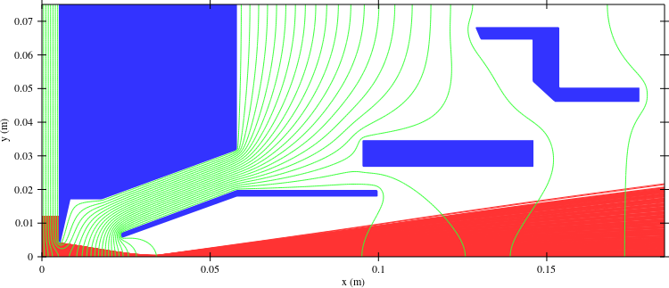
Ion beam simulation
Why do we simulate ion beams?
Simulations are done to optimize the geometries and voltages of the extraction electrodes to receive:
  The largest current
  The smallest emittance
  Good matching to RFQ
What actually needs to be simulated
  2D or 3D distribution of electric field generated
  by electrodes
  Tracking ion movements in this field

Slide 6
Ion beam simulation
After getting the necessary information (either by gathering it or receiving from the company that supplies the source) following steps need to be done
  Finding the best suitable software for simulations
  Reconstructing the geometries of electrodes of the source (as well as the extracting system)
  Setting up correct values of beam characteristics in the program
  Compiling and simulating

Slide 7
Software
Very important to carefully choose the best suitable software for simulations
Some of them are:
  IBSimu
  COMSOL Multiphysics® Finite element analysis – solver and multiphysics simulation software
  GICOSY – Ion optics simulation
  LIMIOPTIC
  And a lot more

Slide 8
IBSimu
Ion Beam Simulator or IBSimu is an ion optical computer simulation
The code has several capabilities for solving electric fields in a defined geometry and tracking particles in electric and magnetic fields
The code is a constructed as a C++
It is used in a LINUX or Windows environment
It has some features as:
  Solid geometry definition using 2D DXF files, 3D STL files, mathematical formulation, etc.
  Finite Difference Method solver for 1D, 2D and 3D Poisson equations with edge smoothing.
  Particle trajectory iteration in self-consistently calculated electric and imported magnetic fields
  And many more

Slide 9
Example of low energy ion beam simulation
First step was installing the IBSimu from the following link:
  http://ibsimu.sourceforge.net/download.html
Second step is following the manual for installation:
  http://ibsimu.sourceforge.net/installation.html
Third step was dowloading the example that was provided on the webpage
  http://ibsimu.sourceforge.net/tutorial.html

Slide 10
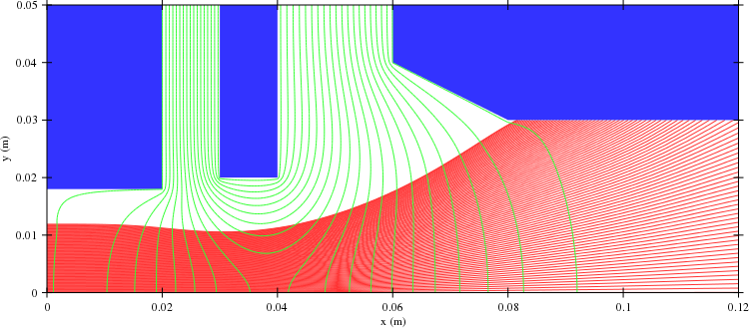
Example of low energy ion beam simulation
After following the steps from the previous site we have received the following plot:
This is only an example of the code and plot from which we start and want to reach the following:

Slide 11
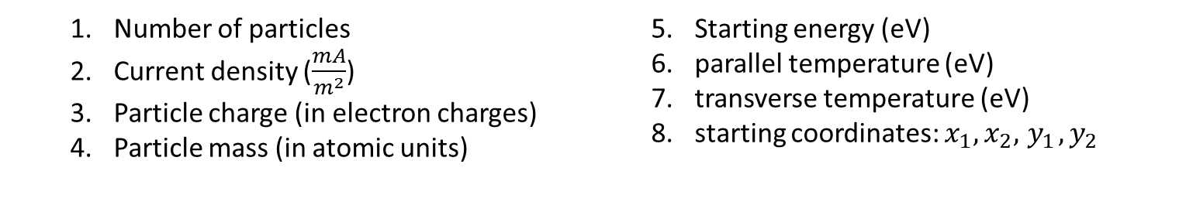
Example of low energy ion beam simulation
To reach the desired geometries parts of the code from the tutorial have to be edited
In the above part of the code we have changed the following parameters:
pdb.add_2d_beam_with_energy( 1000, 50.0, 1.0, 1.0,
3.0e3, 0.0, 0.0,
0.0, 0.0,
0.0, 0.012 );
pdb.add_2d_beam_with_energy( 10000, 20.0, 1.0, 3.0,
30.0e3, 0.0, 1.0,
0.0, 0.0,
0.0, 0.012 );
  Number of particles
  Current density ($\frac{mA}{m^{2}}$)
  Particle charge (in electron charges)
  Particle mass (in atomic units)
  Starting energy (eV)
  parallel temperature (eV)
  transverse temperature (eV)
  starting coordinates: $x_{1},x_{2},{ y}_{1}, y_{2}$

Slide 12
Example of low energy ion beam simulation
Second part of the code to be edited is the size of the field and defining the number of electrodes we need and that is done by editing the following:
Geometry geom( MODE_2D, Int3D(371,151,1), Vec3D(0,0,0), 0.0005 );
Solid *s1 = new FuncSolid( solid1 );
geom.set_solid( 7, s1 );
Solid *s2 = new FuncSolid( solid2 );
geom.set_solid( 8, s2 );
Solid *s3 = new FuncSolid( solid3 );
geom.set_solid( 9, s3 );
Solid *s4 = new FuncSolid( solid4 );
geom.set_solid( 10, s4);
Geometry geom( MODE_2D, Int3D(241,101,1), Vec3D(0,0,0), 0.0005 );
Solid *s1 = new FuncSolid( solid1 );
geom.set_solid( 7, s1 );
Solid *s2 = new FuncSolid( solid2 );
geom.set_solid( 8, s2 );
Solid *s3 = new FuncSolid( solid3 );
geom.set_solid( 9, s3 );
Geometry geom () function is defining the mesh in which our simulation is run
Solid*variable = new FuncSolid (variable) function is defining the solid object in our case the electrode

Slide 13
Example of low energy ion beam simulation
Second to last part to edit is to add/remove and redefine the electrodes of our system
In the code we have edited the x and y values of the electrodes to our desired geometry and after that to repeat the proces for all the electrodes we want to redefine
bool solid1( double x, double y, double z )
{
return((x >= 0.02355 && x <= 0.05794 && y >= -0.00296 + 0.36*x && y <= -0.00163 + 0.371*x) || (x >= 0.05794 && x <= 0.09975 && y >= 0.0178984 && y <= 0.01986574));
}
bool solid1( double x, double y, double z )
{
return( x <= 0.02 && y >= 0.018 );
}

Slide 14
Example of low energy ion beam simulation
The final part before compiling is to edit the voltages of electodes so it would be possible for us to receive the best possible emittance and to match it to RFQ
geom.set_boundary( value, Bound(BOUND_DIRICHLET/NEUMANN, value) ) is the function that defines which electrode (first value) has which value of potential (second value).
BOUND_DIRICHLET/NEUMANN is the boundary conditions we use. Important thing is that the Dirichlet condition is the one that user defined electrodes use
For the first value we use the number of the defined electrode from one of the previous slides. For the numbers 1-4 are space boundaries (respectivly x minimum, x maximum, y minimum and y maximum)
geom.set_boundary( 1, Bound(BOUND_DIRICHLET, -3.0e3) );
geom.set_boundary( 2, Bound(BOUND_DIRICHLET, -1.0e3) );
geom.set_boundary( 3, Bound(BOUND_NEUMANN, 0.0 ) );
geom.set_boundary( 4, Bound(BOUND_NEUMANN, 0.0 ) );
geom.set_boundary( 7, Bound(BOUND_DIRICHLET, -3.0e3) );
geom.set_boundary( 8, Bound(BOUND_DIRICHLET, -14.0e3) );
geom.set_boundary( 9, Bound(BOUND_DIRICHLET, -1.0e3) );
geom.set_boundary( 1, Bound(BOUND_DIRICHLET, 15.0e3) );
geom.set_boundary( 2, Bound(BOUND_DIRICHLET, -1.0e3) );
geom.set_boundary( 3, Bound(BOUND_NEUMANN, 0.0 ) );
geom.set_boundary( 4, Bound(BOUND_NEUMANN, 0.0 ) );
geom.set_boundary( 7, Bound(BOUND_DIRICHLET, -1.0e3) );
geom.set_boundary( 8, Bound(BOUND_DIRICHLET, 1.5e3) );
geom.set_boundary( 9, Bound(BOUND_DIRICHLET, 0.0) );
geom.set_boundary( 10, Bound (BOUND_DIRICHLET, 24.0e3) );

Slide 15
Example of low energy ion beam simulation
* Part of the code written by Mariusz Sapinski
For the purpous of matching the emittance of the source to the RFQ there is a part of the code which is added to the tutorial code*
This part of the code will output the file particles_out.txt which will have values (charge, mass, x position, y position, z position, velocity on the x axis vx, velocity on the y axis vy, velocity on the z axis vz) for every particle at the end of their trajectory
std::ofstream fileOut( "particles_out.txt" );
for( size_t k = 0; k < pdb.size(); k++ ) {
Particle2D &pp = pdb.particle( k );
fileOut << std::setw(12) << pp.IQ() << " ";
fileOut << std::setw(12) << pp.m() << " ";
fileOut << std::setw(12) << pp.location() << " ";
fileOut << std::setw(12) << pp.velocity() << " ";
fileOut << "\n";
}

Slide 16
Example of low energy ion beam simulation
After editing the code and compiling we receive a plot in which we have a change as seen below

Slide 17
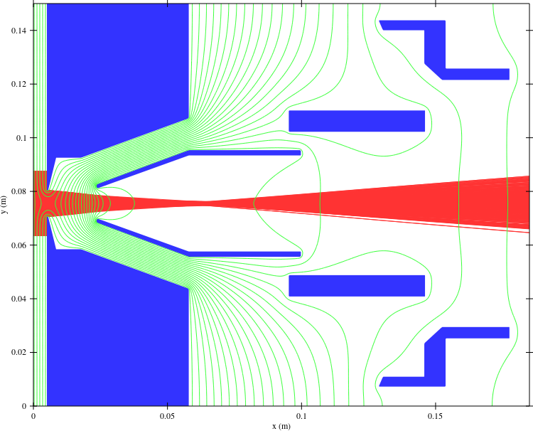
Example of low energy ion beam simulation
The final plot of the picture after some optimisation looks like:

Slide 18
THANK YOU!

