Slide 1
Hands-on TP Results and Radiation
Therapy for Cancer Treatment
Maja Kuzmanović

Slide 2
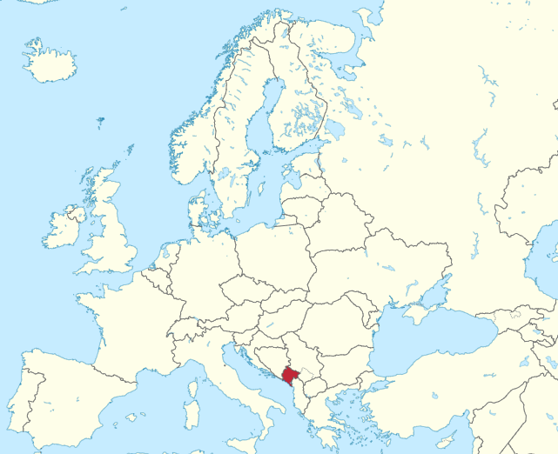
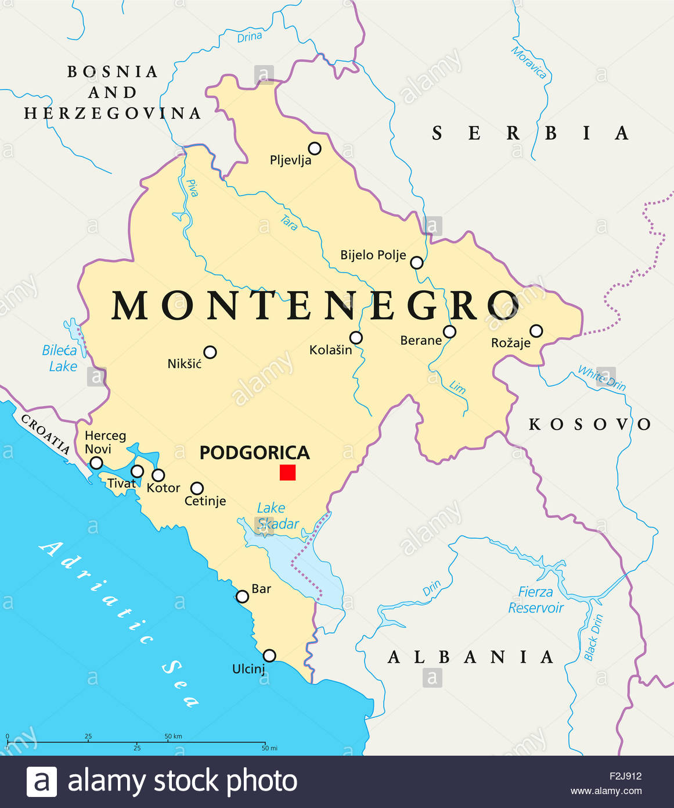

Slide 3

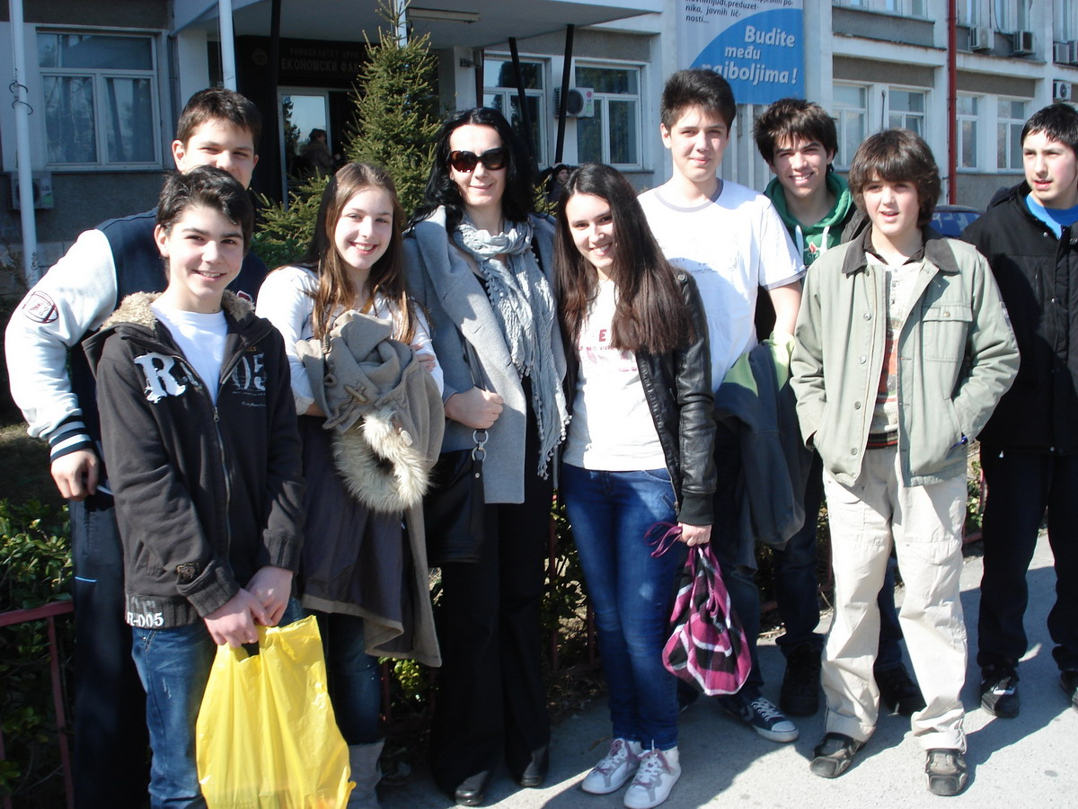
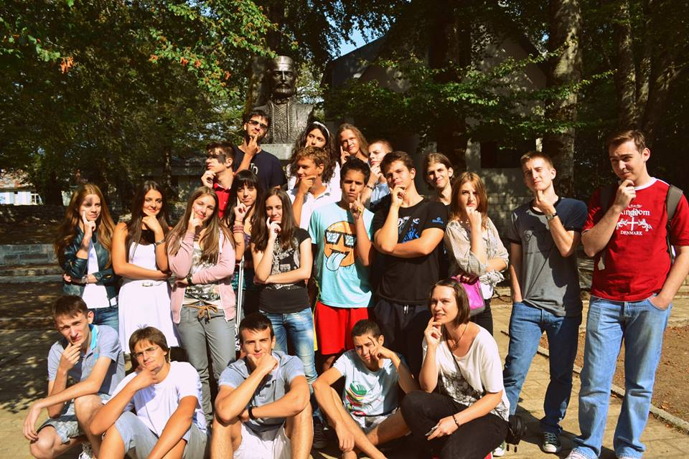
- Elementary school
- Activities in NGO PRONA

Slide 4
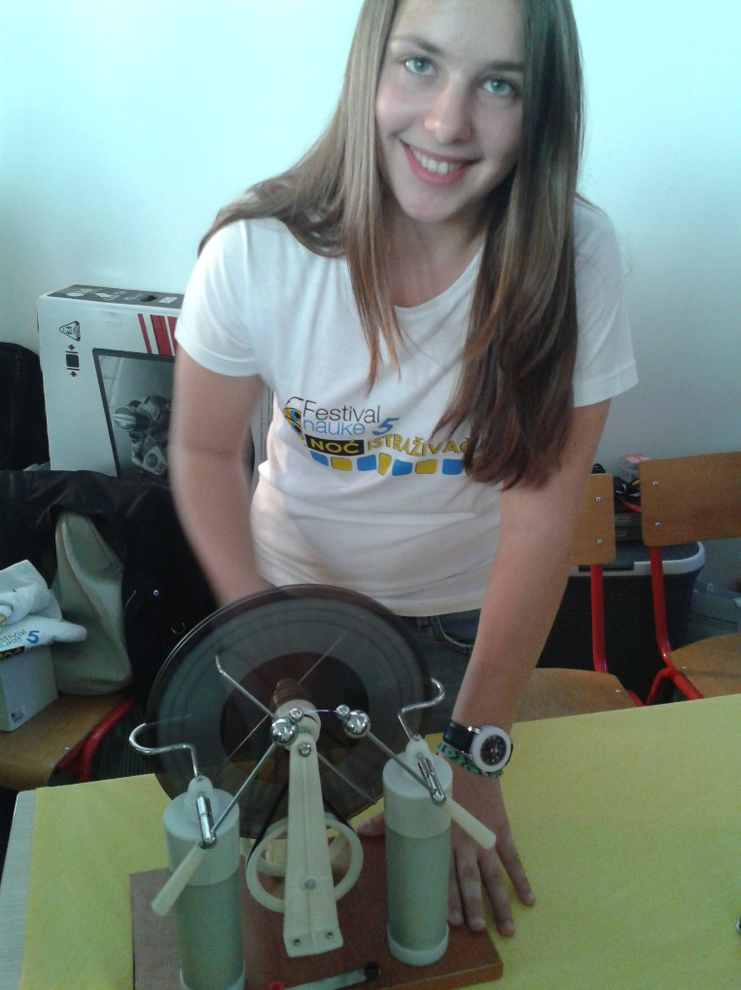
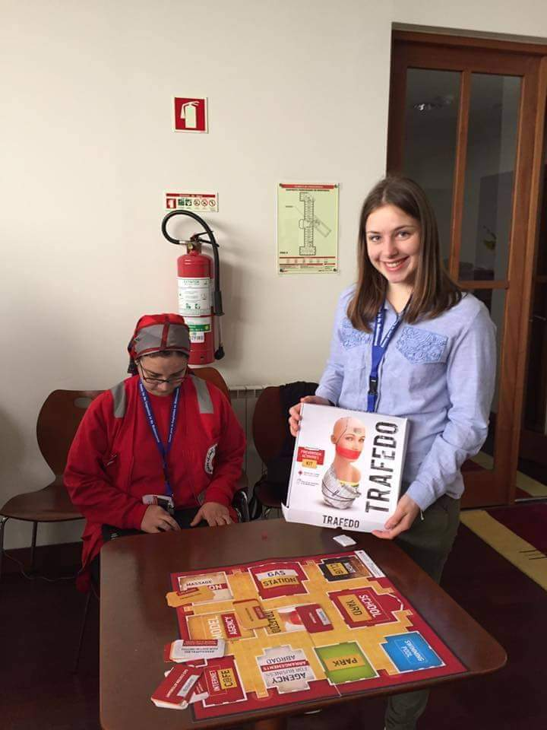
- Gymnasium
- Volunteering in RC of MNE

Slide 5
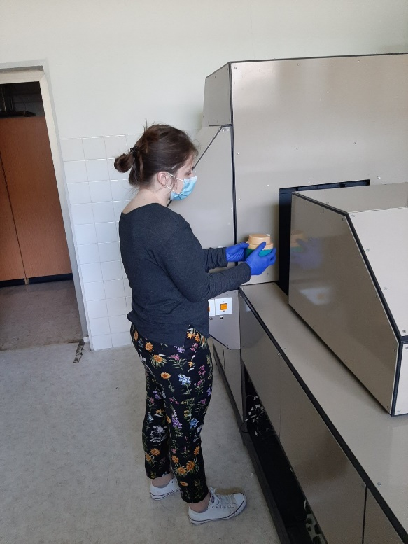
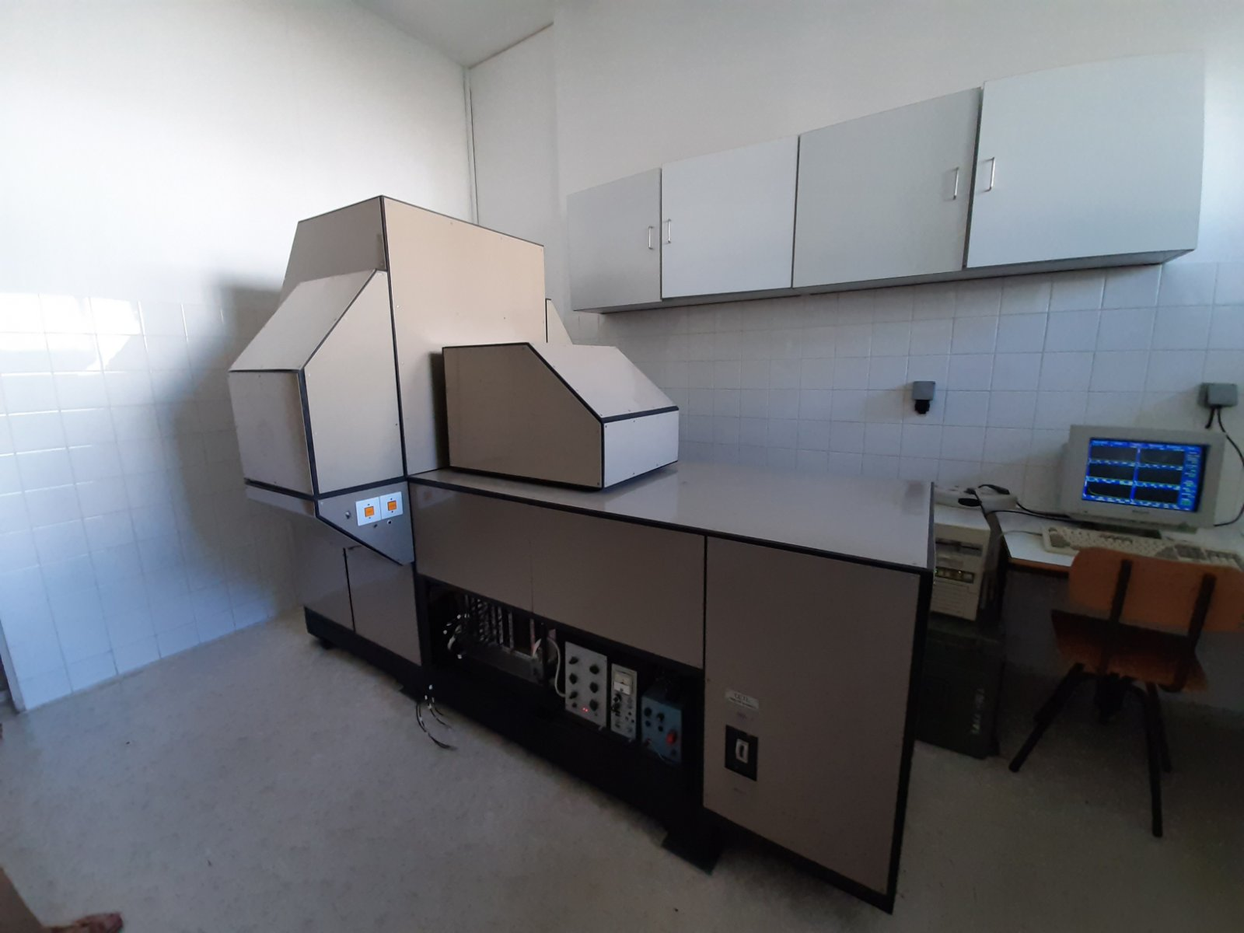
- University of Montenegro
- CERN Summer School 2021
- Internship in NGO PRONA
- Detection of gamma rays from Ba-133 decay by pairs of NaI(Tl) detectors

Slide 6
Thank you!

