Slide 1
Hands-On Treatment Planning Results and Cancer Data Platform
Andrijana gjoreska

Slide 2
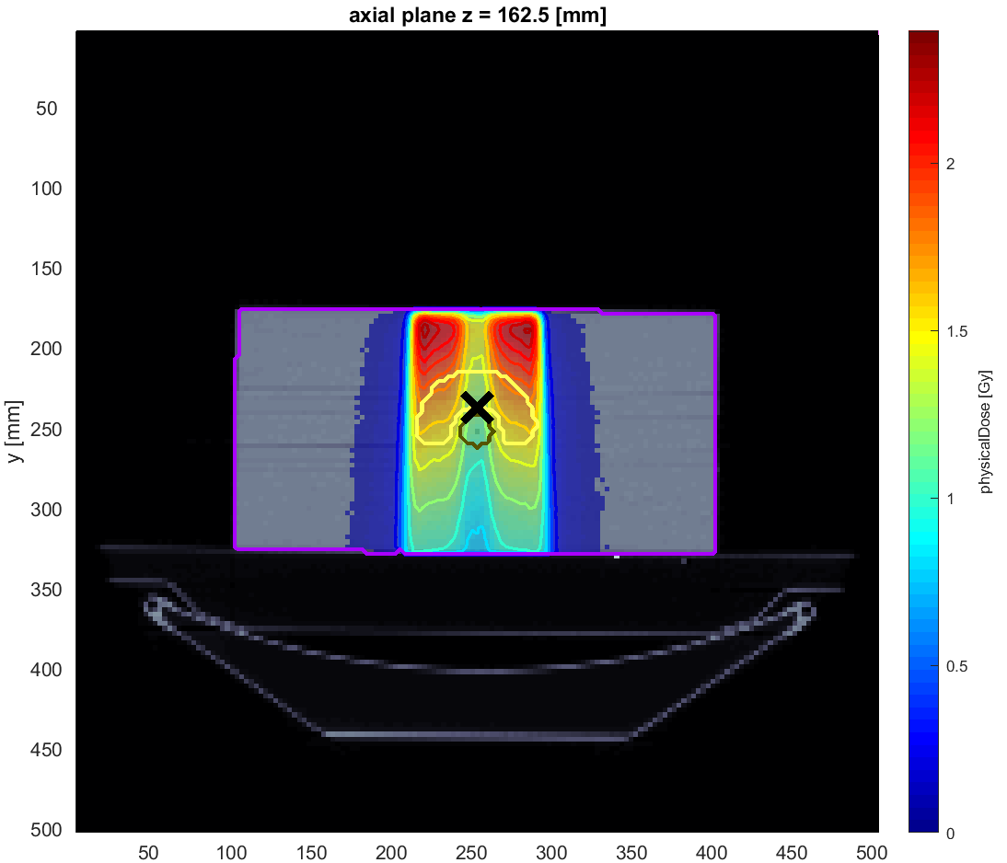
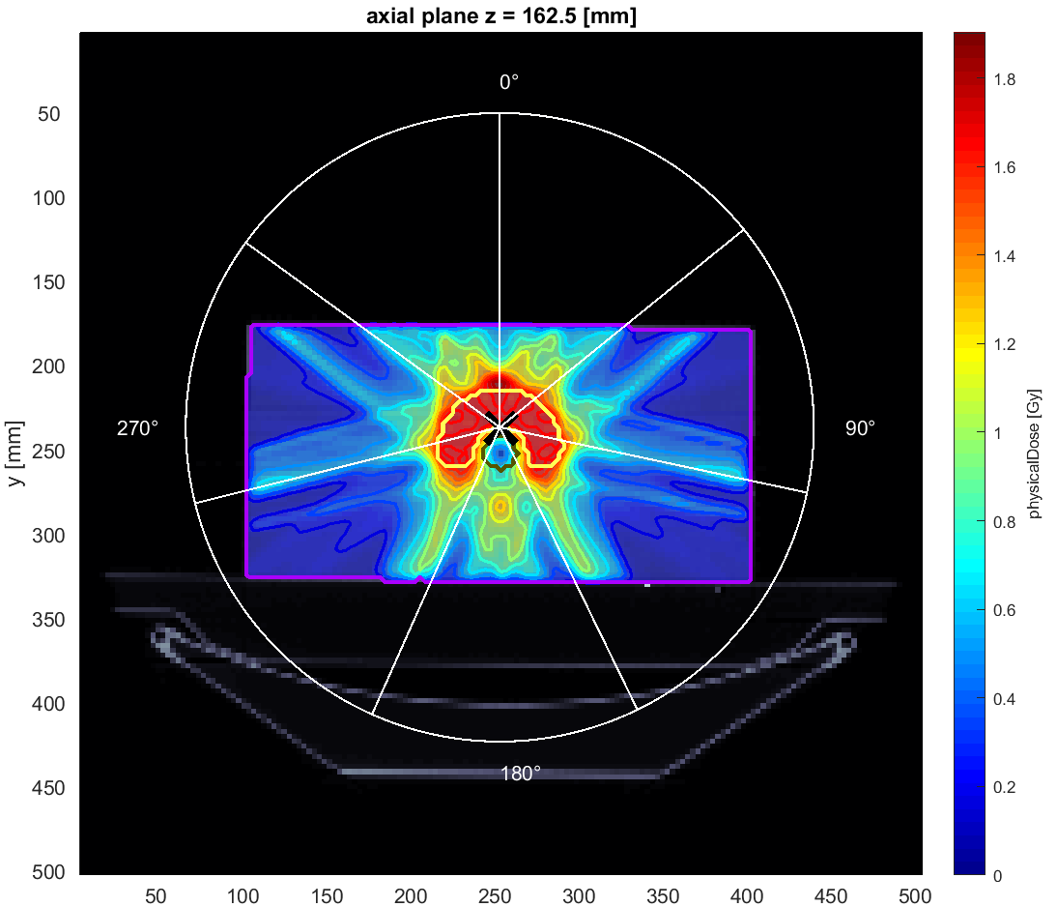
Hands-On Treatment Planning Results
TG119
Photons – one angle
Photons –seven angles

Slide 3
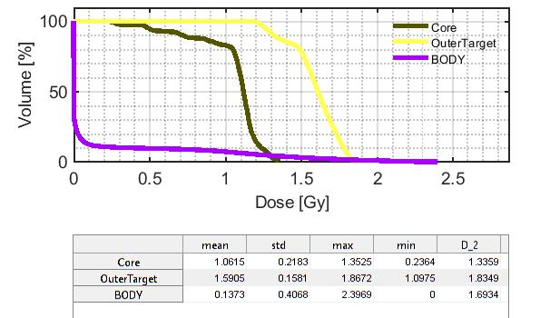
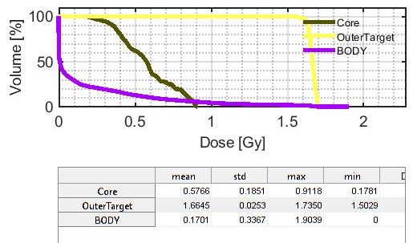
Hands-On Treatment Planning Results
TG119
Photons – one angle
Photons –seven angles

Slide 4
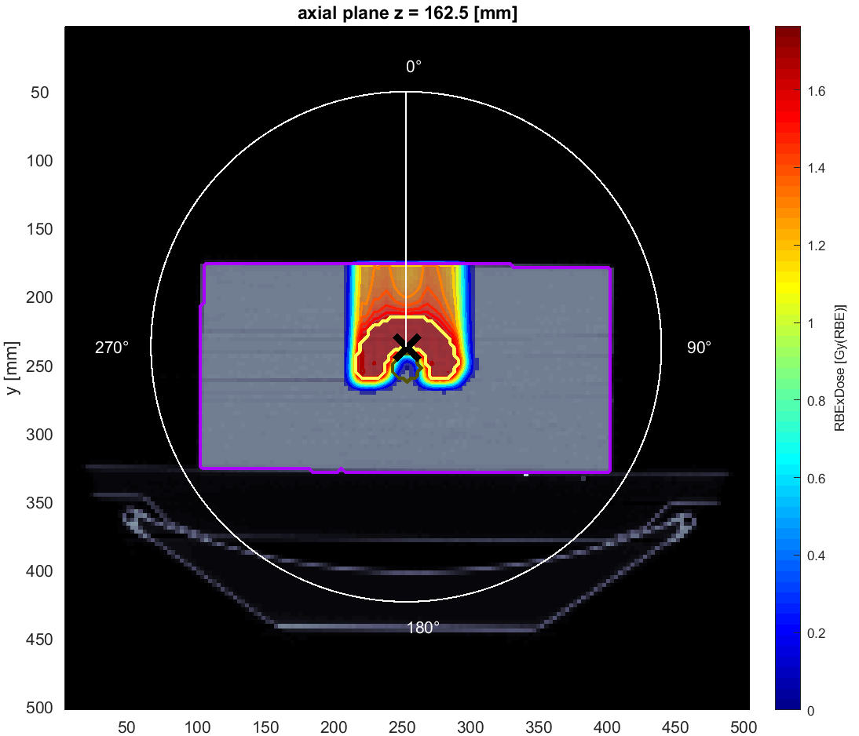
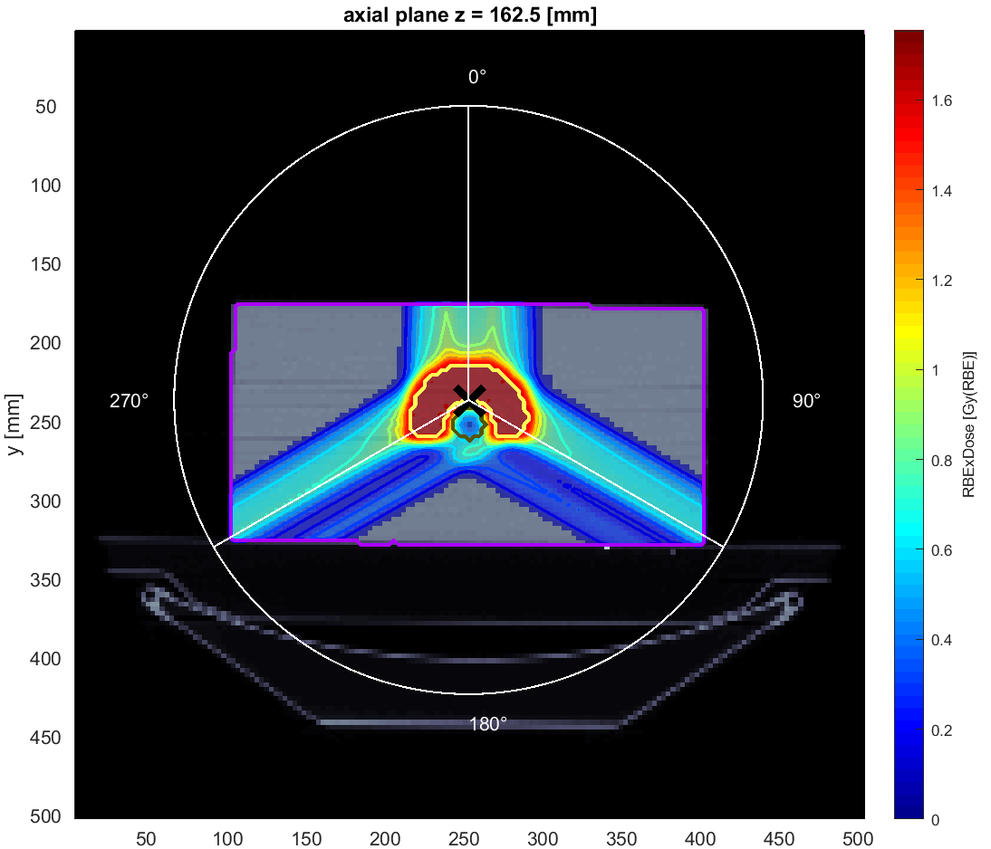
Hands-On Treatment Planning Results
TG119
Protons – one angle
Protons – three angles

Slide 5
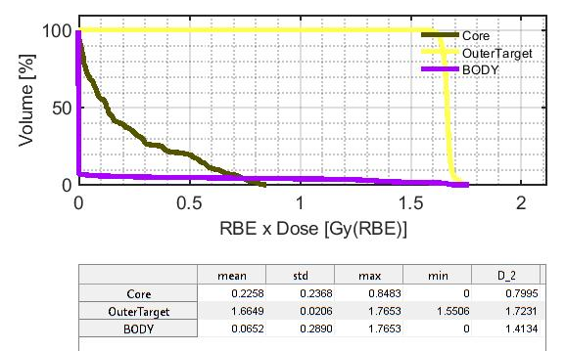
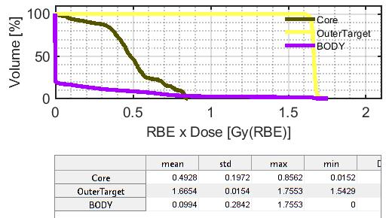
Hands-On Treatment Planning Results
TG119
Protons – one angle
Protons – three angles

Slide 6
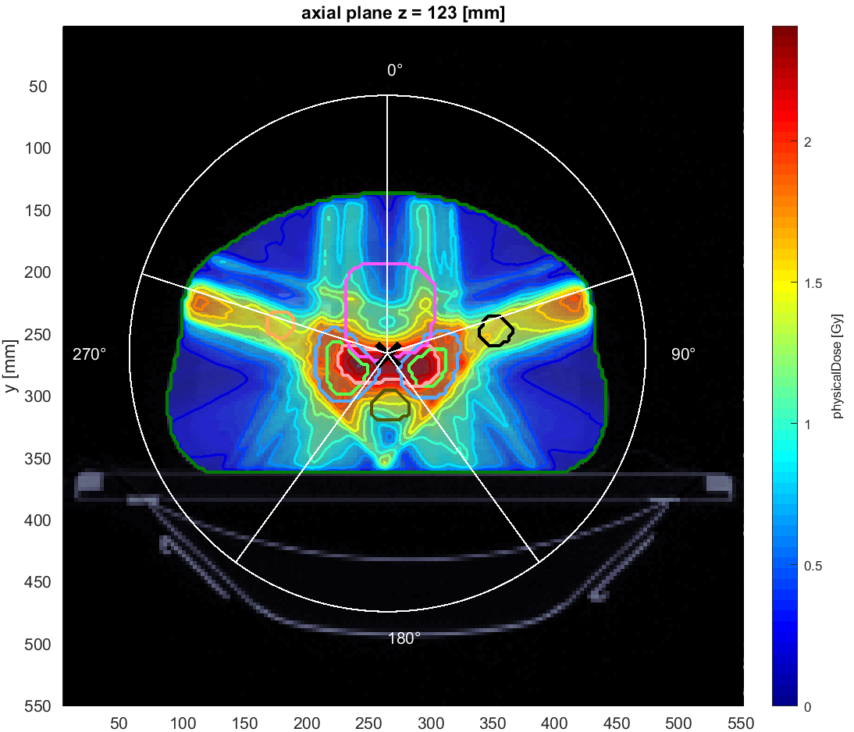
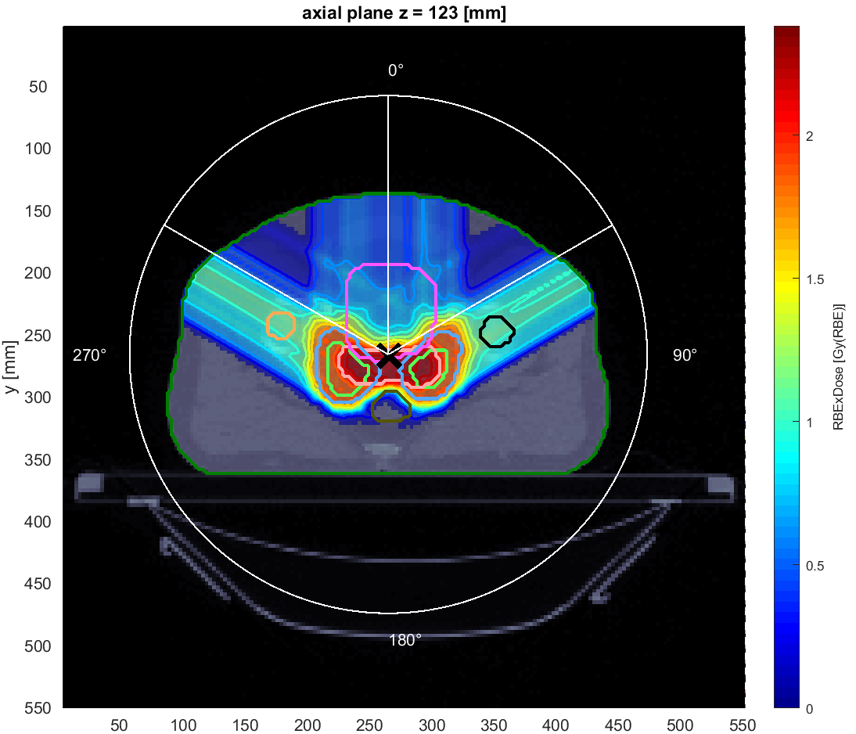
Hands-On Treatment Planning Results
PROSTATE
Photons – five angles
Protons – three angles

Slide 7
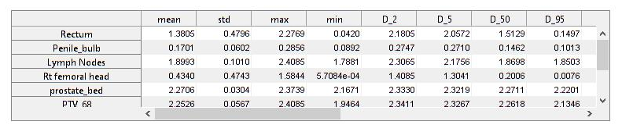
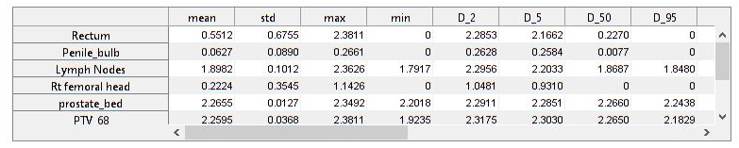
Hands-On Treatment Planning Results
PROSTATE
Photons – five angles
Protons – three angles

Slide 8
Cancer Data Platform
Current practices
Heavy Ion Therapy
Selection of patients
Platform for sharing medical data

Slide 9
THANK YOU FOR YOUR ATTENTION!

