Slide 1

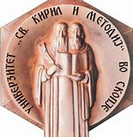

Hadron Therapy for beginners
Mimoza Ristova
Physics Department
Faculty of Natural Sciences and Mathematics
University Ss Cyril and Methodius University in Skopje, North Macedonia
mristova@pmf.ukim.mk, mima.ristova@gmail.com

Slide 2
Why should one believe in particle (hadron) therapy?
LESSON 1. Why particles and not photons?

Slide 3
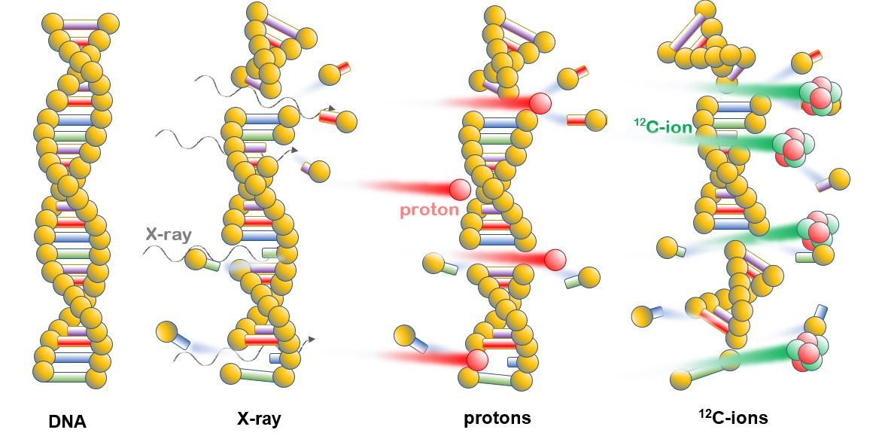
Because the RBE: the damage to DNA induced by radiation with X-rays, protons and C-12 ions.
The damage with protons and even more with C-12 ions provides breakage
of the double chain of DNA.

Slide 4
Why should one believe in particle therapy?
LESSON 2: HADRON THERAPY FOR BEGINNERS

Slide 5
Classical RT with X-ray photons
100%
Dose %
Damage on the entrance tissue
Damage on the exit tissue tissue
X-ray photons
Depth [cm]
Tumour

Slide 6
Charged Particles (Protons, C-12 ions)
Bragg peak
100%
Dose %
Damage on the exit tissue tissue
Damage on the entrance tissue
particles
Depth [cm]
Tumour

Slide 7
THERAPY | TUMOUR dose | HEALTHY TISSUE dose
X-ray (RT)
Particle therapy

Slide 8

Suicide-bomber-particle (KAMIKAZE) dies in order to kill a tumour cell!
C-12
C-12

Slide 9
Why should one believe in particle (hadron) therapy?
LESSON 3: Comparison with X-ray RT for BEGINNERS

Slide 10
Once upon a time there was a little being called Smiley. It was nice and happy, always smiling.

Slide 11
One day Smiley got cancer, and all of his yellow tissue was affected.
His eyes and mouth are very sensitive vital organs that should be spared from radiation.

Slide 12
Smiley’s 3 doctors were discussing what kind of treatment it should receive?

Slide 13
DOCTOR 1 suggested: RT with X-rays
Smiley’s cancer will be cured. BUT, Smiley’s eyes and lips will be burned out. Smiley will not be able to see and eat
any more.

Slide 14
DOCTOR 2 suggested: RT with Intensity Modulated X-rays (IMRT)

Slide 15
DOCTOR 3 suggested RT with Intensity Modulated X-rays (IMRT)
Smiley’s cancer will be partly cured. There will be a big residual.

Slide 16
DOCTOR 3 suggested: Particle therapy
Smiley’s cancer is cured and his eyes and lips are spared

Slide 17
…and Smiley lived happily everafter…..

Slide 18
Do you believe in hadron therapy now?
And thank you for the attention ☺ ☺
Smiley & Mimoza @PTMC-HITRIplus

