Slide 1
Pareto surface approximation and multi-criteria optimization for intensity-modulated radiotherapy
Stipe pavić

Slide 2
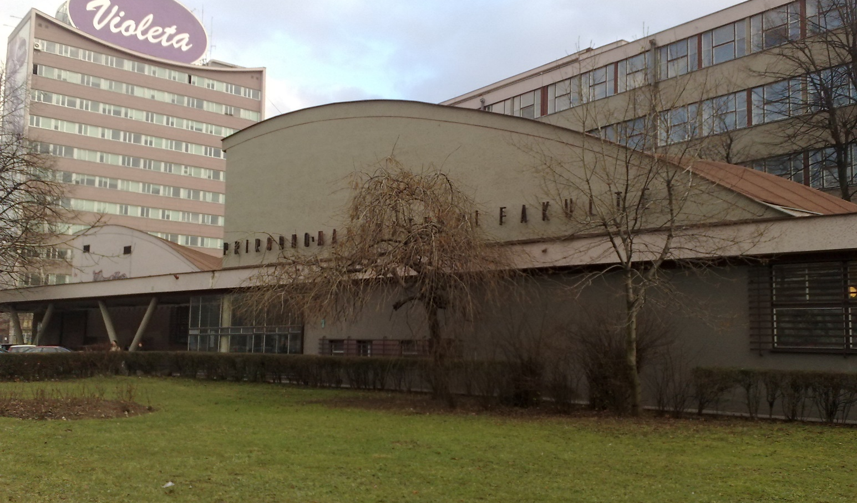
Info
Name: Stipe Pavić
University: UNSA (Sarajevo)
Status: Physics Master’s student
Thesis: Pareto surface approximation and multi-criteria optimization for intensity-modulated radiotherapy
Supervisors: prof. dr. Adnan Beganović and
dr. Niklas Wahl

Slide 3
Radiation therapy
Controlling and killing cancer cells using ionising radiation
The problem of normal tissue doses
Optimisation of therapy plans
Conflicting goals/criterions (high enough tumor dose vs. low normal tissue dose)

Slide 4
Pareto optimisation
Creating a state of Pareto optimality
Pareto optimality is the state at which goals/criterions in a given system are optimized in such a way that one goal cannot improve without a second worsening.
Set of Pareto optimal plans

Slide 5
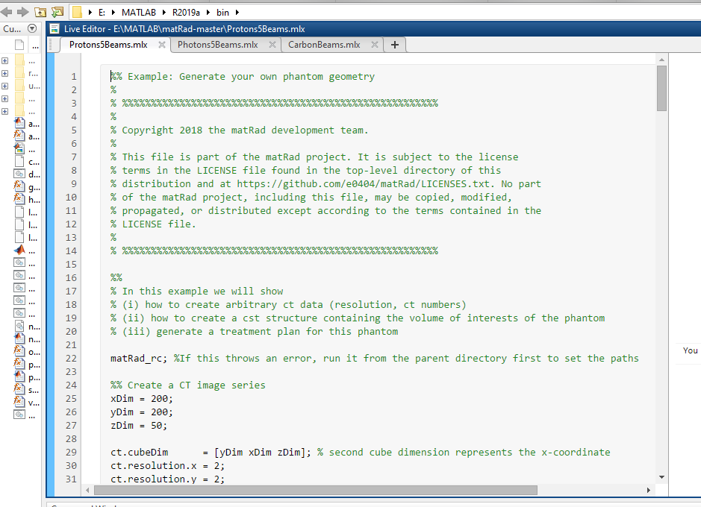
Goal
Implementing Pareto optimisation into matRad

Slide 6
Thank you for your time!

