Slide 1
FLASH EFFECT
Master Thesis Research
Damir škrijelj
Student presentation

Slide 2
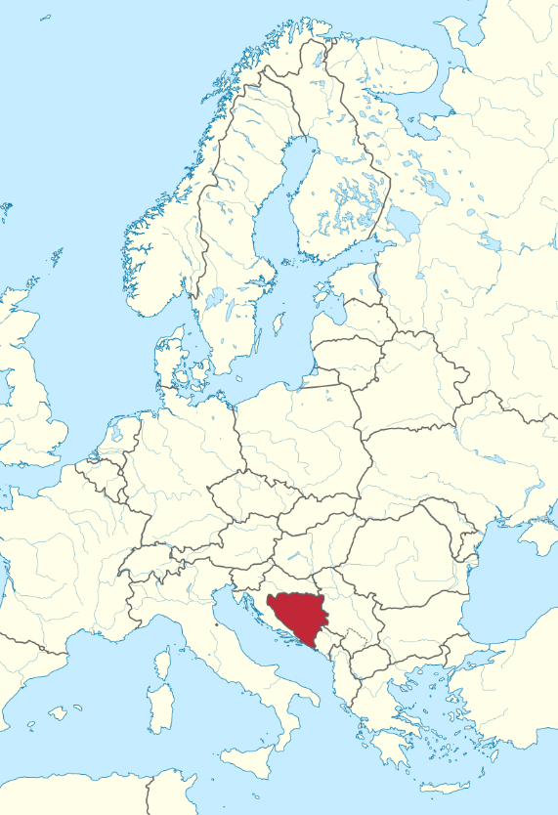
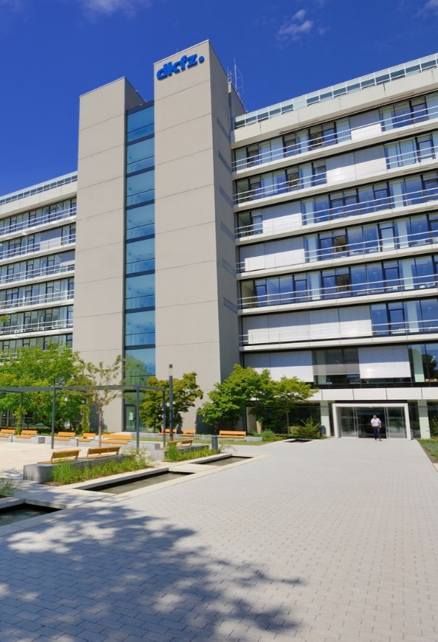
Introduction
Name: Damir Škrijelj
From: Bosnia and Herzegovina, Sarajevo
Affiliation: Master student at UNSA/DKFZ
Currently at DKFZ, Heidelberg
Masters thesis research: FLASH Effect, Radiotherapy
Group: Biomedical Physics in Radiation Oncology (E041)
Supervisors: Prof. Dr. Joao Seco (DKFZ) & Prof. Dr. Adnan Beganović (UNSA)
Email: damir.skrijelj@dkfz-heidelberg.de

Slide 3
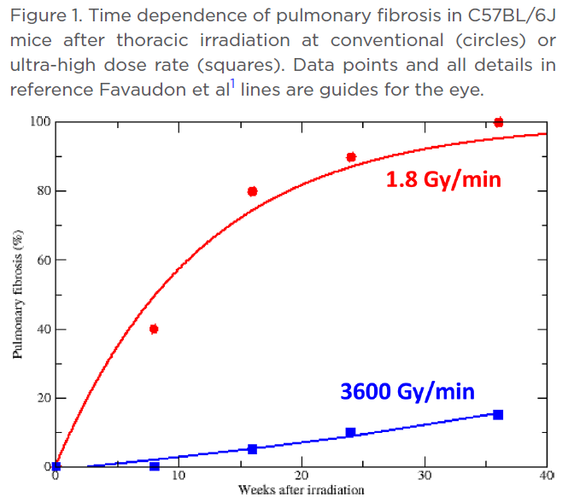
FLASH EFFECT AND RADIOTHERAPY
FLASH effect is a phenomenon where the ultra-high dose rate radiation (>40 Gy/s) reduces the normal tissue toxicities commonly associated with conventional radiotherapy, while still maintaining local tumor control.
FLASH effect was originally reported as far as 1960-1970. It has demonstrating potential as a key tool in the future of clinical radiotherapy.
Whole new understanding of dose-rate.

Slide 4
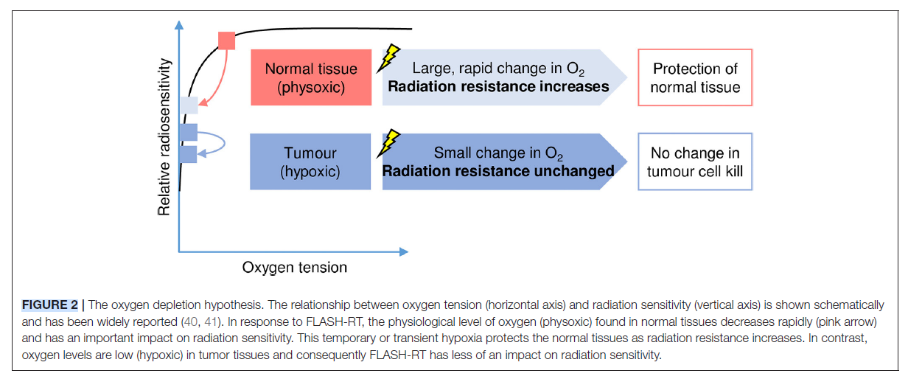
What is going on during FLASH irradiation?
We still don’t know the exact biochemical mechanisms that result in the FLASH effect
In terms of FLASH, the oxygen depletion hypothesis suggests that the ultra-high dose rate modulates the immediate radiochemical events that occur in the irradiated tissue.
In this short exposure time frame, local oxygen is depleted faster than reoxygenation can occur, leading to a transient state of radiation-induced hypoxia, and therefore radioresistance and protection of the normal tissues to the FLASH irradiation

Slide 5
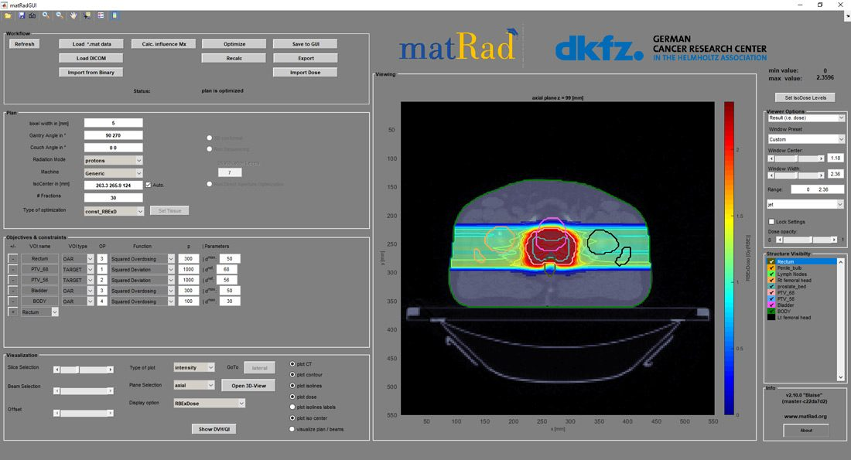
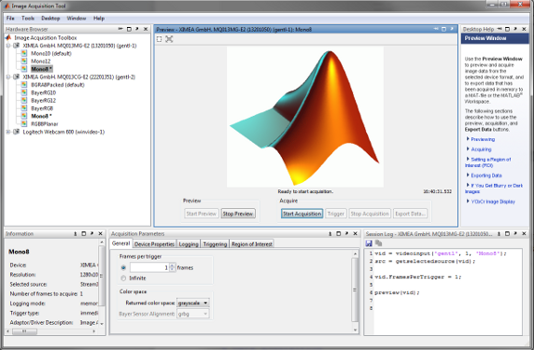
Things I learned
A good radiotherapy treatment plan takes time and experience…
…and research in it takes a bit of coding

Slide 6
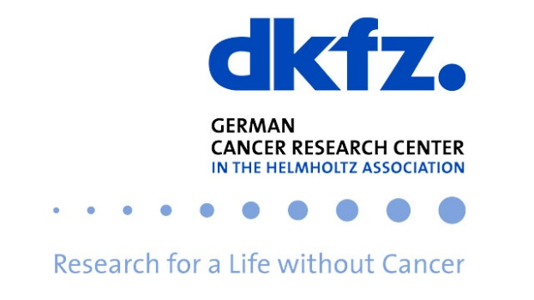

THANK YOU FOR YOUR ATTENTION!
Contact: damir.skrijelj@dkfz-heidelberg.de

