Slide 1
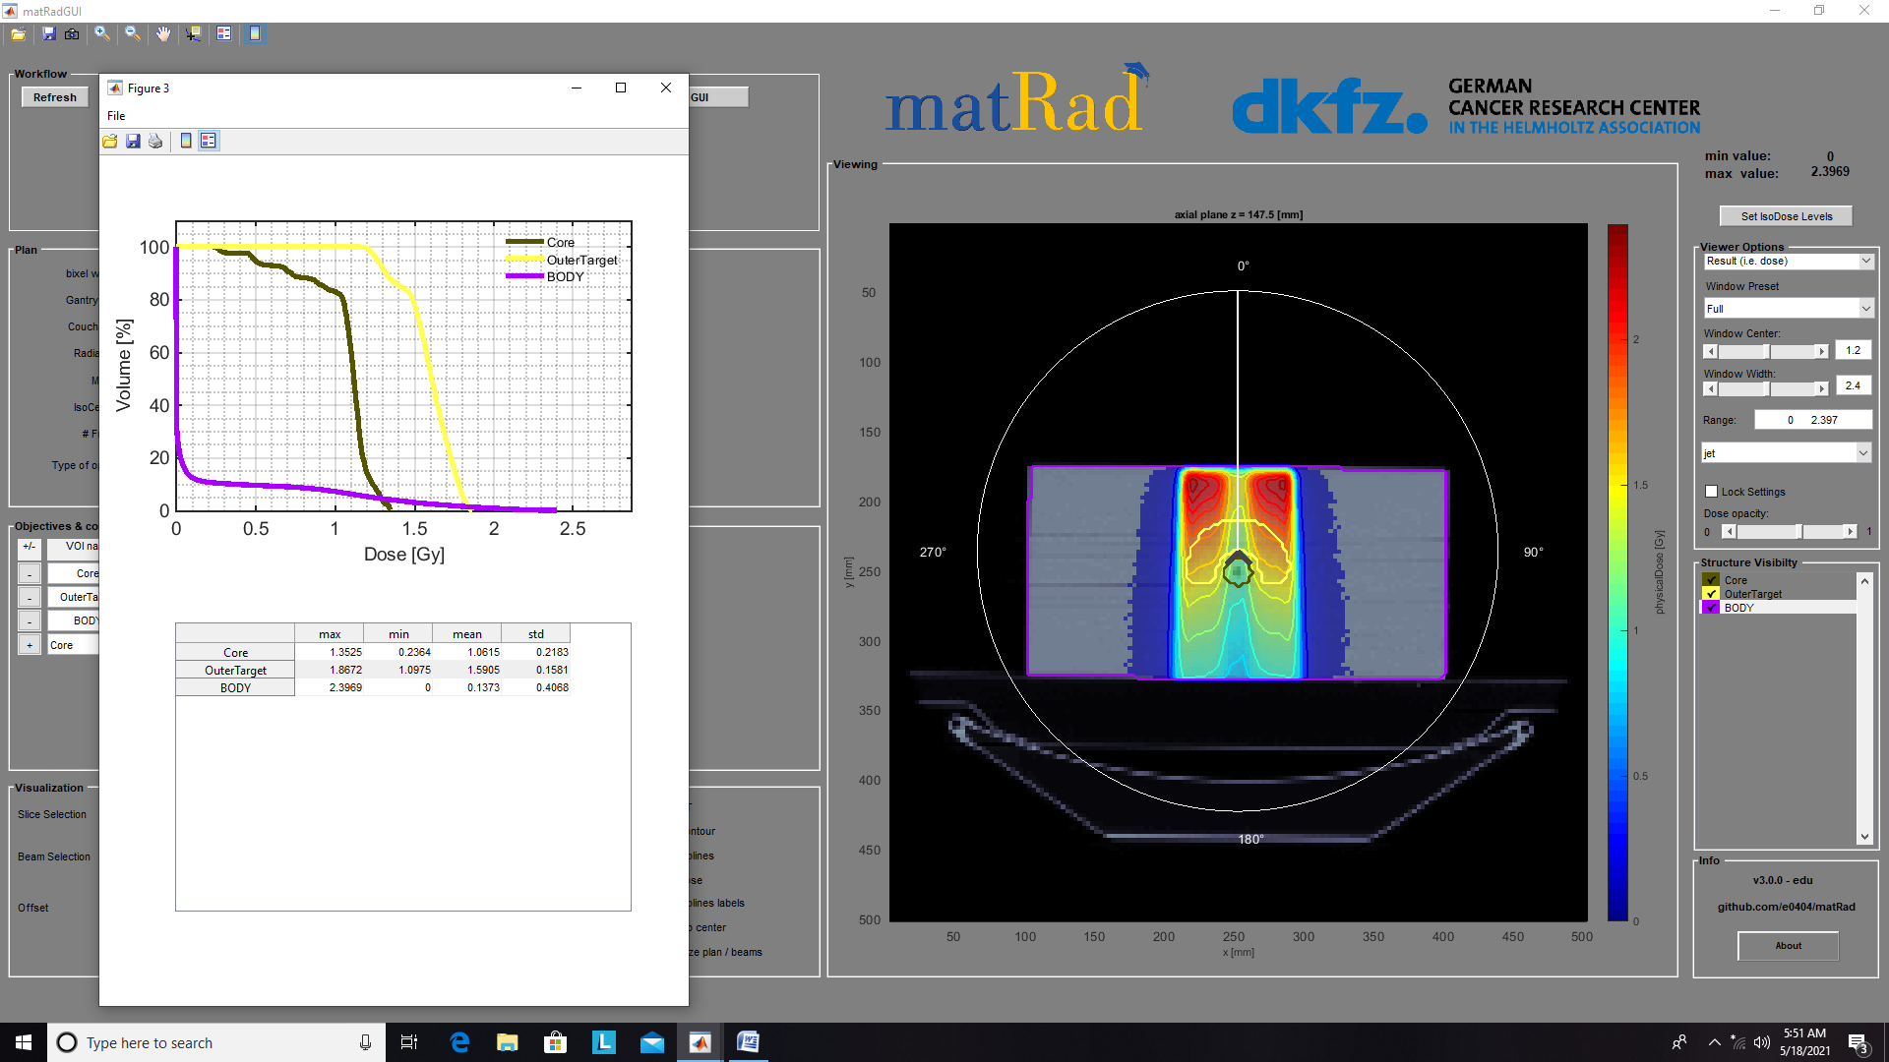
TG119(PHOTONS)

Slide 2
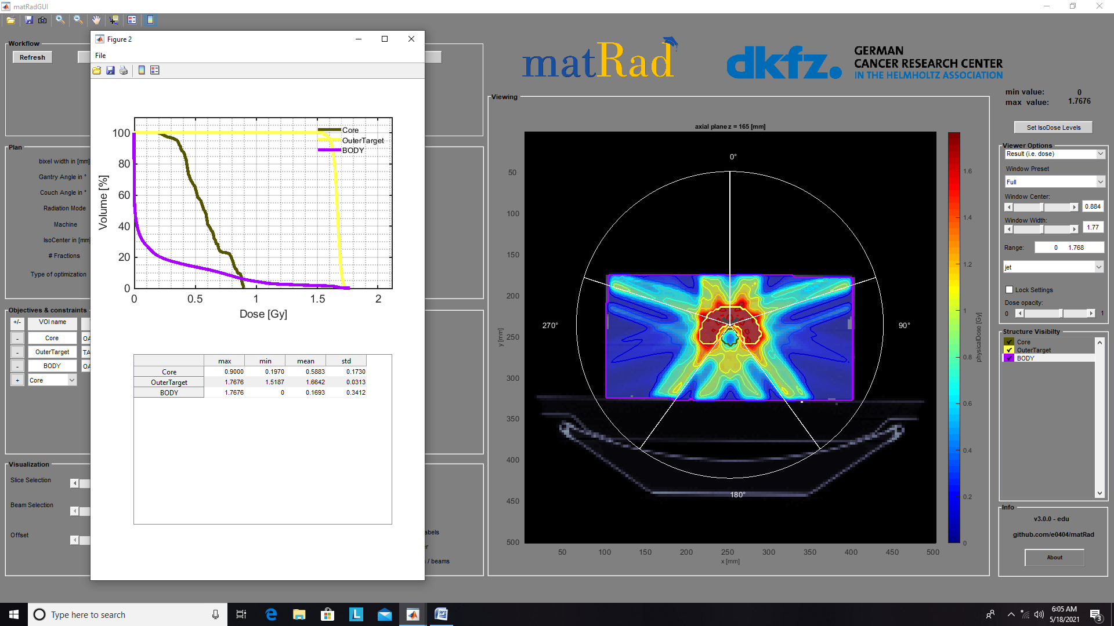
TG119-5angles(PHOTONS)

Slide 3
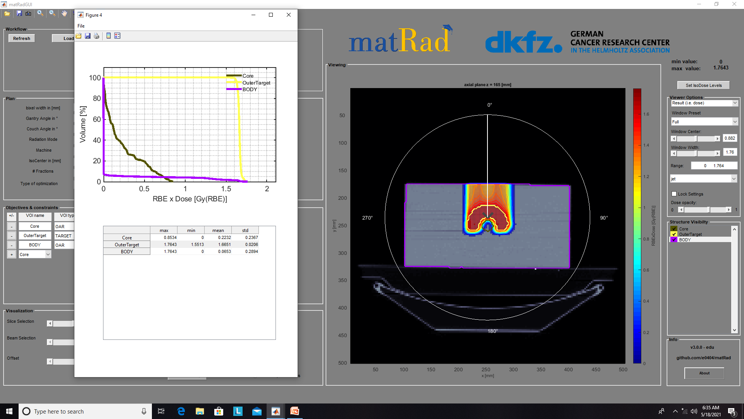
TG119(PROTONS)

Slide 4
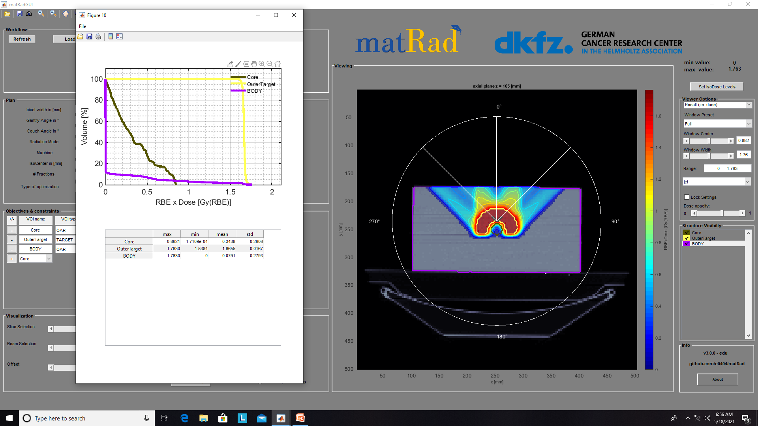
TG119_3ANGLES(PROTONS)

Slide 5
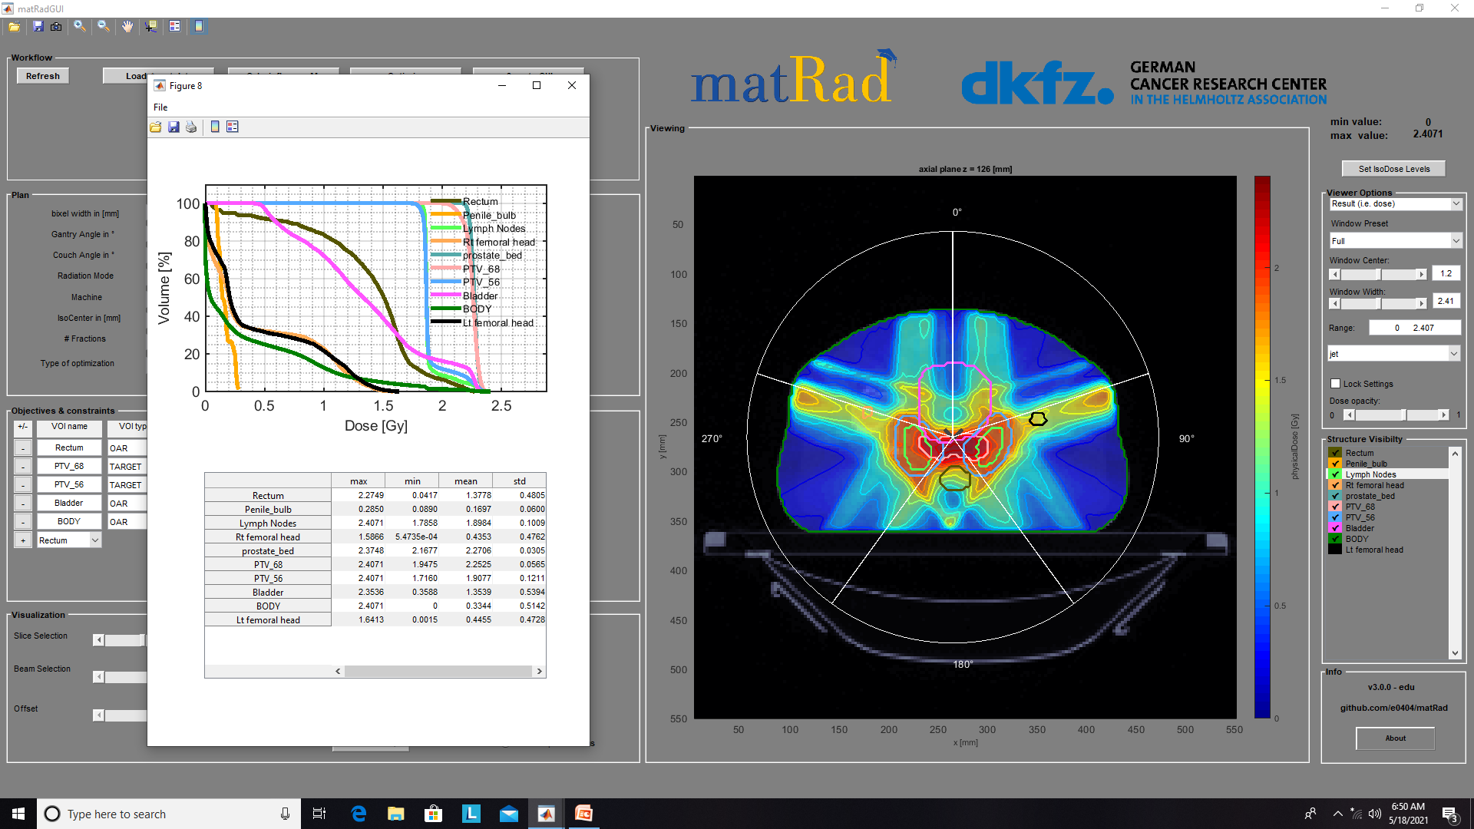
Prostate_5ANGLES

Slide 6
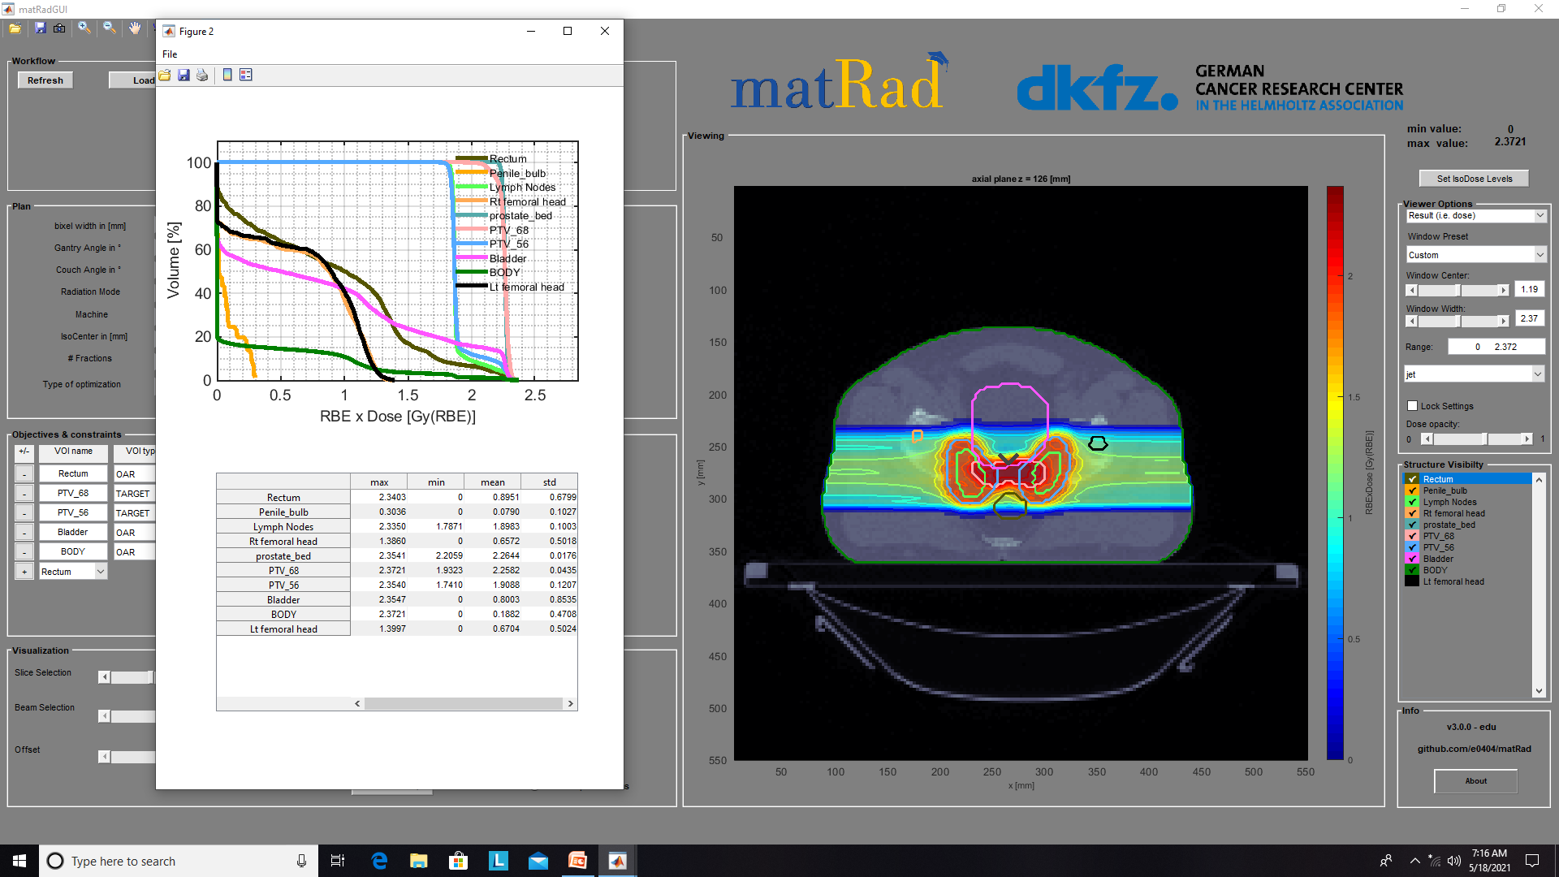
Prostate_3ANGLES(PROTONS)

