Slide 1
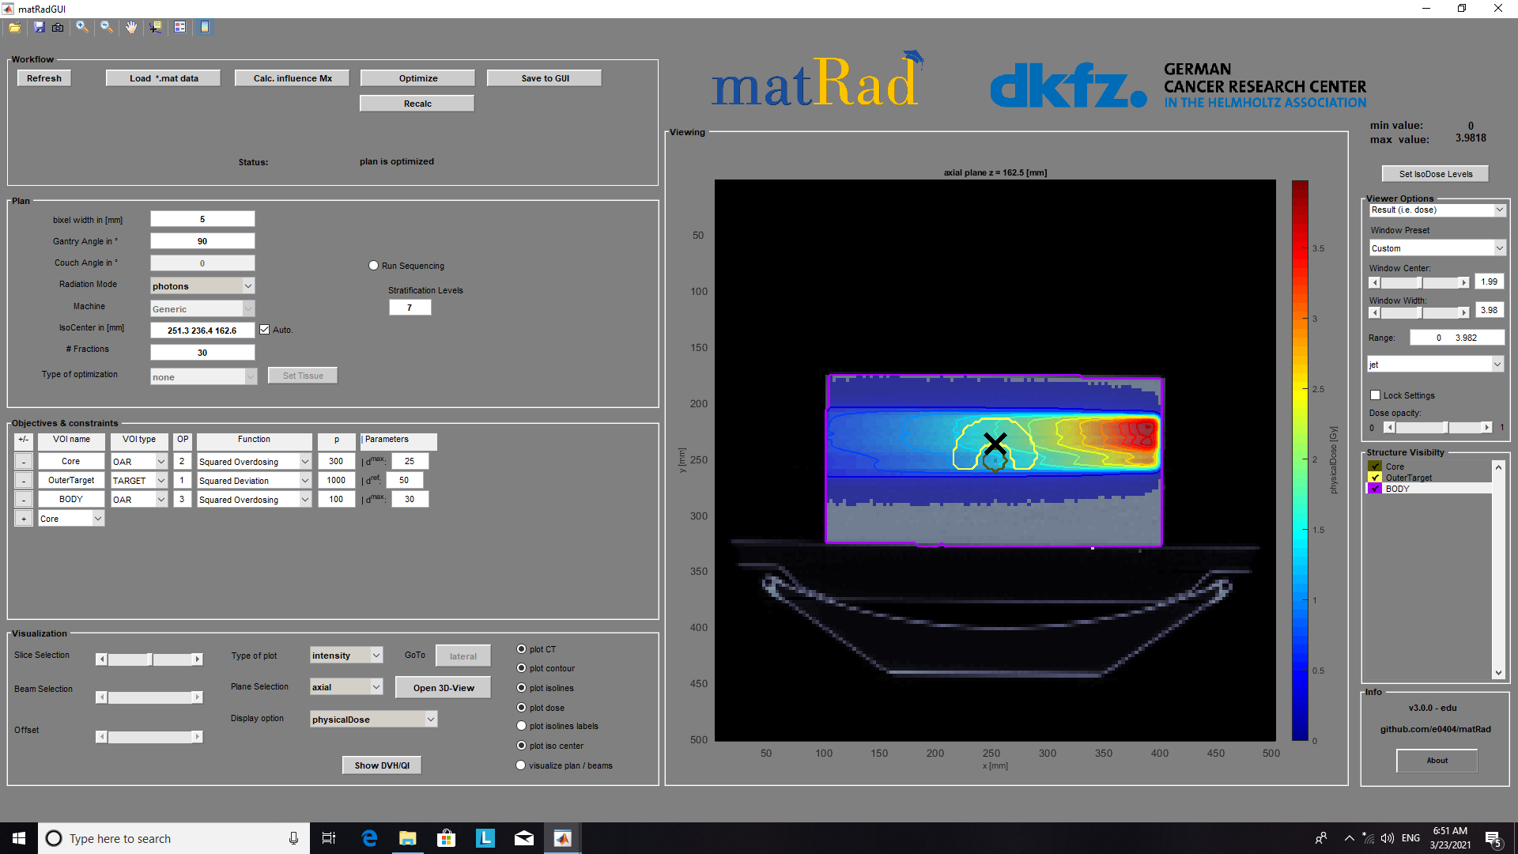

Slide 2
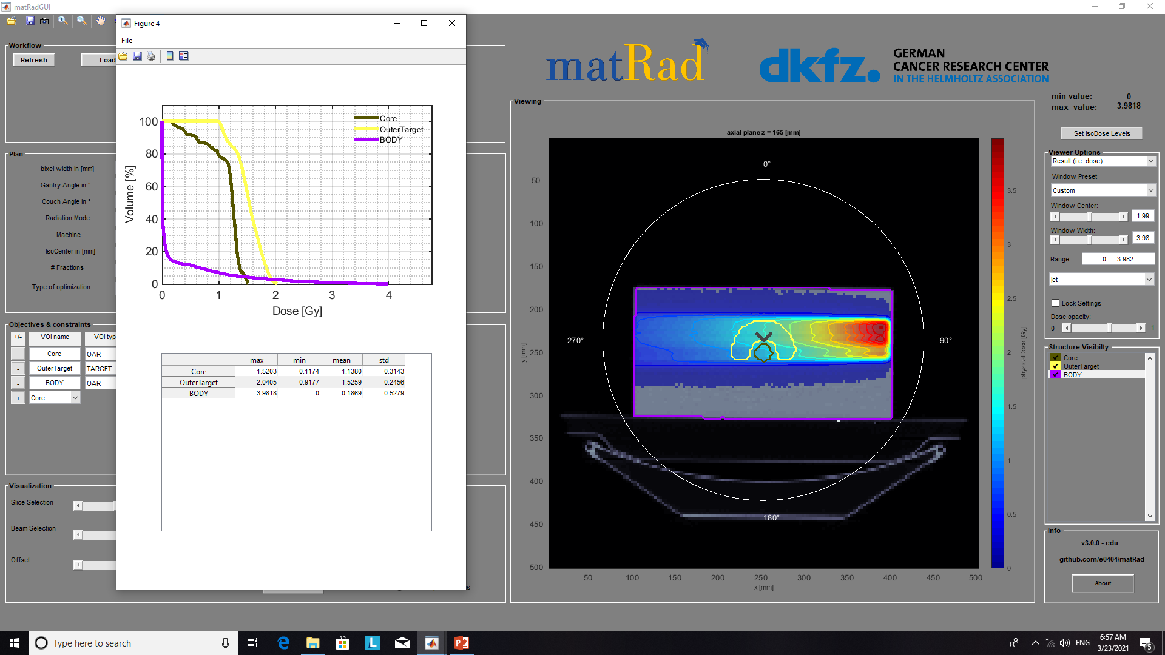
Ph 1 TG119

Slide 3
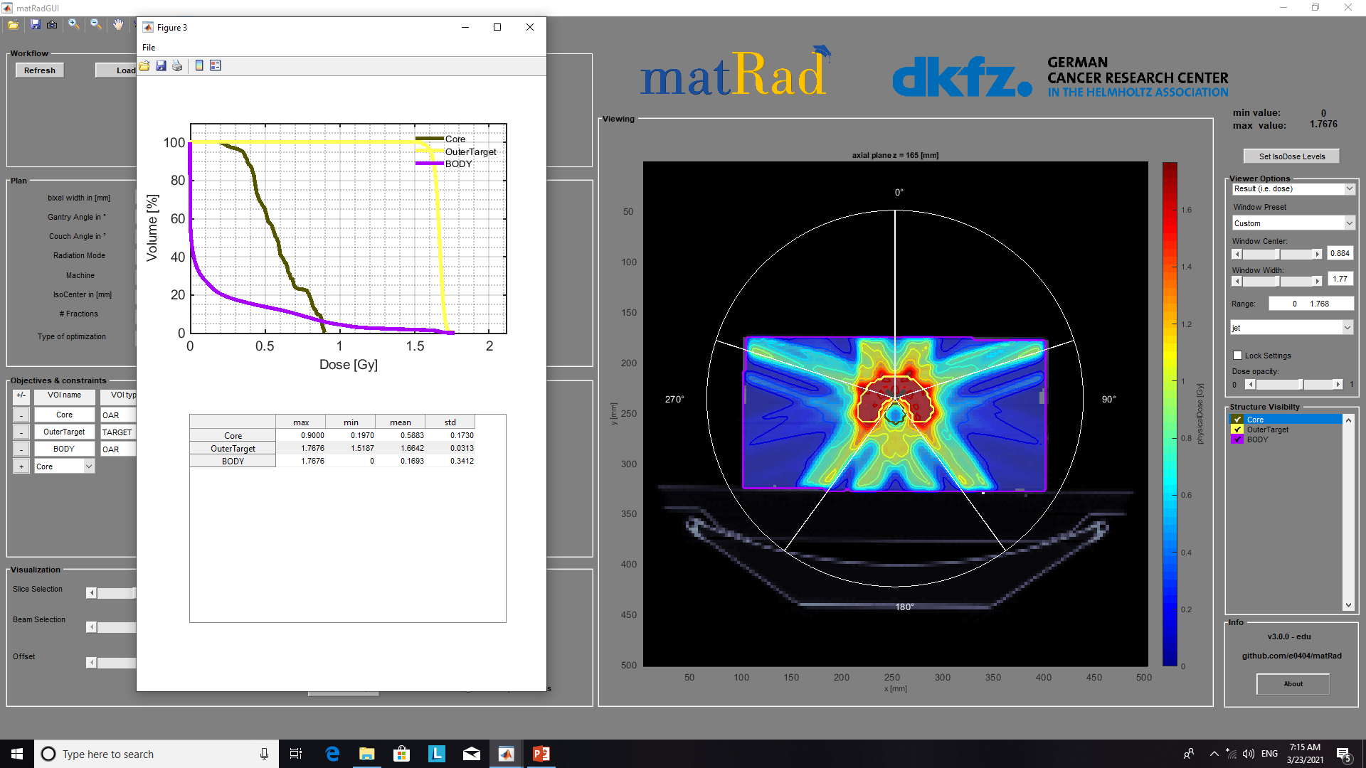
Ph 5 TG119

Slide 4
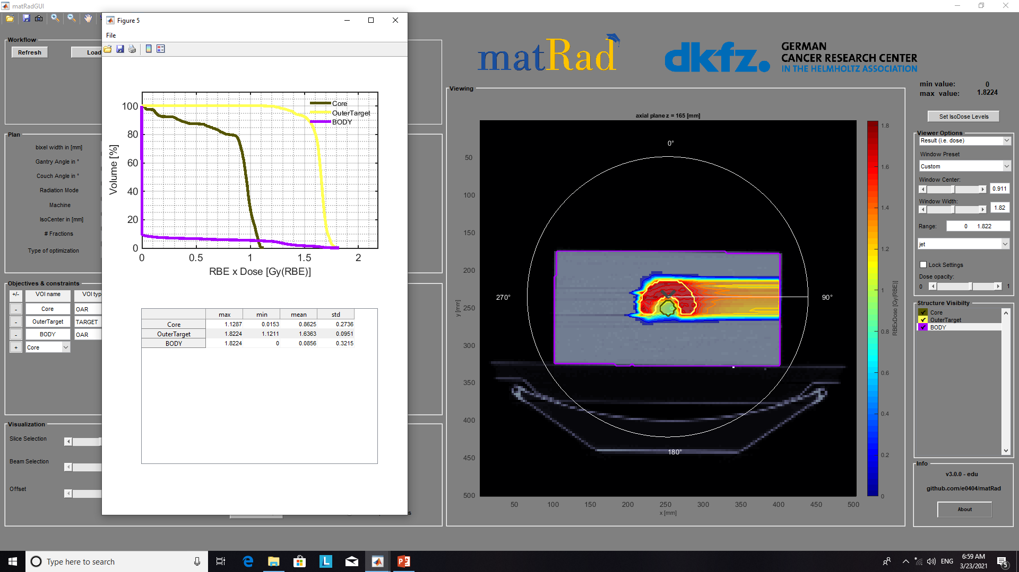
Pr 1 TG119

Slide 5
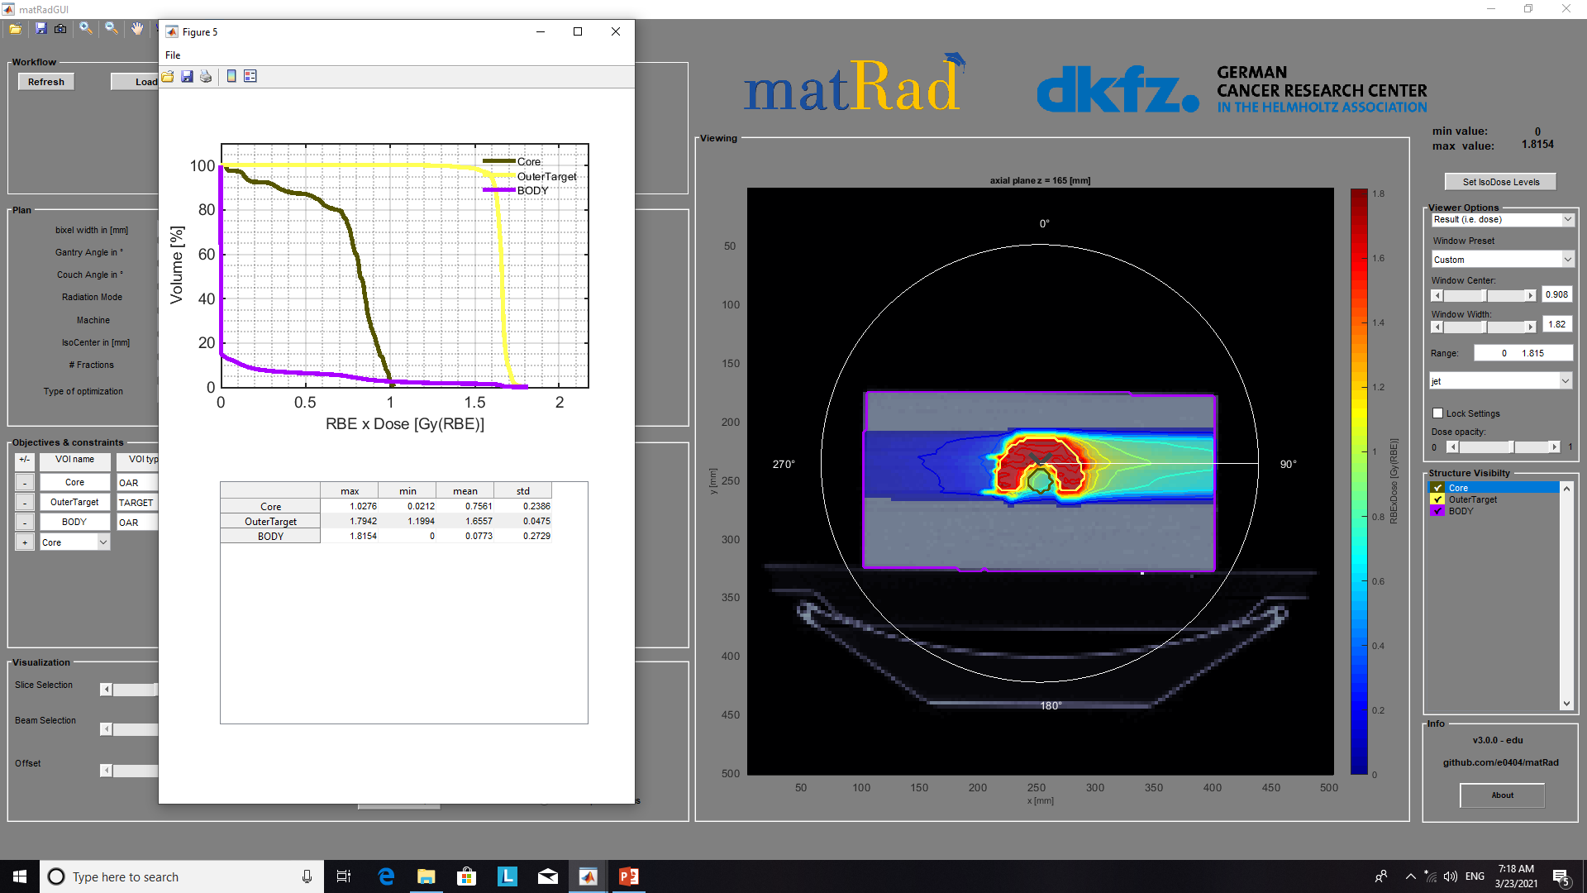
CR 1 TG119

Slide 6
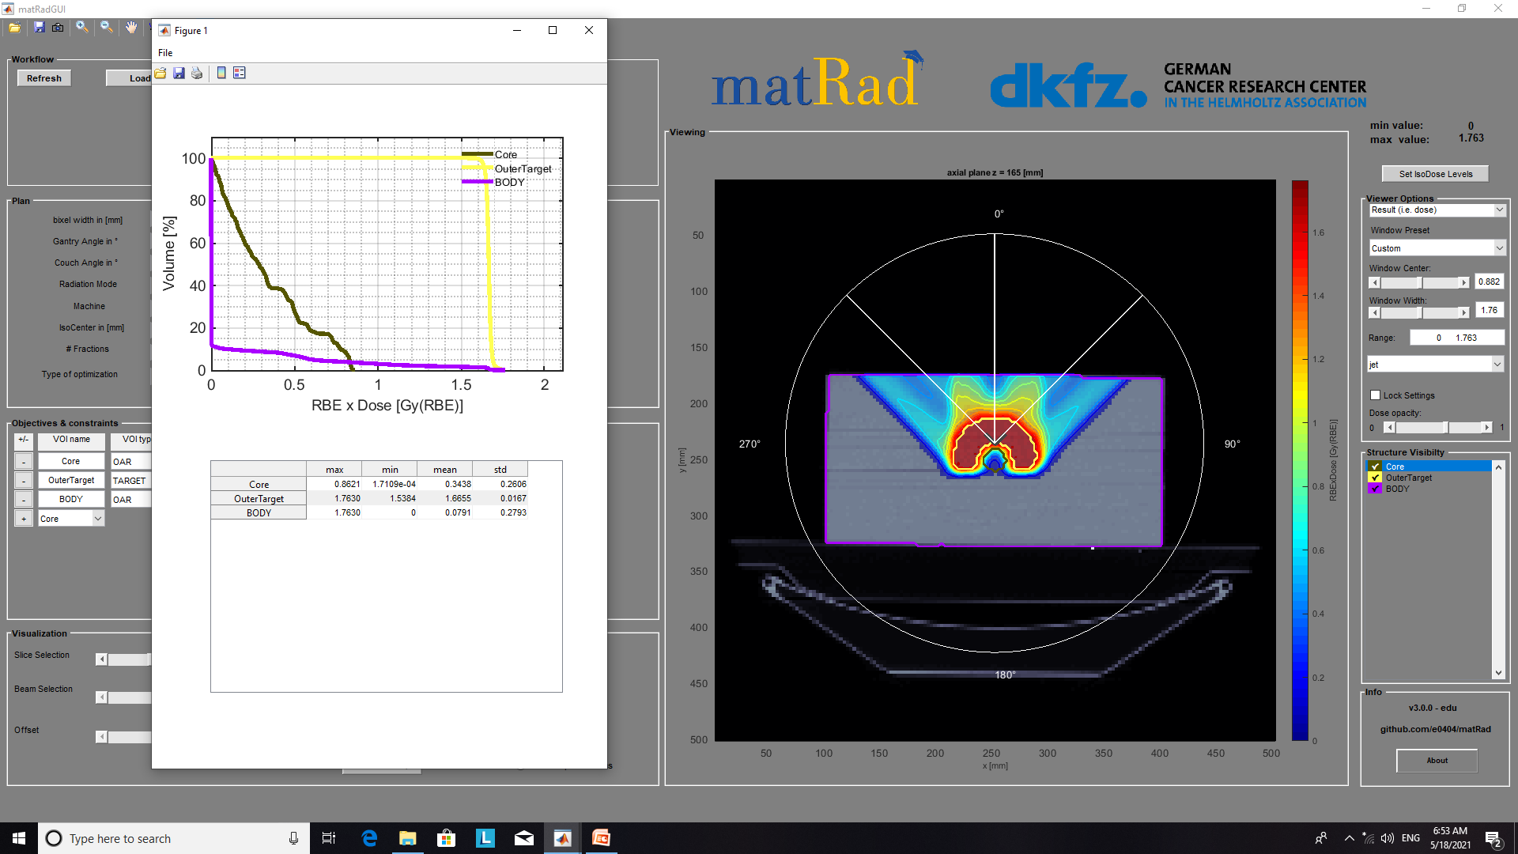
Pr 3 TG119

Slide 7
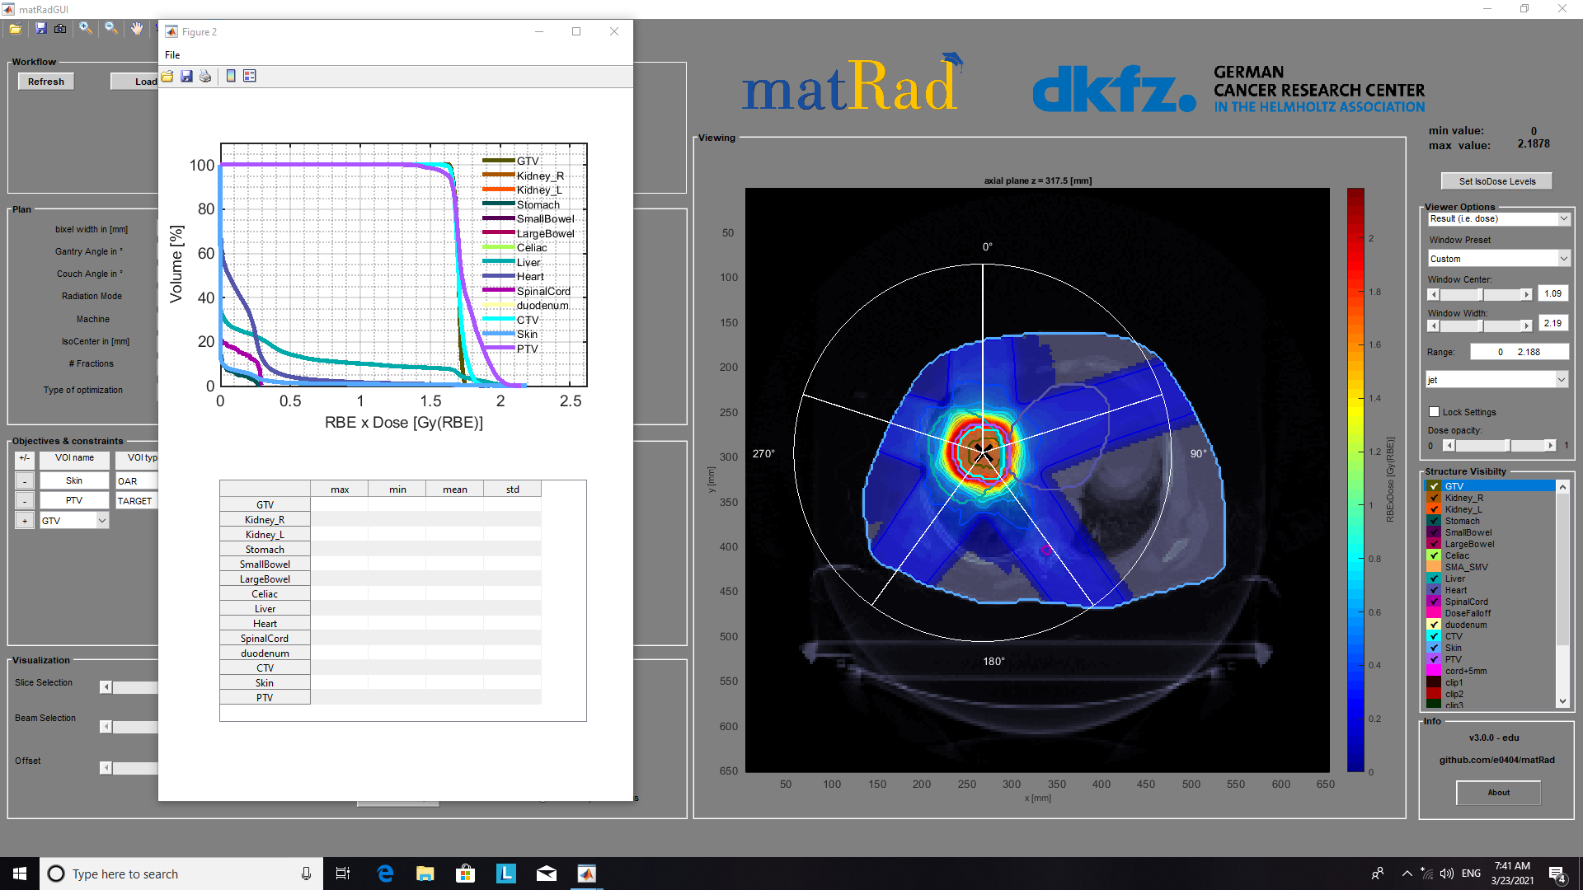
CR 5 LIVER

Slide 8
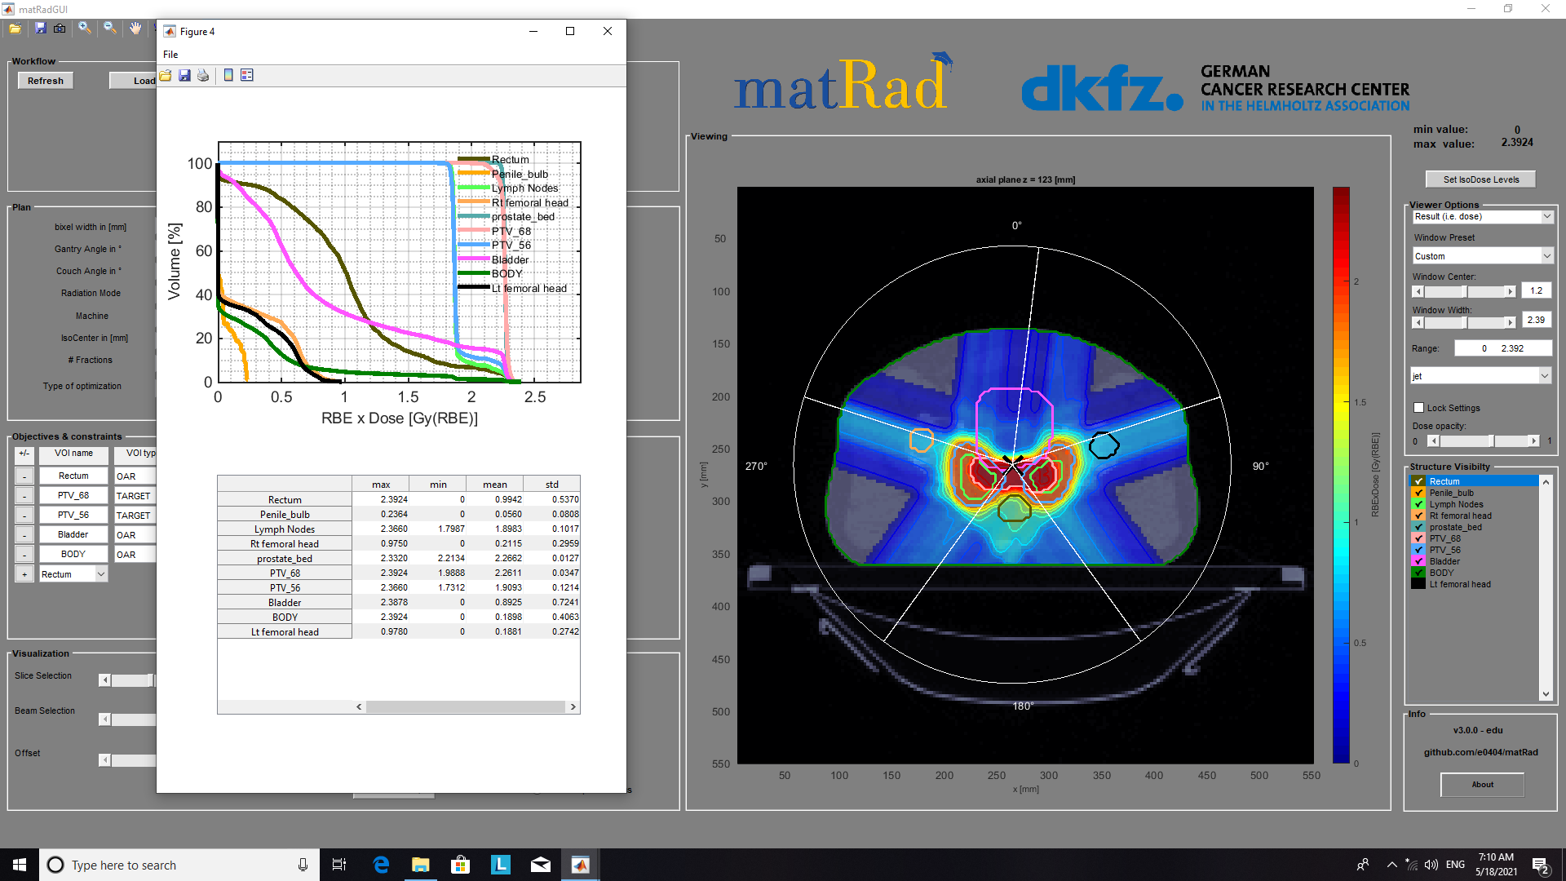
Pr 5 Prostate

Slide 9
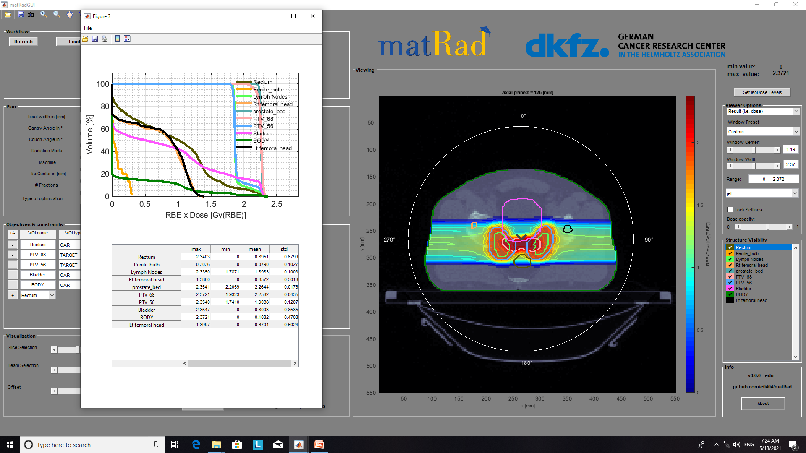
Pr 2 Prostate

