Slide 1
Ion Beam Analysis (IBA) Applications
Fehima Ugarak

Slide 2
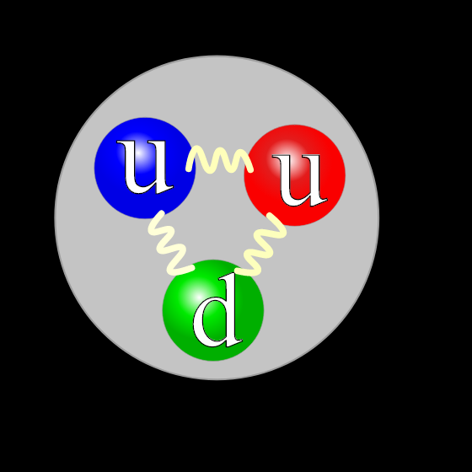
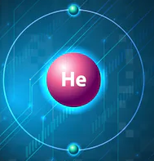
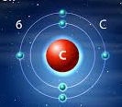

I am going to talk about...
Why am I speaking about the application of ions?
Steps during investigations.
Results and conclusion.

Slide 3
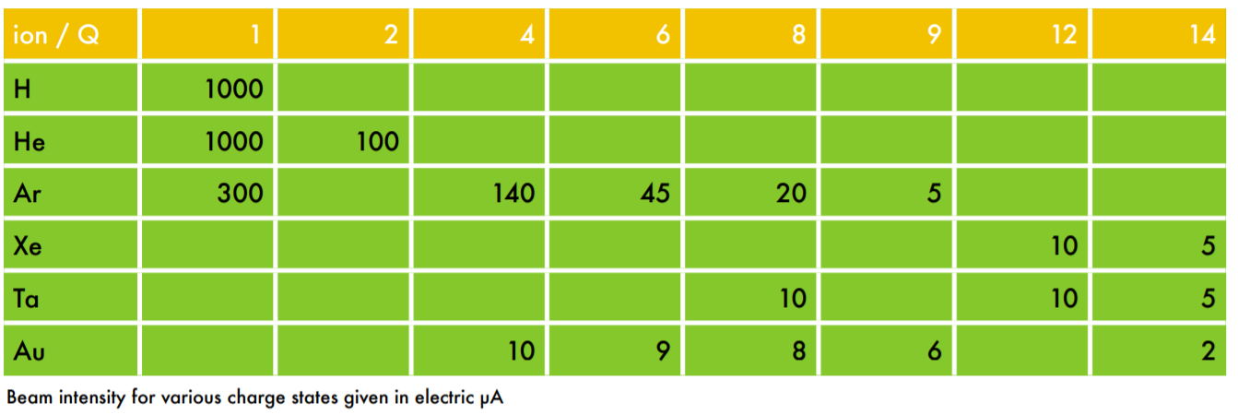
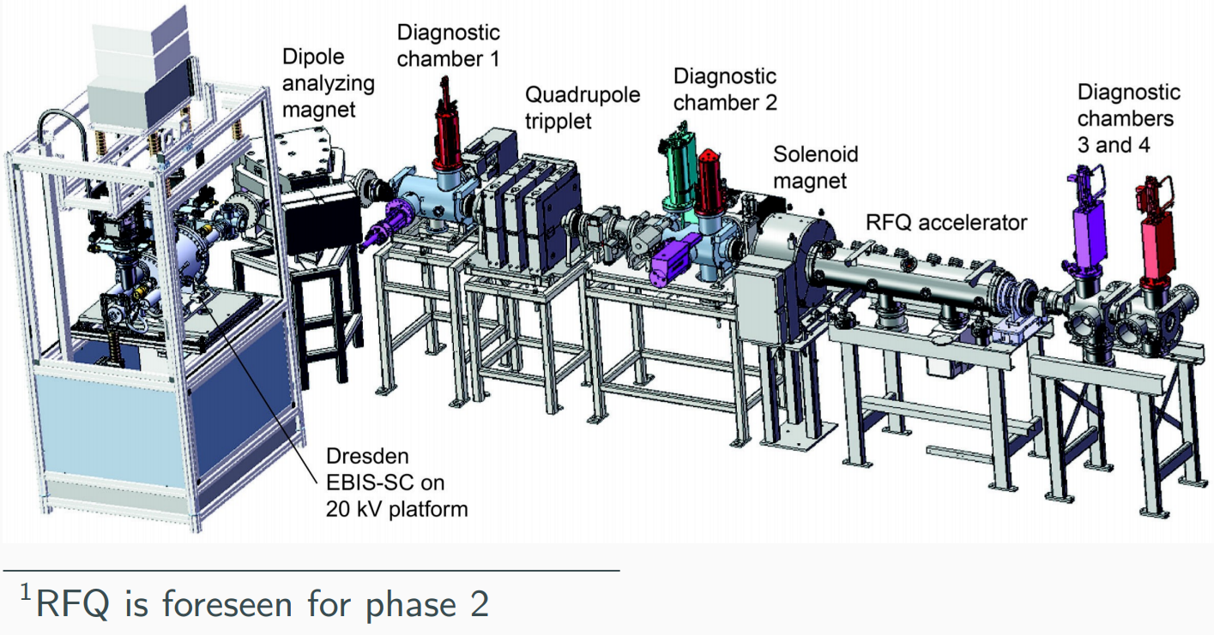
The goal
*A simple low-energy accelerator set up *research, education, study of medical radioisotopes production.
Expansion with RFQ (phase II)
final energy of- up to 0.5-5 MeV/u
Energies: Up to about 10 keV/u (phase I)
Further studies
What are the potential applications?
What is the optimal final energy?
Nanogan source provides ions (Table 1);
RF power up to 100W; the maximum extracting voltage is 20 kV.
Table 1. Nanogan- an ECR ion source provides:
Fig. 1. Future test stand

Slide 4
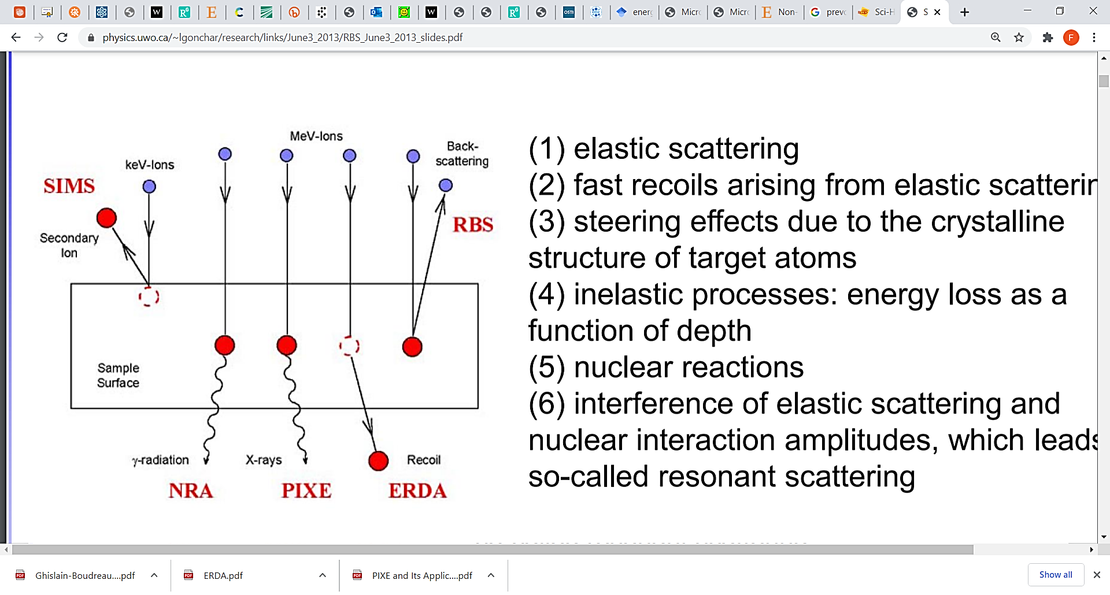
Ion Beam Analysis
Another IBA technique that exists at keV energies- LEIS (Low Energy Ion Scattering) is not shown in the figure 2.
^{[1]} SIMS- Secondary-Ion Mass Spectrometry
^{[2]} NRA- Nuclear Reaction Analysis
^{[3]} PIXE- Particle Induced X- rays Emission
^{[4]} ERDA- Elastic Recoil Detection Analysis
^{[5]} EBS- Εlastic or Nuclear (non Rutherford) Backscattering Spectrometry
^{[6]} RBS- Rutherford Backscattering Spectrometry
^{[7]} LEIS- Low Energy Ion Scattering
Fig. 2. Energies for IBA techniques

Slide 5
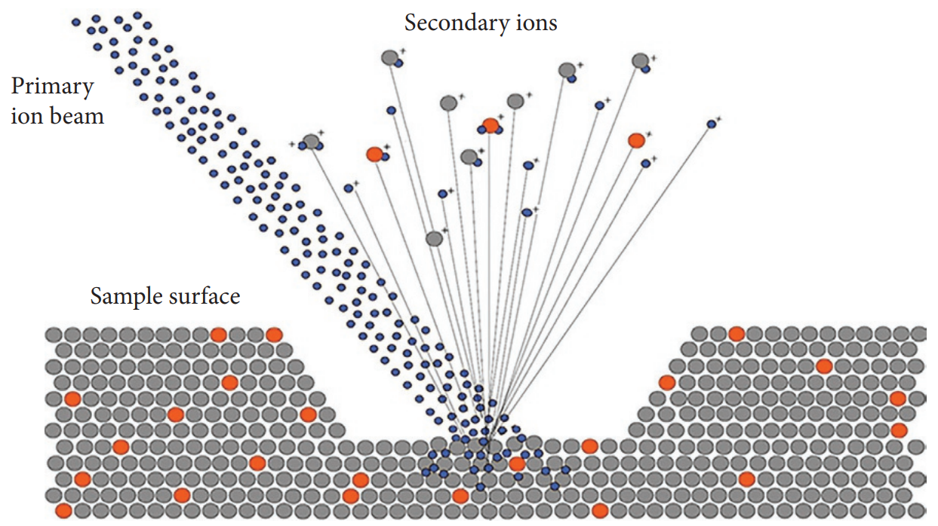
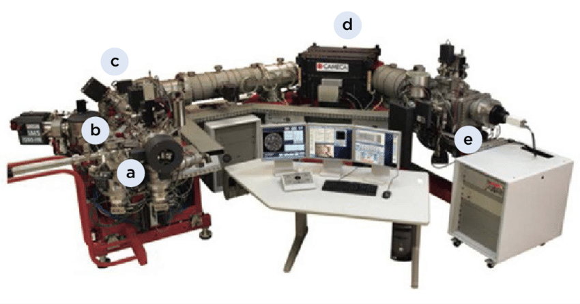
Secondary Ion Mass Spectrometry (SIMS)
Application in Materials Science.
*provides localized elemental, isotopic and molecular characterization of the sample surface.
*insulators, semiconductors, metals and biological samples.
Cs+, O2+, O, Ar+, and Ga+, at energies between 1 and 30 keV, are implanted and mixed with sample atoms to depths of 1 to 10 nm.
Fig. 4. The SIMS instrument
(a) sample chamber, (b) primary ion source, (c) electrostatic analyser, (d) magnet and (e) detection unit.
Fig. 3. Schematic illustration showing the SIMS sputtering and ionization process.

Slide 6
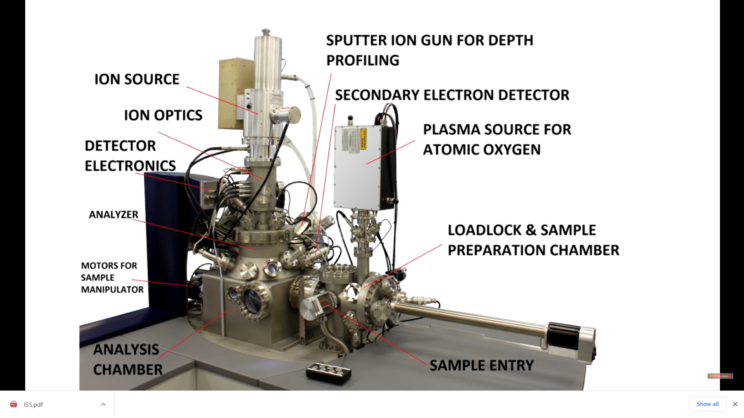
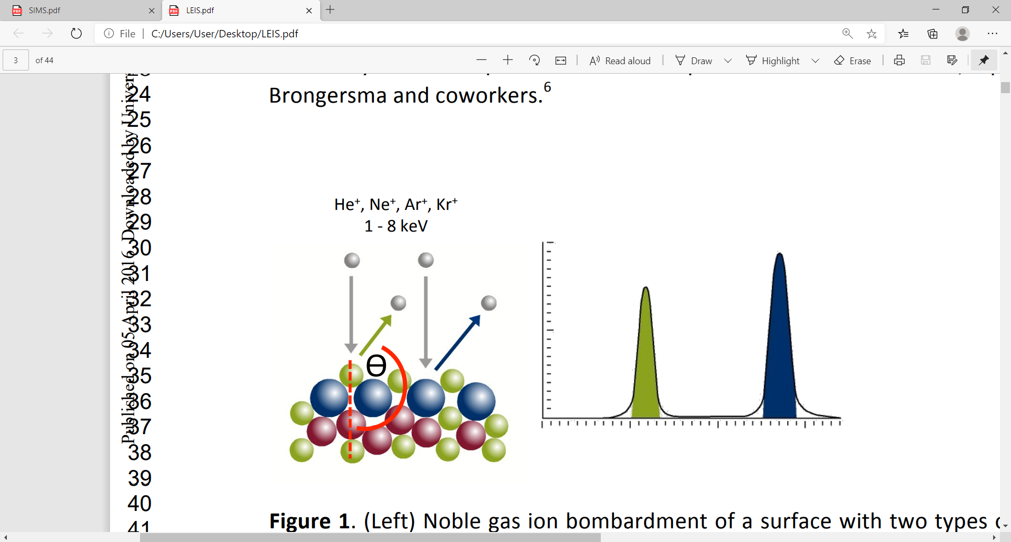
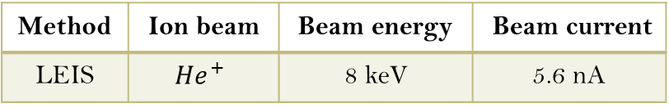
Low Energy Ion Scattering (LEIS)
The elemental composition of the outermost atomic layer of a material, and provides depth profile information about its outer ca. 10 nm.
LEIS is useful for studying:
  the relationships between surface chemistry and surface related phenomena such as wetting, adhesion, contamination, and thin film growth.
Method | Ion beam | Beam energy | Beam current
LEIS | $${He}^{+}$$ | 8 keV | 5.6 nA
Typical ion currents range
from 0.1 to 50 nA.
Fig. 6. The real system of components for LEIS
Fig. 5. (Left) Noble gas ion bombardment of a surface with two types of exposed atoms. (Right) LEIS signal corresponding to the surface on the left. Note that there is no LEIS signal from the ‘red’ atoms.

Slide 7
Modification of Magnetizable Multilayer Systems by Ion Implantation
Magnetizable thin films are irradiated with ions- radiation damages in the films, which affects their (magneto-) optical and (magneto-) electrical properties.
The chemical composition of the thin films.
An industrial application.
1. Magneto-optic (MO) sensors,
4. Nanotubes
6. magnetooptical sensors, ultracompact, self-wound coils or transformers.
2. TMR (Tuning Magneto Resistance)
3. GMR (Giant Magneto Resistance)
5. microchips
Applications

Slide 8
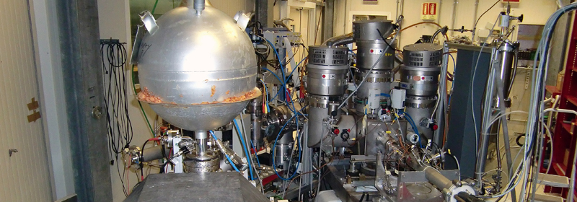
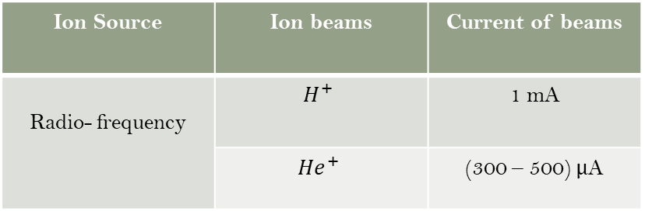
Stellar Physics at keV energies
³He(³He,2p)⁴He & ²H(p, γ)³He
²H(³He,p)⁴He
LUNA
project
Ideal place to measure cross section of nuclear reaction of astrophysical interest.
Nuclear fusion reactions
Emited photons or charged particles.
Energies needed for nuclear reactions in the Sun are 1.6 keV, and in red giants stars 10 keV.
Fig. 7. Inside LUNA
Ion duoplasmatron source,
Components for the LUNA.
An ion-beam extraction.
A double-focusing 90° analyzing magnet
Acceleration system,
Ion Source | Ion beams | Current of beams
Radio- frequency | $$H^{+}$$ | 1 mA
 | ${He}^{+}$ | (300 – 500) μA

Slide 9
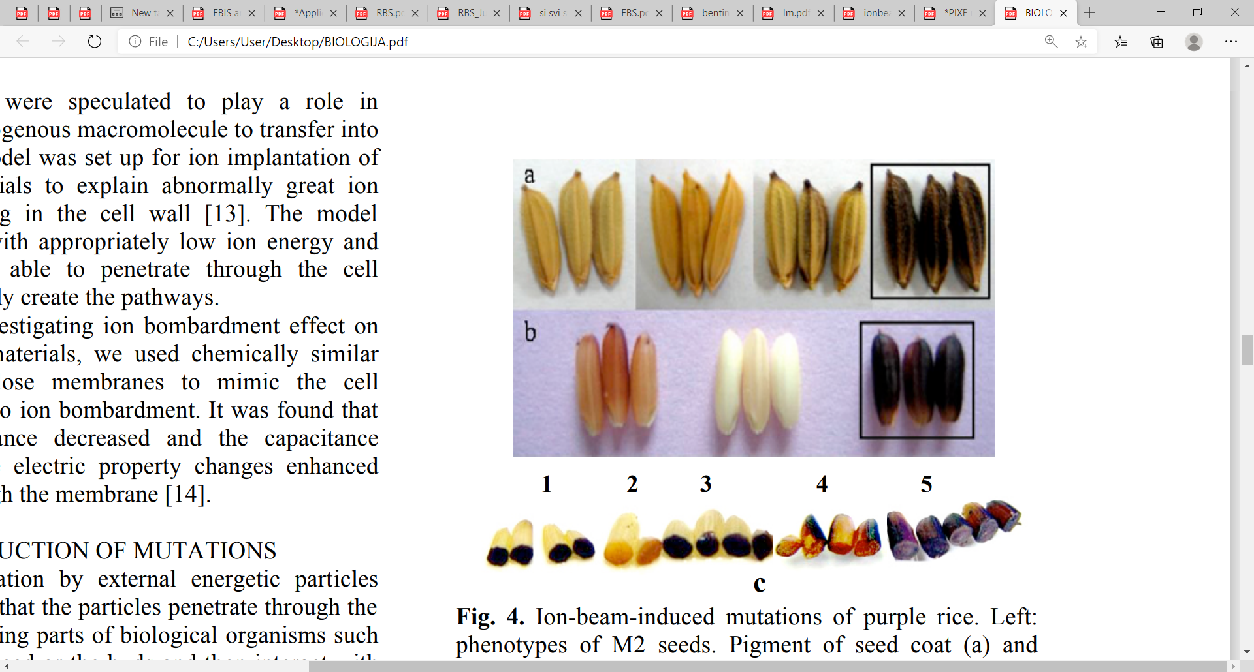
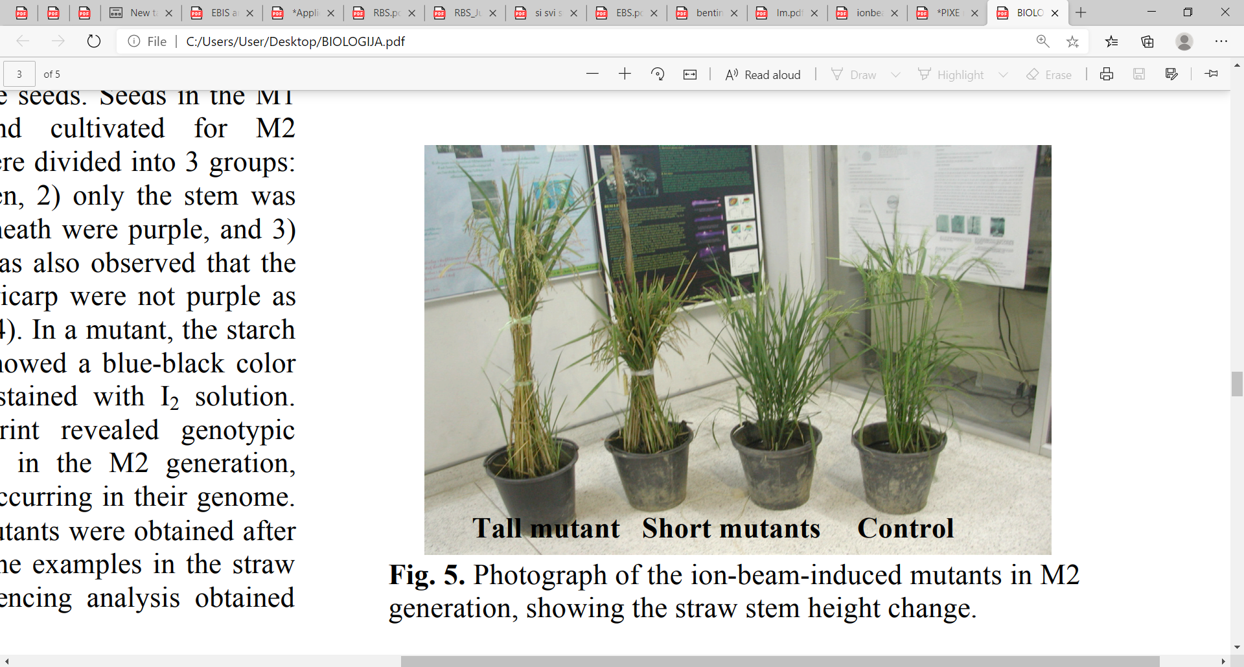
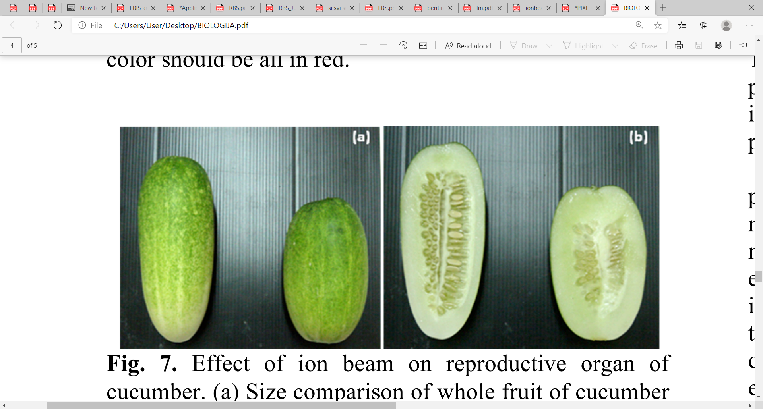
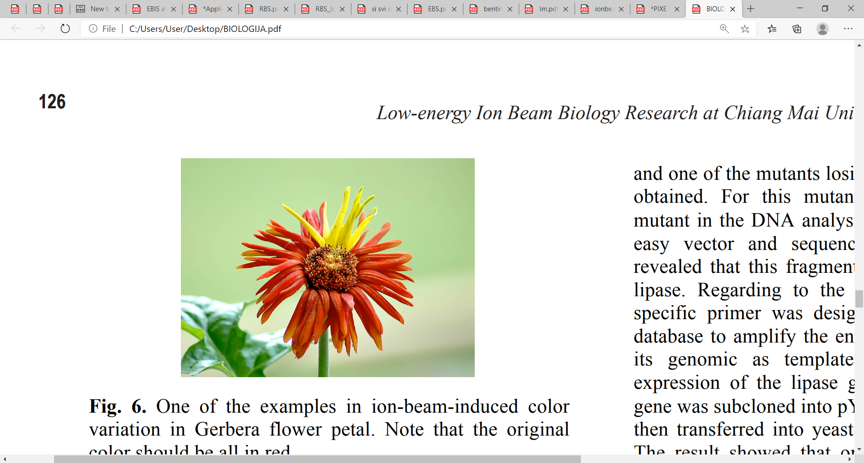
Low Energy Ion Beam Biology Research
For inducing mutation breeding and gene transfer.
RF- (radiofrequency) driven multicasp plasma source- 30 keV
Ion Beams of a few tens keVs.
Seeds were bomarded with N ions.
Energy (30-60) keV
Fluences ${10}^{16}\frac{ions}{{cm}^{2}}$
Fluences 10^16 𝑖𝑜𝑛𝑠/〖𝑐𝑚〗^2
- modification of horticultural plants
- a broad spectrum of mutants has been obtained including changes in phenotypes such as the flower color, color intensity, flower shape, petal shape and size
Fig. 8. Ion-beam-induced mutations of purple rice
Fig. 11. Effect if ion beam reproductive organ of cucumber
a) and b) control (left) hybrid (right)
Fig. 10. Ion-beam- induced color variation in Gerbera flower petal (original color should be red)
Fig. 9. Ion- beam induced mutants showing the straw stem height change

Slide 10

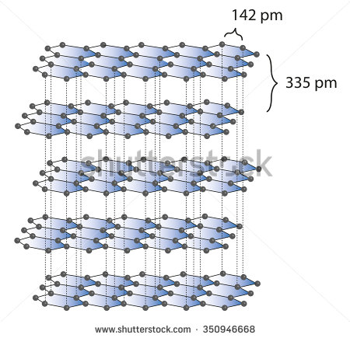
Application of ions on graphene nanomaterials
Bombarding graphene materials with accelerated ions controls the types and number of structural defects.
Ions
${He}^{+}$
〖𝐻𝑒〗^+
$$C^{+}$$
𝐶^+
$$N^{+}$$
𝑁^+
$${Ar}^{+}$$
〖𝐴𝑟〗^+
$${Kr}^{+}$$
〖𝐾𝑟〗^+
Energy
from 50 eVs
to a few hundred keVs.
Research and practical application of these systems.
The possibility of controlling the types and number of vacancies by choosing a corresponding ion type and its velocity.

Slide 11
RFQ provides...
Applications
Depth profiling
Micromachining
2D (3D) profiling
Environment
Biology
Medicine
Archeometry
Fusion
MeV energies

Slide 12
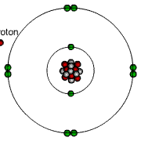
Particle Induced X-rays Emission- PIXE
1. Proton/helium ions beam.
2. Ionized atoms try to stabilize by attracting electrons (from outer shells) leading to photon emission – quantum x-rays.
3. Energy of X-ray- identification card of the element.
4. X-ray energy (wavelength)- identification of atom that emitted x-ray!
Fig 12. PIXE mechanism

Slide 13
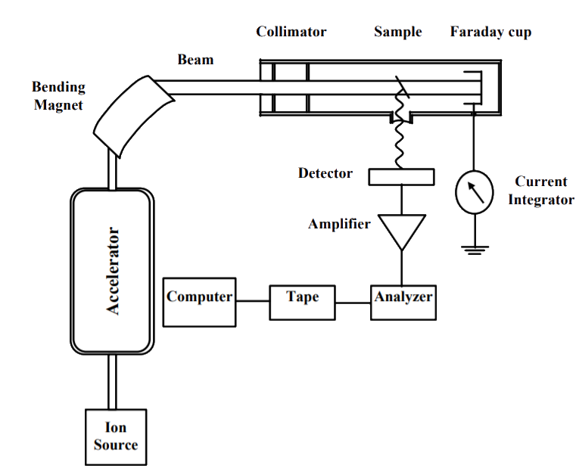
*(1-10) nA are currents for the PIXE
*larger currents - pile-up effect
The Van de Graaff accelerator
Energies of (2-3) MeV for protons and twice that to doubly charged helium ions.
Several tens of µA current is generated by the accelerator.
Fig. 13. Typical arrangement for the PIXE technique

Slide 14
PIXE applications
Analysis of juices, water
Spatial distributions of Ca and Fe from earthenware
Distributions of elements in grains grown in soil containing cesium
Analysis of airborne dust
Brain elemental distributions associated to Alzheimer’s disease,
Study of size and distribution of gold nanoparticles used as agents in cancer fighting strategies;
prosthesis degradation

Slide 15
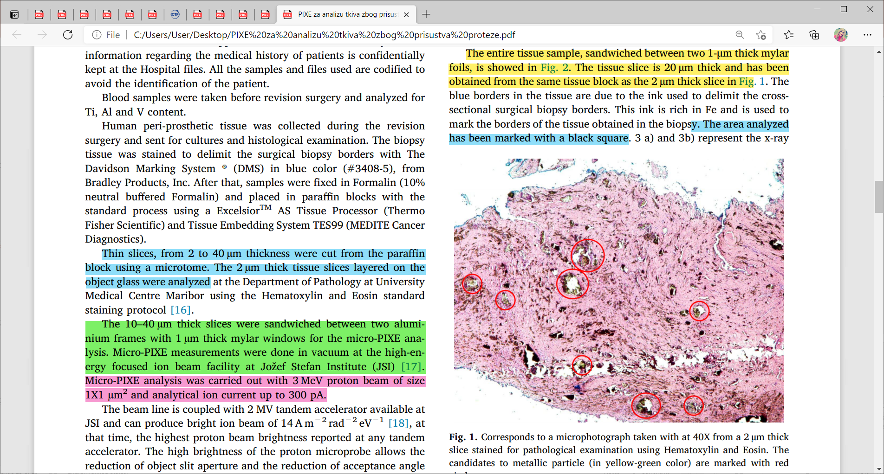
Interesting application- µPIXE technique
The 2 µm thick tissue slices layered on the object glass
3 MeV proton beam of size 1x1 ${\text{µ}\text{m}}^{2}$and analytical ion current up to 300 pA
3 MeV proton beam of size 1x1 〖"µm" 〗^2and analytical ion current up to 300 pA
*the optical microscope
*the potential presence of the metallic particles
High amounts of metal elements (Ti, V or Al) in blood- rough estimation of the degree of prosthesis degradation.
Fig. 14. Corresponds to a microphotograph taken with at 40X from a 2 µm thick slice stained for pathological examination using Hematoxylin and Eosin. The candidates to metallic particle (in yellow-green color) are marked with red circles.

Slide 16
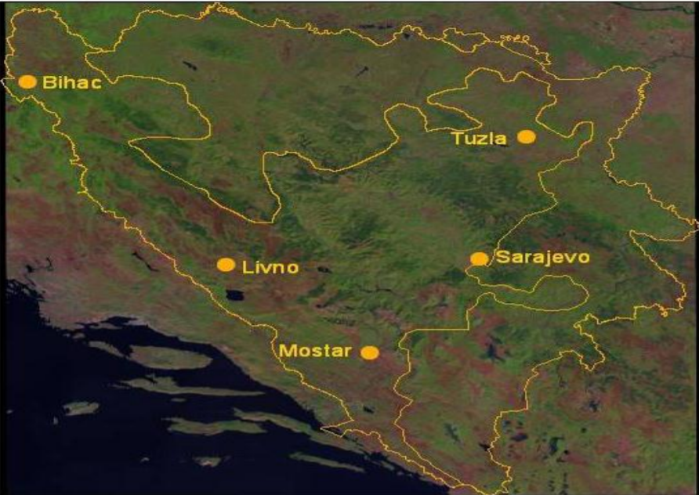
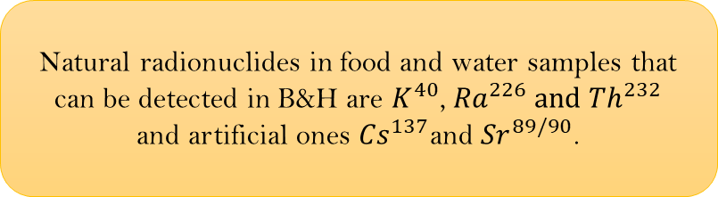
Maybe we can use PIXE...
Determining the presence of radionuclides (natural and artificial origin) in the environment.
The aim is to assess the risk of exposure of the population to ionizing radiation.
Neum
Fig. 15. Sampling locations in BiH
.
.
.
Natural radionuclides in food and water samples that can be detected in B&H are $K^{40}$, ${Ra}^{226} and {Th}^{232}$
and artificial ones ${Cs}^{137}$and ${Sr}^{89/90}$.

Slide 17
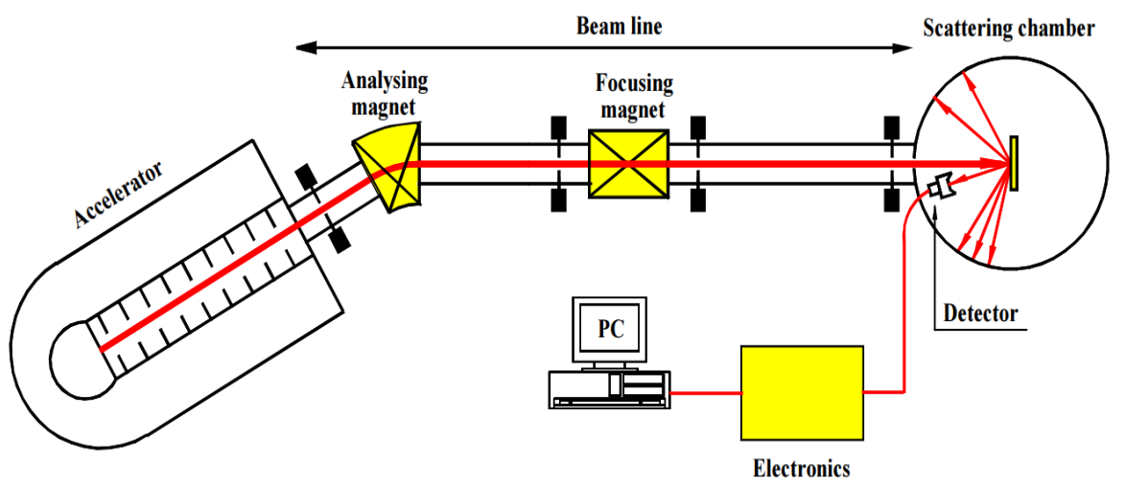
Rutherford Backscattering Spectrometry (RBS)
The RBS method- in a combination with the PIXE method.
Application of the RBS- the composition of material and profile depth of 2 µm for α particles, and up to 20 µm for protons.
(a) metallurgy
(d) surface science
(b) solid-state physics
(c) electrochemistry
Figure 16. Schematic overview of the RBS set-up

Slide 18
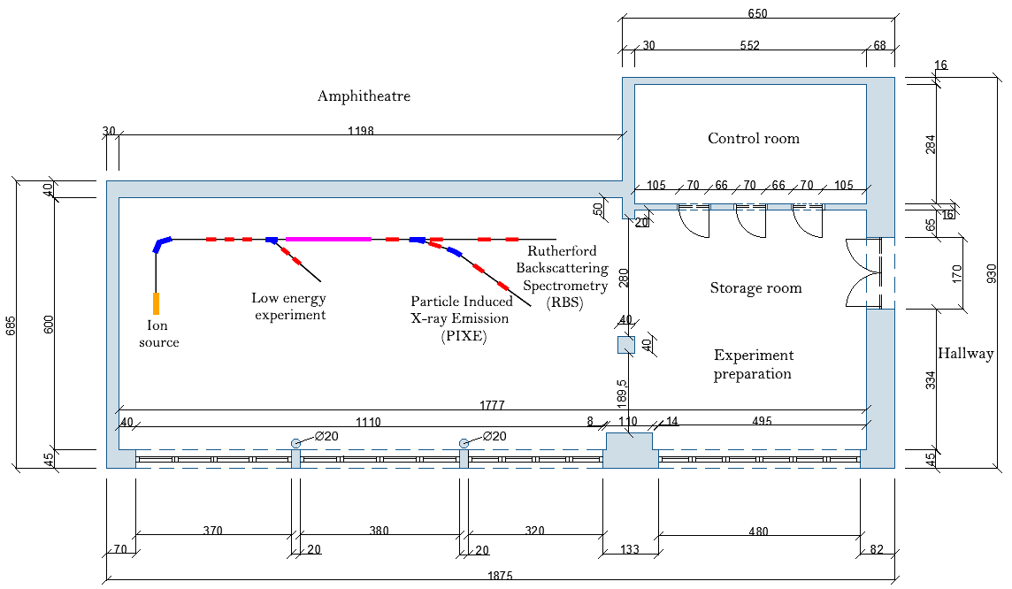
An Auto CAD drawing of a possible setup in a room located in the building of the Faculty of Science in Sarajevo

Slide 19
Summary
SIMS & LEIS
Nanomagnetism and Spintronics
Biology
Nuclear astrophysics
Graphene
Application (keV energies) | Viability | Remarks
SIMS, LEIS | rather not | Nanogan source can produce O+, O2+ and Ar+, much weaker beam currents required, other equipment, electrostatic analyzer is expensive.
Ion implantation | possible | Right intensities, additional equipment not very expensive, but low energies limit depth of implantation – requires interest from local scientists.
Graphene nanomaterials | possible | At the Chemistry department exist strong interest in this application.
Stellar physics | rather not | Other equipment (detectors) quite expensive, need strong interests from local physicists.
Biology, Agriculture, Microbiology, and Medical science. | possible | Need interests from local scientists.
PIXE
RBS
EBS
ERDA
NRA

Slide 20
Thank you!

Slide 21
References
1. Kokkoris, M. Ion Beam Analysis Techniques for non-Destructive Profiling studies . Athens : Department of Physics, National Technical University of Athens, October 2013.
2. D.W.Grainger and D.G.Castner. Surface Analysis and Biointerfaces: Vacuum and Ambient In Situ Techniques. 2017.
3. Ishii, Keizo. PIXE and Its Applications to Elemental Analysis. Sendai : Cyclotron and Radioisotope Center, Tohoku University, 10 June 2019.
4. PIXE (Particle‐Induced X‐Ray Emission). Mandò, P.A. 15 September 2006.
5. Rutherford Backscattering Spectrometry (RBS). Mayer, M. Garching, Germany : Max-Planck-Institut f¨ur Plasmaphysik, EURATOM Association, 2003.
6. C.R.Gossett. Non-Rutherford elastic backscattering for light element cross section enhancement. Washington, DC 20375-5000, USA : s.n., 1989.
7. M.Roumié, et al. Determination of stoichiometry in silicon carbide materials using elastic backscattering spectrometry. s.l. : Lebanese Atomic Energy Commission-CNRS, Riad El Solh, Beirut, Lebanon; Department of Physics, American University of Beirut, Bliss Street, Riad El Solh, Beirut, Lebanon, July 2007.
8. Ion Beam Methods, Introduction. [Online] https://bit.ly/3dCAgoK.
9. Light element depth profiling using elastic recoil detection. Habraken, F.H.P .M. Utrecht, Netherlands : Atomic and Interface Physics, Debye Institute, Utrecht University, P.O. Box 80000, 3508 TA , 1992.
10. Application of Nuclear Reaction Analysis for aging. G.Gavrilov, A.Krivchitch*, V.Lebedev. St. Petersburg district, Russia. : Petersburg Nuclear Physics Institute, Russian Academy of Science, 2001.
11. Dynamic Secondary Ion Mass Spectrometry. 2019.
12. Rutherford backscattering spectrometry; [Online] https://bit.ly/3nYi25X.
13. Boudreault, Ghislain. Accurate ion beam analysis. Surrey, UK : School of Electronics and Physical Sciences, august, 2002.
14. Microanalytical center- MIC. NRA - Nuclear reaction analysis. [Online] https://bit.ly/346Zit5.
15. Introduction to SIMS; https://www.cameca.com/products/sims/technique
16. L. Pillatsch,T. Wirtz, H.-N. Migeon and H. Scherrer; SIMS using negative primary ion bombardment[Online] https://bit.ly/31Rsm6g
17. H. W. Werner; Theoretical and experimental aspects of secondary ion mass spectrometry [Online] https://bit.ly/31TfLjb

Slide 22
19. A. Amaral , P. Galle , F. Escaig , C. Cossonnet , M.H. Henge-Napoli , E. Ansoborlo , L. Zhang; The use of SIMS for uranium localization in biological research; [Online] https://bit.ly/3kQusuV
S.F. Belykh, V.V. Palitsin, I.V. Veryovkin, A.P. Kovarsky, R.J.H. Chang, A. Adriaens, M. Dowsett, F. Adams; Caesium sputter ion source compatible with commercial SIMS instruments [Online] https://bit.ly/3e5gAdu
21. Trevor R. Ireland; Janaína N. Ávila; Maria Lugaro; S. Amari; Rare Earth Element abundances in presolar [Online] https://bit.ly/34oxnF6
22. A Preliminary SIMS Study Using Carbon Isotopes to Separate Natural from Synthetic Diamonds [Online] https://bit.ly/2TqcgMp
23. Low energy ion scattering (LEIS). A practical introduction to its theory, instrumentation, and applications [Online] https://rsc.li/3dMCnGS
24. Low-Energy Ion Scattering Spectroscopy (LEIS) [Online] https://bit.ly/3kmfeNM
25. Surface Composition Analysis by Low-Energy Ion Scattering[Online] https://bit.ly/2HyWtJ3
26. Thin film analysis by low-energy ion scattering by use of TRBS simulations [Online] https://bit.ly/34BbnHl
27. A revolutionary He+ ion beam process technology to enhance ultra-thin magnetic films for both MRAM and HDD applications [Online] https://bit.ly/36mBxNw
28. Towards Improved Cancer Treatment: IAEA and Okayama University to Cooperate in Boron Neutron Capture Therapy R&D; [Online] https://bit.ly/355VBEI
29. Laboratory for Underground Nuclear Astrophysics; [Online] https://bit.ly/3laM30t
30. LUNA: Nuclear Astrophysics Deep Underground; [Online] https://bit.ly/36eXVII
31. Low- energy Ion Beam Biology Research at Chiang Mai University; [Online] https://bit.ly/3lgkh2F
32. Accelerated ion beams for art forensics; [Online] https://bit.ly/315RZjv
33. PIXE and Its Applications to Elemental Analysis; [Online] https://bit.ly/38te5Rt
34. Trace element analysis of hot spring water by PIXE method [Online] https://bit.ly/36uXKJf
35. Sample preparation procedure for PIXE elemental analysis on soft tissues; B. Kubica, W. M. Kwiatek, E. M. Dutkiewicz, M. Lekka
36. Particle Induced X-ray Emission (PIXE) for elemental tissue imaging in hip modular prosthesis fracture case; Esther Punzón-Quijornaa, Mitja Kelemena, Primož Vavpetiča, Rajko Kavalarb, Primož Pelicona, Samo K. Fokter; Jožef Stefan Institute (JSI), Jamova 39, 1000 Ljubljana, Slovenia b University Medical Centre Maribor, Ljubljanska ulica 5, 2000 Maribor, Slovenia. [Online] https://bit.ly/3hiSCPw
https://bit.ly/36eXVII

