Slide 1


Radioisotope production using linear accelerators
Aristeidis Mamaras, AUTh/cern
21/05/2021

Slide 2
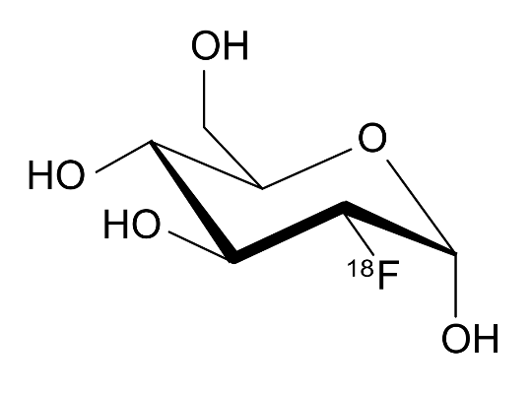
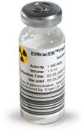
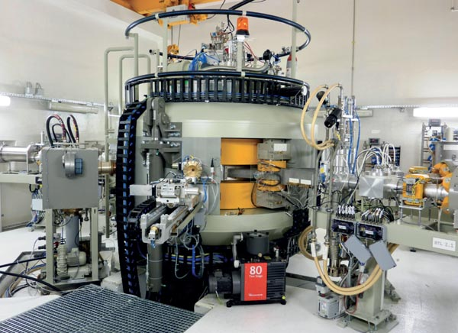
Medical radioisotope production
¹⁸F-FDG
From radioisotope ¹⁸F to the radiopharmaceutical FDG
Main topic of bachelor thesis work was to investigate the possibility to use linear accelerators for the production of radioisotopes commonly used for PET imaging.
Medical radioisotopes are usually produced by cyclotrons in dedicated facilities and transported to the hospitals for their use.
The basic idea is to install a linac-based system for radioisotope production at or near the location where the radioisotopes are used, since linacs may offer many advantages compared to cyclotrons.
The Cyclone 30 isotope-producing cyclotron, 8.3 tons
Source: https://bit.ly/3l5ihdu

Slide 3
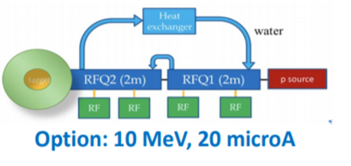
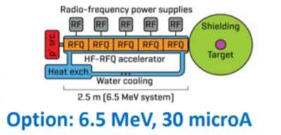
Possible RFQ Linac designs
Source: https://bit.ly/3p0efFQ, M. Vretenar et al.
Characteristics
Accelerator length | 4 m
Surface | 15 m²
Weight | 500 kg
Output Energy | 10 MeV
Duty Cycle | 10%
Power Consumption | 350 kW
Operating Frequency | 750 MHz
Characteristics
Accelerator length | 2.5 m
Surface | 10 m²
Weight | 350 kg
Output Energy | 6.5 MeV
Duty Cycle | 4 %
Power Consumption | 400 kW
Operating Frequency | 750 MHz

Slide 4
Development of numerical calculations
The production yield of ¹⁸F commonly used for PET imaging was estimated in a certain range of energies together with the corresponding number of PET doses.
Developed a method of numerical calculations for radioisotope production to:
    Search for an energy range in which we can achieve efficient radioisotope production
    Keep the setup compact and cost effective
    Investigate the possibility for injection to the synchrotron in the same energy range

Slide 5
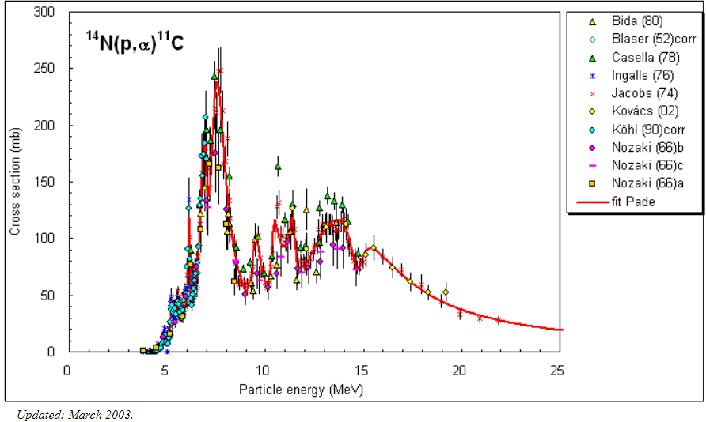

Radioisotope Production Yield
$A=I·\left(1−e^{−λ·t}\right)· \frac{N_{A}·ρ}{M}·\int_{E_{i}}^{E_{th}}{\frac{σ (Ε)}{\frac{dE}{dx}}}·dE$
Yield
( mCi or GBq)
Beam current (μΑ)
Number of target atoms per unit volume
Irradiation time
λ decay constant of
the radionuclide
E_{i} is the beam energy,
E_{th} is the reaction threshold energy,
σ(E) is the cross section as a function of energy (excitation function),
dE/dx is the stopping power of the target material.
Excitation function is a term used in nuclear physics to describe a graphical plot of the yield of a radionuclide or reaction channel as a function of the bombarding projectile energy or the calculated excitation energy of the compound nucleus.
For practical reasons, saturation factor, λ, is considered at 3.5 T_{1/2} of the radioisotope.
Source:https://www-nds.iaea.org/medical/n4p11c0.html

Slide 6
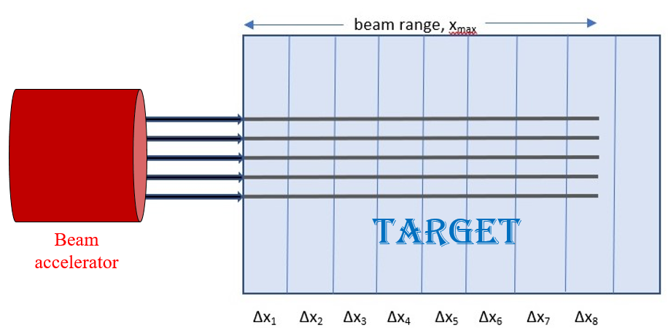
Development of numerical calculation for radioisotope production
Obtain the “range” of the particle beam inside the target from the literature.
We divide the “range” that the particles of the beam will reach, x_{max}, in the target in several thin slices of equal thickness Δx.
Knowing the initial kinetic energy E_{input} = E₁ of the particle beam impinging on the first slice, we can get from the literature the value of the stopping power S₁ =S(E₁) for this energy, which is valid in the whole slice, assuming that the stopping power is approximately constant for small variations of energy.
The energy loss of particles passing this slice must be equal to ΔE₁ = S₁·Δx₁ , and the energy of particles exiting this slice and entering into the next will be equal to E₂ = E₁ - ΔE₁ = E₁ - S₁·Δx₁.
We proceed in the same way to the following slices, the particle energy in each slice is decreasing in small but unequal steps, until it reaches zero (in the figure this happens somewhere into the 8th slice).

Slide 7
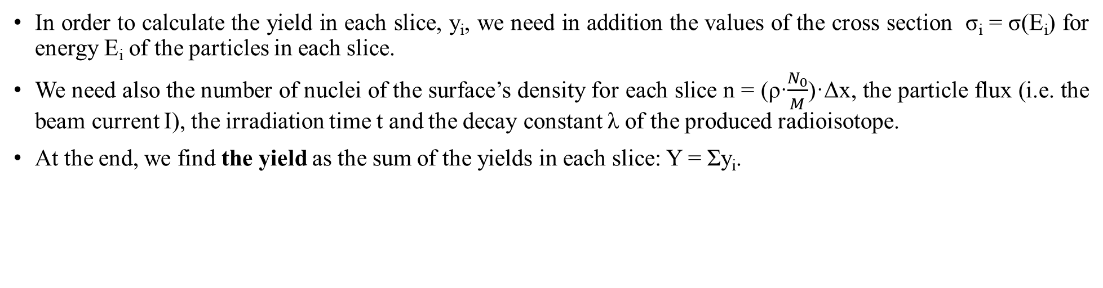
Development of numerical calculation for radioisotope production
In order to calculate the yield in each slice, y_{i}, we need in addition the values of the cross section σ_{i} = σ(E_{i}) for energy E_{i} of the particles in each slice.
We need also the number of nuclei of the surface’s density for each slice n = (ρ·$\frac{N_{0}}{M}$)·Δx, the particle flux (i.e. the beam current I), the irradiation time t and the decay constant λ of the produced radioisotope.
At the end, we find the yield as the sum of the yields in each slice: Y = Σy_{i}.

Slide 8
Yield calculation for ¹⁸F production from H₂¹⁸O water target.

Slide 9
Possible RFQ Linac designs
Source: https://bit.ly/3p0efFQ, M. Vretenar et al.
Saturation yield after 3.5 T_{1/2} ≅ 6 h:
104 GBq → 282 PET doses
Saturation yield after 3.5 T_{1/2} ≅ 6 h:
74 GBq → 200 PET doses
¹⁸F arriving from Athens, by plane and/or car → Great yield loss.
The produced yield at the production laboratory is 120 GBq out of which only 15 GBq reach the hospital (after 5-6 hours) and 4.4 GBq are finaly used.
This loss can be avoided with a production unit close to the hospital → Possible linac setup designs.

Slide 10
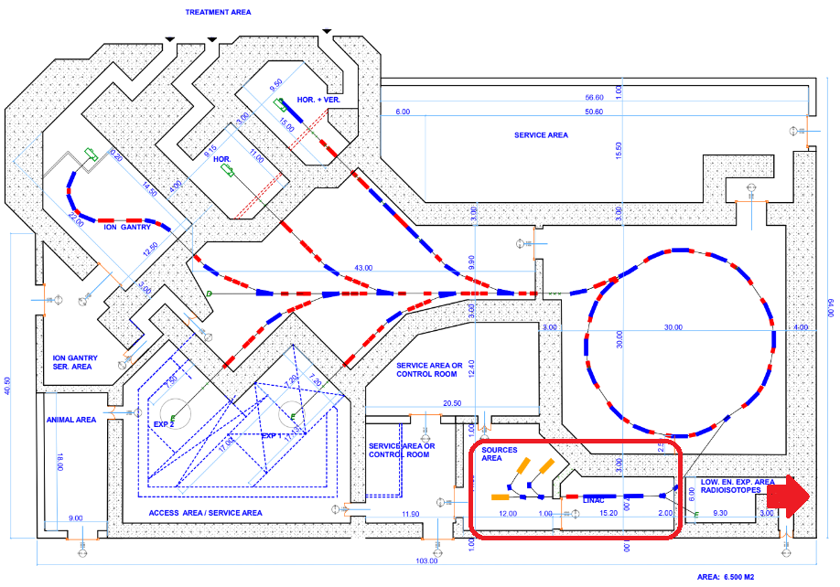
Possibility of radioisotope production in SEEIIST facility
In the context of the South East European International Institute for Sustainable Technologies (SEEIIST) a cancer therapy facility is being designed.
Possibility for an extension to construct a unit dedicated to the extraction of the produced radioisotope from the target and the production of radiopharmaceuticals.
The surplus of radioisotope quantities could be made available to other hospitals.
Research field for exploring more promising radioisotopes for diagnostic and therapeutic purposes.
Source: Dimitris Kaprinis design for SEEIIST

Slide 11
Conclusions and Outlook
The possibility of using linacs for radioisotope production looks promising. Investigation of new radioisotopes used for theranostics.
Study the simultaneous optimization of the parameters needed for the production of these radioisotopes, by a compact cost effective linear accelerating system that could also be used for injection to the synchrotron.
Optimize the design of this area including efficient radioprotection methods, shielding calculations and appropriate construction materials.

Slide 12
Thank you for your attention!

