Slide 1
Collective effects for Single-beam in FCC-ee
E. Carideo, M. Migliorati, F. Zimmermann, M. Zobov, D. De Arcangeli
Acknowledgements: N. Monet, S. Joly
Collaborations: Y. Zhang

Slide 2
Outline
The FCC-ee project : parameters used for our simulations
Wakefields and impedances evaluated so far
Longitudinal single beam instabilities: MI analysis
Transverse single beam instabilities : TMCI mode analysis

Slide 3
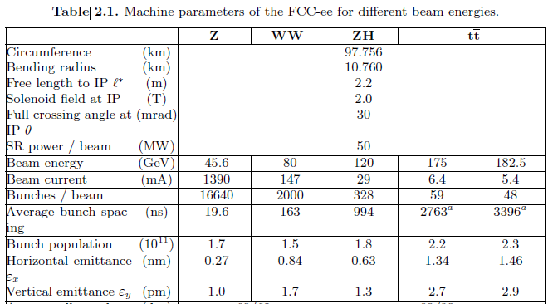
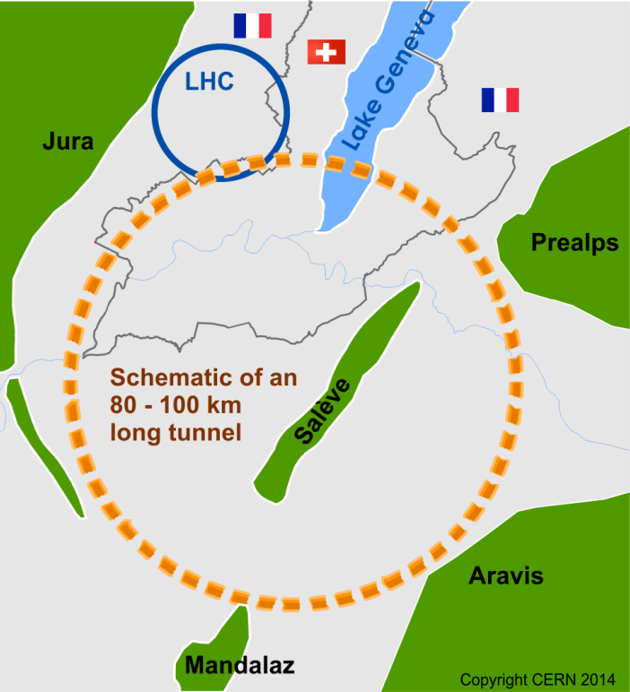
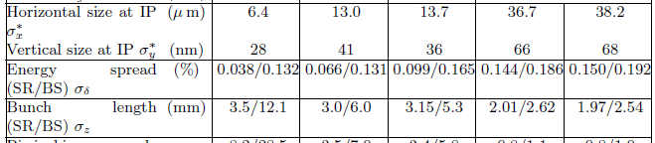
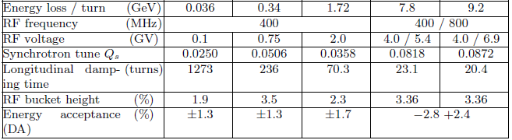
FCC-ee: FUTURE CIRCULAR COLLIDER
High luminosity e⁺e⁻ collider as potential first step to cover a beam energy range from 45.6 GeV to 182.5GeV

Slide 4
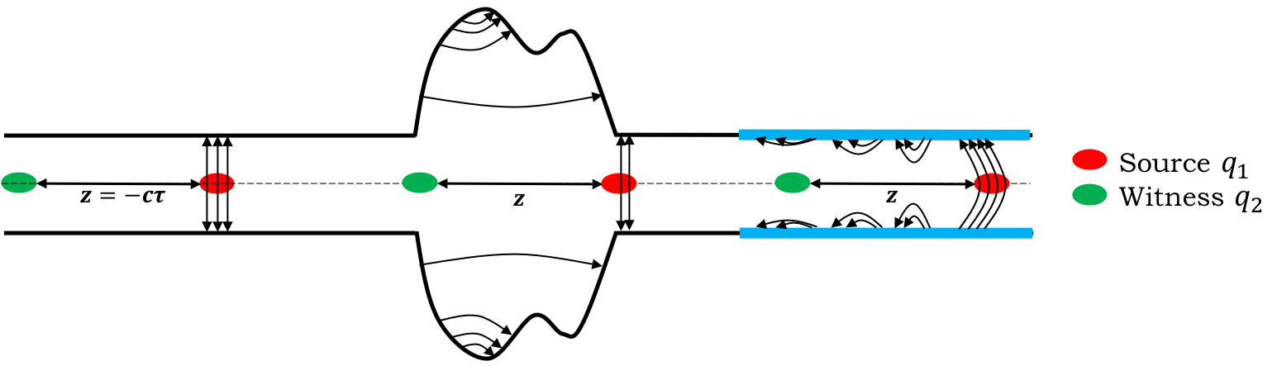

Motivation of this study
Future Circular Collider (FCC) has been launched for the era after the High-Luminosity Large Hadron Collider project
The interaction of the beam with the environment can produce wakefields (impedances in the frequency domain) that induce instabilities
      The resistive wall impedance is produced by the finite conductivity of the pipe walls. The presence of the coating affects the RW impedance, making its contribution very critical
      Since the resistive wall impedance is proportional to $C$, its contribution to the total machine impedance increases linearly with the machine length.
      The main difference between FCC-ee and other colliders is its large circumference ≈ $97.75$ km
      By increasing the machine length the contribution of the RW impedance assumes more and more importance with respect to other elements
      In FCC-ee, RW represents the main source of wakefields

Slide 5
Impedance Sources: CST and Iw2d simulations
Longitudinal wake potentials for a Gaussian bunch with nominal bunch length σ_{z} = 3.5mm due to the main FCC-ee components, evaluated so far.
Loss factor and Power loss contribution of FCC-ee devices at nominal intensity and bunch length of 12.1 mm, in the lowest energy case of 45.6 GeV
Component | Number | K_{loss}(12.1mm)[V/pC] | 𝑃_{𝑙𝑜𝑠𝑠} [𝑀𝑊]
Resistive Wall | 97.75 km | 33.1 | 1.21
RF cavities | 52 | 8.76 | 0.334
BPMs | 4000 | 4.81 | 0.180
Bellows | 20000 | 23.95 | 0.880
RF double tapers | 13 | 2.33 | 0.088

Slide 6
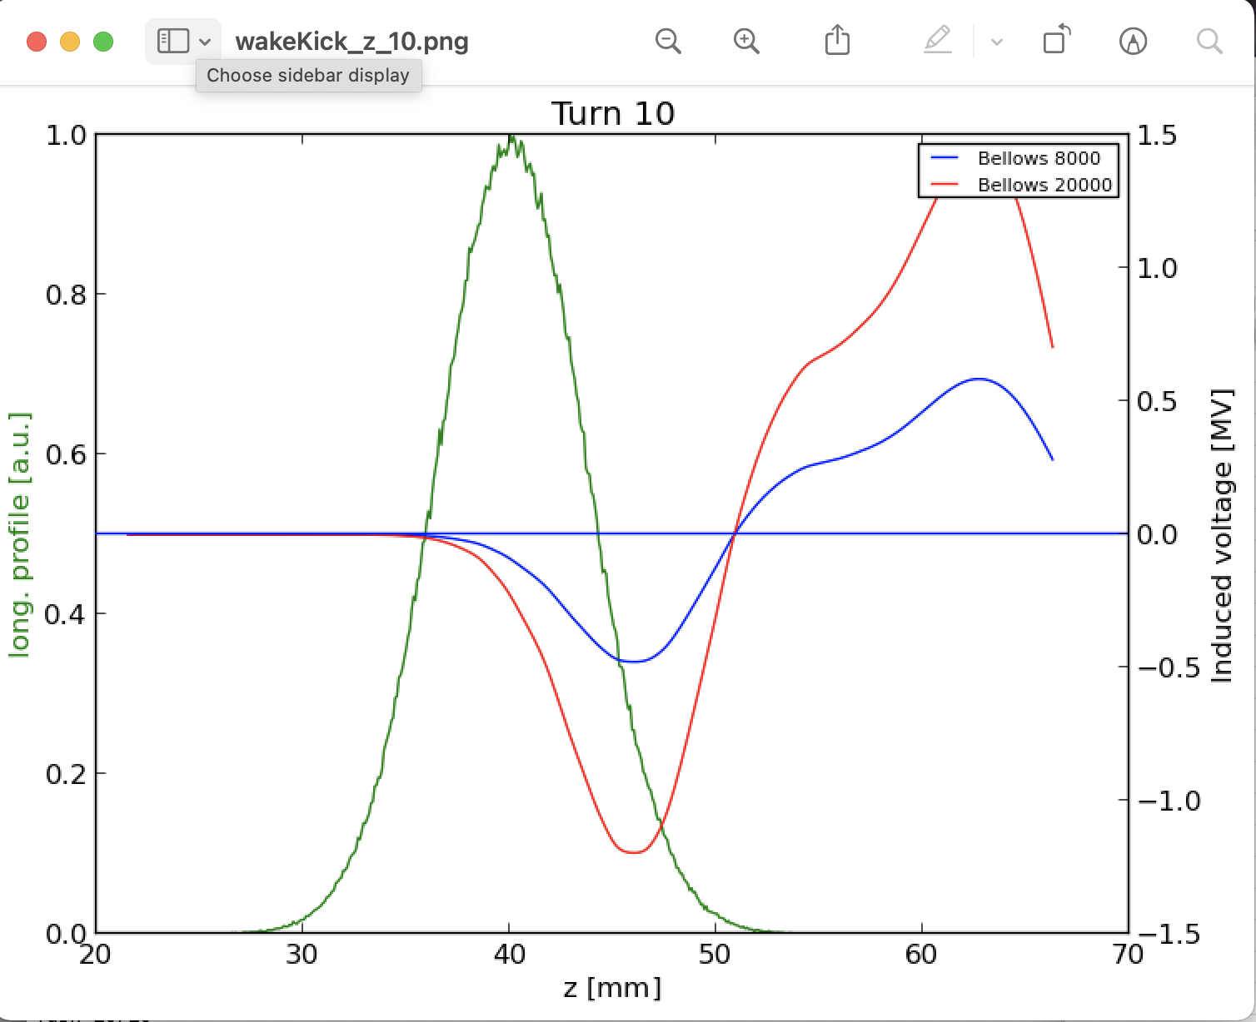
Updated FCc-ee impedance model: 20000 BEllows
We initially considered a number of 8000 Bellows
BUT
85% of arcs (~ 79 km)
Every arc is 8m long
X2 because we have another bellow before any quadrupole
12000-13000 but to be sure we are performing our calculations considering up to 20000 bellows

Slide 7
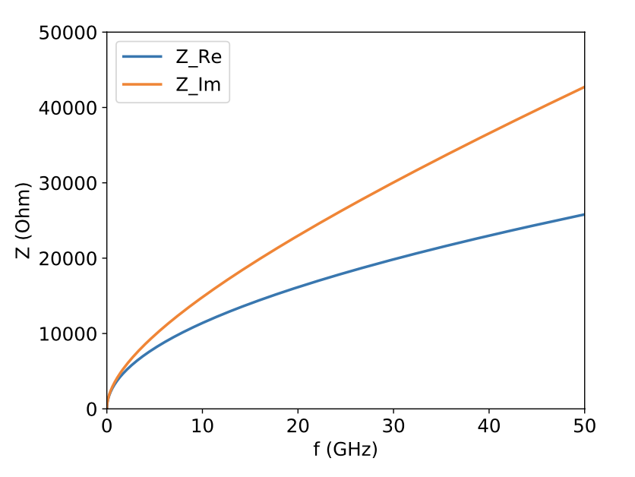
Method to calculate the Wake Potential by software simulation: Resistive Wall
Real and imaginary part of the resistive wall impedance calculated by using the code IW2D
Wake potential of a 0.4 mm Gaussian bunch convoluted with the nominal bunch length and compared with the wake potential obtained directly from the convolution of the wakefield with the 3.5 mm Gaussian bunch.

Slide 8
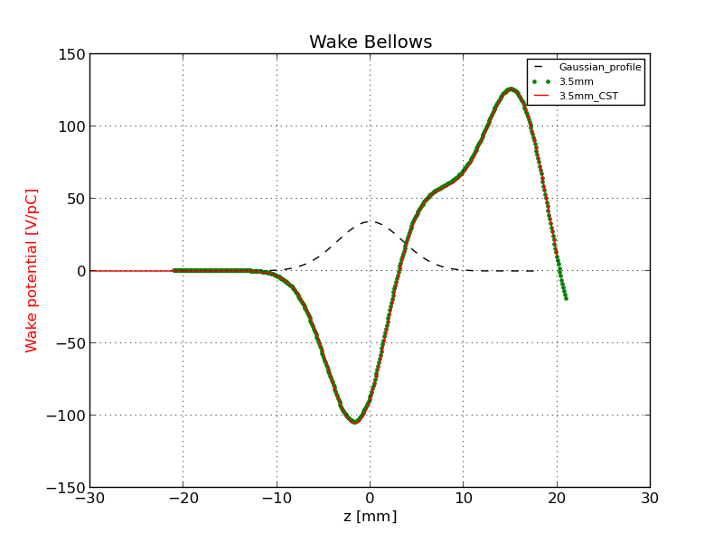
COMPARISON OF THE WAKE POTENTIAL OF 3.5 MM BUNCH LENGTH BETWEEN PYHT AND CST: BELLOWS
Wake potential for a Bellow of a 3.5 mm Gaussian bunch obtained directly by CST (red curve) and with the convolution by using the wake potential of 0.4 mm Gaussian bunch (green dots).

Slide 9
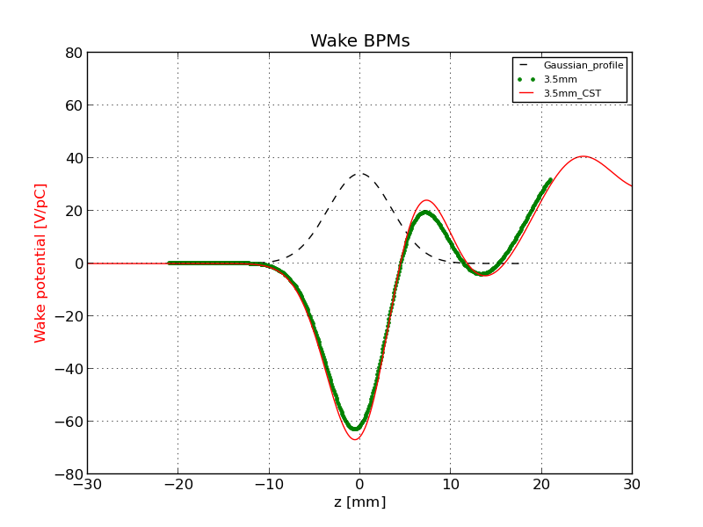
Comparison of the wake potential of 3.5 mm bunch length between PyHT and CST: BPMs

Slide 10
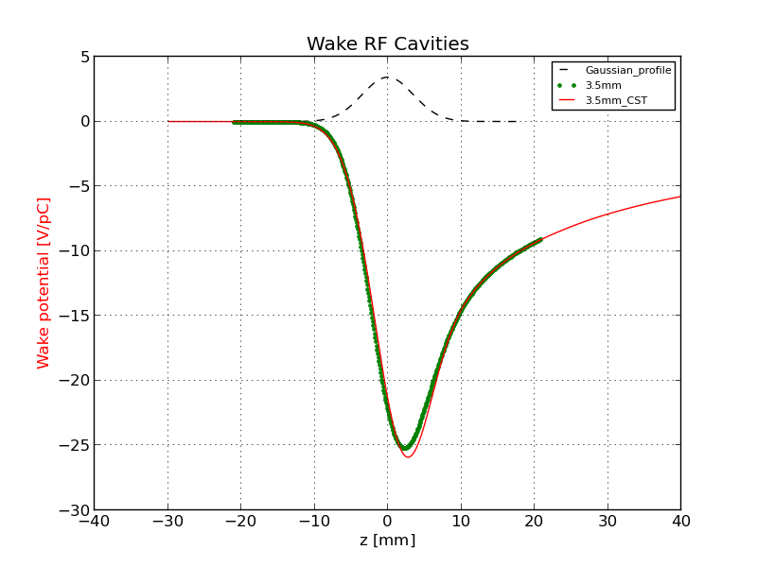
Comparison of the wake potential of 3.5 mm bunch length between PyHT and CST: RF Cavities

Slide 11
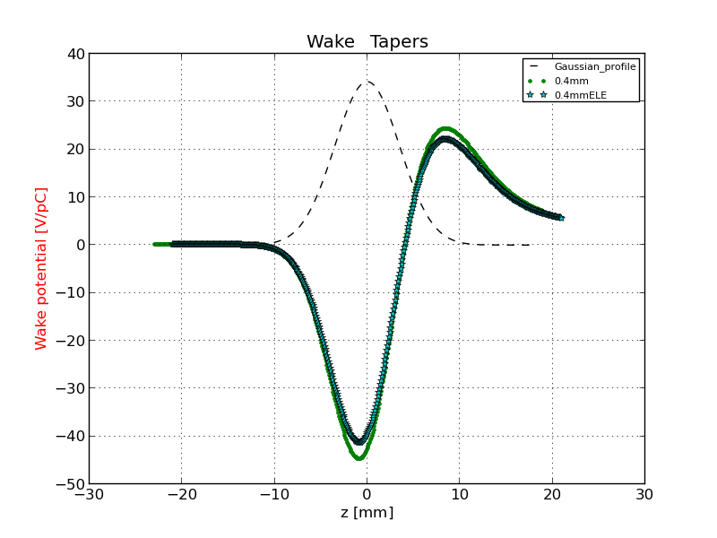
Comparison of the wake potential of 3.5 mm bunch length between PyHT and CST: RF double tapers
3.5 mm
3.5_ABCI

Slide 12
Real and imaginary impedance of some machine devices
Wake and impedance repository for FCC-ee: https://gitlab.cern.ch/ecarideo/FCCee_IW_Model

Slide 13
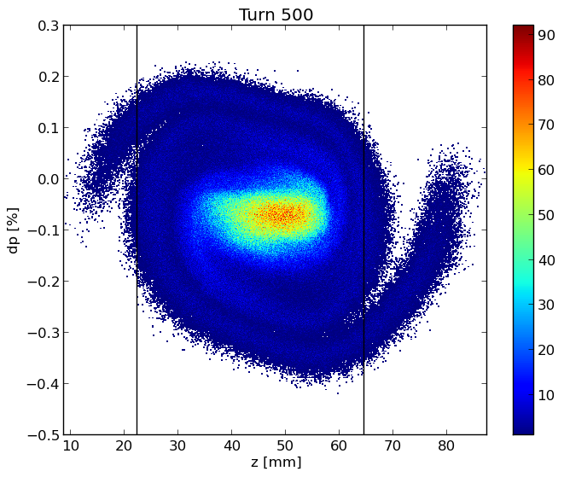
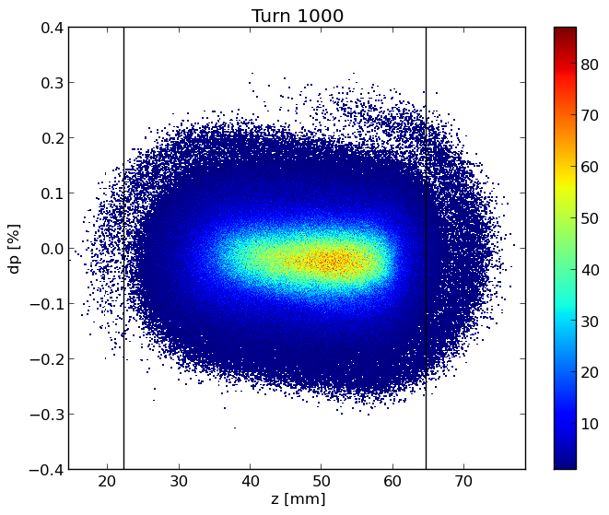
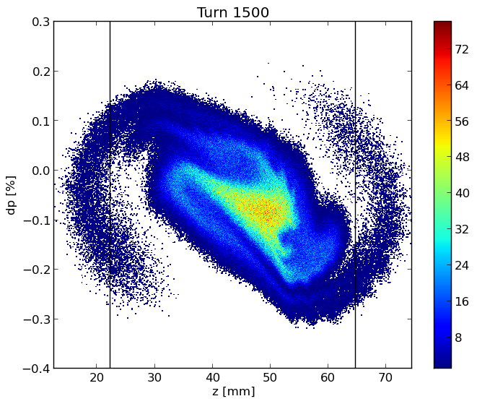
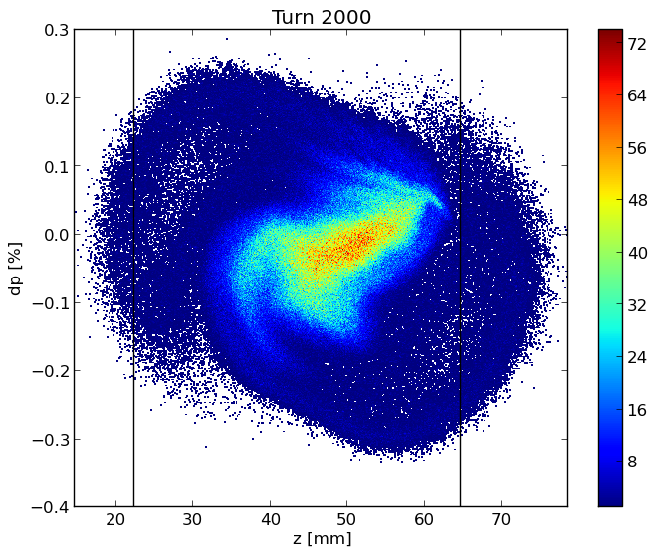
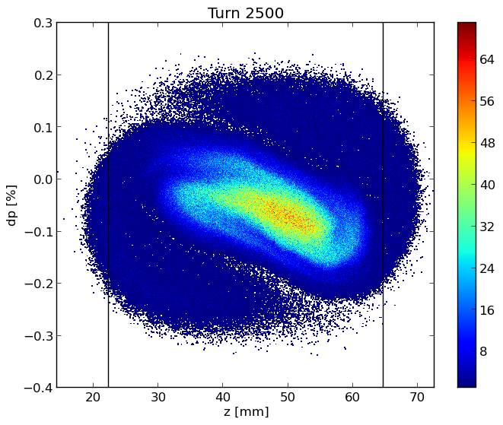
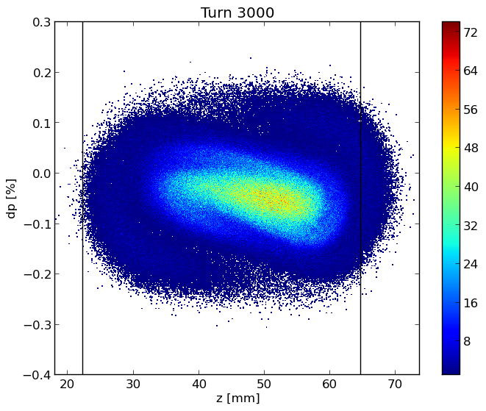
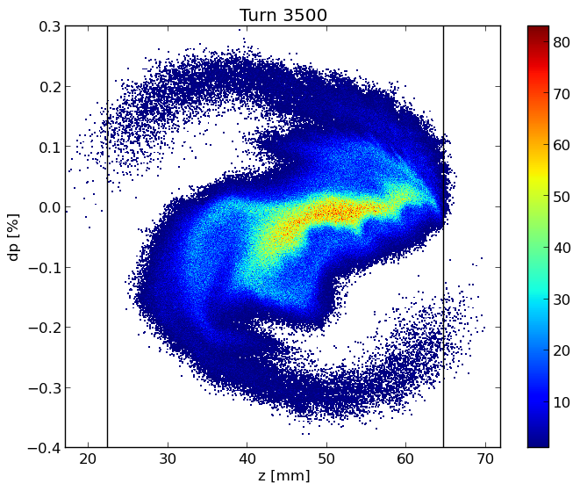
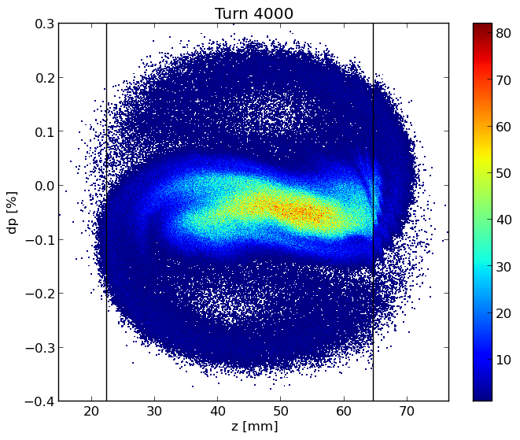
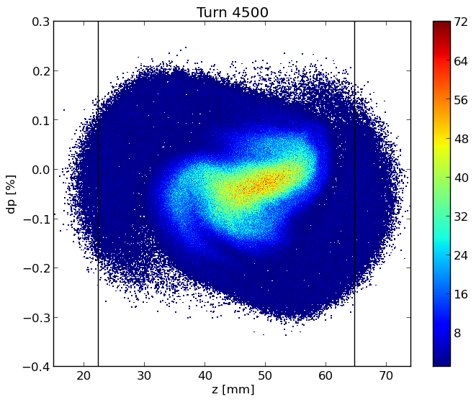
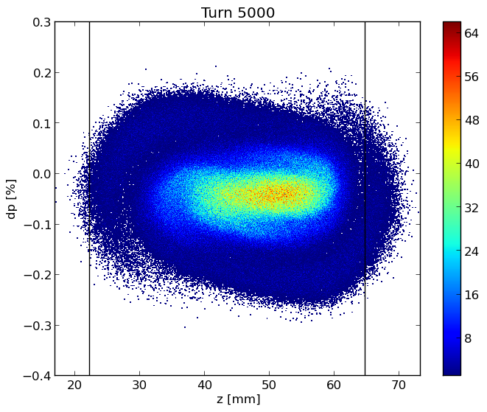
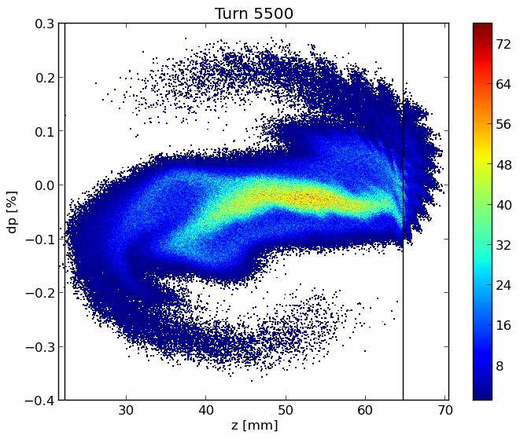
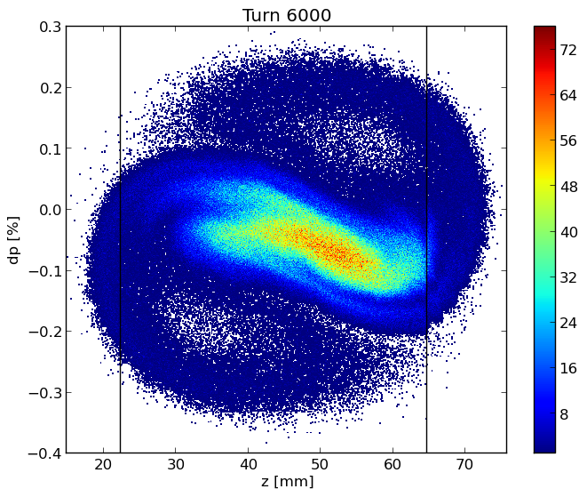
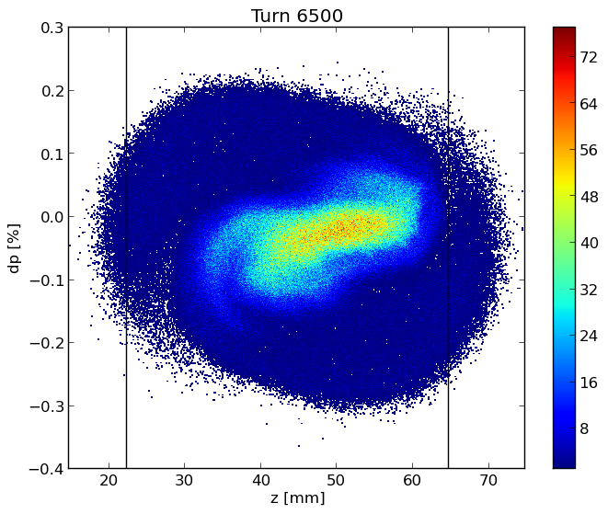
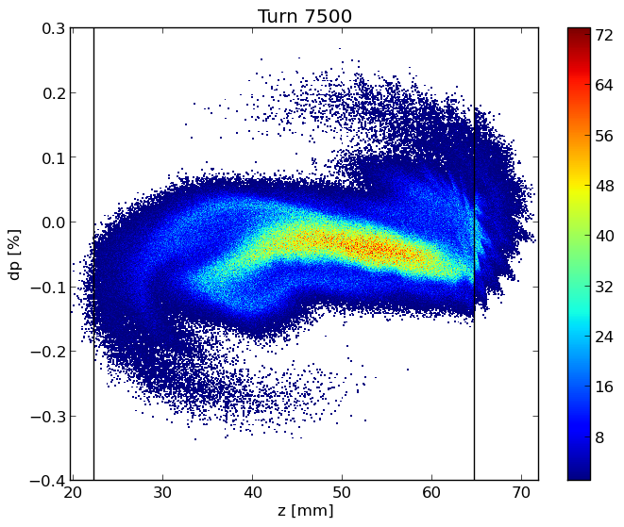
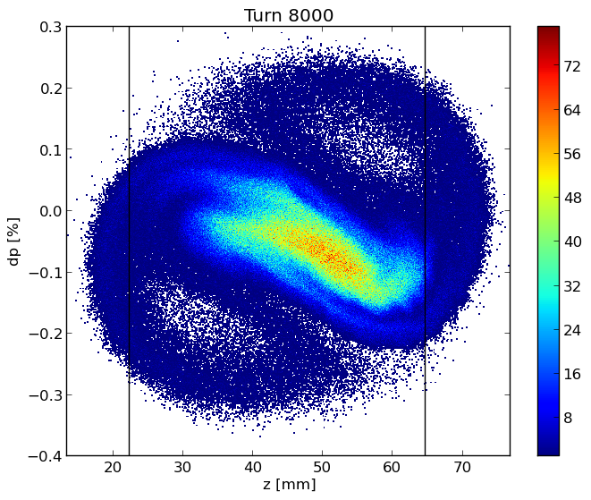
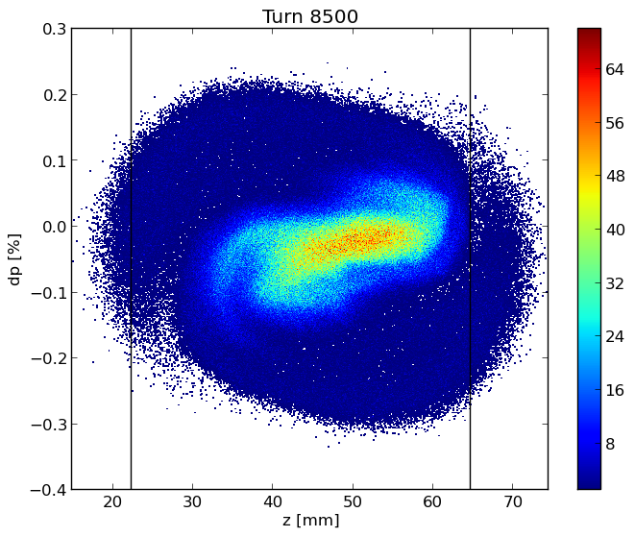
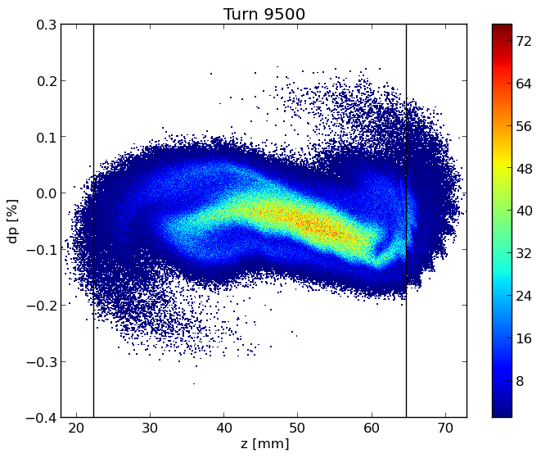
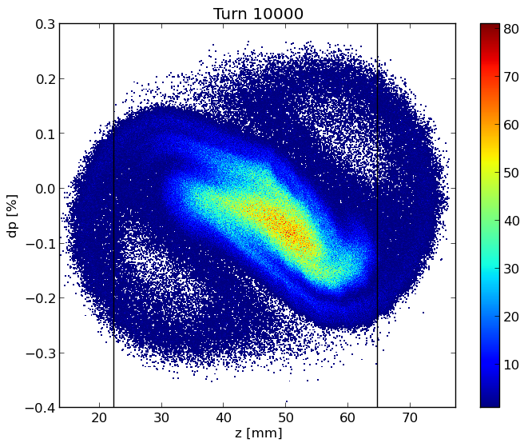
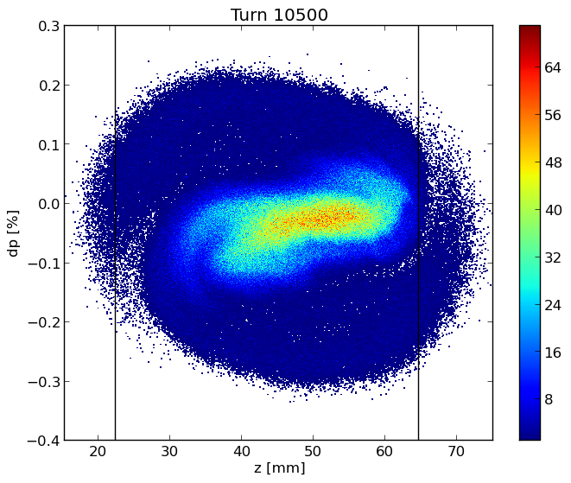
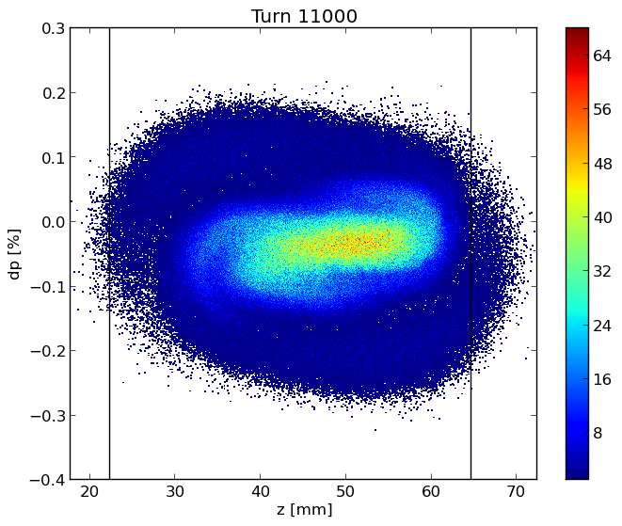
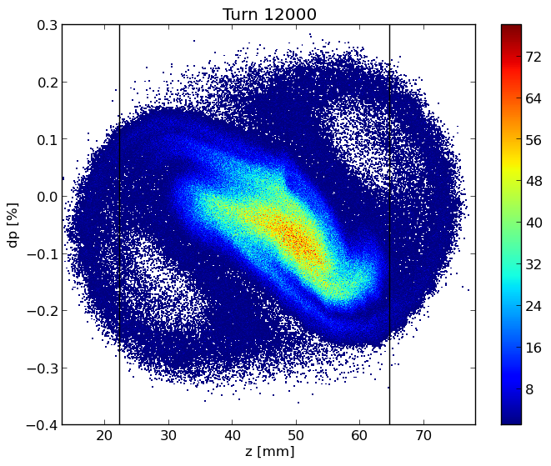

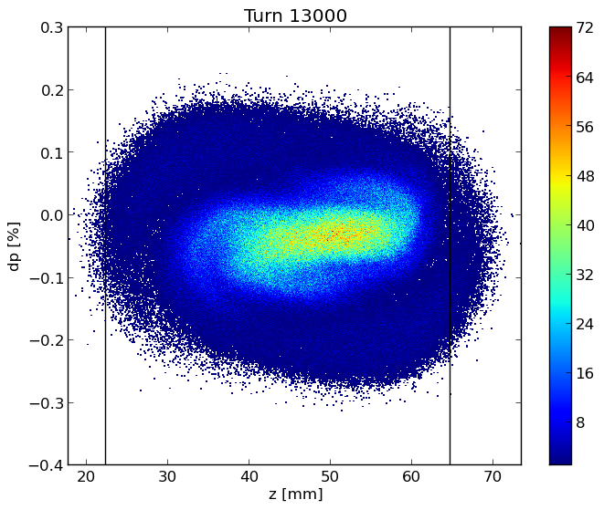
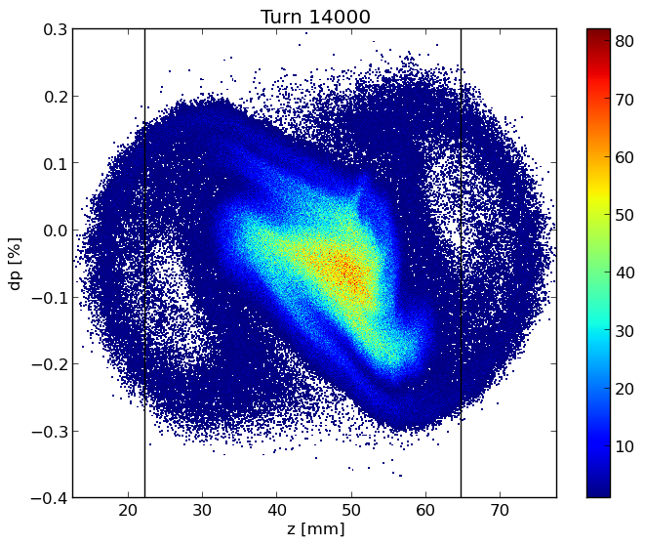
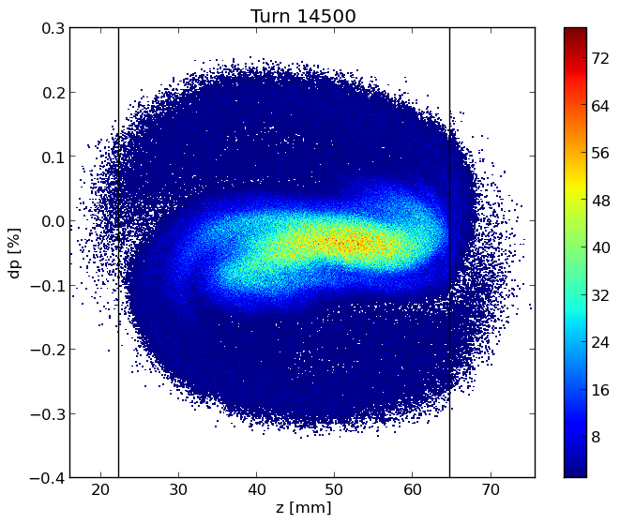
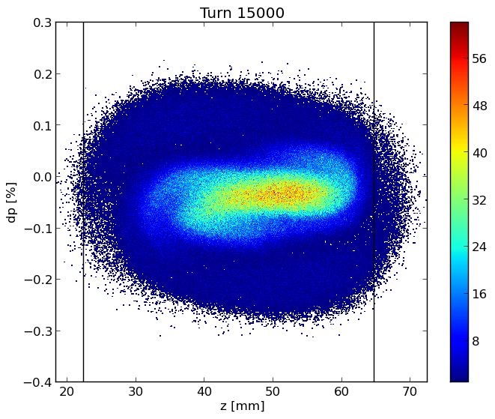
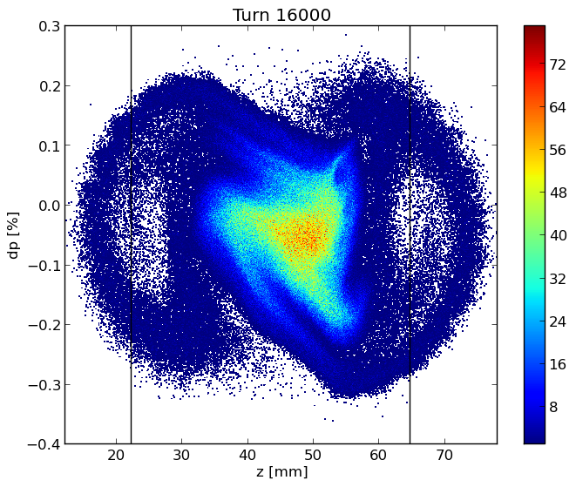
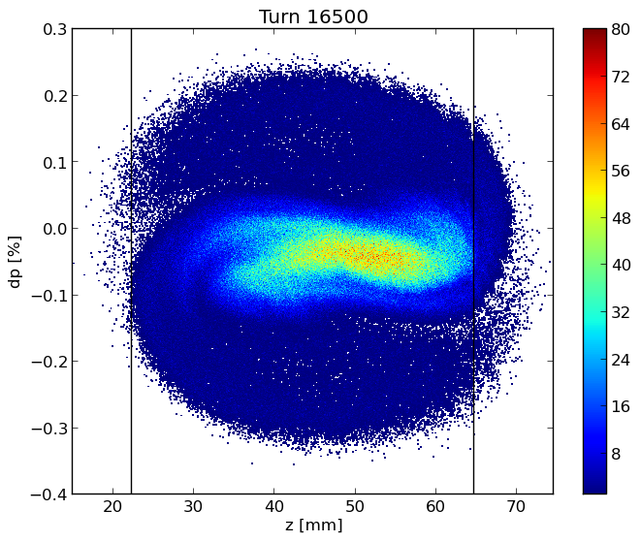

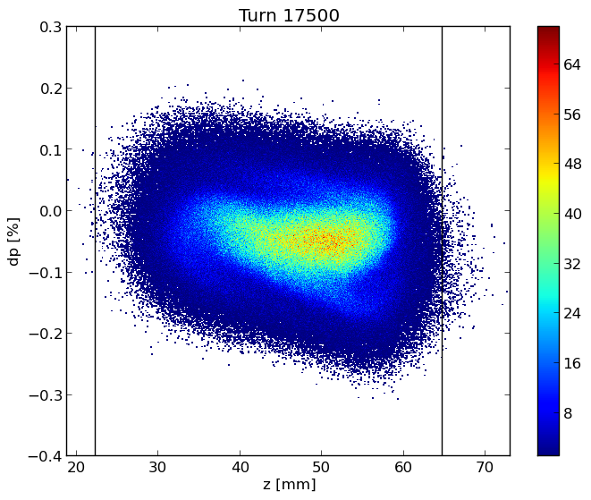
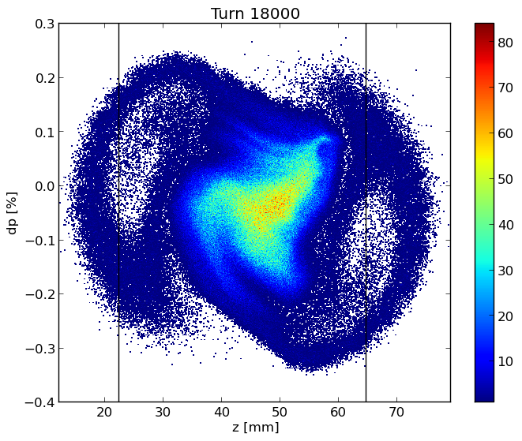
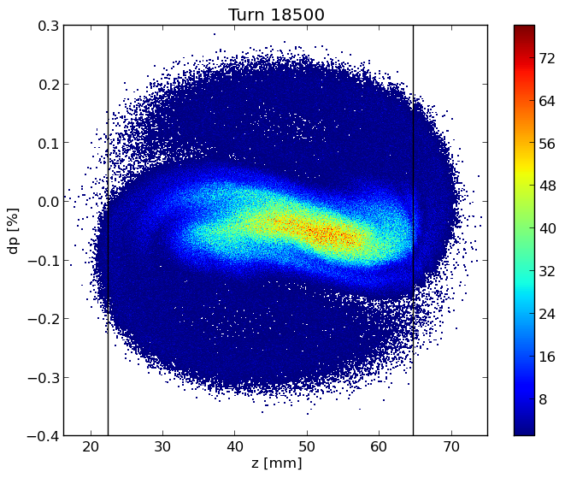
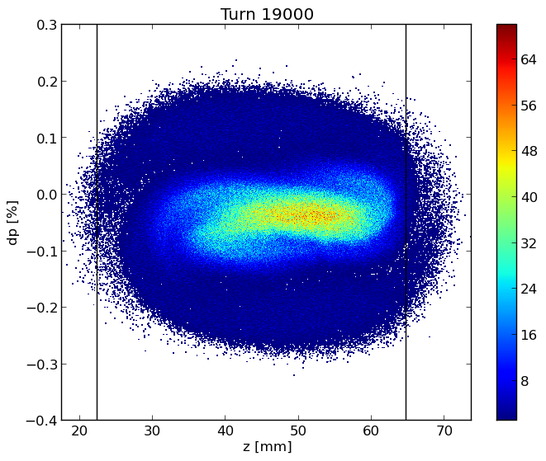
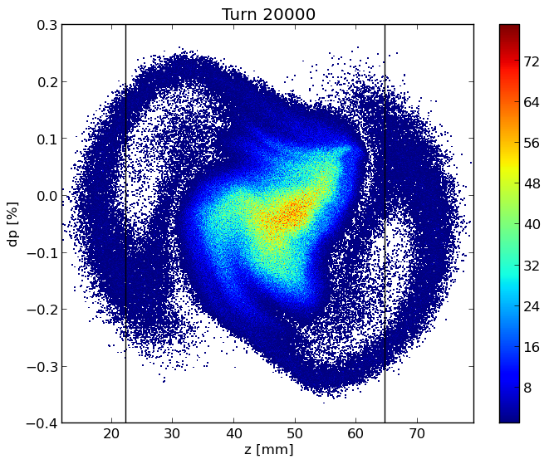
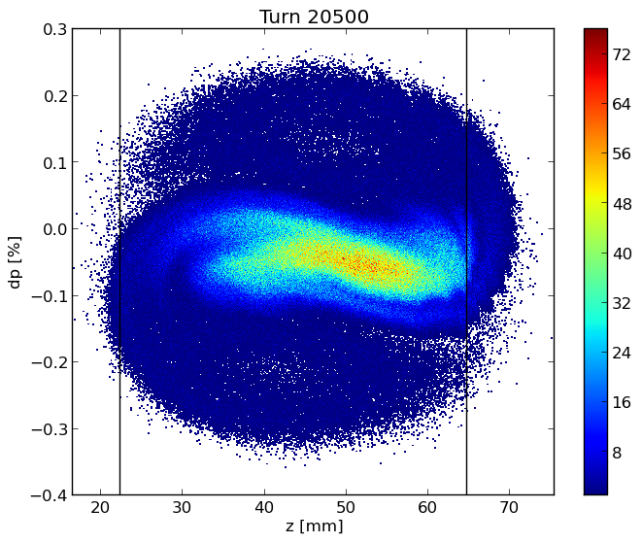
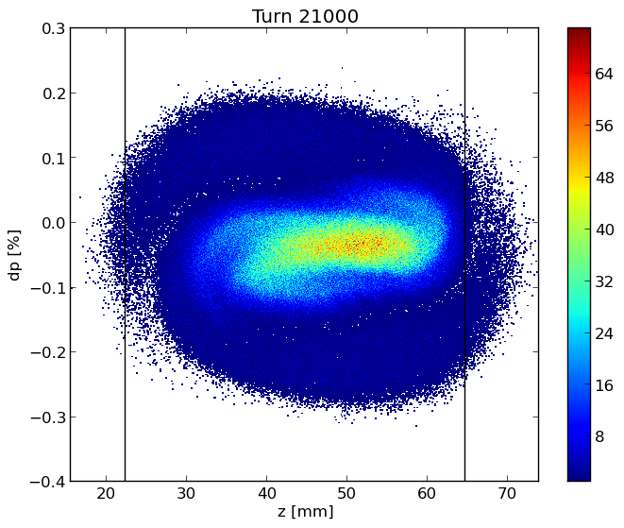
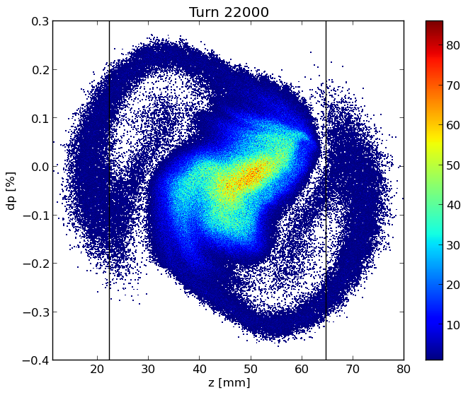
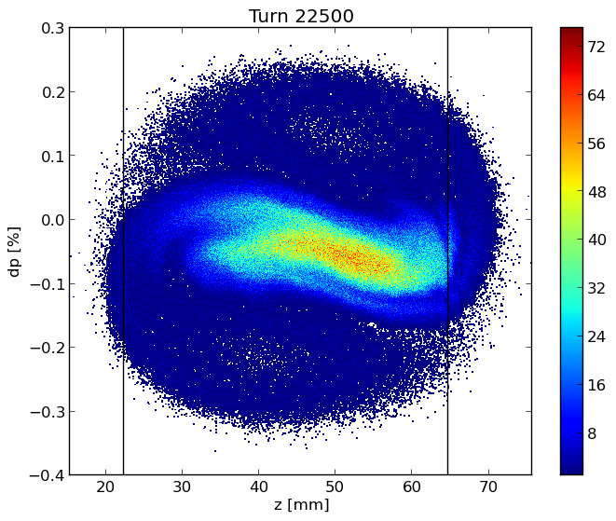
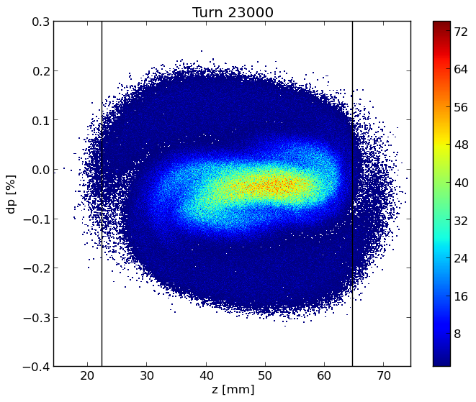
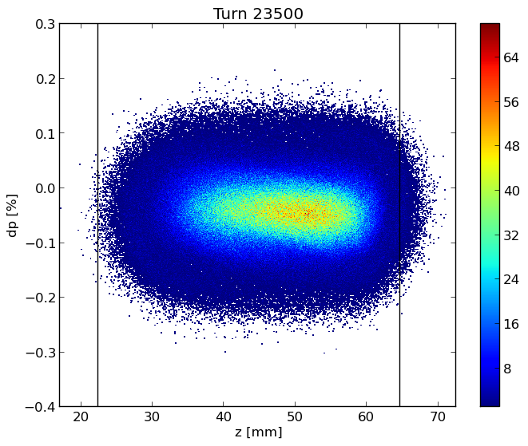
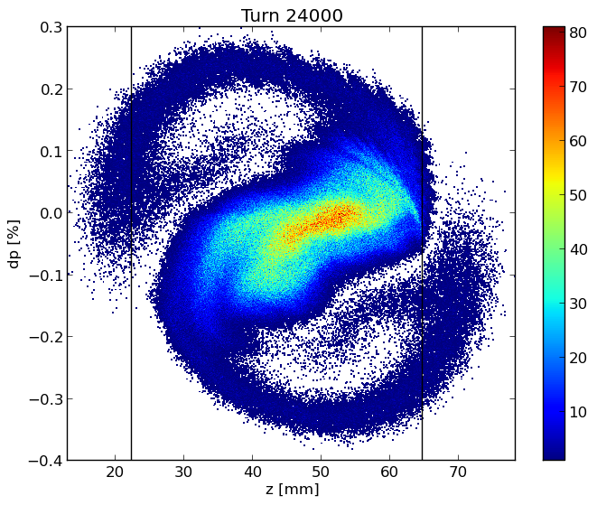













Longitudinal dynamics
Longitudinal phase
space
Bunch length (bottom) and RMS energy spread (top) as a function of bunch population in the case with (BS) and without (SR) beamstrahlung, which is considered here independent of the longitudinal impedance.
Bunch shape distortion at nominal intensity from the original Gaussian one.

Slide 14


Bunch length and energy spread for considered cases
The transverse impedance almost does not affect the longitudinal dynamics

Slide 15
Transverse Dynamics
The TMCI occurs when the frequencies of two neighbouring coherent oscillation modes merge together. Above the transverse instability threshold the bunch is lost and this makes the TMCI very dangerous for the beam.
In addition to simulations with the tracking code, the TMCI threshold has been also evaluated with the analytic Vlasov solver DELPHI
On the top, real part of the frequency shift of the first coherent oscillation modes as a function of the bunch population without beamstrahlung, by considering only the RW impedance produced by a NEG film with 100 nm thickness given by IW2D.
On the right, real part of the coherent tune shift as a function of intensity considering the longitudinal resistive wall wakefield, by using PyHEADTAIL.

Slide 16

TMCI
Without longitudinal resistive wall wakefield
Considering the longitudinal resistive wall wakefield

Slide 17
future plan
Continue the work for the evaluation, reduction and optimization of the impedances of the main machine elements (e. g. flanges, collimators), and also implementing the FCC-ee repository.
Update of some impedance sources (e. g. bellows, RW, RF tapers) with more realistic models (for now we neglected the perturbation introduced by the lateral winglets used to place synchrotron radiation absorbers)
Evaluate the transverse wakefields and impedances and perform PyHEADTAIL simulations in addition to RW
Study of countermeasures for the coupling between the beam-beam interaction and longitudinal impedance
Future investigations about the reduction of the TMCI threshold due to the longitudinal wake are required, as well as possible mitigation solutions.

Slide 18
Thanks for your attention!

Slide 19
Back-up Slides

Slide 20



The presence of the coating affects the RW impedance, making its contribution very critical
Resistive wall impedance of a two-layer tube with metallic layers
$$\frac{Z_{∥}(ω)}{C}=\frac{Z_{0}ω}{4πcb}\left\{\left[\operatorname{sgn}\left(ω\right)−i\right]δ_{2}−2iΔ\right\}$$
$$\frac{Z_{⊥}(ω)}{C}=\frac{Z_{0}ω}{2πb^{3}}\left\{\left[1−isgn\left(ω\right)\right]δ_{2}−2iΔ\operatorname{sgn}\left(ω\right)\right\}$$
E. Belli – ‘Coupling impedance and single beam collective effects for FCC-ee’
For FCC-ee at low energy, the RW impedance contribution can be reduced by decreasing the thickness of the coating
NEG thin films with 1$μm$, 200nm, 100nm, 50nm thicknesses

Slide 21



E. Belli – ‘Coupling impedance and single beam collective effects for FCC-ee’
$1μm$ thickness makes the bunch unstable
Thinner films allow to increase the MI threshold
For 100 nm film
  MI threshold increased by a factor 7 w.r.t. 1000 nm film and $≈$ 2x higher than nominal bunch population
  Bunch length $≈$ 40% larger than nominal value

Slide 22
Conclusions of the neg study
The lower is the thickness of the coating, the lower is its contribution to the (imaginary) longitudinal impedance with respect to pure copper.
Since a coating is needed, some measurements were performed at CERN to characterize NEG thin films, with the purpose of finding the minimum effective thickness satisfying vacuum and electron cloud requirements.
A NEG film thickness between 100 and 200 nm, is a good candidate for coating thickness. For the beam collective effects we use, as reference, 100 nm.

Slide 23


Updated FCc-ee impedance model
Longitudinal wake potentials of some machine elements evaluated so far for a Gaussian bunch with a nominal bunch length of 3.5 mm, considering 8000 bellows.

