Slide 1
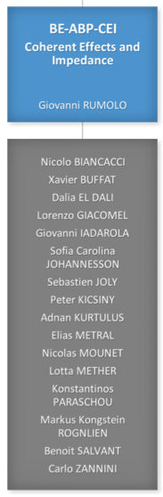
Coherent Effects and Impedances section (CEI) – general information
Giovanni Rumolo
CEI Section Meeting, 20/05/2020
https://indico.cern.ch/event/1007418/

Slide 2
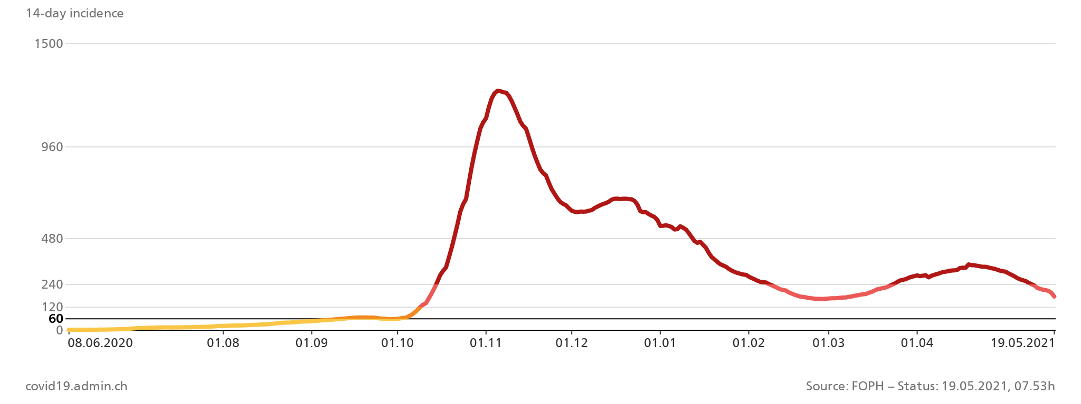
General information from department/group/section
Covid-19 general info (CERN Covid-19 info page)
  Current teleworking measures have been extended up to the 31 May 2021. Please keep your EDH leave status up to date.
  Most probably next step will be that we will be allowed to come on-site once per week
    People must still be alone in their offices
    It is very important that people who are sharing offices arrange CLEARLY with their office mates a schedule for the office occupancy. No exception to the single occupancy is granted!
  Problems with masks
    When receiving masks from Alessia, Richard or Yannis, you’ll be requested to open the box on the spot to check together the conformity
    Due to defects have recently observed in
    DEKOTURF brand type 1 surgical masks, you
    are asked to no longer use these masks and
    return your boxes.
  Covid caseload is still improving in the host
  countries and restrictions are being relaxed ☺
CH

Slide 3
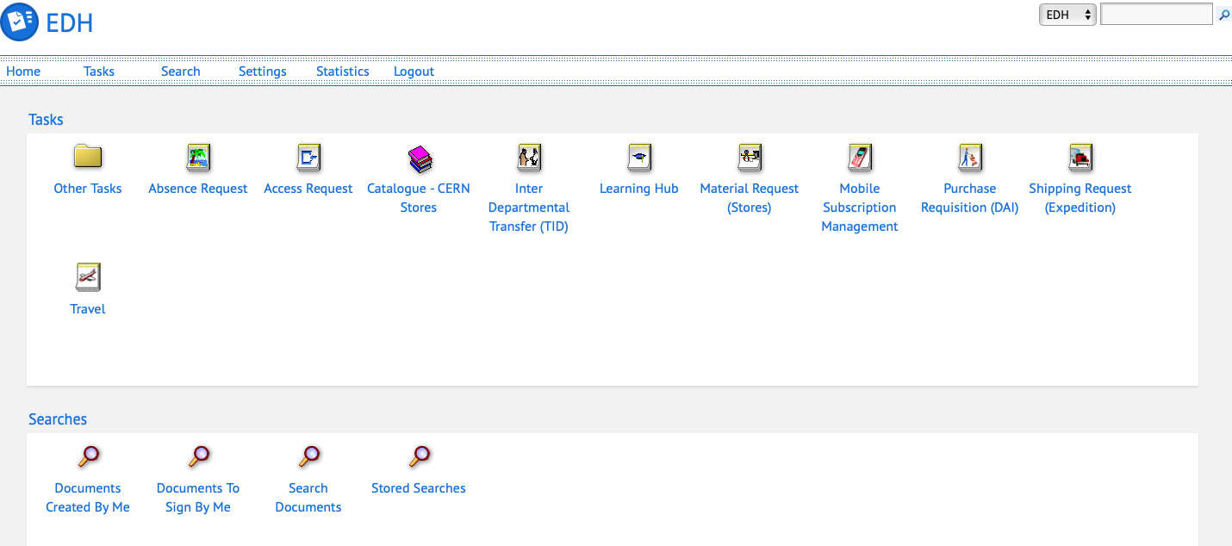
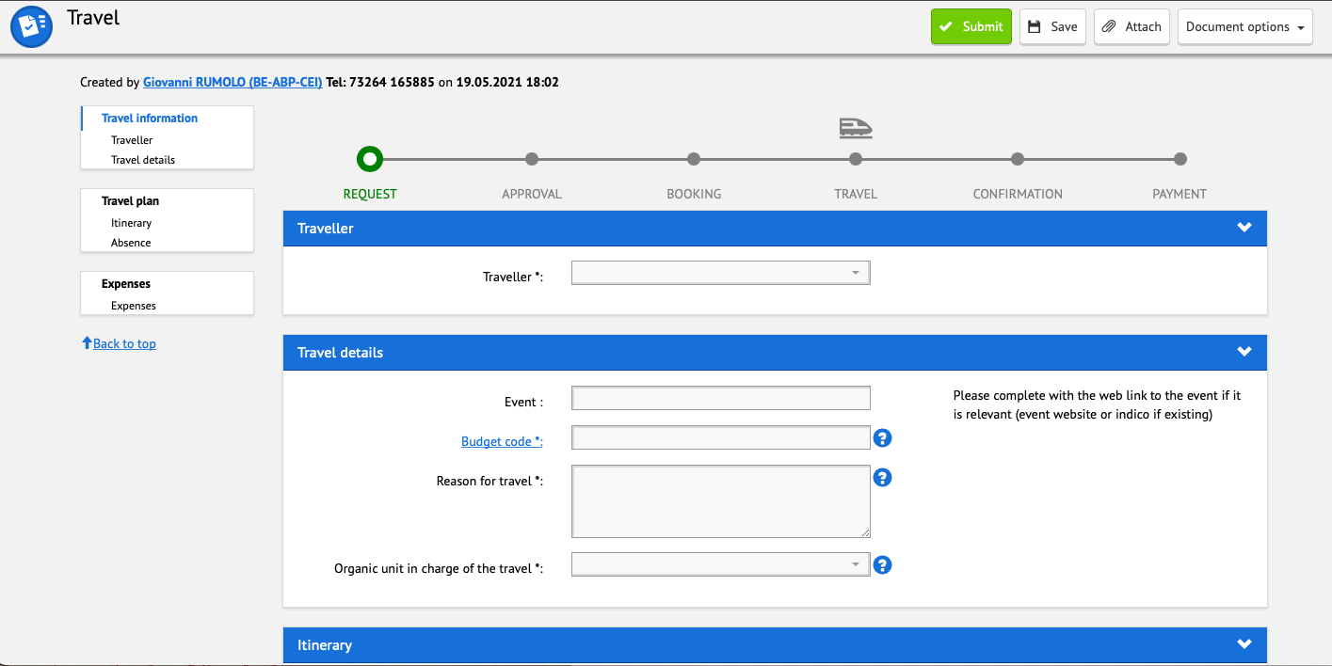
General information from department/group/section
New EDH form for travel
  It is called Travel and replaces the old official travel request form (TREQ)
  It also extends its functions, covering all the process from the travel request to booking (via Traveldoo tool), traveling and filing the reimbursement claim
  To be widely tested hopefully soon, as soon as official on a more regular basis can resume!

Slide 4
General information from department/group/section
News from LHC:
  Planning for the exchange of the B28L8 magnet has been discussed
    Warm-up of S78 started on 3 May
    Expected to take 10 weeks without contingency
  Extracted magnet comes from a high heat load half-cell, which was also instrumented with additional thermometers and flowmeters during LS2
    It will be interesting to analyse the beam screens and observe if their surface exhibits the same features as the one of the previously extracted from a high heat load magnet
  Impact on schedule being analysed by EN/ACE
    2021 pilot beam test might move forward by 2-3 weeks
    Implies reshuffling of ion beam tests in the SPS in order to ensure the availability of RF manpower
    Initial reaction from LHC experiments seems that this will also cause a bump forward by 2-3 weeks of the 2022 run start → however to be defined at the 7 June meeting between ATS management and experiments
  Decision on Run 3 energy will be taken after seeing the progress on the magnet training of all sectors (but 78)

Slide 5
General information from department/group/section
Beam commissioning in the injectors
We are here

Slide 6
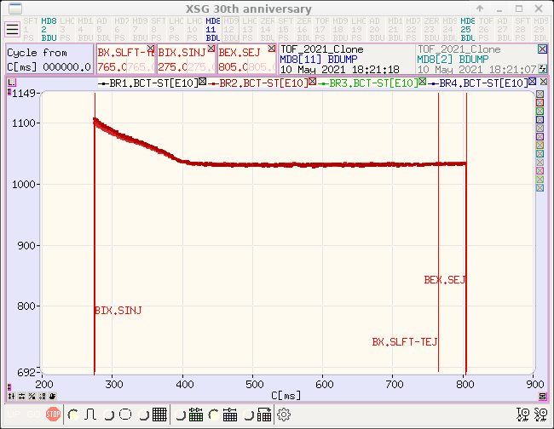
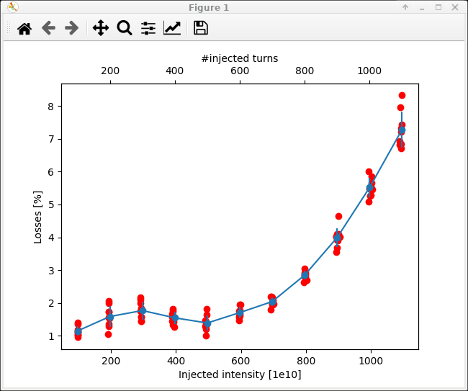
General information from department/group/section
Beam commissioning in the PSB
  nTOF beam was affected by a horizontal instability for N>500e10 p and close to 2 GeV
  Could be cured with linear coupling, now record intensity 1050e10 p extracted at 2 GeV!
Notes:
LCH

Slide 7
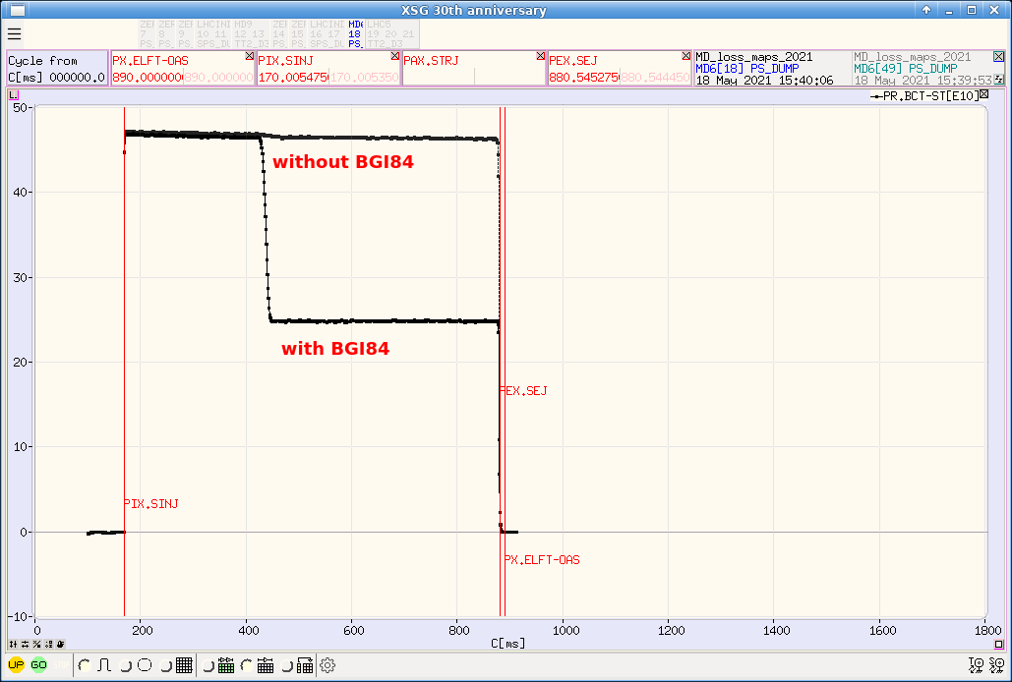
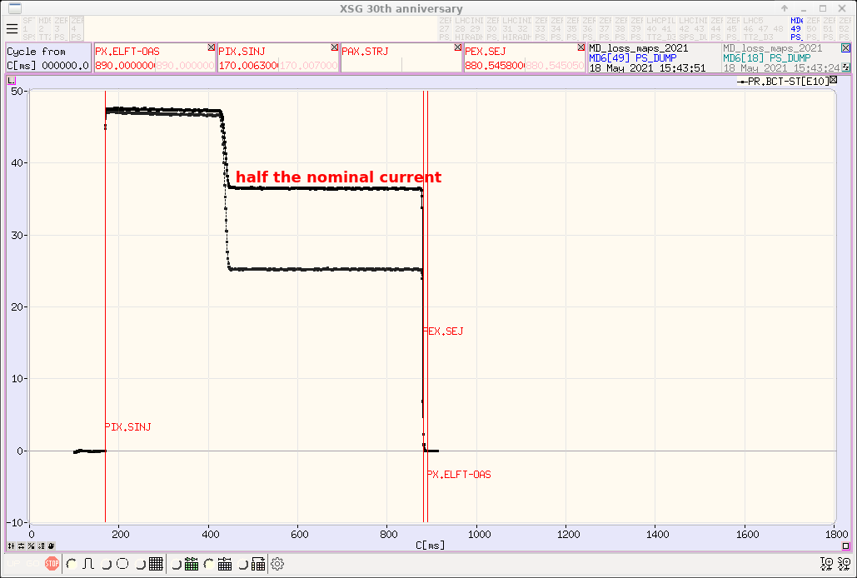
General information from department/group/section
Beam commissioning in the PS
  Found the origin of the skew sextupolar resonance that caused losses close to septum 42
  Introduced by the magnet of the BGI84, which was always on
  Great progress on set up of LHC and MTE beams
Notes:
LCH

Slide 8
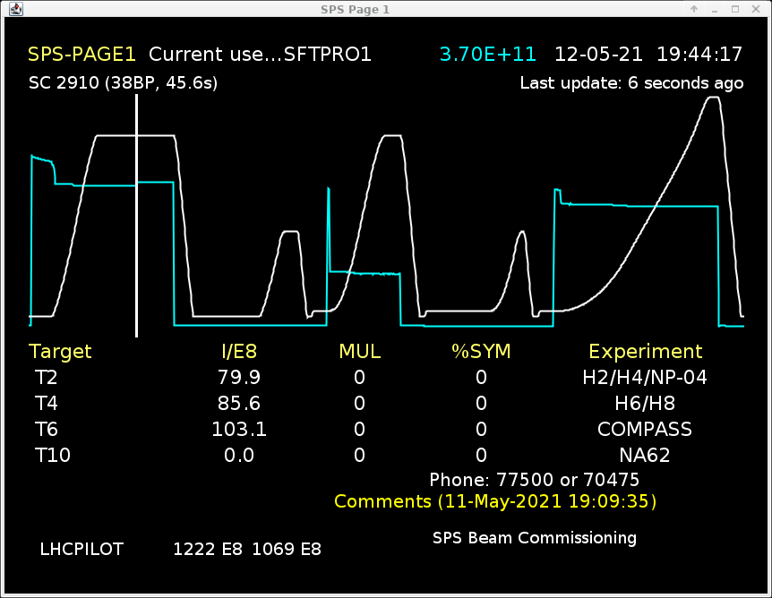
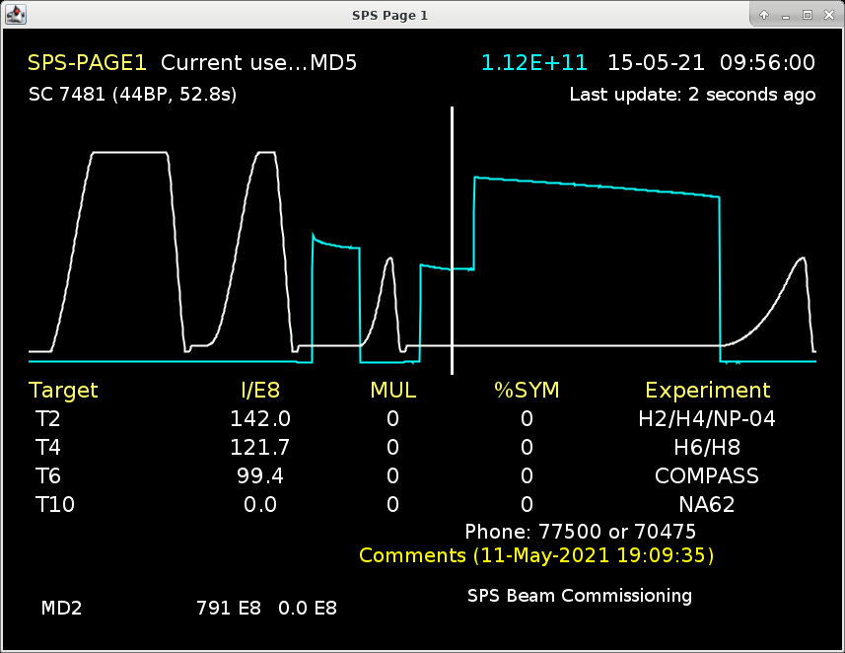
General information from department/group/section
Beam commissioning in the SPS
  Orbit correction
    Successfully crossed transition with fixed target beam (SFTPRO) – low intensity
    Orbit measurements at 450 GeV used to define needed quad shifts for orbit correction
    Calculated shifts implemented during long weekend and orbit corrected as expected
  Setting up long flat bottom cycle for scrubbing
Notes:
LCH

