Slide 1
I.FAST Collaborative Space
I.FAST Kick-off Meeting
Prof. Toms TORIMS / RTU & CERN

Slide 2
Information Flow Management and Cross-coordination
Collaborative Space (SharePoint) - to ensure overall cross-coordination and information flow of the project - Task 1.2
Web-based platform to easily access more deep-level project information - Task 1.2
A common archive repository, real-time communication tools and online workspace for documents - i.e. organisation of agendas, minutes and action lists, knowledge management etc. – Task 1.3
To avoid duplications of efforts

Slide 3
Objectives of the Collaborative Space
Well structured and safe – clear levels of the access to information
Entire project information accessible and up-to date and all in one place
Safe space for exchange of info and working documents
Easy to use and intuitive
Linked with Indico and I.FAST Web page, etc.
Inter-linked calendars for efficient event planning (to avoid overlaps)
The main responsibility is in the hands of Task Leaders
IT support is available

Slide 4
Project Management Team
Responsibility: overall management of the main I.FAST SharePoint site design, templates, layouts, mailing lists, interlinks, etc.
Access rights for WP Coordinators and Task Leaders
Creation of the e-groups (mailing lists)
Roles: responsible for the practical implementation and regular updates – content, documents, calendars and cross-links between WP sub-sites and Task sub-sites, of the relevance to all the project
Overall content, annual meetings, calendars, general documents which are applicable to all the Project, etc.

Slide 5
WP Coordinators and deputies
Rights: Full Control over the content – WP sub-site + all WP Tasks
Read access to all I.FAST SharePoint sites
Responsibility: overall content management of WP sub-site
N.B.! Non-disclosure of the information granted by privileged access to the all WP sub-sites and all Task sub-sites
Roles: practical implementation and regular updates – content, documents, descriptions, progress reports and calendars of the relevance to all the WP
WP sub-site content, WP meetings, WP calendars, WP general documents

Slide 6
Task Leaders and deputies
Rights: Full Control of the content - Task sub-site + administration of individual membership (access) in IFAST-Task-X-X-members@cern.ch
Read access to the Task sub-sites of relevant WP - can view pages and list items and download documents
Responsibility: independent management - content and members of Task sub-site
N.B.! Non-disclosure of the information granted by privileged access to the Task sub-sites of WP
Roles: practical implementation and regular updates – content, documents, descriptions, progress reports and calendars of the relevance to the Task
Granting access: https://e-groups.cern.ch/e-groups/EgroupsSearchForm.do

Slide 7
Task Members
Rights: Contributor access - can view, add, update, and delete list items and documents of the relevant Task sub-site
Read access to the main IFAST SharePoint site page - can view pages and list items and download documents
Access is granted by TL to Members of the relevant Task
Responsibility: Task Members can contribute to the Task

Slide 8
Stakeholders
Visitor access - View Only - can view all I.FAST SharePoint site and sub-site pages, list items, and documents
Document types with server-side file handlers can be viewed in the browser but not downloaded
Access is granted by PMT via e-mail group:
IFAST-GoverningBoardMembers@cern.ch
IFAST-ScientificContactBeneficiaries@cern.ch
IFAST-ScientificContactsPartners@cern.ch … etc.

Slide 9
Useful links
I.FAST Collaborative Space
Collaborative Space - rules of the game
9

Slide 11
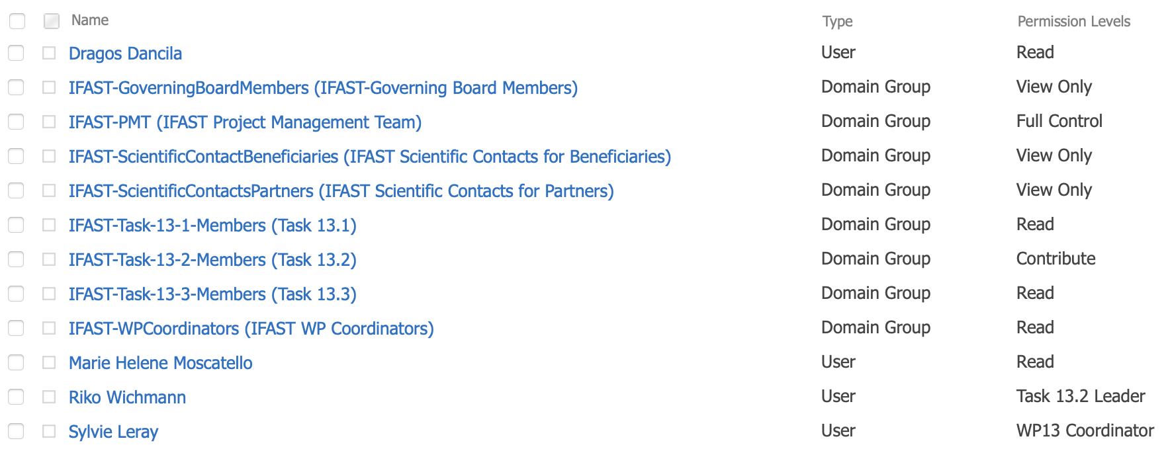
Permission levels – screen shot

