Slide 1







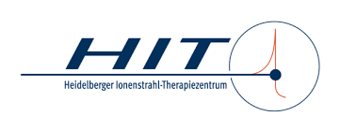

IFAST Prototyping Activity REX
Resonant EXtraction Improvement
Work Package 5 Task 3
Kick-off meeting / 4th of May 2021
Peter Forck and Rahul Singh, GSI
Consortium:

Slide 2
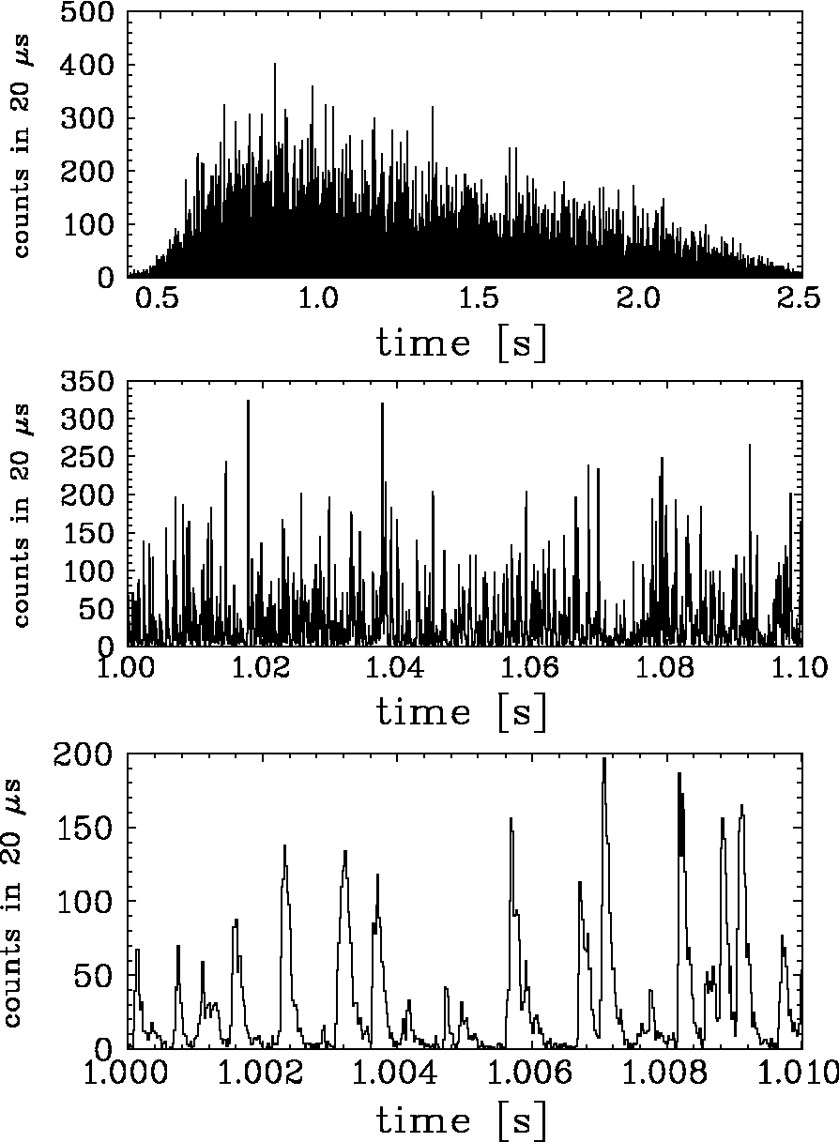

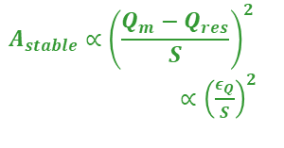
Challenges for slow Extraction form Synchrotrons
Slow extraction: Gentle excitation of a beam third order resonance
Beam physics: Extraction as ‘slow losses’ for 1 … 10 s
Particle crosses stability boarder sequentially
Exponential amplitude growth during ‘transit time’
≈ 50 … 1000 turns reaching septum and is extracted
Problem: Sensitivity to any unintended resonance condition, e.g.:
Change of tune: unintended quadrupole current ripple
Change of excitation strength: sextupole current ripple
Stochastic amplitude excitation of ‘knock-out’ extraction
Mitigation research within IFAST-REX:
Beam physics: Methods for beam sensitivity reduction
Proposal of non-standard excitation methods
⇒ Extensive simulation of extraction process
Technical installations: Improved power supplier for magnets
Improved transverse particle excitation for knock-out extraction
⇒ Non-standard power converter and rf-amplifier control
Validation: Experimental validation at all facilities
Tailored improvements for IFAST-REX participants
Example: C⁶⁺ at 300 MeV/u
Quad. scan, un-bunched beam
2 s extraction
called ‘spill’
Stored beam horizontal phase space at electrostatic septum
x’
shrinkage of $A_{stable}$
by tune scan
Q_{m} (t) → n ± 1/3
$ε_{Q}(t)$→ 0
ele.-stat. septum
thickness
$$A_{stable}∝{\left(\frac{Q_{m}−Q_{res}}{S}\right)}^{2}$$
$∝{\left(\frac{ε_{Q}}{S}\right)}^{2}$
extr.
channel
x
unintended quadrupole current ripple
⇒ tune ripple
⇒ bursts extracted
transit time T_{transit}
last spiral step x_{step}
after 3 turns
Sextupoles: non-linear fields
Ion’s amplitude growth per turn
⇔ T_{transit} & x_{step}

Slide 3
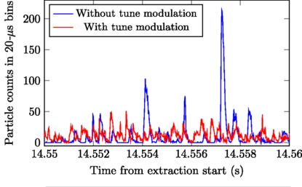
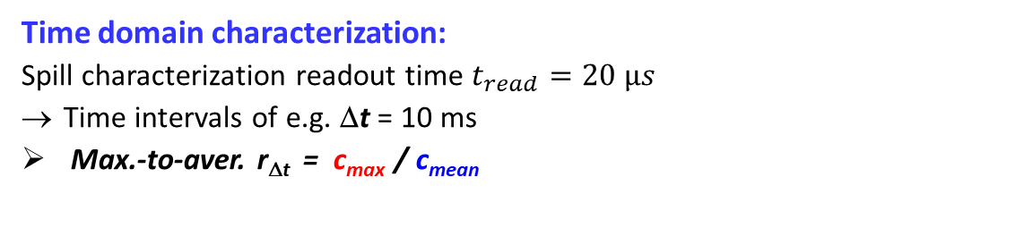
Example for ‘Spill Micro-Structure’ for a coasting Beam
Slow extraction: Gentle Excitation of a beam third order resonance
Beam physics: Extraction as ‘slow losses’ for 1 … 10 s
Particle crosses stability boarder sequentially
Exponential amplitude growth during ‘transit time’
≈ 50 … 1000 turns reaching septum and is extracted
Problem: Sensitivity to any disturbance of resonance condition
Example: C⁶⁺ at 300 MeV/u
Quad. scan, un-bunched beam
2 s extraction
called ‘spill’
Time domain characterization:
Spill characterization readout time $t_{read}=20 µs$
Time intervals of e.g. Δt = 10 ms
Max.-to-aver. r_{Δt} = c_{max} / c_{mean}
c_{mean} = 31 ⇔ r_{mean} = 1.6 ⋅10⁶ 1/s
100ms time window
Duty factor, i.e. normalized fluctuations $F_{∆t}≡ \frac{c_{mean}^{2}}{c_{mean}^{2}+ σ_{c}^{2}}≡\frac{{\left\langle c\right\rangle }^{2}}{\left\langle c^{2}\right\rangle }$
Improvement possible:
Low sextupole strength
Controlled tune variation
experimental & theoretical
demonstration
*
c_{mean} = 29
c_{max}=180
10 ms time window
10 ms time window
R. Singh et al., Phys. Rev. Applied 13,044076 (2020)

Slide 4
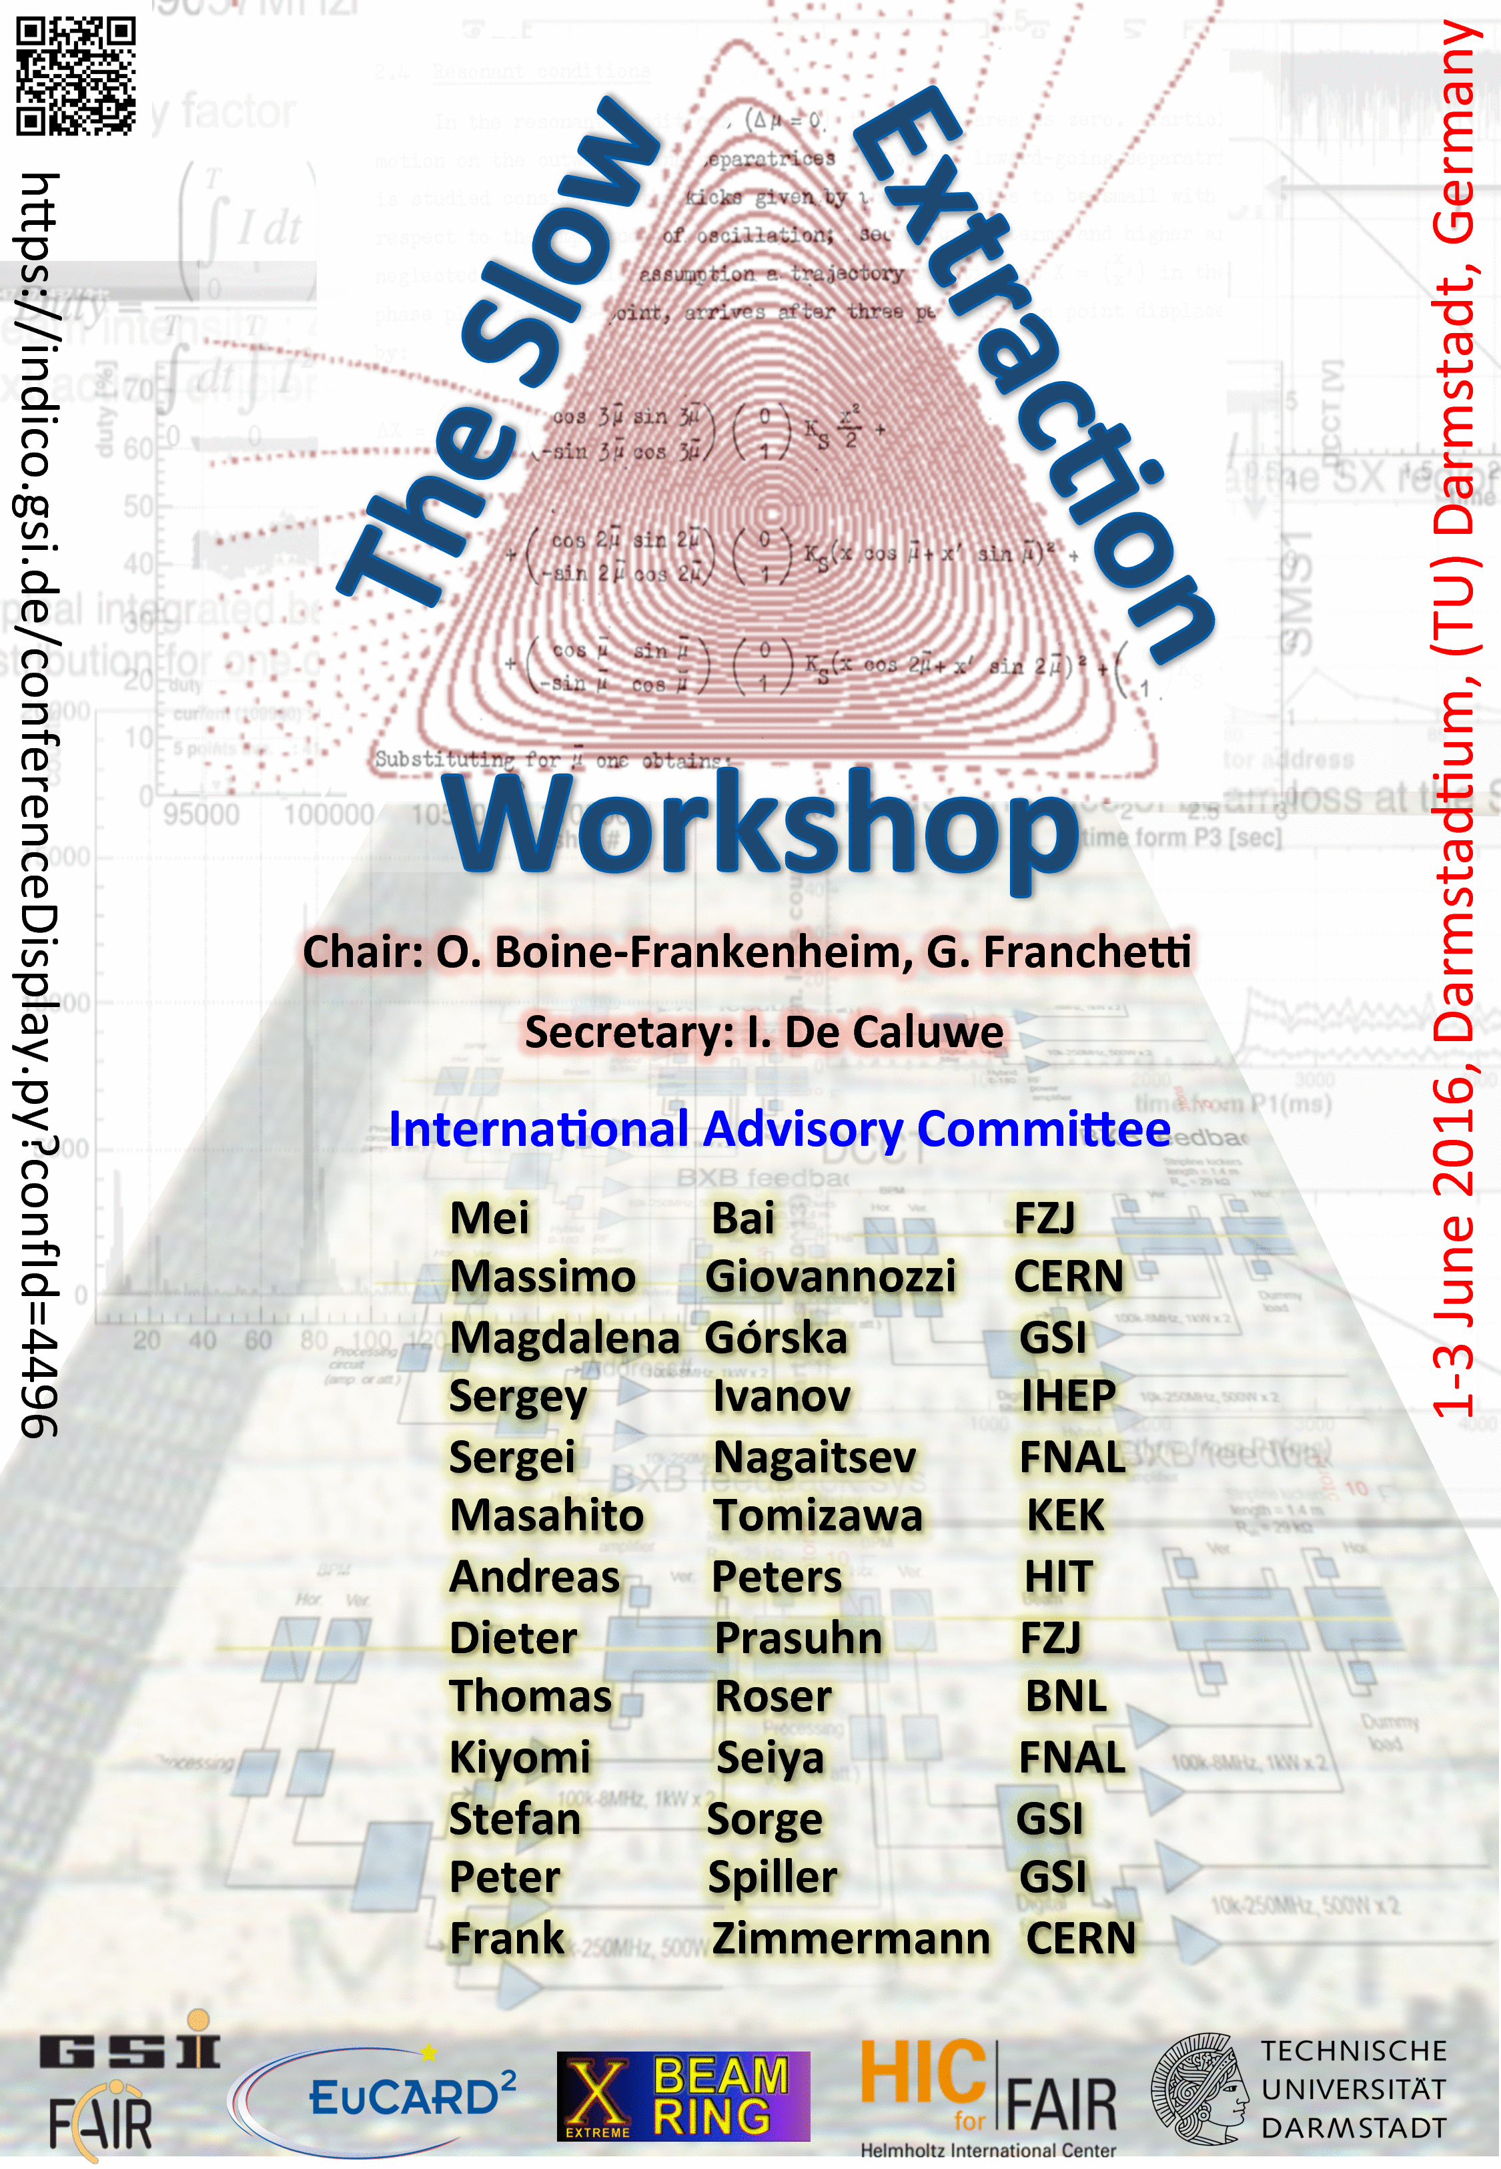
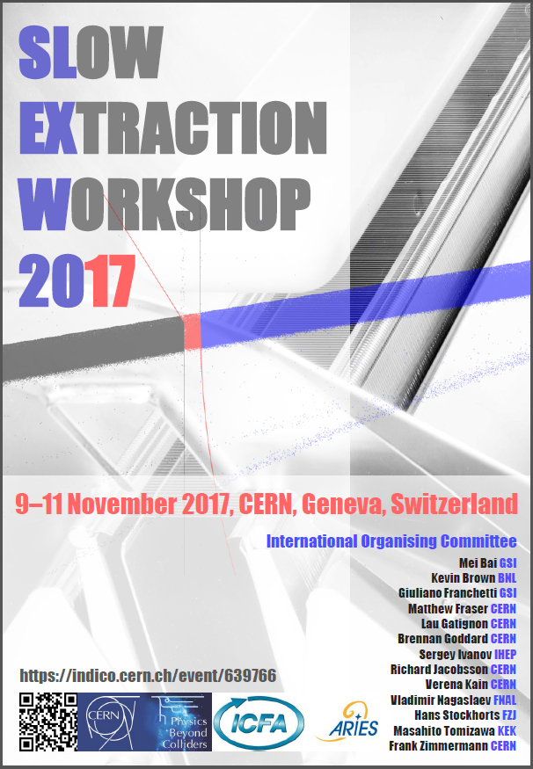
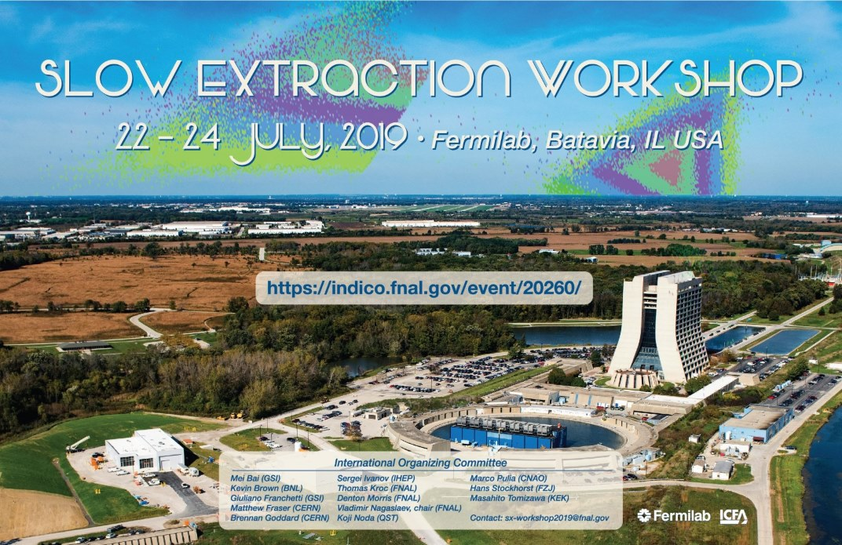
Requirements at different Synchrotrons focusing on ‘Spill Micro-Structure’
Slow extraction is used for fixed target users:
CERN & GSI: Uniformity of spill required for high count rate matched to detectors
CERN PS & SPS: Tune scan including optics correction via COSE (Constant Optics Slow Extraction)
GSI SIS18 & planned for SIS100: Tune scan & stochastic horizontal amplitude excitation, so-called ‘rf-knockout’
Hadron therapy facilities: Safety requirements of intensity monitoring
HIT & MIT: rf-knockout with bunched beams, air-core quadrupole for 50 Hz compensation, slow spill control
CNAO & MedAustron: Longi. acceleration by ‘betatron-core’, bucket channeling & rf-knockout, air-core quadrupole
⇒ Improvement of spill micro-structure for all facilities required and envisaged
Methodology:
Beam dynamics simulation: Detailed modeling of extraction process for all facilities
Technical improvements: Magnet power supplier and rf exciter control
Validation: Experimental validation at all facilities
Workshops 2016 to 2019
about 50 participants each,
EuCARD² & ARIES frame.
Follow-up planed in Japan
Further topics for slow extraction from user perspective:
Transverse beam stability at target
Handling of different horizontal and vertical emittance
High transmission for loss reduction at septum (within synchr.)
Varying beam parameter during extraction, ‘macro-spill control’
4

Slide 5
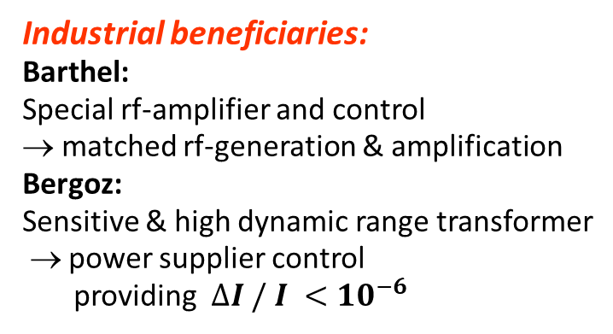
IFAST-REX Participants and Goals
Industrial beneficiaries:
Barthel:
Special rf-amplifier and control
→ matched rf-generation & amplification
Bergoz:
Sensitive & high dynamic range transformer
→ power supplier control
providing $∆I / I <{10}^{−6}$
Facility beneficiaries:
CERN:
- Detailed simulations
- Feedforward and feedback systems
- Accelerator physics description
GSI:
- Detailed simulations
- Accelerator physics description
- Versatile fast detector system
HIT:
- rf-control development
- Power supplier development
Associated partners:
CNAO:
- Methodology for extraction
- Test of different extraction types
MedAustron:
- Test of different extraction types
- Power supplier development
MIT:
- ‘air-coil’ quadrupole
SEEIIST:
- Presently observer
All facilities:
- Contribution to development
- Experimental verification
Beneficiaries of improvement
Proposals for facilities (USA, Japan, China)
5

Slide 6
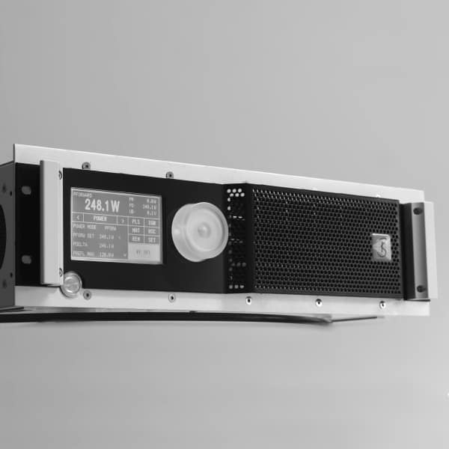
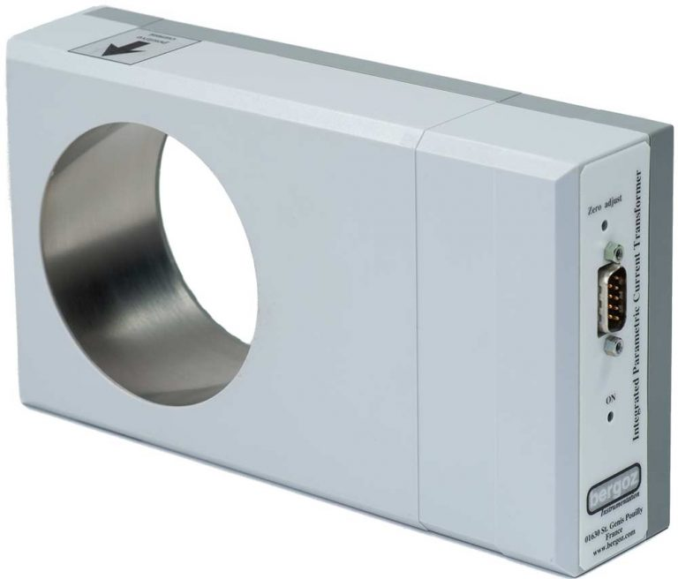
IFAST-REX Kick-off Meeting 8th and 9th Feb. 2021
Remote kick-off meeting at 8th & 9th February, 1.5 days:
INDICO: https://indico.gsi.de/event/11868/
40 participants from all consortium members,
Participants per institution: Barthel:1, Bergoz: 2, CERN: 6, CNAO: 4, GSI: 12, HIT: 5, MedAustron: 6, MIT: 2, SEEIIST: 2
Discussed topic:
Introduction of involved people and institutions
Overview on each facility requirements → understanding of different realizations
Achievements and ideas for spill quality → condensed information on present status
Used beam dynamics simulation tools → overview on methodology for improvements
Status of technical developments & plans → first plans for innovative technical realizations
Technical status form companies → roadmap for technical realization
Barthel: Rf-amplifier
Bergoz:
transformer
CERN SPS: Measure
CNAO: air-coil quad.
GSI: MAD-X simulation
HIT: Signal generation of knock-out
MedAustron & CERN: COSE test
MIT: Macro-spill control
SEEIIST:
SC-synchr. proposal
6

Slide 7
Working Groups and first Steps
Working groups formation:
Specifications for development and integration of high dynamic range current measurement device
Specification and contribution for knock-out signal generation, exciter and amplifier design
Slow extraction simulations
Fast particle detector development and measurement analysis
Most working groups have members from all facilities; industry partners in 1 and 2, respectively.
Frist Steps:
Compilation of important slow extraction parameters by Florian Kühteubl, MedAustron
⇒ Comparison of parameters at facilities
⇒ Possible ‘scaling’ of parameter for comprehensive comparison of different beam parameter (e.g. beam energy)
Roadmap for theoretical investigations, e.g. simplified model synchrotron
First ideas for performant detector development
Design specifications for technical developments
⇒ Start-up of working groups to form a lively consortium
Milestone and deliverable:
MS20 report (M24): Engineering design of improved power supply current meas. and rf-amplifier layout, April 2023
D5.3 demonstrator & report (M46): Ripple mitigation for slow extraction beam quality improvement, February 2025
7

Slide 8
Thank you for your attention

Slide 9
IFAST-REX Participants and Tasks
Consortium:
Financial support by EU of Beneficiaries and Associated Partners:
Beneficiaries:
Associated
Partners:
Associated
Partners’ budget:
Request: 70 k€
Overhead: -17.5 k€
included in GSI budget:
Ass. Part: 70 k€
GSI direct: +120 k€
Administrative documents: Grand agreement, consortium agreement
& contract GSI ↔ Associated Partners will be produced & signed
9

Slide 10
IFAST-REX Working Group members
1) Development and integration of high dynamic
range current measurement device:
CERN: Diogo Alves, Marek Gasior
CNAO: ---
GSI: Rahul Singh, Andrzej Stafiniak
HIT: Eike Feldmeier
MedAustron: Claus Schmitzer
MIT: ?
SEEIIST: Mariusz Sapinski
Bergoz: Frank Stulle
2) Specification and contribution for KO signal generation,
exciter and amplifier design:
CERN: Paolo Sota
CNAO: Marco Pullia, Luciano Falbo, Paolo Meliga, Al.Mereghetti
GSI: Rahul Singh
HIT: Eike Feldmeier
MedAustron: Claus Schmitzer, Florian Kühteubl, Dale Prokopovich
MIT: ?
SEEIIST: Elena Benedetto
Barthel: Matthias Barthel
3) Slow extraction simulations:
CERN: Verena Kain, Matthew Fraser, Francesca Velotti
CNAO: Marco Pullia, Luciano Falbo, Paolo Meliga, Al Mereghetti
GSI: Peter Forck, Stefan Sorge
HIT: ---
MedAustron: Florian Kühteubl, Alexander Wastl, Dale Prokopovich
MIT: ?
SEEIIST: Rebecca Tayor
4) Spill detector development and analysis:
CERN: Federico Roncarolo (maybe Matthew Fraser)
CNAO: Marco Pullia, Luciano Falbo, Paolo Meliga, A. Mereghetti
GSI: Peter Forck, Plamen Boutachkov
HIT: Andreas Peters
MedAustron: Dale Prokopovich
MIT: ?
SEEIIST: Mariusz Sapinski

