Slide 1
WP8 – Innovative Superconducting Magnets
I.FAST kick off meeting – 4 May 2021 - remote
Lucio Rossi – INFN-Milano –LASA for WP8 collaboration members

Slide 2
WP8 Listing (only part of Magnets)
INFN-LASA
Gabriele.Ceruti@mail.polimi.it

Slide 3
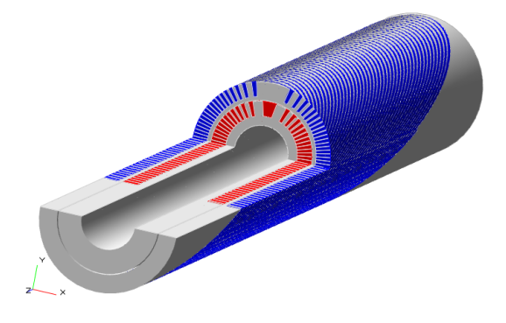

WP8 duration: from M1 to M48 !!
Scope of our WP8 (Magnet part)
Here we want to develop technologies supporting the EU Industry that wish to learn about the CCT developed by CERN.
We aim at something useful for advanced HatronTherapy (SEEIIST)
→ 1 HTS CCT preceeded by 1 NbTi of same dimension as “gauge”
  2 HTS CCT ideal: need additional effort for budget (HTS tapes -> CERN)
Straight!, since we consider that HTS is already difficult enough!
Baseline
Dream
CCT dipole
4 T operative
5 T target; Ø =60-90 mm;
500mm < L < 1000 mm

Slide 4
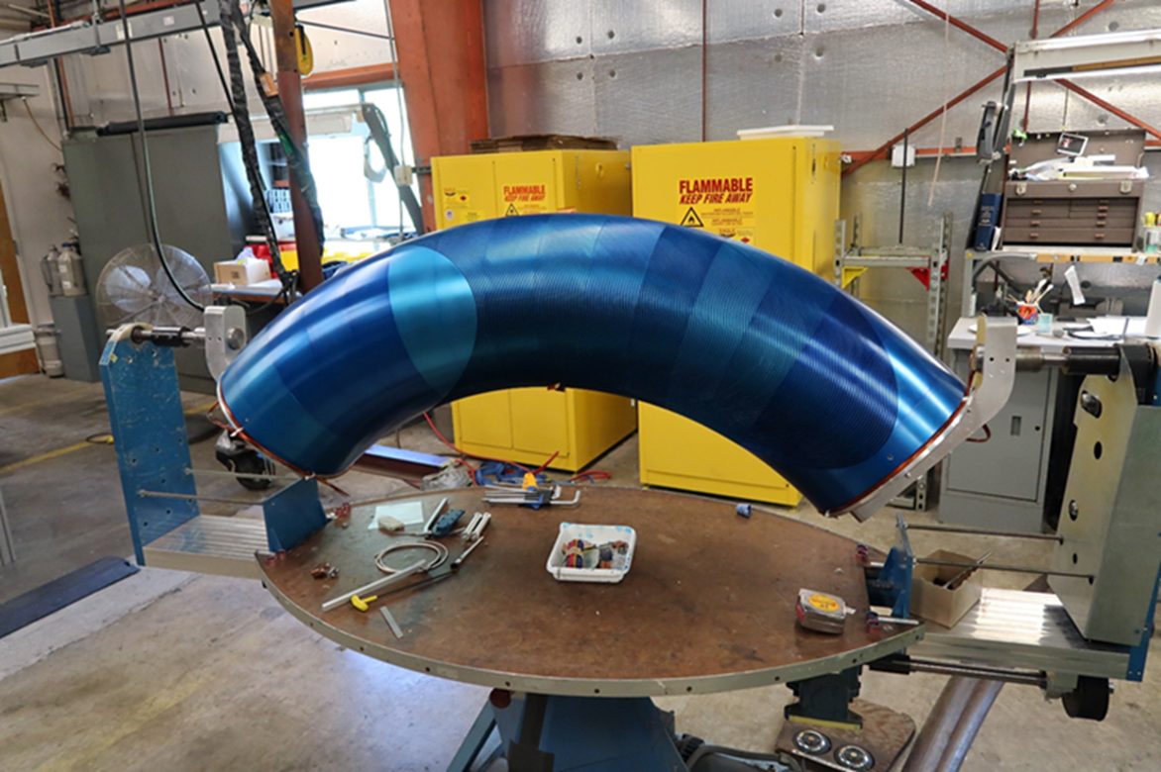
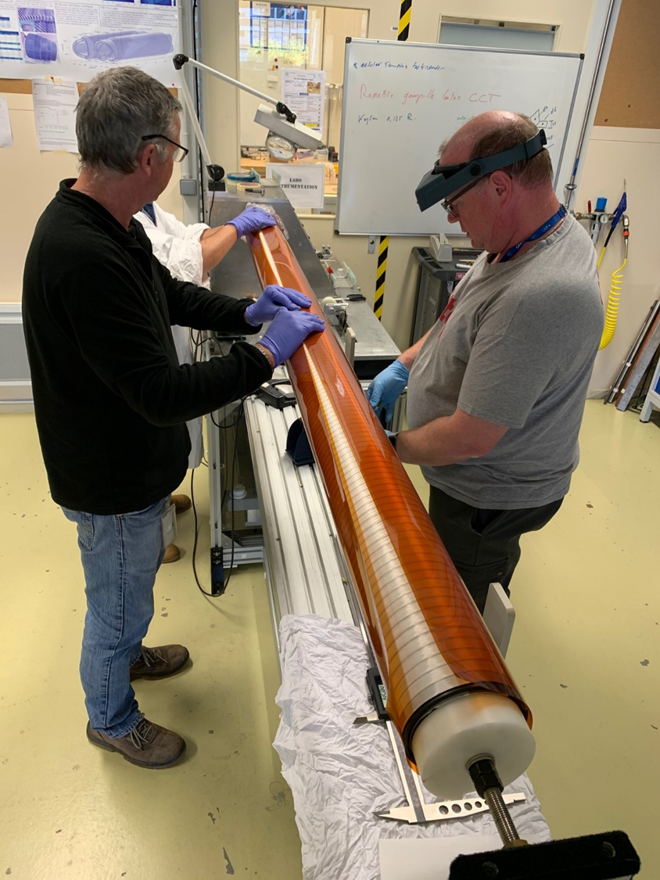
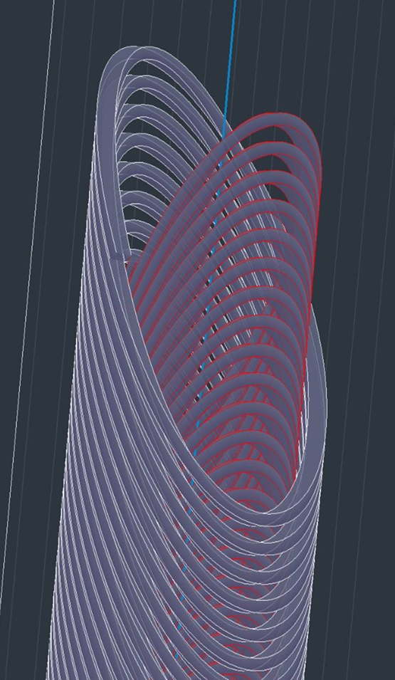
Nb-Ti CCT: p-gantry and HiLumi LHC
LBNL: CCT coil prototype for large acceptance proton gantry ∅ = 400 mm: Successfully tested to 3.5 T; segmented former.
HiLumi LHC: CERN has designed, built and tested a dual 3 T, 2 m long - ∅ = 105 mm, straight CCT. Now IHEP Beijing producing 2x13 units
Short circuit at 3.5T!!
Proto 2m 2.9 T 105 mm very successful at CERN. However, learning and transfer not easy (China…, SE)…

Slide 5
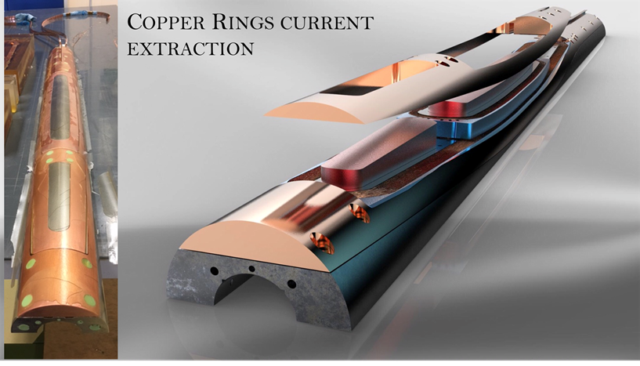
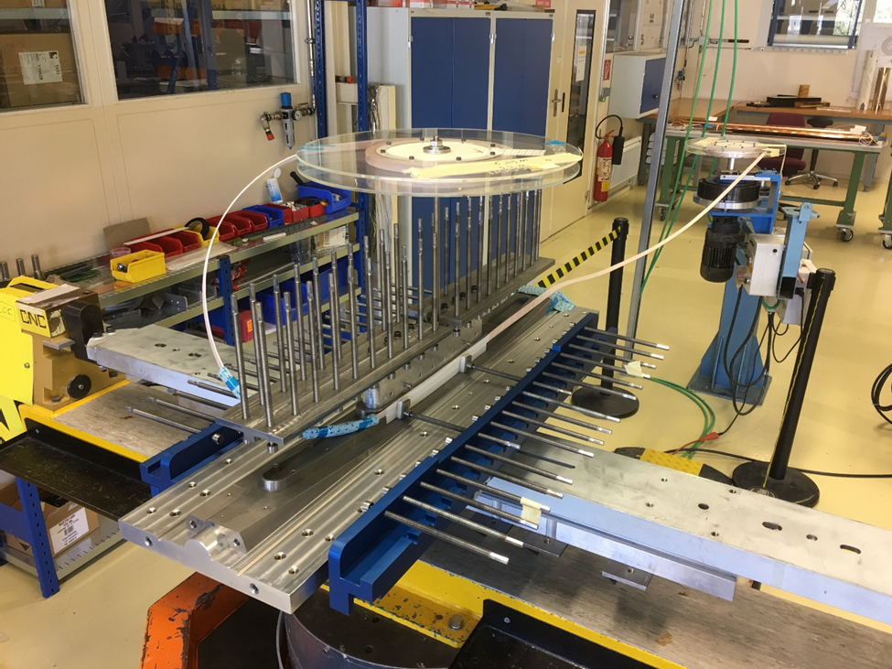

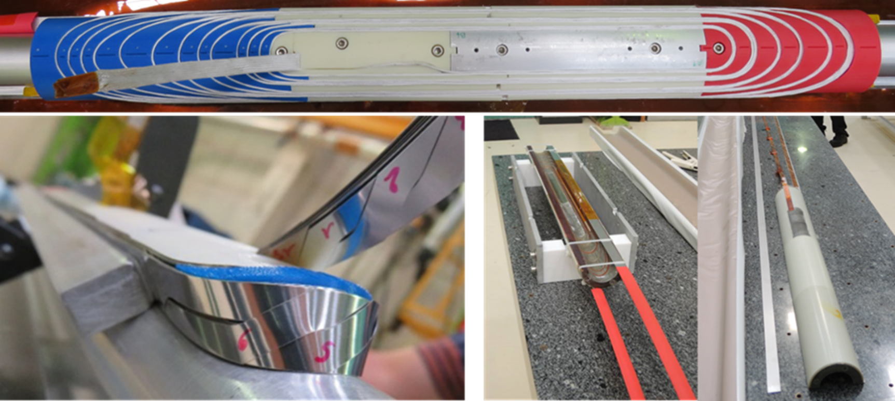


We build on HTS in Eucard2 – ARIES programs
Courtesy of Glyn Kirby

Slide 6
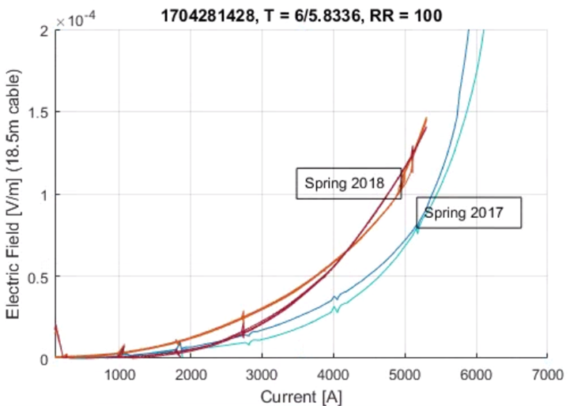
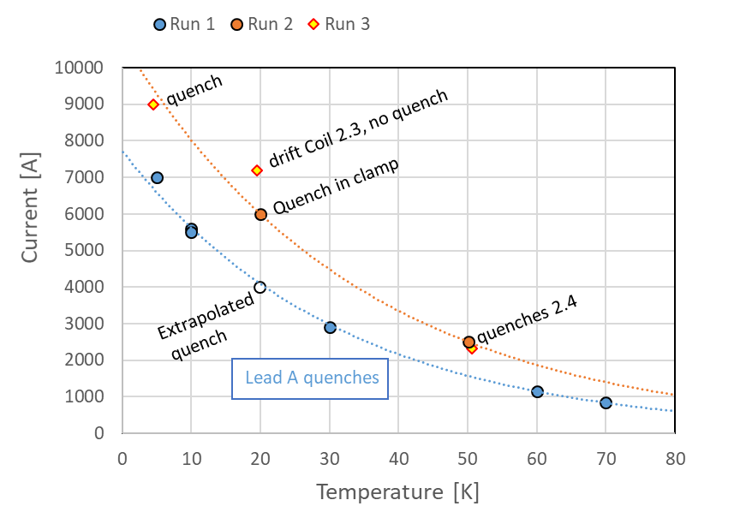
Degradation due to the cycle? Cold down also a little suspicious. But happened other times
G. Willering, CERN
FeatherM2_1-2
3.1 T in ss - 3.5 T in overshooting mode
FeatherM2_3-4
(Eucard2 cable) 4.5 T (expected > 5 T)

Slide 7
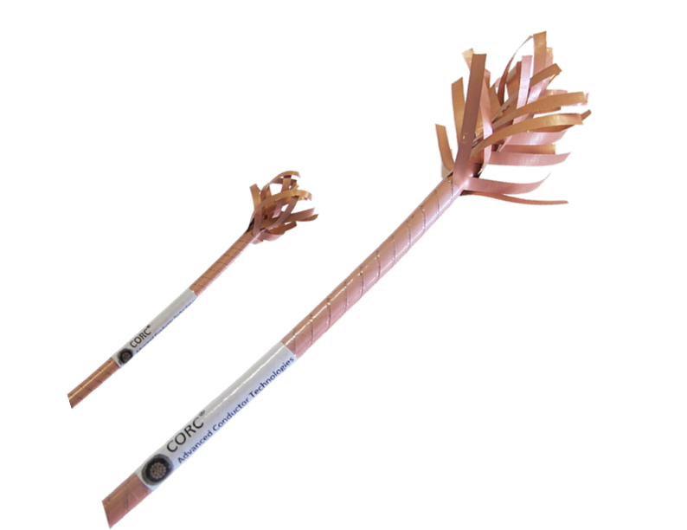

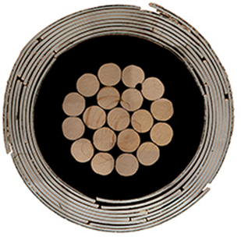

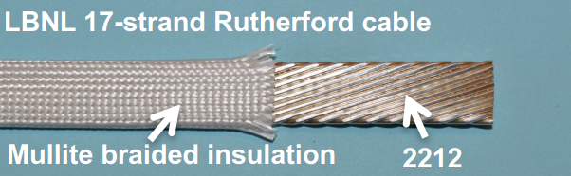
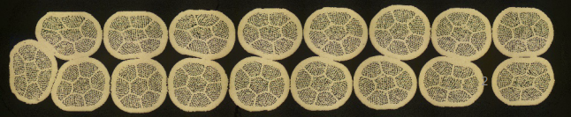
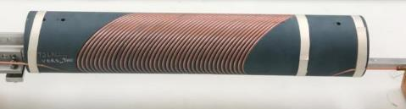
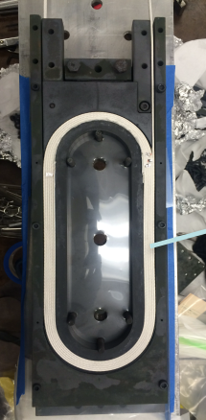

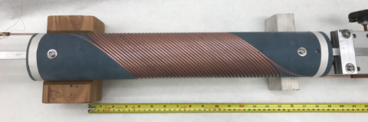
LBNL effort on HTS accelerator magnets
Program based on CORC and CCT layout led by X. Wang & S. Prestemon
Program on use of Bi-2212 Rutherford cable with race track and CCT layout
led by T. Shen and S. Prestremon
By Advanced Conductor
Technologies
Outer layer
Courtesy of Xiaorong Wang
Inner layer
Courtesy of Tengming Shen

Slide 8
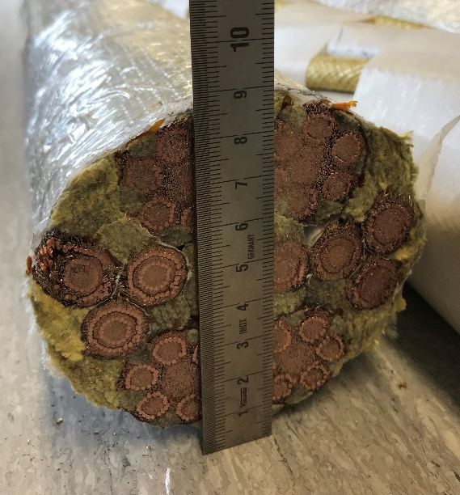
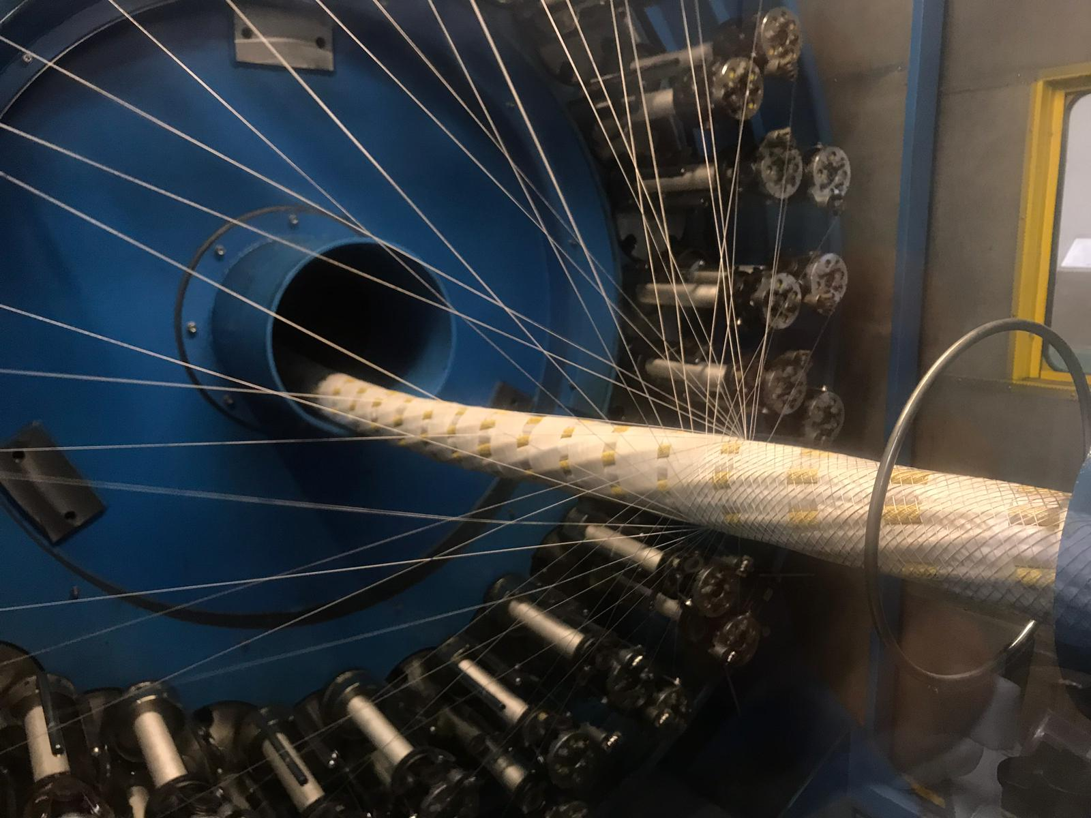
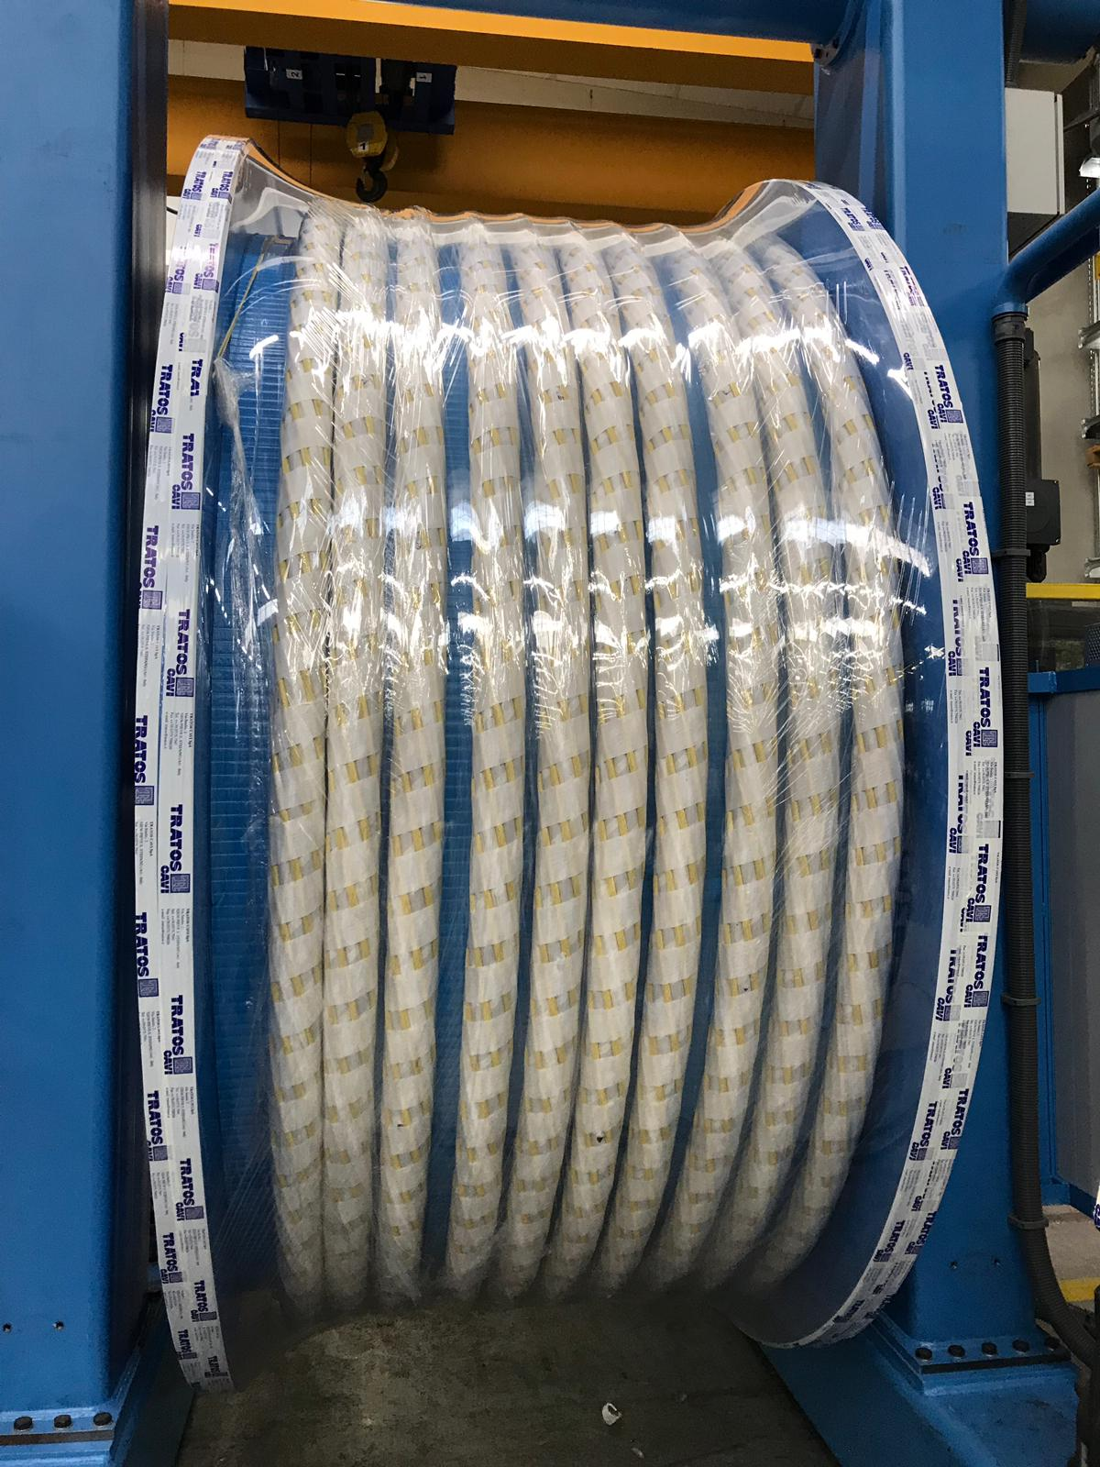
MgB₂, instead? It maybe convenient for 3 T
MgB₂ cable from HiLumi LHC – WP6 – Courtesy A. Ballarino - CERN
Maybe using MgB₂ instead of the first NbTi…
If we can afford the conductor - depending on CERN mainly and on Ic degradation vs curvature radius, we can get some field (3T) with MgB₂?
Alternative : explore low losses Nb₃Sn, like the one for ITER, as possible alternative to Nb-Ti. Probably it works but is also expensive… Depending also on our Industry partner.

Slide 9
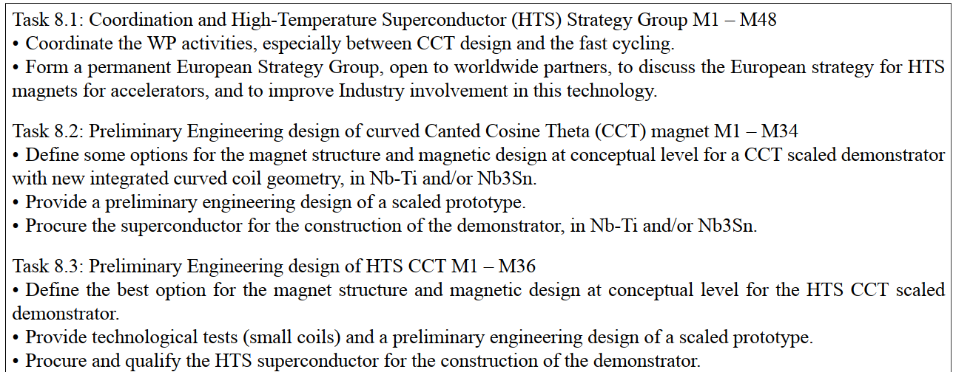
Program in short

Slide 10
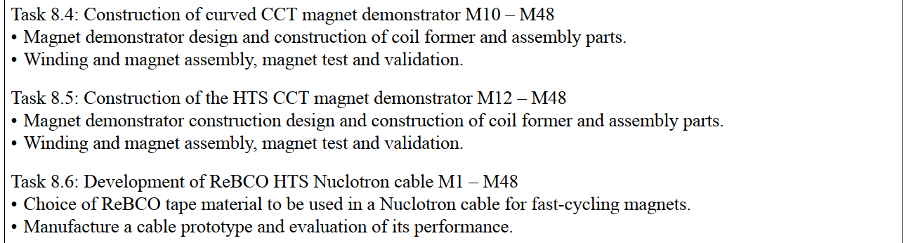
Program in short – cont.
See next talk by Timeo Winkler

Slide 11
Timeline
Task 8.1
Task 8.2
Task 8.3
Task 8.4
Task 8.5
Task 8.6

Slide 12
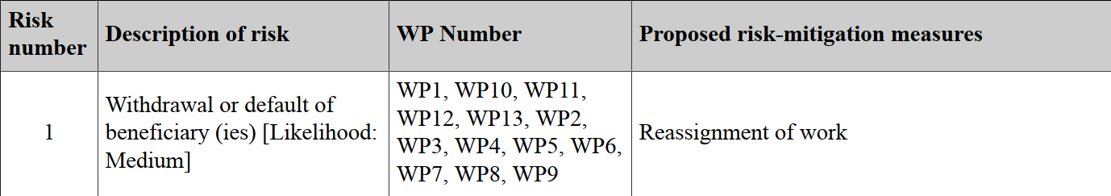
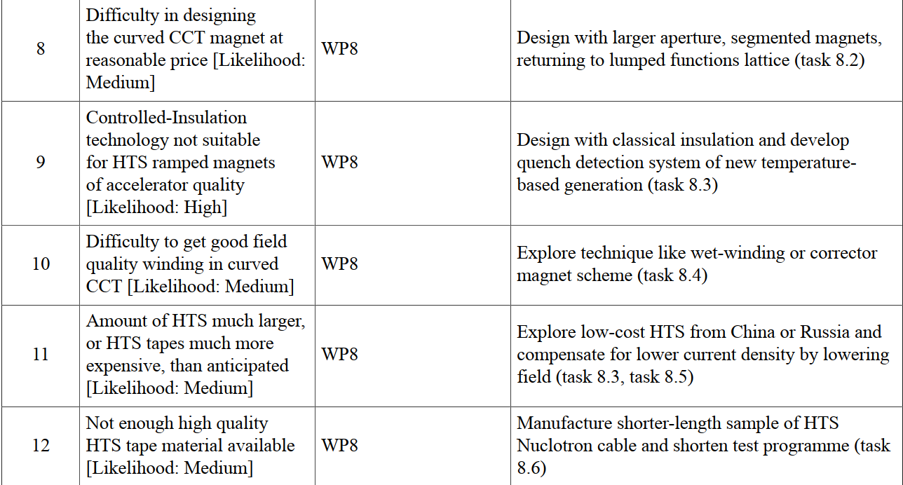
WP8 Risk & Mitigation Actions
See next talk by Timeo Winkler

Slide 13









I.FAST WP8 Innovative SC Magnet.
Budget for the program.
17.5 94,300 121,200 215,500
22.5 89,900 115,600 205,500
CERN is Project Coordinator
INFN is the WP8 – Magnet Coordinator (CEA is the deputy) START: 1 May 2021

Slide 14
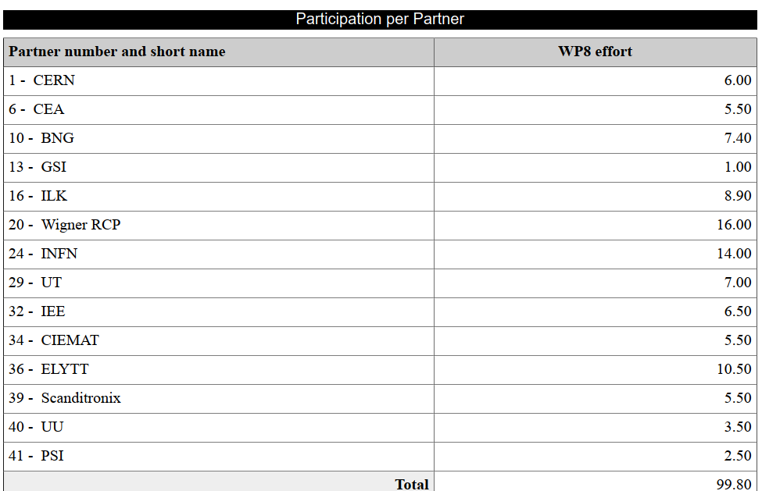
The amount of personnel paid by EC must be complemented by the matching resources by Institutes.
We MUST MEET Deliverables!!

Slide 15







HITR+ WP8 (Magnet Design) and I.FAST WP8 (Innovative Magnets) will work closely together …
&

Slide 16
Thanks!
(reserve slides follow)

Slide 17
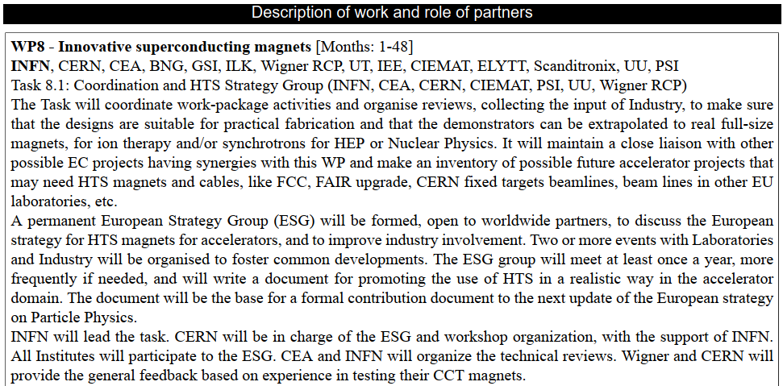

Slide 18
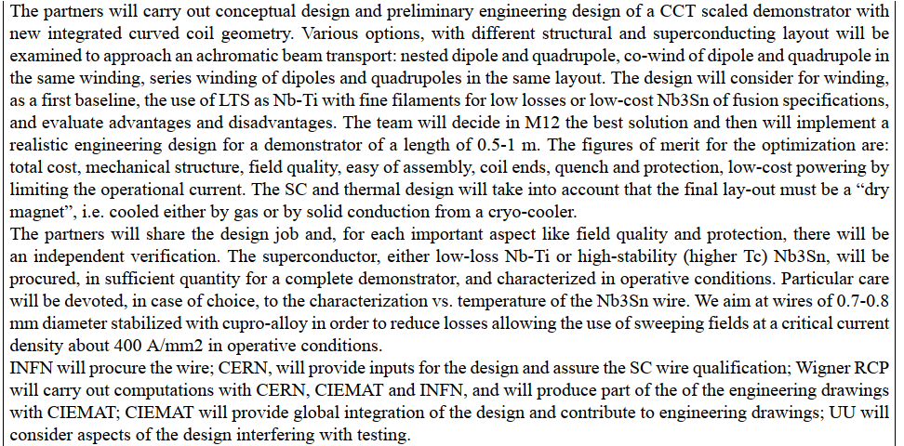

Slide 19
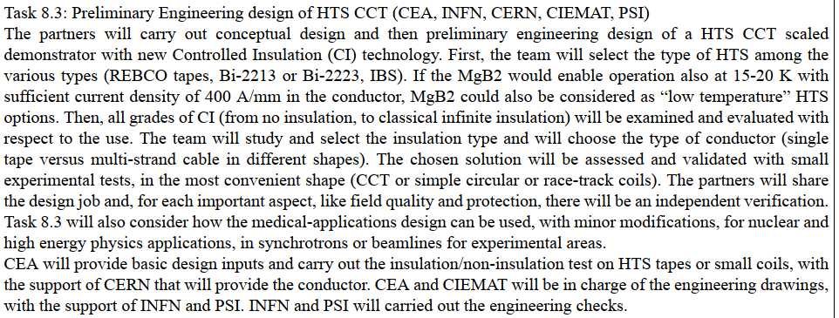

Slide 20
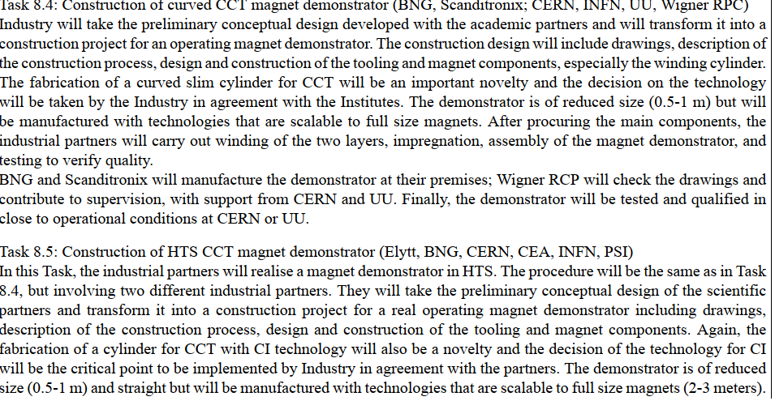
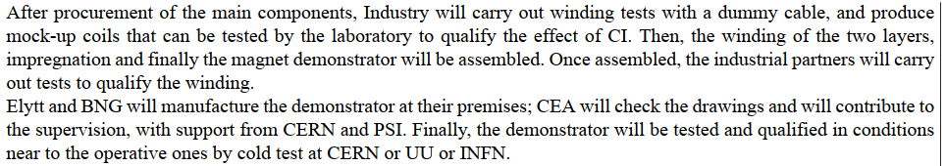

Slide 21
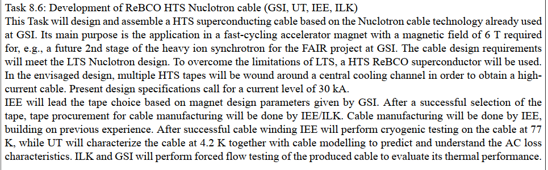
Last task led by GSI – see next talk!

