Slide 1
IFAST WP11.3
Permanent Magnet Quadrupoles & Combined Function Magnets for Ultra Low-Emittance Rings
IFAST kick-off meeting
Ben Shepherd, STFC Daresbury Laboratory

Slide 2



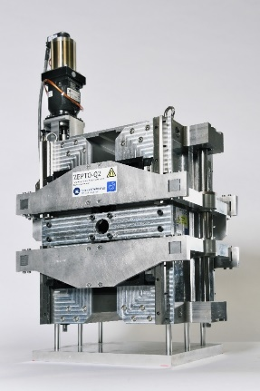
Task description
Shepherd, IPAC2020 MOVIR05
Task 11.3: Permanent Magnet Quadrupoles & Combined Function Magnets for Ultra Low-Emittance Rings
  Partners: UKRI – Diamond Light Source – Kyma
This task addresses the need for reducing the electricity consumption and carbon footprint in future storage rings
Two prototypes to be designed, assembled and tested: (D11.3)
  PM-based strong focusing quadrupole magnet
  PM-based combined function dipole-quadrupole (DQ) magnet
Parameters similar to Diamond-II and other facilities
Second-stage prototypes
  Basic concept already tested
  Examine requirements for cost-effective series production
Adjustment using either coils or motors
UKRI’s ZEPTO tunable PM quadrupole
Diamond combined function DQ magnet

Slide 3
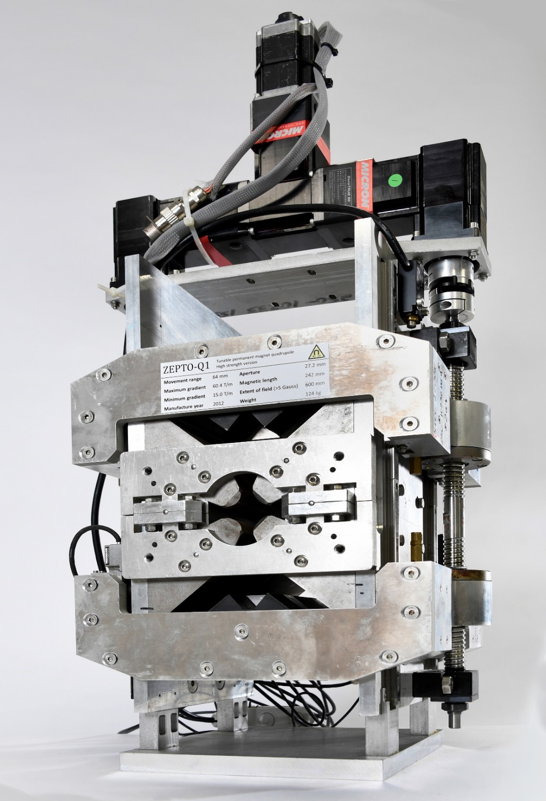
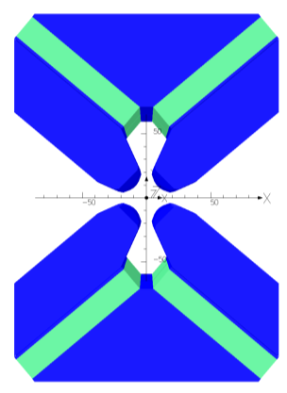
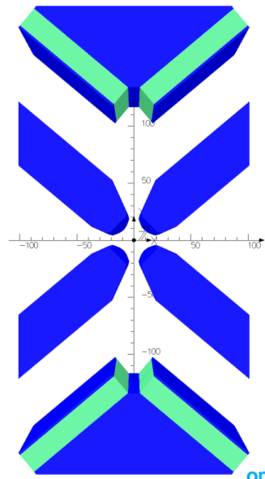
ZEPTO Q1: High Strength
Shepherd et al, IEEE Trans Appl SC, vol. 22, no. 3, p4004204 (2012)
Shepherd et al, IPAC2013 THPME043
ZEPTO “Zero-Power Tunable Optics”
High gradient: 60 T/m
  Can reduce to 15 T/m by moving PMs up to 64 mm
  Tuning using variable gap in magnetic circuit
Magnetic force: 16.4 kN per side
  Pulling PMs parallel to magnetic axis → large forces
Some unwanted magnetic centre movement
(100 µm) due to ferromagnetic rails
4 NdFeB blocks, each 18 x 100 x 230 mm
Gradient 15-60 T/m
Pole gap 27.2 mm
Field quality ±0.1%
over 23 mm
Length 230 mm
Max gradient
Min gradient
Fixed poles =
fixed field quality

Slide 4
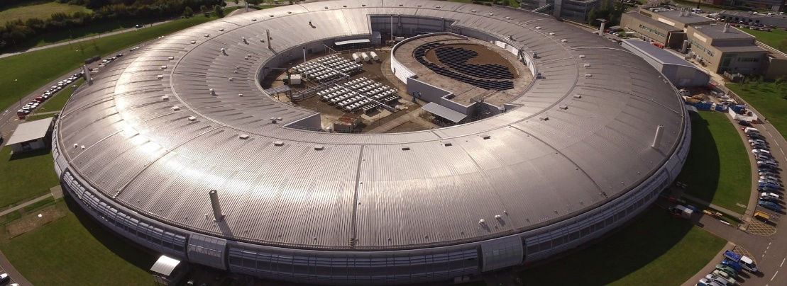

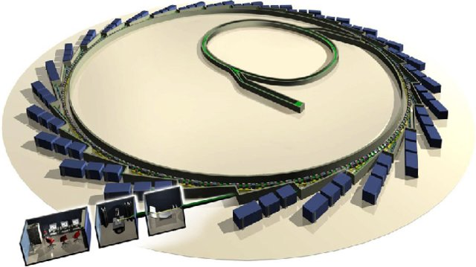
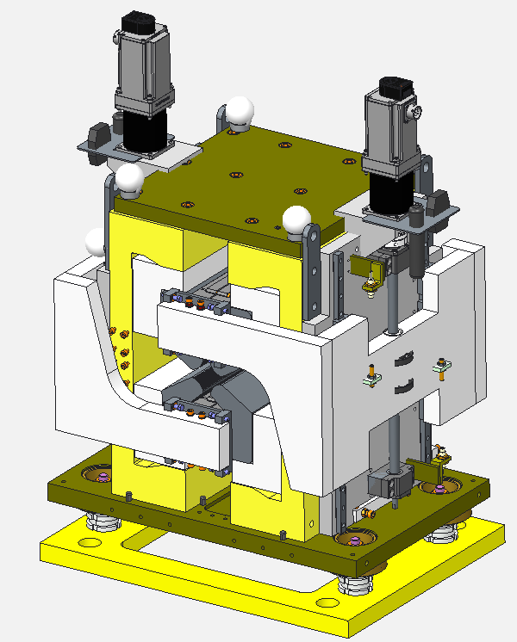
ZEPTO Diamond Quadrupole
Aim: demonstrate operation of a ZEPTO quadrupole on a working accelerator
Install a tunable PM quad as a drop-in replacement for an EM quadrupole
To be installed at Diamond Light Source, on the BTS transfer line
Enabled by STFC’s Proof of Concept Fund
  Step towards commercialisation of ZEPTO technology
Design complete
  Assembly and testing at Daresbury
  in early 2021
  Installation at Diamond
  in May-June 2021 shutdown
  Similar design to ZEPTO-Q2
    Outer shell for large tuning range
  SmCo blocks
    improved temperature stability
    radiation resistance
  Max gradient 19 T/m
  Min gradient 0.5 T/m
  Movement range 90 mm
  Aperture diameter 32 mm
  Splittable to allow installation around vacuum chamber
  Two independent motors for magnetic centre correction

Slide 5
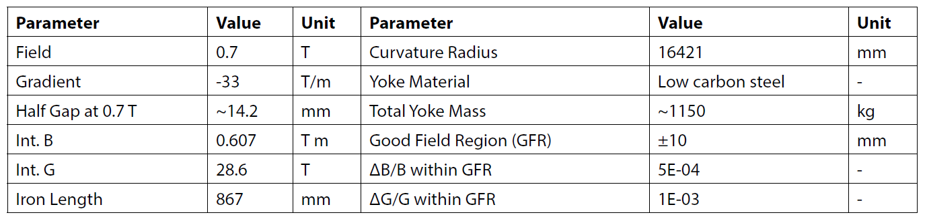
“Diamond-II” prototype
DQ magnet
Permanent magnet version
Tunable over a small range – maybe use coils

Slide 6
“PETRA-IV” prototype
PETRA IV in TDR phase
What to do with quadrupoles, DQs, sextupoles: EM or PM?
  Quads: 90 T/m, 12.5mm radius
  Sextupoles: 4000 T/m², 200mm length
  DQs:
Need to look at adjustment requirements
Name | L_{eff} | L_{tot} [m] | Ø [mm] | Gradient max | ΔB/B (at radius 7.9 mm)
DQ1 | 1.02 | 1.108 | >25 | 0.28 T and 38.4 T/m | 5·10⁻⁴
DQ2 | 0.795 | 0.895 | >25 | 0.19 T and 27.0 T/m | 5·10⁻⁴

Slide 7
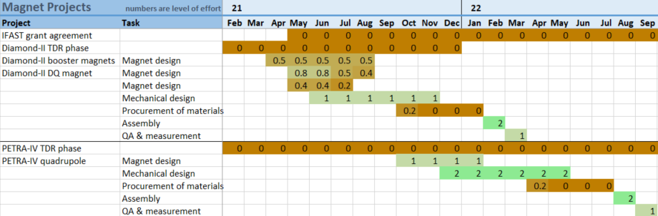
Outline plan
MaRS staff to develop magnet design for Diamond-II PM-based prototype
DLS staff to validate compatibility of design with Diamond systems
Kyma to develop mechanical design, assemble and test magnet

