Slide 2
LHC restart after LS2
LHC instrumentation status
E. Bravin

Slide 3
From last LMC
The duration of 13-14 days for the Pilot Beam Test, including machine checkout, was confirmed and remains foreseen to take place in Weeks 39 and 40 (27 September onwards).
The Pilot Beam Test could be delayed if necessary by up to two weeks, but this delay would probably impact the 2022 start date by the same amount.
The present date for experimental cavern closure on February 1st 2022 is maintained with the next review on the schedule to take place on June 7th 2021.

Slide 4
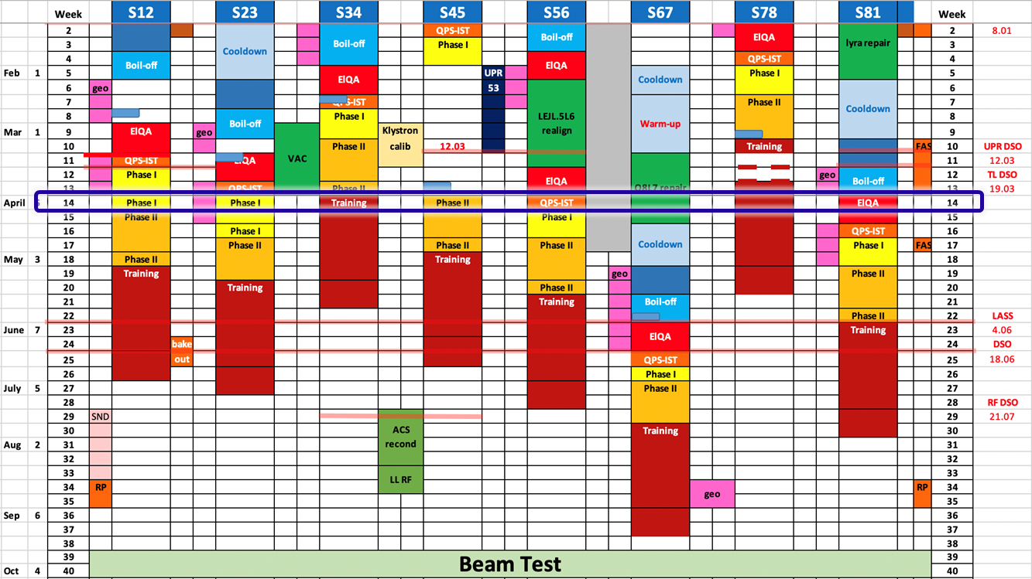
Present planning
3 days for checkout
  Most systems validated before
The following beam conditions are considered (ATLAS pit open)
  Up to 3 probe bunches at injection
  One probe bunch at flat top
  Up to 3 nominal bunches at injection with possible collisions
Collisions are now almost certain (at injection) and in STABLE BEAMS

Slide 5
Next steps
Presentation of BI status at the LBOC on April 20
Presentation of BI status at the LMC on May 12
Request for slides sent to SL, only one reply so far
Status tracking using the usual WEB tool
https://be-dep-bi-lhc.web.cern.ch/status/
Now available also for the other machines

