Slide 2
Renovation of the LHC beam-based FBs during LS2
D. Alves (BI-IQ), L. Grech (BI-IQ), S. Jackson (BI-SW)
in collaboration with OP-LHC

Slide 3
Contents
Overview
Hardware changes
Software changes
Operational changes
Management
Testing
Status
Outlook & Planning

Slide 4
Overview

Slide 5
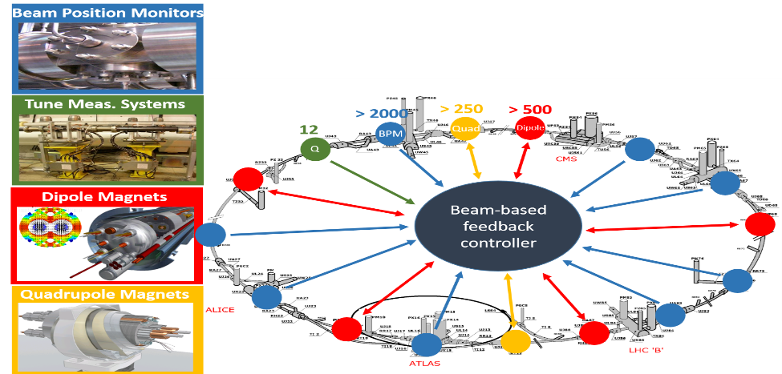
LHC beam-based feedback system
> 1000

Slide 6
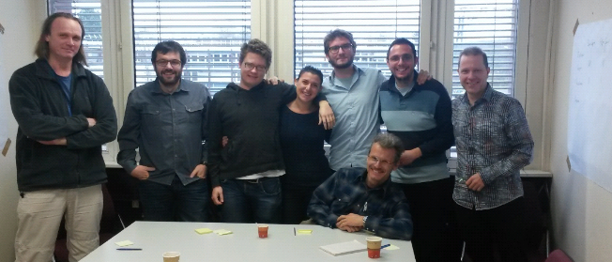
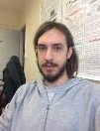
Refactoring during LS1
> 90k lines of inherited code
New Proliant servers (64bit)
Fesa 2 → Fesa 3
RDA 2 → RDA 3
Re-factoring
Stability
Joint collaboration BI+OP+CO
  Developed a testbed system

Slide 7
Overview
What do we want to achieve?
Optimize functionality benefiting from years of experience in LHC operations
Make API simpler and more transparent (Fesa2 legacy)
Make system more standard and flexible
Improve maintainability
How?
Double staged approach:
  Stage 1 (minimize changes in the core of the code)
    Implement single FESA class
    Establish new API
    New features
    Test, test, test until ready for operations
  Stage 2 (more ambitious re-design)
    Re-design the FESA class from scratch – clean-up + simplify
    Benefit from already established API
    Benefit from suite of tests already in place
    Test, test, test until ready for operations

Slide 8
Hardware
Software
Operations
Data proxy + Async settings
24 Cores
2.7 GHz
32 GB RAM
15 MB cache
OFC
(Standalone C++)
OFSU
(FESA)
RUN 2
SLC6
Hardware → Upgrade
Installation of new machines
Software → Standardise
Merge,simplify & optimize (>90k lines of code)
Operations → Homogenise
Adapt, simplify & optimize
BI-OP tight collaboration
RUN 3
CC7
Playable Functions
64 Cores
2.3 GHz
200 GB RAM
22 MB cache
BFCLHC
(FESA)
Optimized handling of
Optics

Slide 9

Hardware changes

Slide 10
Hardware changes
Run 2
Run 3
2 operational machines
  private eth link
2 spare machines
  private eth link
24 cores
2.7GHz
32GB RAM
15MB cache
1 operational machine
  private eth link
1 spare machine
64 cores
2.3GHz
200GB RAM
22MB cache

Slide 11
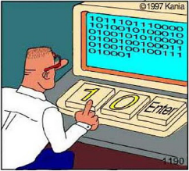
Software changes

Slide 12
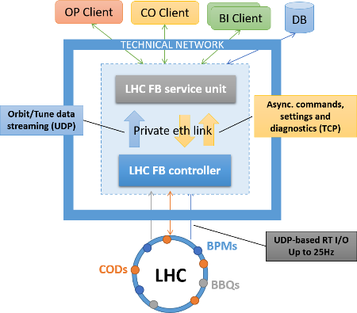
Software in Run 2
SLC 6
LHC FB controller (aka OFC)
  Standalone C++ program
  Concentrate BPM, BBQ & Corrector data
  Runs control loops
LHC FB service unit (aka OFSU)
  FESA class
  Settings management
  Data proxy
Serializing and de-serializing ROOT objects (private eth link)

Slide 13
Software in Run 3
BFCLHC
(Fesa class)
CC7
Single FESA class
No more serialization of ROOT objects
More standard
More maintainable

Slide 14
Operational changes
Adapt system to the way the LHC is operated
Adapt API
  Remove unused properties and fields
  Make it more transparent and obvious
Playback of functions
  More homogeneous with the way PCs are operated
Optimize handling of the optics
Simplicity and flexibility

Slide 15
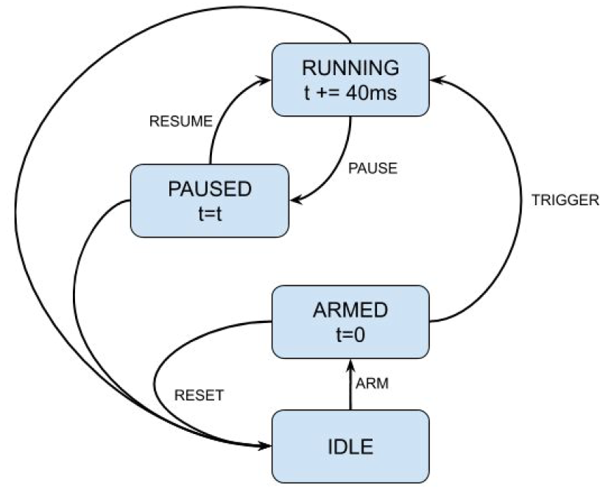
Operational changes
Function Player – new feature in Run3
Functions (time+value arrays):
Optics
Reference orbit
Reference tunes
Loop gains
MTG event
CMD property
Perform all sanity checks:
Monotonic time vectors
Successful optics calculation
Sanity of refs
Sanity of gains

Slide 16
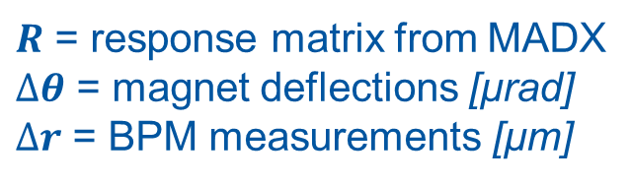

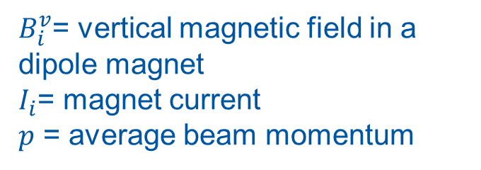


Operational changes Optics
$R$ = response matrix from MADX
$∆θ$ = magnet deflections [μrad]
$∆r$ = BPM measurements [μm]
Linear optics: $R ∆θ=∆r$
$B_{i}^{v}$= vertical magnetic field in a dipole magnet
$I_{i}$= magnet current
$p$ = average beam momentum
Magnet deflections: $∆θ_{i}∝{∆B}_{i}^{v}∝{∆I}_{i}$
$$∆r=R ∆I⟺∆I=R^{−1} Δr$$

Slide 17




Operational changes Closed Orbit Control
Orbit controller
PI regulator
$$Δr=r−r_{ref}$$
$$∆I=R^{−1} Δr$$
$$r$$
$$ΔI$$
LHC
BPMs
Beam
Dipoles

Slide 18


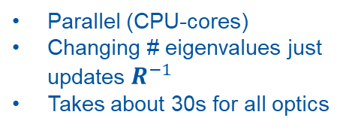
Operational changes Optics calculations
Orbit Correction:
$$∆I=R^{−1}∆r$$
LSA
Optics info
USV
Build response matrix
Calculate SVD
$$R^{−1}=VS^{+}U^{T}$$
# eigenvalues
Sequential
Changing # eigenvalues meant new SVD decomposition
Took about 30s per optic (2-3min before ramp)
Parallel (CPU-cores)
Changing # eigenvalues just updates $R^{−1}$
Takes about 30s for all optics
Run2
Run3

Slide 19
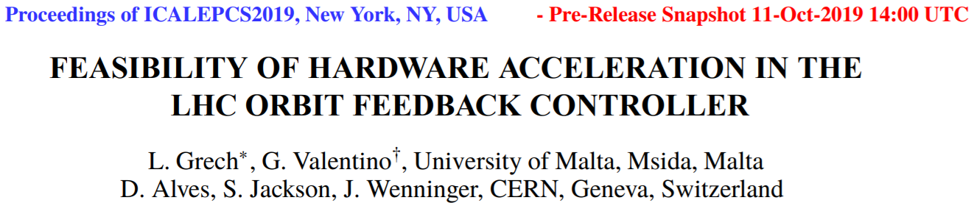
Study on the parallelization of optics calculations
http://icalepcs2019.vrws.de/papers/mopha151.pdf
Conclusion: GPU acceleration brings no benefit when compared to parallelization with CPU cores. In particular, our matrix sizes ~(1000x500) are not large enough to compensate for the overhead of copying to and from GPU memory.

Slide 20
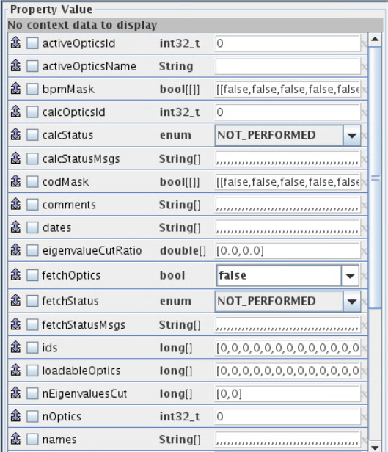
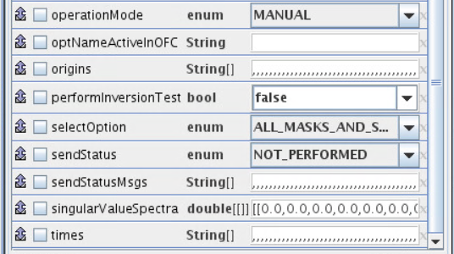
Optics handling during Run 2
partial-sets
Fetch optics info from LSA
Save in local disk
Read info from files
1. fetchOptics → Java process
Calculate RM
SVD decomposition
Calculate RM⁻¹
Repeat for each optics
2. calcOpticsId + selectOption + nEigenvalues
3. activeOpticsId → upload optics to OFC
4. send MTG event → set optics to active

Slide 21
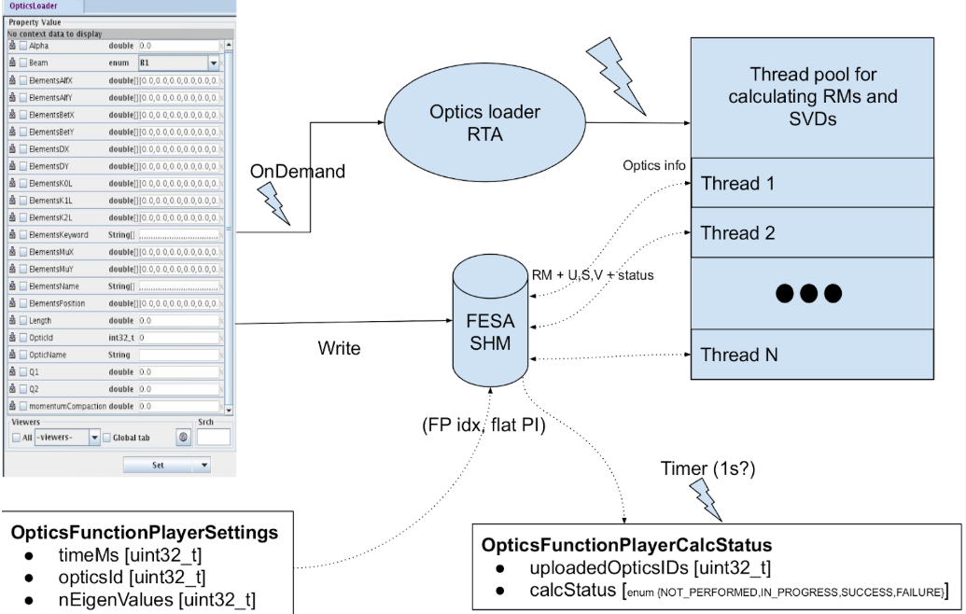
Optics handling during Run 3

Slide 22
Management
Tight collaboration BI+OP
Weekly progress meetings
Monthly(ish) review meetings
Joint sprints

Slide 23
Testing
Andrea’s presentation

Slide 24
Status
Stage 1: code porting/implementation well underway > 80-90%
  Some adaptations might still be required to accommodate testing
  Optics handling done
  Function player nearly finished (loop gains missing)
Some tests already in place
  e.g. orbit response matrix calculation

Slide 25
Outlook & planning
Implement automatic optics recalculation based on element status
  May be possible to save the beam when an orbit corrector fails
Advancement to stage 2 depends on the test coverage achieved by late this year (Q4 2020)
Test, test, test!!!

Slide 26
