Slide 1
LHC instrumentation status meeting
The Halo Monitor (BSRH)

Slide 2
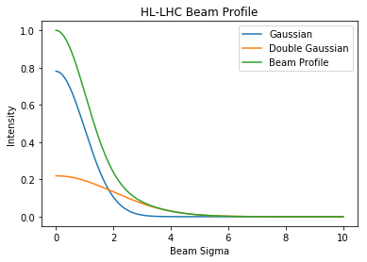
The Problem
Halo population (above 3σ)
  Lead to loss spikes through orbit jitter
  Damage to collimators or other components
Halo measurements
  Determine effectiveness of equipment that influences the halo
  Failure of crab cavities

Slide 3
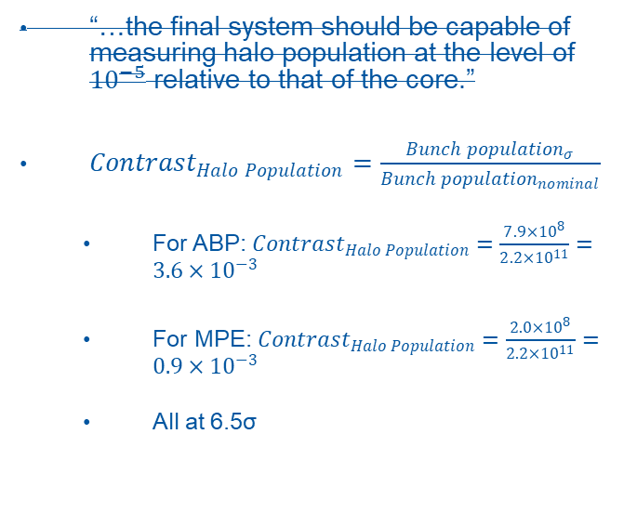
The (preliminary) Requirements
“…the final system should be capable of measuring halo population at the level of ${10}^{−5}$ relative to that of the core.”
${Contrast}_{Halo Population}=\frac{{Bunch population}_{σ}}{{Bunch population}_{nominal}}$
  For ABP: ${Contrast}_{Halo Population}=\frac{7.9×{10}^{8}}{2.2×{10}^{11}}={3.6×10}^{−3}$
  For MPE: ${Contrast}_{Halo Population}=\frac{2.0×{10}^{8}}{2.2×{10}^{11}}={0.9×10}^{−3}$
  All at 6.5σ
 | Per bunch | Full beam (2544 bunches) | Train of 48 bunches
Gaussian core | 5.7e5 | 1.5e9 | 2.7e7
Double Gaussian core | 7.9e8 | 2e12 | 3.8e10
Depleted (0.25) | 5.9e8 | 1.5e12 | 2.8e10
Depleted (0.5) | 4.0e8 | 1.0e12 | 1.9e10
Depleted (0.75) | 2.0e8 | 5.1e11 | 9.6e9

Slide 4
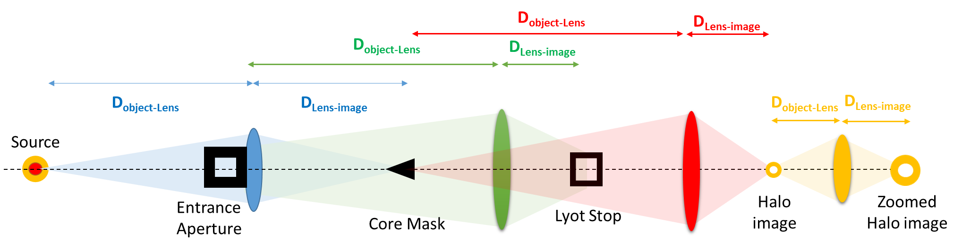
The Solution
The Lyot Coronagraph
  Non-invasive method
  Well known method (in the astrophysics community)
Field Group
Imaging the
entrance
aperture
Relay Group
re-imaging
the beam
Objective Group
Imaging the beam

Slide 5
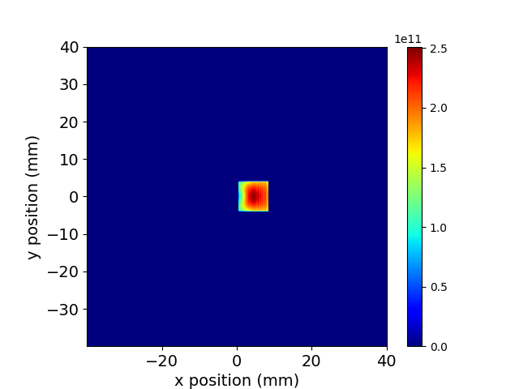
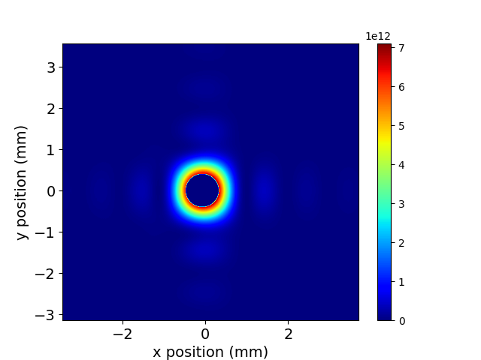
The BSRH
Magnification at Core Mask | Magnification at Lyot Stop | Magnification at Image
0.5 | 1 | 0.1
Minimum magnification required to minimize the effects of diffraction by the core mask | Value required to better control the diffraction fringes at the lyot stop coming from the entrance aperture | Good value to use directly a camera An eye piece can be used if bigger magnification is required
Optics design: Zemax
Simulations: SRW (contribution from Daniele

Slide 6
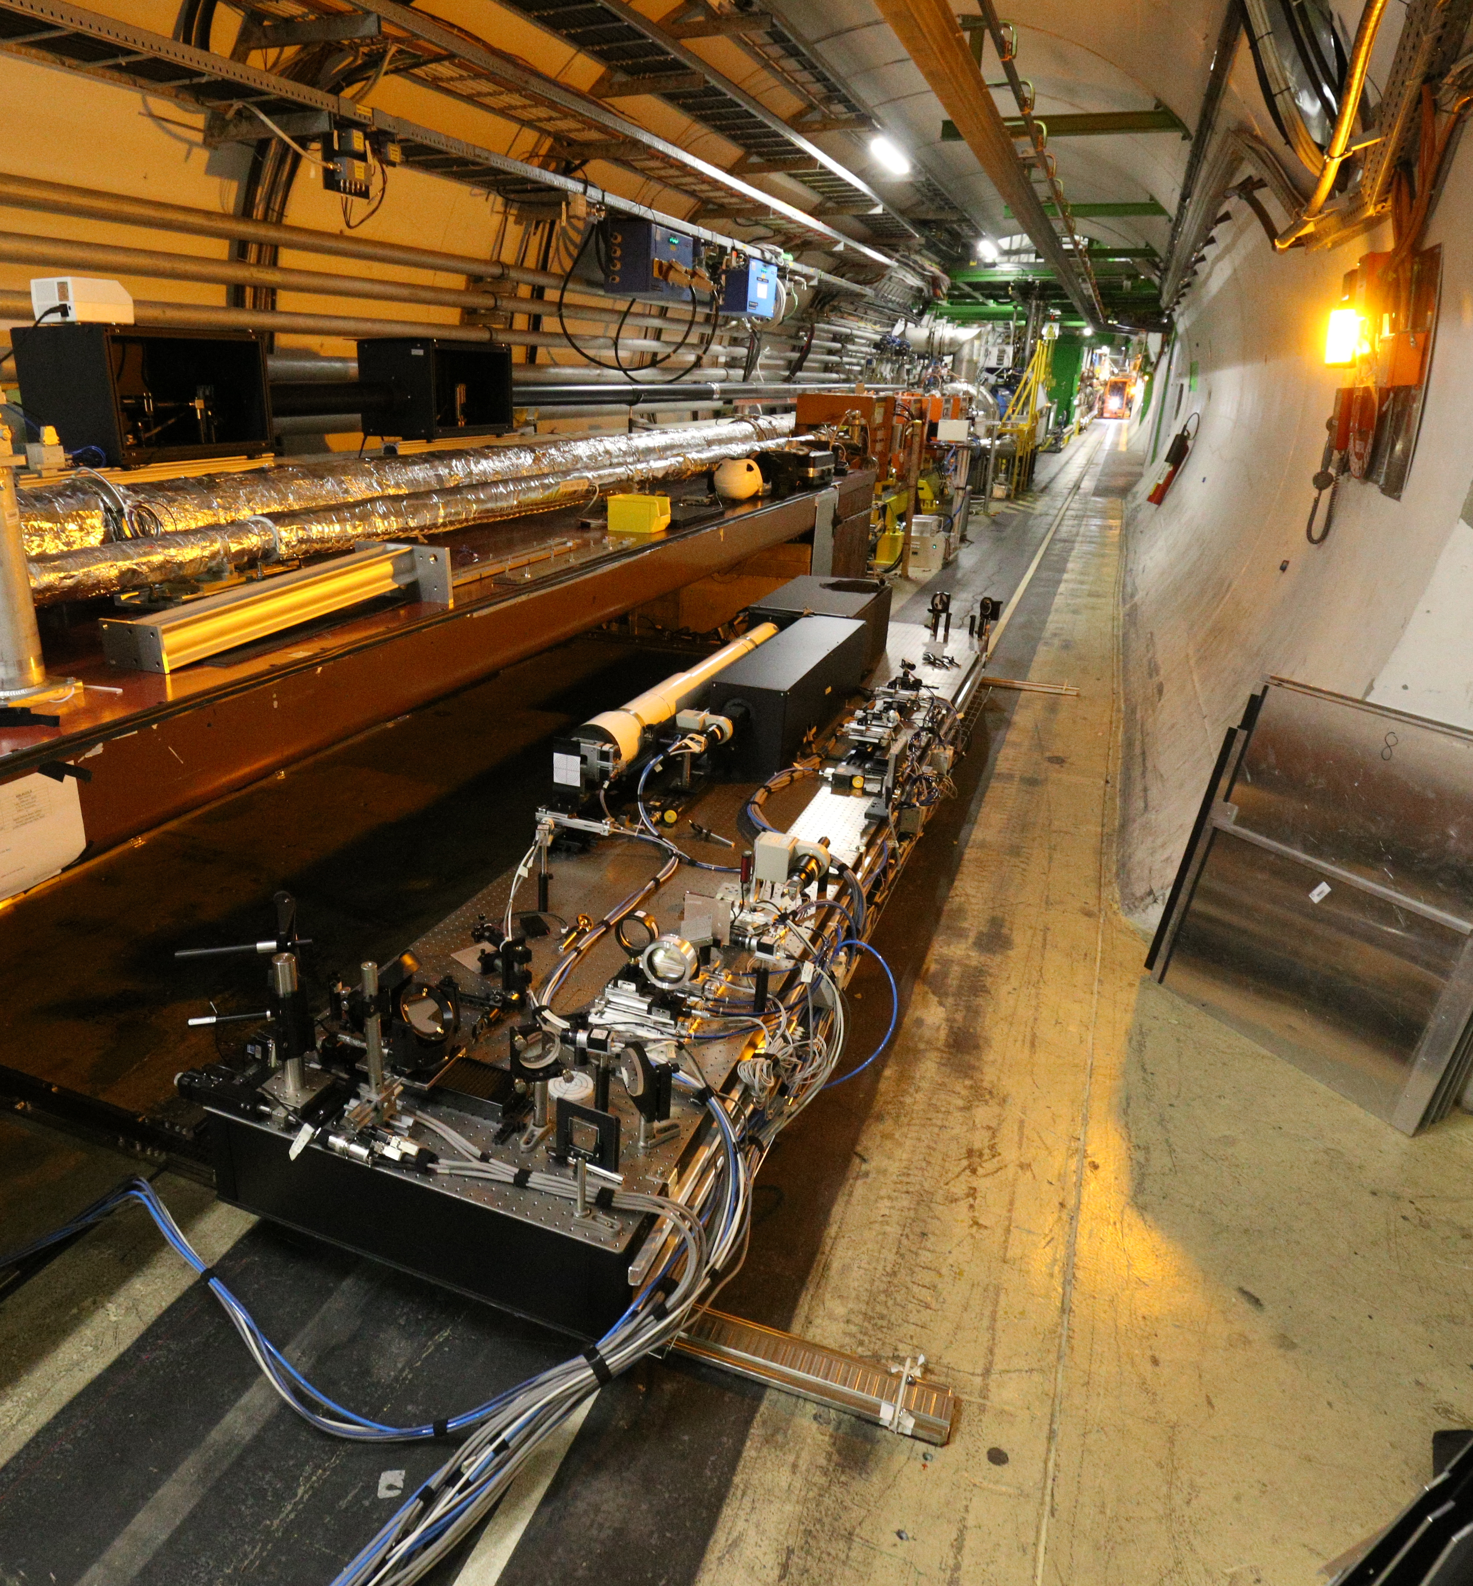
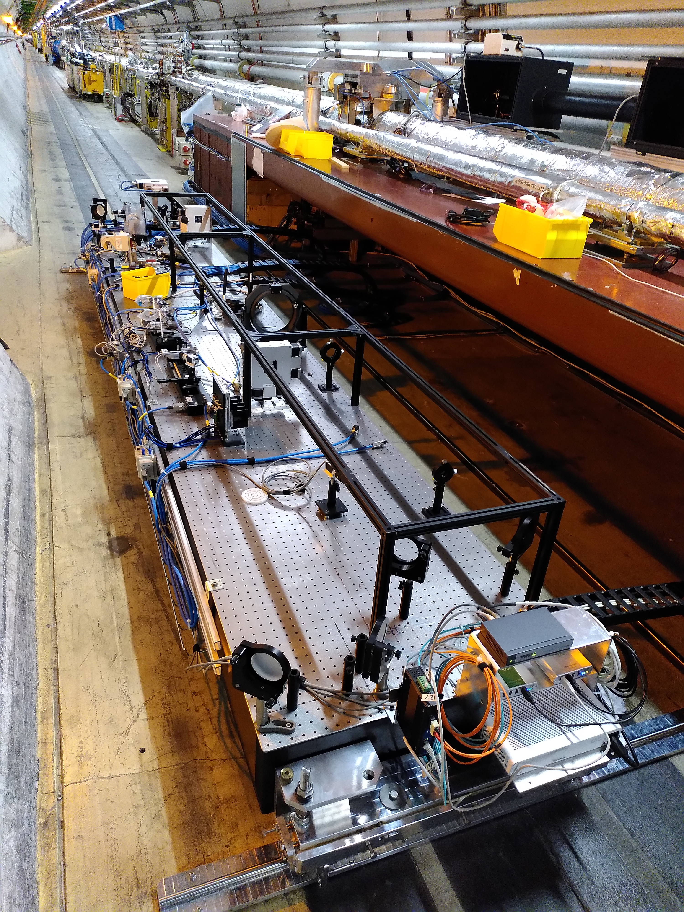
LHC

Slide 7
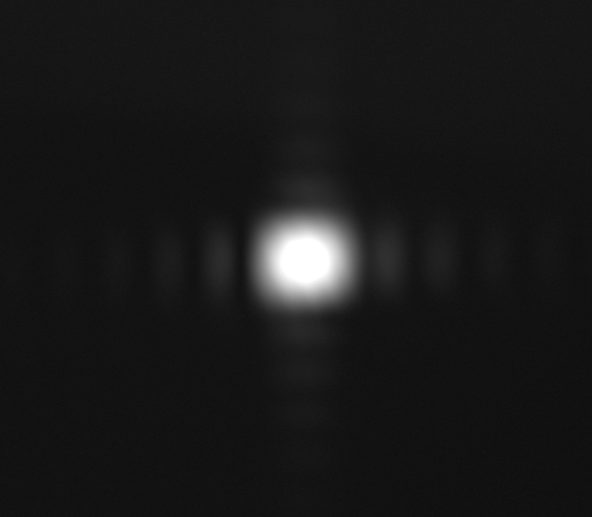
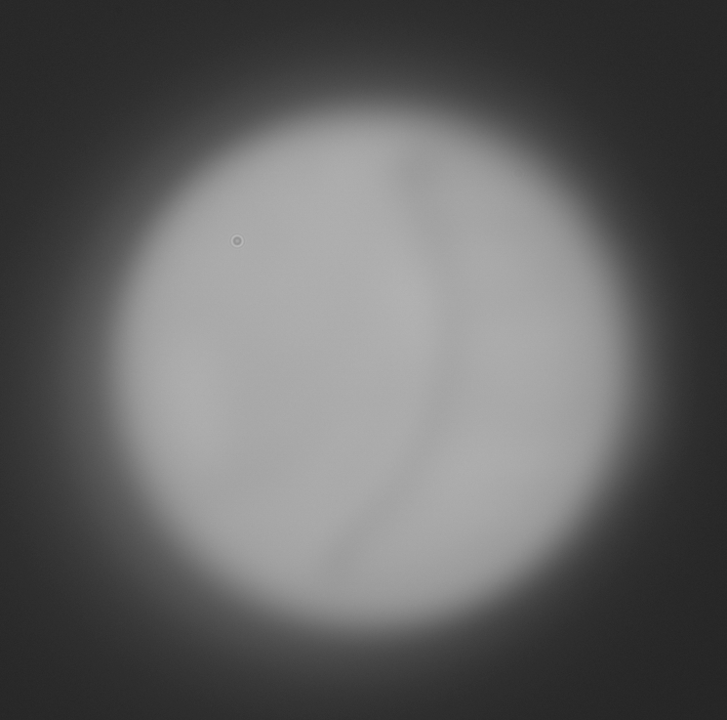
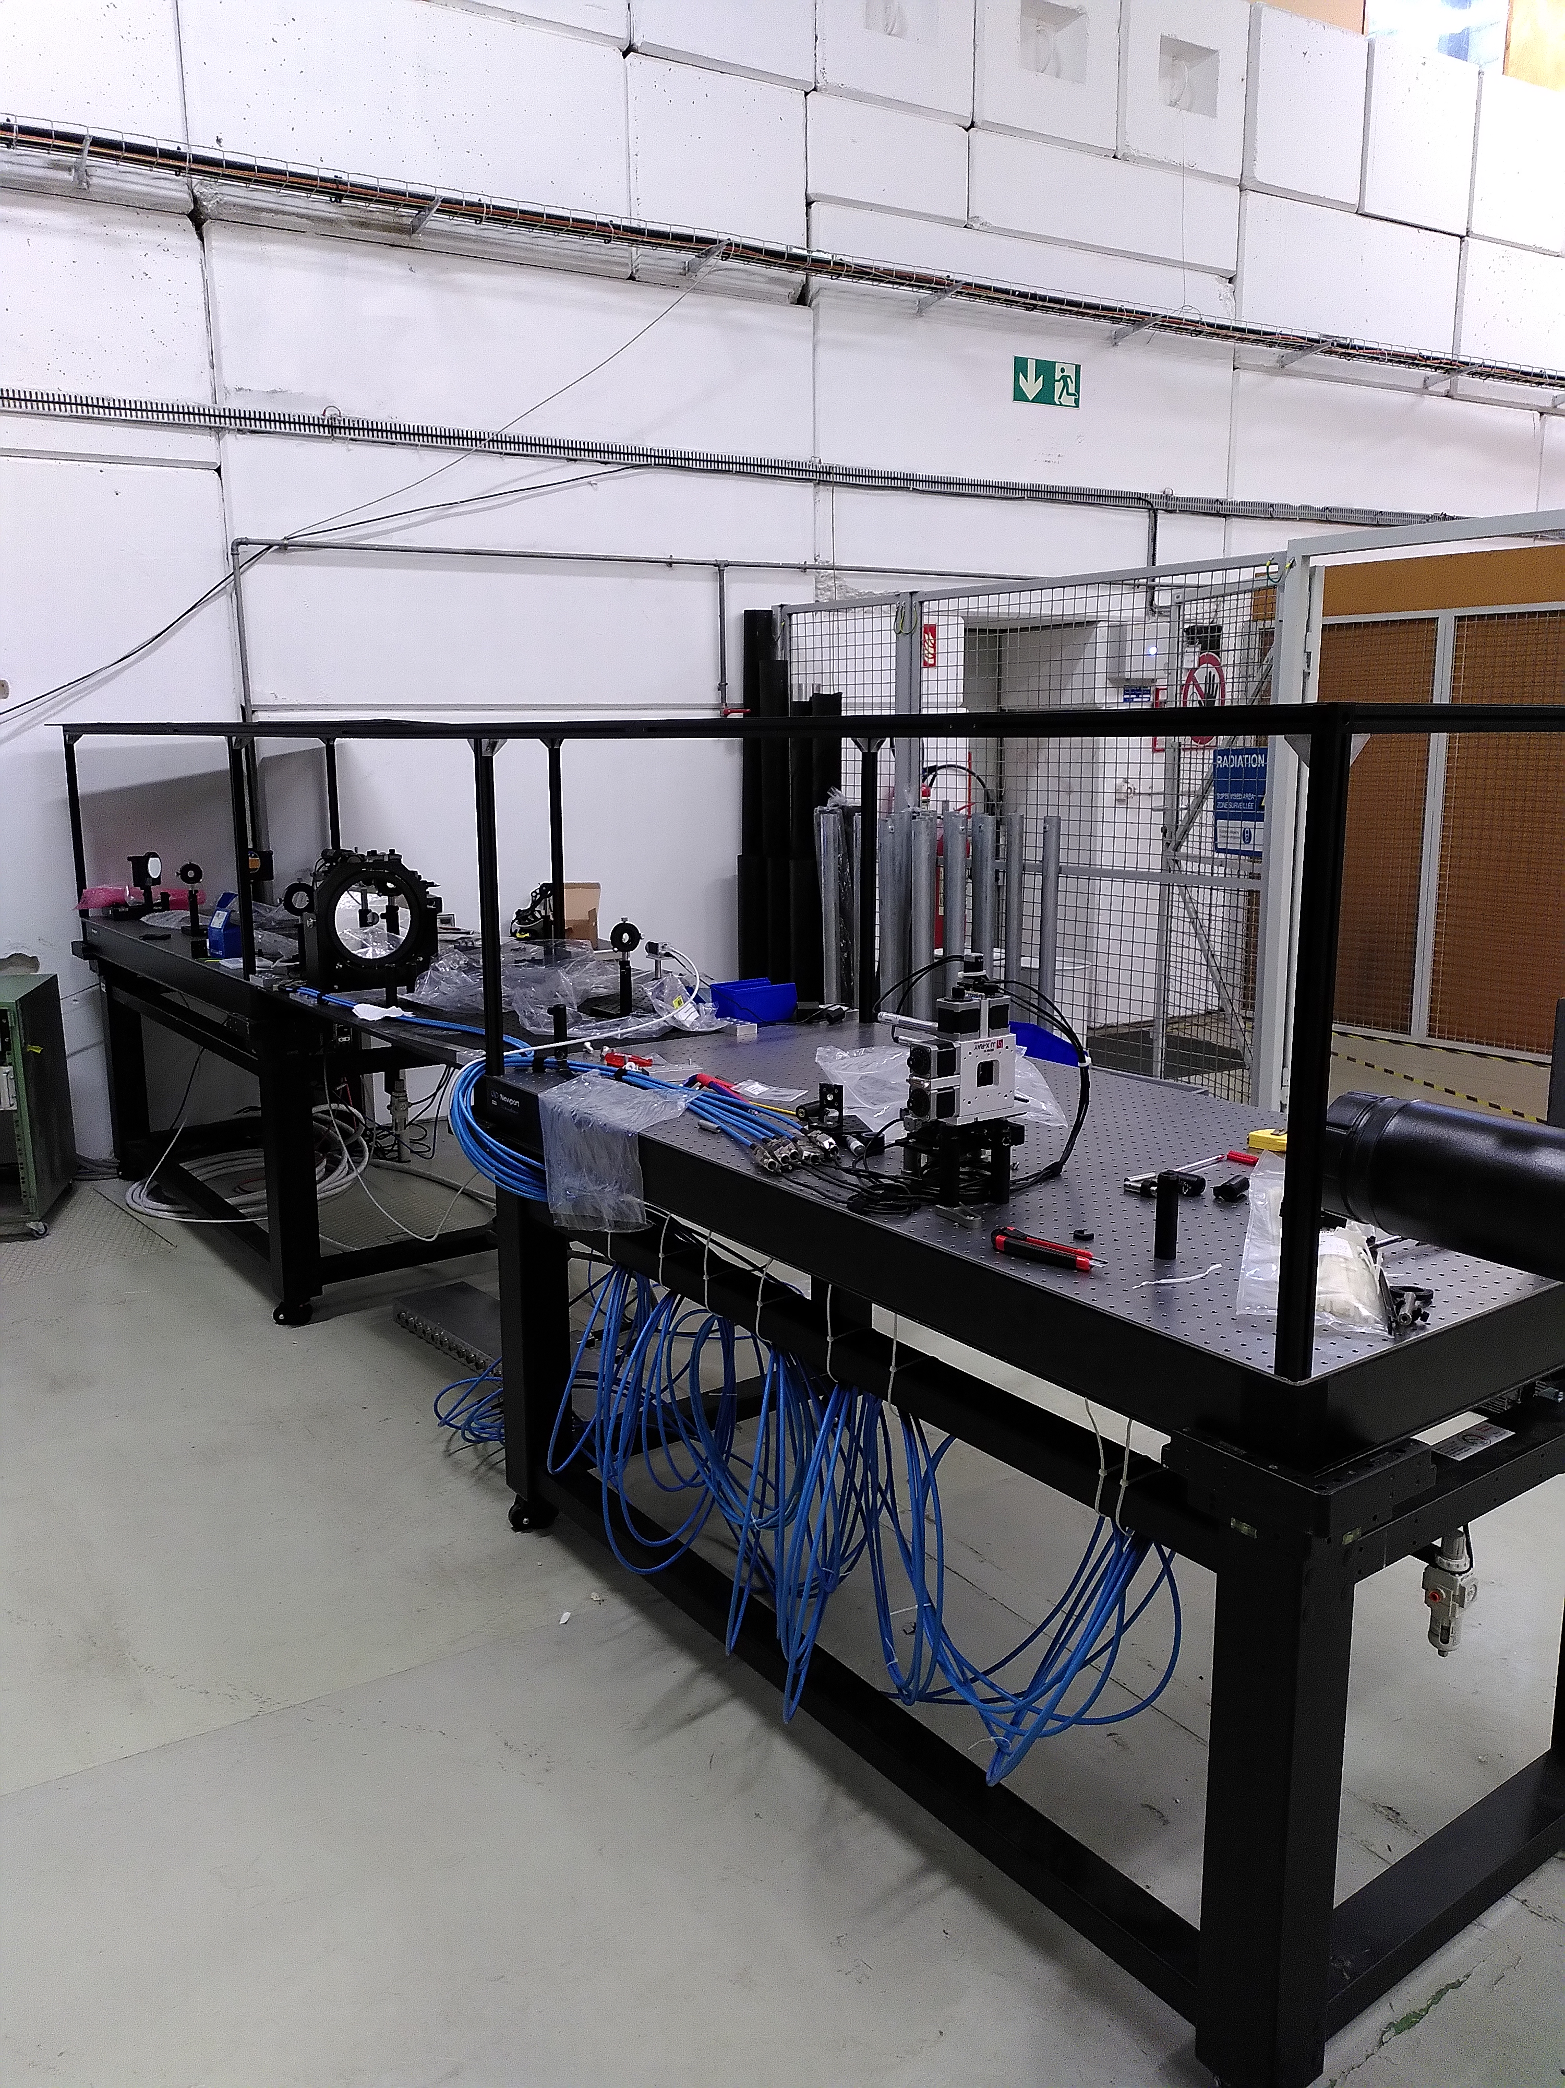

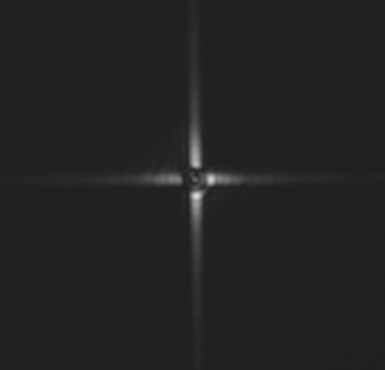
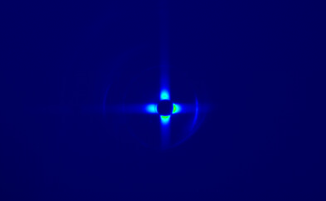
ISR

Slide 8
Current Status
LHC
  Most items installed
  Optics are missing
  Enclosure incomplete
ISR
  Everything Installed
  Measurements being done
Funcional Specifications
  Discussions with Enrico ongoing

Slide 9
Thank you

