Slide 1
Search for feebly interactive particles: the PADME experiment
Danilo Domenici
on behalf of the PADME collaboration

Slide 2


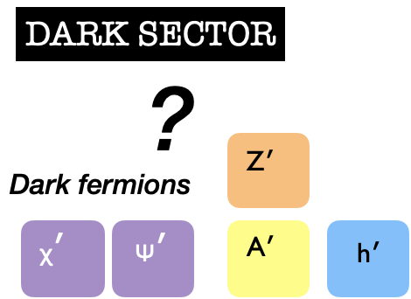


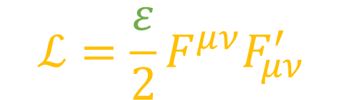
Dark Sector extension to SM
can address g-2, antimatter in cosmic rays, dark matter
Standard Model
PORTAL
vector A’
pseudo-scalar ALPs
?
dark bosons
dark fermions
$$ℒ=\frac{ε}{2}F^{μν}F_{μν}^{′}$$
$$ε≪1$$
Notes:
The search for light particles in the MeV-GeV range from a dark sector has attracted an increasing attention, also due to the lack of positive observation of WIMP or other heavy dark matter candidates.
A rich experimental program has flourished all around the world in the recent years, as well as phenomenological studies.

Slide 3








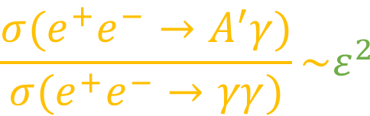







Production mechanisms
A’-strahlung
resonant annihilation
$$e^{+}$$
$$A^{′}$$
$$e^{−}$$
cross-section enhanced if mass is known
$$A^{′}$$
$$e^{+}$$
$$e^{+}$$
annihilation with SM photon
coupling constant can be extracted
meson decay
$$e^{−}$$
$$γ$$
$$γ$$
$$π^{0}$$
$$\frac{σ(e^{+}e^{−}→A^{′}γ)}{σ(e^{+}e^{−}→γγ)}\sim ε^{2}$$
$$A^{′}$$
$$e^{+}$$
$$A^{′}$$

Slide 4
















PADME Technique
$$e^{−}$$
$$γ$$
Positron Annihilation into Dark Matter Experiment
Signal
$$e^{+}e^{−}→A^{′}γ$$
PRODUCTION
A’ produced in $e^{+}e^{−}$annihilation
positron (beam) ↔ electron (target)
DECAY
A’ invisible channel
missing mass technique
visible channel in SM particles
A’ $→$ $e^{+}e^{−}$
$$e^{+}$$
$$A^{′}$$
$$e^{−}$$
$$γ$$
Background
$$e^{+}$$
$$γ$$
$e^{+}e^{−}→γγ(γ$)
$$e^{+}N→e^{+}Nγ$$
${M^{2}}_{A′}=({\overline{P}}_{e^{+}}+$ ${\overline{P}}_{e^{− }}−{\overline{P}}_{γ})^{2}$
$$e^{+}$$
$$γ$$
beam induced
$$e^{+}$$

Slide 5
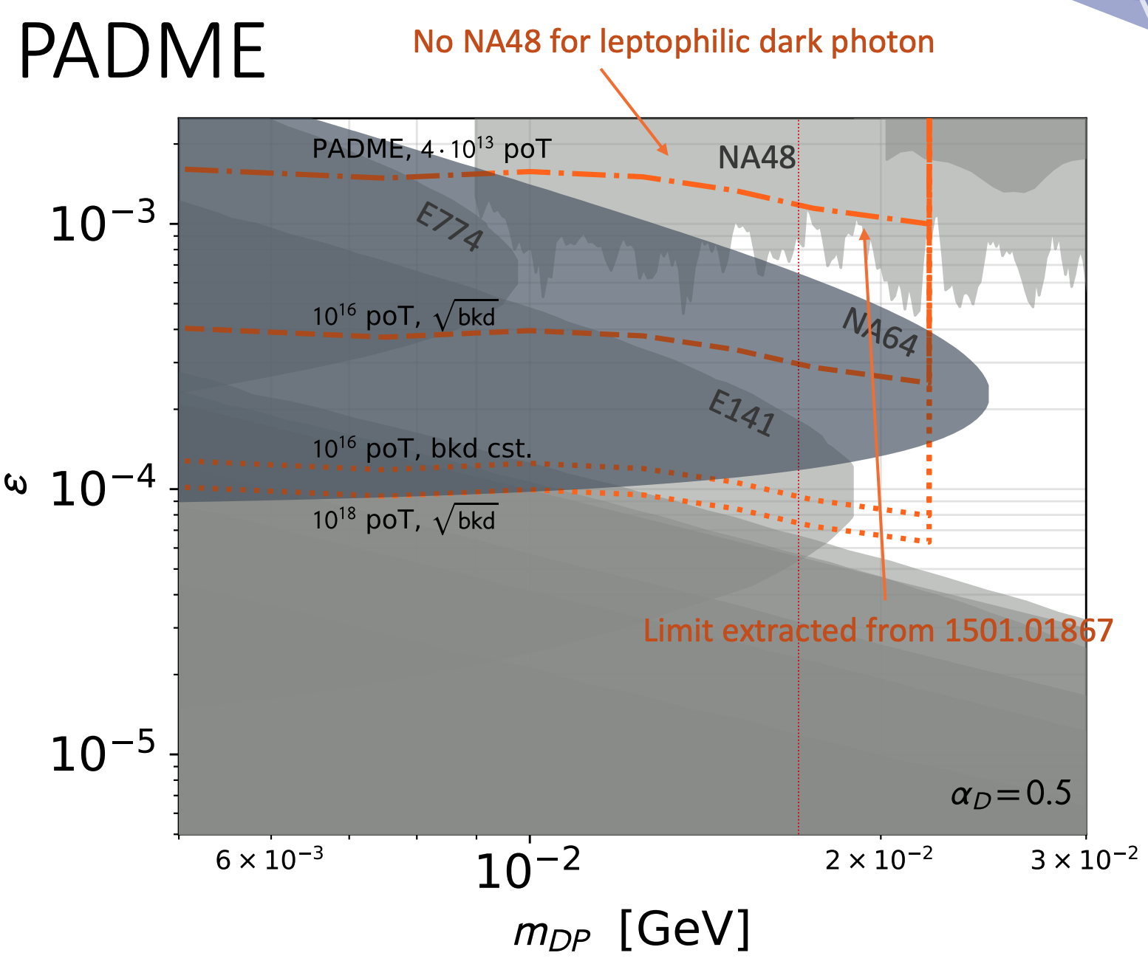
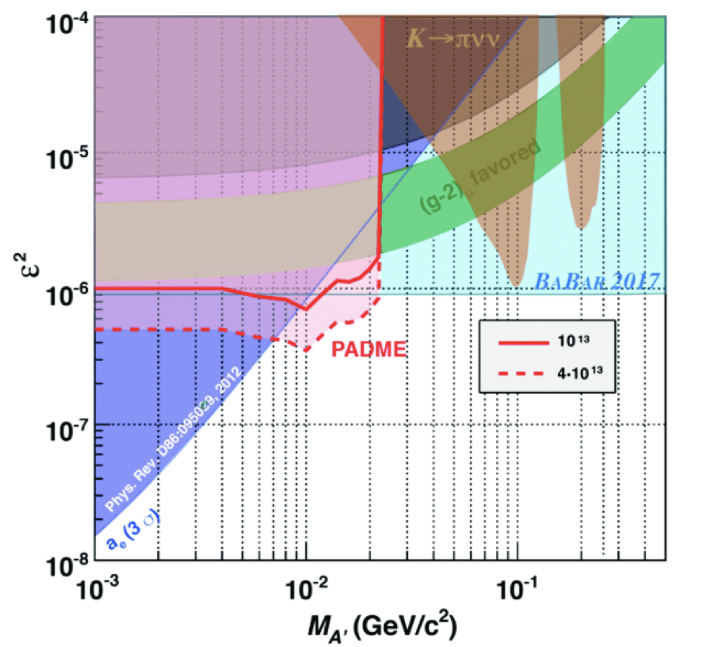
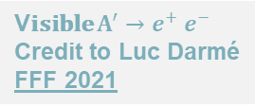

PADME Sensitivity
VISIBLE CHANNEL
INVISIBLE CHANNEL
M_{A} < 23.7 MeV/c²
𝜀² > 5 x 10⁻⁶
4 x 10¹³ POT
V𝐢𝐬𝐢𝐛𝐥𝐞 $A^{′}→e^{+} e^{−}$
Credit to Luc Darmé FFF 2021
$$Invisible A^{′}→χχ$$

Slide 6
PADME Outline
e⁺ high energy veto
TimePix
beam monitor
dipole magnet
vacuum vessel
e⁺ veto
e⁺ beam
active target
small angle calorimeter
e– veto
BGO calorimeter

Slide 7

Dark Photon Signal
$$e^{+}e^{−}→A^{′}γ$$
e⁺ high energy veto
TimePix
beam monitor
dipole magnet
vacuum vessel
e⁺ veto
A’
e⁺ beam
active target
γ
small angle calorimeter
e– veto
BGO calorimeter
one γ and no in time activity in the detectors

Slide 8

Background: Bremmstrahlung
$$e^{+}N→e^{+}N γ$$
e⁺ high energy veto
TimePix
beam monitor
dipole magnet
vacuum vessel
e⁺ veto
e⁺
e⁺ beam
γ
active target
small angle calorimeter
e– veto
BGO calorimeter
one γ but in time low energy e⁺ in the spectrometer
σ = 4b / C atom @ E_{γ} = 1MeV

Slide 9
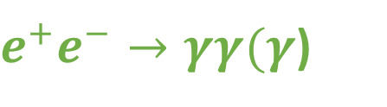
Background: annihilation
$e^{+}e^{−}→γγ(γ$)
e⁺ high energy veto
TimePix
beam monitor
dipole magnet
vacuum vessel
e⁺ veto
γ
e⁺ beam
active target
small angle calorimeter
e– veto
BGO calorimeter
γ
(γ)
one (or two) γ not in detector acceptance
σ = 0.15mb @ E_{γ} > 1MeV

Slide 10

Visible decay
$e^{+}e^{−}→A^{′}→$ $e^{+}e^{−}$
e⁺ high energy veto
TimePix
beam monitor
dipole magnet
vacuum vessel
e⁺ veto
e⁺
e⁺ beam
A’
active target
small angle calorimeter
e–
e– veto
BGO calorimeter
lepton pair detected in the spectrometer

Slide 11
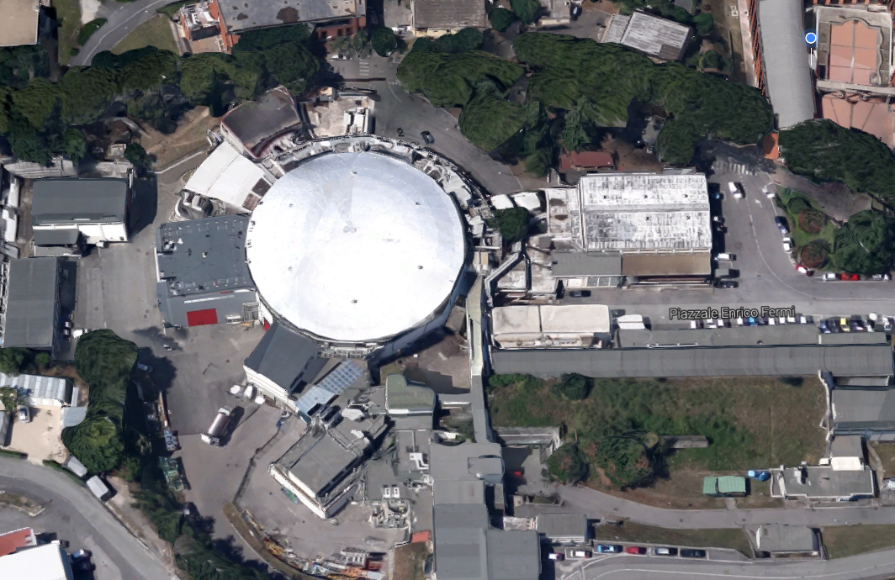
the accelerator complex of INFN Frascati National Laboratories
Energy: up to 550 MeV – 1% spread
Bunch spacing: 50 Hz
Intensity: 1 ÷ 25x10³ e⁺/bunch
Bunch lenght: 10 ÷ 200 ns
Beam spot: σ_{xy} ~ 1 mm
Divergence: ~ 1 mrad
main rings
linac
dumping
ring
electrons
PADME
positrons
both

Slide 12
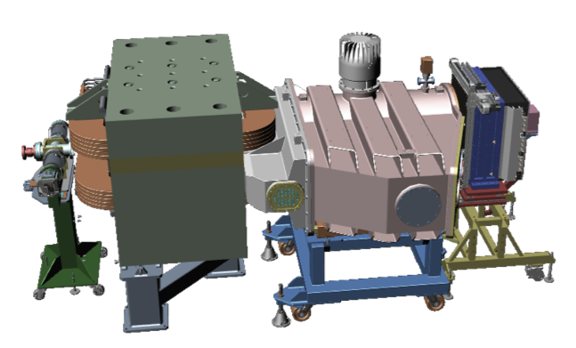
the PADME Detector
vacuum chamber with vetoes
BGO crystal calorimeter
diamond sensitive target
PbF₂ Cherenkov Small Angle Calo
positron beam
beam exit
dipole magnet
Mimosa beam monitor
Timepix
beam monitor

Slide 13
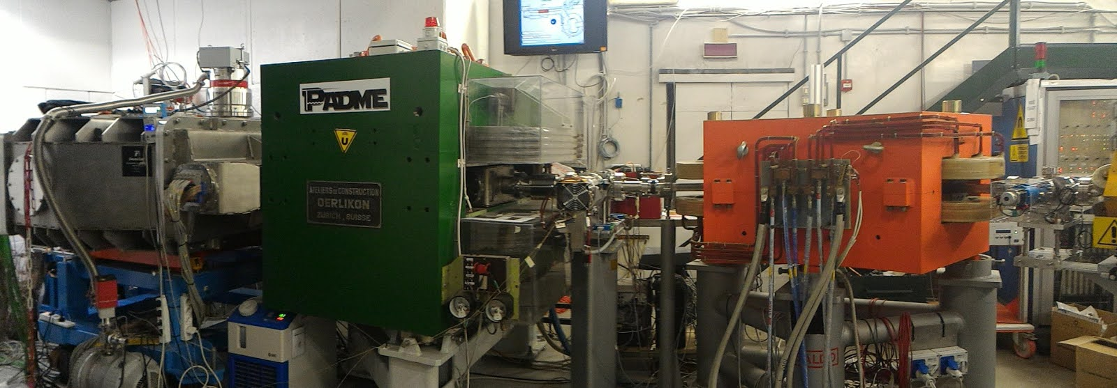
a PADME Picture

Slide 14
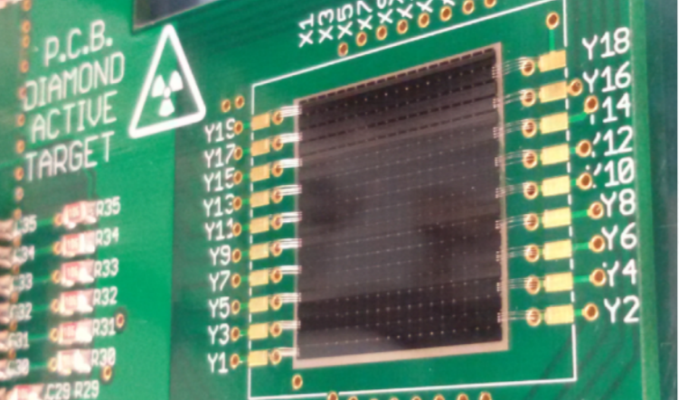
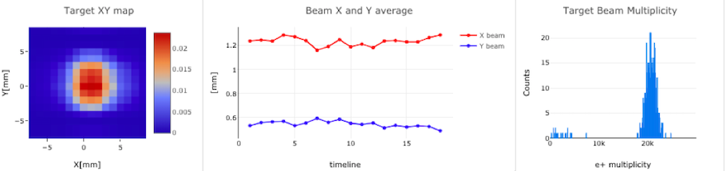
Diamond Active Target
annihilation target
provides single bunch XY profile
provides beam multiplicity
20x20x0.1 mm³ pCVD sensor
16+16 XY graphite strips
1 mm pitch
60 µm charge cetroid resolution
10% intensity measurement
Notes:
diamond (Z=6) has, among solid materials, highest annihilation/bremmstrahlung ratio

Slide 15
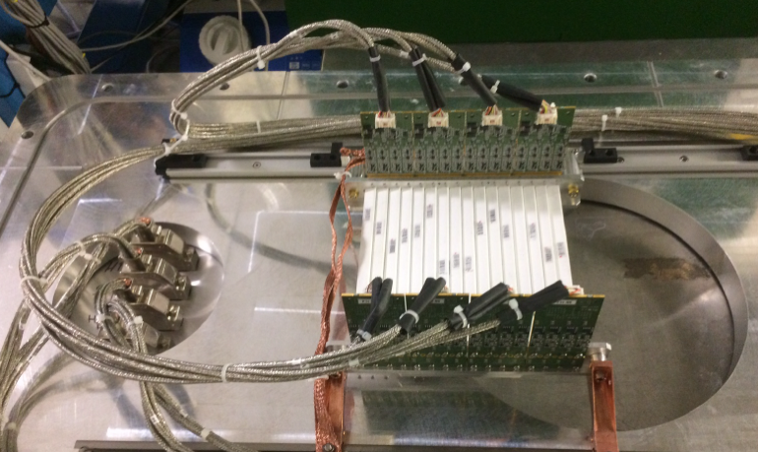
Charged Particle Veto
bremmstrahlung suppression
detection of visible decays
plastic scintillators bars
10x10x178 mm³
WLS fiber + 3x3 mm² SiPM
700 ps time resolution
2% momentum resolution
E veto (96 bars)
P veto (90 bars)
HEP veto (16 bars)

Slide 16
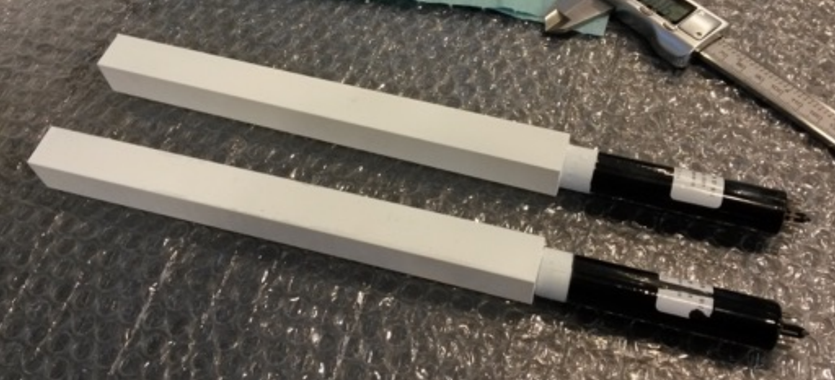
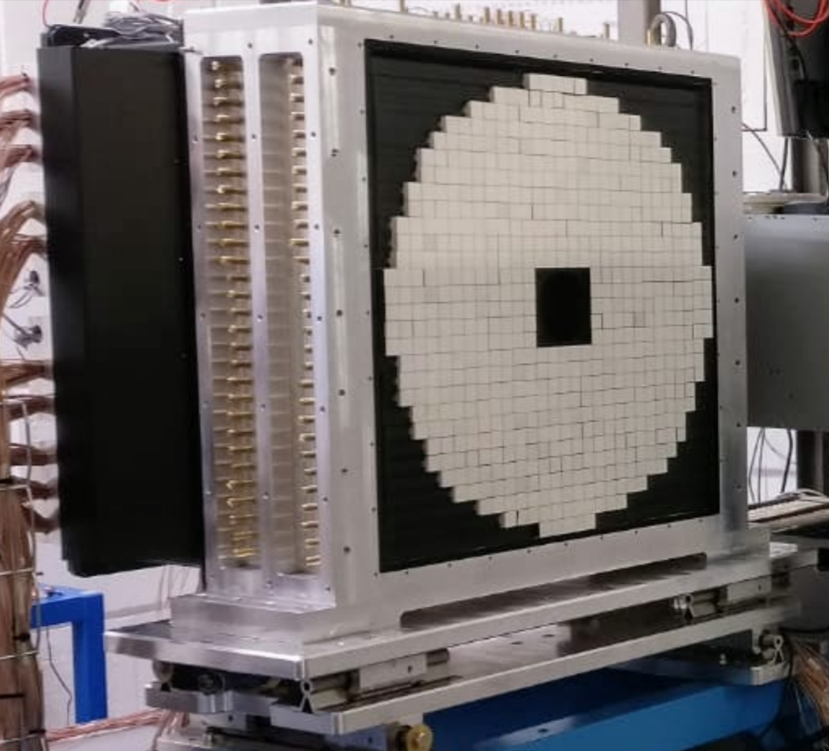
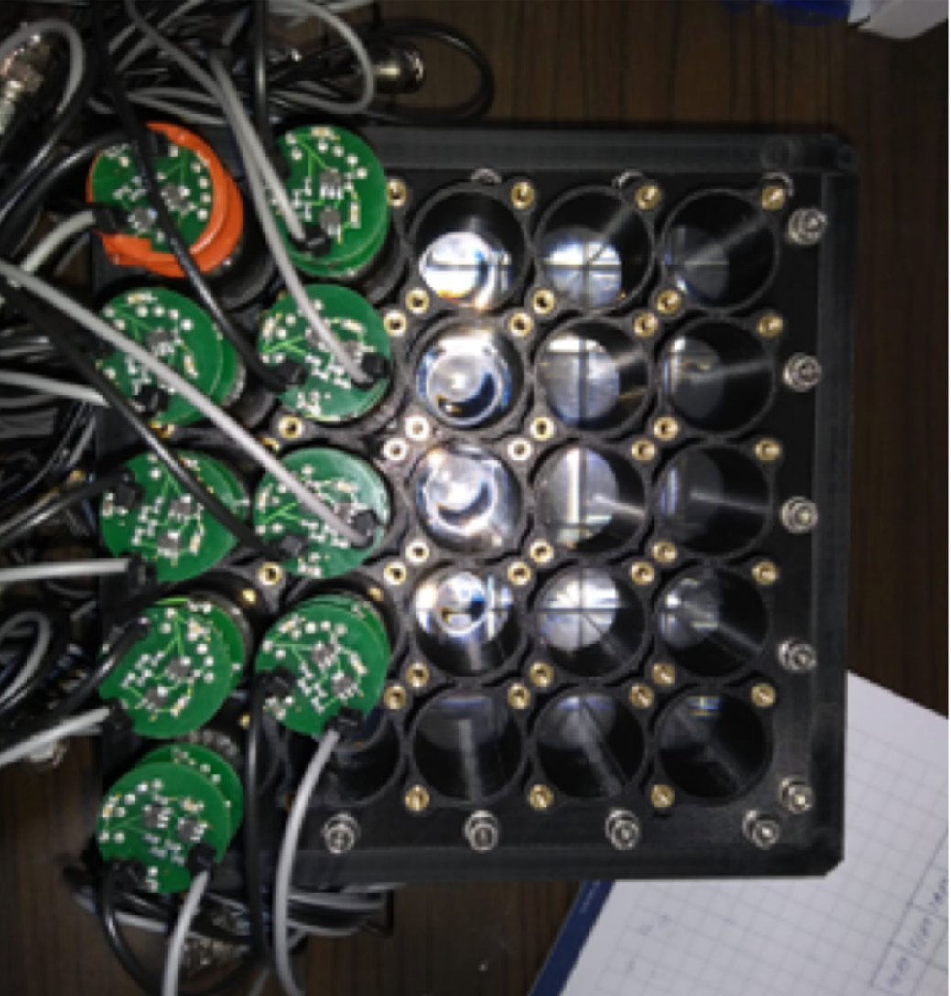
Electromagnetic Calorimeters
detection of annihilation events
bremmstrahlung suppression
ECAL
ECAL - Electromagnetic Calorimeter
616 scintillating BGO crystals 21×21×230 mm³
PMT readout
σE/E = 2.7% at 490 MeV
BGO decay time = 300 ns
Radiation length = 20.5 X0
SAC – Small Angle Calorimeter
25 Cherenkov PbF₂ crystals 30×30×140 mm³
PMT readout
PbF2 signal time = 3 ns
Time resolution = 86 ps
Rate capability = 40 cluster/bunch

Slide 17
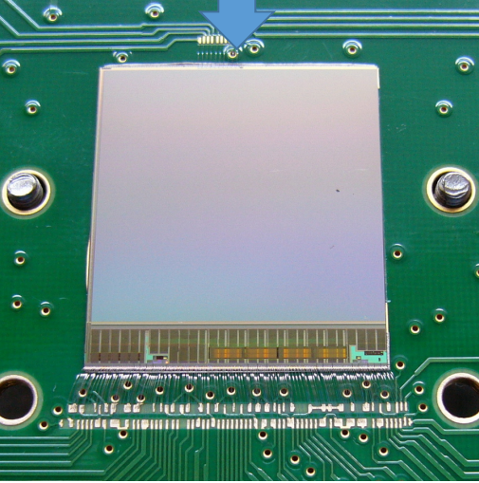
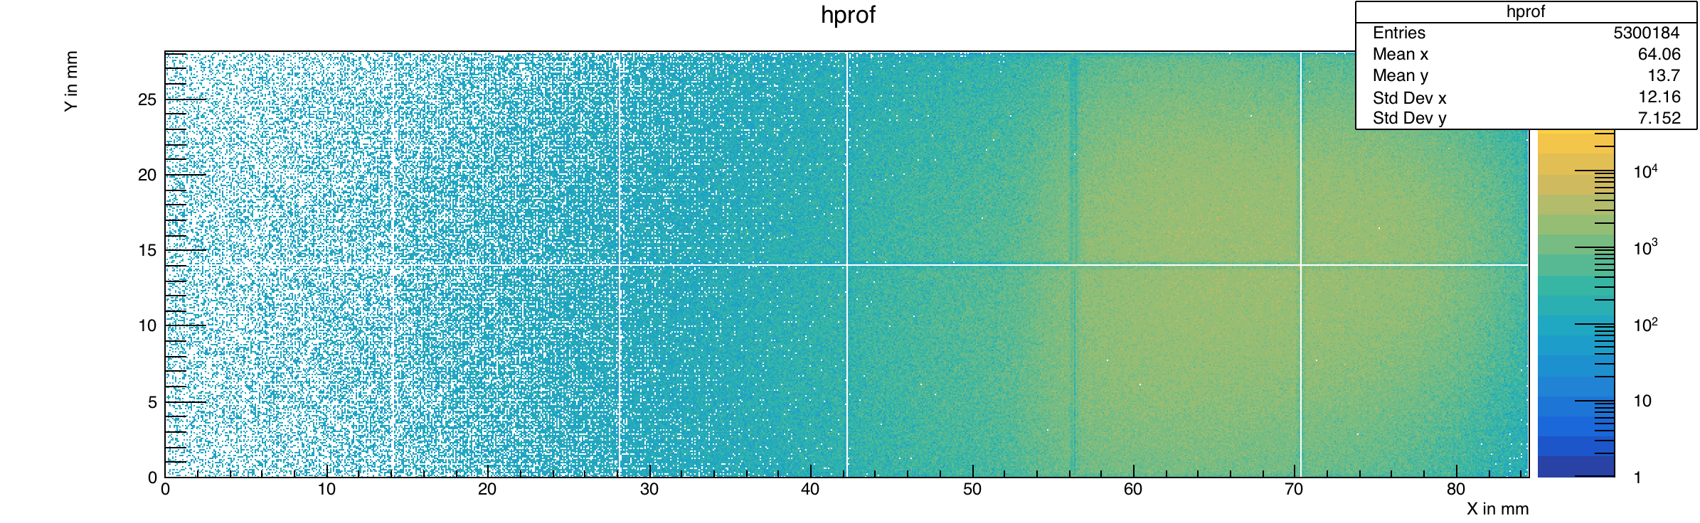
Beam Monitors
sensor
UPSTREAM - MIMOSA
Monolitic pixel tracker in vacuum
19.9x19.2 mm² sensor area
960x928 pixel array
20.7 µm pitch – 0.9 million pixels
Single point resolution= 3 µm
Readout time = 200 µs
DOWNSTREAM - TIMEPIX
2x6 matrix of 14x14 mm2 Timepix3
0.13 µm CMOS technology
256x256 pixel matrix, 55x55 µm²

Slide 18
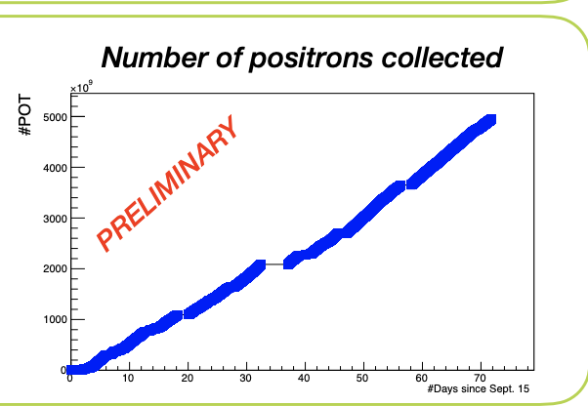
Data Taking
Run1 POT vs Time
Run2 POT vs Time
Primary Beam
Christmas
shutdown
N_{pot}/day = 0.9x10¹¹
RUN1 (Oct 18 – Feb 19)
7x10¹² POT
RUN2 (Sep 20 – Dec 20)
5.6x10¹² POT

Slide 19
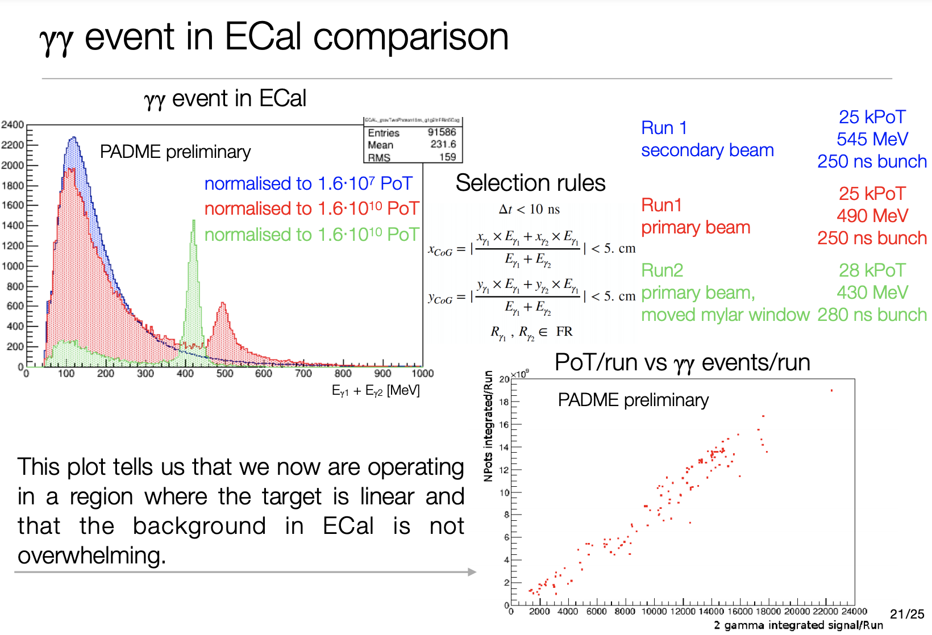
Beamline Characteristics
RUN1 – Secondary Beam
250 µm Be window
545 MeV
25kPOT / 250 ns bunch
Dumping Rings
RUN1 – Primary Beam
250 µm Be window
490 MeV
25kPOT / 250 ns bunch
DAFNE
Main Rings
BTF1
RUN2 – Primary Beam
125 µm Mylar window
430 MeV
28kPOT / 280 ns bunch
BTF2
PADME

Slide 20
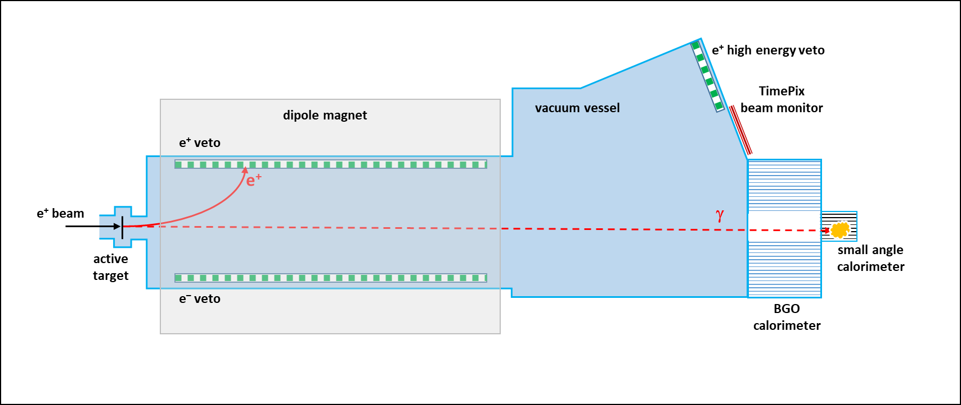
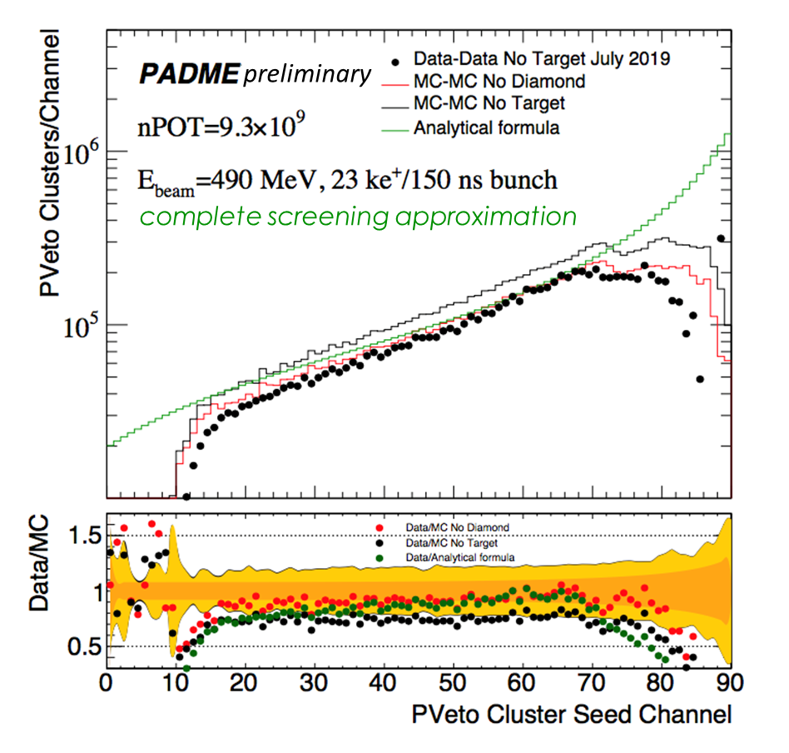
Positron Bremmstrahlung
Cluster distribution in PVeto
beam background measured w/o target
and subtracted
bremmstrahlung photon distribution in agreement with simulation and analytical calculation
systematic uncertainties dominated by background normalization, positron momentum scale, POT measurement calibration
much improved in Run2

Slide 21
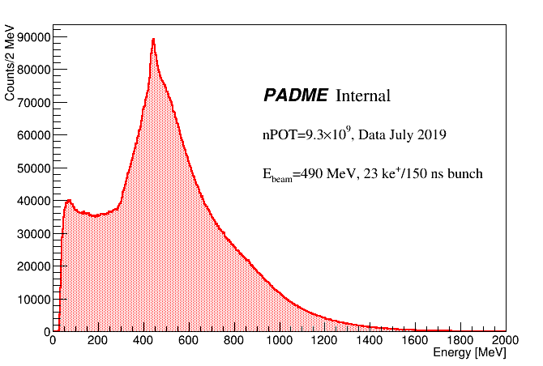
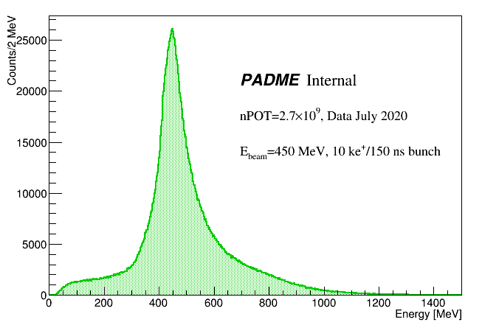
Beamlines Comparison
July 2019, Run1
PADME preliminary
photon energy in calorimeter
+
e+ energy computed by PVeto position
(in time within 1ns)
enlarged scale
July 2020, Run2
PADME preliminary
much cleaner distribution evident in Run2

Slide 22
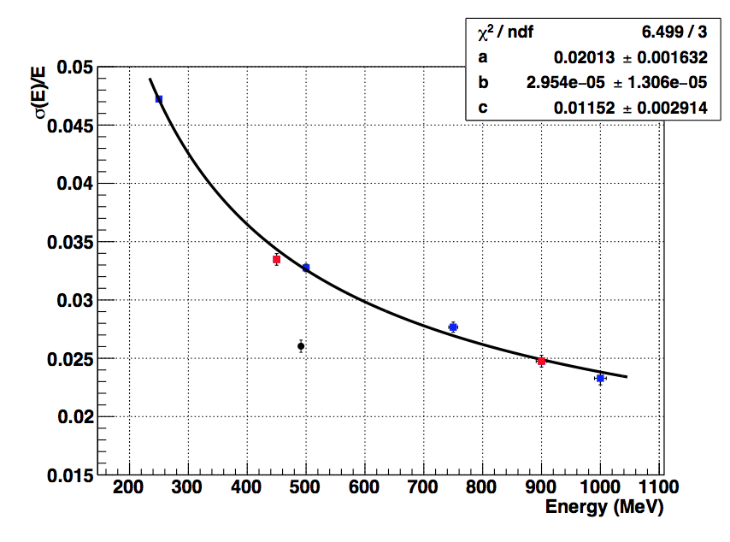
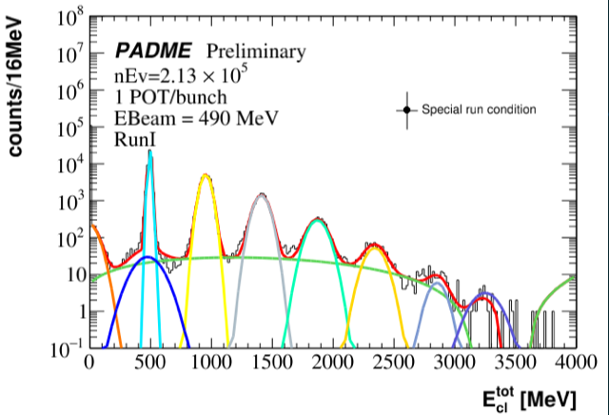
Calorimeter Performance
Multihit reconstruction
in 1 POT/bunch calibration run
Time resolution
σ_{t} ~ 1 ns
for photons > 100 MeV
Testbeam small prototype
JINST 15 (2020) no.10, T10003
PADME
N_{e+} = 1.18 ± 0.22 /bunch
Energy resolution
σ_{E}/E= (2.62 ± 0.05)% @ 490 MeV
in 1 POT/bunch calibration run

Slide 23
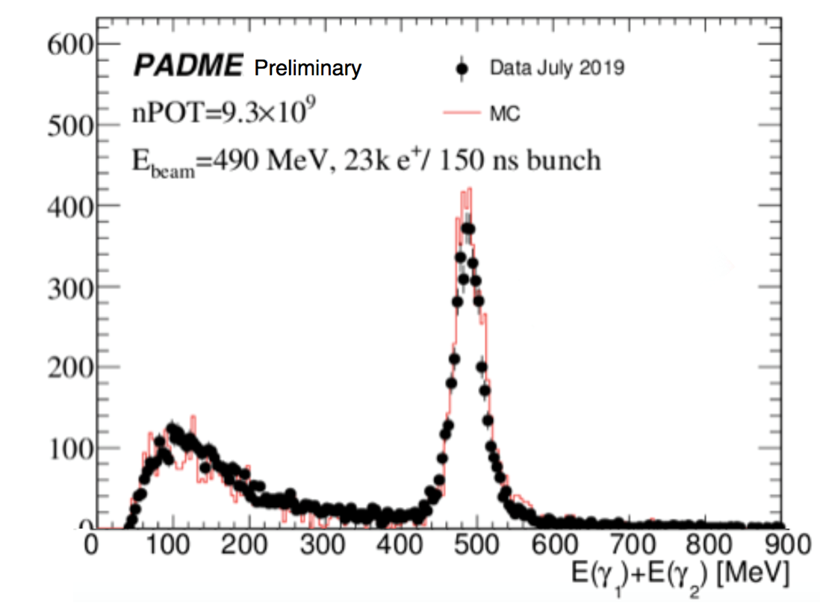
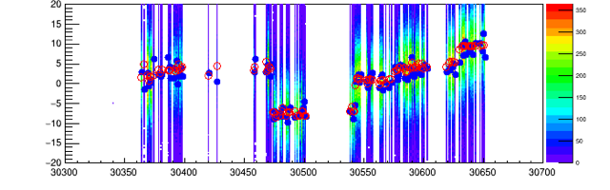
SM Signal Analysis
powerful run-dependent monitor of the luminous point
X COG (mm)
Run #
SM annihilation signal
Δt < 10 ns
Δφ < 25°
γγ COG < 1 cm from nominal beam
Cross-section measurement with clear Run2 sample
in progress

Slide 24
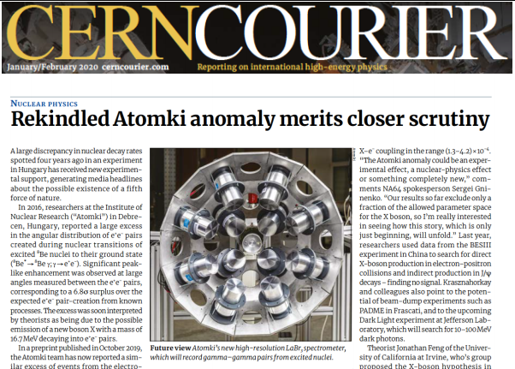
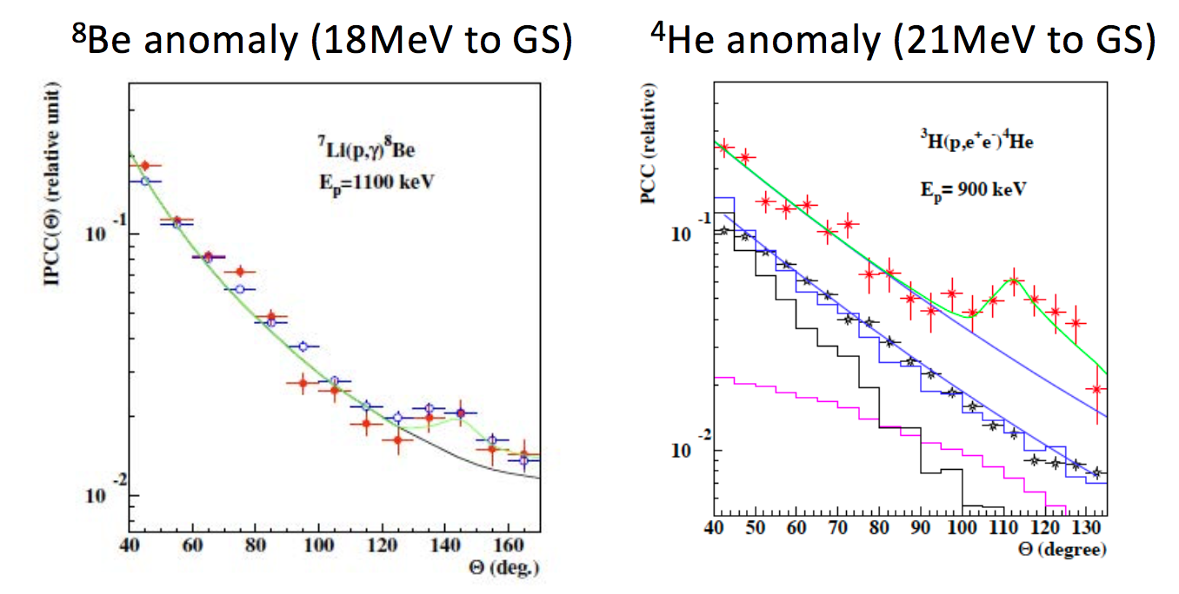
Run3: hunt to X17
⁸Be anomaly (18 MeV to GS)
⁴He anomaly (21 MeV to GS)
Dumping Rings
BTF1
Phys. Rev. D97 (2018) 095004
m_{X}=16.84 ± 0.16(stat) ± 0.20(syst) MeV
Γ_{X}= 3.9 × 10⁻⁵ eV
PRL 116, 052501 (2016)
BTF2
PADME Run3 (Spring-Summer 2022)
search for X17 in resonant production with 282.7 MeV e⁺ beam and e⁺ e– decay

Slide 25

Conclusions
PADME has started to explore the Dark Sector
Run1 (2019) has been very fruitful to understand
and optimize the positron beam
Run2 (2020) clean data sample is under analysis to give first physics results
Run3 (2022) will be devoted to the hunt of the hypothetical X17 boson from Be anomaly
Dumping Rings
BTF1
BTF2

