Slide 1
THE COMPRESSED BARYONIC MATTER
(CBM) EXPERIMENT AT FAIR
Kshitij Agarwal
/ʂɪ.t̪ɪd͡ʒ əɡ.ɾᵊ.ʋɑːl/
Eberhard-Karls-Universität Tübingen (DE)
- For the CBM Collaboration -
10th International Conference on New Frontiers in Physics (ICNFP 2021)
Kolymbari, Crete, Greece, August 23 – September 02, 2021

Slide 2


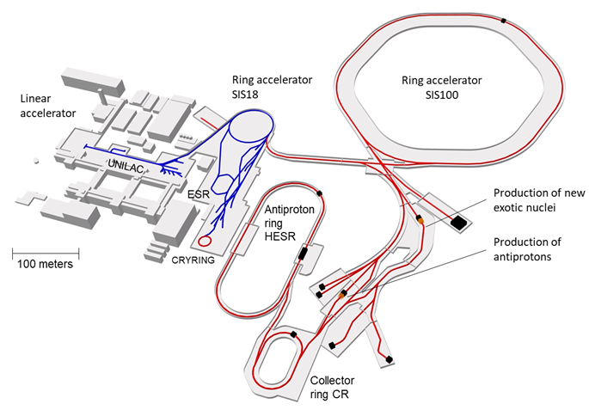
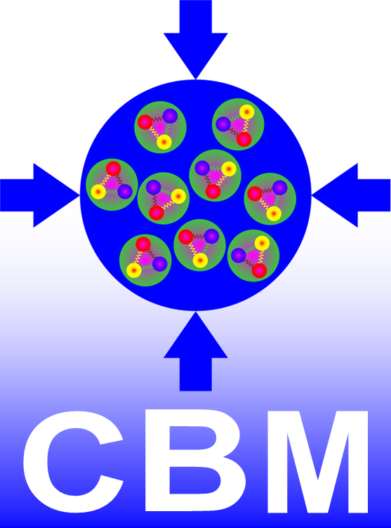


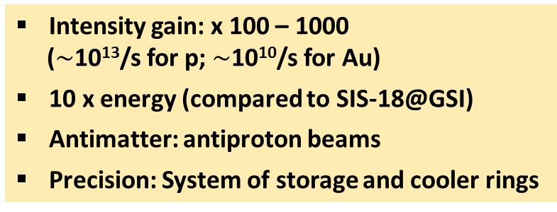
FACILITY FOR ANTI-PROTON AND ION RESEARCH (FAIR)
SIS-100 Capabilities
Beam | Z | A | E [AGeV]
p | 1 | 1 | 29
d | 1 | 2 | 14
Ca | 20 | 40 | 14
… | 28 | 58 | 13.6
Au | 79 | 197 | 11
U | 92 | 238 | 10.7
C. Höhne et al. (2011) CBM Experiment. In: B. Friman (eds)
The CBM Physics Book. Lecture Notes in Physics, vol 814. Springer
M. Durante et al., Phys. Scr. 2019, 94, 033001
Intensity gain: x 100 – 1000
($\sim$10¹³/s for p; $\sim$10¹⁰/s for Au)
10 x energy (compared to SIS-18@GSI)
Antimatter: antiproton beams
Precision: System of storage and cooler rings
Jens Stadlmann (GSI)
GSI-FAIR Schematic: P. Giubellino,
FAIR Status Report @ KHuK meeting (2018)

Slide 3
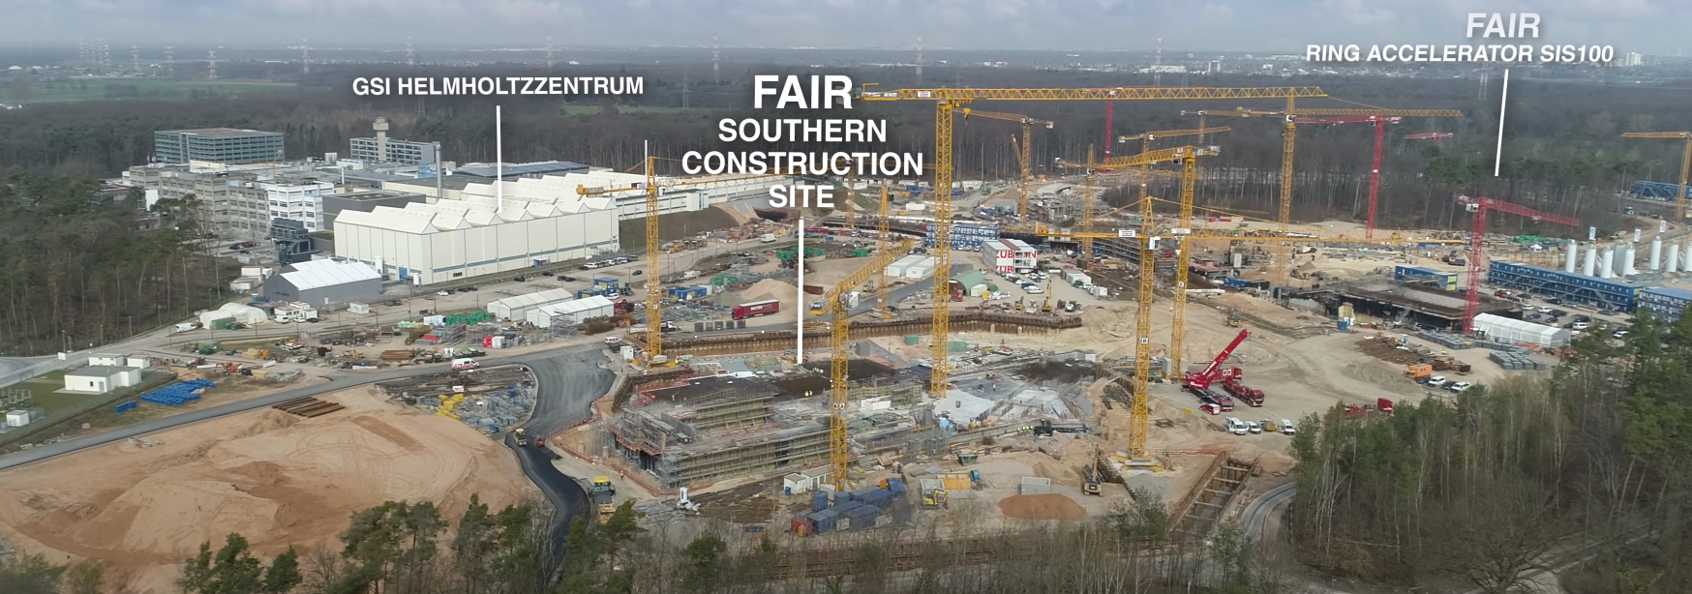
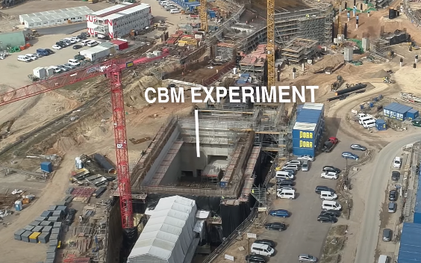
UPDATE ON FAIR CONSTRUCTION (JUNE 2021)
FAIR is progressing well towards strategic objectives
CBM Building’s construction progressing well on schedule
Ready for ‘Heavy Installation’ from mid-2022
CBM integration to be completed by 2025
Updates on construction available at: GSI Webpage | YouTube | …

Slide 4
CBM PHYSICS CASE & OBSERVABLES

Slide 5
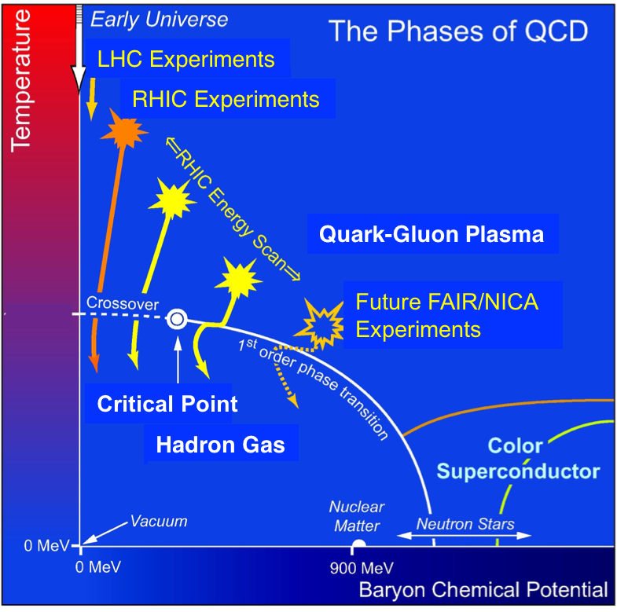
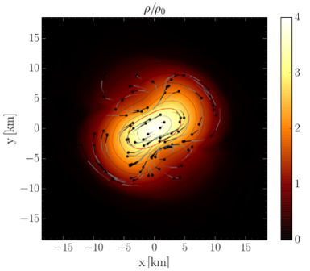
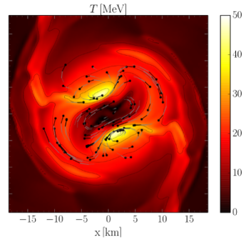
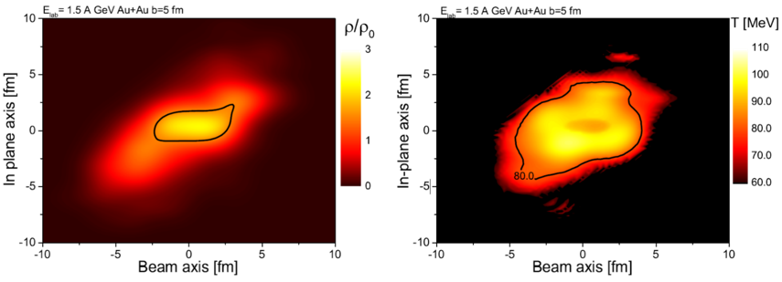
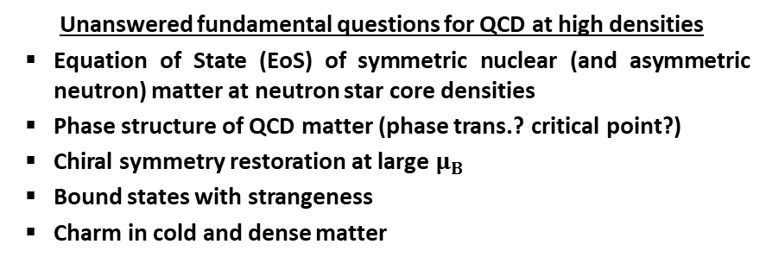
CBM PHYSICS GOALS
BNS Merger
BNS Merger
[STAR], Studying the Phase Diagram of QCD Matter at RHIC, STAR Note 598 (2014)
Heavy-Ion Collision @ SIS-18
Heavy-Ion Collision @ SIS-18
Unanswered fundamental questions for QCD at high densities
Equation of State (EoS) of symmetric nuclear (and asymmetric neutron) matter at neutron star core densities
Phase structure of QCD matter (phase trans.? critical point?)
Chiral symmetry restoration at large $μ_{B}$
Bound states with strangeness
Charm in cold and dense matter
NuPECC Long Range Plan 2017
Perspectives in Nuclear Physics
M. Hanauske et al., 2017 J. Phys.: Conf. Ser. 878 012031​
The CBM research program can decipher dense QCD matter properties
Microscopic (CBM) + Macroscopic Collisions (Astro) = True Multi-Messenger Physics

Slide 6
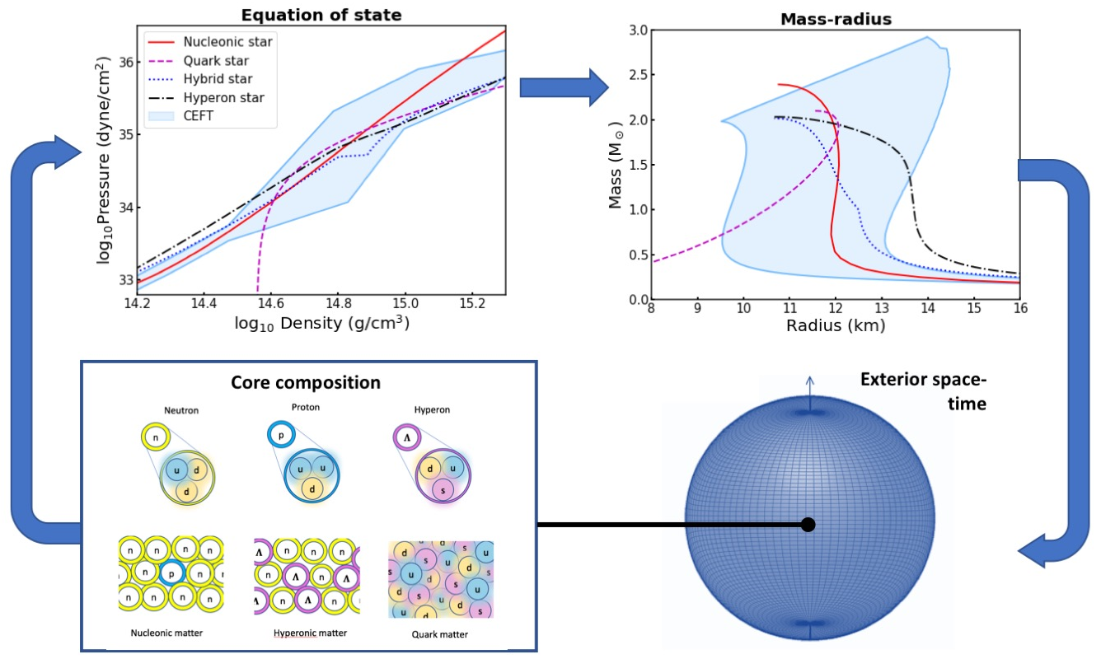
PHYSICS CASE 1: EQUATION OF STATE AND NEUTRON STAR PROPERTIES
P. Ray et al., STROBE-X: X-ray Timing and Spectroscopy on Dynamical Timescales from Microseconds to Years, arXiv:1903.03035
Heavy-Ion Collisions

Slide 7
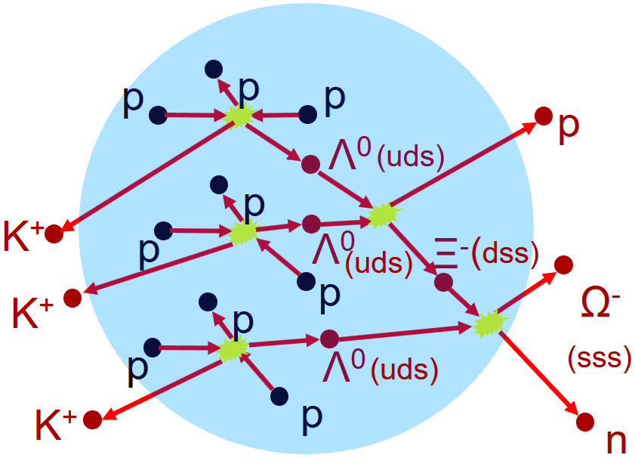
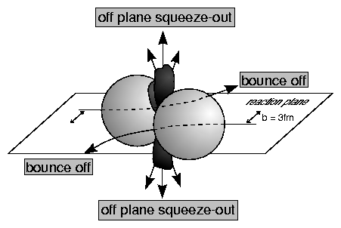
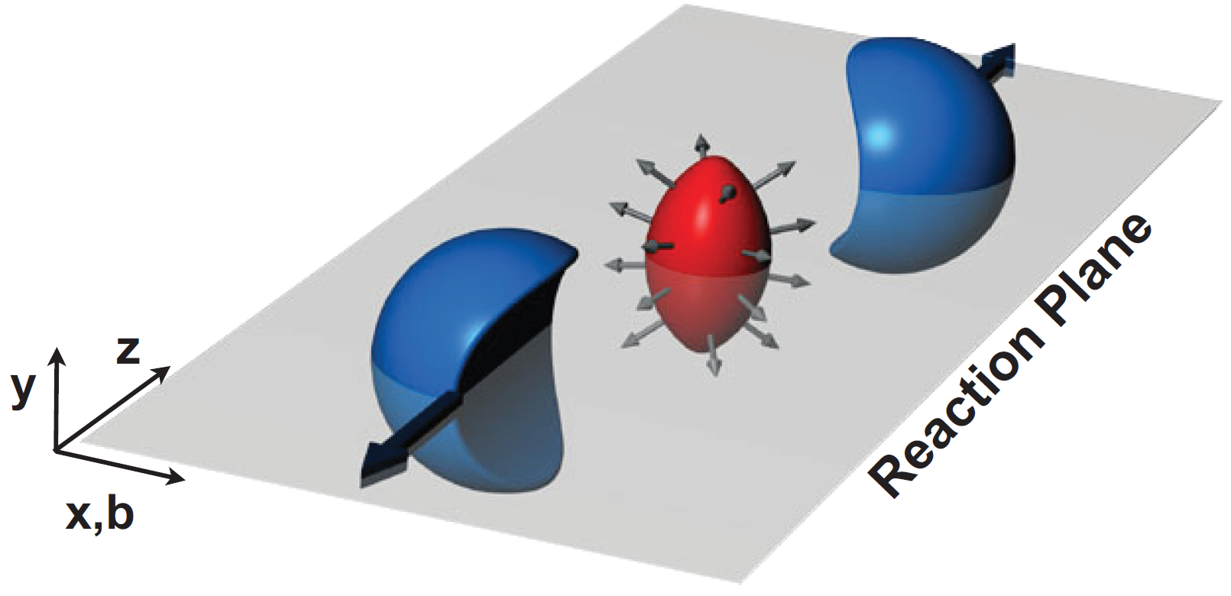
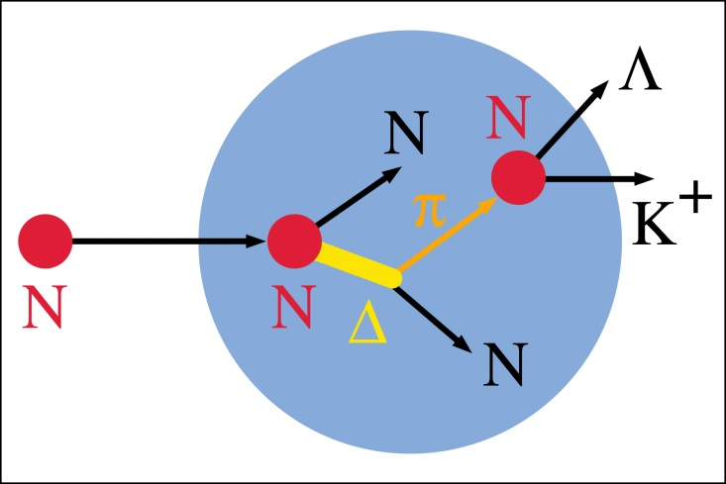


PHYSICS CASE 1: EQUATION OF STATE AND NEUTRON STAR PROPERTIES
ANISOTRPIC FLOW
SUB-THRESHOLD STRANGENESS PRODUCTION
Nucelar EoS ∝ ‘(In)Compressibility’ of the nuclei ∝ ‘Flow’ direction of participants and spectators
Nucelar EoS ∝ ‘(In)Compressibility’ of the nuclei ∝ Density ∝ Strangeness Yield
An illustration with water drops
$$\frac{dN}{dφ}∝1+\left(2∙v_{1}∙\cos{φ}\right)+\left(2∙v_{2}∙\cos{2φ}\right)+…$$
CBM
SIS-100
0
1
2
3
4
5
6
7
8
9
10
11
12
13
K^{+,0}, Λ⁰, Σ
K⁻
Ξ^{-,0}
Ω⁻
$$Λ^{0}\overline{Λ^{0}}$$
Ξ⁺
Ω⁺
E_{thr,NN} (GeV)
KaoS
SIS-18

Slide 8
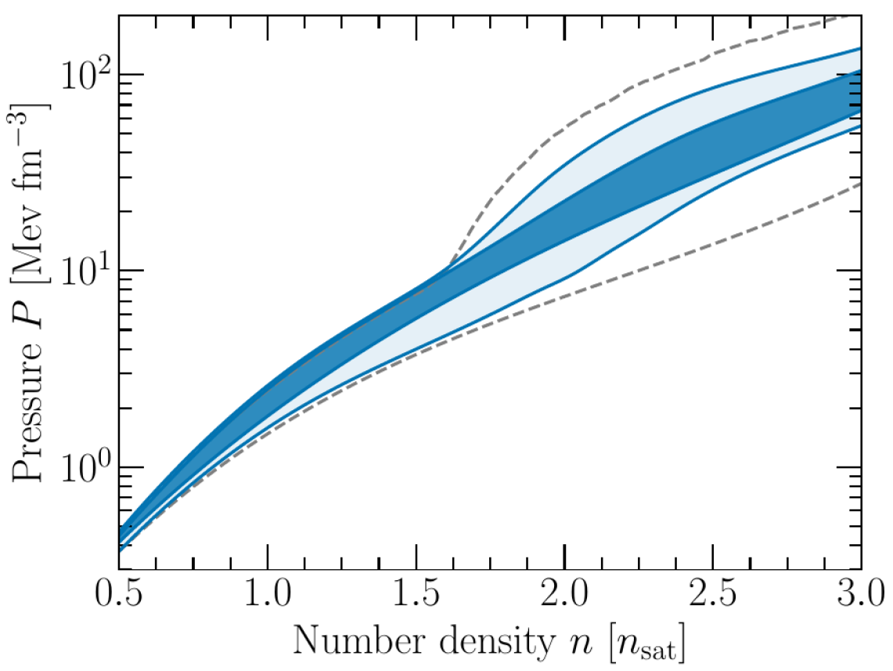
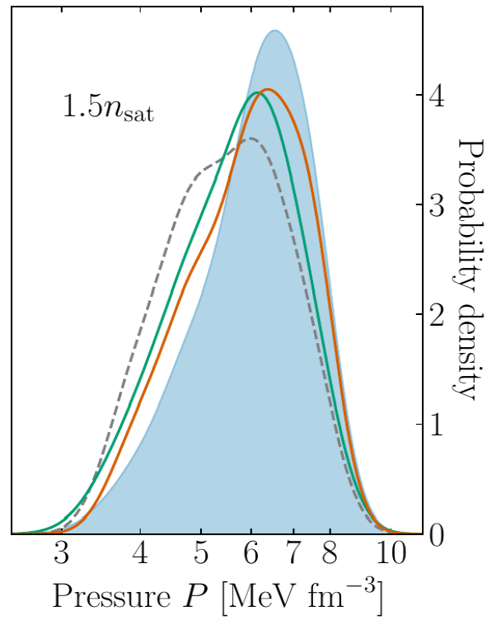
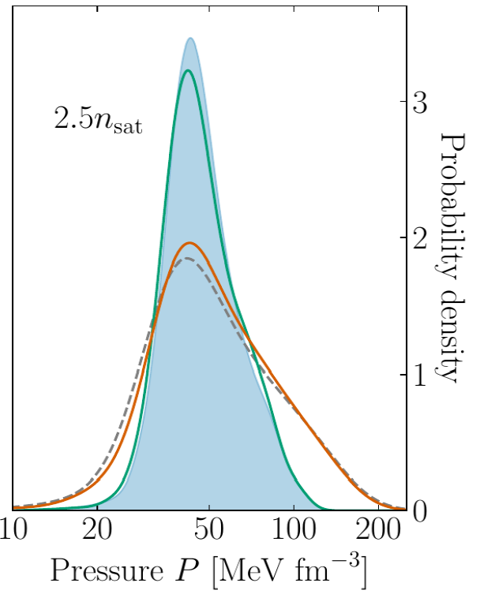
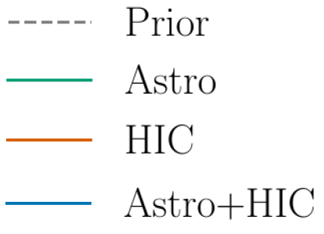
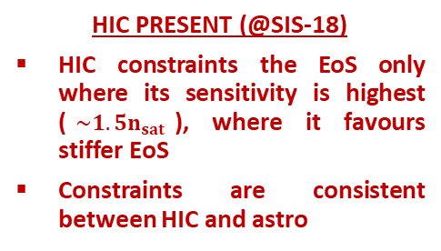
PHYSICS CASE 1: EQUATION OF STATE AND NEUTRON STAR PROPERTIES
SIS-18
SNM: FOPI + KaoS
PNM: ASY-EoS-I/II
SIS-100
CBM
…
Pure Neutron Matter (PNM)
S. Huth, P.T.H. Pang et al., arXiv:2107.06229 [nucl-th]
68% C.I.
95% C.I.
FOPI: Nucl. Phys. A 945, 112 (2016)
AGS, BEVALAC: Science 298, 1592 (2002)
KaoS: Phys. Rev. Lett. 86, 39 (2001)
J. Phys. G 28, 1615 (2002)
ASY-EOS-I: Phys. Rev. C 94, 034608 (2016)
SπRIT: Phys. Rev. Lett. 126, 162701 (2021)
HIC PRESENT (@SIS-18)
HIC constraints the EoS only where its sensitivity is highest ($\sim 1.5n_{sat}$), where it favours stiffer EoS
Constraints are consistent between HIC and astro
HIC FUTURE (@SIS-18, SIS-100, …)
Higher density constraints are currently driven by Astro (which are limited in statistics)
HIC has the potential to limit the constraints at higher densities
CBM, with its capability with observables like particle flow and sub-threshold particle production, is in pole position to push our understanding of SNM and PNM at higher densities, thereby enhancing HIC’s compatibility with astrophysical observations

Slide 9
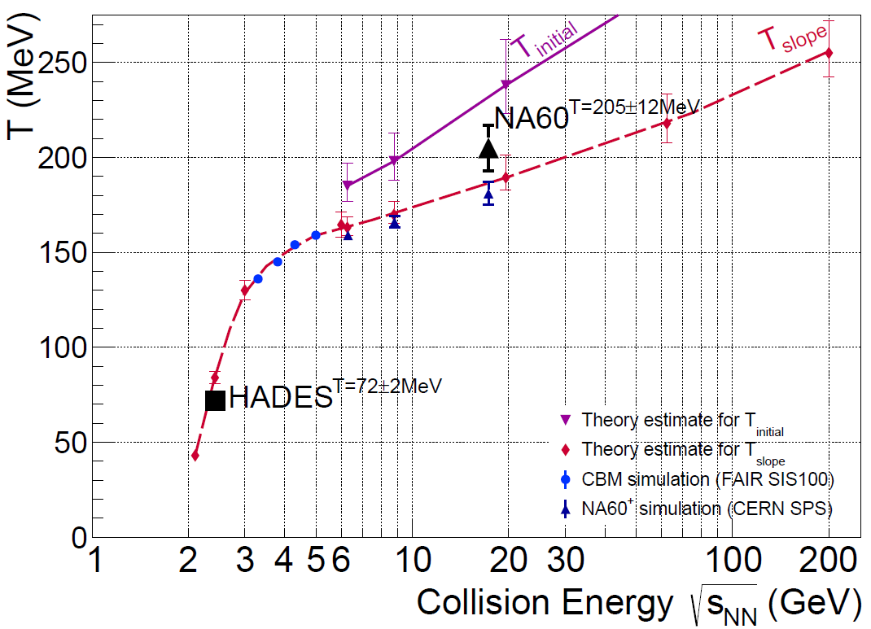
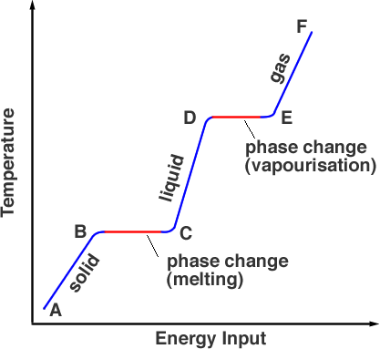
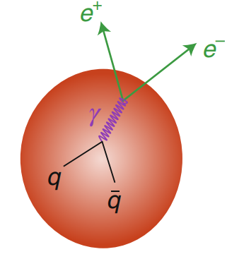

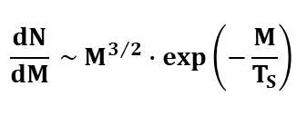
PHYSICS CASE 2: CALORIC CURVE AND DECONFINEMENT
Non-monotonous behaviour of the caloric curve potentially signals phase transition
CBM
Image - http://www.splung.com/content/sid/6/page/latentheat
Liquid-Gas Phase Transition - [ALADIN] Phys. Rev. Lett. 75 (1995) 1040
Terra Incognita
DI-LEPTONS
Nucl.Phys.A 1005 (2021) 121755
[NA60]: Eur. Phys. J. C 59 (2009) 607
[HADES]: Nature Physics 15 (2019) 1040
Theory: $\sqrt{s_{NN}}>6GeV$ - Phys. Lett. B 753 (2016) 586
$\sqrt{s_{NN}}<6GeV$ - Eur. Phys. J. A 52 (2016) 131
Dileptons, being electromagnetic probes, act as a thermometer of the strong-interacting fireball medium
Ralf Rapp, Nature Physics, Volume 15, pg. 990–991 (2019)
CBM will be the first experiment to use di-leptons for systematic measurements in both production channels (e⁺e⁻ and μ⁺μ⁻) in the same coverage.
$$\frac{dN}{dM} \sim M^{3/2}∙exp⁡\left(−\frac{M}{T_{S}}\right)$$
Simplification of McLerran - Toimela formula,
Phys. Rev. D 31 (1985) 545

Slide 10
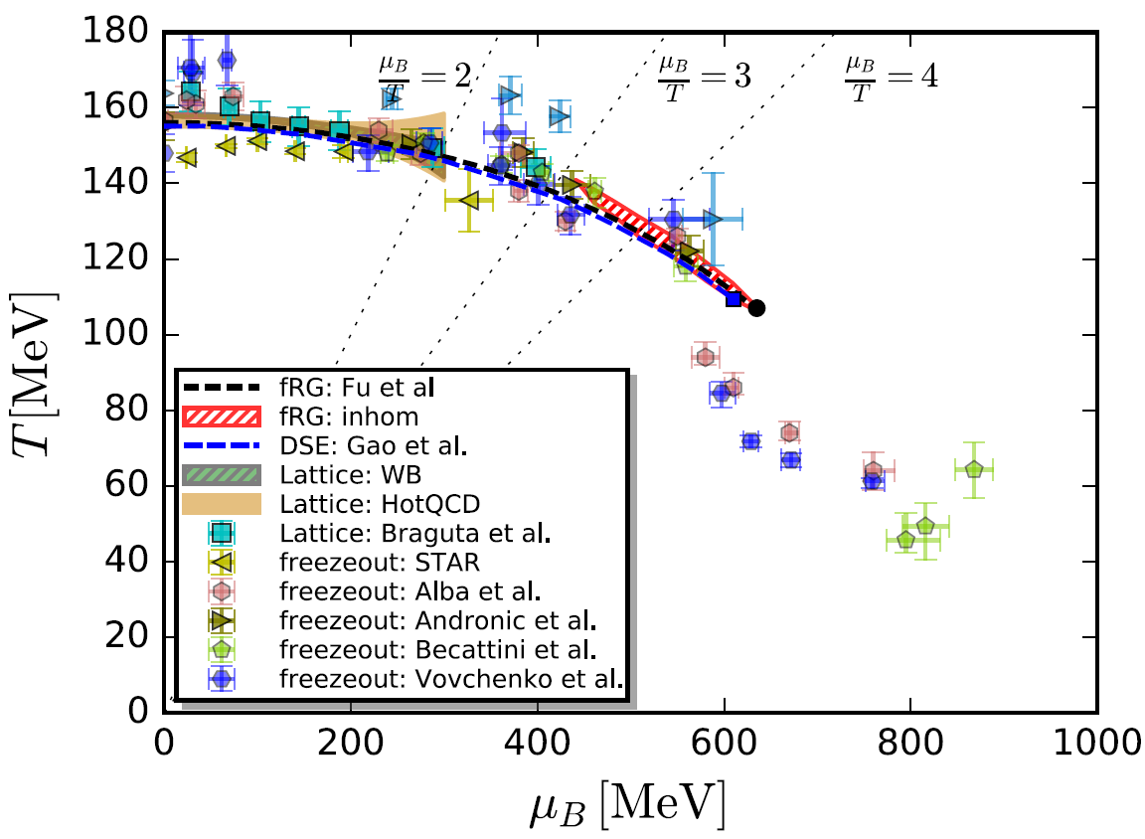
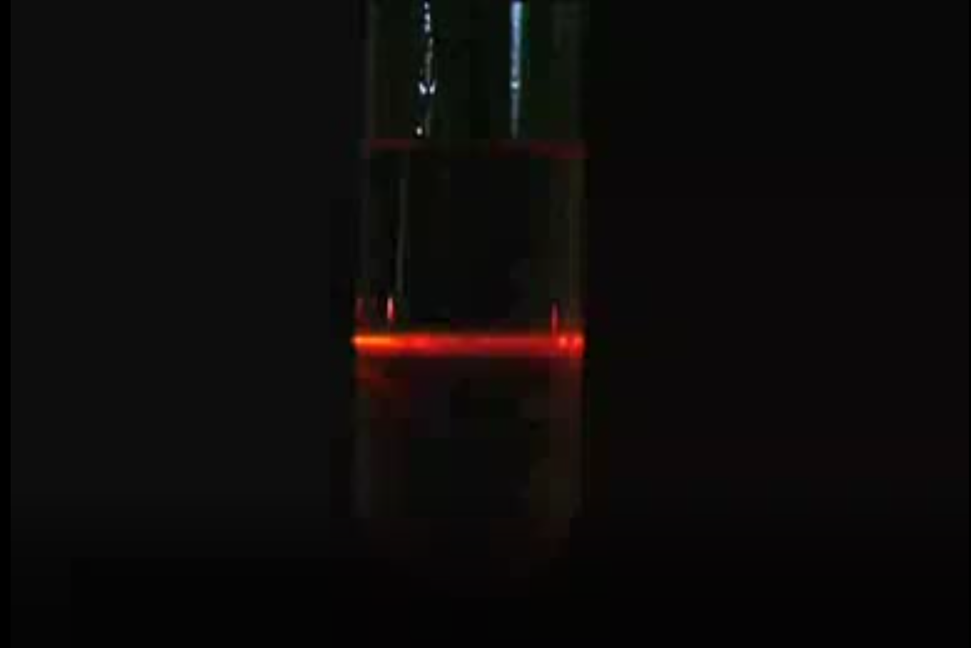
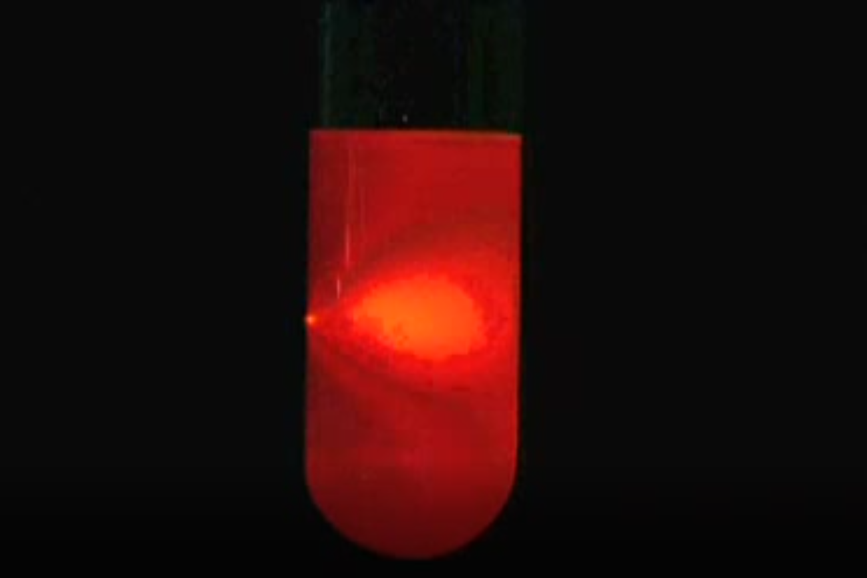


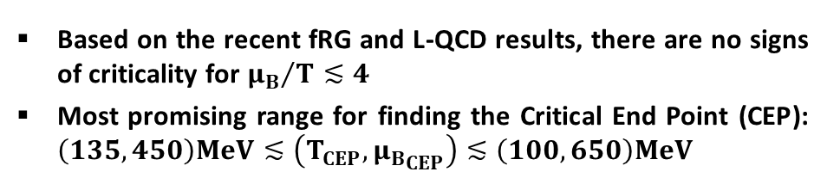
PHYSICS CASE 3: QCD CRITICAL END POINT
EVENT-BY-EVENT FLUCTUATIONS
$$\left(T_{CEP},{μ_{B}}_{CEP}\right)=\left(107,635\right)MeV$$
T ≠ T_{CEP}
W.J. Fu, J.M. Pawlowski, F. Rennecke,
Phys. Rev. D 101, 054032 (2020)
A vial containing a mixture of cyclohexane and aniline cooling from 35°C, has been filmed perpendicular to the direction of the laser light (left to right) - https://www.doitpoms.ac.uk/vidlib/full_record.php?id=58
T $≈$ T_{CEP}
Based on the recent fRG and L-QCD results, there are no signs of criticality for ${μ_{B}}/T≲4$
Most promising range for finding the Critical End Point (CEP): $\left(135,450\right)MeV≲\left(T_{CEP},{μ_{B}}_{CEP}\right)≲\left(100,650\right)MeV$
F. Karsch, arXiv:1905.03936
F. Karsch, RHIC Beam Energy Scan and Beyond 2021
A. Lahiri, LATTICE 2021
J.M. Pawlowski, CPOD 2021

Slide 11
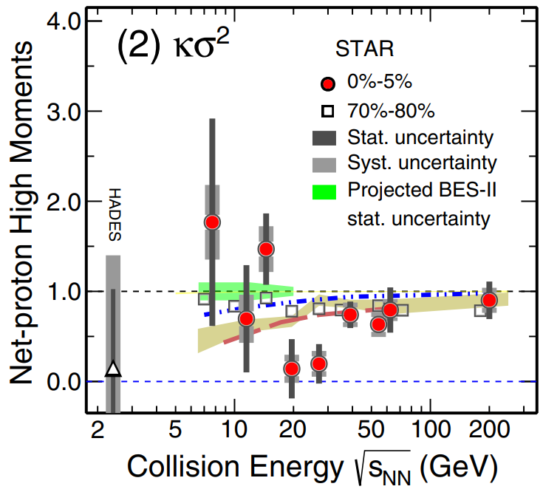
PHYSICS CASE 3: QCD CRITICAL END POINT
EVENT-BY-EVENT FLUCTUATIONS
Higher-order cumulants and ratios of conserved quantities (B, Q, S) are sensitive to QCD CEP
$$\left(T_{CEP},{μ_{B}}_{CEP}\right)=\left(107,635\right)MeV$$
M.A. Stephanov, Phys. Rev. Lett. 102 032301 (2011)
J.W. Chen et al., Phys. Rev. D 95, 014038 (2017)
CBM
C
BM
W.J. Fu, J.M. Pawlowski, F. Rennecke,
Phys. Rev. D 101, 054032 (2020)
[STAR] Phys. Rev. Lett. 126, 092 (2021)
[STAR] arXiv:2101.12413 [nucl-ex]
[HADES] Phys. Rev. C 102, 024914 (2020)
Based on the recent fRG and L-QCD results, there are no signs of criticality for ${μ_{B}}/T≲4$
Most promising range for finding the Critical End Point (CEP): $\left(135,450\right)MeV≲\left(T_{CEP},{μ_{B}}_{CEP}\right)≲\left(100,650\right)MeV$
CBM can systematically study the higher-order cumulants and ratios to contribute significantly to the search of QCD-CEP
F. Karsch, arXiv:1905.03936
F. Karsch, RHIC Beam Energy Scan and Beyond 2021
A. Lahiri, LATTICE 2021
J.M. Pawlowski, CPOD 2021

Slide 12
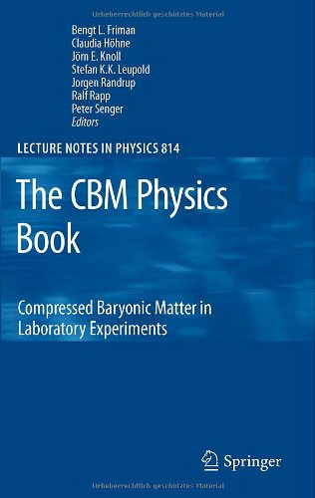
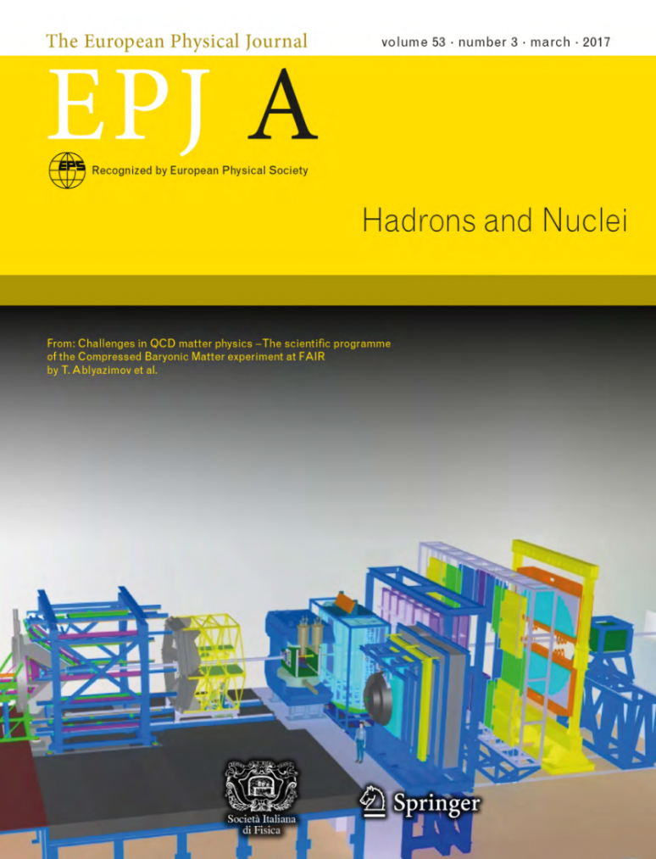
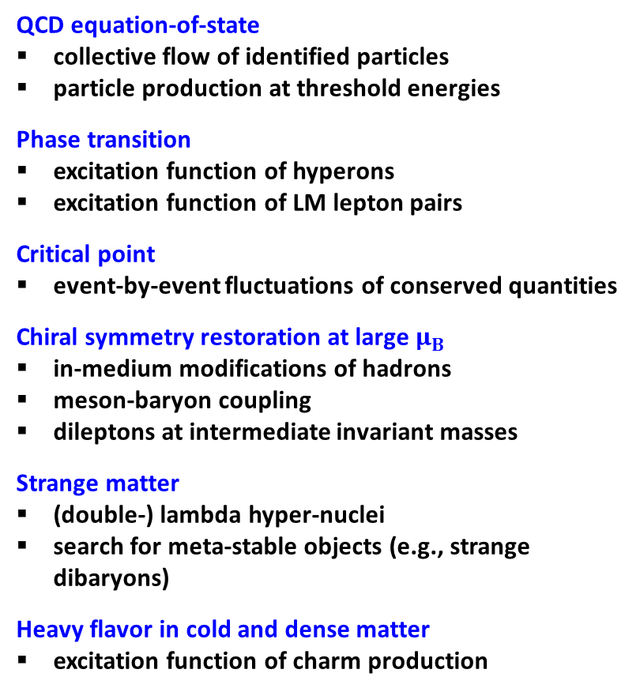
FOR MORE READING...
QCD equation-of-state
collective flow of identified particles
particle production at threshold energies
Phase transition
excitation function of hyperons
excitation function of LM lepton pairs
Critical point
event-by-event fluctuations of conserved quantities
Chiral symmetry restoration at large $μ_{B}$
in-medium modifications of hadrons
meson-baryon coupling
dileptons at intermediate invariant masses
Strange matter
(double-) lambda hyper-nuclei
search for meta-stable objects (e.g., strange dibaryons)
Heavy flavor in cold and dense matter
excitation function of charm production
Lect. Notes Phys. 814 (2011) pp.1-980
DOI: 10.1007/978-3-642-13293-3
Eur.Phys.J.A 53 (2017) 3, 60
DOI: 10.1140/epja/i2017-12248-y

Slide 13
CBM SIMULATED PHYSICS PERFORMANCE

Slide 14
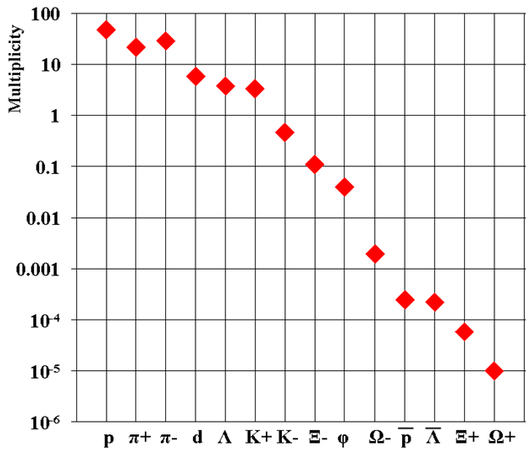
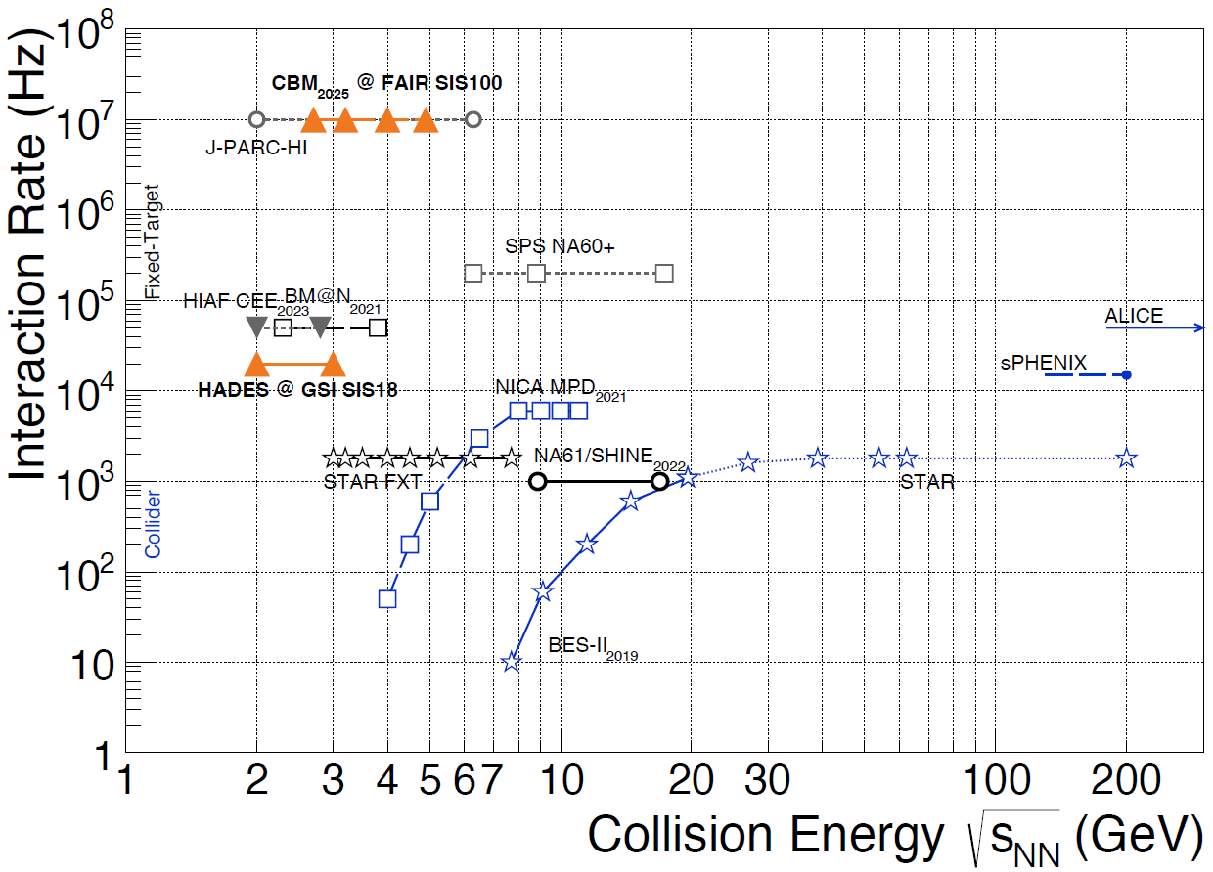
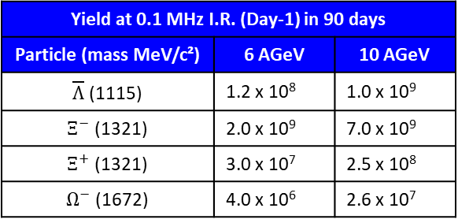
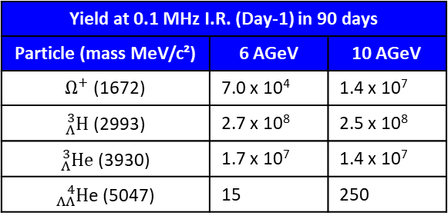
BEAM-TARGET INTERACTION RATES AND RARE PROBES’ YIELDS
CBM@Day-1: 0.1 MHz
CBM@Max.: 10 MHz
Alternating Gradient Synchrotron (AGS)
[CBM], Eur.Phys.J.A 53 (2017) 3, 60
T. Galatyuk, Nucl.Phys.A 982 (2019) 163-169, update (2021)
P. Senger, Phys.Scripta 96 (2021) 5, 054002
Yield at 0.1 MHz I.R. (Day-1) in 90 days
Particle (mass MeV/c²) | 6 AGeV | 10 AGeV
$\overline{Λ}$ (1115) | 1.2 x 10⁸ | 1.0 x 10⁹
$Ξ^{−}$ (1321) | 2.0 x 10⁹ | 7.0 x 10⁹
$Ξ^{+}$ (1321) | 3.0 x 10⁷ | 2.5 x 10⁸
$Ω^{−}$ (1672) | 4.0 x 10⁶ | 2.6 x 10⁷
Yield at 0.1 MHz I.R. (Day-1) in 90 days
Particle (mass MeV/c²) | 6 AGeV | 10 AGeV
$Ω^{+}$ (1672) | 7.0 x 10⁴ | 1.4 x 10⁷
${}_{Λ}^{3}H$ (2993) | 2.7 x 10⁸ | 2.5 x 10⁸
${}_{Λ}^{3}{He}$ (3930) | 1.7 x 10⁷ | 1.4 x 10⁷
${}_{ΛΛ}^{4}H$e (5047) | 15 | 250
The CBM research program comprises a comprehensive scan of observables, beam energies and collision systems at up to 10 MHz beam-target interaction rates giving an unprecedent access to the ‘rare probes’
Y. Vassiliev (GSI)

Slide 15
CBM EXPERIMENTAL SETUP (DAY-1)
Projectile Spectator Detector (PSD)
Beam
Time-Of-Flight (TOF)
Dipole Magnet
Micro-Vertex Detector (MVD)
Silicon Tracking System (STS)
MUon CHamber (MUCH); or
Ring Image Cherenkov (RICH)
Transition Radiation Detector (TRD)

Slide 16








PARTICLE IDENTIFICATION WITH CBM
CBM Simulations, central Au-Au@10AGeV
ToF - Hadron Identification
$$e^{−}$$
RICH -
Electron ID
$$π^{−}$$
$$\overline{p}$$
$$p$$
$$K^{−}$$
$$K^{+}$$
$${\left(e^{−},μ^{−}\right),π}^{−}$$
$${\left(e^{+},μ^{+}\right),π}^{+}$$
TRD + ToF -
Electron, Light Nuclei, Heavy Fragments
Clear separation between charged protons, pions and kaons
Clear separation between pions and electrons, and light nuclei

Slide 17
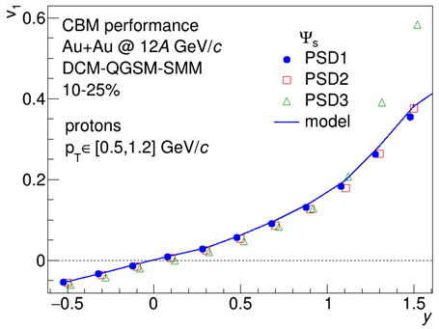
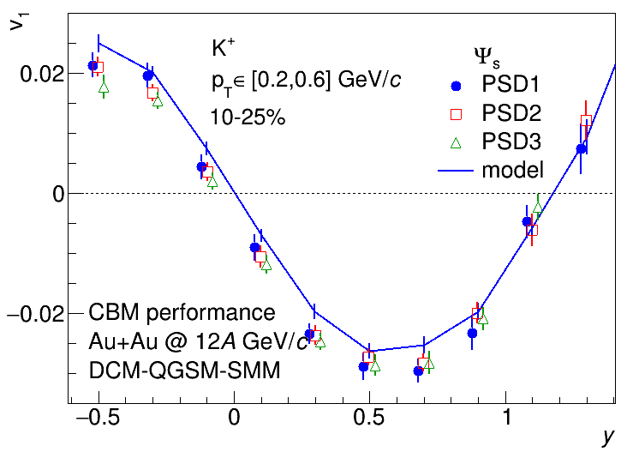
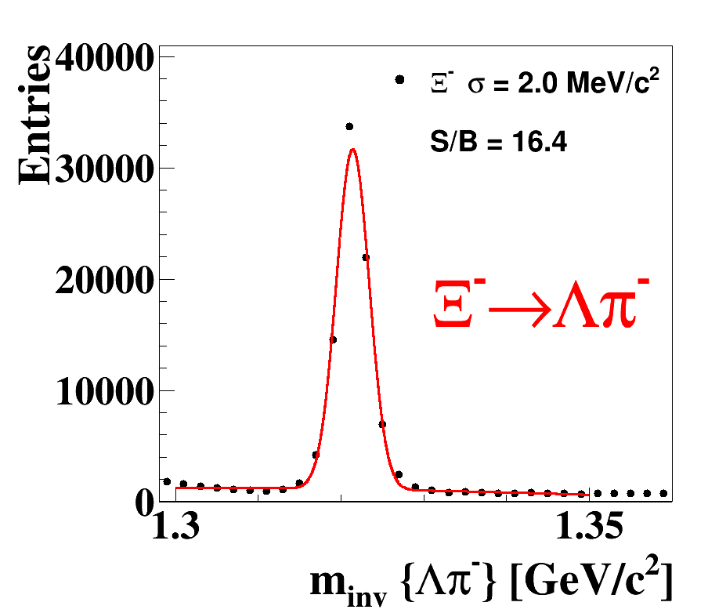
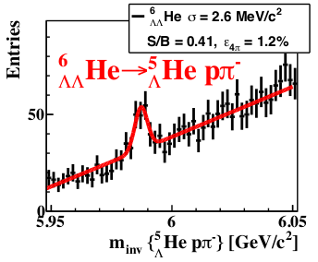
PHYSICS PERFORMANCE – [I]
Anisotropic Flow
Input model v₁ is recovered using data-driven methods with projectile spectators
Procedures for centrality determination, particle identification and corrections for effects of detector’s azimuthal non-uniformity are applied
Results for v₁ of π⁺, Λ also available
Ongoing – Higher harmonics (v₂, …)
O. Golosov et al., CBM Progess Report 2020
J.Phys.Conf.Ser. 1690 (2020) 1, 012104
O. Lubynets et al., Particles 2021, 4(2), 288-295
O. Golosov, CPOD 2021
UrQMD
Au-Au @ 10 AGeV/c
Central, 5M events
(Multi-) Strangeness Production
Tools for the multi-differential physics analysis are prepared for strange hadrons
Reconstruction is based on the dedicated KFParticleFinder package
Magnetic field scaling and multi-strange hyperon reconstruction performance also studied at lowest SIS-100 energies
Possible improvements by using Machine Learning are ongoing
UrQMD
Au-Au @ 10 AGeV/c
mbias, 10¹² events
I. Vassiliev et al., CBM Progress Report 2020
S. Khan, SQM 2021

Slide 18
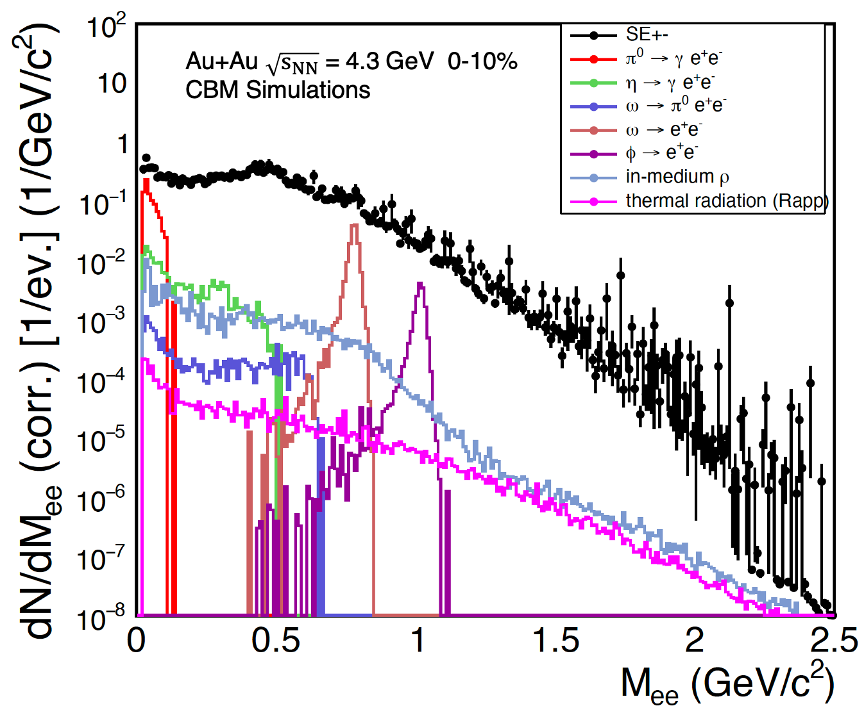
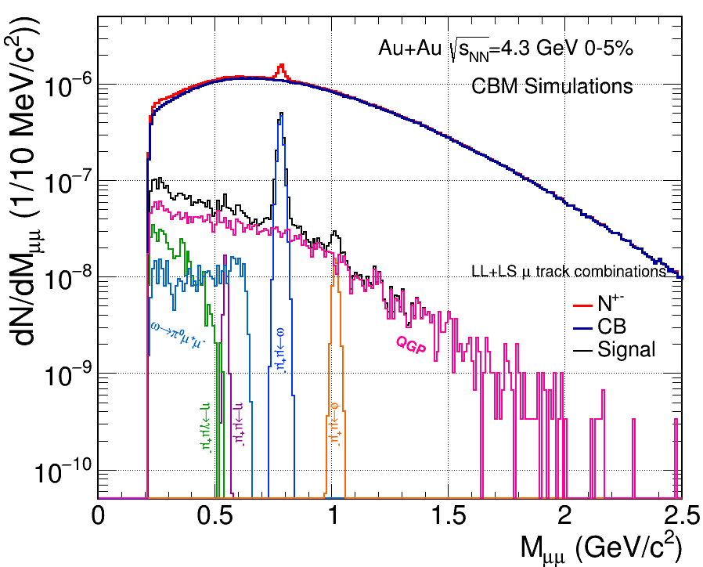
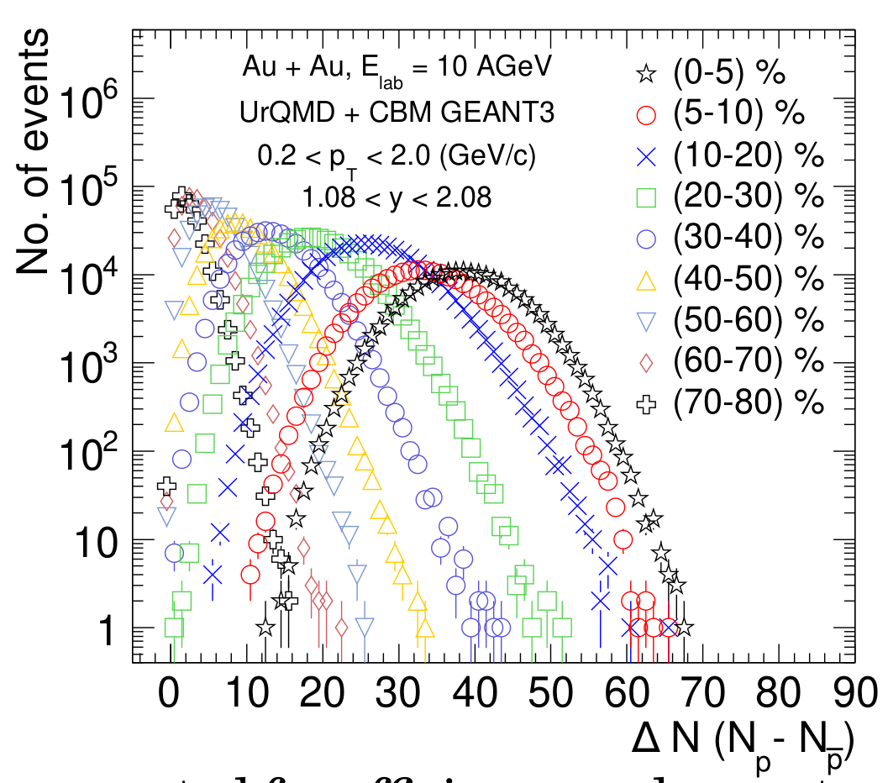
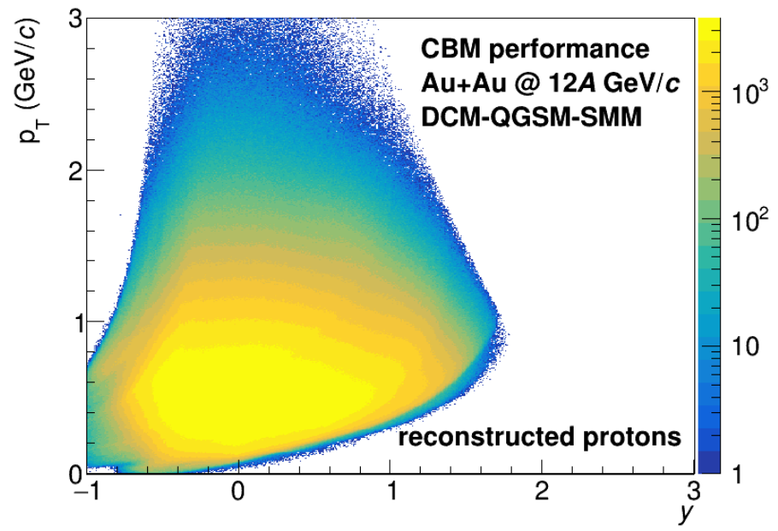
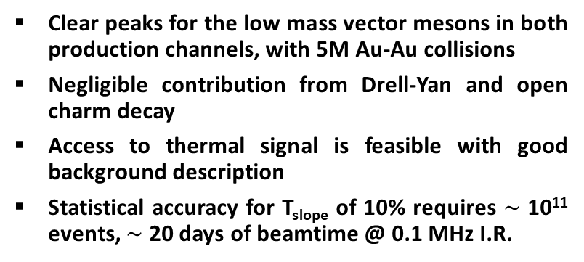
PHYSICS PERFORMANCE – [II]
e⁺e⁻
Di-lepton Distribution
µ⁺µ⁻
Clear peaks for the low mass vector mesons in both production channels, with 5M Au-Au collisions
Negligible contribution from Drell-Yan and open charm decay
Access to thermal signal is feasible with good background description
Statistical accuracy for T_{slope} of 10% requires $\sim$ 10¹¹ events, $\sim$ 20 days of beamtime @ 0.1 MHz I.R.
Net-Proton Multiplicities and Cumulants
The centrality dependence of cumulants of net-proton up to order four is under investigation
Plans to analyze cumulants up to order six with large statistics and other SIS-100 energies
Analysis ongoing for the net-charge and net-kaon

Slide 19
EXPERIMENTAL CHALLENGES

Slide 20
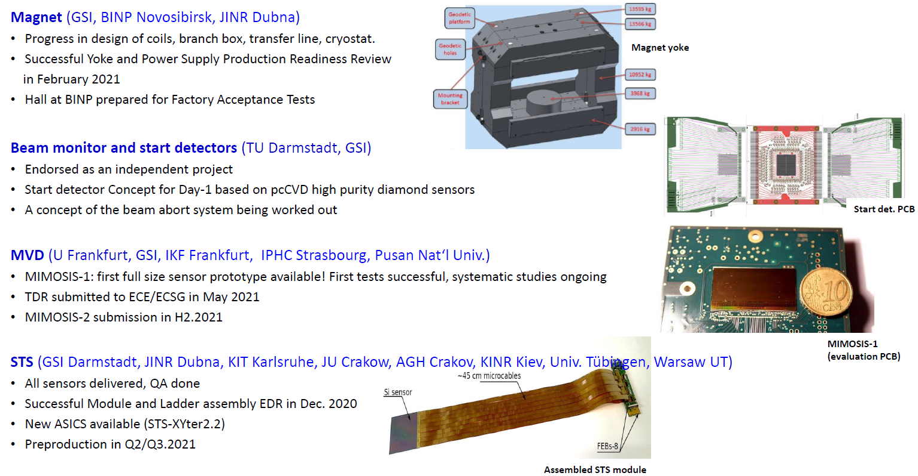
RECENT ACHIEVEMENTS IN DETECTOR PROJECTS – [I]

Slide 21
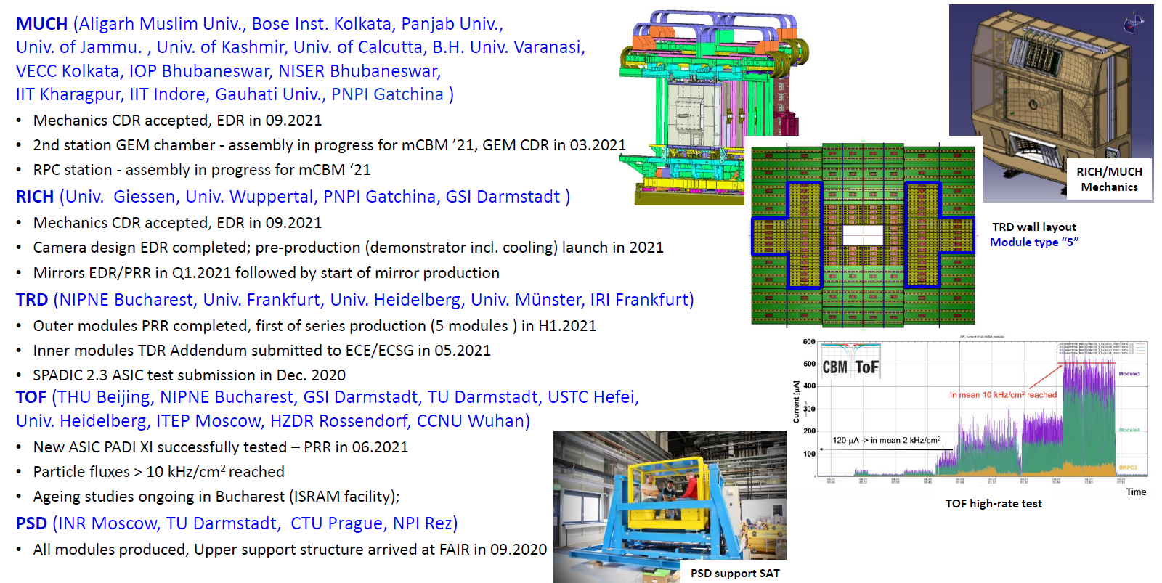
RECENT ACHIEVEMENTS IN DETECTOR PROJECTS – [II]
CDRs accepted for LV, GEM, Mechanics and Gas systems
2nd GEM station assembled and tested with cosmic rays using MUCH/STS-XYTER
mCBM with mMUCH couldn’t be attended due to covid, planning for the next campaign

Slide 22
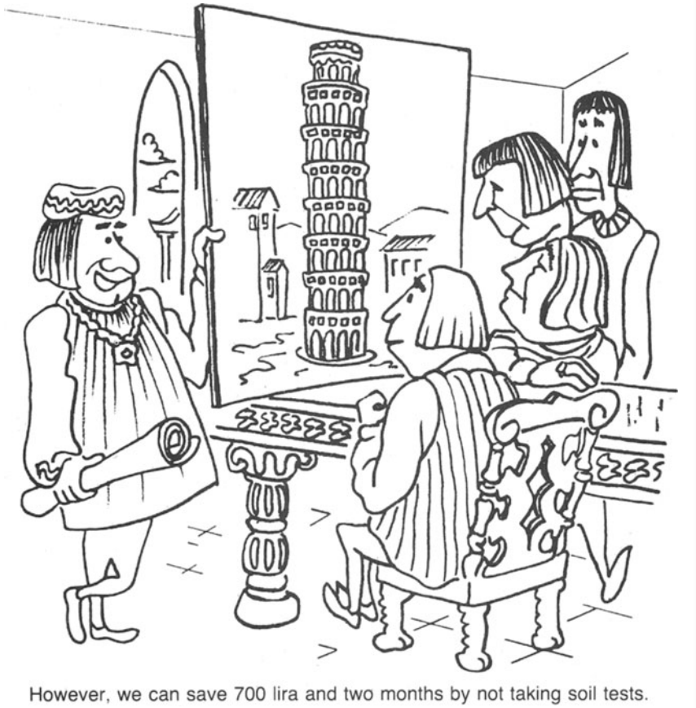
FAIR PHASE 0 – AVOIDING RISKS AND SPECTACULAR FAILURES...
L.E. Wiele and M.E. Messner, Essential Elements of a Successful Engineering and Construction Project, JOM 36, 41–45 (1984)

Slide 23
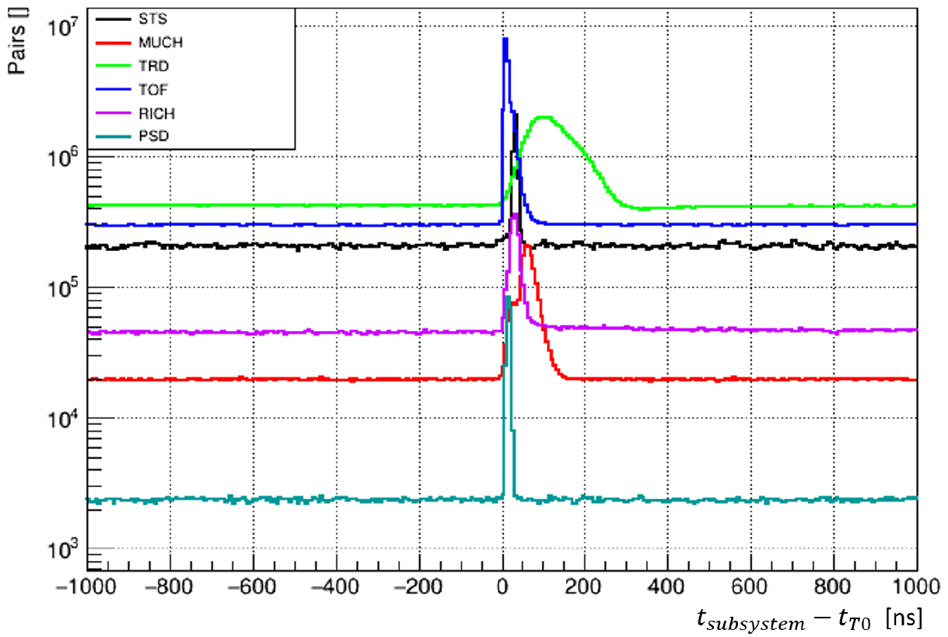
mCBM @ SIS-18
Spatial correlations b/w detector subsystems
C. Sturm, N. Herrmann, CBM Progress Report 2020
N. Herrmann, S-QM 2021
Time correlations b/w detector subsystems
mCBM - Pre-series and prototype detectors under realistic conditions with SIS18 beams
First results show time and spatial correlations between the synchronized data streams of the detector subsystems demonstrating for the first time a conceptual verification of the triggerless-streaming read-out and data transport of CBM
Charged particle fluxes up to 20 kHz/cm² at 3m from the target → Detailed high-rate tests for TOF and MVD, LGADs, SMX FEB, STS LV with Pb and Xe beams → validated radiation tolerance

Slide 24
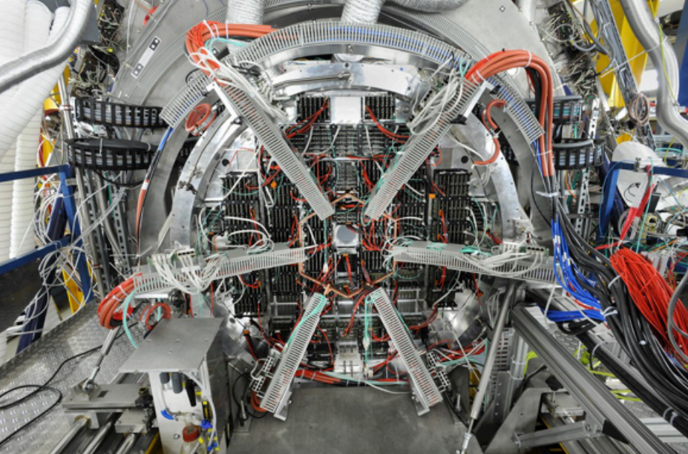








CBM CONTRIBUTION TO FAIR PHASE 0
HADES-RICH: Already 1/2 (430 MAPMTs + FEE) of CBM-RICH
STAR-eTOF: 10% (108 MRPCs) of CBM-TOF
J. A-Musch et al., CBM Progress Report 2020
I. Deppner et al., CBM Progress Report 2019
P. Weidenkaff et al., CBM Progress Report 2019
Double-ring pad pattern
BM@N-STS: 1/3 (300 Si-sensors; 4 tracking layers) of CBM-STS
BM@N-FHCal & NA61-PSD: 20 and 13 modules, respectively, of CBM-PSD
CBM Online Reconstruction Software for STAR-BES
A. Sheremetev et al., CBM Progress Report 2020
S. Morozov et al., CBM Progress Report 2020
BM@N
STS
I. Vassiliev et al., CBM Progress Report 2020
Y. Fisyak et al., CBM Progress Report 2020
BM@N
FHCal
BES-II Run 2020
$$\sqrt{s_{NN}}=3 GeV$$
BES-II Run 2020

Slide 25

SUMMARY
CBM@SIS-100 (2 – 11 AGeV Au-Au) provides unique conditions in lab to probe QCD matter properties at neutron star core densities, including the high-density EOS, and the search for new phases at higher densities
CBM
68% C.I.
S. Huth, P.T.H. Pang et al.,
arXiv:2107.06229 [nucl-th]
95% C.I.
FAIR (Intermediate Objective) is secured and on track
to start operation in 2026+
employ high statistics capability
to achieve high precision of multi differential observables
to enable rare processes as sensitive probes
CBM day-1 setup already has significant discovery potential
excitation function of hyperon production
excitation function of di lepton production
study of light hyper-nuclei
CBM Phase 0 activities (HADES, STAR, BM@N, NA61, mCBM)
understanding of major components
production of physics results with CBM devices
CBM
W.J. Fu, J.M. Pawlowski, F. Rennecke,
Phys. Rev. D 101, 054032 (2020)
MOVING TOWARDS A TRULY MULTI-MESSENGER PHYSICS ERA

Slide 26

THANK YOU

Slide 27

Lukas R. Weih & Luciano Rezzolla (Goethe University Frankfurt) (right half of the image from cms.cern)

Slide 28


Slide 29


